Slide 1







THE 9th INTERNATIONAL CONFERENCE ON
MULTIMEDIA ANALYSIS AND PATTERN RECOGNITION
Paper-ID: 104
PRECISE: Precision-Driven Discovery
of Token-centric MEV
Authors:
Dinh-Khang Nguyen, Huynh-Nhu Nguyen Thi,
Bich-Nhu Hong, Quang-Trung Do, Tuan-Dung Tran, and Van-Hau Pham
University of Information Technology, Vietnam National University Ho Chi Minh City
Ho Chi Minh City, Vietnam
Presentation: Dinh-Khang Nguyen
01

Slide 2
Table of Contents
Introduction
03
Related Work
05
Methodology
06
Experimental Results
09
Discussion
18
Conclusion
20
Blockchainist Research Team - University of Information Technology, VNU-HCM
02

Slide 3

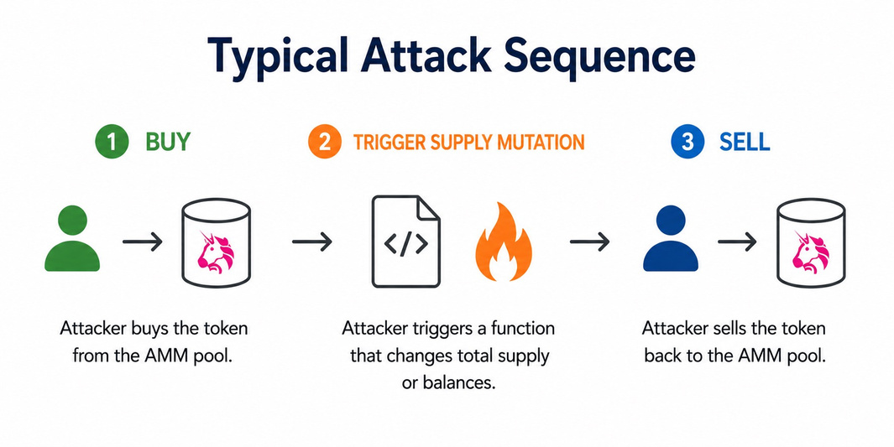
Introduction: The Challenge of Token-centric MEV
Background
ERC
ERC-20 assumptions shape AMM behavior.
DeFi
DeFi protocols rely on balance invariants.
MEV
MEV emerges when token state and price diverge.
Core Problem
Typical Attack Sequence
Token state changes
↓
AMM price remains unchanged
↓
Price inconsistency
$ Searcher Profit
Blockchainist Research Team - University of Information Technology, VNU-HCM
03

Slide 4
Introduction: Motivation and Research Objective
SA
Static and Symbolic Analysis
DF
Unguided Dynamic Fuzzing
- Scalable to large contract datasets
- Effective at identifying suspicious code patterns
- Cannot confirm runtime feasibility
- May suffer from path explosion
- Often produces false positives
- Provides execution-grounded evidence
- Explores a large and unfocused search space
- Wastes fuzzing budget on:
+ View functions
+ Irrelevant setters
+ Infeasible execution paths
RO
Research Objective
Develop a framework that is: Scalable → Execution-grounded → Token-aware → Profitability-aware → Reproducible.
Blockchainist Research Team - University of Information Technology, VNU-HCM
04

Slide 5
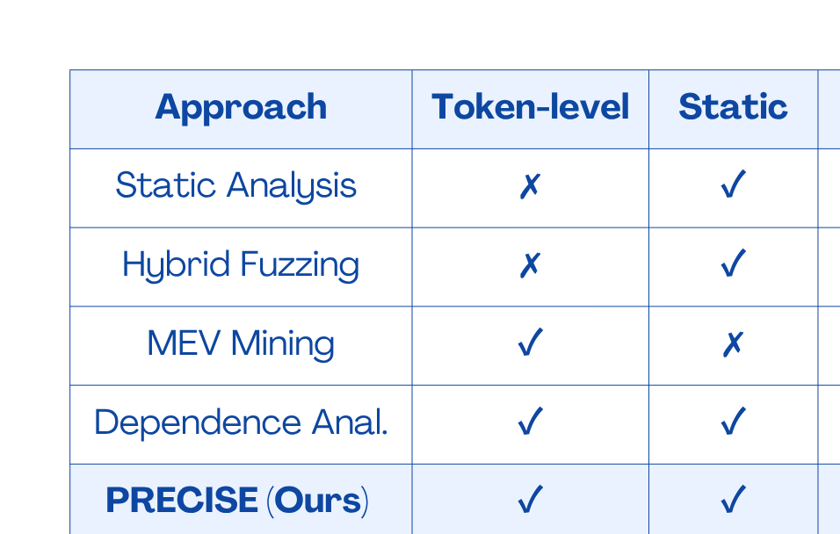
Related Work: Comparison with Existing Approaches
Table I. Comparison with representative analysis and MEV frameworks
Research Gap
×
Static only
×
Dynamic only
×
No replayable witness
✓
PRECISE integrates all.
Blockchainist Research Team - University of Information Technology, VNU-HCM
05

Slide 6










Methodology: PRECISE Hybrid Architecture
Pre-processing Layer
Execution Layer
List of Target Functions
Generate Random
& Directed Inputs
Smart Contract
Source Code
Slither Analyzer
AST, tSDG Generator
Candidate
Functions Extractor
Forge/Echidna
Fuzzer
Tx Broadcaster
Environment Layer
Send TX / Read State
Verification Layer
Feedback Loop /
Mutate Seeds
Fork
Mainnet State
EVM State Updates
Yes
RPC Provider
Alchemy/Infura
Anvil Local Node
EVM Environment
State Diff Extractor
debug_traceTransaction
Balance Change Checker
> 2 accounts
Tag: True tMEV
Opportunity
Discard/Re-Fuzz
No
Figure 1. Overview of the PRECISE framework
Key Features
SDG Static SDG Pruning
FORK Fork-based Fuzzing
DIFF State Difference Verification
$ Economic Validation
Blockchainist Research Team - University of Information Technology, VNU-HCM
06

Slide 7
Methodology: Static Analysis and Utility-Guided Fuzzing
Static Candidate Generation
Utility-Guided Fuzzing
  - Build an inter-procedural SDG: G​ = (V,E)
  - Backward slicing starts from writes to balances, totalSupply, or rebase factors.
  - Preserve access-control conditions, events emissions, and data, control, call, and return dependencies.
  - Maximum SDG depth: D = 3
Mutation strategy:
- 30% boundary values
- 40% SDG-derived dictionary values
- 30% state-aware scheduling
Utility objective:
U(u) = E[Φ(u)] − λc ​T(u)
- Prioritize inputs with high expected profit and low latency.
c
t
Blockchainist Research Team - University of Information Technology, VNU-HCM
07

Slide 8
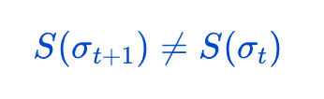
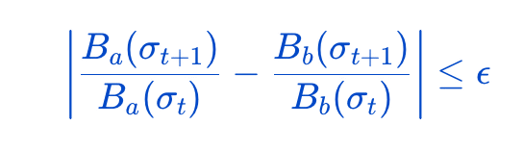
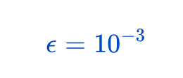
Methodology: Detection Predicates
T1
Type-1: Non-Standard Total Supply Control
function is classified as Type-1 when:
- The total supply changes.
- The function is successfully called by an unprivileged user.
- No matching Transfer event involving address(0) is emitted.
T2
Type-2: Non-Announced Synchronized Balance Update
A function is classified as Type-2 when:
- At least two non-zero account balances change proportionally.
- No matching account-level Transfer events are emitted.
- No public rebase marker is updated:
where
Blockchainist Research Team - University of Information Technology, VNU-HCM
08

Slide 9
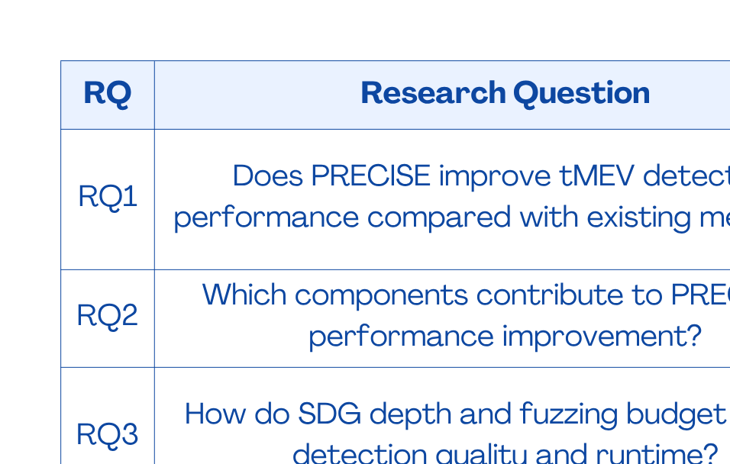
Experimental Results: Research Question
Blockchainist Research Team - University of Information Technology, VNU-HCM
02

Slide 10
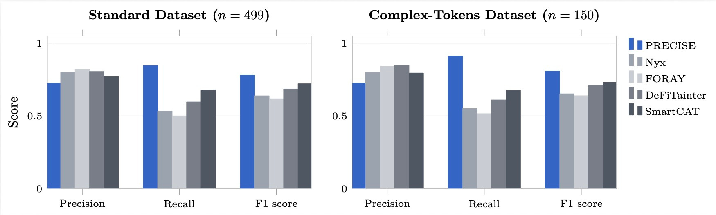
Experimental Results: Research Question 1
Figure 2. Precision, recall, and F1 on the standard (n = 499) and Complex-Tokens (n = 150) sets
Key Finding
✓ Highest recall across both datasets.
Blockchainist Research Team - University of Information Technology, VNU-HCM
02

Slide 11
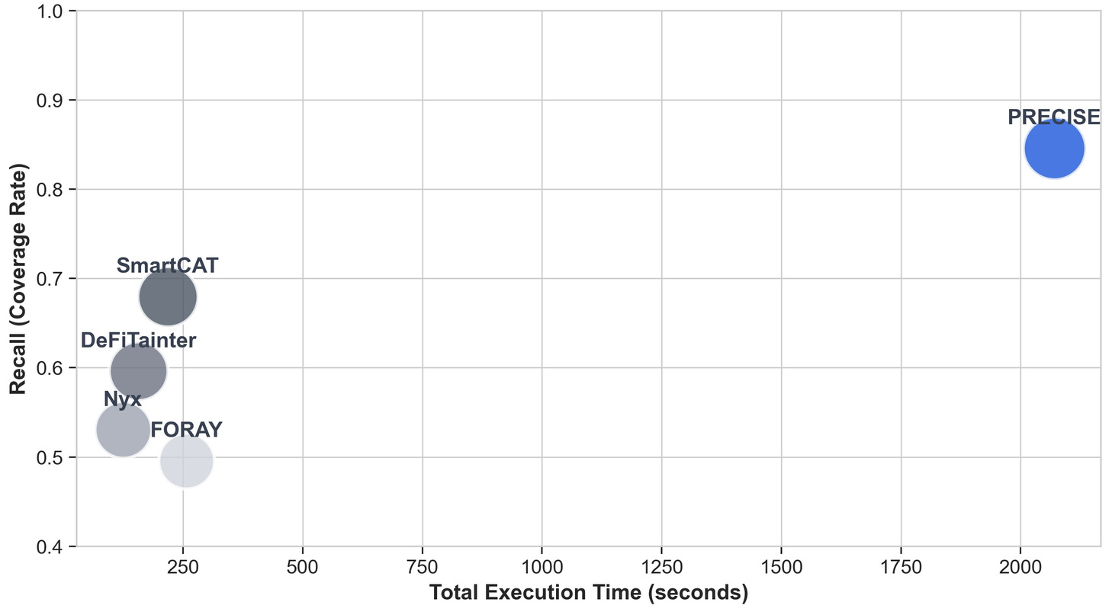
Experimental Results: Research Question 1
Figure 4. Recall versus aggregate execution time under matched replay
Key Finding
✓ Highest recall with competitive execution time.
Blockchainist Research Team - University of Information Technology, VNU-HCM
02

Slide 12
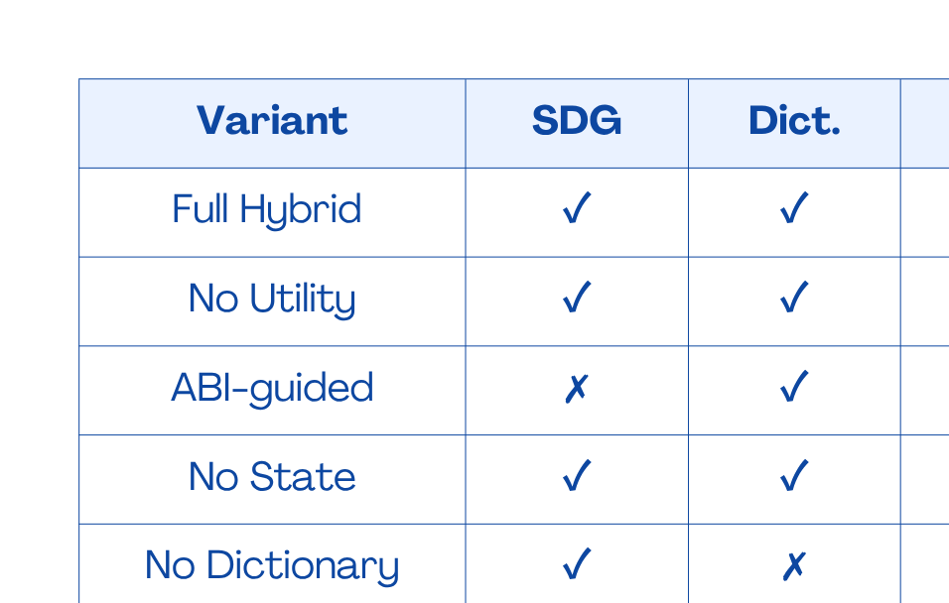
Experimental Results: Research Question 2
Table II. Ablation Study on the Standard Dataset
Key Finding
✓ SDG pruning provides the greatest runtime reduction.
Blockchainist Research Team - University of Information Technology, VNU-HCM
02

Slide 13
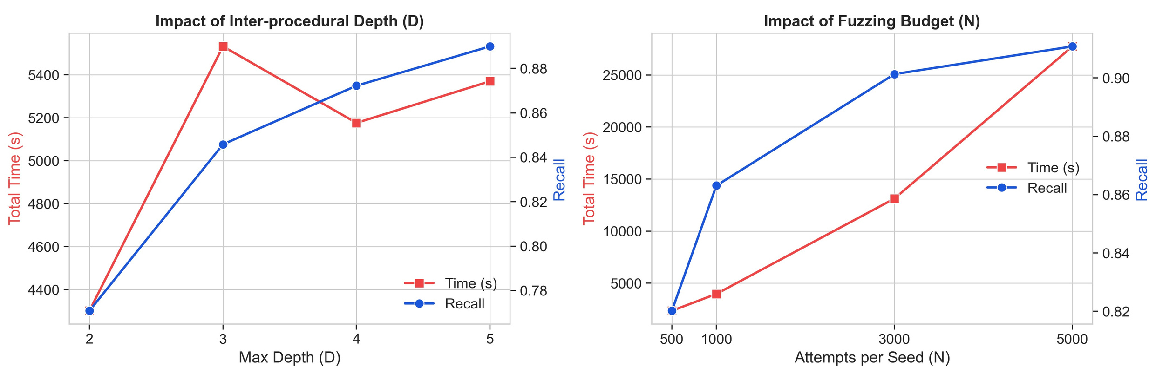
Experimental Results: Research Question 3
Figure 5. Recall and runtime versus inter-procedural depth D and per-path fuzzing budget N
Key Finding
✓ D = 3 and N = 1000 offer the best trade-off.
Blockchainist Research Team - University of Information Technology, VNU-HCM
02

Slide 14
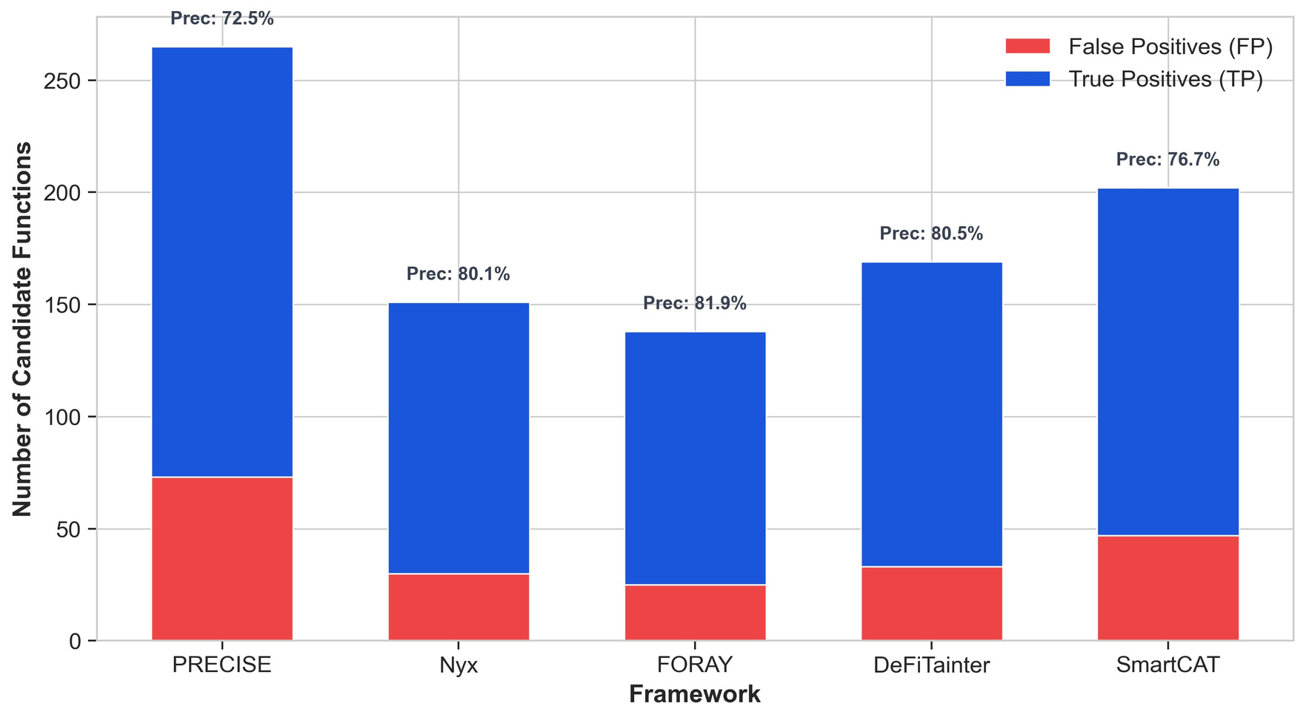
Discussion
Top Root Causes
SDG
SDG slicing
ADM
Admin adjustment
PRX
Dynamic proxy
POOL
Pool context
Figure 3. Candidate functions classified as true positives or false positives
Blockchainist Research Team - University of Information Technology, VNU-HCM
02

Slide 15
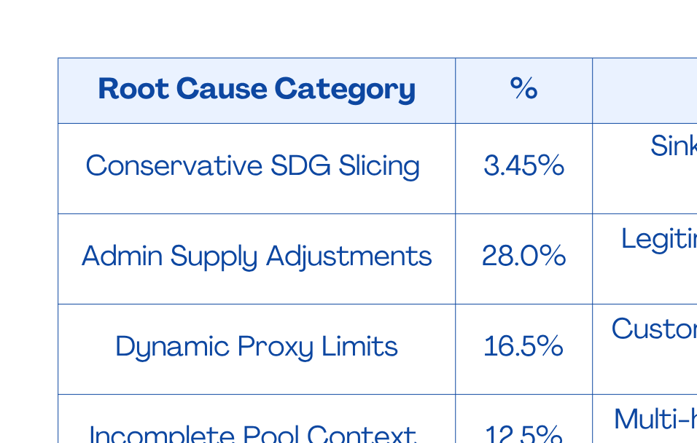
Discussion
Table III. Root Causes in 200 Sampled False-Positives Alerts
Blockchainist Research Team - University of Information Technology, VNU-HCM
02

Slide 16
Limitations
S
Scope
!
Practical Constraints
•
Ethereum Mainnet only
•
Constant-product AMMs
•
D = 3
•
No builder competition
•
Max 3-call sequences
•
No private order flow
Discoverability
does not imply
Real-world Profitability
!
Blockchainist Research Team - University of Information Technology, VNU-HCM
02

Slide 17
Conclusion
H
Hybrid Detection
Key Achievement
SDG + Fork Fuzzing
↓
✓
22,279 contracts
S
State Verification
✓
84.58% Recall
↓
✓
78.04% F1
P
Profitability Validation
✓
Ecosystem-scale deployment
↓
T
Scalable tMEV Discovery
Static pruning + execution-grounded validation is an effective solution for scalable Token-centric MEV detection.
Blockchainist Research Team - University of Information Technology, VNU-HCM
02

Slide 18

Thank you
for listening!
Questions?
Blockchainist Research Team - University of Information Technology, VNU-HCM
22

