Slide 1
WFS3 PoC Update
109th OGC Technical Committee
Charlotte, NC USA
Roope Tervo, Ilkka Rinne
Finnish Meteorological Institute, Spatineo, Vaisala
11th December 2018

Slide 2
Project
Interface
O&M Simple Feature Data model
Examples and open questions
Short recap/update

Slide 3
Scope, timeframe, partners
Goals
To design O&M Simple Profile data model
To test feasibility of WFS3 for weather data
Project frame
2018-2019
Partners
Spatineo | Implements WFS3 Core Take part in designing O&M Simple Profile
Finnish Meteorological Institute | Implements integration to its open data
Vaisala | Implements integration to its backend services

Slide 4
All open source
Open source (MIT)
https://github.com/vaisala-oss/sofp-core
https://github.com/vaisala-oss/sofp-example-backend
Open
https://github.com/opengeospatial/omsf-profile

Slide 5
Main use case to provide data in web
Main use case is to provide point weather data (single time and time series) from any given point in web usable form
Both observations and forecasts
Existing/regular clients should work with the data

Slide 6
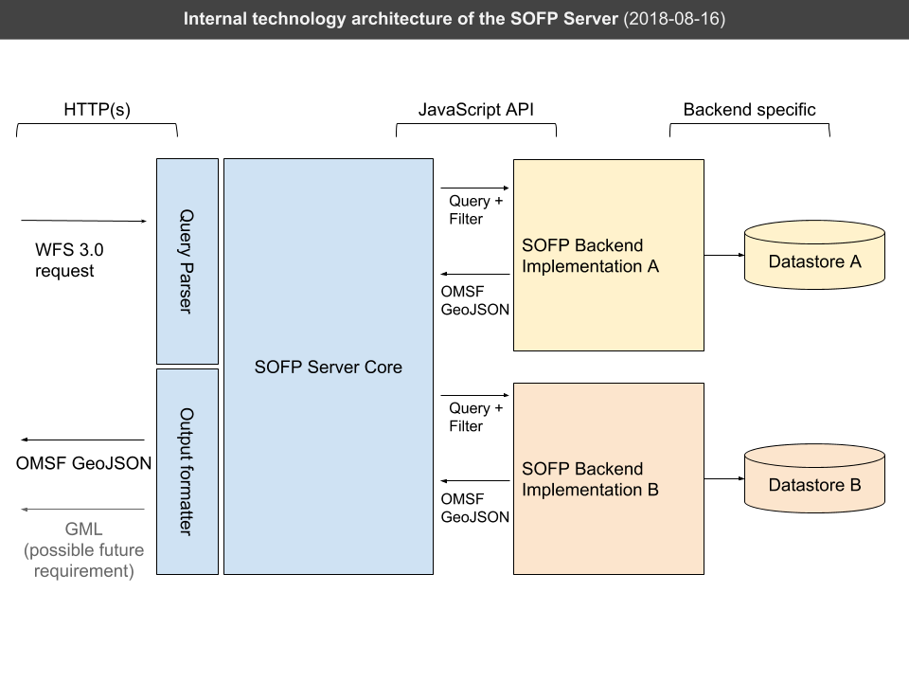
Architecture
Image: Sampo Savolainen / Spatineo
Notes:
Few main things are worth mentioning
Server is done with nodejs --> javascript, more specific typescript
Server works as proxy
WFS3 core hancles compliance
Users can/need to create backend integration to their systems who gets the data from backend server
FMI is using its existing servers
Can be also integrated for example to database
Designed to be ran on containers

Slide 7
Project
Interface
O&M Simple Feature Data model
Example sand open questions
Short recap/update

Slide 8
Observations are the simplest case
GET /datasets/weather/observation/aws/items?
parametername=Temperature,Humidity
&time=20181204T150000/20181204T180000
&bbox=20,60,30,70
Returns all temperature and humidity observations within asked time range
Time step support would require extension to the WFS3 Core
Origin time? Lead time? Do we need them?

Slide 9
Forecast models are resampled
GET /datasets/weather/forecast/harmonie/items?
parametername=Temperature,Humidity
&time=20181204T150000/20181204T180000
&bbox=20,60,30,70
&limit=100
Returns a feature collection of Harmonie weather model output. Regular grid with 100 points (10x10) is resampled from the data
Smaller bbox provides more detailed information
How about pressure and hubrid levels?
Notes:
What we should return in cases like this? All grid points?

Slide 10
Any single point can be asked
GET /datasets/weather/forecast/harmonie/items?
parametername=Temperature,Humidity
&time=20181204T150000/20181204T180000
&bbox=20,60,30,70
&lat=60.159900&lon=24.876116
Returns a feature collection Harmonie weather model output. Time series from exact given location is returned.
The point is interpolated from original data
Same handle or extension for timeseries?
Extension would be more clear but would lead to a specific interface for environmental data
Notes:
If one wants a timeseries to a single point (most typical case)
Timeseries can be returned as SF0 (every item in as separate feature) or as SF2 (unified timeseries)

Slide 11
One can use place names as well
GET /datasets/weather/forecast/collections/cities/items?
observedProperty=air_temperature
&ultimateFeatureOfInterestName=Helsinki*
Returns a feature collection of MeasureObservations for air temperature with Helsinki as the ultimate feature of interest.

Slide 12
Feature IDs can identified with parts
GET /datasets/weather/forecast/harmonie/items/{id}
Returns a feature with given ID
Wearher forecast ID can be formed following: parameter:producer:level_type:level:forecast_type:forecast_number:generation:area:time:area_interpolation_method:time_interpolation_method:level_interpolation_method

Slide 13
Project
Interface
O&M Simple Feature Data model
Examples and open questions
Short recap/update

Slide 14
Observations as Simple Spatial Features
New observation data encoding to make it easier and more cost-efficient to take existing standards in use
Enables observation data sharing and processing with a variety of existing technologies having simple feature handling capabilities.
Does not replace existing data encodings when more detailed information is required (OMXML 10-025r1, ICAO IWXXM etc.)
Based on OGC & ISO TC211 Standards (O&M 2.0, GML Simple Features Profile 2.0)
https://github.com/opengeospatial/omsf-profile
Notes:
Complex feature type XML is not well supported in desktop GIS/Web GIS client applications
Ability to share observation data using WFS and variety of existing GIS client software (OpenLayers & QGIS etc.)
Complex feature type XML is not well supported in desktop GIS/Web GIS client applications: needs app. schema specific parsing code. OGC OMXML encoding (10-025r1) schema is complex (deeply structural) -> limited client software support.
Simpler (~flat) GML structures with limited geometry types:
data ingestion & viewing easier for the clients applications,
GIS data storage easier at the server side (one table row / observation event), and
data provisioning simpler for the WFS (GetFeature) & WMS (GetFeatureInfo) server applications (simple feature model).

Slide 15
GML Simple Features Profile 2.0
Three levels of conformance for simplified GML application profiles: SF-0, SF-1 and SF-2:
SF-0: Restricted geometry and data types, no user-defined types, property multiplicity 0..1, all references only using gml:ReferenceType.
SF-1: SF-0, but multiplicities 0..n and user-defined types allowed.
SF-2: Restrictions only on the geometry types.
SF-2 corresponds to the OGC Simple Features standard (OGC 06-103r4)
JSON encoding supported
https://github.com/opengeospatial/omsf-profile
Notes:
OGC 10-100r3 GML Simple Features Profile:
"This profile defines a restricted but useful subset of XML-Schema and GML to lower the “implementation bar” of time and resources required for an organization to commit for developing software that supports GML"

Slide 16
Future Directions
This project
Test usage for FMI Open Data as soon as possible
INSPIRE
Data model is one alternative to consider in Maintenance and Implementation Work Programme 2016-2020, Action 2017.2 on alternative encodings for INSPIRE data
Hackaton
Maybe in upcoming unofficial INSPIRE meet in Helsinki
Modify the O&M SWG Charter to work on this along the next revision of the O&M Standard (OGC Abstract Specification Topic 20 & ISO 19156)
Change request done
Weather on the Web ?

Slide 17
Resources
https://github.com/opengeospatial/omsf-profile
https://github.com/vaisala-oss/sofp-core
https://github.com/vaisala-oss/sofp-core/tree/master/api-design
roope.tervo@fmi.fi,
ilkka.rinne@spatineo.com

