Slide 1


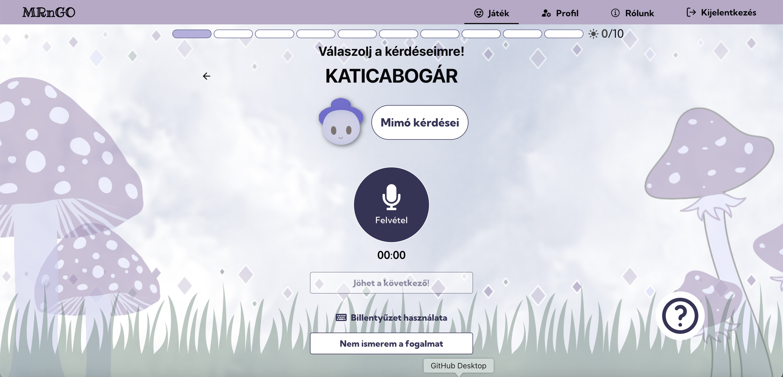
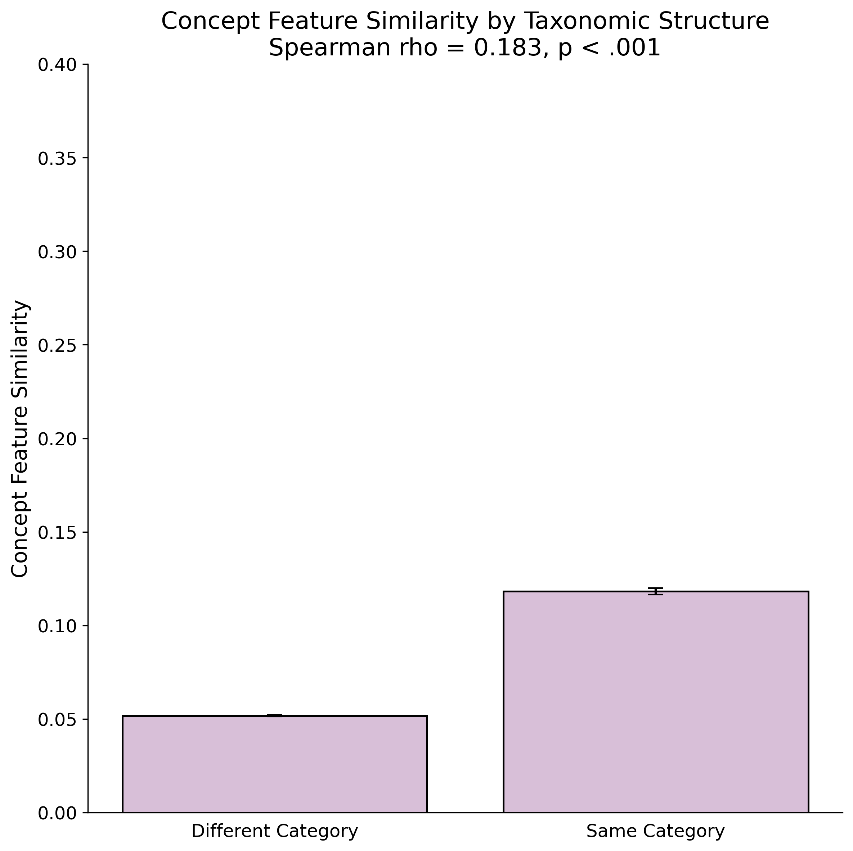
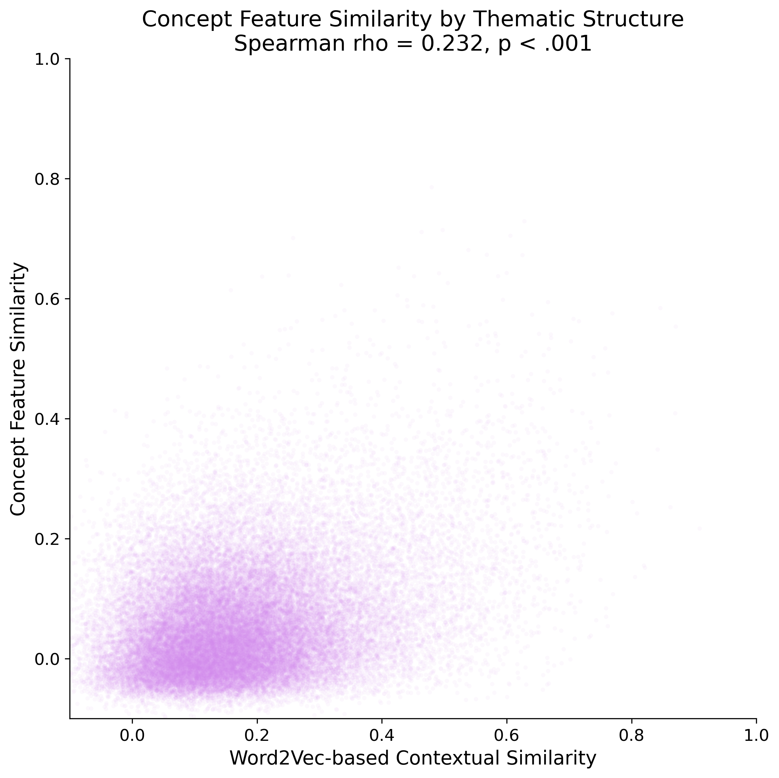
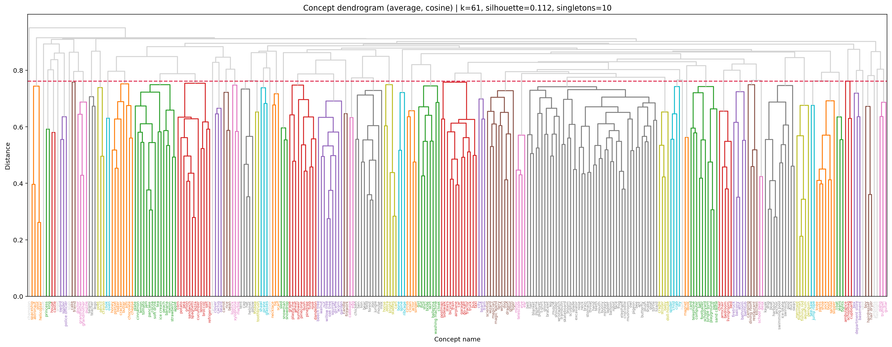
Comparison of Semantic Organization in a Concept Feature Norm of 6–9-Year-Old Children with Thematic and Taxonomic Language Models
Anna Noémi Illés ^{1, 2}, Alex Ilyés^{1, 3, 4}, Borbála Brosig^{1, 6}, Anna Bródy ^{1, 5}, Rebecca McFegan ^{1, 2}, Mónika Egyed^{1, 2}, Szonja Szabó^{1, 2}, Donát Keszthelyi^{1, 2}, Éva Kovaliczky², Boróka Ferencz^{1,3,4}, Attila Keresztes^{1,4}
Hippocampal Circuit and Code for Cognition Lab
1. Brain Imaging Centre, HUN-REN Research Centre for Natural Sciences, Budapest, Hungary; 2. Faculty of Education and Psychology, ELTE Eötvös Loránd University, Budapest, Hungary; 3. Doctoral School of Psychology, ELTE Eötvös Loránd University, Hungary; 4. Institute of Psychology, ELTE Eötvös Loránd University, Hungary; 5. Department of Economics, Budapest University of Technology and Economics, Budapest, Hungary; 6. Semmelweis University, Doctoral School of Mental Health Sciences and Psychiatry, Budapest, Hungary
PS1-4
Introduction
Preprocessing
Contact info: illes.anna@ttk.hu
Concepts are mental representations defined by observable and latent semantic features that enable categorization [1, 2].
In adults, concepts are suggested to be organized taxonomically based on pre-existing categories for efficient retrieval (Figure 1.) [3].
In contrast, in children before the age of seven, concepts are suggested to be organized primarily based on thematic relations defining situational co-occurrence (Figure 2.) [4, 5].
Eliciting verbal descriptions of concepts from participants can be quantified into semantic feature norms to model inter-concept relations [6, 7].
Our goal is to create a concept feature norm based on Hungarian children producing concept definitions.
We first extracted tokens from utterances via the Hungarian model of HuSpaCy [11] and retained tokens with content words (verbs, nouns, adverbs, adjectives, numerals, pronouns, adpositions, and postpositions) filtering minimal responses (e.g., ‘yes’ or ‘no’), comments (e.g., ‘I know’), and naming the concepts themselves.
Tokens were lemmatized and compiled into feature segments (e.g., "have_four_leg", "live_water"), retaining specific prefixes (e.g., negation as ‘NEG’, ‘it has’ as ‘HAS’).
Punctuations, conjunctions, stopwords and low-information tokens (e.g., “the”) were either used as segment boundaries or discarded (Figure 6.).
FastText vectors [12] were averaged across lemmas within each segment and submitted to k-means clustering, producing 300-dimensional clusters (Figure 12) representing the proportional feature loading of each concept.
Tokens, including words and punctuation, were extracted and labelled by part of speech (tag).
Tokens marking segment boundaries, but lacking semantic content, were discarded.
Sample utterance for the concept "frog", with semantically meaningful features highlighted in green and low-information elements (e.g., conjunctions) left unmarked.
Only content-bearing entities (e.g., nouns) were kept
Figure 6. Feature extraction procedure through an example in our data.
Figure 1. Taxonomic organization of two random concepts and their semantic features in our data. General attributes shared across subordinate concepts are stored at the superordinate level (e.g., ”amphibian – lives in water”), while unique features are represented at the subordinate level (e.g., "turtle – has a hard shell”).
Figure 2. Thematic organization of 30 random concepts from our data, derived by aggregating shared semantic features via tf-IDF weighting, with dimensionality reduction applied using UMAP and cluster identification via DBSCAN. Colored dots represent a priori taxonomic categories. Clusters reflect contextual similarity rather than taxonomic membership (e.g., “ambulance” and “police officer” are part of different taxonomic orders, yet they might appear in similar contexts).
Results
We constructed representational dissimilarity matrices (RDM) via pairwise Pearson correlations between concept feature vectors, pairwise category agreements in the a priori taxonomic model, and pairwise similarities between word2vec vectors reflecting a thematic model (Figure 7-9.). Then, we used Spearman correlation to compare similarities between the model RDMs and our data RDM.
Comparing the RDM of our data with the taxonomic RDM yielded a significant positive result (r = 0.18, p < .001) (Figure 10.)
Comparing the RDM of out data with the thematic RDM yielded a significant positive result as well (r = 0.23, p < .001) (Figure 11.)
While both thematic and taxonomic structures positively correlated with our dataset, thematic structure showed stronger alignment. Weak correlations with both RDMs, however, indicate limited feature overlap across conceptual categories.
Questions
Does comparing verbal definitions of concepts by 6-9-year-olds to large language corpora reveal an underlying thematic representational structure?
H1: When modelling concept representations based on co-occurring verbal feature descriptions by 6-9-year-olds, we expect that the pairwise similarities will correlate positively with pairwise similarities based on a word-embedding derived from word-to-word co-occurrences, and not with pairwise similarities based on a priori encyclopaedic categories derived from WordNet.
Furthermore, we aim to develop a methodological framework for extracting semantic features and mapping children's conceptual representations from verbal descriptions.
Methods
We selected 300 Hungarian concepts denoting common, familiar concepts from 10 a priori taxonomic categories (Figure 5.) based on the WordNet lexical database [8].
Subsequently, we used a Hungarian word2vec word-embedding [9] to extract 200-dimensional vectors, with vector similarities representing thematic relations.
We recruited 245 Hungarian children (130 females, M_{age} = 7.76, SD_{age} = 1.46) from fifteen elementary schools in Budapest and its agglomeration (Figure 4.), asking them to teach concept definitions to 'Mimó', an imaginary character, via a web-based application (Figures 3-4).
We collected an average of 7.4 responses per concept (SD = 2.4, range = 1-25), with participants generating 9.54 features per concept on average (SD = 2.58, range = 4.5-17.0).
Voice recordings were manually transcribed via a reliable protocol by 15 transcribers (mean pairwise Cohen’s kappa = .94, SD = .02, all above .88).
Inter-rater reliability was assessed at the word level via a modified Word Error Rate approach [10], measuring pairwise comparisons between transcribers.
Figure 3. "Mimó”, a magical creature from a distant universe, is the central character of the study's cover story, inviting children to assist in their quest to learn about the world.
Figure 7-9. Representational Dissimilarity Matrices (RDMs) comparing pairwise similarities between: (1) the a priori taxonomic structure of 300 concepts derived from WordNet (2) a word2vec-derived thematic structure representing distance in vector-space of the 300 concepts (3) semantic similarity between concept vectors based on features extracted from children's verbal responses.
Figure 4. Main screen of the web application displaying the practice concept "ladybug", through which children are familiarized with the task and guided towards producing direct semantic features rather than indirect associative content.
Animals
Bodyparts
Frog
Butterfly
Cat
Shoulder
Leg
Brain
Figure 10-11. Pairwise correlation plots contrasting the dataset against a priori taxonomic and thematic structures. (1) Bar plot: within – (e.g., dog-duck) versus cross-category (e.g., dog-apple) similarity; (2) Scatter plot: contextual co-occurrence (x-axis) against shared semantic features per concept pair (y-axis).
Tools
Food
Guitar
Spoon
Carpet
Peach
Cocoa
Sandwich
Outstanding Questions
Clothes
Locations
Hat
Jeans
Skirt
Kitchen
Restaurant
Forest
How to optimize extraction of semantic features from free verbal productions?
What are the inferential limits of children’s verbal descriptions of concepts?
E.g., do negations signal the absence of a feature, or can they be interpreted as implying a feature of opposite meaning?
How to optimize clustering via quantified feature relations?
E.g., k-means, DBSCAN, agglomerative clustering etc.
People
Vehicles
Pilot
Witch
Scientist
Bus
Plane
Train
Plants
Toys
Tulip
Mushroom
Sunflower
Puzzle
Ball
Crayon
Figure 5. Sample concepts across the 10 taxonomic categories.
Figure 12. Hierarchical agglomerative clustering of concepts based on shared feature segments, with lower values indicating greater similarity. Colors represent 61 independent clusters (below red line). A silhouette score of 0.112 indicates fuzzy cluster boundaries, with singletons reflecting single-concept clusters.
References
[1] Vinson, D. P., & Vigliocco, G. (2008). Semantic feature production norms for a large set of objects and events. Behavior Research Methods, 40(1), 183–190. https://doi.org/10.3758/BRM.40.1.183
[2] Sloutsky, V. M. (2010). From Perceptual Categories to Concepts: What Develops? Cognitive Science, 34(7), 1244–1286. https://doi.org/10.1111/j.1551-6709.2010.01129.x
[3] Lin, E. L., & Murphy, G. L. (2001a). Thematic relations in adults’ concepts. Journal of Experimental Psychology: General, 130(1), 3–28. https://doi.org/10.1037/0096-3445.130.1.3
[4] Hashimoto, N., McGregor, K. K., & Graham, A. (2007). Conceptual Organization at 6 and 8 Years of Age: Evidence From the Semantic Priming of Object Decisions. Journal of Speech, Language, and Hearing Research, 50(1), 161–176. https://doi.org/10.1044/1092- 4388(2007/014)
[5] Lucariello, J., Kyratzis, A., & Nelson, K. (1992). Taxonomic Knowledge: What Kind and When? Child Development, 63(4), 978. https://doi.org/10.2307/1131248
[6] McRae, K., Cree, G. S., Seidenberg, M. S., & Mcnorgan, C. (2005). Semantic feature production norms for a large set of living and nonliving things. Behavior Research Methods, 37(4), 547–559. https://doi.org/10.3758/BF03192726
[7] Kremer, G., & Baroni, M. (2011). A set of semantic norms for German and Italian. Behavior Research Methods, 43(1), 97–109. https://doi.org/10.3758/s13428-010-0028-x
[8] Loper, E., & Bird, S. (2002). NLTK: The Natural Language Toolkit. Proceedings of the ACL-02 Workshop on Effective Tools and Methodologies for Teaching Natural Language Processing and Computational Linguistics -, 1, 63–70. https://doi.org/10.3115/1118108.1118117
[9] Orosz, G., Szabó, G., Berkecz, P., Szántó, Z., & Farkas, R. (2023). Advancing Hungarian Text Processing with HuSpaCy: Efficient and Accurate NLP Pipelines. In K. Ekštein, F. Pártl, & M. Konopík (Szerk.), Text, Speech, and Dialogue (Köt. 14102, o. 58–69). Springer Nature Switzerland. https://doi.org/10.1007/978-3-031-40498-6_6
[10] Klakow, D., & Peters, J. (2002). Testing the correlation of word error rate and perplexity. Speech Communication, 38(1–2), 19–28. https://doi.org/10.1016/S0167-6393(01)00041-3
[11] Mikolov, T., Sutskever, I., Chen, K., Corrado, G., & Dean, J. (2013). Distributed Representations of Words and Phrases and their Compositionality (Verzió 1). arXiv. https://doi.org/10.48550/ARXIV.1310.4546
[12] Grave, E., Bojanowski, P., Gupta, P., Joulin, A., & Mikolov, T. (2018). Learning Word Vectors for 157 Languages (Verzió 2). arXiv. https://doi.org/10.48550/ARXIV.1802.06893
Acknowledgements
The conference participation was supported by the Talent Support Council of ELTE and the Faculty Scholarship Committee of ELTE PPK.

