Slide 1

Palm oil production modeling
Time series analysis
eleks.com

Slide 2






Python and libraries

Slide 3
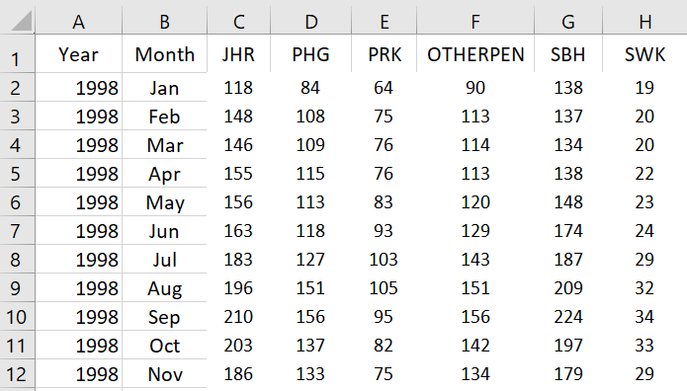
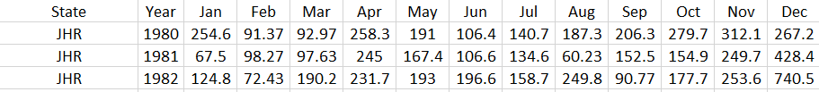
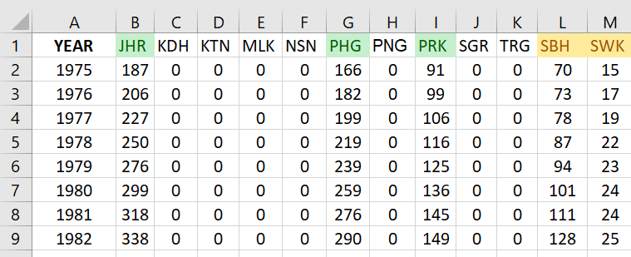
Data preparation
Oil production
Rainfalls
Planted area

Slide 4
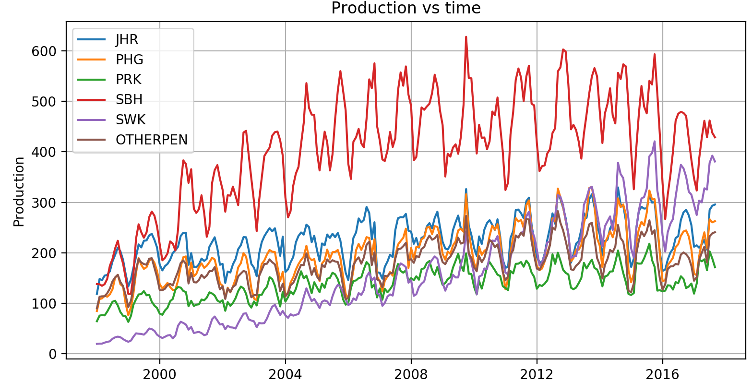
Regions production

Slide 5
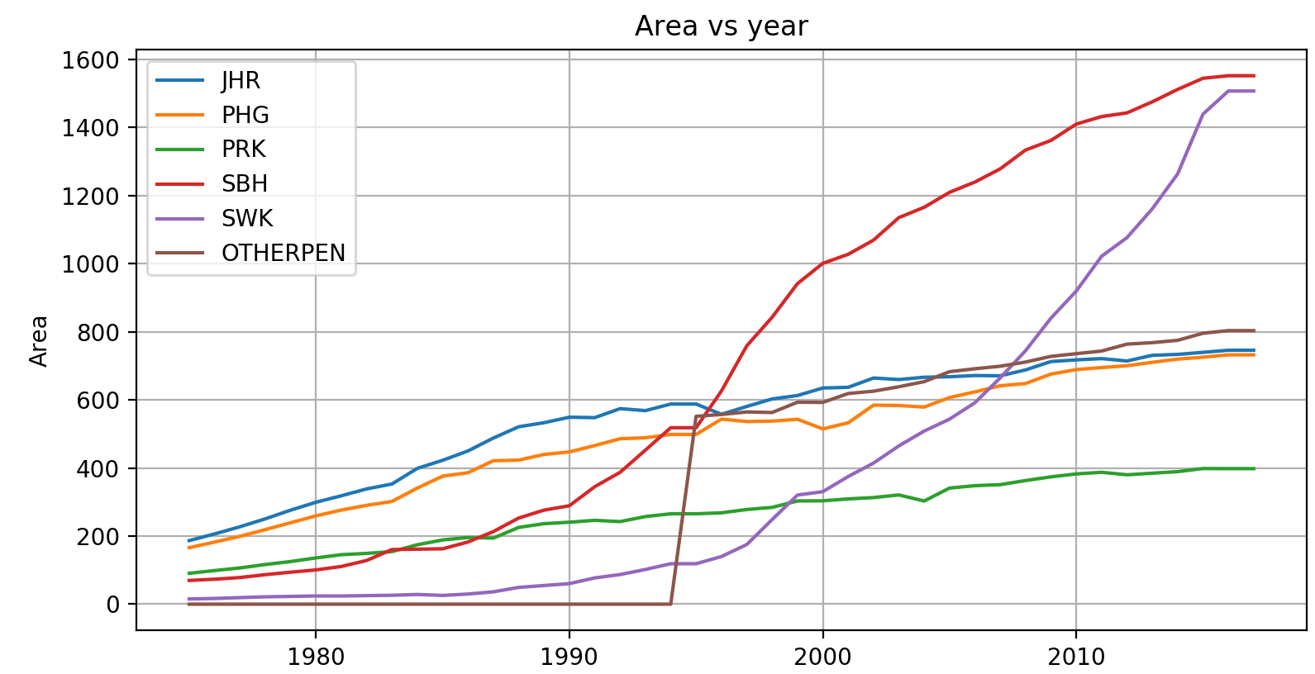
Planted area

Slide 6
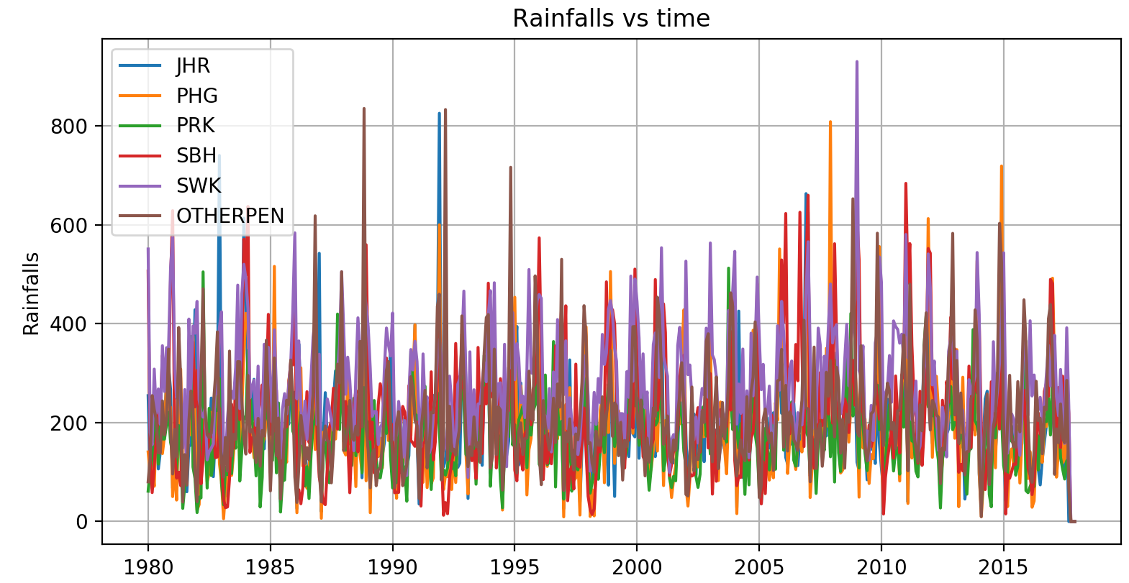
Rainfalls

Slide 7
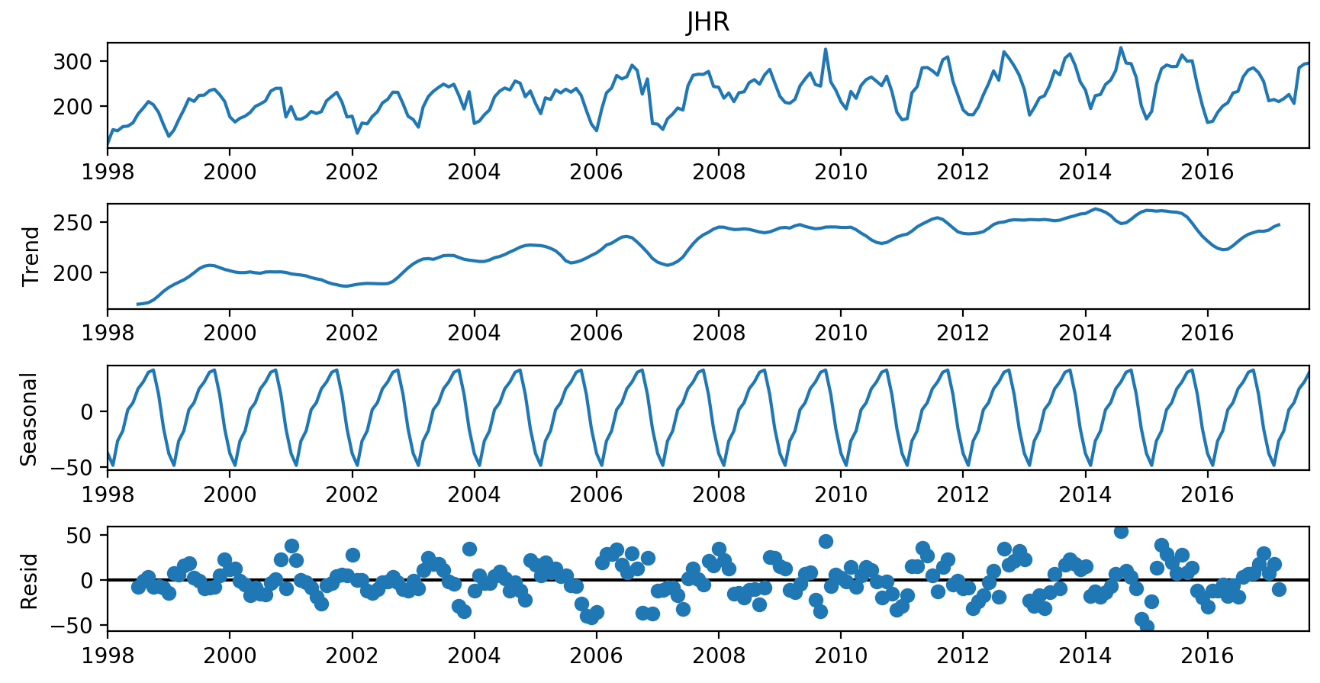
Decomposition

Slide 8
Model types
SMA, WMA, EMA
ARIMA
Regression
Machine learning

Slide 9
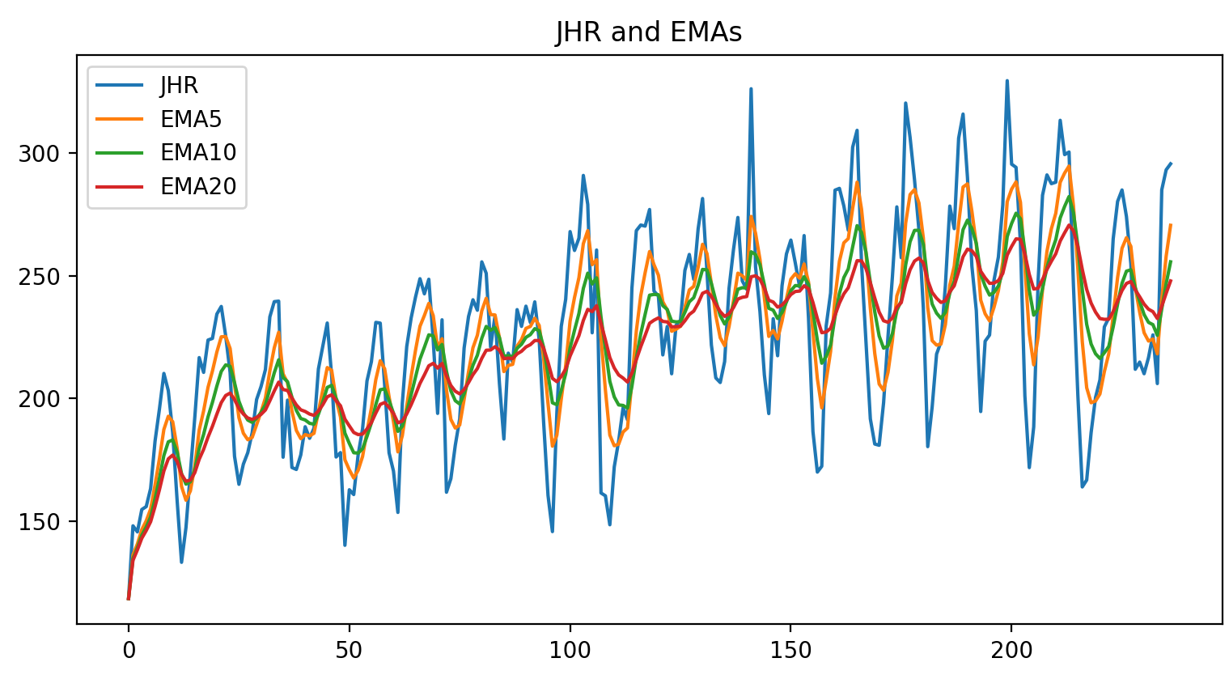
EMA 5,10,20

Slide 10
ARIMA
Instead of formula
AR I MA

Slide 11
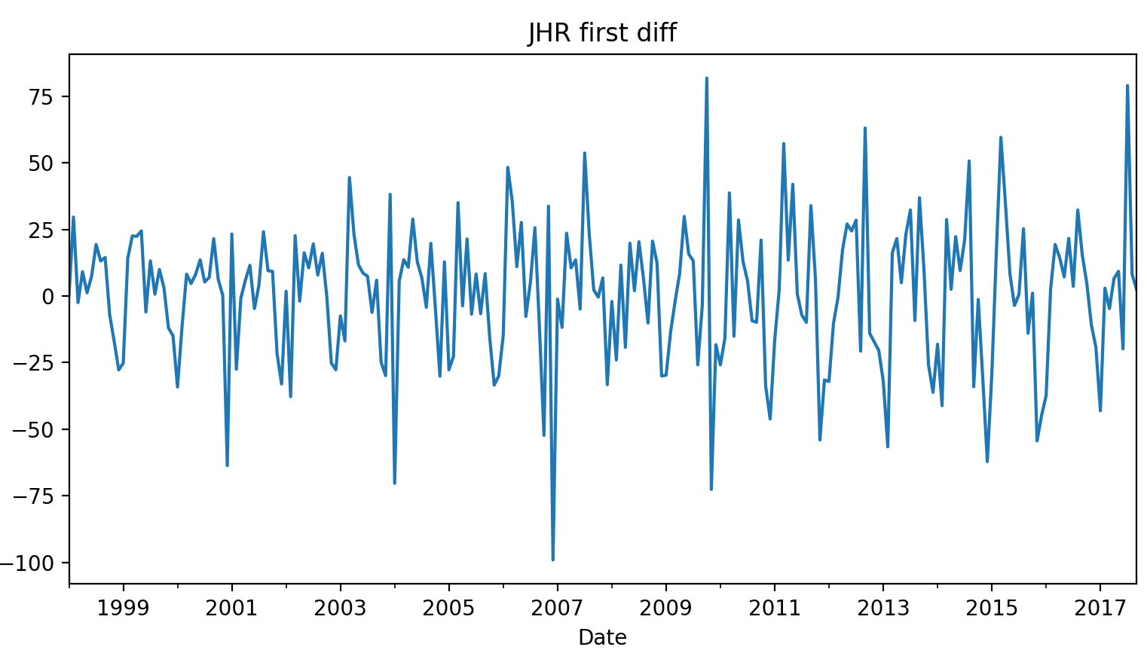
Diffs first level evaluation

Slide 12
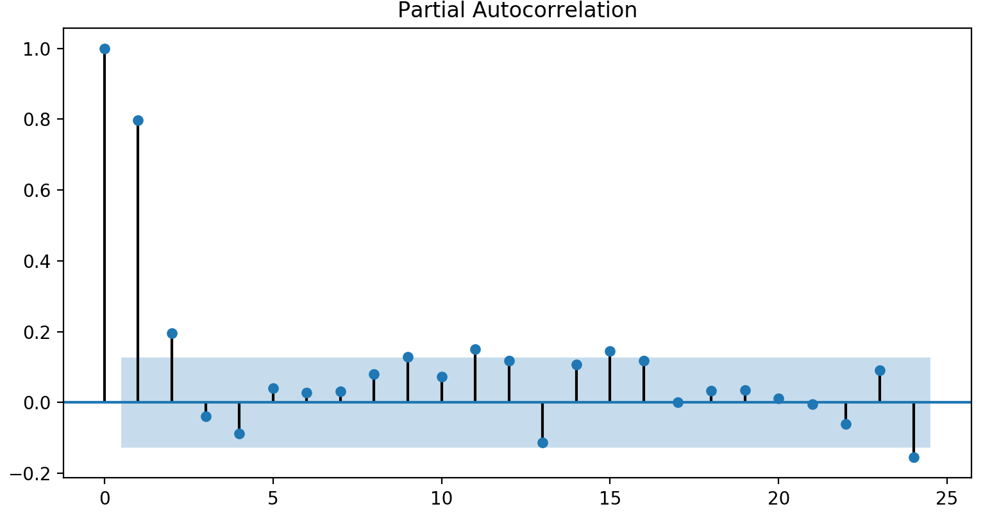
PACF, ACF

Slide 13
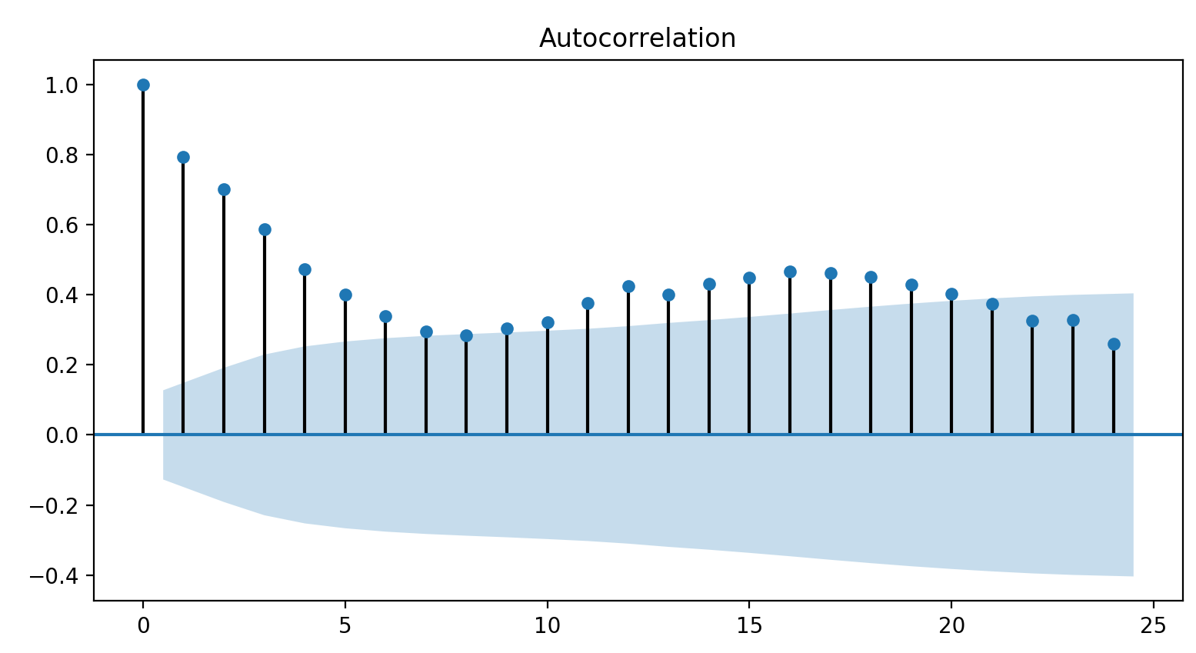

Slide 14
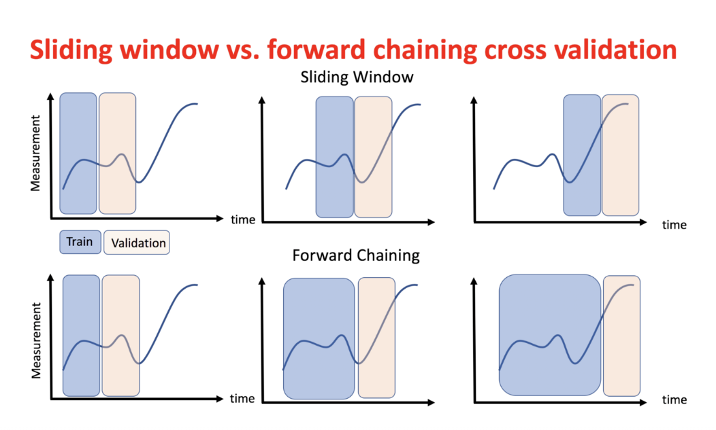

Slide 15
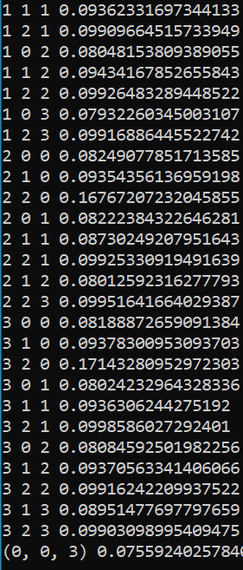
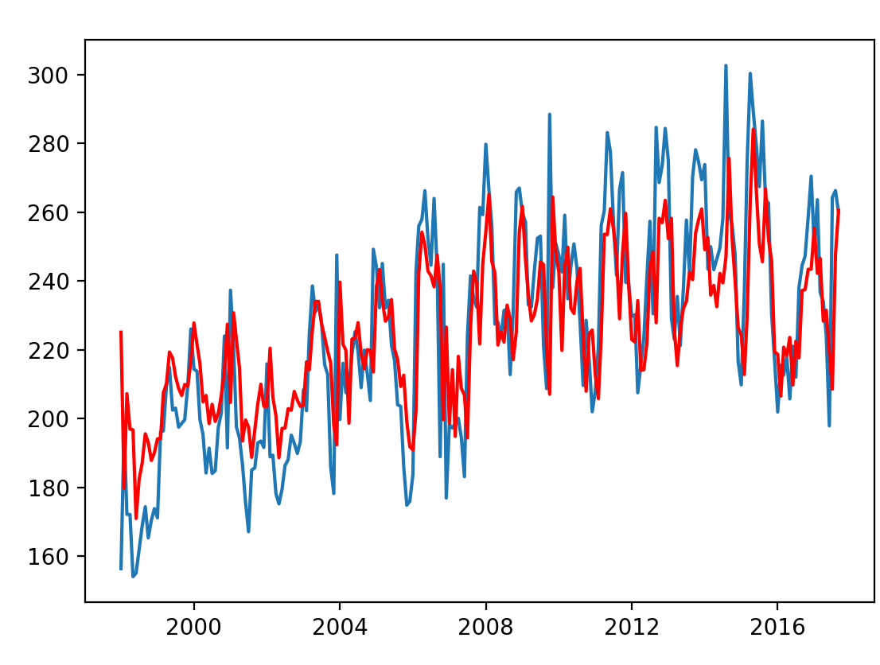
JHR ARIMA result (p, d, q)

Slide 16
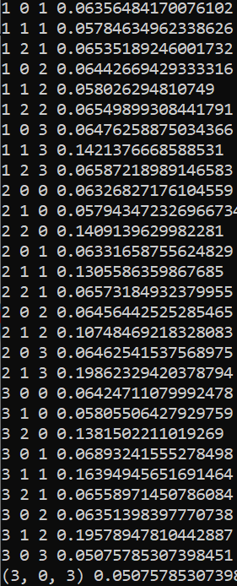
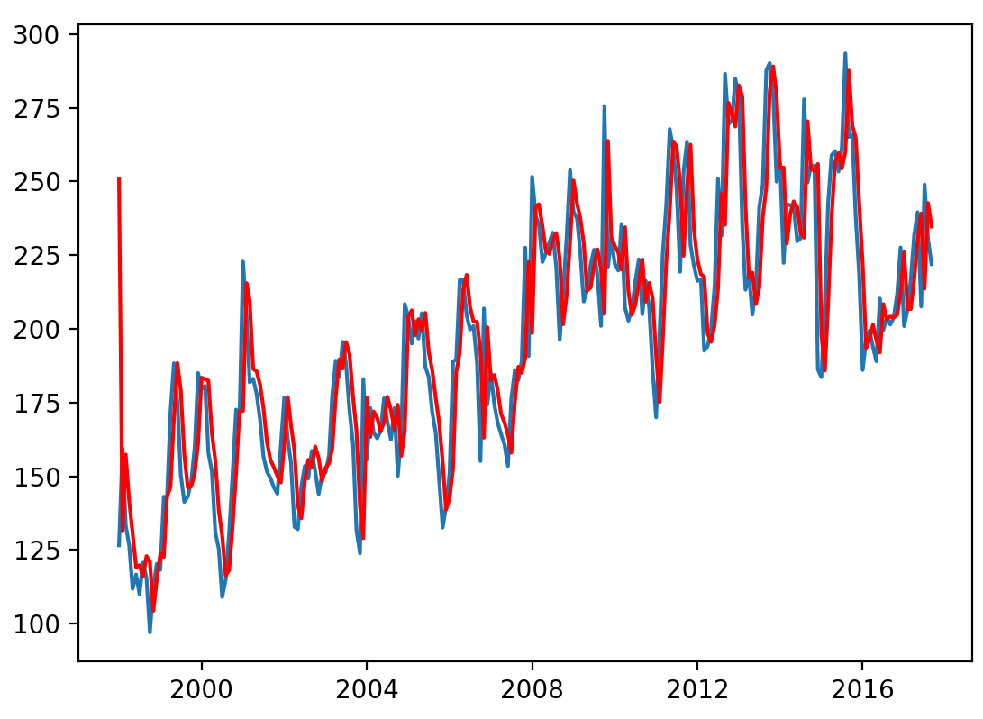
PHG ARIMA result (p, d, q)

Slide 17
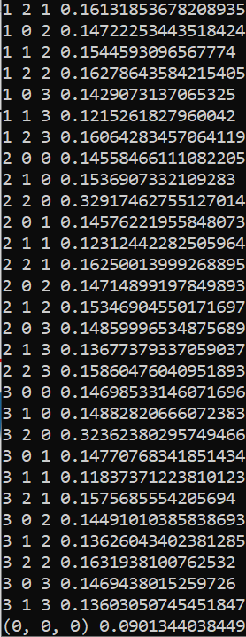
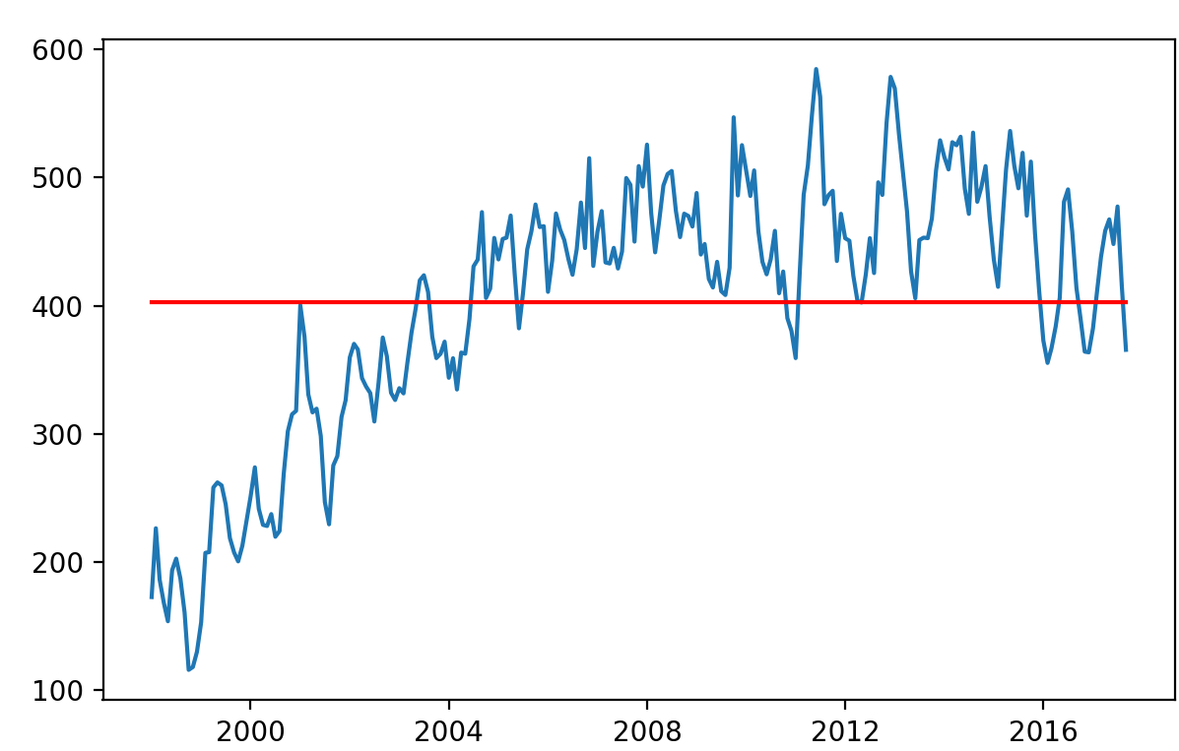
SBH, ARIMA result (p, d, q)

Slide 18

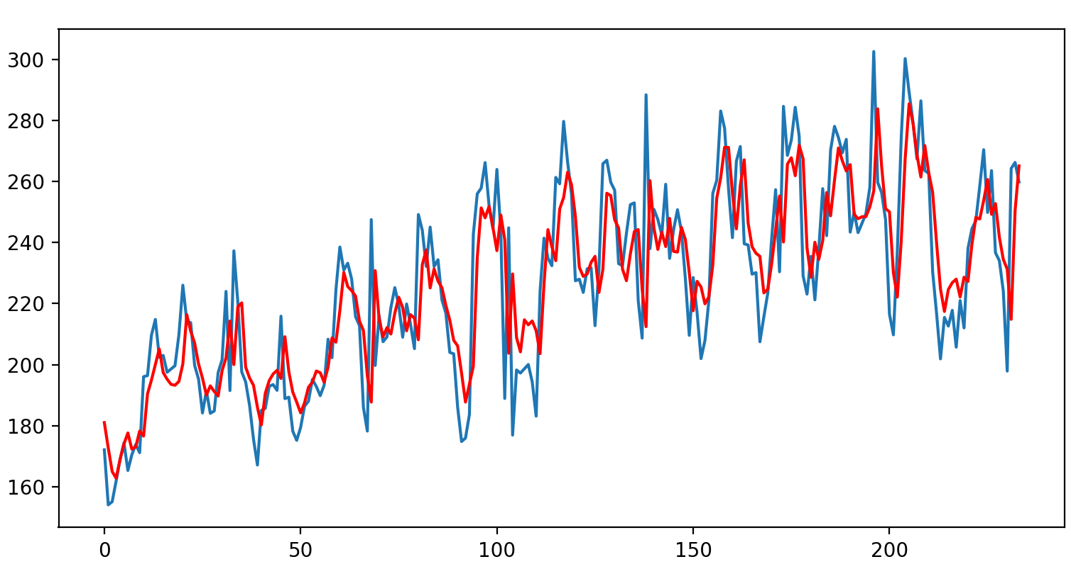
Regression, JHR

Slide 19

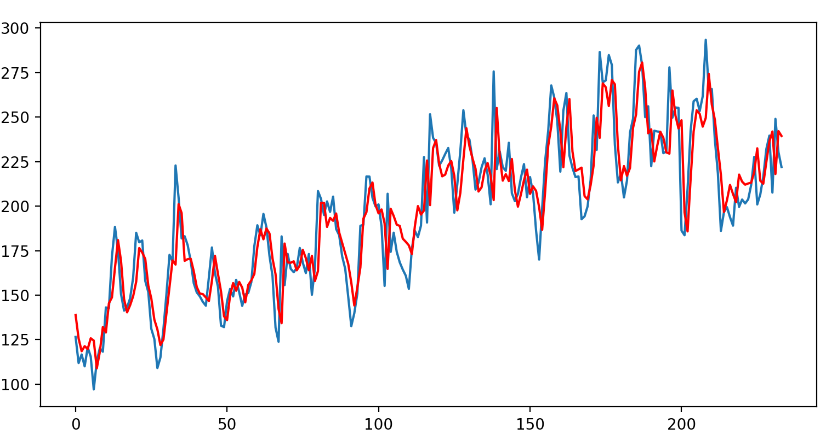
Regression, PHG

Slide 20

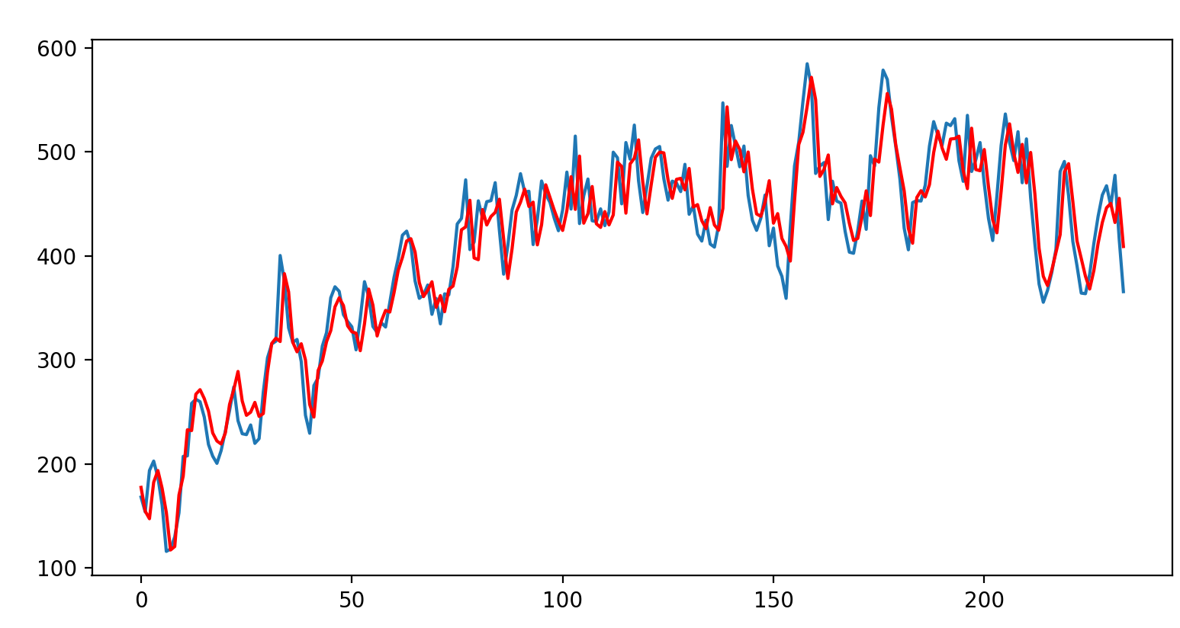
Regression, SBH

Slide 21
Next steps
Use other data sets
Machine learning

Slide 22
Sources
https://medium.com/datadriveninvestor/time-series-analysis-with-python-f5ab388b865a
https://towardsdatascience.com/time-series-machine-learning-regression-framework-9ea33929009a
https://towardsdatascience.com/machine-learning-part-19-time-series-and-autoregressive-integrated-moving-average-model-arima-c1005347b0d7
https://www.statsmodels.org/
https://pandas.pydata.org/
Wes McKinney “Python for Data Analysis Data”
Avishek Pal, PKS Prakash “Practical time series”
https://github.com/illia-alifanov/ds_palm_oil

Slide 23
Inspired by Technology.
Driven by Value.

