Slide 1

Palm oil production modeling
Time series analysis
eleks.com

Slide 2






Python and libraries

Slide 3
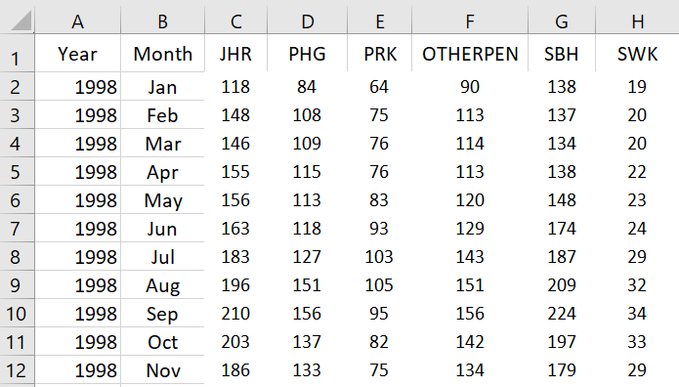
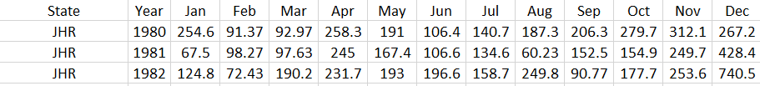
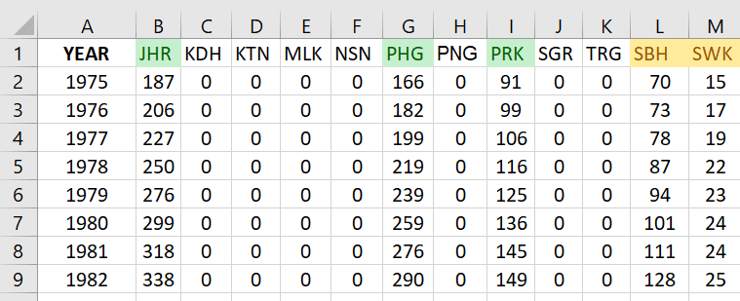
Data preparation
Oil production
Rainfalls
Planted area

Slide 4
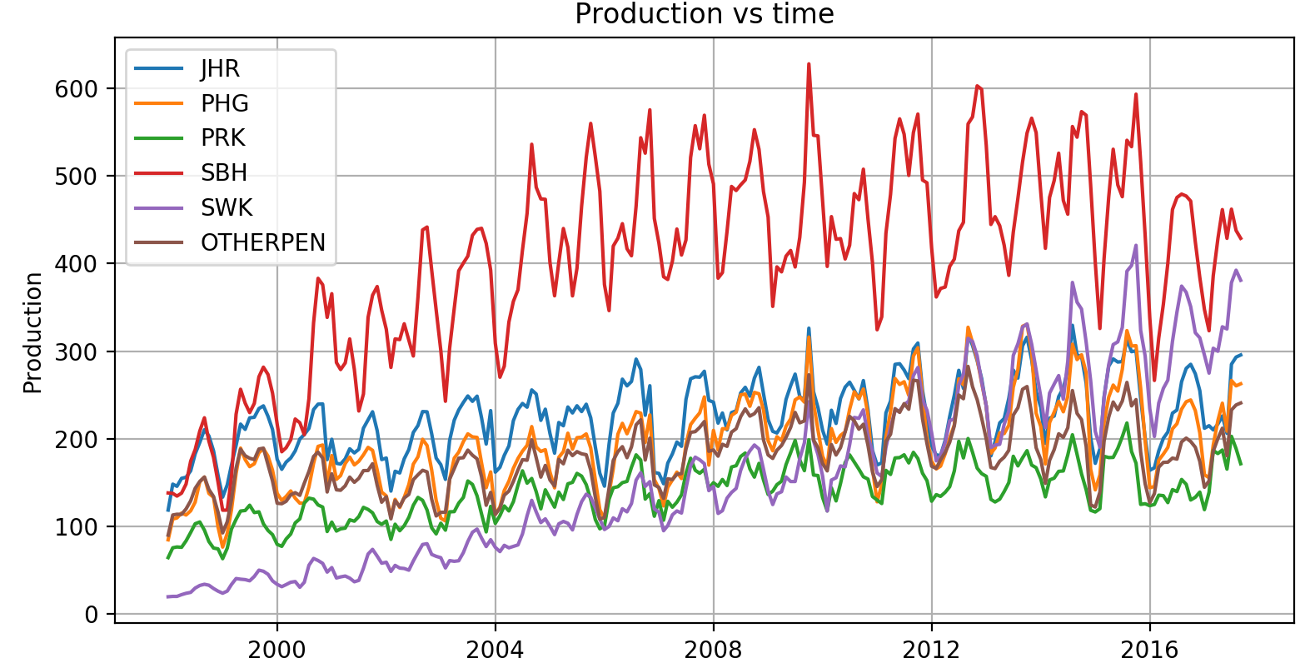
Regions production

Slide 5
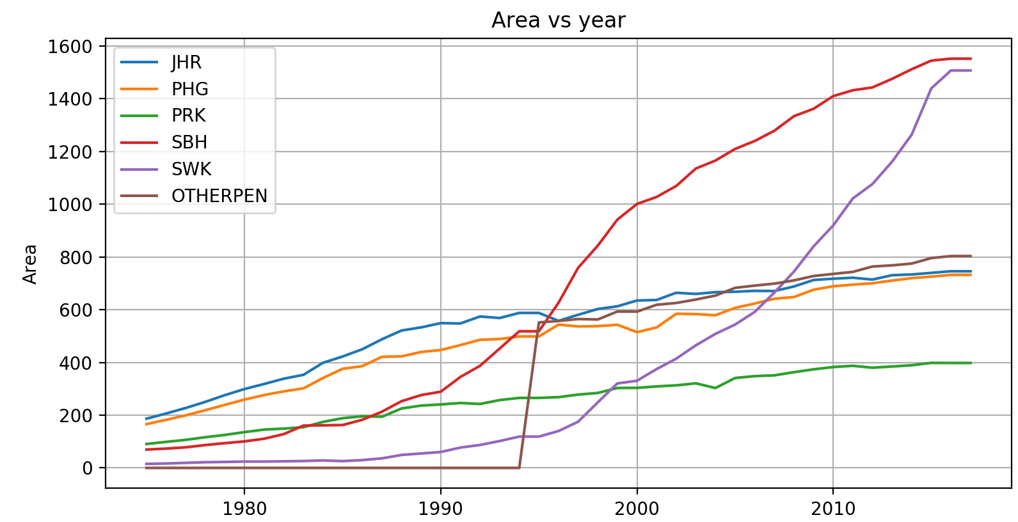
Planted area

Slide 6
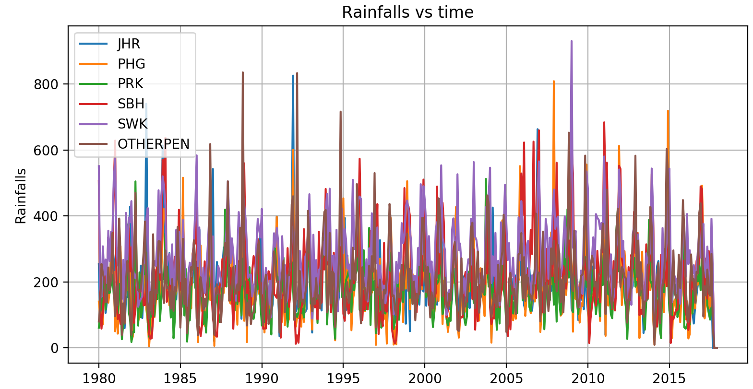
Rainfalls

Slide 7
Big blue heading
Bold text and regular one.

Slide 8

Slide with image
and bullet list
Heading 2
List item 1
List item 2
Heading 2
List item 1
List item 2

Slide 9

Slide with some details
Text
Smartwatch vibration
Smartphone notification
Music volume up

Slide 10

Image on left
Cool Feature
List Item 1
List Item 2
One more
List Item 1
List Item 2

Slide 11
Inspired by Technology.
Driven by Value.

