Slide 1

Python Final Project
Done by: Illia Martynov
s29076

Slide 2

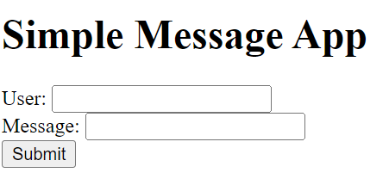
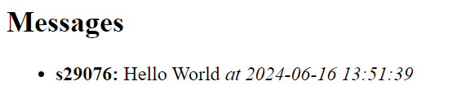
Application

Slide 3

Where can you use it
Internal Communication Tool: Use it within a team or organization for quick messages and updates.
Customer Feedback: Allow customers to leave messages or feedback on a website.
Online Community: Create a simple forum for community members to interact and share messages.

Slide 4

Information for the investors

Slide 5
My LinkedIn: https://www.linkedin.com/in/illia-martynov-335800283/
My GitHub: https://github.com/illiamartynov

