Slide 1

Bezier Patches
CS 418: Interactive Computer Graphics
UNIVERSITY OF ILLINOIS AT URBANA-CHAMPAIGN
Some material courtesy
The Essentials of CAGD by Gerald Farin and Dianne Hansford
Eric Shaffer

Slide 2
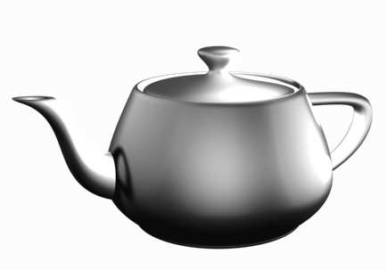
Bezier Patches
The Utah teapot model
Created with Bezier patches by Martin Newell in 1975

Slide 3
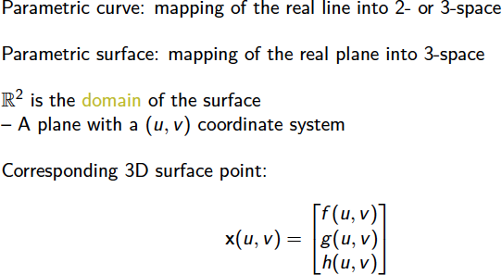
Parametric Surfaces

Slide 4
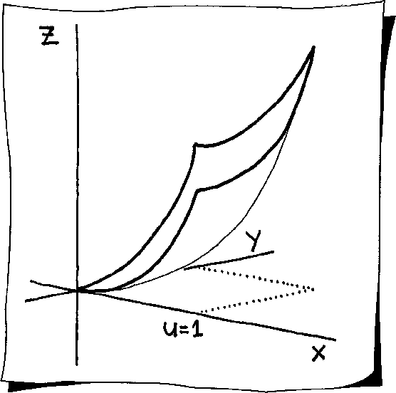
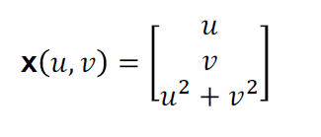
Example: Parametric Surface
This is also functional surface
• two of the coordinate functions are simply u and v
Parametric surfaces may be rotated or moved around
Much more general than bivariate functions z = f (x, y )
Why are parametric forms more
general? Think about a graph of a
function versus a parametric curve..

Slide 5
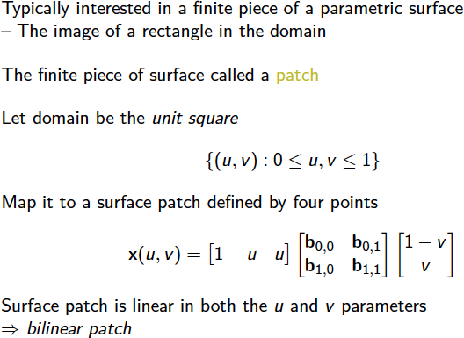
Bilinear Patches

Slide 6
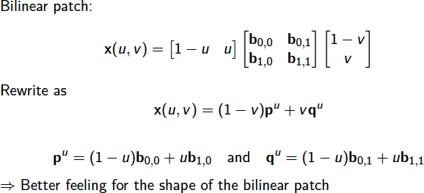
Bilinear Patches

Slide 7
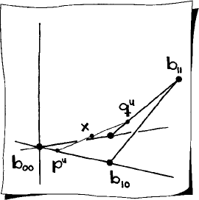
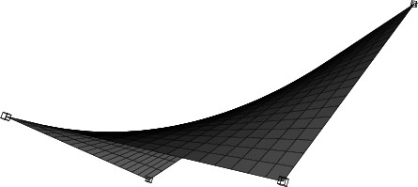
Bilinear Patch: Example

Slide 8
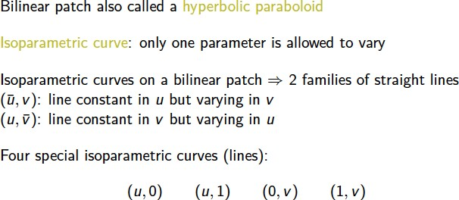
Isoparametric Curves

Slide 9
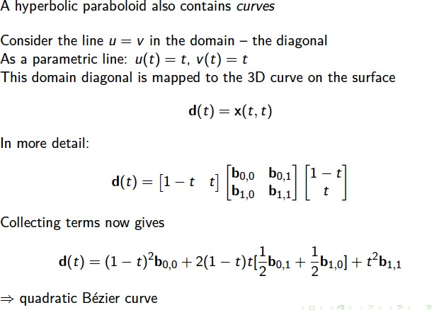
Curves on Patches

Slide 10
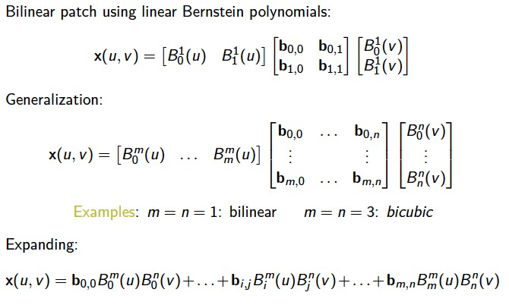
Bezier Patches
What is the shape of the control point matrix for a bicubic patch (i.e. how many rows and columns?
What kind of data is each entry in the matrix?

Slide 11
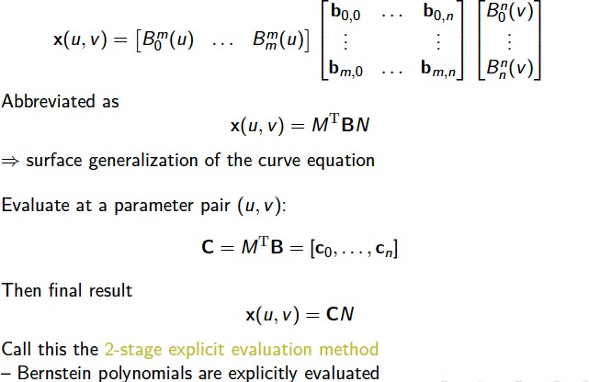
Bezier Patches

Slide 12
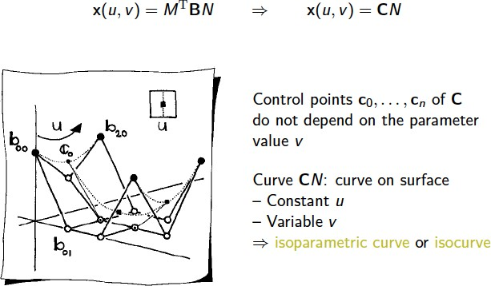
Bezier Patches
Meaning that the value of v will determine a point on the curve CN

Slide 13
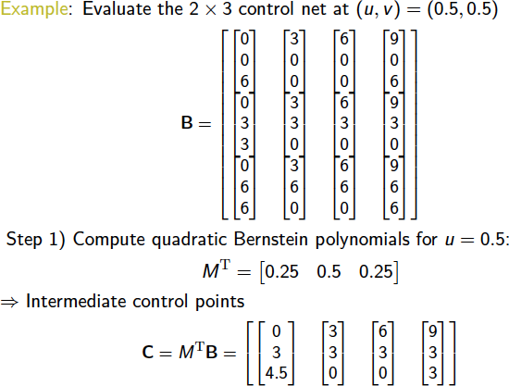
Bezier Patches: Example
Here, 2x3 refers to the degree of the polynomials…the control points form a matrix with 3 rows and 4 columns

Slide 14
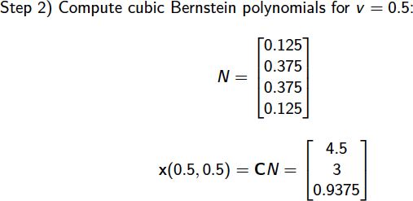
Bezier Patches: Example

Slide 15
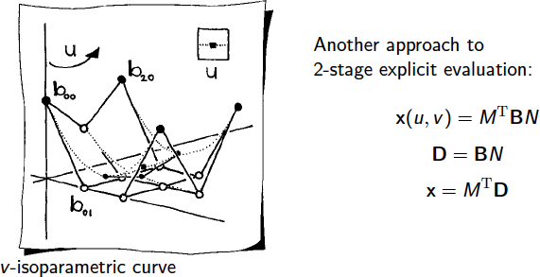
Another Approach to Evaluation

Slide 16
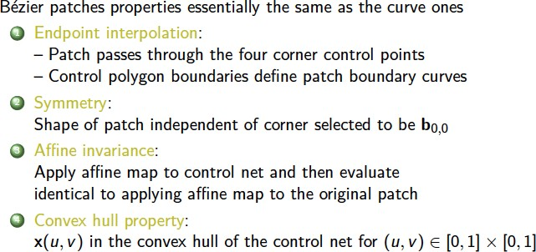
Properties of Bezier Patches

Slide 17
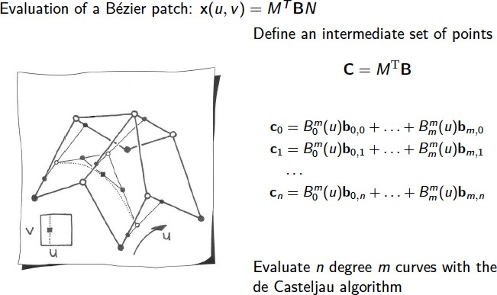
de Casteljau Algorithm
Each curve yields a control point c_{i} that will get used to form a curve for the next stage…

Slide 18
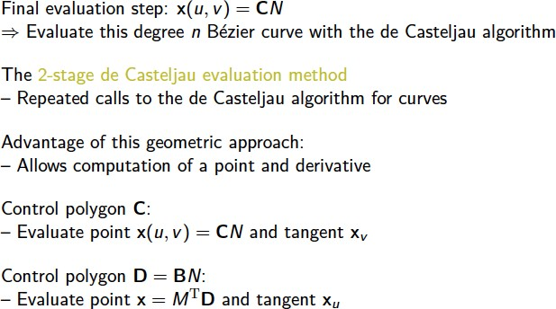
de Casteljau Algorithm
One last question: How would we generate triangles to render from a Bezier patch?

