Slide 1

Affine Transformations
CS 418: Interactive Computer Graphics
UNIVERSITY OF ILLINOIS AT URBANA-CHAMPAIGN
Eric Shaffer

Slide 2
Rendering Pipeline: Coordinate Transformations
Model Coords
Model Xform
World Coords
Viewing Xform
Viewing Coords
Perspective Distortion
Still Clip Coords.
Clipping
Clip Coords.
Homogeneous Divide
Window
Coordinates
Window
to
Viewport
Viewport
Coordinates

Slide 3
Rendering Pipeline: Coordinate Transformations
Model Coords
Model Xform
World Coords
Viewing Xform
Viewing Coords
Not everyone uses the same terminology…
in Unity, viewport coordinates are in the range [-1,1]
we’ll use what you see listed here
Perspective Distortion
Still Clip Coords.
Clipping
Clip Coords.
Homogeneous Divide
Window
Coordinates
Window
to
Viewport
Viewport
Coordinates
Most of the transformations described here are accomplished by matrix-vector multiplications…so we will review some linear algebra
Window Coordinates: 2D and in range [-1,1]
Viewport Coordinates: pixel coordinates
What stages that you see here happen in the vertex shader?

Slide 4
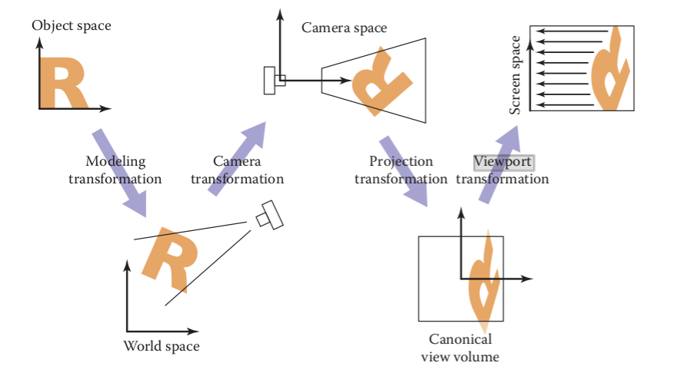
Another way of looking at it…
From
Fundamentals of Computer Graphics by Marschner and Shirley
For this course: Camera space = View space Camera Transformation = View Transformation
Screen space = Viewport coordinates

Slide 5
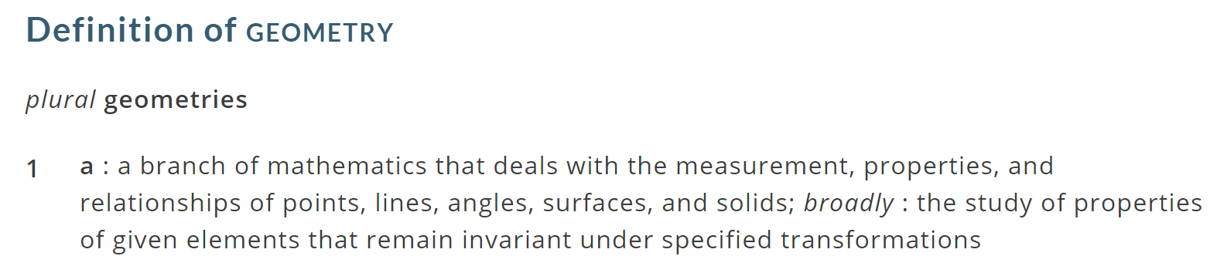
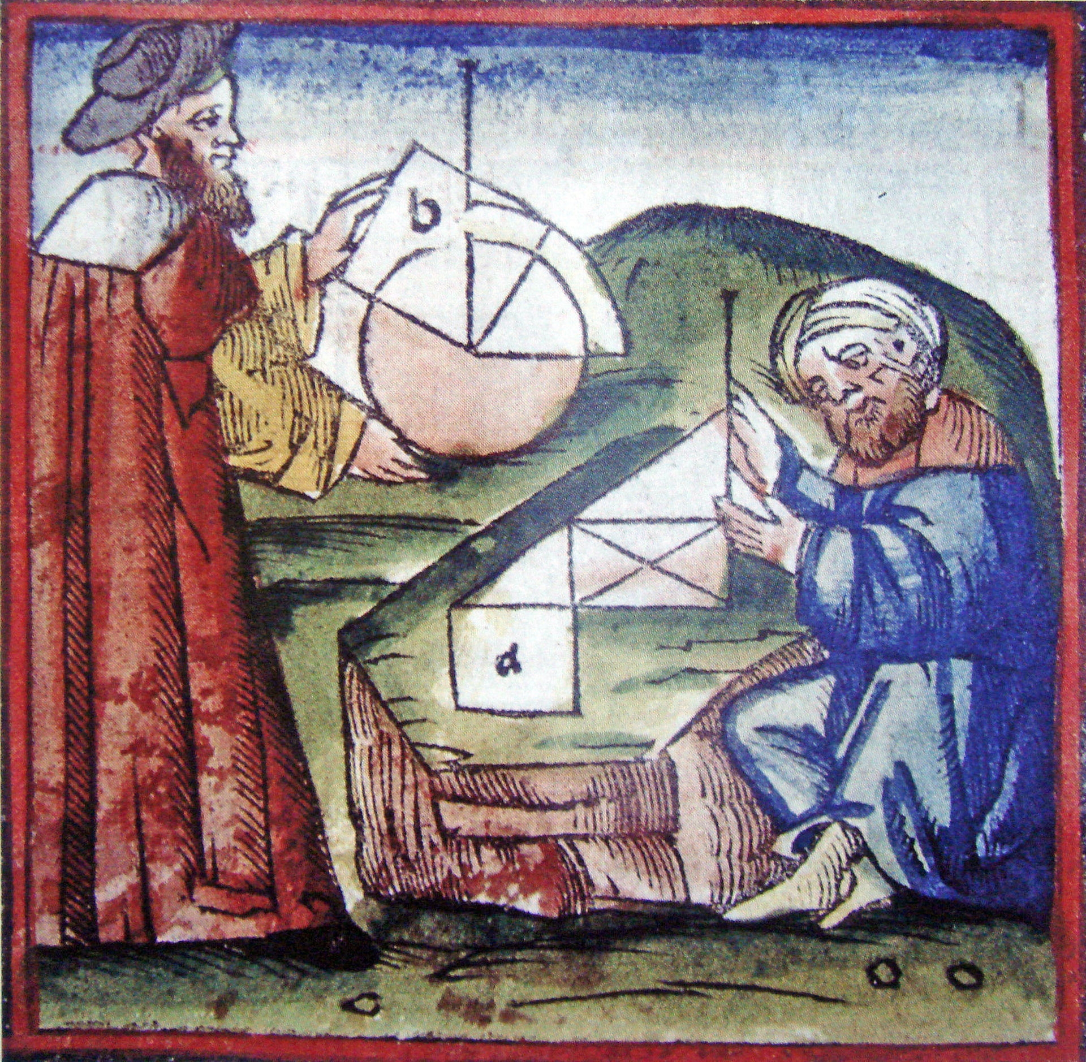
A Brief Sampling of Useful Math
We will look at three basic geometric elements Scalars: Encode a magnitude Vectors: Encode a magnitude and direction Points: Encode a position in space

Slide 6
Scalars
Scalars are quantities which express only a magnitude… Think of them as just a single number like 3.14
Scalars:
members of a set which
can be combined by two operations (addition and multiplication)
obey some fundamental laws (associativity, commutativity, inverses)
Examples include the real numbers
under the ordinary arithmetic rules with which we are familiar
Scalars have no geometric properties

Slide 7
Vectors
A vector is a quantity with two attributes
Direction
Magnitude
Examples include
Force
Velocity
Directed line segments
v

Slide 8
Vector Operations
Every vector has an additive verse
Same magnitude but points in opposite direction
Every vector can be multiplied by a scalar
There is a zero vector
Zero magnitude, undefined orientation
The sum of any two vectors is a vector
Use head-to-tail axiom
v
w
v
-v
αv
u

Slide 9
Operations on Vectors
Scalar-vector multiplication u = αv
Vector-vector addition: w =u + v
Allows expressions such as v=u+2w-3r
Vectors lack position
…need points to make things interesting

Slide 10
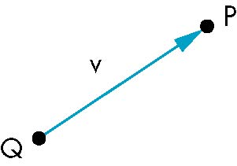
Points
Location in space
Operations allowed between points and vectors
Point-point subtraction yields a vector
Equivalent to point-vector addition
P=V + Q
V = P - Q

Slide 11
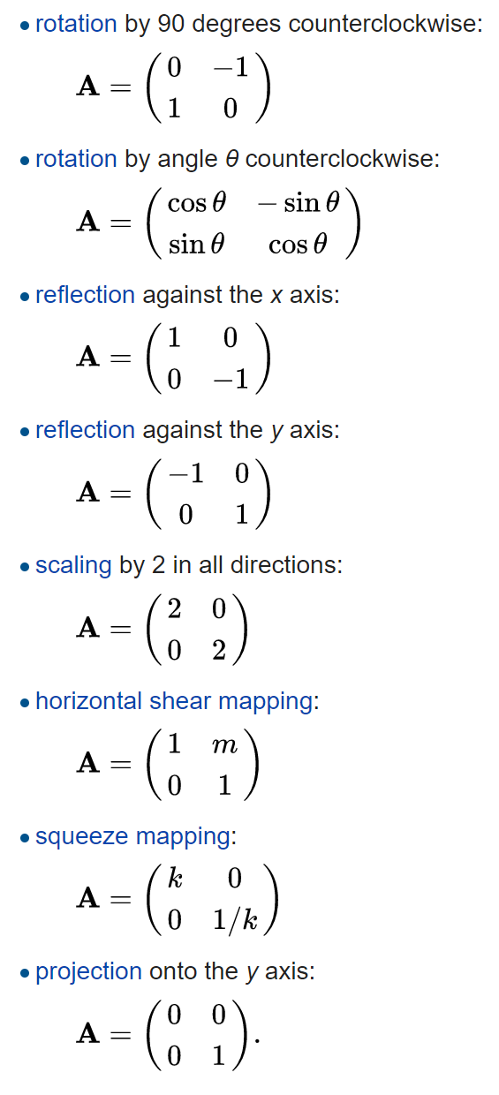
Linear Transformations
In other words: doesn’t matter if we add the vectors and
then apply the map, or apply the map and then add the
vectors…same for scaling
A transformation f is linear if
$$f(au+bv)=af(u)+bf(v)$$
for vectors u and v and scalars a and b.
Linear transformations have a geometric interpretation and can be applied to points or vectors.
In two-dimensional space R² linear transformations are described by 2 × 2 real matrices.

Slide 12
2-D Points
(1,1)
Represents points and vertices as column vectors:
(-1,-1)

Slide 13
2-D Points
(1,1)
Represents points and vertices as column vectors:
Transform polygonal object by transforming its vertices
(-1,-1)

Slide 14
2-D Points
(1,1)
Represents points and vertices as column vectors:
Transform polygonal object by transforming its vertices
Scale by matrix multiplication
(-1,-1)

Slide 15
2-D Points
(1,1)
Represents points and vertices as column vectors:
Transform polygonal object by transforming its vertices
Scale by matrix multiplication
Translation via vector sum
(-1,-1)

Slide 16
Squash & Stretch
Classic animation technique Scale one coordinate by matrix multiplication

Slide 17
2-D Points
(1,1)
Represent points and vertices as column vectors:
Transform polygonal object by transforming its vertices
Scale by matrix multiplication
Translation via vector sum
Order is important
Translate then scale
Scale then translate
(-1,-1)

Slide 18
Homogeneous Coordinates
Translation by vector sum is cumbersome
Add a extra coordinate
Called the homogeneous coordinate
For now, set to one
Translation now expressed as a matrix
Now we can compose scales and translations into a single matrix by matrix multiplication

Slide 19
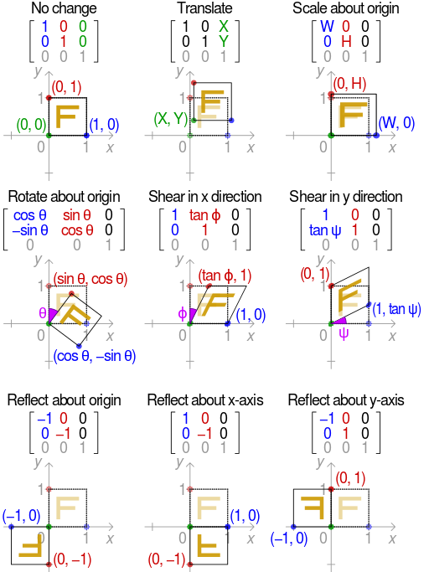
Affine Transformations
An affine transformation is the sum of a linear transformation and a constant vector…
Linear transformations preserve the origin
Translations map the origin to a new position

Slide 20
Order Dependence
(-1,-1)

Slide 21
Window-to-Viewport
(1,1)
First translate lower-left corner to (0,0)
Then scale upper-right corner from (2,2) to (w-1,h-1)
To get
(-1,-1)
W2V
(w-1,h-1)
This is the transformation WebGL and DirectX10+ use…pixel centers are at offsets of 0.5 from integer values
(0,0)

Slide 22
2-D Rotation
Pick a point (x,y)

Slide 23
2-D Rotation
Pick a point (x,y)
Assume polar coords
x = r cos θ, y = r sin θ

Slide 24
2-D Rotation
Pick a point (x,y)
Assume polar coords
x = r cos θ, y = r sin θ
Rotate about origin by φ
x’ = r cos θ +φ, y’ = r sin θ +φ

Slide 25
2-D Rotation
Pick a point (x,y)
Assume polar coords
x = r cos θ, y = r sin θ
Rotate about origin by φ
x’ = r cos θ +φ, y’ = r sin θ +φ
Recall trig. identities
x’ = r (cosθ cos φ –sinθ sinφ) y’ = r (sinθ cos φ +cosθ sinφ)

Slide 26
2-D Rotation
Pick a point (x,y)
Assume polar coords
x = r cos θ, y = r sin θ
Rotate about origin by φ
x’ = r cos θ +φ, y’ = r sin θ +φ
Recall trig. identities
x’ = r (cosθ cos φ –sinθ sinφ) y’ = r (sinθ cos φ +cosθ sinφ)
Rearrange terms
x’ = cos φ (r cosθ ) – sinφ (r sinθ ) y’ = (r cosθ ) sinφ + (r sinθ ) cos φ

Slide 27
2-D Rotation
x’ = cos φ (r cosθ ) – sinφ (r sinθ )
y’ = (r cosθ ) sinφ + (r sinθ ) cos φ

Slide 28
2-D Rotation
x
y
x’ = cos φ (r cosθ ) – sinφ (r sinθ )
y’ = (r cosθ ) sinφ + (r sinθ ) cos φ
x
y

Slide 29
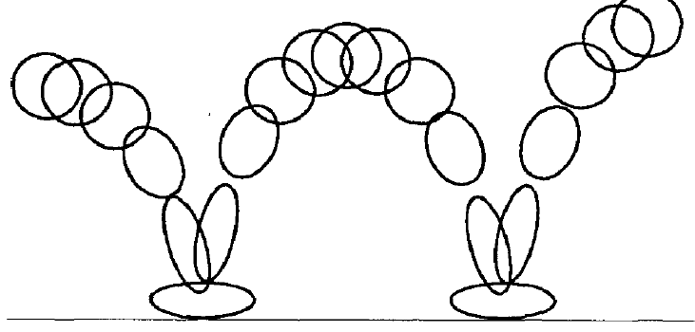
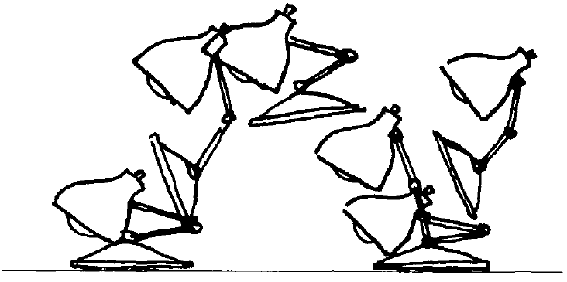
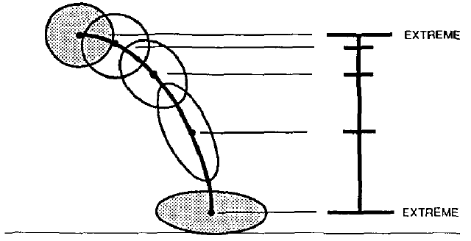
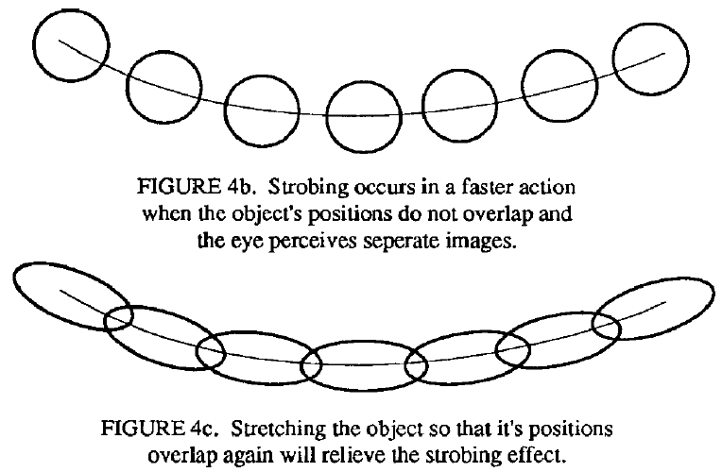
Squash & Stretch
From: John Lasseter: “Principles of Traditional Animation Applied to 3-D Computer Animation” Proc. SIGGRAPH 87

Slide 30
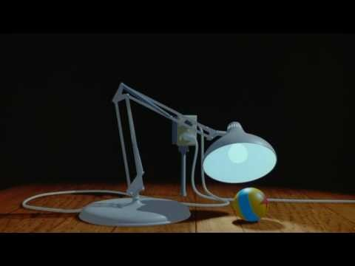
Luxo Jr.
Directed by | John Lasseter
Written by | John Lasseter
Production company | Pixar
Release date | Aug. 17, 1986 (SIGGRAPH)

Slide 31

Luxo Jr.
Breakthrough demonstration of computer animation in 1987
Demonstrates shadow maps and Renderman surface shaders
Lamp and ball behavior implemented using affine transformations
Took about 5 months of work from Pixar’s (then) tiny animation team
It was the first CGI film nominated for an Academy Award.
In 2014, Luxo Jr. was deemed "culturally, historically, or aesthetically significant" by the Library of Congress and selected for preservation in the National Film Registry.

Slide 32
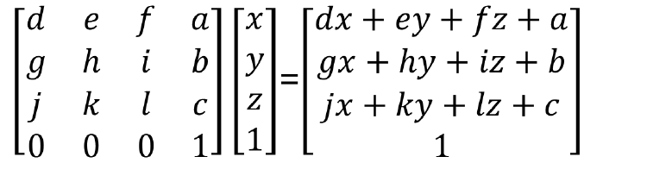
3-D Affine Transformations
General Form (with homogenous coordinates)

Slide 33
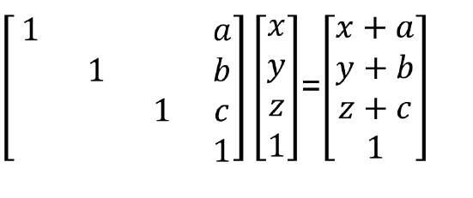
Translation

Slide 34
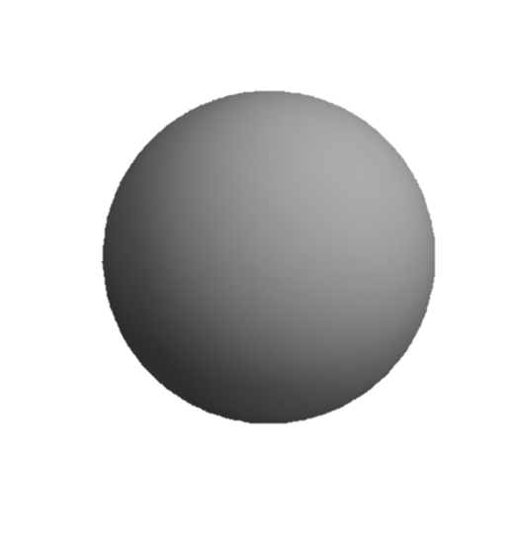
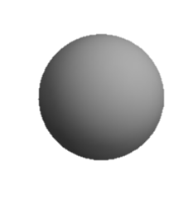
Scale
y
x
z
Uniform Scale
a = b = c = ¼
Stretch
a = b = 1, c = 4
Squash
a = b = 1, c = ¼
Project
a = b = 1, c = 0
Invert
a = b = 1, c = -1

Slide 35
3-D Rotations
About x-axis
rotates y → z
About y-axis
rotates z → x
About z-axis
rotates x → y
Rotations do not commute!

Slide 36
Graphics Pipeline
Model Coords
Model Xform
World Coords
Viewing Xform
Viewing Coords
Perspective Distortion
Homogeneous Divide
Still Clip Coords.
Clipping
Clip Coords.
Window
Coordinates
Window
to
Viewport
Viewport
Coordinates

Slide 37

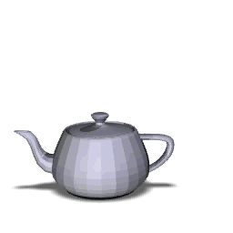
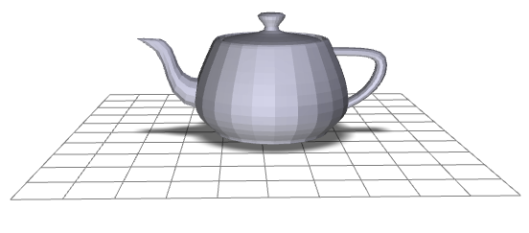
Transformation Order
y
x
z
M
M
M
R
T
T
R

