Slide 1

Compositing
CS 418: Interactive Computer Graphics
UNIVERSITY OF ILLINOIS AT URBANA-CHAMPAIGN
Eric Shaffer

Slide 2
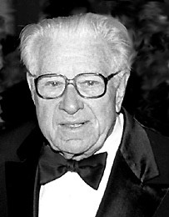

Lynwood Dunn (1904-1998)
Visual effects pioneer
Acme-Dunn optical printer
Run film through a projector and re-photograph it
Can zoom in or out, applies filters etc.

Slide 3
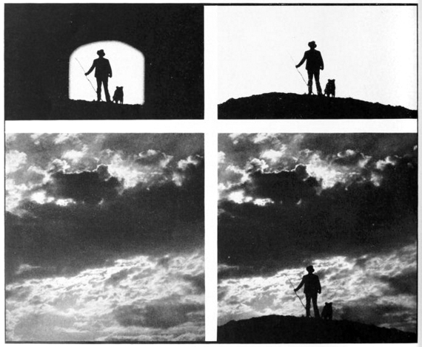
Compositing Example

Slide 4
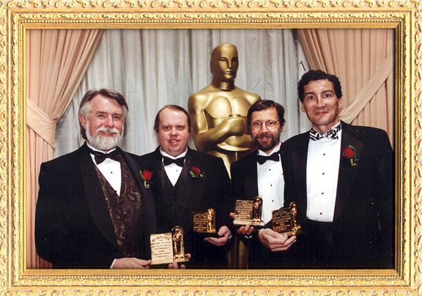
Academy of Motion Picture Arts & Sciences
Scientific and Engineering Award
To Alvy Ray Smith, Tom Duff, Ed Catmull and Thomas Porter for their Pioneering Inventions in Digital Image Compositing.
PRESENTED MARCH 2, 1996

Slide 5
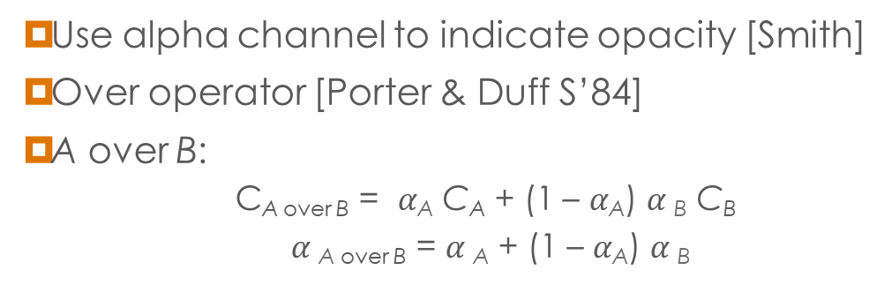
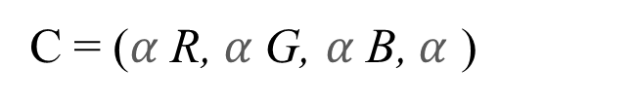
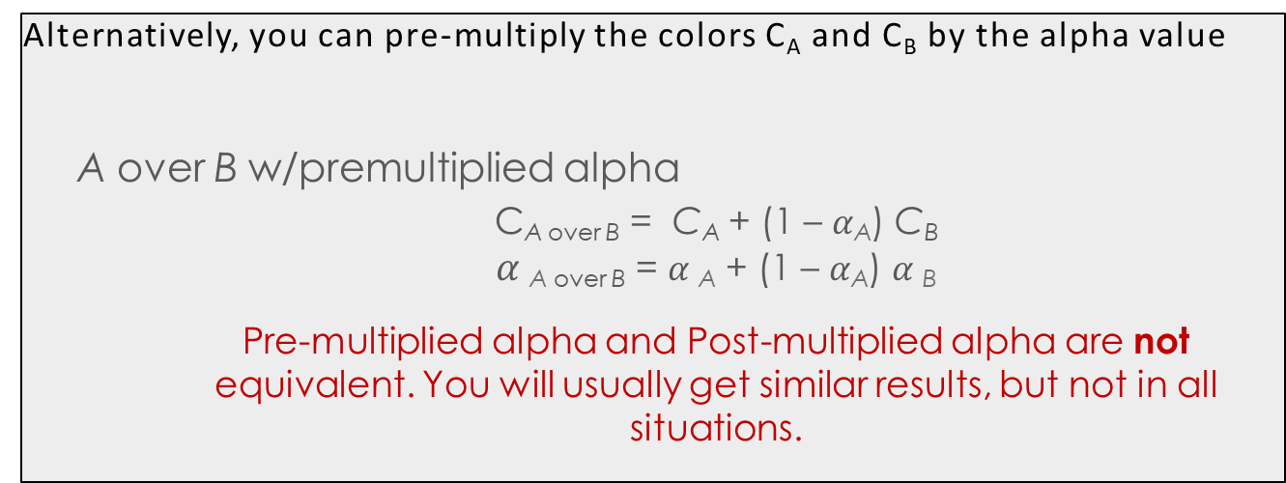
The Over Operator
◉ Use alpha channel to indicate opacity [Smith]
◉ Over operator [Porter & Duff S’84]
◉ A over B:
C_{A over B} = $α$_{A} C_{A} + (1 – $α$_{A}) $α$_{B} C_{B}
$α$_{A over B} = $α$_{A} + (1 – $α$_{A}) $α$_{B}
A
Alternatively, you can pre-multiply the colors C_{A} and C_{B} by the alpha value
A over B w/premultiplied alpha
C_{A over B} = C_{A} + (1 – $α$_{A}) C_{B} $α$_{A over B} = $α$_{A} + (1 – $α$_{A}) $α$_{B} Pre-multiplied alpha and Post-multiplied alpha are not equivalent. You will usually get similar results, but not in all situations.
B
C = ($α$R, $α$G, $α$B, $α$ )

Slide 6




Is Over Associative?
¤ A over (B over C) = C_{A} + (1-α_{A})(C_{B} + (1- α _{B})C_{C})
C
B
A

Slide 7
Is Over Associative?
A over (B over C)
= C_{A} + (1- α _{A})(C_{B} + (1- α _{B})C_{C})
= C_{A} + (1- α _{A})C_{B} + (1- α _{A})(1- α _{B})C_{C}
= C_{AB} + (1 – α_{A} – (1- α _{A}) α _{B})C_{C}
= C_{AB} + (1- α _{AB}) C_{C}
= (A over B) over C
What about α ?
= α _{A} + (1- α _{A}) α _{BC}
= α _{A} + (1- α _{A})(α _{B} + (1- α _{B}) α _{C})
= α _{A} + (1- α _{A}) α _{B} + (1- α _{A})(1- α _{B}) α _{C}
= α _{AB} + (1- α _{AB}) α _{C}
C
B
A

Slide 8
Questions….
Is post-multiplied alpha associative?
Is the over operator commutative?

Slide 9
Questions….
Is post-multiplied alpha associative? NO
Is the over operator commutative? NO

Slide 10
Accumulating Opacity
What if you have multiple layers of surfaces to blend? What is the impact of over being non-commutative?
Have to work in sorted order
Back to front: Over operator C_{out} = C + (1 – α) C_{in} α _{out} = α + (1 – α) α _{in}
^{C}out
^{C}in
C, α
view
Could also work front to back…

Slide 11
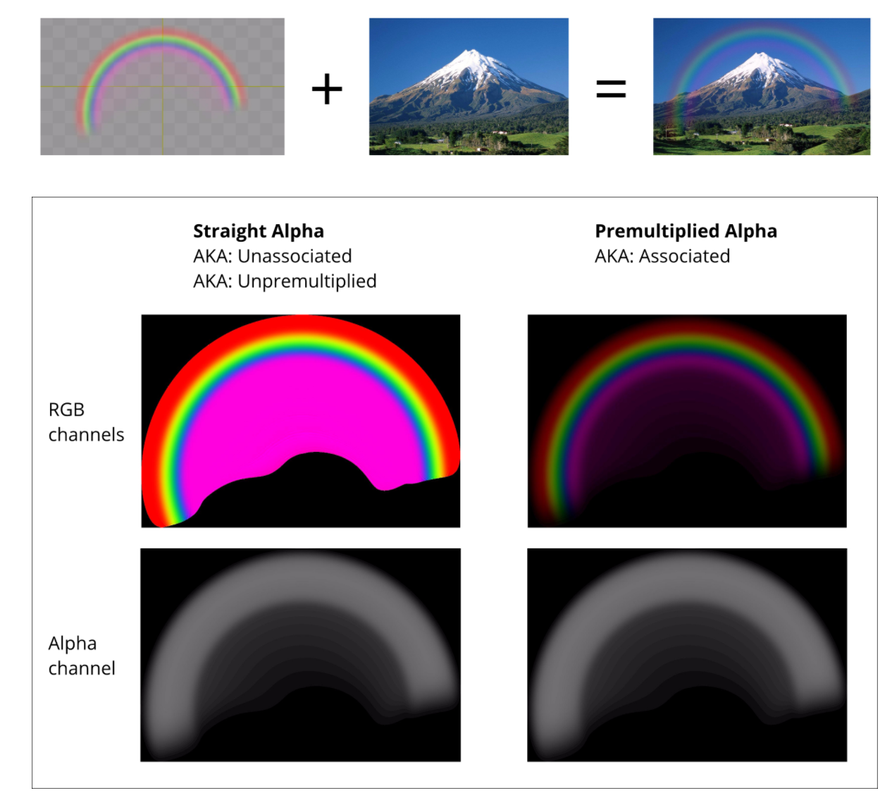
Which Alpha Should You Use?
Which version of alpha is most natural for a digital artist to use?
What alpha is used by the rendered image in your framebuffer?

Slide 12
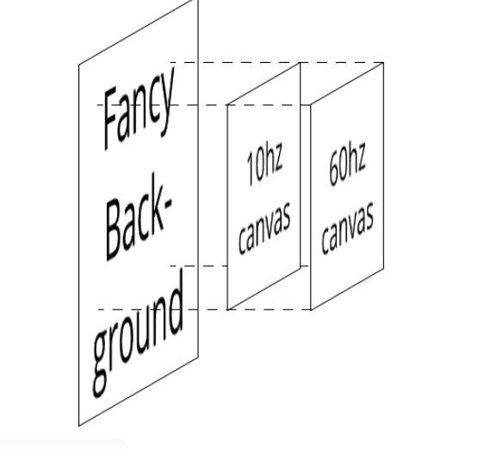
WebGL Canvases are Composited
A browser composites your WebGL canvas on the displayed page
This is done using premultipled alpha
You could stack multiple canvasses (I don’t know why…)

Slide 13
Hidden Surface Removal
Hidden Surface Removal
…don’t render surfaces occluded by surfaces in front of them
Was a significant area of research in early days of CG
…lots of algorithms suggested
Painter’s Algorithm
Render objects in order from back to front
i.e. sort your triangles by depth and render deepest first
Can anyone imagine any problems with this approach?

Slide 14
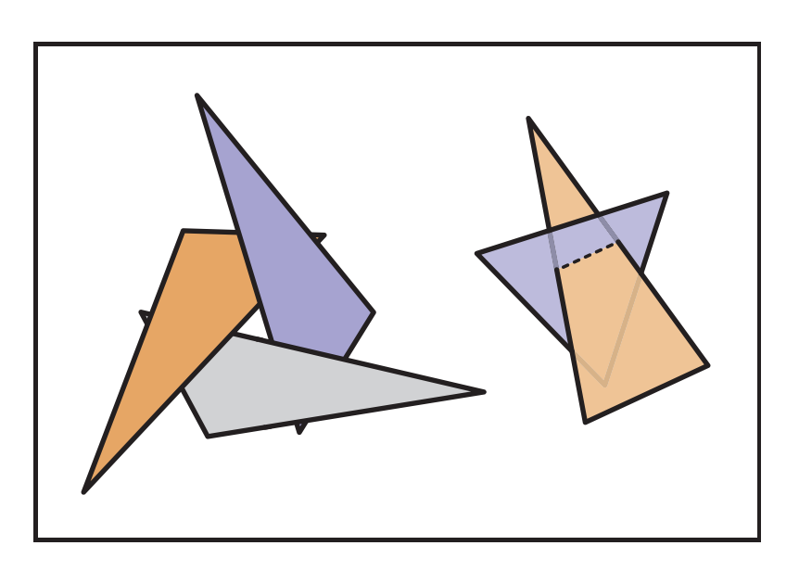
Problems with the Painter’s Algorithm
No correct rendering order for
intersecting triangle
occlusion cycles
Sorting is slow…too slow for interactivity in complex scenes

Slide 15
Hidden Surface Removal: Z-Buffer
Hidden Surface Removal: Z-Buffer
Key Observation: Each pixel displays color of only one triangle, ignores everything behind it
Donʼt need to sort triangles, just find for each pixel the closest triangle
Z-buffer: one fixed or floating point value per pixel
Algorithm:
For each rasterized fragment (x,y)
If z < zbuffer(x,y) then framebuffer(x,y) = fragment color
zbuffer(x,y) = z
far
far
far
far
far
far
far
far
far
far
far
far
framebuffer
zbuffer
Frame Buffer: buffer that stores the colors for the pixels we will render

Slide 16
Z-Buffer
far
.1
.2
.3
.4
.5
.6
.7
.8
far
far
far
Key Observation: Each pixel displays color of only one triangle, ignores everything behind it
Donʼt need to sort triangles, just find for each pixel the closest triangle
Z-buffer: one fixed or floating point value per pixel
Algorithm:
For each rasterized fragment (x,y)
If z < zbuffer(x,y) then framebuffer(x,y) = fragment color
zbuffer(x,y) = z
framebuffer
zbuffer

Slide 17
Z-Buffer
Key Observation: Each pixel displays color of only one triangle, ignores everything behind it
Donʼt need to sort triangles, just find for each pixel the closest triangle
Z-buffer: one fixed or floating point value per pixel
Algorithm:
For each rasterized fragment (x,y)
If z < zbuffer(x,y) then framebuffer(x,y) = fragment color
zbuffer(x,y) = z
far
.1
.2
.3
.4
.3
.1
.7
.8
far
far
far
framebuffer
zbuffer

Slide 18
Z-Buffer
far
.1
.2
.3
.4
.3
.1
.7
.8
far
far
far
Get fragment z-values by interpolating z-values at vertices during rasterization
True perspective projection destroys z-values, setting them all to –d
The perspective distortion we use preserves at least the ordering of z-values
framebuffer
zbuffer

Slide 19
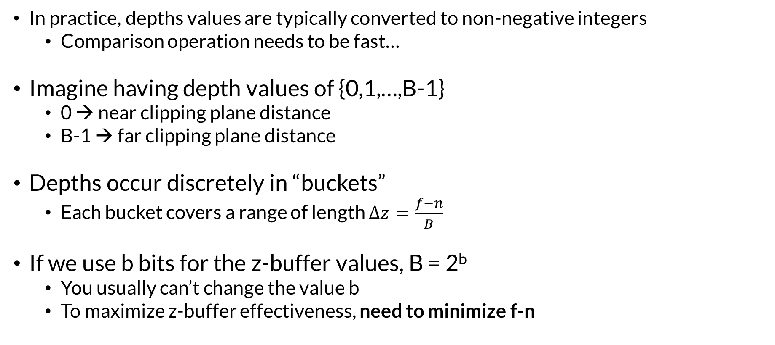
Precision Issues with Z-Buffering
In practice, depths values are typically converted to non-negative integers
Comparison operation needs to be fast…
Imagine having depth values of {0,1,…,B-1}
0 → near clipping plane distance
B-1 → far clipping plane distance
Depths occur discretely in “buckets”
Each bucket covers a range of length $∆z=\frac{f−n}{B}$
If we use b bits for the z-buffer values, B = 2^{b}
You usually can’t change the value b
To maximize z-buffer effectiveness, need to minimize f-n

Slide 20
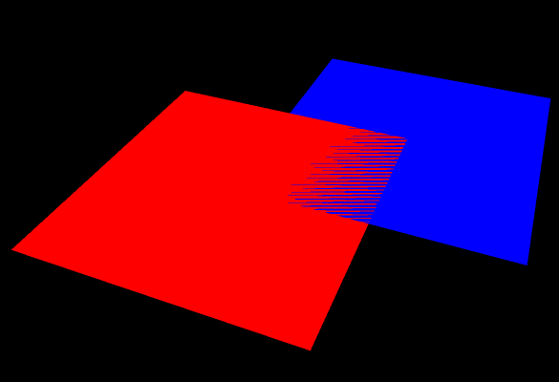
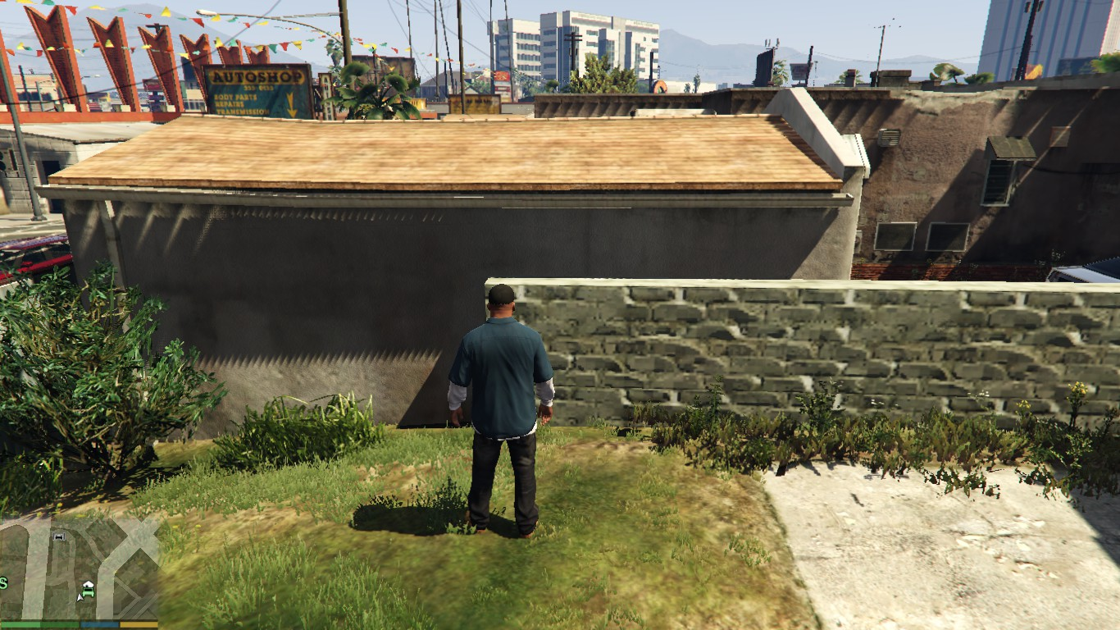
Z-Fighting
How can you fix z-fighting?

Slide 21
Z-Fighting
How can you fix z-fighting?
Move co-planar polygons slightly away from each other
Move near and far clipping planes as close together as you can

Slide 22
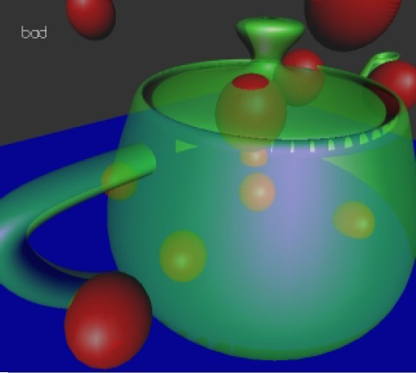
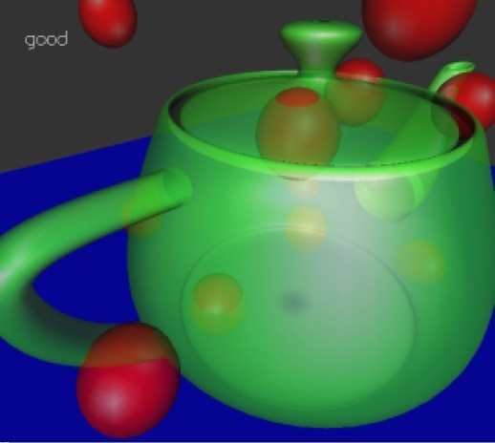
Order Independent Transparency
Alpha blending works for sorted rendering
Front to back
Back to front
Doesn’t work for out-of-order
Front, back, middle
Could keep a linked list at each pixel (modified z-buffer)
A-buffer (Carpenter)
Not practical for hardware

Slide 23
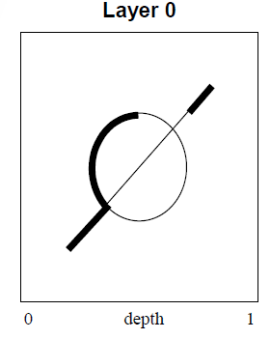
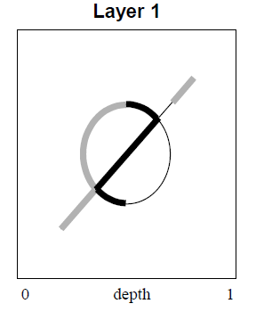
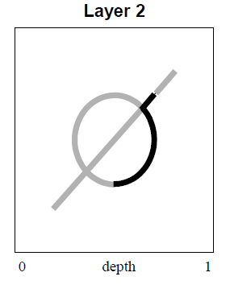
Depth Peeling
Cass Everett, NVIDIA
Needs 2 z-buffers (previous, current)
One rendering pass per layer
Fragment written to frame buffer if
Farther than previous z-buffer
Closer than current z-buffer
After each pass, current z-buffer written to previous z-buffer
Surviving fragment composited “under” displayed fragment

Slide 24
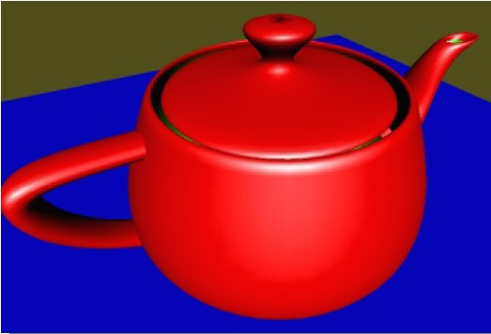
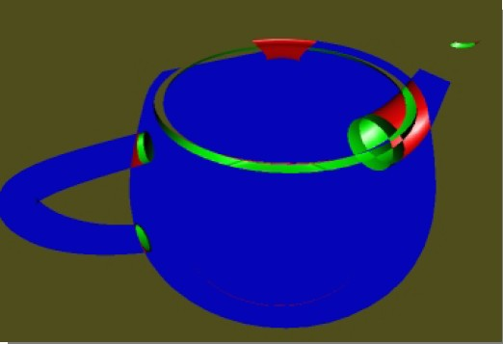
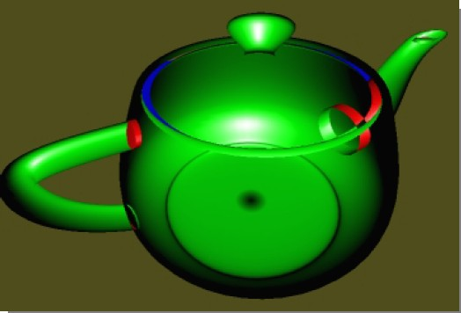
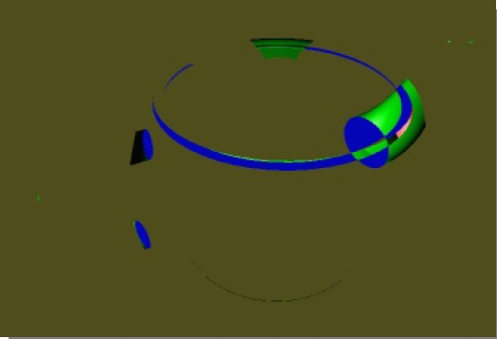
Depth Peels – Which Layer is Which?

Slide 25
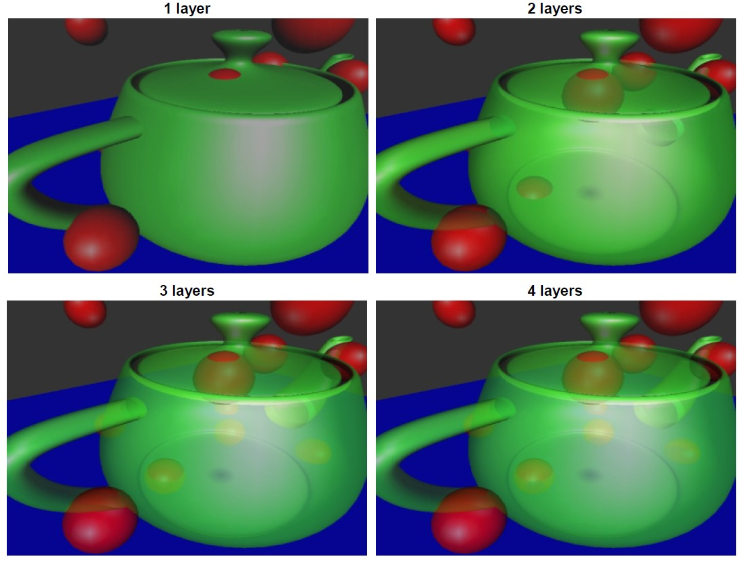
Results

Slide 26
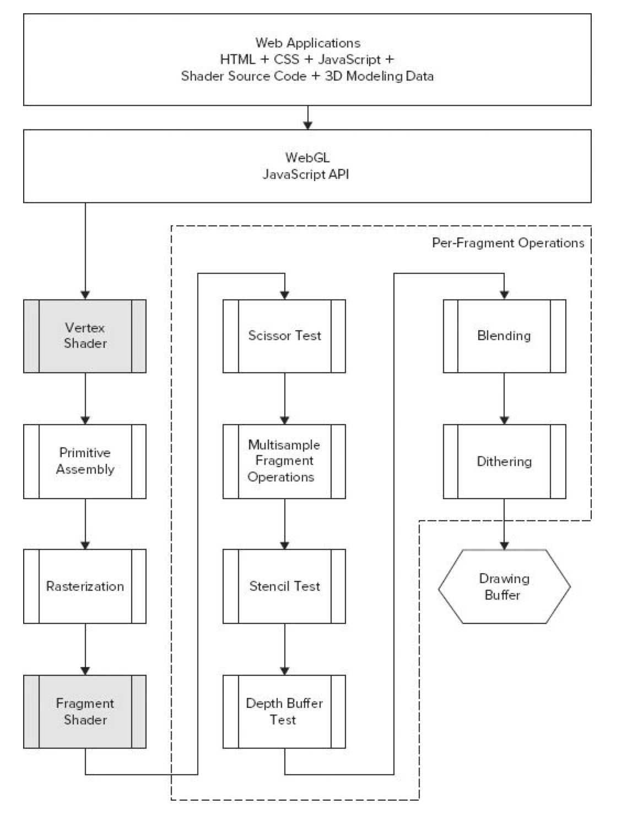
WebGL Pipeline
Scissor Test: cull pixels outside of a rectangular area
Multisample:
anti-aliasing operation
Stencil Test:
uses a stencil buffer to mask pixels
can be used in shadow generation
Depth Buffer Test:
hidden surface removal
Blending:
compositing using alpha channel

Slide 27
WebGL Hidden Surface Removal
gl.enable(gl.DEPTH_TEST); // use depth test for hidden surface remove
gl.depthFunc(gl.LESS); //this is the default
gl.clear(gl.DEPTH_BUFFER_BIT); // clear depth values form previous frame
Hidden surface removal uses the depth buffer (z-buffer)
Happens after the fragment shader

Slide 28
Blending
//enable blending
gl.Enable(gl.BLEND)
//to set up the parameters of the generic blending equation //call ONE of the functions below
gl.blendFunc(GLenum sfactor, GLenum dfactor); //OR gl.blendFuncSeparate(GLenum srcRGB, GLenum dstRGB, GLenum srcAlpha, GLenum dstAlpha);
WebGL lets you specify the factors and operations in the generic blending equation:
color_{final} = factor_{source} × color_{source} op factor_{dest} × color_{dest}

Slide 29
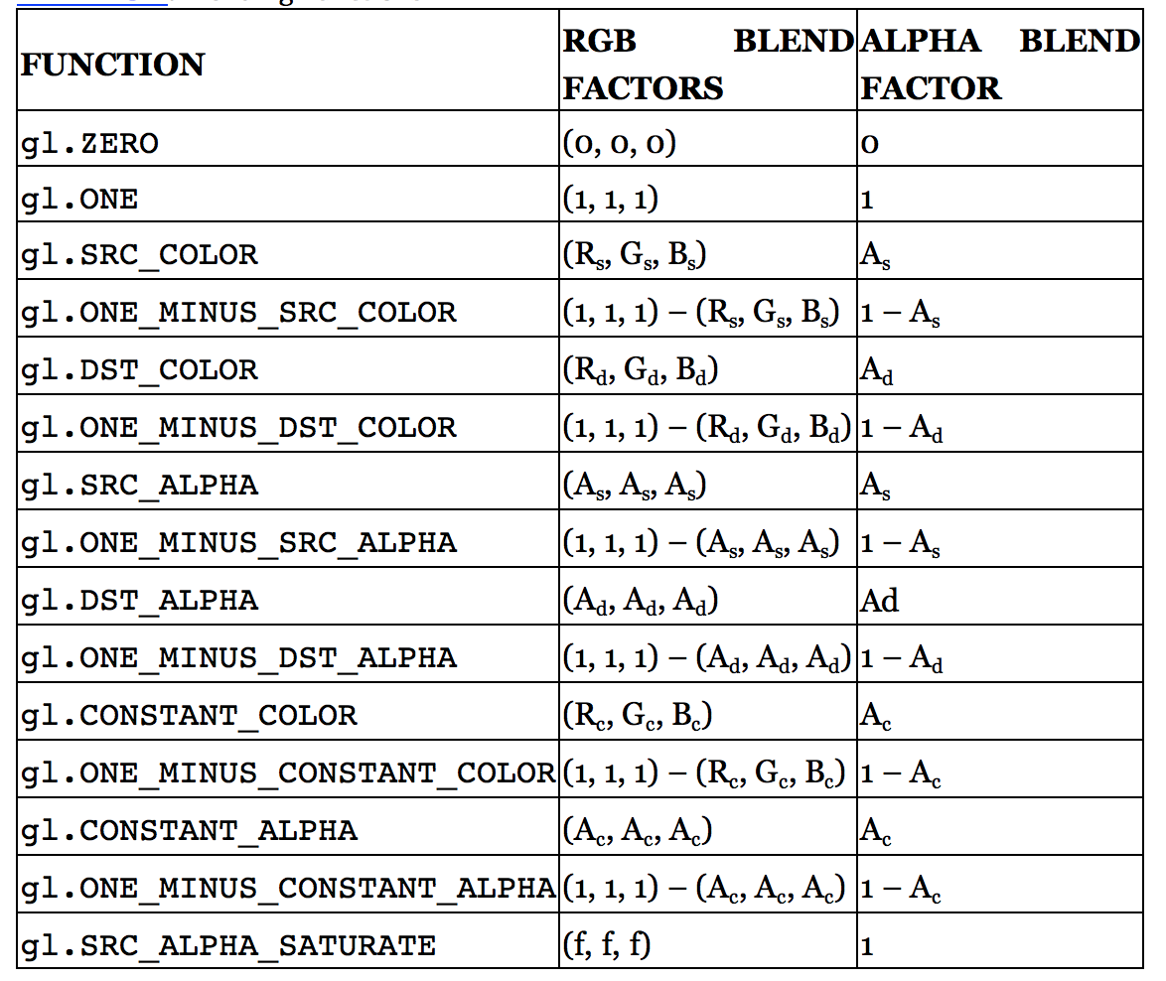
Blending
color_{final} = factor_{source} × color_{source} op factor_{dest} × color_{dest}

Slide 30
Changing the Blending Operator
gl.blendEquation(Glenum mode);
Lets you specify the blending operation.
Addition is the default.
//colorfinal = factorsource × colorsource + factordest × colordest gl.blendEquation(GL_FUNC_ADD);
//colorfinal = factorsource × colorsource − factordest × colordest
gl.blendEquation(GL_FUNC_SUBTRACT);
//colorfinal = factordest × colordest − factorsource × colorsource
gl.blendEquation(GL_FUNC_REVERSE_SUBTRACT);

Slide 31
Blending
gl.blendFunc(GLenum sfactor, GLenum dfactor);
Lets you specify the blending function for both the RGB and Alpha values for both the source and destination
gl.blendFunc(gl.SRC_ALPHA, gl.ONE_MINUS_SRC_ALPHA);
Is the traditional way to implement alpha blending in the style if non-pre-multiplied alpha.
Is this correct?

Slide 32
Blending
gl.blendFunc(GLenum sfactor, GLenum dfactor);
Lets you specify the blending function for both the RGB and Alpha values for both the source and destination
gl.blendFunc(gl.SRC_ALPHA, gl.ONE_MINUS_SRC_ALPHA);
Is the traditional way to implement alpha blending in the style if non-pre-multiplied alpha.
Is this correct? New alpha is calculated incorrectly….should use gl.blendFuncSeparate(gl.SRC_ALPHA, gl.ONE_MINUS_SRC_ALPHA, gl.ONE, gl.ONE_MINUS_SRC_ALPHA);

Slide 33
Pre-multiplied Alpha
Non-pre-multiplied alpha example: (1.0, 0.0, 0.0, 0.5)
Pre-multiplied alpha example: (0.5, 0.0, 0.0, 0.5)
For blending use:
PNG images use non-pre-multipled alpha
in case you are loading colors from an image
When you load use gl.UNPACK_PREMULTIPLY_ALPHA_WEBGL
You should use pre-multiplied alpha in your code
gl.blendFunc(gl.ONE, gl.ONE_MINUS_SRC_ALPHA);

Slide 34
Blending and Drawing Order
// 1. Enable depth testing, make sure the depth buffer is writable // and disable blending before you draw your opaque objects. gl.enable(gl.DEPTH_TEST); gl.depthMask(true); gl.disable(gl.BLEND); // 2. Draw your opaque objects in any order (preferably sorted on state) // 3. Keep depth testing enabled, but make depth buffer read-only // and enable blending gl.depthMask(false); gl.enable(gl.BLEND); // 4. Draw your semi-transparent objects back-to-front // 5. If you have UI that you want to draw on top of your // regular scene, you can finally disable depth testing gl.disable(gl.DEPTH_TEST); // 6. Draw any UI you want to be on top of everything else
Anyuru, Andreas Professional WebGL Programming: Developing 3D Graphics for the Web

Slide 35
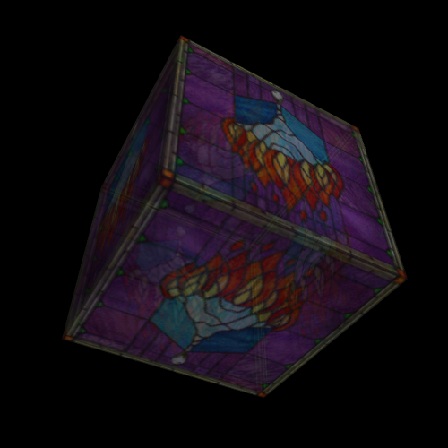
Blending in WebGL

