Slide 1

Lab 5
CS 418: Interactive Computer Graphics
UNIVERSITY OF ILLINOIS AT URBANA-CHAMPAIGN
Eric Shaffer

Slide 2
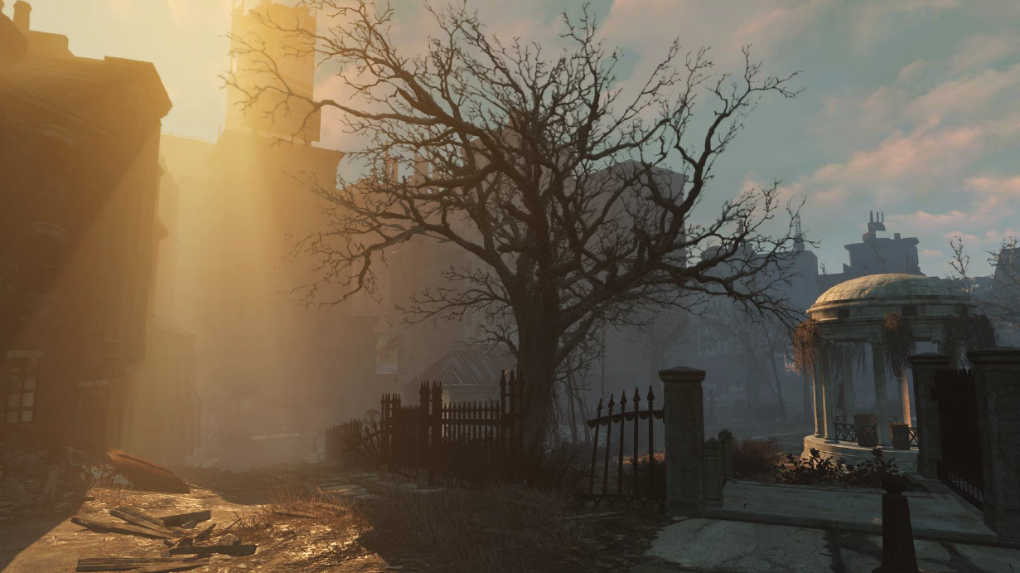
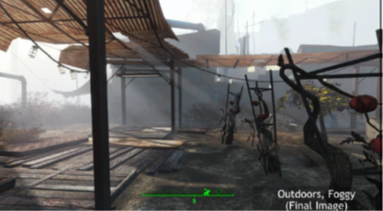
Fog
Fog is an example of participating media
These are typically some sort of particulate
Scatters and otherwise changes light
There are a number of sophisticated ways to render such phenomena …we’ll use a simple one For something complex, check out
http://www.gdcvault.com/play/1023519/Fast-Flexible-Physically-Based-Volumetric

Slide 3
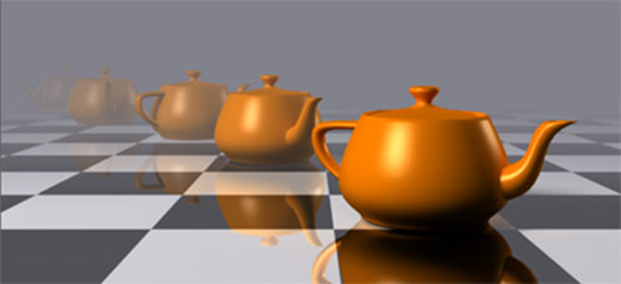
Distance Fog
Just mix a fragment color with a fog color
The farther the fragment from the viewer, more fog color
…and less original color
You should use your terrain generation code as the starting point…for fog you will change the shader code…and eventually add a radio button to turn the fog on and off….

Slide 4
Fog in WebGL and GLSL
gl_FragCoord.xyz is the window-space position. gl_FragCoord.w contains the inverse of the clip-space w
We implement fog in the fragment shader
Compute the distance from fragment to camera
And define a fog color
White is a good choice…especially with a white background
float fogCoord = (gl_FragCoord.z/gl_FragCoord.w);
vec4 fogColor = vec4(1.0, 1.0, 1.0, 1.0);

Slide 5
Mixing in Fog
Use linear interpolation to mix fog with the fragment color
fragColor is the color computed by your shading equation
Probably Blinn-Phong
The mix function is built-in GLSL function that performs lerp
But what is fogFactor?
gl_FragColor = mix(fogColor, fragColor, fogFactor );

Slide 6
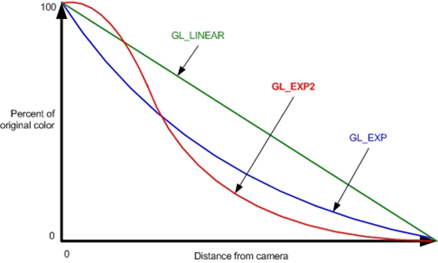
Fog Factor
const float LOG2 = 1.442695;
float fogDensity = 0.0005
float fogFactor = exp2( -fogDensity * fogDensity * fogCoord * fogCoord * LOG2 );
fogFactor = clamp(fogFactor, 0.0, 1.0);
Fog factor determines how much of the color is fog
A value of 1 means all fog in this case…a value of 0 means no fog
You can see the curve below…we’re computing GL_EXP2
On the next foggy day, you can try to verify by eyesight if fog works this way…

Slide 7
Fog Factor Debugging
In case you have trouble, try just implementing the linear curve for the fogFactor…see if that works.
Can also render your fogCoord values
Compute z=fogCoord/farClipDistance;
Set gl_FragColor to (z,z,z, 1.0)
See if the image makes sense

Slide 8
MP2: Flight and Orientation
Lots of ways to implement flight…this isn’t the only acceptable way
MP requires the use of quaternions
One option to change orientation:
Set up an initial view using mat4.lookat
Keep an orientation quaternion that records current orientation of the viewer
Each frame:
Capture key presses as Euler angles
Construct a temporary quaternion based on the Euler angles.
quat.fromEuler in glMatrix library…get current release!
Update the orientation quaternion using the temp
To figure out how review lecture notes on quaternions and read the glmatrix doc
Use the orientation quaternion to construct a new view using mat4.lookat

Slide 9
Flight: Moving Forward
Keep a user set speed factor
User can adjust
Move in the forward direction as given by the current orientation
By speedFactor*directionVector
You’ll need to experiment to find appropriate speedFactor
What’s the current directionVector?
Think about how you could compute it….

