Slide 1

Surface Meshes: Representation and Storage
CS 418: Interactive Computer Graphics
UNIVERSITY OF ILLINOIS AT URBANA-CHAMPAIGN
Eric Shaffer

Slide 2
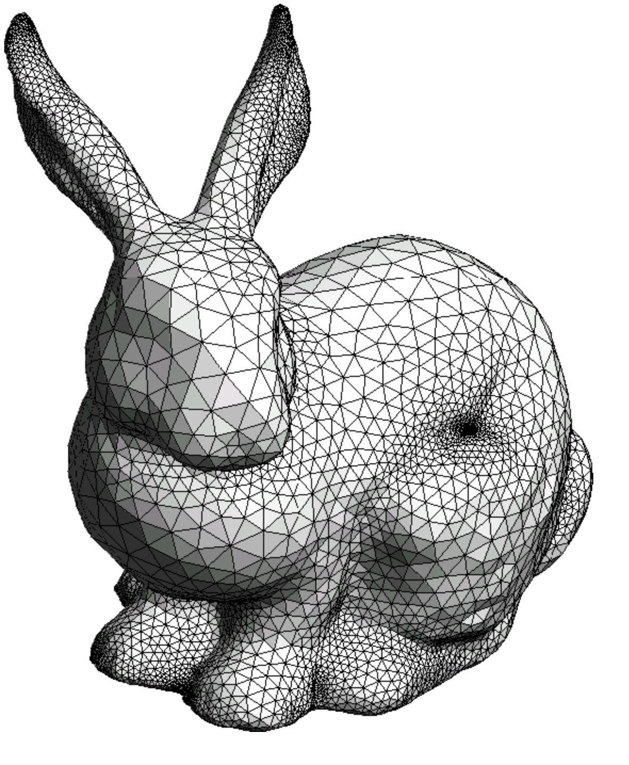
Polygonal Meshes
In rendering, we typically will generate an image by simulating the reflection of light off surfaces
Rasterization engines most often use polygonal meshes to represent surfaces
Modern GPUs are designed specifically to rasterize triangles
Many advantages to using triangles:
Simplest 2D primitive…
Any 2D polygon can be triangulated
Can easily represent sharp surface features
Any disadvantages you can think of?
Why do we say 2D when we are rendering in 3D?

Slide 3
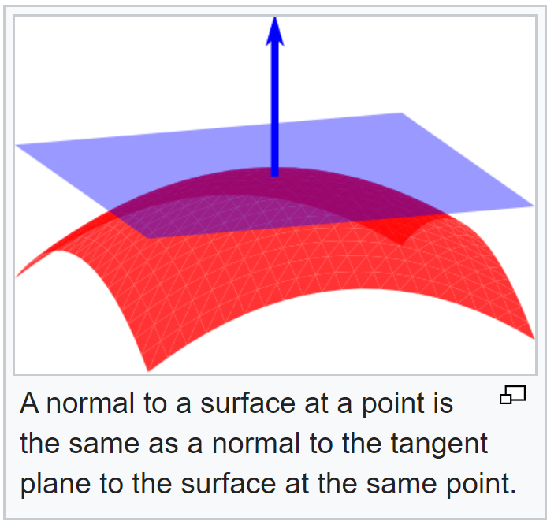
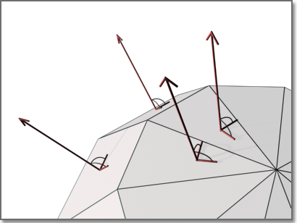
Vocabulary: Surface Normals
A normal is a vector that is perpendicular to object
Each triangle in a surface mesh has outward facing normal
The normal is just the vector perpendicular to the triangle
Courtesy Wikipedia

Slide 4
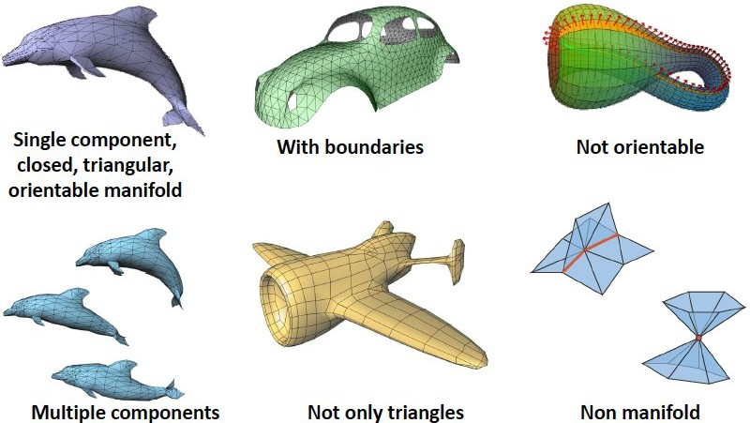
Vocabulary: Surface Mesh Properties

Slide 5
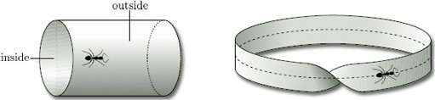
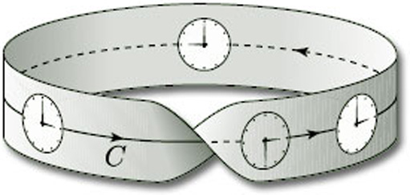
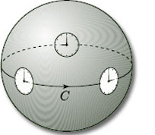
Orientability
Not that relevant to this course….but since someone will ask….and it is interesting….
Imagine you are an ant walking over a surface…at each spot you plant a flag normal to the surface
If the surface is orientable, whenever you return to point the new flag will be in the same direction as the old
If you ever plant a new flag pointing the opposite direction of the old flag, the surface is non-orientable

Slide 6

Surface Mesh Properties
Manifold:
Every edge connects exactly two faces
Vertex neighborhood is “disk-like”
Orientable: Consistent normals
Watertight: Orientable + Manifold
Boundary: Some edges bound only one face
Ordered: Vertices in CCW order when viewed from normal
The blue and pink meshes above are tetrahedra, like 4-sided pyramids

Slide 7
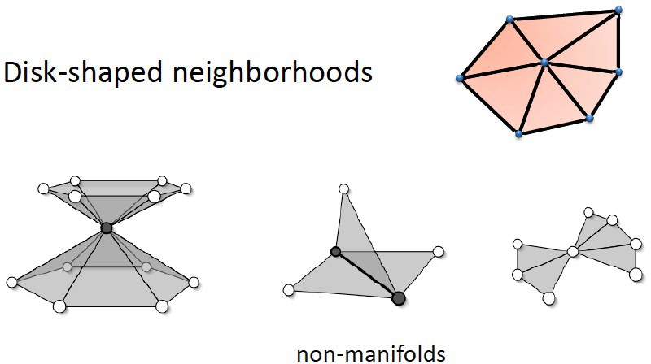
2-­Manifold Mesh Examples

Slide 8
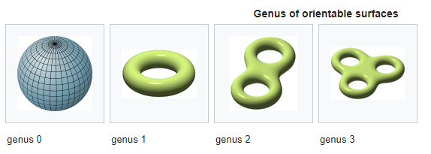
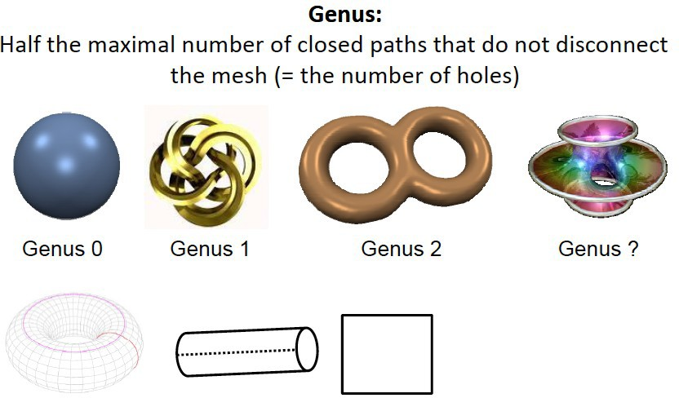
Genus

Slide 9
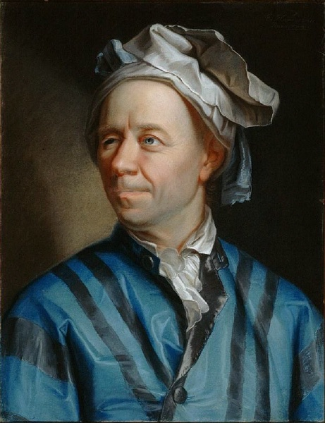
Euler Characteristic
For a closed (no boundary), manifold, connected surface mesh:
V-E+F= 2(1-G)
V = number of vertices E = number of edges
F = number of faces
G = genus (number of holes in the surface)
A 2-manifold is a surface (locally like a plane)
Leonhard Euler 1707 – 1783 Can you think of anything else named for him?

Slide 10
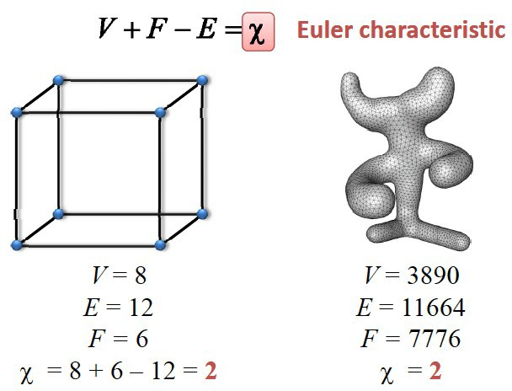
Euler Characteristic for Closed 2-­Manifold Polygonal Meshes

Slide 11
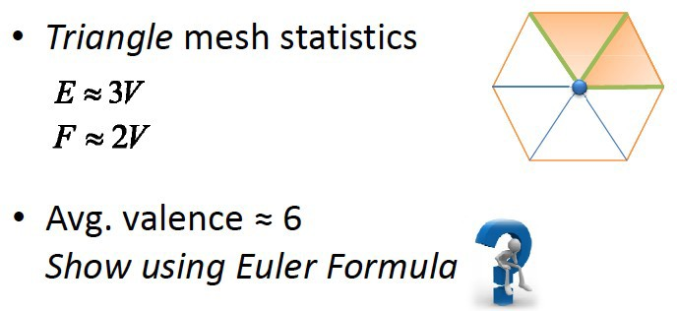
…and if they are triangle meshes
Aside from being totally interesting on their own, these formulas are useful for computing memory usage

Slide 12
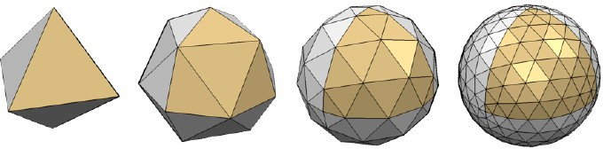
Mesh Data Structures
Need to store
Geometry
Connectivity
Can be used as file formats or internal formats Considerations
Space
Efficient operations
Mesh processing has different requirements than rendering
Example: Deforming a mesh when simulating physics…

Slide 13
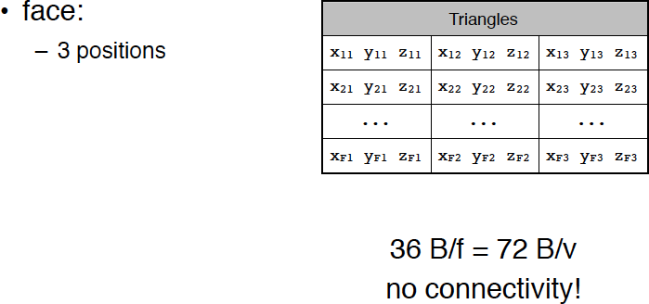
Mesh Data Structure: Face Set (STL)
Corresponds to structure used for WebGL call gl.drawArrays(gl.TRIANGLES, 0, vertexPositionBuffer.numberOfItems);

Slide 14
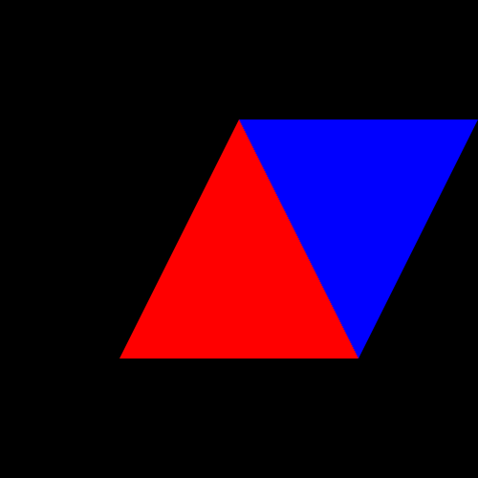
gl.TRIANGLES
vertexPositionBuffer = gl.createBuffer();
gl.bindBuffer(gl.ARRAY_BUFFER, vertexPositionBuffer);
var triangleVertices = [
0.0, 0.5, 0.0,
-0.5, -0.5, 0.0,
0.5, -0.5, 0.0,
0.0, 0.5, 0.0,
1.0, 0.5, 0.0,
0.5, -0.5, 0.0
];
gl.bufferData(gl.ARRAY_BUFFER, new Float32Array(triangleVertices), gl.STATIC_DRAW);
vertexPositionBuffer.itemSize = 3;
vertexPositionBuffer.numberOfItems = 6;
… gl.drawArrays(gl.TRIANGLES, 0, vertexPositionBuffer.numberOfItems);
Assuming you are using gl.drawArrays():
Each triangle requires you specify three new vertices
Number of triangles = number vertices/3

Slide 15
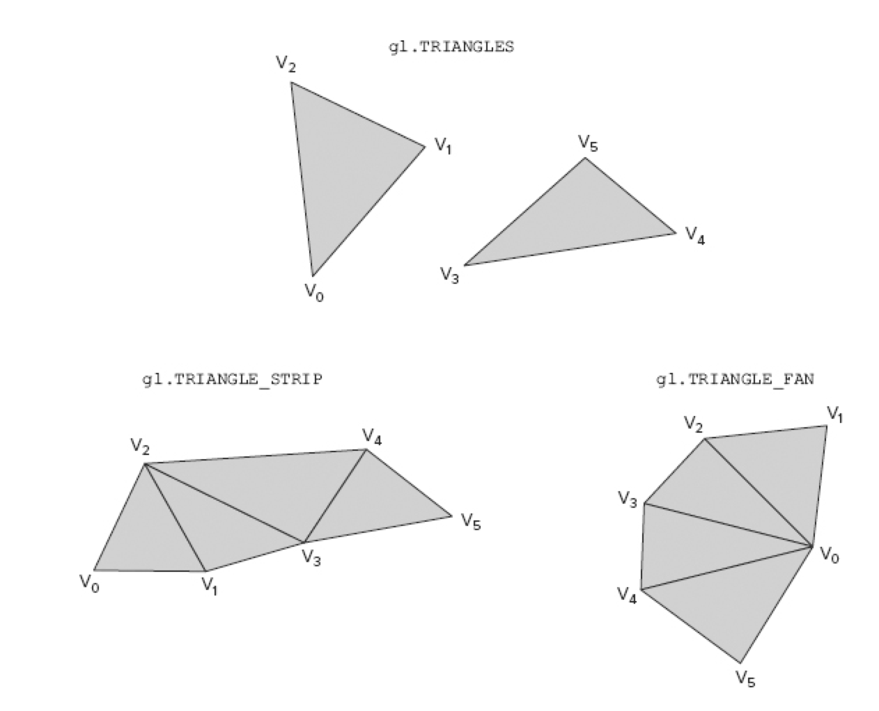
Geometric Primitives in WebGL
WebGL supports 3 basic geometric primitives:
Triangles
Lines
Point Sprites
We’ve already seen one way to send triangles into the pipeline.
There are three different triangle
drawing modes depending on how you specify the connectivity:
gl.TRIANGLES
gl.TRIANGLE_STRIP
gl.TRIANGLE_FAN

Slide 16
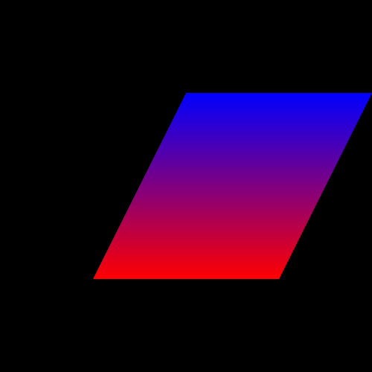
gl.TRIANGLE_STRIP
vertexPositionBuffer = gl.createBuffer();
gl.bindBuffer(gl.ARRAY_BUFFER, vertexPositionBuffer);
var triangleVertices = [
-0.5, -0.5, 0.0,
0.5, -0.5, 0.0,
0.0, 0.5, 0.0,
1.0, 0.5, 0.0,
];
gl.bufferData(gl.ARRAY_BUFFER, new Float32Array(triangleVertices), gl.STATIC_DRAW);
vertexPositionBuffer.itemSize = 3;
vertexPositionBuffer.numberOfItems = 4;
….
gl.drawArrays(gl.TRIANGLE_STRIP, 0, vertexPositionBuffer.numberOfItems);
Allows you to reuse vertices when drawing triangles that share vertices.
Number of triangles = what?
Notice that per-triangle color is not easy to achieve
Order of the vertices is important

Slide 17
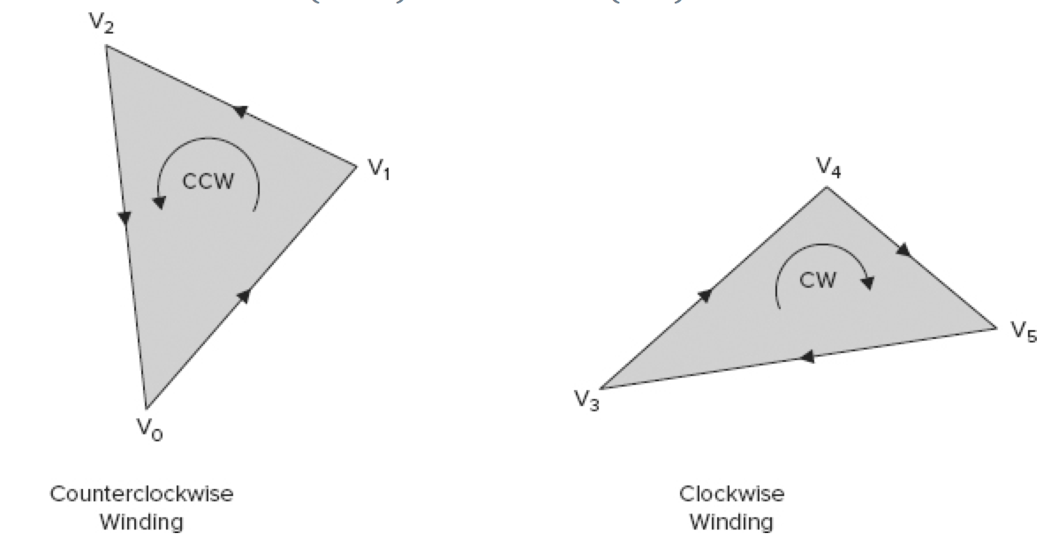
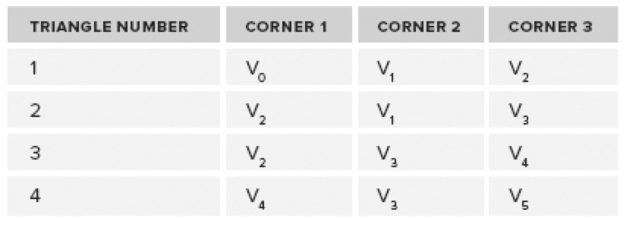
Winding Order
Winding order is determined by the order of the vertices making up a triangle when seen from the viewing direction.
Equivalently, winding order tells you the direction of the triangle surface normal.
CCW is traditional and is WebGL default: gl.frontFace(gl.CCW)
For triangle strips, winding order determines the order in which vertices in the buffer are used to form triangles

Slide 18
gl.TRIANGLE_FAN
vertexPositionBuffer = gl.createBuffer();
gl.bindBuffer(gl.ARRAY_BUFFER, vertexPositionBuffer);
var triangleVertices = [
0.5, -0.5, 0.0,
1.0, 0.5, 0.0,
0.0, 0.5, 0.0,
-0.5, -0.5, 0.0,
];
gl.bufferData(gl.ARRAY_BUFFER, new Float32Array(triangleVertices), gl.STATIC_DRAW);
vertexPositionBuffer.itemSize = 3;
vertexPositionBuffer.numberOfItems = 4;
….
gl.drawArrays(gl.TRIANGLE_FAN, 0, vertexPositionBuffer.numberOfItems);
First vertex is the fan center
Next two vertices specify the first triangle
Each succeeding vertex forms a triangle with the center and previous vertex
How many triangles for a given number of vertices?
Are fans and strips equivalent?

Slide 19
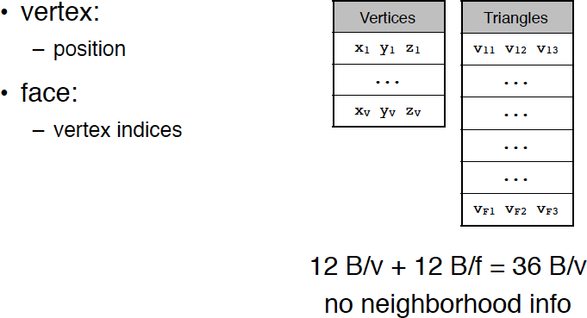
Mesh Data Structure: Indexed Face Set (OBJ)
The OBJ file format is a popular storage format for meshes
Developed by Wavefront Technologies…now part of AutoDesk
Text files with .obj extension
# List of geometric vertices v 0.123 0.234 0.345 1.0 v ... v ...
# List of triangles f 1 3 4 f 2 4 5
…

Slide 20
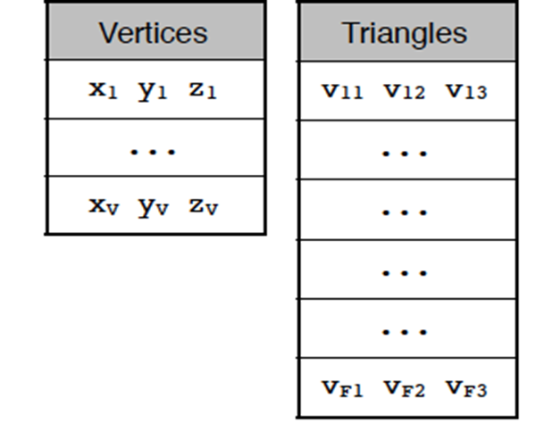
Indexed Face Set
Can be used for offline storage…a file format
Or can be used as an internal data structure
One block of data are the vertices
Each vertex is a set of 3 coordinates
Often referred to as the geometry of the mesh
Another block of data is the set of triangles
Each triangle is set of 3 integers vertex IDs
The vertex IDs are indices into the vertex block
What are some advantages of this representation?

Slide 21
Indexed Meshes in WebGL
gl.drawElements() method
WebGL supports drawing indexed face meshes
Simply need another buffer for the indexed faces
function draw() {
...
gl.bindBuffer(gl.ARRAY_BUFFER,meshVertexPositionBuffer); gl.vertexAttribPointer(
shaderProgram.vertexPositionAttribute, meshVertexPositionBuffer.itemSize,gl.FLOAT, false, 0, 0);
gl.bindBuffer(gl.ELEMENT_ARRAY_BUFFER, meshIndexBuffer); gl.drawElements(gl.TRIANGLES, meshIndexBuffer.numberOfItems, gl.UNSIGNED_SHORT, 0);
}

Slide 22
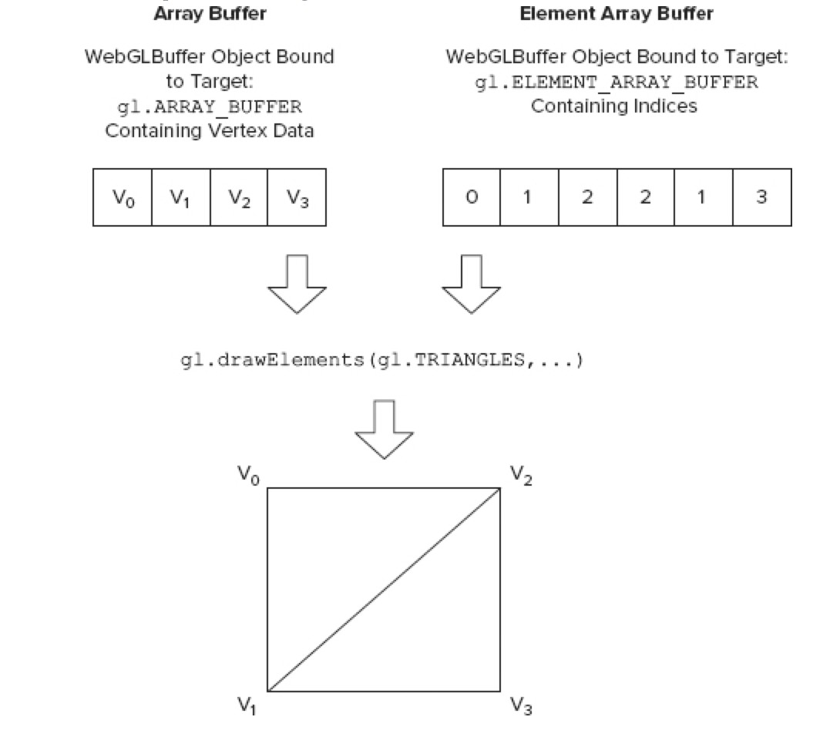
WebGL: gl.drawElements() method

Slide 23
Setting up Indexed Drawing
function setupBuffers() { meshVertexPositionBuffer = gl.createBuffer();
gl.bindBuffer(gl.ARRAY_BUFFER, meshVertexPositionBuffer);
// the … below isn’t valid JS, there’s just too many numbers for the slide
var meshVertexPositions = [1.0, 5.0, 0.0,…];
gl.bufferData(gl.ARRAY_BUFFER, new
Float32Array(meshVertexPositions), gl.STATIC_DRAW);
meshVertexPositionBuffer.itemSize = 3;
meshVertexPositionBuffer.numberOfItems = 36; gl.enableVertexAttribArray(
shaderProgram.vertexPositionAttribute);

Slide 24
Setting up Indexed Drawing
meshIndexBuffer = gl.createBuffer(); gl.bindBuffer(gl.ELEMENT_ARRAY_BUFFER,meshIndexBuffer); // the … below isn’t valid JS, there’s just too many numbers for the slide var meshIndex = [ 0, 1, 2, 2, 1, 3, 2, 3, 4, …]; gl.bufferData(gl.ELEMENT_ARRAY_BUFFER, new Uint16Array(meshIndex), gl.STATIC_DRAW); meshIndexBuffer.itemSize = 1; meshIndexBuffer.numberOfItems = 150;
}

Slide 25
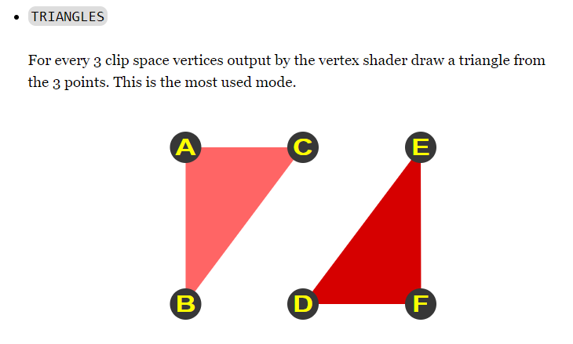
Summary: TRIANGLES primitive
A primitive in rendering is a kind of geometric object
TRIANGLES is the most used primitive
Can be used with either gl.drawArrays or gl.drawElements
From webglfundamentals.org

Slide 26
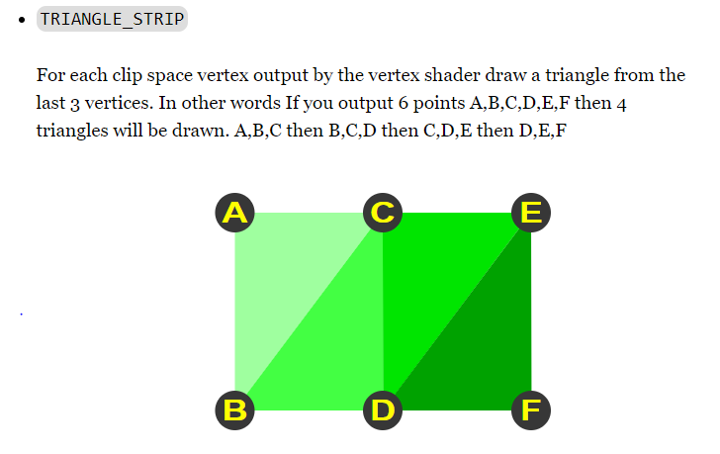
Summary: TRIANGLE_STRIP primitive
From webglfundamentals.org

Slide 27
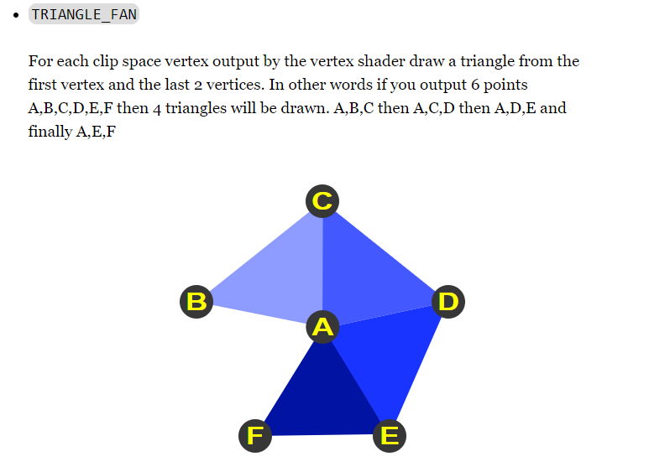
Summary: TRIANGLE_FAN primitive
Fans and strips are sort of relics
Not often used now…
May be best avoided…
…complicates code
From webglfundamentals.org

Slide 28
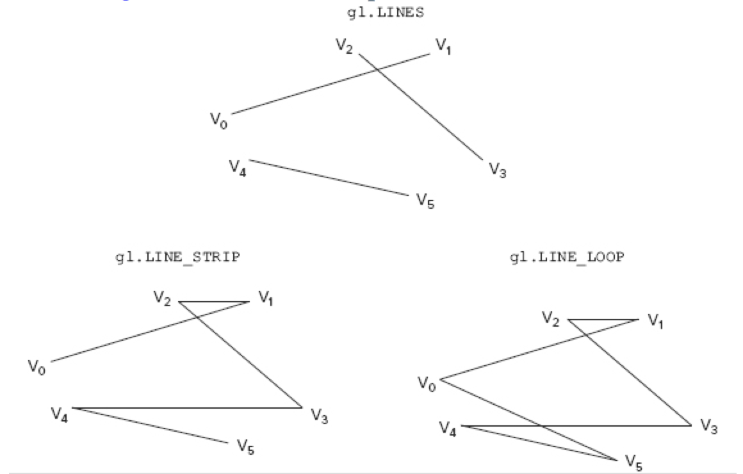
Other WebGL Primitives: Lines
gl.LINES draws independent lines (v0,v1), (v2,v3), (v4,v5)
gl.LINE_STRIP draws a polyline (v0,v1),(v1,v2),(v2,v3),(v3,v4),(v4,v5)
gl.LINE_LOOP draws a line strip with a line connecting the first and final vertex
Generally have poor visual quality in most browser implementations….people often use triangle strips instead.

Slide 29

Other WebGL Primitives: Point Sprites
The star field below uses some extra shader code to achieve it’s look
Specified with gl.POINTS mode
Renders one point per vertex in the buffer
Uses N pixels in the point is specified using gl.pointSize(N)

Slide 30
Using Multiple Buffers
gl.bindBuffer(gl.ARRAY_BUFFER, vertexBuffer1);
gl.vertexAttribPointer(shaderProgram.vertexPositionAttribute, vertexBuffer1.itemSize, gl.FLOAT, false, 0, 0);
gl.bindBuffer(gl.ARRAY_BUFFER, vertexColorBuffer1);
gl.vertexAttribPointer(shaderProgram.vertexColorAttribute, vertexColorBuffer1.itemSize, gl.FLOAT, false, 0, 0);
gl.drawArrays(gl.TRIANGLES, 0, vertexBuffer1.numItems);
gl.bindBuffer(gl.ARRAY_BUFFER, vertexBuffer2);
gl.vertexAttribPointer(shaderProgram.vertexPositionAttribute, vertexBuffer2.itemSize, gl.FLOAT, false, 0, 0);
gl.bindBuffer(gl.ARRAY_BUFFER, vertexColorBuffer2);
gl.vertexAttribPointer(shaderProgram.vertexColorAttribute, vertexColorBuffer2.itemSize, gl.FLOAT, false, 0, 0);
gl.drawArrays(gl.TRIANGLES, 0, vertexBuffer2.numItems);
Complex scenes and geometry may require more than one buffer
You can use more than one vertex buffer Set them up like you did the the first buffer
Call gl.drawArrays multiple time in your draw function
Is there a way to draw multiple objects from a single buffer?

Slide 31
Minimizing draw calls
You generally want as few calls to gl.drawArrays as possible
Same is true for gl.drawElements…we’ll discuss that later
For triangle strips, you can insert degenerate triangles into the stream
These triangles will have two identical vertices and 0 area
Can connect strips using a sequence of degenerate triangles
Better to do this with gl.drawElements
Bigger performance hit for gl.drawArrays due to cache effects

Slide 32
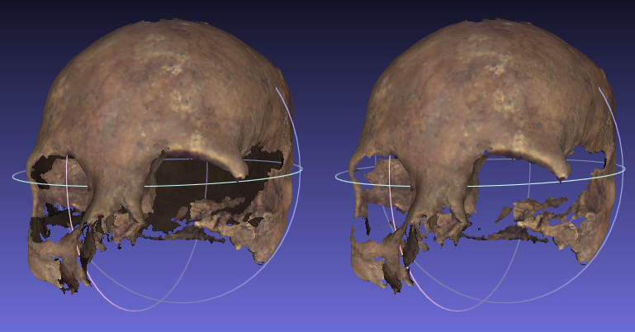
Back Face Culling
Backface culling is an optimization technique
It drops backfacing polygons from the pipeline.
Why would backface culling be useful?
What artifact do you see here?
Backface culling is not hidden surface removal

Slide 33
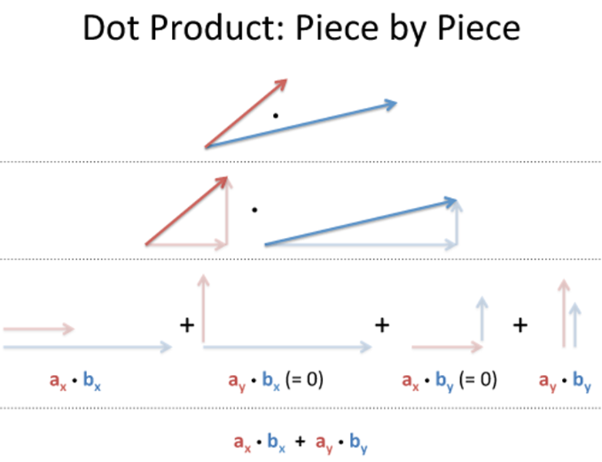
Vector Dot Product
The dot product or inner product of two vectors is
Can think of it as a measure of how aligned the vectors are
$$u⋅v=u_{x}v_{x}+u_{y}v_{y}+…=\left\|u\right\|\left\|v\right\|\cos{θ}$$

Slide 34
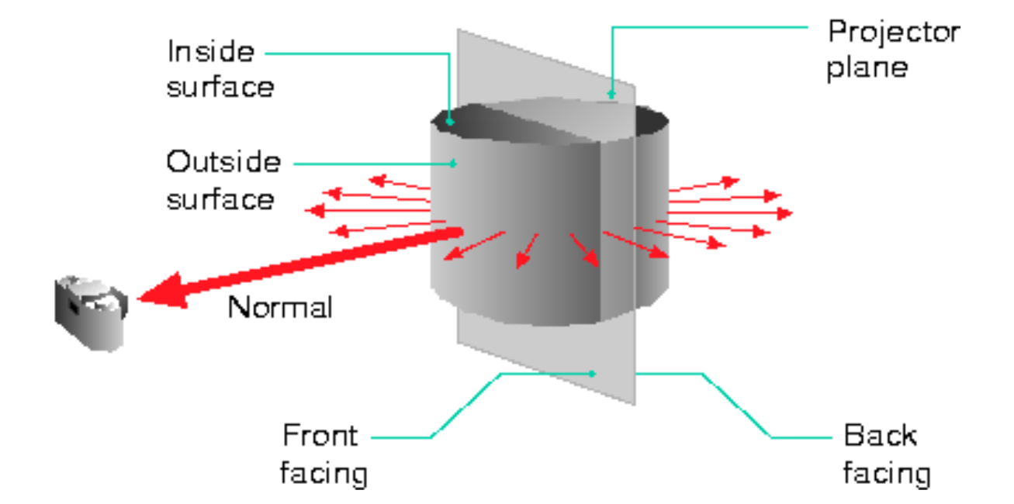
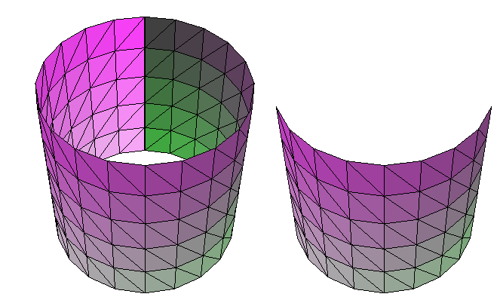
Vector Dot Product
Is a polygon facing away from the viewer?
We can decide by using a dot product test

Slide 35
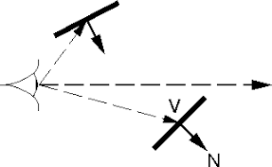
Back Face Culling
Decide whether the view vector V runs from the surface to the eyepoint or from the eyepoint to the surface
For this test, we’ll use eyepoint to surface.
So, if 90 ≤ θ ≤ 270 where θ > 0 then dot product is negative and polygon faces viewer
IF the dot product is positive then polygon does not face viewer

Slide 36
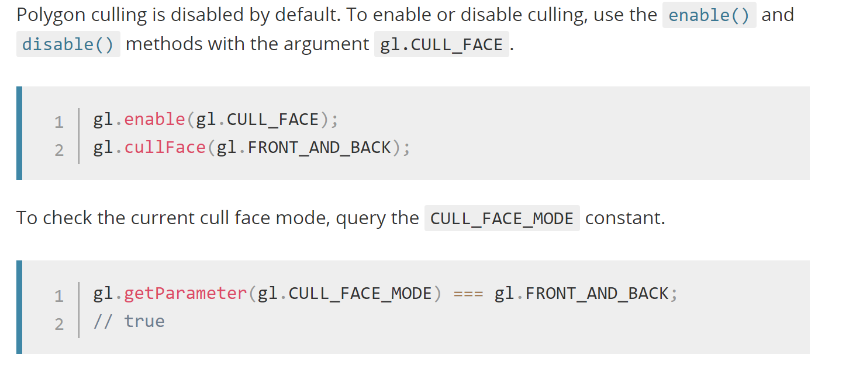
WebGL Back Face Culling

