Slide 1

Lab 3
CS 418: Interactive Computer Graphics
UNIVERSITY OF ILLINOIS AT URBANA-CHAMPAIGN
Eric Shaffer

Slide 2
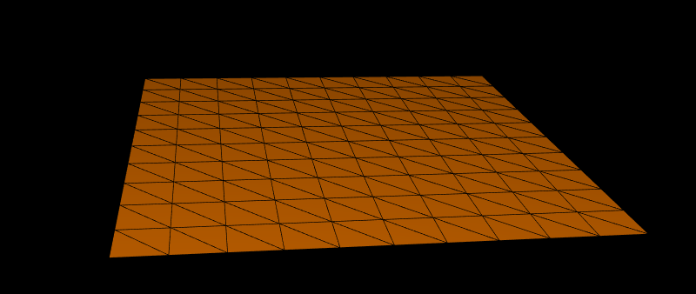
Generating a Terrain
Today, we will generate a flat triangulated mesh
This can be the start of your code for MP 2

Slide 3
Creating a Terrain Class
We will create a JavaScript class for our terrain
It will be rendered using the drawElements method
We will need to generate three buffers
A buffer of the vertex positions
A buffer of the triangles, specified by vertex indices
A buffer of normal vectors
Each vertex will have a normal vector associated with it

Slide 4
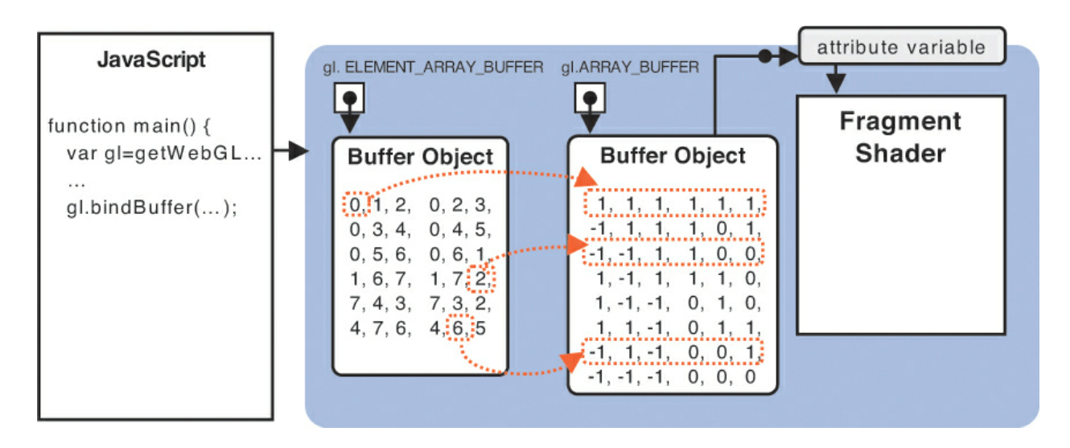
drawElements in WebGL
Here, the buffer object is storing both position and color in a single six-tuple that will be sent to the shader…it’s an optimization but unnecessary for this lab and the upcoming MP. So don’t do it….

Slide 5
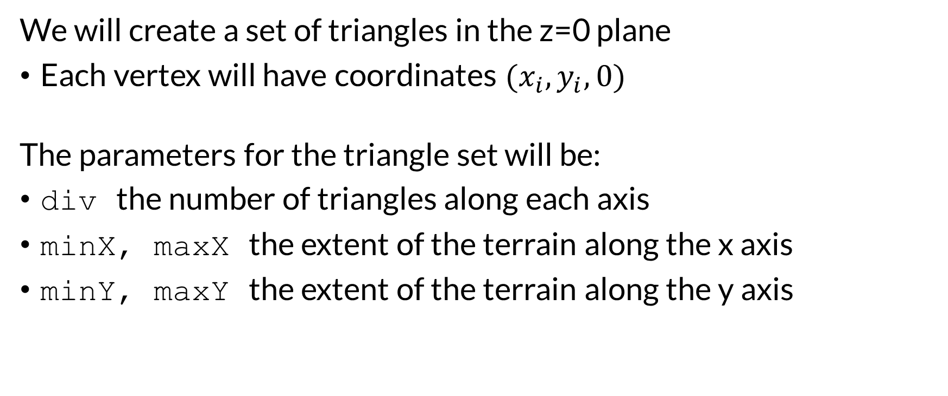
The Terrain Geometry
We will create a set of triangles in the z=0 plane
Each vertex will have coordinates ${(x}_{i},y_{i},0)$
The parameters for the triangle set will be:
div the number of triangles along each axis
minX, maxX the extent of the terrain along the x axis
minY, maxY the extent of the terrain along the y axis

Slide 6
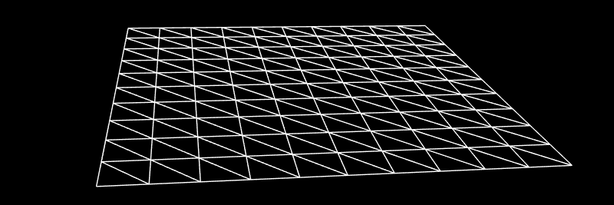
Terrain Geometry
div the number of triangles along each axis
minX, maxX the extent of the terrain along the x axis
minY, maxY the extent of the terrain along the y axis
Vertex (i,j) is in the ith row and jth column
with i,j in the range [0,div]
Generate it so that (0,0) is the first vertex with coordinates (minx,minY,0)
What are the indices of the faces?
How many total vertices?
How many total triangles?

Slide 7
Terrain Geometry
div the number of triangles along each axis
minX, maxX the extent of the terrain along the x axis
minY, maxY the extent of the terrain along the y axis
Vertex (i,j) is in the ith row and jth column
with i,j in the range [0,div]
Generate it so that (0,0) is the first vertex with coordinates (minx,minY,0)
What are the indices of the faces?
If there are div edges along an axis then there are div+1 vertices along the axis
There are (div+1)² vertices in the terrain
There are 2div² triangles
How many total vertices?
How many total triangles?

Slide 8
Your Tasks
Write the following functions in the terrain.js file
getVertex
…this is a function you can use (or not) to get the coordinates of a vertex
setVertex
…this is a function you can use (or not) to set the coordinates of a vertex
generateTriangles
…this function fills the javascript arrays containing the
Vertex positions
Triangle connectivity
Vertex normals

Slide 9
GenerateTriangles: Vertex Positions
…you can write it any way you want that works
…our solution computes the following values:
deltaX the distance along the x axis between two neighboring vertices in a row
deltaY the distance along the y axis between two neighboring vertices in a column
Then, a nested loop, iterating over the rows and columns, set the vertex positions
The delta values are used to increment the X and Y coordinates in the loop

Slide 10
GenerateTriangles: Triangle connectivity
…our solution loops over the rows and columns of triangles
in the same order as the vertices were created
the body of the loop inserts two triangles into the array
The illustration here shows a grid with div=2^{k}=4
You can split each quad into two triangles and
You need to figure what the indexing for the vertices is
For example the vertex in the bottom left corner has index 0
The vertex above it would have index 5

Slide 11
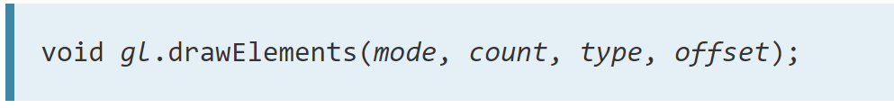
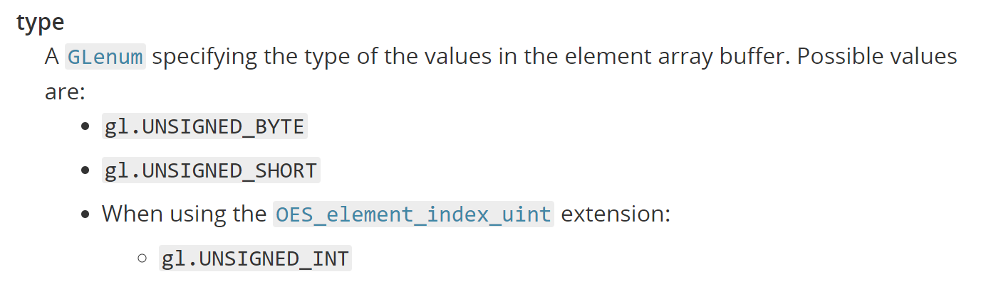
Indexing with drawElements
In WebGL 1.0 you are limited to using 2-byte integer indices
How may vertices could you index?
There’s an extension to let you use 4-byte integer indices
Need to initialize/check with var ext = gl.getExtension('OES_element_index_uint');

Slide 12
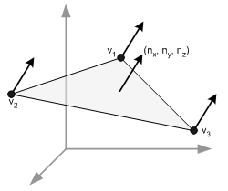
Computing Normal Vectors
For shading you need per vertex normal
Vertex buffer contains N vertices with x,y,z coordinates
So 3N floating point numbers
Normal buffer will contain N normals with x,y,z So 3N floating point numbers
The Kth vertex will start at location 3(K-1) in the buffer The normal for vertex K will start at location 3(K-1)
What are the normal vectors for the terrain in this lab?
How would you compute them in general?

Slide 13
The Shader
The shader code you have been given implements
Phong reflection model
Gouraud shading
This generates a color per-vertex in the vertex shader
It does not implement Phong shading

Slide 14
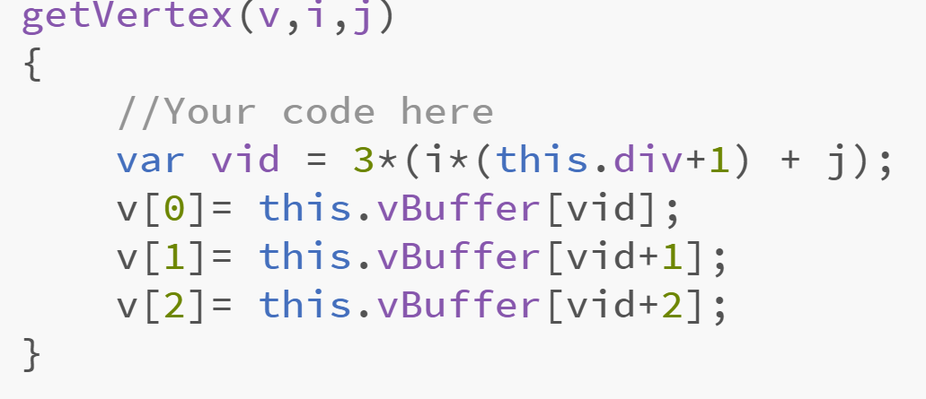
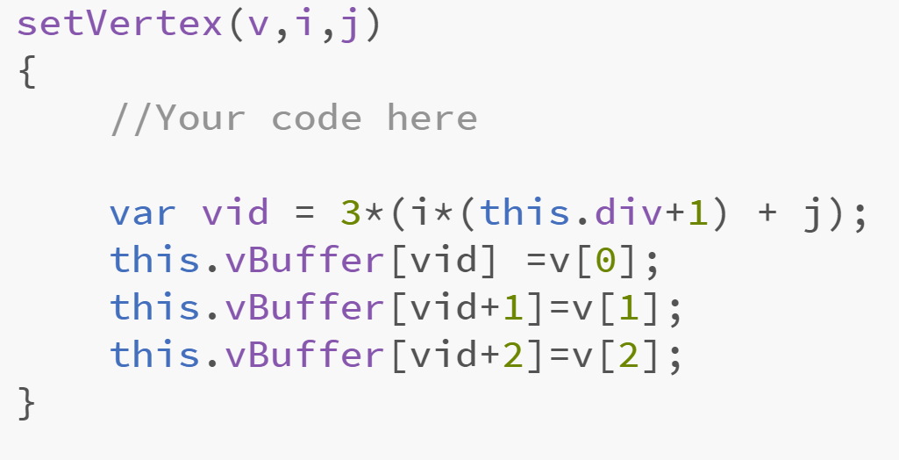
Lab Solution
One possible solution

Slide 15
