Slide 1

Lab 1
CS 418: Interactive Computer Graphics
UNIVERSITY OF ILLINOIS AT URBANA-CHAMPAIGN
Eric Shaffer

Slide 2
Agenda for Today
Debugging tips
Review animation
Understand what you are seeing
MP1 Exercise – Changing coordinates in the vertex buffer

Slide 3
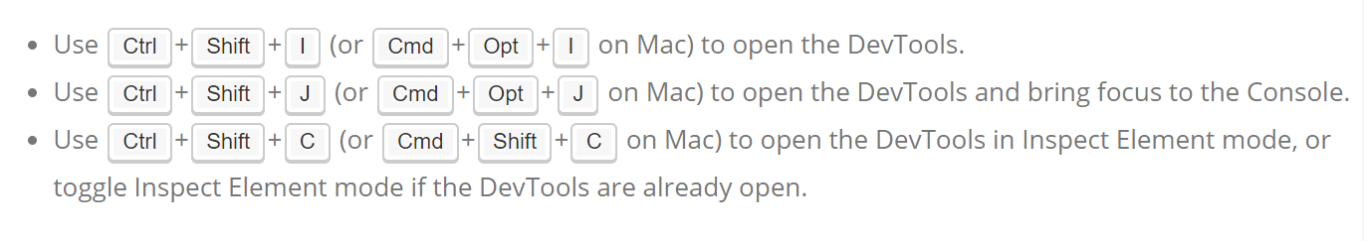
Debugging Tips: Chrome Development Tools
Recommended Development Environment
http://www.google.com/chrome
Built-in debugging environment within Google Chrome browser
Use this to set breakpoints, examine variables, etc.
Check out the chrome devtools overview https://developer.chrome.com/devtools
I

Slide 4
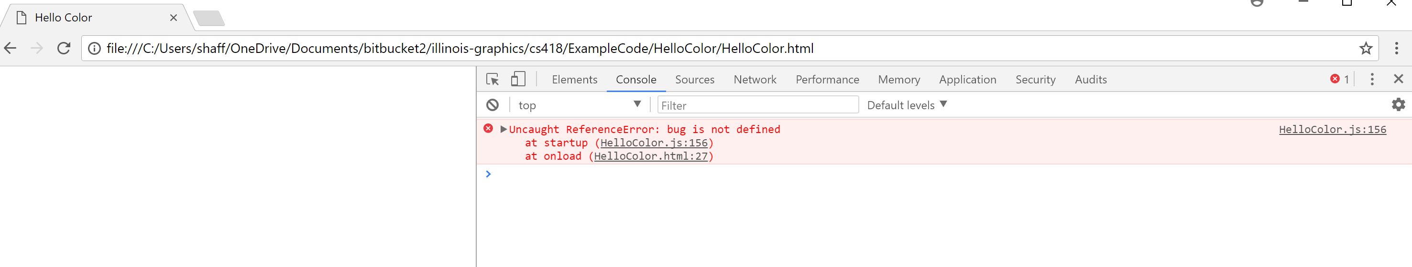
Dev Tools: How to Look at the Console…

Slide 5
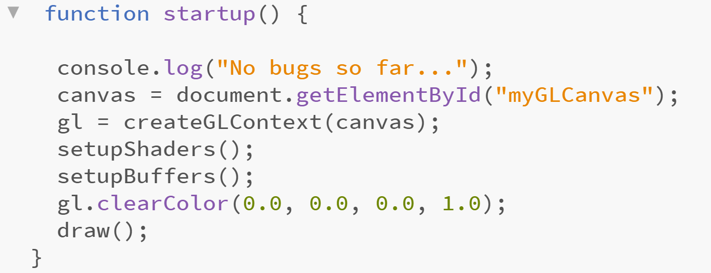
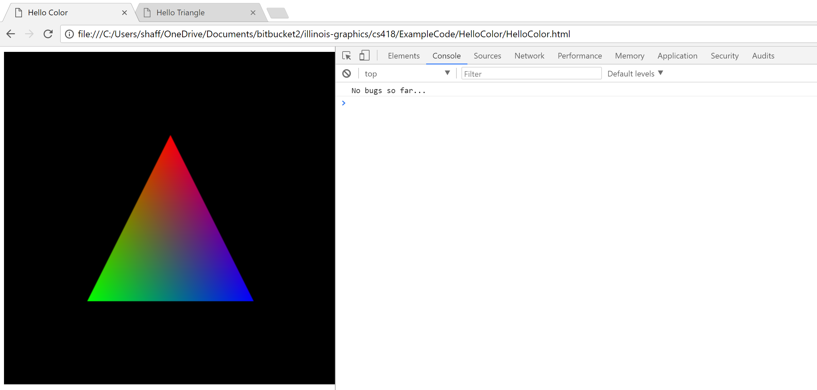
Dev Tools: How to Print to the Console

Slide 6
Most Important Debugging Tips Ever
Test as you write code…
Test each new significant piece of functionality
Write your test code so that it is resuable

Slide 7
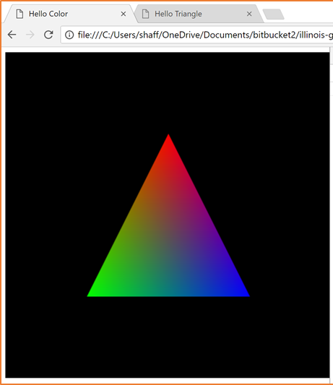
WebGL: What do you see?
What is the default view volume in WebGL?
Where is the default eyepoint?
In what direction are you looking?

Slide 8
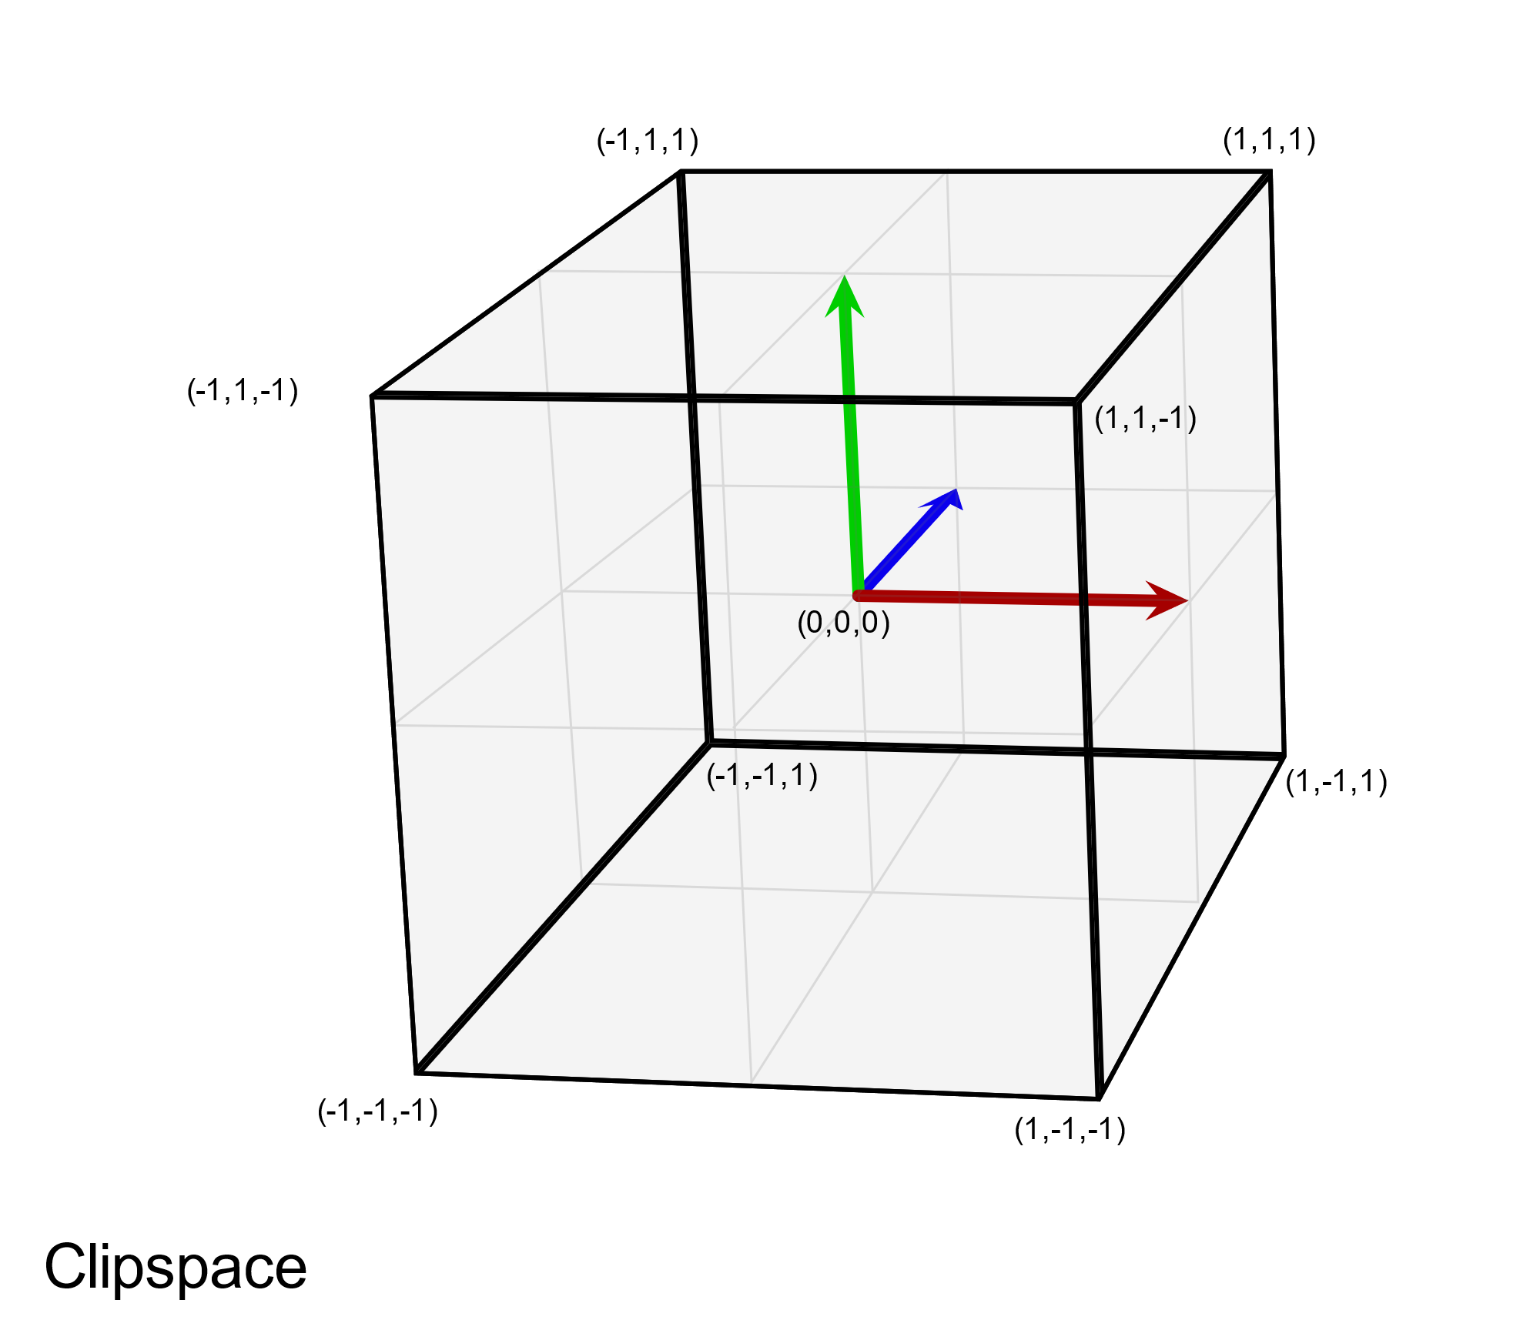
WebGL View Volume
View volume is a box running between [-1,1] in x, y, and z
Geometry outside volume will not be rendered
WebGL default eyepoint is on the z axis…

Slide 9
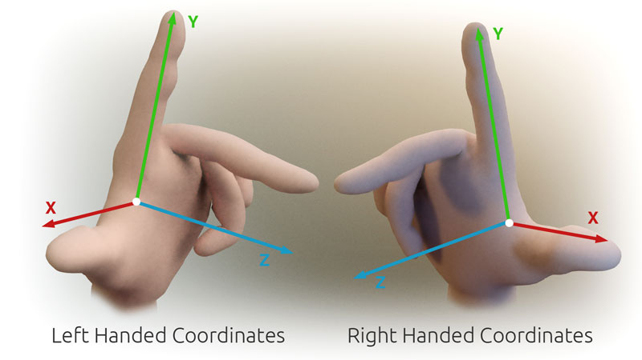
WebGL View Volume
The default view volume is called clip space
WebGL clip space is a left-handed coordinate system
Many (most?) programmers don’t realize this…they think WebGL is a right-handed system…this is because the tradition is to model in right-handed system looking down the –Z axis and then use a matrix transformation to invert the Z axis….
Which is +Z in relation to +X and +Y ?

Slide 10
WebGL View Volume
When WebGL renders, all geometry is projected onto Z=0 plane
Eye is considered to be at the origin (0,0,0)

Slide 11
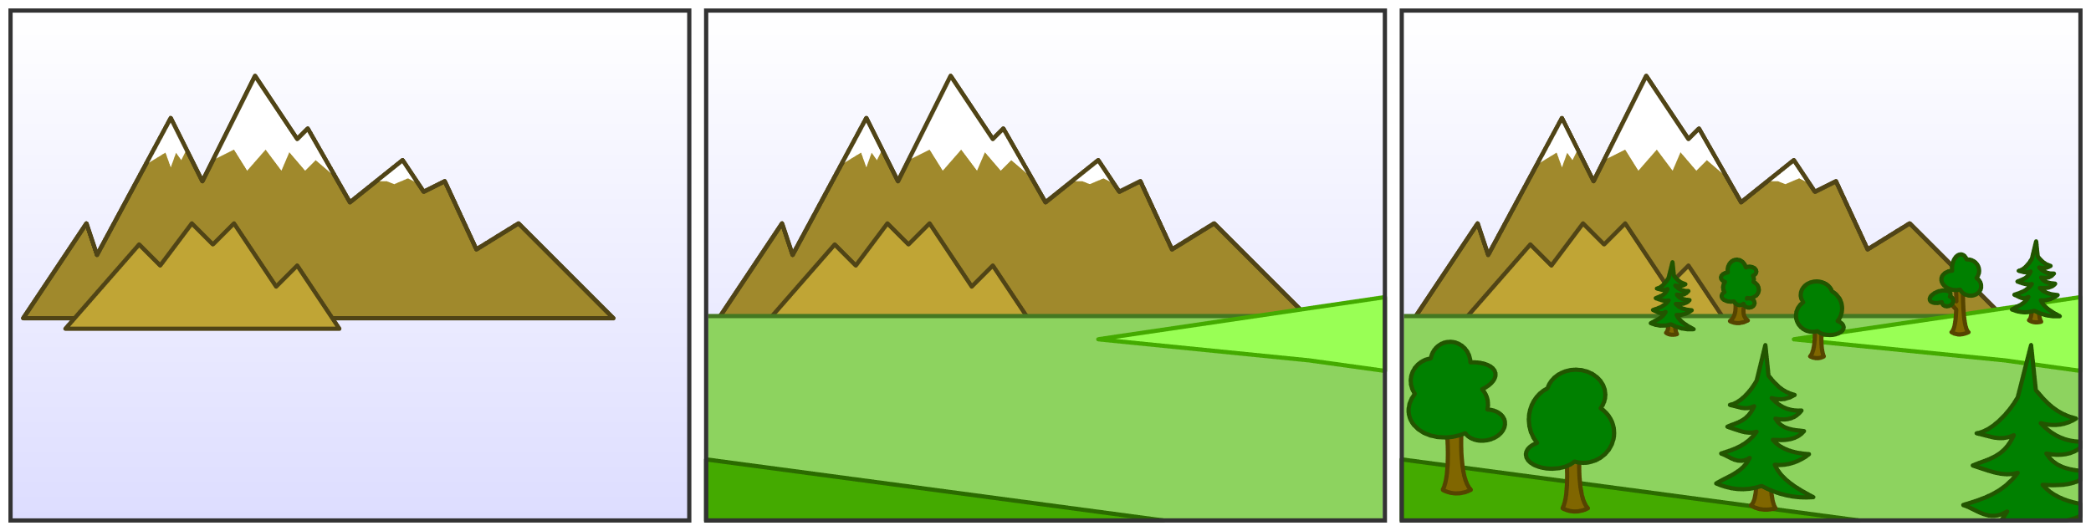
Which Surfaces are Visible?
The default is that you see the surface you drew last…like painting
By Zapyon - Own work, CC BY-SA 3.0, https://commons.wikimedia.org/w/index.php?curid=14256921

Slide 12
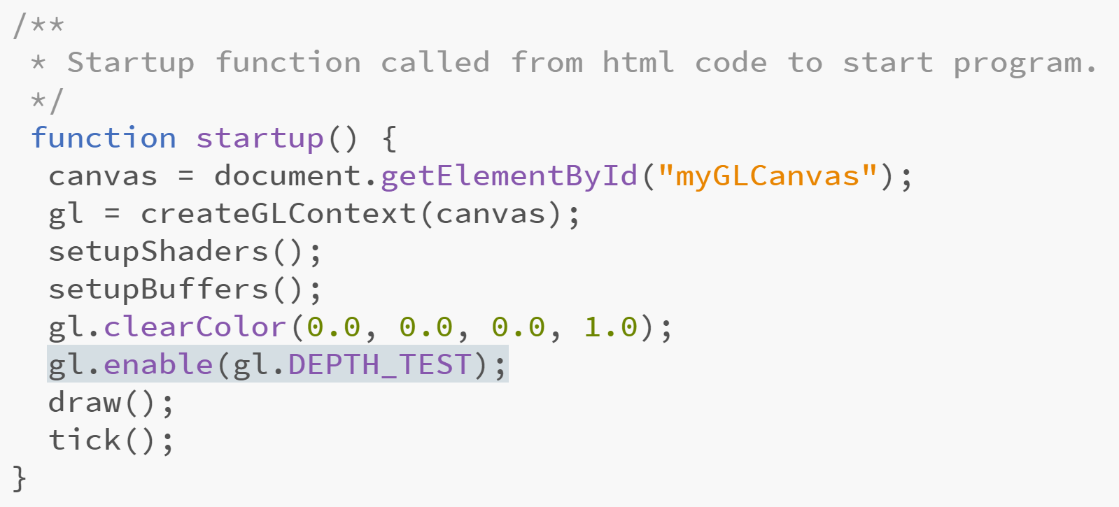
Hidden Surface Removal
You can draw in any order and have WebGL remove hidden surfaces
Hidden surface removal is also known as depth-testing or z-buffering.

Slide 13
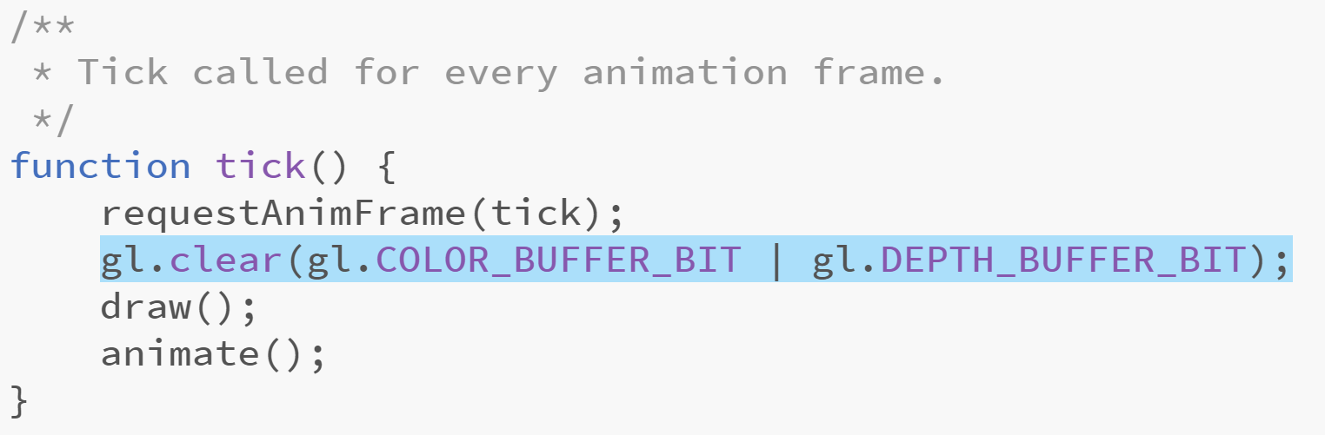
Hidden Surface Removal
If you are animating, you need to re-initialize the depth buffer each frame

Slide 14
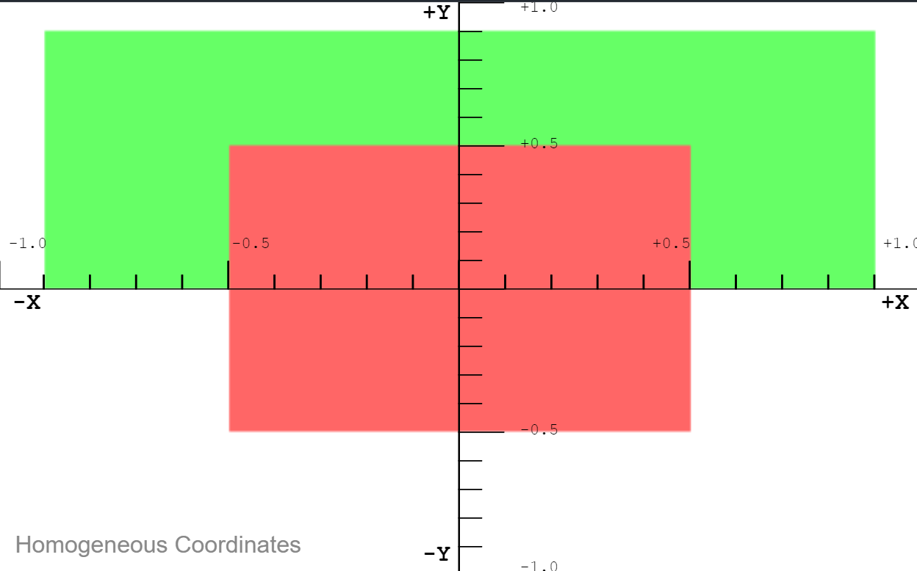
Hidden Surface Removal
In clip space, the z coordinate is depth.
Small z values come before large z values (negative before positive).
https://jsfiddle.net/mff99yu5

Slide 15
Changing the View Volume
Suppose we wanted to model in a view volume like [-100,100]³
…bcause you hate decimal points
How could you use code to let you do this?

Slide 16
WebGL View Volume
How can you work with more convenient coordinates (e.g. [-100, 100])?
Let’s call those world coordinates….
View volume coordinates are often called clip coordinates
You can change coordinate systems pretty easily…
Specify your geometry in whatever world coordinates you want
Transform the coordinates into clip coordinates
In other words…scale down all your geometry to fit in the view volume
To do so we will use an affine transformation

Slide 17
Coding Up the Transformation
One way to move geometry is to apply an affine transformation to it.
We can encode that transformation using a matrix multiplication
The transformation can be implemented in the vertex shader
In the JavaScript we create a matrix using the glMatrix library
That matrix is then passed to the vertex shader as a Uniform variable
Let’s look at the code……

Slide 18
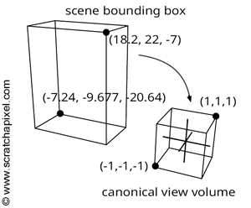
The ortho Transformation
The ortho transformation maps any rectangular axis-aligned viewing volume to the WebGL view volume
It’s basically just a translation and scale

Slide 19
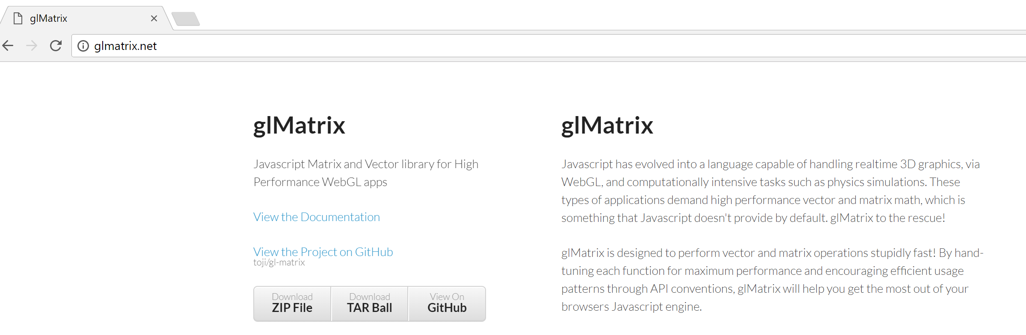
The glmatrix Library
A javascript library that supports 3D matrix and vector operations
To use it grab a copy from glmatrix.net

Slide 20
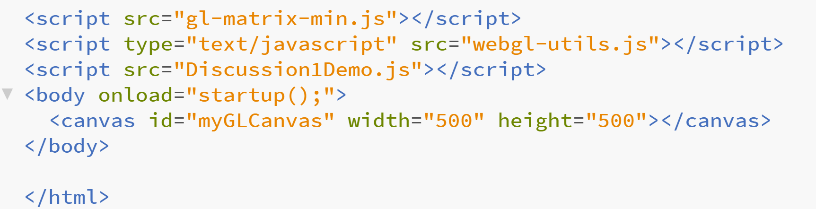
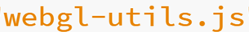
The glmatrix Library
Add a line to your html file with the location of the glmatrix library
In this example, library is in the same folder/directory as html file
Also, a set of utility JavaScript code is being used as well

Slide 21
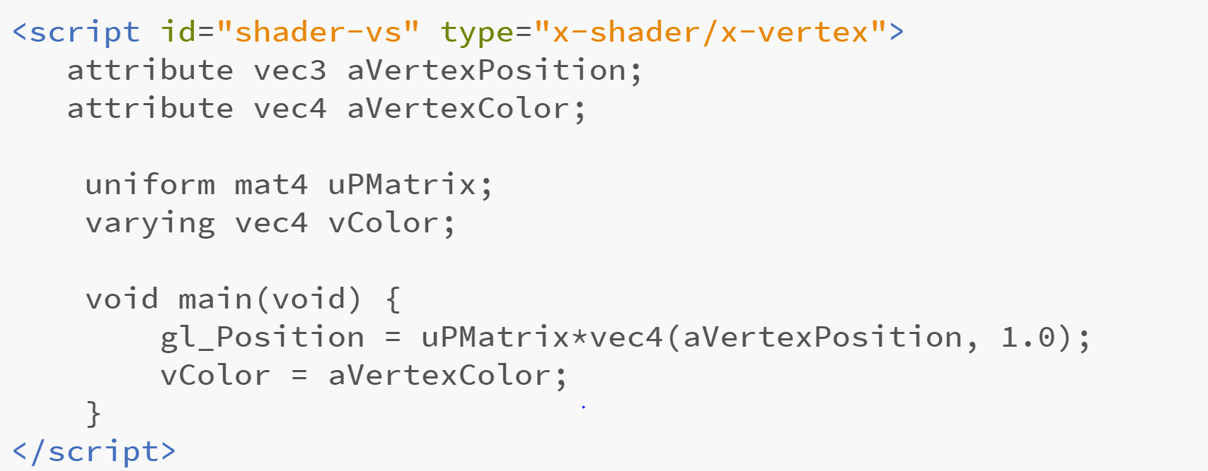
Transforming a Vertex in a Shader
This vertex shader code expects a matrix to be loaded from the application
The matrix is provided as a uniform variable

Slide 22
Transforming a Vertex in a Shader
In GLSL a uniform is a variable that is the same for all executions of a shader program in a given draw call
In GLSL an attribute is a variable that may be different for all executions of a shader program in a given draw call

Slide 23
Creating an ortho Matrix in JavaScript
First, when you create the shader program, get the uniform location
shaderProgram.pMatrixUniform = gl.getUniformLocation(shaderProgram, "uPMatrix");
Create the matrix
var pMatrix = mat4.create(); mat4.ortho(pMatrix, left, right , bottom , top , near, far);
Send the matrix to the GPU before you issue a draw call gl.uniformMatrix4fv(shaderProgram.pMatrixUniform, false, pMatrix);

Slide 24
The ortho Matrix
The parameters left and right are the x coordinates of the planes forming those sides of the view volume
The parameters top and bottom are the y coordinates of the planes forming those sides of the view volume
The parameters near and far are distances down the negative z axis measured from the origin

Slide 25
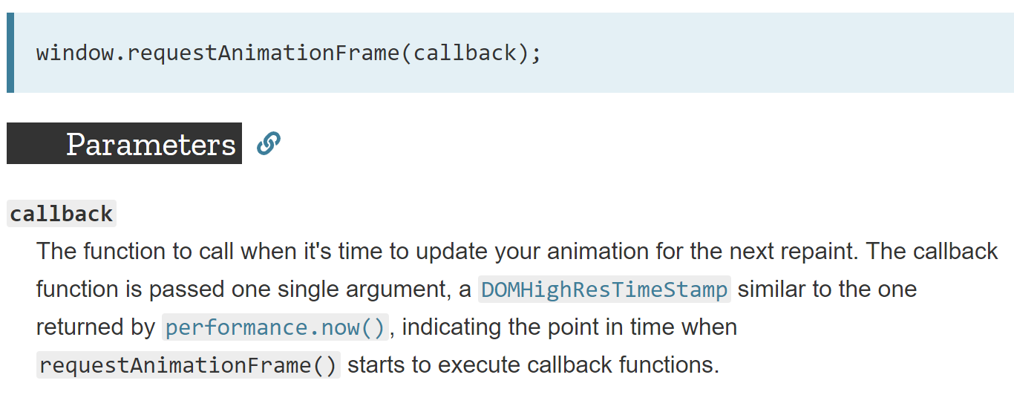
Animation…
What would happen if you called requestAnimationFrame without drawing anything new?

Slide 26
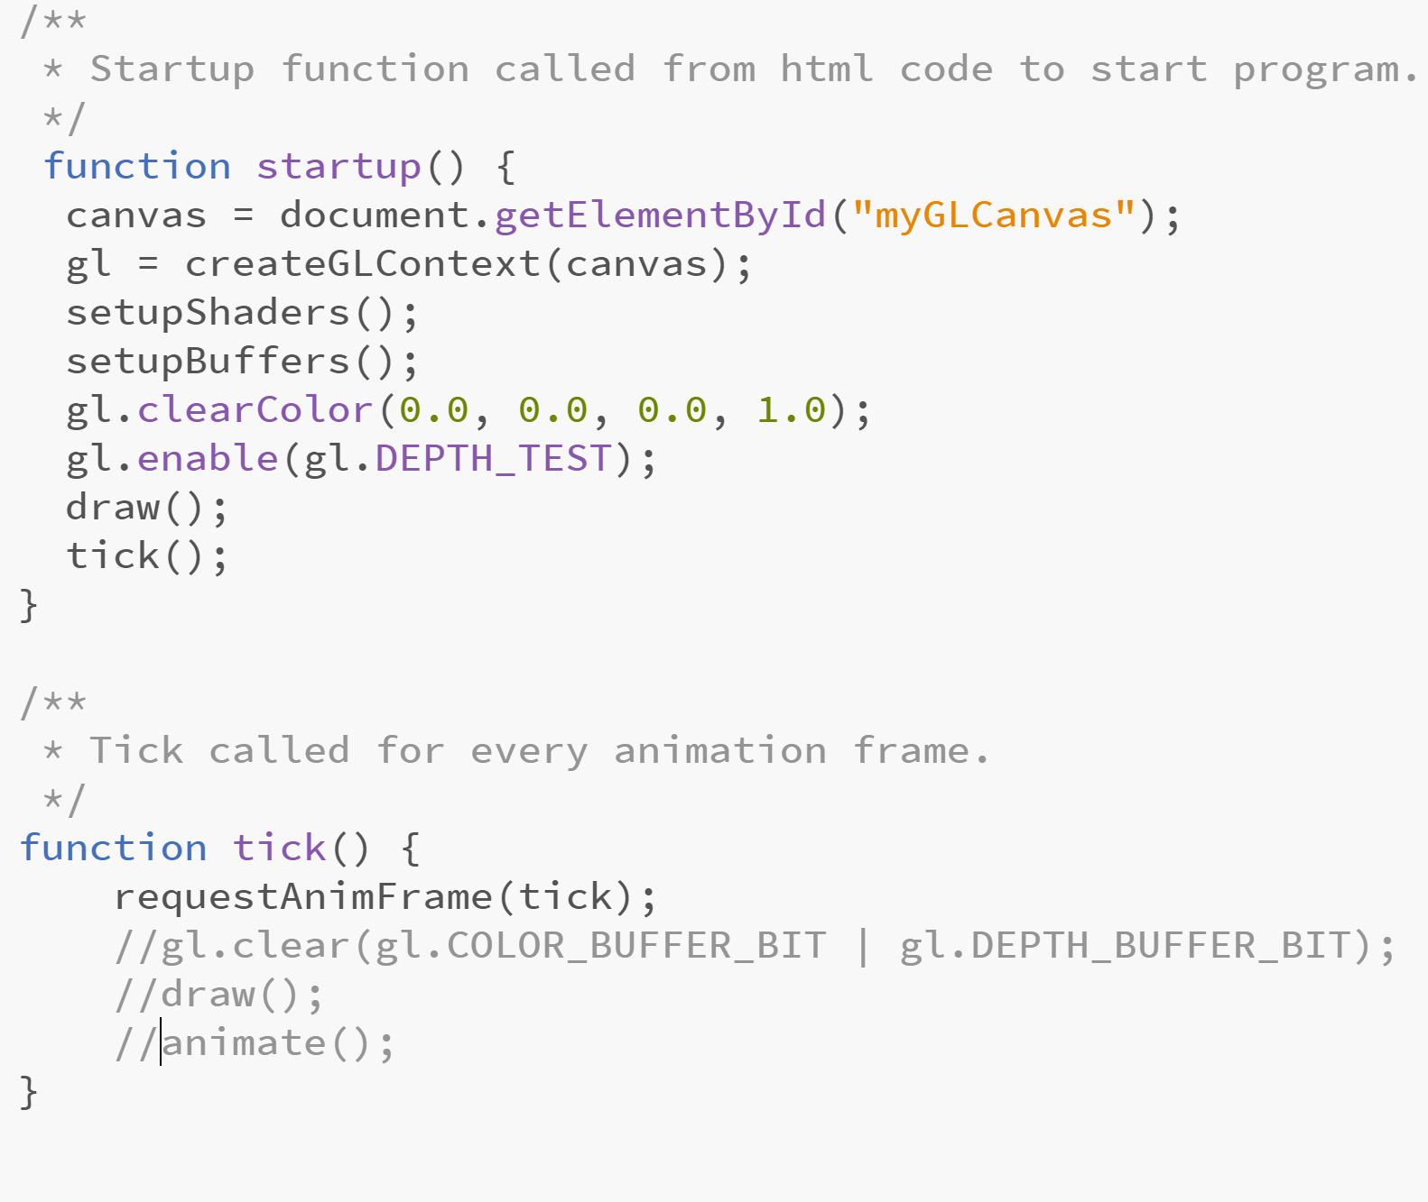
Animation….

Slide 27
Animation….
In most browsers, your original framebuffer will just be redrawn…the image won’t change.

Slide 28
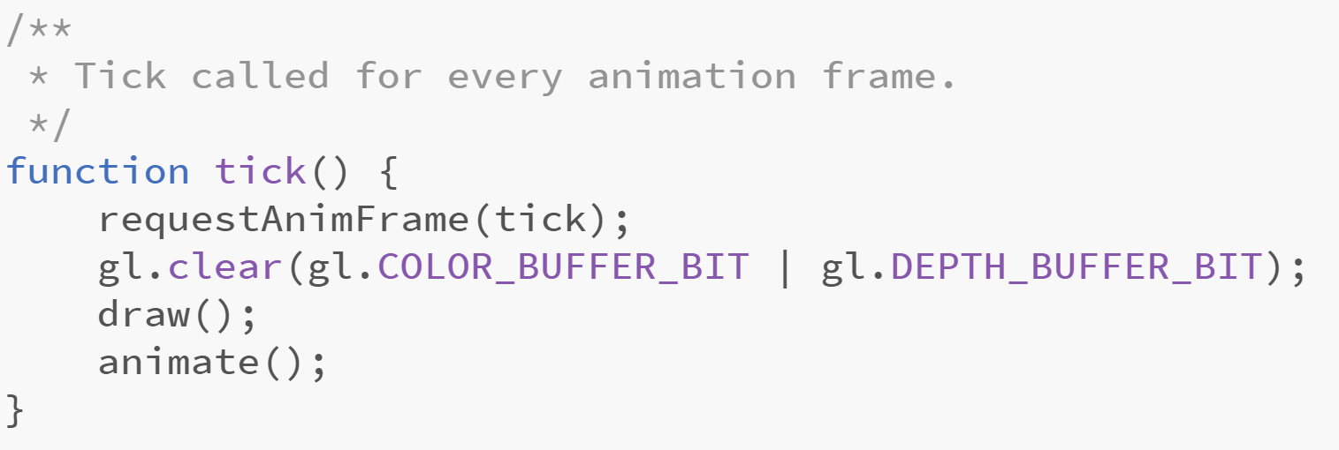
Animation
Gl.clear() re-initializes pixels to the background color
You then overwrite those colors using class like gl.drawArrays()
You can call gldrawArrays() multiple times per frame

Slide 29
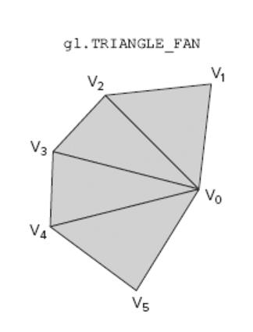
Drawing Triangle Fans
WebGL offers as special drawing mode to render triangle fans
A triangle fan is a triangulated polygon with a central vertex
This central vertex forms one corner of every triangle

Slide 30
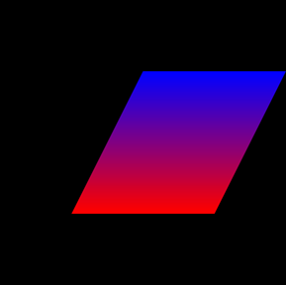
Drawing Triangle Fans
vertexPositionBuffer = gl.createBuffer();
gl.bindBuffer(gl.ARRAY_BUFFER, vertexPositionBuffer);
var triangleVertices = [
0.5, -0.5, 0.0,
1.0, 0.5, 0.0,
0.0, 0.5, 0.0,
-0.5, -0.5, 0.0,
];
gl.bufferData(gl.ARRAY_BUFFER, new Float32Array(triangleVertices), gl.DYNAMIC_DRAW);
vertexPositionBuffer.itemSize = 3;
vertexPositionBuffer.numberOfItems = 4;
….
gl.drawArrays(gl.TRIANGLE_FAN, 0, vertexPositionBuffer.numberOfItems);
First vertex is the fan center
Next two vertices specify the first triangle
Each succeeding vertex forms a triangle with the center and previous vertex
Which vertices correspond to which coordinates in the code?

Slide 31
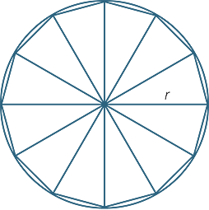
Drawing a Circle
We can procedurally generate the geometry for a circle
Easy to approximate the shape using a triangle fan

Slide 32
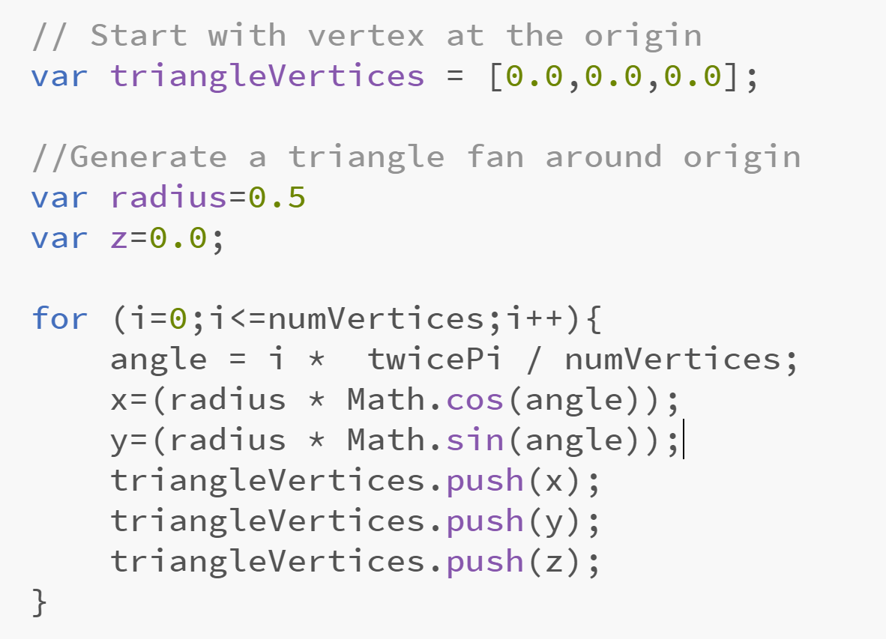
Generating the Circle Vertices
What would we draw if the loop were for(i=0;i<numVertices;i++) ?
Where in the array does the JavaScript push function place the new coordinate?

Slide 33
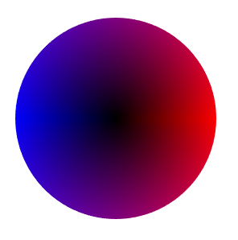
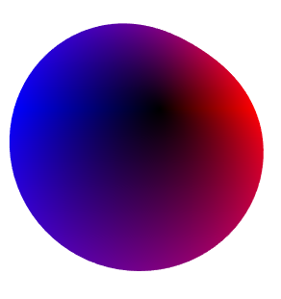
Exercise: Deforming a Mesh
Let’s try deforming the circle by explicitly changing the vertex buffer.
We’ll add offsets based on a sine curve to the circle boundary vertices
Grab the demo code and take a look….it should draw a circle

Slide 34
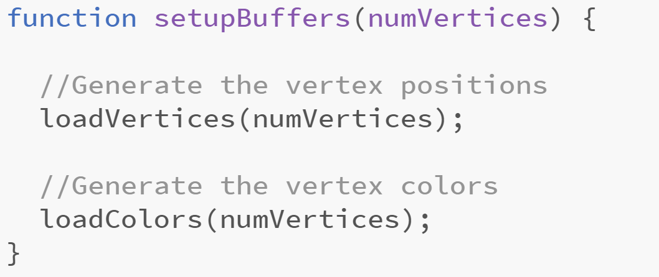
Deforming a Circle
Some things to notice about the code
gl.bufferData(gl.ARRAY_BUFFER, new Float32Array(triangleVertices), gl.DYNAMIC_DRAW);
This is a hint to WebGL that we’ll be changing the values in the buffer….
We keep a global defAngle that is incremented once per frame We’ll use this to move the deformation around the boundary….
The setupBuffers function has been refactored There are now separate functions for setting up the vertex and color buffers. Why?

Slide 35
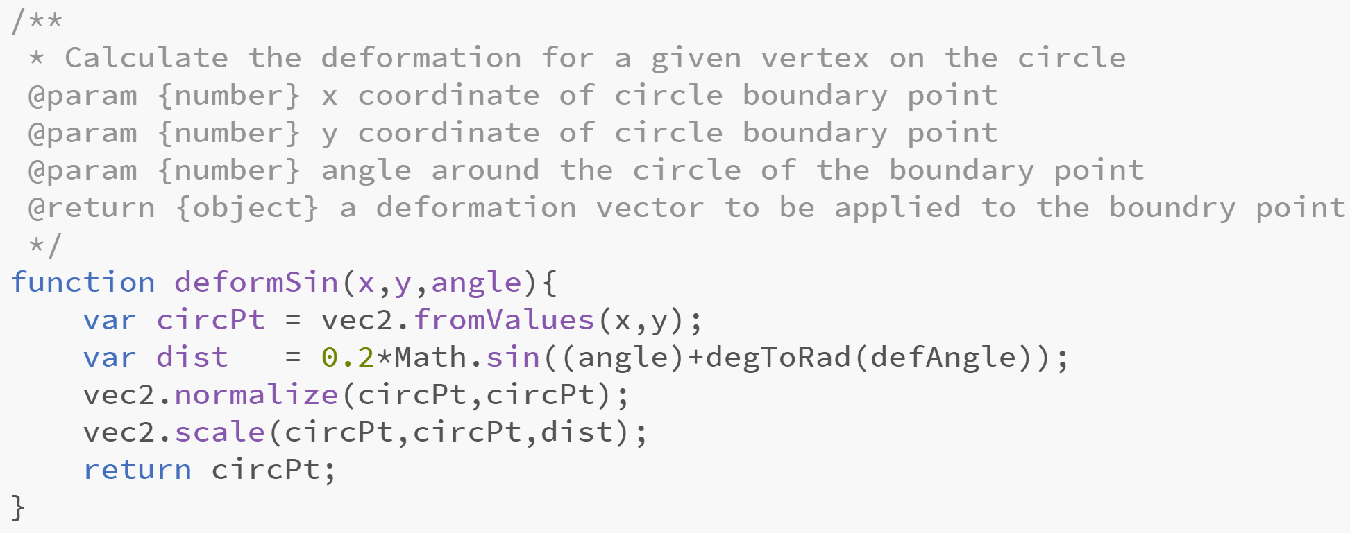
Deforming a Circle
Here’s some code you could use to calculate the deformation…
Can you explain what it is doing?

Slide 36
Deforming a Circle
Your Tasks
Add code for the deformSin function
In loadVertices, call deformSin Use it to adjust the positions of the boundary vertices: …add the returned x value from deformSin to the x coordinate of the vertex …add the returned y value from deformSin to the y coordinate of the vertex
3. What needs to be added to the animate function? Just a single line…but it needs to happen to see the geometry change

