Slide 1

Rendering Implicit Surfaces
CS 418: Interactive Computer Graphics
UNIVERSITY OF ILLINOIS AT URBANA-CHAMPAIGN
Some slides courtesy of John Hart
Eric Shaffer

Slide 2
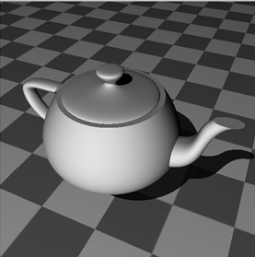
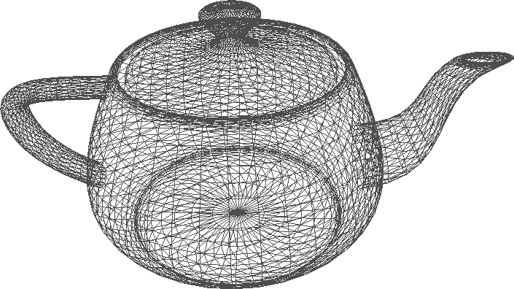
Why Use Implicits?
v. polygons
smoother
compact, fewer higher-level primitives
harder to display in real time
v. parametric patches
easier to blend
no topology problems
lower degree
harder to parameterize
easier to ray trace
well defined interior

Slide 3
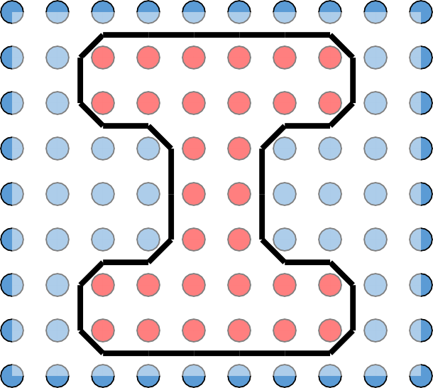


Marching Cubes
For each cubic cell Compute index
(using bitmask of vertices)
Output polygon(s) stored at index translated to cell position
End for

Slide 4


Marching Cubes
For each cubic cell Compute index
(using bitmask of vertices)
Output polygon(s) stored at index
translated to cell position End for
0:
1:
2:
3:
4:
5:
6:
7:
8:
9:
10:
11:
12:
13:
14:
15:

Slide 5
Marching Cube Cases
256 in all
15 modulo symmetry

Slide 6
Marching Tet Cases
+
-
+
-
+
+
+
+
+
- +
-
+
+
+
+
+
-
+
-
-
+
-
+
-
- -
-
+
+
+
+
+
-
+
-
+
+
+
+
+
- +
-
-
-
-
-
+
-
+
-
-
+
-
+
-
- -
16 in all
-
-
-
-
-
3 modulo symmetry

Slide 7
Orientation
Consistency allows polygons to be drawn with correct orientation
Supports backface culling
+
-
-
+
+
-
+
-

Slide 8
Problem: Ambiguity

Slide 9
Problem: Ambiguity

Slide 10
Problem: Ambiguity

Slide 11
Problem: Ambiguity

Slide 12
Problem: Ambiguity
a
b
(a + b + c + d)/4
c
d

Slide 13
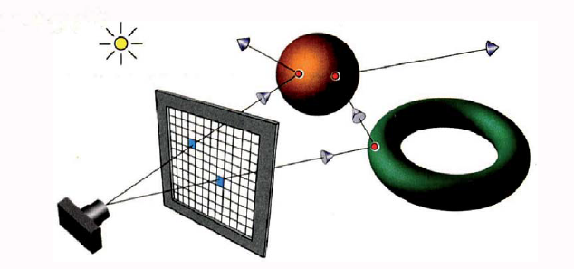
Alternative: Ray Tracing
Figure from Ray Tracing from the Ground Up by Kevin Suffern

Slide 14
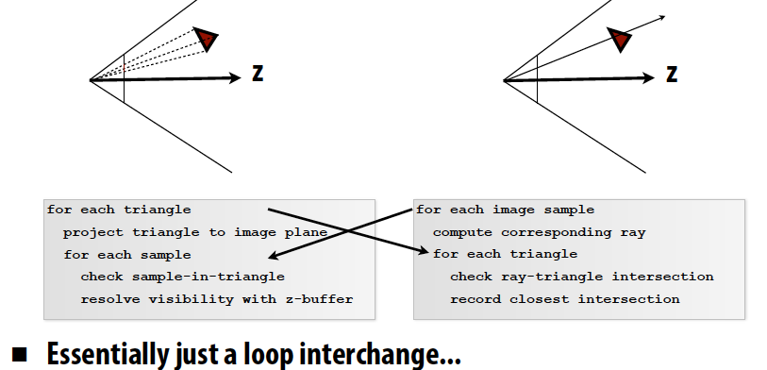
How Does Ray Tracing Differ from Rasterization?
Slide from CS348b: Image Synthesis by Matt Pharr

Slide 15
Ray Tracing – basic algorithm
define some objects
specify a material for each object
define some light sources
define window that consists of a grid of pixels (the view plane)
for each pixel
shoot a ray into the model world
compute the intersection of the ray with each object
find the intersection (if any) closest to the view plane
if there was an intersection
use lights and material to compute the pixel color
else
pixel is set to background color

Slide 16
Orthographic ray-tracing
Figure from Ray Tracing from the Ground Up by Kevin Suffern

Slide 17
Orthographic ray-tracing
Figure from Ray Tracing from the Ground Up by Kevin Suffern

Slide 18
Rays
p is a point on the ray
o is point that is origin of the ray
t is scalar parameter
d is unit vector giving the direction of the ray

Slide 19
Intersecting Rays and Implicit Surfaces
We can intersect an implicit surface with a ray
Just find the point p on the ray that satisfies the equation for the implicit surface
For now, we’ll just focus on planes and spheres….

Slide 20
Plane Equation
Here a is a point on the plane And n is the normal
All points p that satisfy the equation form the plane

Slide 21
Ray-Plane Intersection
the plane equation with normal n and point on plane a
What happens if d is parallel to the plane?
How do you know if the hit happens in front or behind the view plane?

Slide 22
Ray-Sphere Intersection
Equation of a sphere
So…a quadratic equation that we can solve

Slide 23
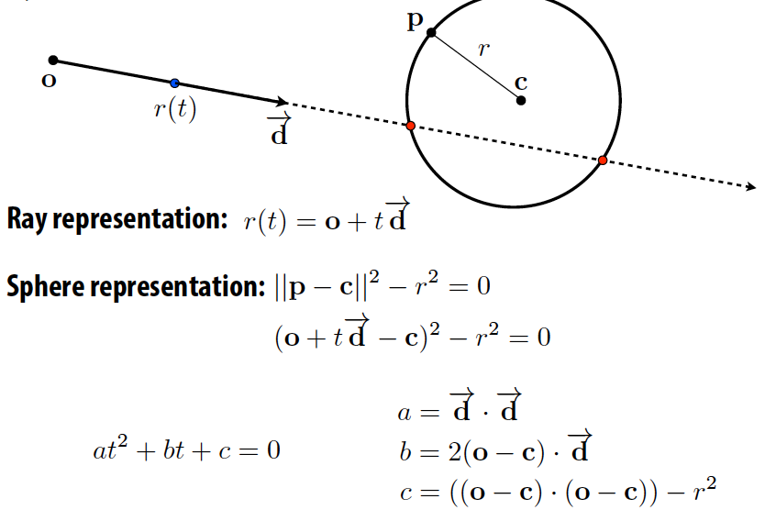
Ray-Sphere Intersection
Slide from CS348b: Image Synthesis by Matt Pharr

Slide 24
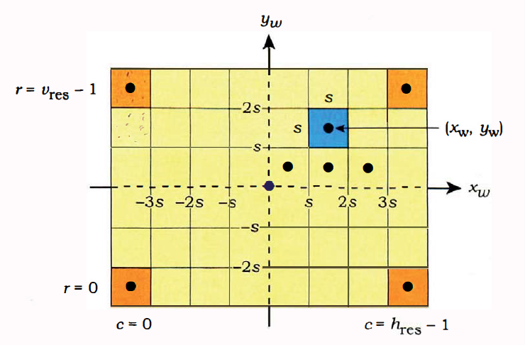
Computing Pixel Coordinates

Slide 25


Resolution

Slide 26
Changing Field of View

