Slide 1

Lab 2
CS 418: Interactive Computer Graphics
UNIVERSITY OF ILLINOIS AT URBANA-CHAMPAIGN
Eric Shaffer

Slide 2
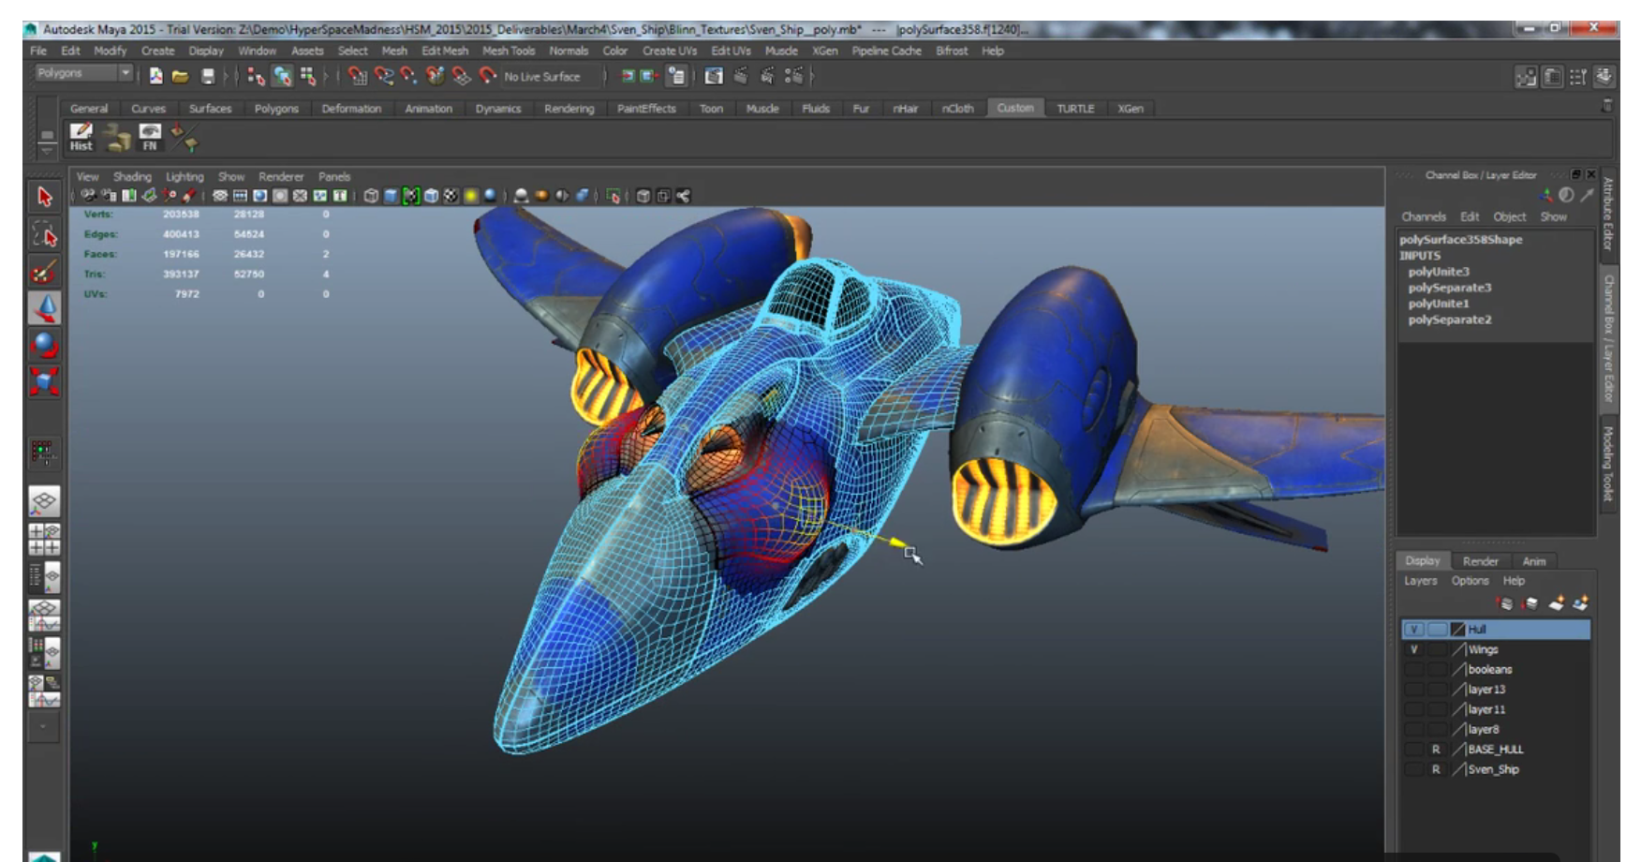
Geometric Modeling
You may have noticed we have drawn only simple shapes
Geometric modeling is not easy
Even with sophisticated computational tools like Maya
Still labor intensive

Slide 3
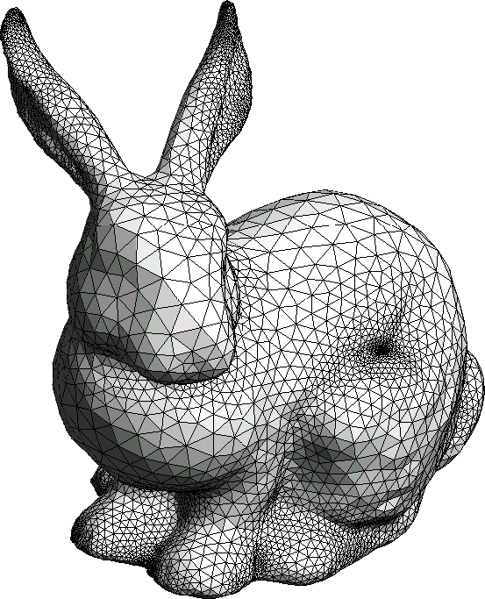
Geometric Modeling
So how do you get geometric models for this course?
Well…you can get models in files and implement a file reader
Some browsers prevent file reading for security reasons
We’ll see how to work around that later

Slide 4
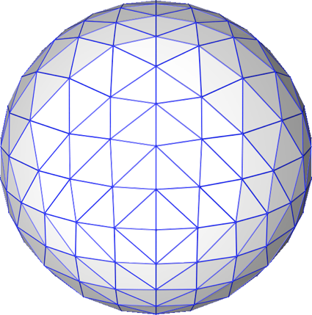
Geometric Modeling
You can type the geometry in by hand
Hard code it into the .js file
Useful for testing
Obviously not scalable
You can procedurally generate geometry
Write code to produce a bunch of triangles
We’ll write code to do that for one type of surface today

Slide 5
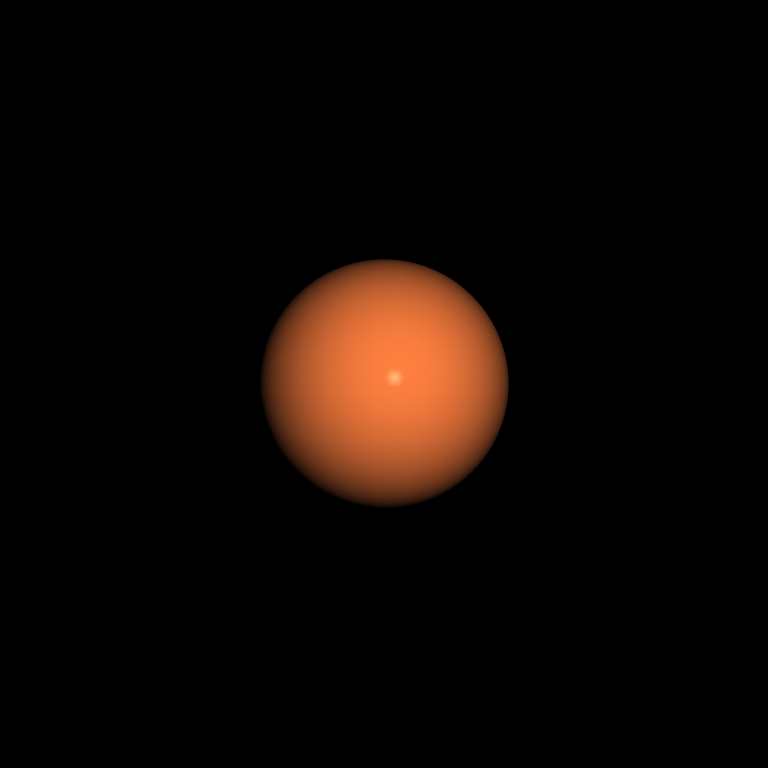
Generating a Mesh for a Sphere
Today we’ll create our first really 3D image
Provided code will do two important things
It will render the scene in perspective
It will shade the sphere as if lit by a light-source
You will learn how to implement that later
For today, just use the code…
You will write the code to generate the sphere mesh

Slide 6
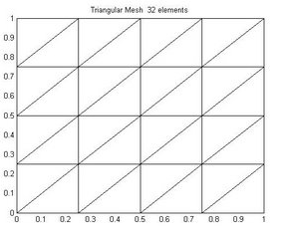
Generating a Tessellated Quadrilateral
Let’s look at how to generate the triangles for a simpler shape
Technically, a tessellation is a tiling of a plane using geometric shapes
We will divide a rectangle up into triangles

Slide 7
Generating a Tessellated Quad
Recursion (or iteration) can be used to generate refined geometry
Meaning lots of triangles…
How can we generate a tessellated plane recursively?
What does this code do?
function planeFromSubdivision(n, minX,maxX,minY,maxY, vertexArray)
{
var numT=0; var
var var var
va = vec4.fromValues(minX,minY,0,1); vb = vec4.fromValues(maxX,minY,0,1); vc = vec4.fromValues(maxX,maxY,0,1); vd = vec4.fromValues(minX,maxY,0,1);
numT+=divideTriangle(va,vb,vd,n, vertexArray); numT+=divideTriangle(vb,vc,vd,n, vertexArray); return numT;
}

Slide 8
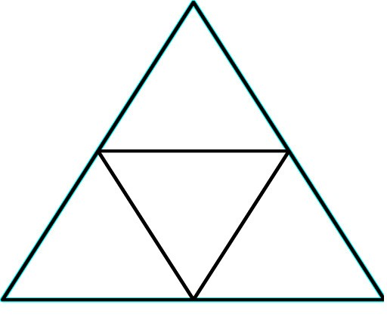
Subdividing a Triangle
Find the midpoints of each edge
Create 4 triangles from the original triangle
There are other ways you could subdivide
This method generates equilateral triangles
…if you start out with an equilateral

Slide 9
Subdividing a Triangle
function divideTriangle(a,b,c,numSubDivs, vertexArray){ if (numSubDivs>0){
var numT=0;
var | ab | = | vec4.create(); | vec4.lerp(ab,a,b,0.5);
var | ac | = | vec4.create(); | vec4.lerp(ac,a,c,0.5);
var | bc | = | vec4.create(); | vec4.lerp(bc,b,c,0.5);
numT+=divideTriangle(a,ab,ac,numSubDivs-1, numT+=divideTriangle(ab,b,bc,numSubDivs-1, numT+=divideTriangle(bc,c,ac,numSubDivs-1,
vertexArray); vertexArray); vertexArray);
numT+=divideTriangle(ab,bc,ac,numSubDivs-1, vertexArray); return numT;
}
else …

Slide 10
Subdividing a Triangle
else
{
// Add 3 vertices to the array pushVertex(a,vertexArray); pushVertex(b,vertexArray); pushVertex(c,vertexArray); return 1;
}
}
function pushVertex(v, vArray)
{
for(i=0;i<3;i++)
{
vArray.push(v[i]);
}
}

Slide 11
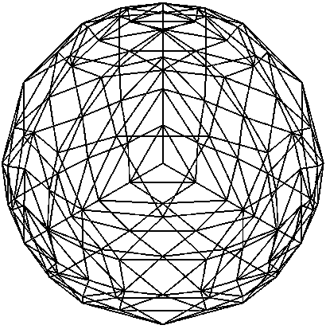
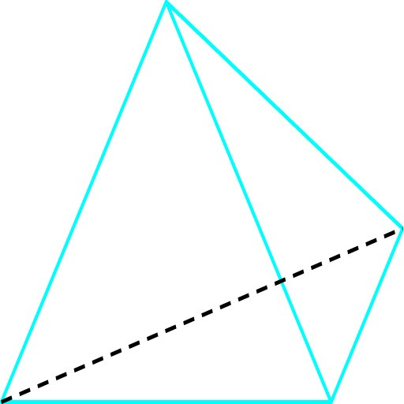
Generating a Sphere
Start with a tetrahedron centered on the origin
Vertices at a distance of 1 from the origin
Recursively subdivide the triangular faces
Normalize the new vertices that get introduced normalize means move the vertex to a distance of 1 around the origin keep same direction

Slide 12
Generating a Sphere
In the file SimpleModeling.js
Write the code for the function sphDivideTriangle(a,b,c,numSubDivs, vertexArray,normalArray)
a b and c are the corners of triangle…each is a vec4 specifying (x,y,z,w)
numSubDivs is how many times to subdivide the triangles
The vertexArray is where you add the vertices you compute
The normalArray is where you add per-vertex normal vectors

Slide 13
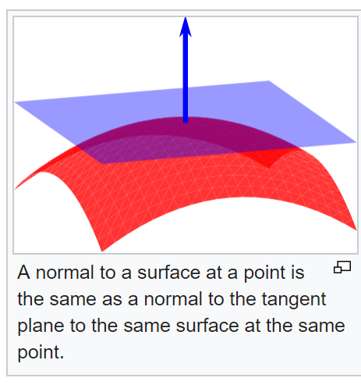
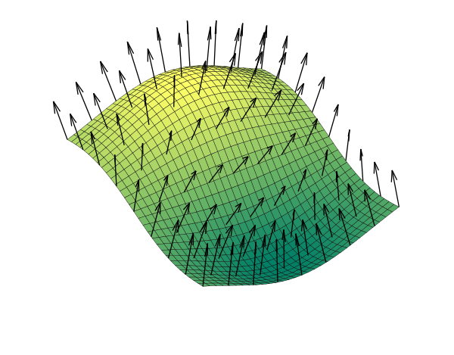
Generating Normals
In order to shade the mesh in a realistic way we will need per-vertex normal vectors
Normal vectors are vectors perpendicular to the surface
We will discuss how the vectors are used in shading next week
For the sphere, what are the normals?
In general, if we have no other information about a surface mesh, we compute a normal for each vertex by averaging the normal of the surrounding faces

