Slide 1

Normal Mapping
CS 418: Interactive Computer Graphics
UNIVERSITY OF ILLINOIS AT URBANA-CHAMPAIGN
Eric Shaffer

Slide 2
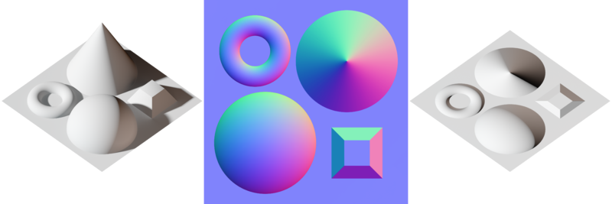
Bump Mapping and Normal Mapping
Bump Mapping:
Perturbing mesh normals to create the appearance of geometric detail
Normal Mapping:
A way of implementing bump mapping

Slide 3
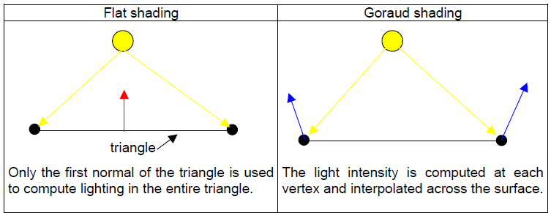
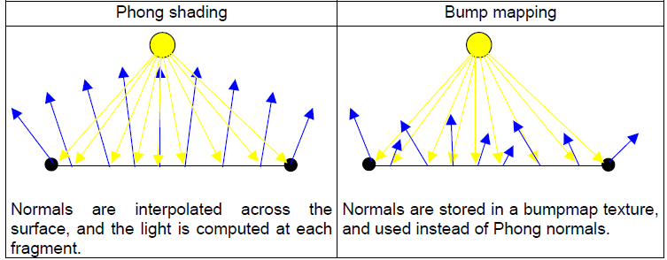
Shading

Slide 4
Normal Map
Normal vector encoded as rgb
[-1,1]³ →[0,1]³: rgb = n*0.5 + 0.5
RGB decoding in fragment shaders
vec3 n = texture2D(NormalMap, texcoord.st).xyz * 2.0 – 1.0
Normal maps typically map direction out of image to +z
Hence RGB color for the straight up normal is (0.5, 0.5, 1.0).
This is why normal maps are mostly a light blue color
Normals are then used for shading computation
Diffuse: n•l
Specular: (n•h)^{shininess}
Computations done in tangent space at each fragment

Slide 5
Tangent Space
Why do we need a tangent space?
Suppose we just set the per-fragment to a value from the map
Imagine the actual surface normal is (0,0,-1)
And the map normal is (0,0,1)
…we’d invert the normal and get a black spot when shading
What normal should the mapping process generate?

Slide 6
Tangent Space
In order to build this Tangent Space, we need to define an orthonormal (per vertex) basis
Tangent space is composed of 3 orthogonal vectors (T, B, N)
Tangent (S Tangent)
Bitangent (T Tangent)
Normal
One has to calculate a tangent space matrix for every vertex
This matrix can be used to transform vectors
From world space coordinates
To tangent space coordinates

Slide 7
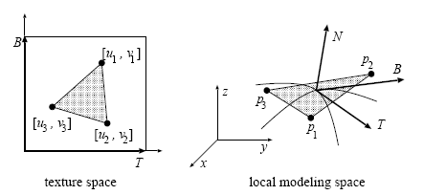
Tangent Space
Suppose we have a vertex p_{i} in world coordinates
Texture coordinates are (u_{i}, v_{i}) are in a space tanget to p_{i}
We can use them
The vertices p1, p2 and p3, defining the triangle :
p₁ = u₁.T + v₁.B p₂ = u₂.T + v₂.B p₃ = u₃.T + v₃.B

Slide 8
Tangent Space
6 eqns, 6 unknowns
Why are there 6 equations?
What are the 6 unknowns
p₂ - p₁ = (u₂ - u₁)T + (v₂ - v₁)B p₃ - p₁ = (u₃ - u₁)T + (v₃ - v₁)B
(v₃ - v₁)(p₂ - p₁) = (v₃ - v₁)(u₂ - u₁)T + (v₃ - v₁)(v₂ - v₁)B - (v₂ - v₁)(p₃ - p₁) - (v₂ - v₁)(u₃ - u₁)T - (v₂ - v₁)(v₃ - v₁)B
(u₃ - u₁)(p₂ - p₁) = (u₃ - u₁)(u₂ - u₁)T + (u₃ - u₁)(v₂ - v₁)B - (u₂ - u₁)(p₃ - p₁) - (u₂ - u₁)(u₃ - u₁).T - (u₂ - u₁)(v₃ - v₁)B
(v₃ - v₁)(p₂ - p₁) - (v₂ - v₁)(p₃ - p₁) T = ------------------------------------------------ (u₂ - u₁)(v₃ - v₁) - (v₂ - v₁)(u₃ - u₁)
(u₃ - u₁)(p₂ - p₁) - (u₂ - u₁)(p₃ - p₁) B = ------------------------------------------------ (v₂ - v₁)(u₃ - u₁) - (u₂ - u₁)(v₃ - v₁)

Slide 9
TBN Matrix Per Vertex
For each triangle compute N, T, B
For each vertex:
Use the averaged face normal as the vertex normal
Do the same for tangent and bitangent vectors
Note that the T, B vectors might not be orthogonal to N vector
Use Gram-Schmidt to make sure they are orthogonal
Normalize them
…you now have per vertex NTB which you can use to
convert world shading calculations to tangent space
use the bump normal instead of the geometric normal

Slide 10
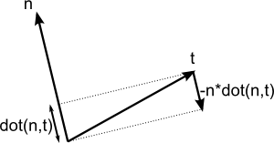
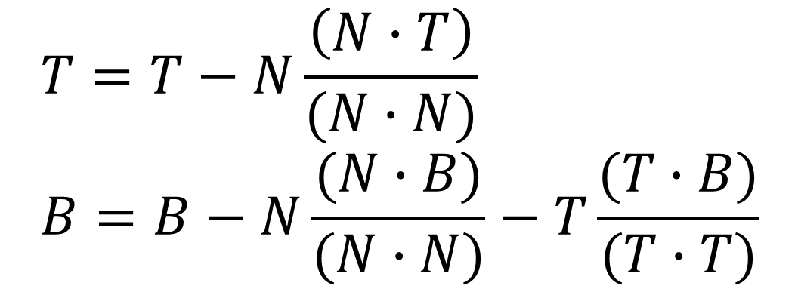
Gram-Schmidt Orthogonalization
Assume N,T, and B are unit length
How could the equations below be simplified?
$$T=T−N\frac{\left(N∙T\right)}{(N∙N)} \\ B=B−N\frac{(N∙B)}{(N∙N)}−T\frac{(T∙B)}{(T∙T)}$$

Slide 11
Coordinate Transformation
Tangent space to world (object) space
World (object) space to tangent space

Slide 12
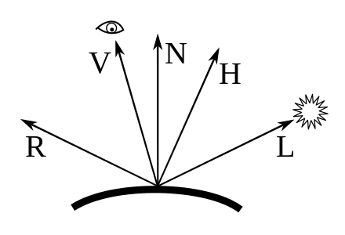
Shading in the Tangent Space
We only need to convert
The light direction L
the eye direction V
into the tangent space
Multiply each of the above by matrix [TBN] and we can find the vectors V and L and then R or H in the tangent space We then compute Phong reflectance model in the tangent space using the normal from the map to generate a color

Slide 13
