Slide 1

Lab 3
CS 418: Interactive Computer Graphics
UNIVERSITY OF ILLINOIS AT URBANA-CHAMPAIGN
Eric Shaffer

Slide 2
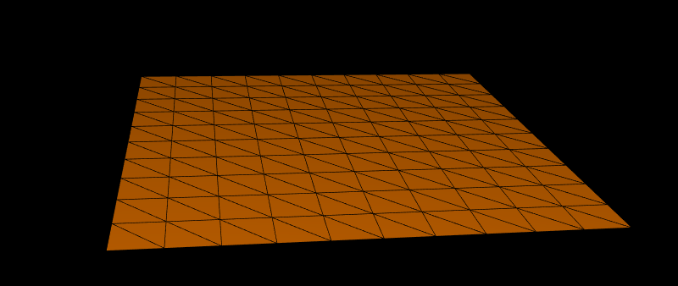
Generating a Terrain
Today, we will generate a flat triangulated mesh
This can be the start of your code for MP 2

Slide 3
Creating a Terrain Class
We will create a JavaScript class for our terrain
It will be rendered using the drawElements method
We will need to generate three buffers
A buffer of the vertex positions
A buffer of the triangles, specified by vertex indices
A buffer of normal vectors
Each vertex will have a normal vector associated with it

Slide 4
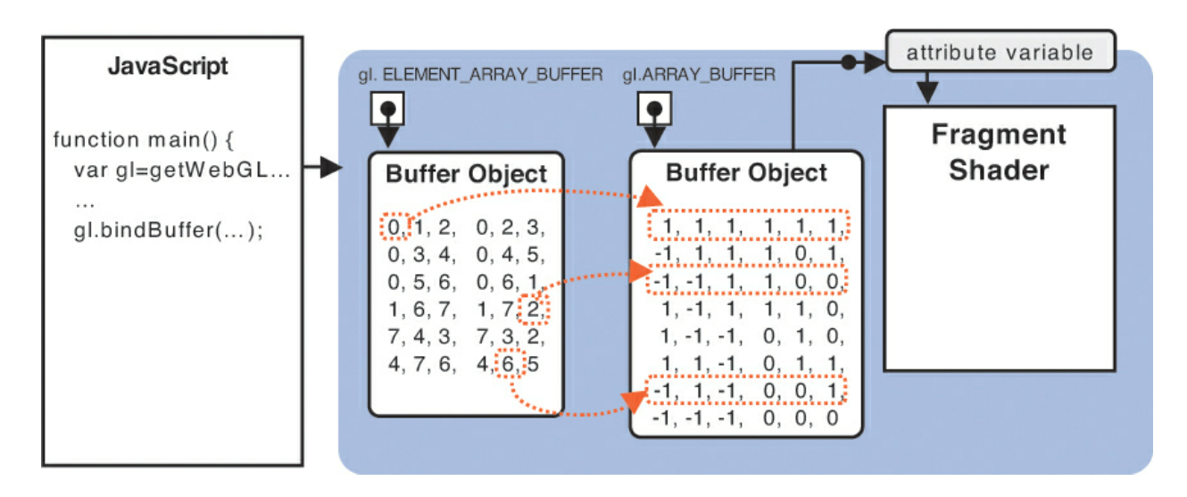
drawElements in WebGL

Slide 5
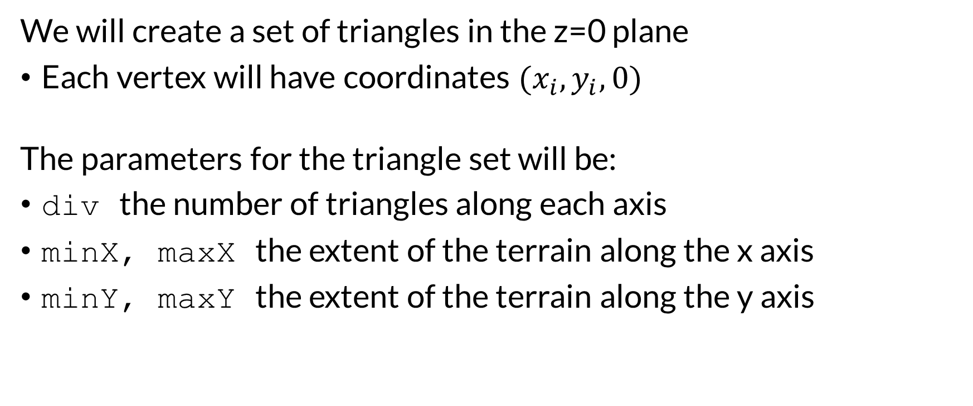
The Terrain Geometry
We will create a set of triangles in the z=0 plane
Each vertex will have coordinates ${(x}_{i},y_{i},0)$
The parameters for the triangle set will be:
div the number of triangles along each axis
minX, maxX the extent of the terrain along the x axis
minY, maxY the extent of the terrain along the y axis

Slide 6
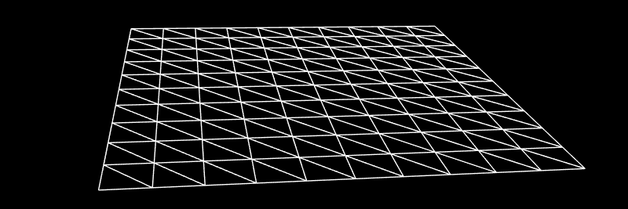
Terrain Geometry
div the number of triangles along each axis
minX, maxX the extent of the terrain along the x axis
minY, maxY the extent of the terrain along the y axis
Vertex (i,j) is in the ith row and jth column
with i,j in the range [0,div]
Generate it so that (0,0) is the first vertex with coordinates (minx,minY,0)
What are the indices of the faces?
How many total vertices?
How many total triangles?

Slide 7
Your Tasks
Write the following functions in the terrain.js file
getVertex
setVertex
generateTriangles

Slide 8
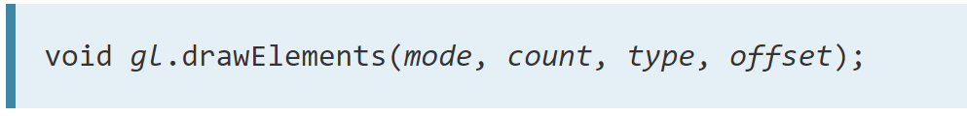
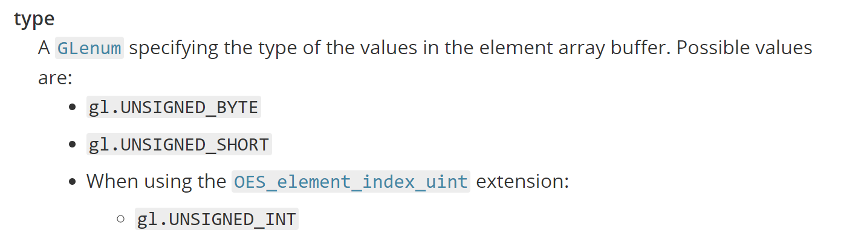
Indexing with drawElements
In WebGL 1.0 you are limited to using 2-byte integer indices
How may vertices could you index?
There’s an extension to let you use 4-byte integer indices
Need to initialize/check with var ext = gl.getExtension('OES_element_index_uint');

Slide 9
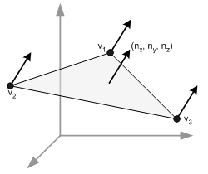
Computing Normal Vectors
For shading you need per vertex normal
Vertex buffer contains N vertices with x,y,z coordinates
So 3N floating point numbers
Normal buffer will contain N normals with x,y,z So 3N floating point numbers
The Kth vertex will start at location 3(K-1) in the buffer The normal for vertex K will start at location 3(K-1)
What are the normal vectors for the terrain in this lab?
How would you compute them in general?

Slide 10
The Shader
The shader code you have been given implements
Phong reflection model
Gouraud shading
This generates a color per-vertex in the vertex shader
It does not implement Phong shading
Phong shading generates a color per-fragment
This happens in the fragment shader
You will need to implement this for MP 2

Slide 11
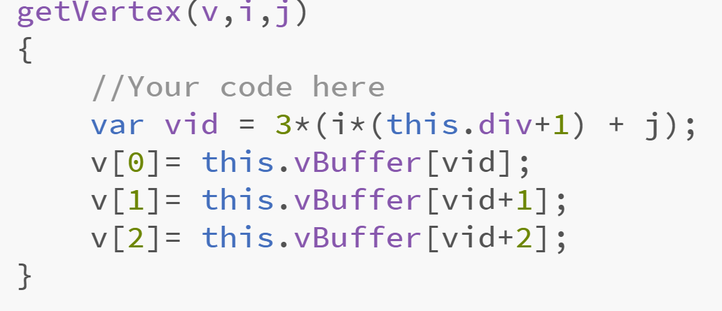
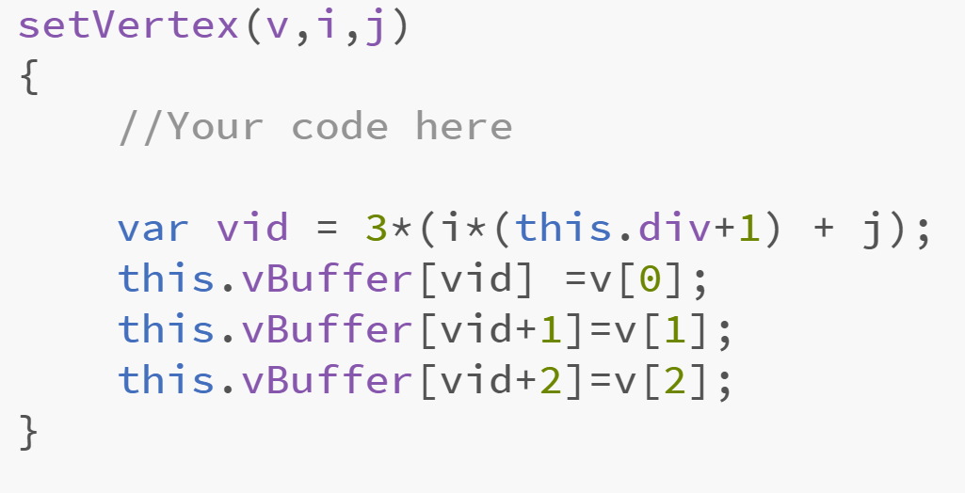
Lab Solution
One possible solution

Slide 12
