Slide 1

Subdivision Surfaces
CS 418: Interactive Computer Graphics
UNIVERSITY OF ILLINOIS AT URBANA-CHAMPAIGN
Some material courtesy Stanford University
Eric Shaffer

Slide 2
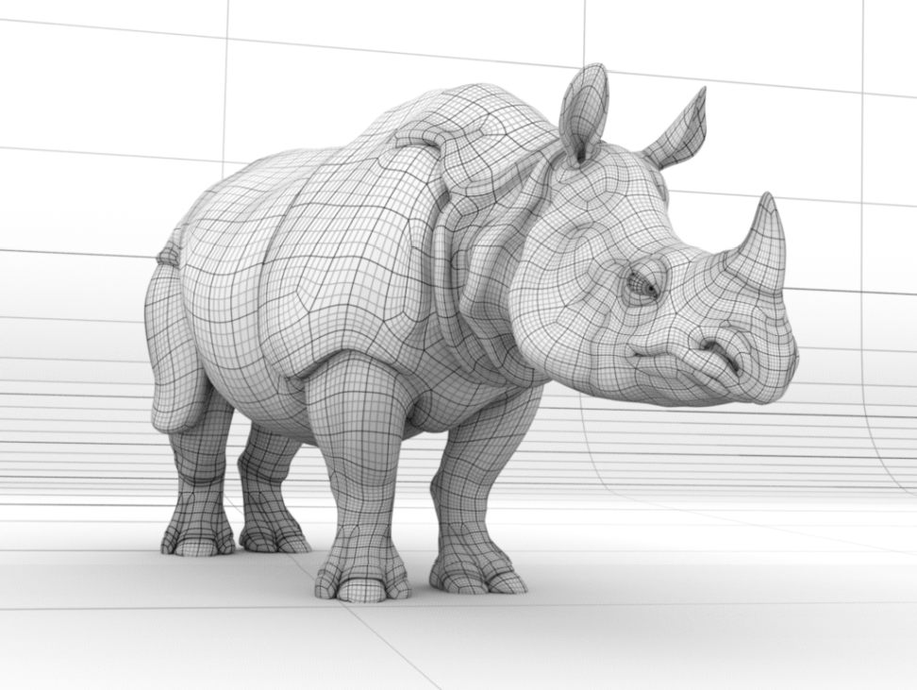
Subdivision Surfaces
2

Slide 3
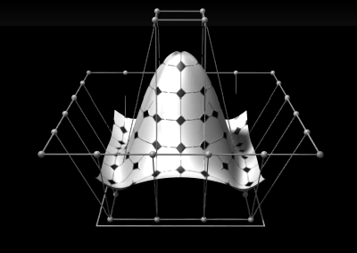
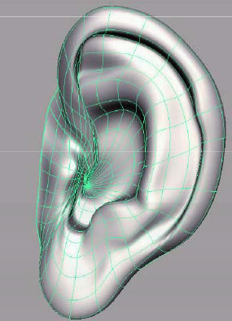
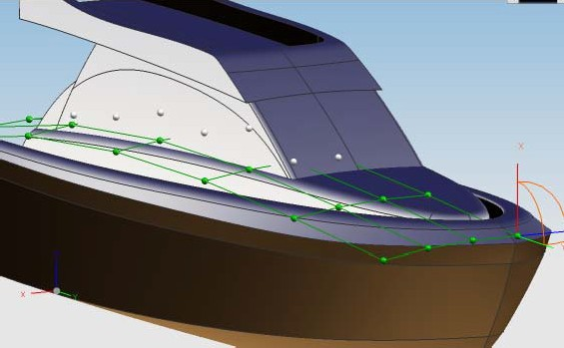
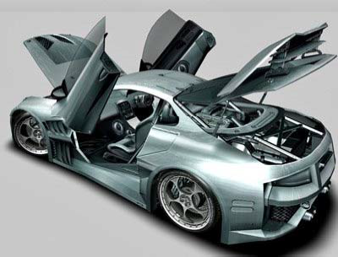
Geometric Modeling
Sometimes need more than polygon meshes
Smooth surfaces
Traditional geometric modeling used NURBS
Non uniform rational B-Spline
3

Slide 4
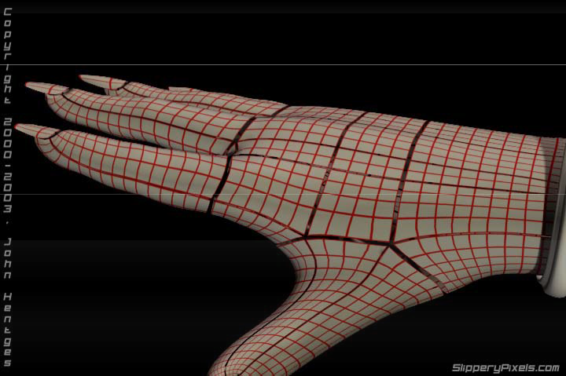
Problems with NURBS
A single NURBS patch is either a topological disk, a tube or a torus
Must use many NURBS patches to model complex geometry
When deforming a surface made of NURBS patches, cracks arise at the seams
4

Slide 5
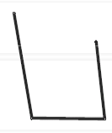
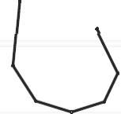
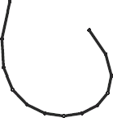
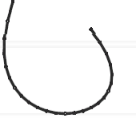
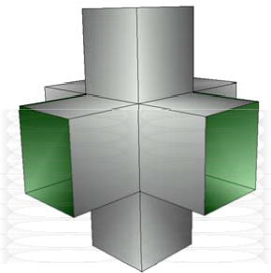
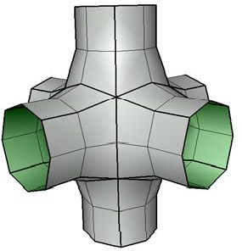
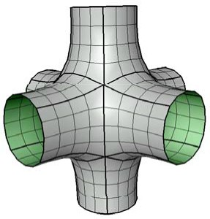
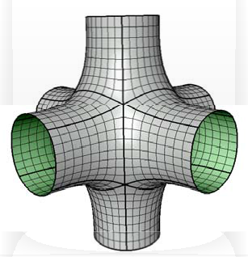
Subdivision
“Subdivision defines a smooth curve or surface as the limit of a sequence of successive refinements”
5

Slide 6
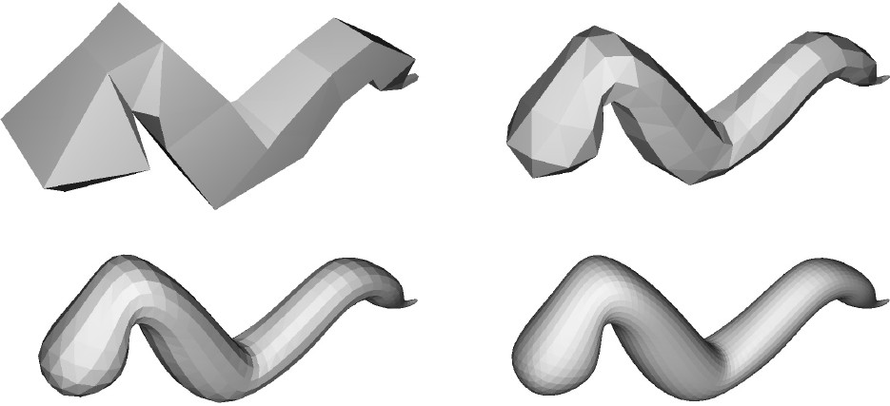
Subdivision

Slide 7
Subdivision Surfaces
Generalization of spline curves / surfaces
Arbitrary control meshes
Successive refinement (subdivision)
Converges to smooth limit surface
Connection between splines and meshes

Slide 8
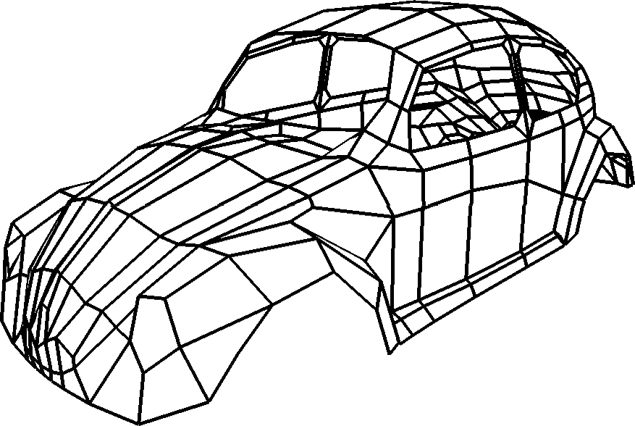
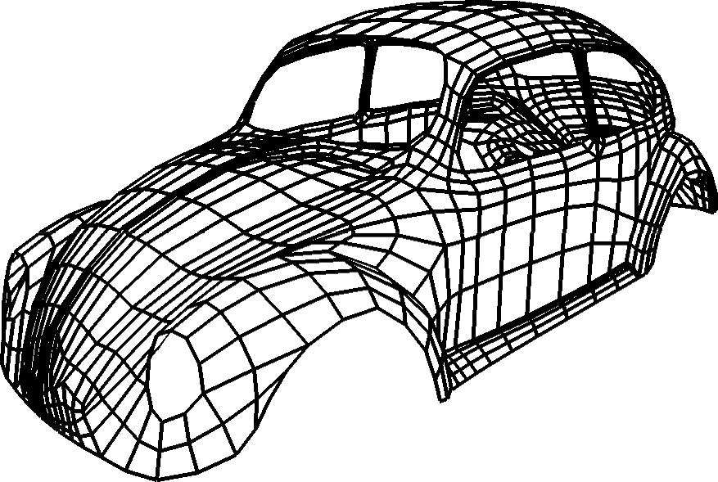
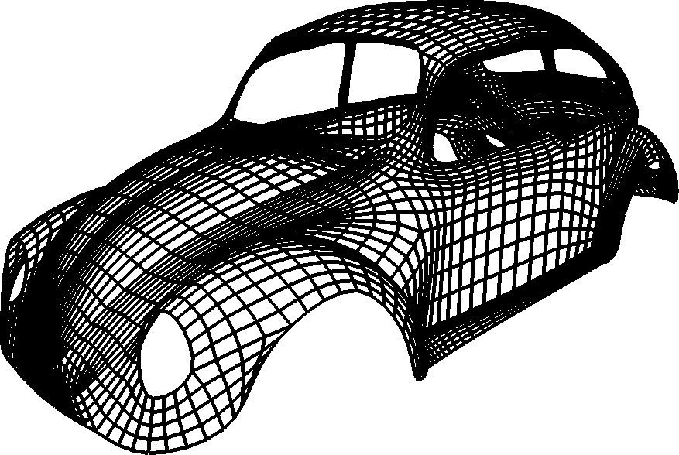
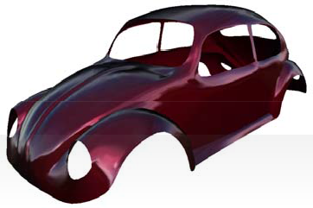
Subdivision Surfaces
Generalization of spline curves / surfaces
Arbitrary control meshes
Successive refinement (subdivision)
Converges to smooth limit surface
Connection between splines and meshes

Slide 9

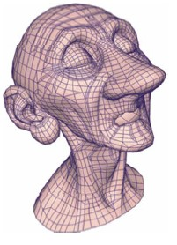
Example: Geri’s Game (Pixar 1997)
Subdivision used for
Geri’s hands and head
Clothing
Tie and shoes

Slide 10
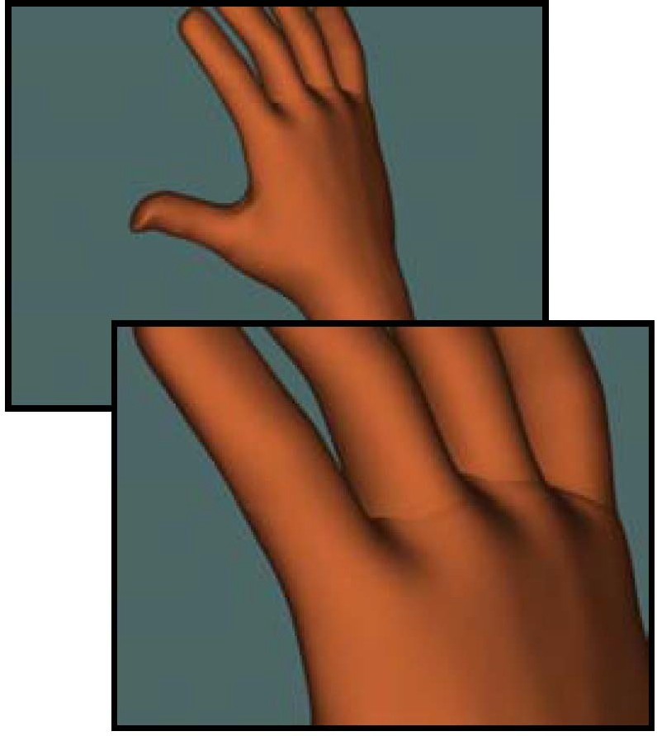
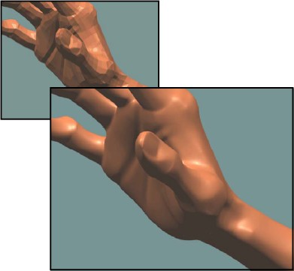
Example: Geri’s Game (Pixar)
Woody’s hand (NURBS)
Geri’s hand (subdivision)

Slide 11

Example: Geri’s Game
(Pixar)
Sharp and semi-sharp features

Slide 12






Subdivision Curves
Given a control polygon...
...find a smooth curve related to that polygon.

Slide 13






Subdivision Curve Types
Approximating
Interpolating

Slide 14
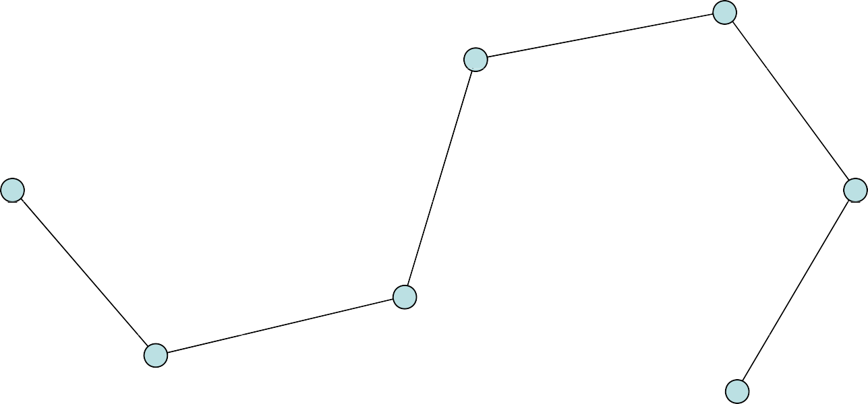
Approximating

Slide 15
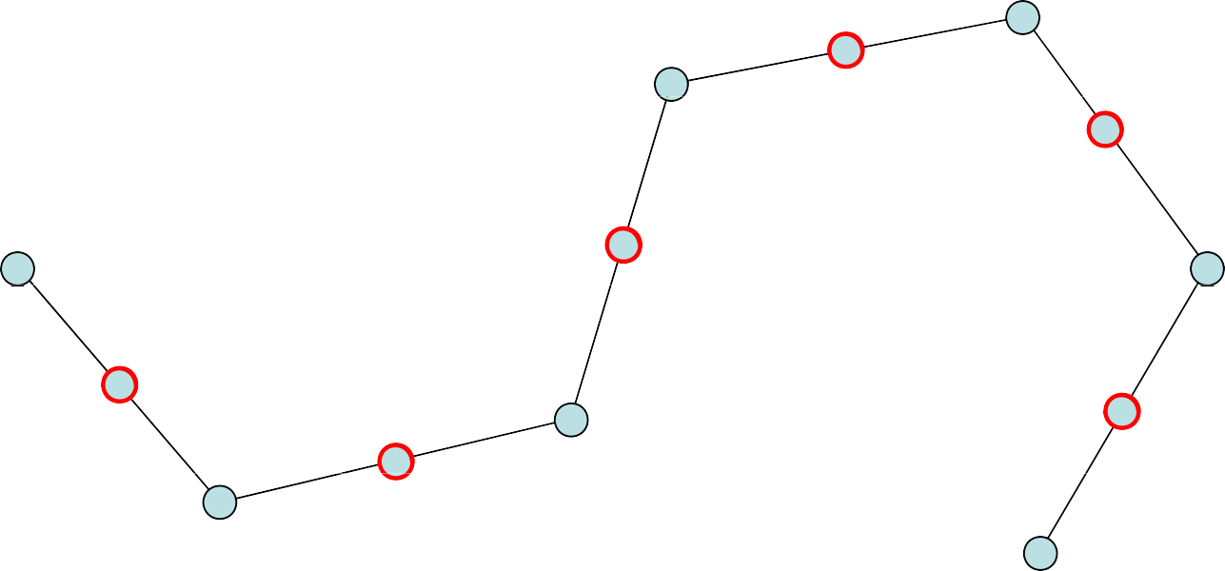
Approximating
Splitting step: split each edge in two

Slide 16
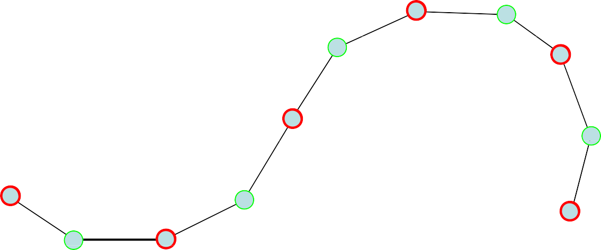
Approximating
Averaging step: relocate each (original) vertex according to some (simple) rule...

Slide 17
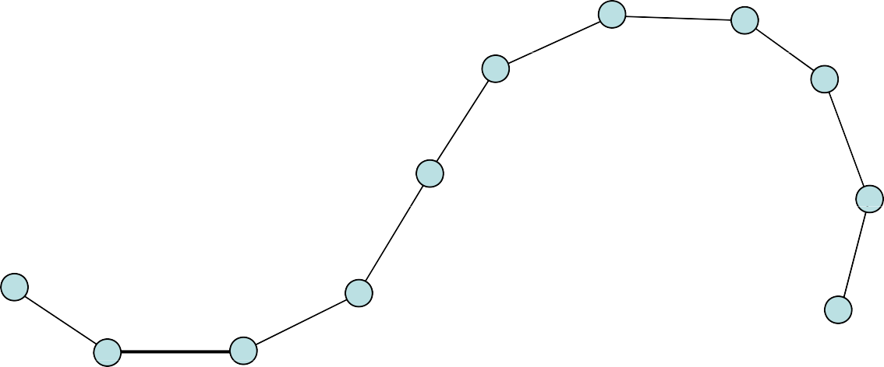
Approximating
Start over ...

Slide 18
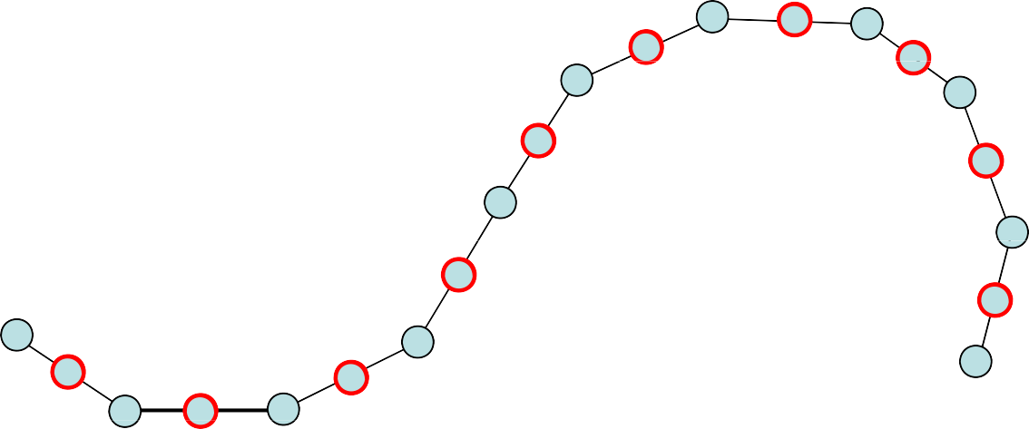
Approximating
...splitting...

Slide 19
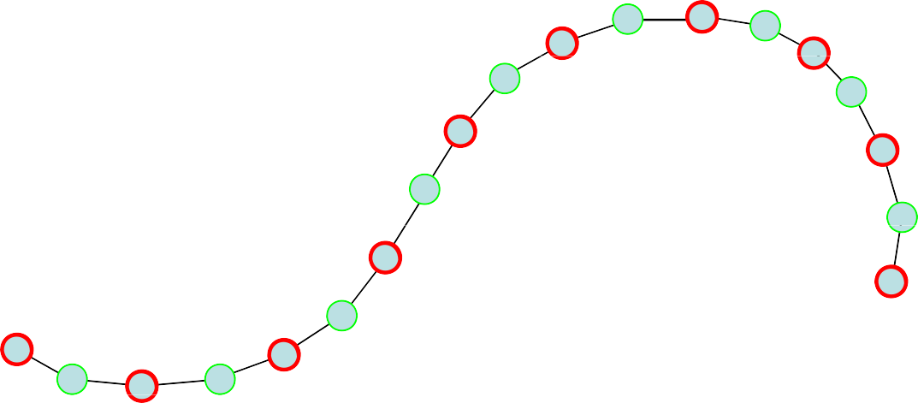
Approximating
...averaging...

Slide 20
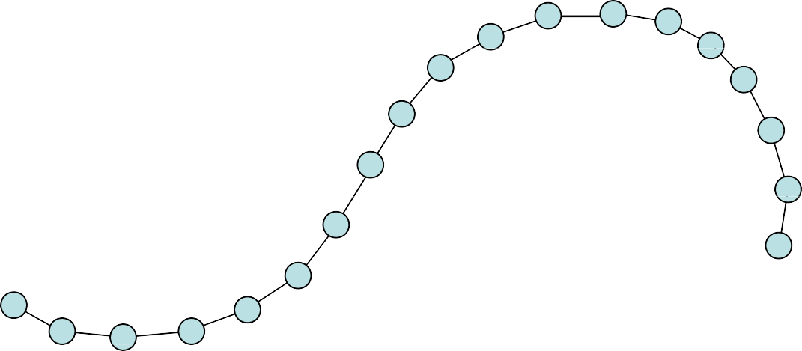
Approximating
...and so on...

Slide 21

Approximating
If the rule is designed carefully...
... the control polygons will converge to a smooth limit curve!

Slide 22
Equivalent to …
Insert single new point at mid-edge
Filter entire set of points.

Slide 23
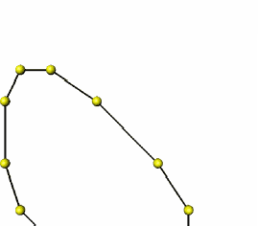
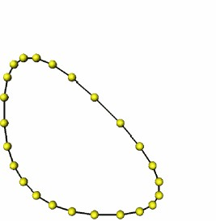
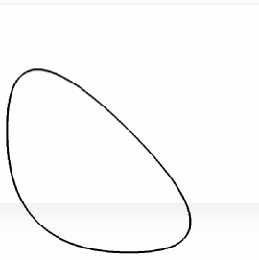

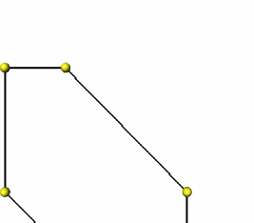
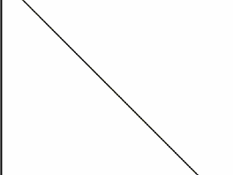
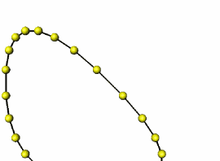



Corner Cutting
Subdivision rule:
Insert two new vertices at ¼ and ¾ of each edge
Remove the old vertices
Connect the new vertices
In the limit, generates a curve called a quadratic B-Spline

Slide 24
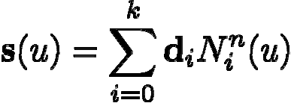

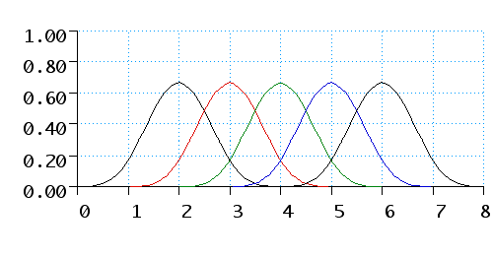
B-Spline Curves
Piecewise polynomial of degree n
B-spline curve control points
parameter value
basis functions

Slide 25













Cubic B-Spline
even
odd

Slide 26











Cubic B-Spline
odd
even

Slide 27
Cubic B-Spline
odd
even

Slide 28



Cubic B-Spline
odd
even

Slide 29

Cubic B-Spline
odd
even

Slide 30


Cubic B-Spline
odd
even

Slide 31

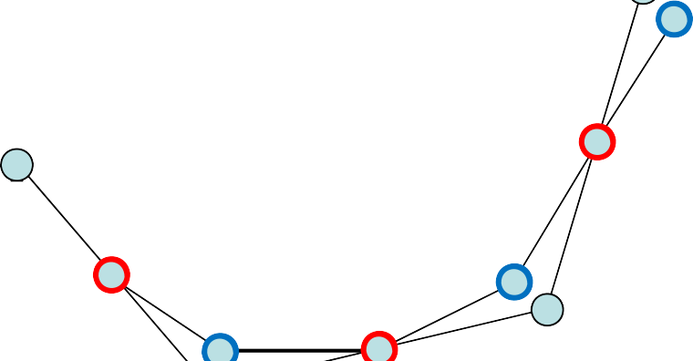

Cubic B-Spline
odd
even

Slide 32



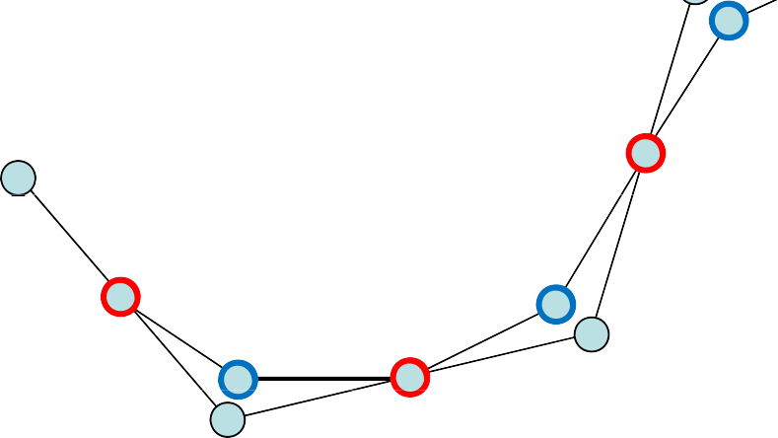
Cubic B-Spline
odd
even

Slide 33




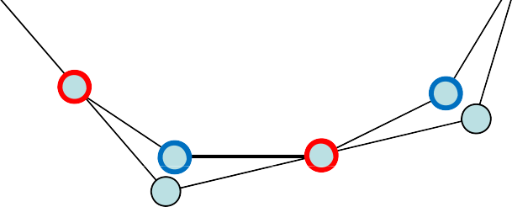
Cubic B-Spline
odd
even

Slide 34


Cubic B-Spline
odd
even

Slide 35



Cubic B-Spline
odd
even

Slide 36


Cubic B-Spline
odd
even

Slide 37
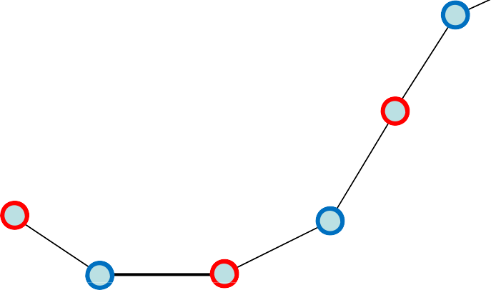
Cubic B-Spline
odd
even

Slide 38


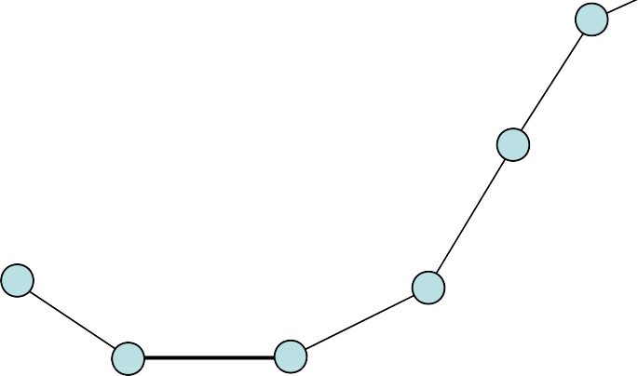


Cubic B-Spline
odd
even

Slide 39
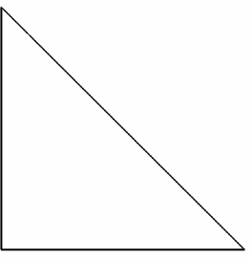
B-Spline Curves
Distinguish between odd and even points
Linear B-spline
Odd coefficients (1/2, 1/2)
Even coefficient (1)

Slide 40
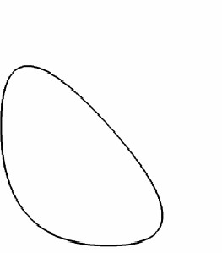

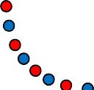

B-Spline Curves
Quadratic B-Spline (Chaikin)
Odd coefficients (¼, ¾)
Even coefficients (¾ , ¼)
Cubic B-Spline (Catmull-Clark)
Odd coefficients (4/8, 4/8)
Even coefficients (1/8, 6/8, 1/8)

Slide 41
B-Spline Curves
Subdivision rules for control polygon
Mask of size n yields C^{n-1} curve

Slide 42
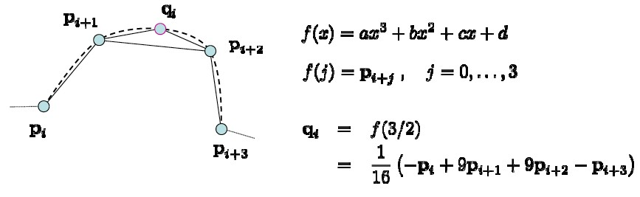
Interpolating (4-point Scheme)
Keep old vertices
Generate new vertices by fitting cubic curve to old vertices
C¹ continuous limit curve

Slide 43
Interpolating

Slide 44
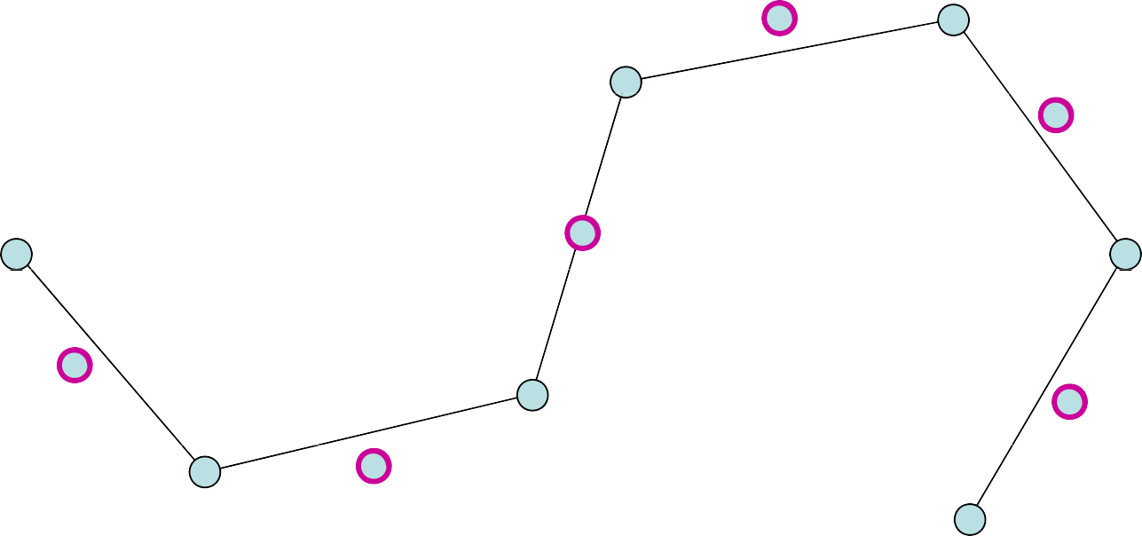
Interpolating

Slide 45
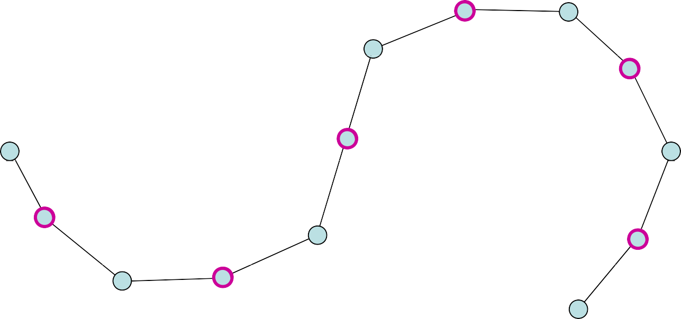
Interpolating

Slide 46
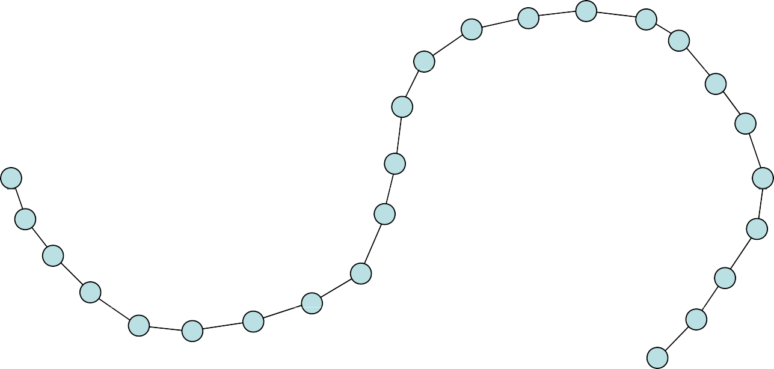
Interpolating

Slide 47
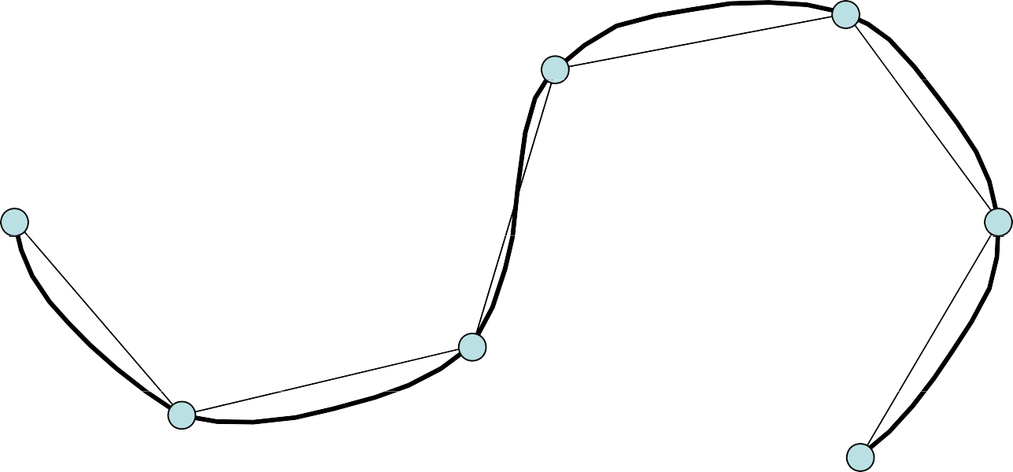
Interpolating

Slide 48

Subdivision Surfaces
No regular structure as for curves
Arbitrary number of edge-neighbors
Different subdivision rules for each valence

Slide 49

Subdivision Rules
How the connectivity changes
How the geometry changes
Old points
New points

Slide 50
Subdivision Zoo
Classification of subdivision schemes
Primal | Faces are split into sub-faces
Dual | Vertices are split into multiple vertices
Approximating | Control points are not interpolated
Interpolating | Control points are interpolated

Slide 51

Subdivision Zoo
Classification of subdivision schemes

Slide 52

Subdivision Zoo
Classification of subdivision schemes

Slide 53
Catmull-Clark Subdivision
Generalization of bi-cubic B-Splines
Primal, approximation subdivision scheme
Applied to polygonal meshes
Generates G² continuous limit surfaces:
C¹ for the set of finite extraordinary points
Vertices with valence ≠ 4
C² continuous everywhere else

Slide 54
Catmull Clark Subdivision
NOTE: valence = number of neighboring vertices
First subdivision generates quad mesh
Some vertices extraordinary (valence ≠ 4)
Rules
Face vertex = average of face’s vertices
Edge vertex = average of edge’s two vertices & adjacent face’s two vertices
New vertex position = (1/valence) x sum of…
Average of neighboring face points
2 x average of neighboring edge points
(valence – 3) x original vertex position Boundary edge points set to edge midpoints Boundary vertices stay put

Slide 55

Catmull-Clark Subdivision

Slide 56
Catmull Clark Subdivision

Slide 57

Catmull-Clark Subdivision

Slide 58

Catmull-Clark Subdivision

Slide 59

Comparison

Slide 60

Comparison
Subdividing a cube
Loop result is assymetric, because cube was triangulated first
Both Loop and Catmull-Clark are better then Butterfly (C² vs. C¹ )
Interpolation vs. smoothness

Slide 61

Comparison
Subdividing a tetrahedron
Same insights
Severe shrinking for approximating schemes

Slide 62

So Who Wins?
Loop and Catmull-Clark best when interpolation is not required
Loop best for triangular meshes
Catmull-Clark best for quad meshes
– Don’t triangulate and then use Catmull-Clark

