Slide 1

Environment Mapping
CS 418: Interactive Computer Graphics
UNIVERSITY OF ILLINOIS AT URBANA-CHAMPAIGN
Eric Shaffer

Slide 2
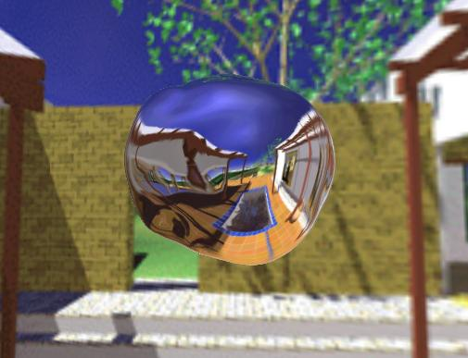
Environment Mapping
How can we render reflections with a rasterization engine?
When shading a fragment, usually don’t know other scene geometry
Answer: use texture mapping….
Create a texture of the environment
Map it onto mirror object surface
Any suggestions how generate (u,v)?

Slide 3
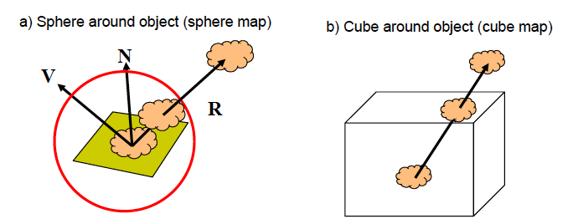
Types of Environment Maps

Slide 4
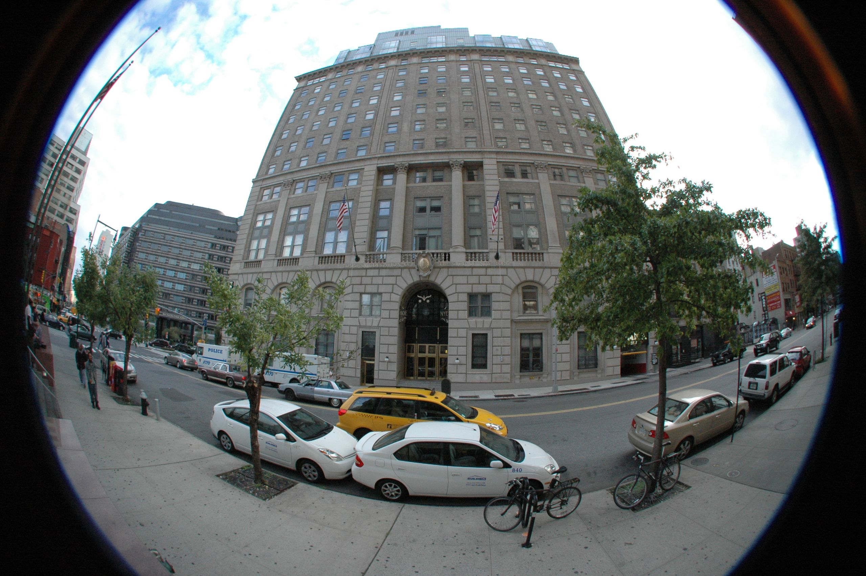
Sphere Mapping
Classic technique…
Not supported by WebGL
OpenGL supports sphere mapping
Requires a “circular” texture map
Equivalent to an image taken with a fisheye lens

Slide 5
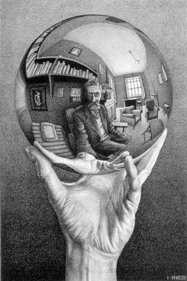
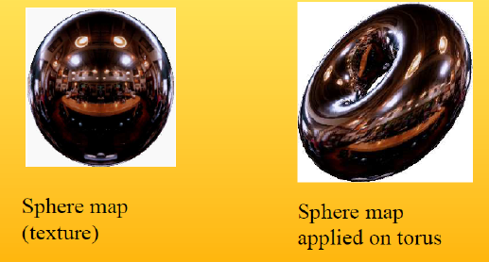
Sphere Mapping Example

Slide 6
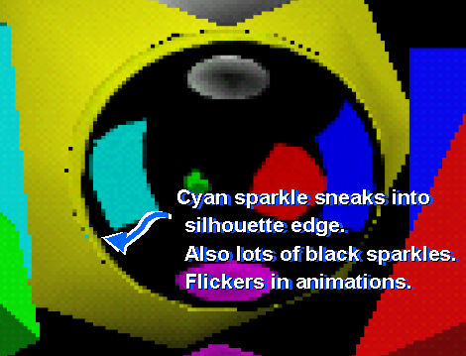
Sphere Mapping Limitations
Visual artifacts are common
Sphere mapping is view dependent
Acquisition of images non-trivial
Need fisheye lens
Or render from fisheye lens
Cube maps are easier to acquire

Slide 7
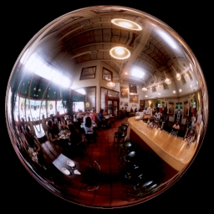
Acquiring a Sphere Map….
Take a picture of a shiny sphere in a real environment
Or render the environment into a texture (see next slide)

Slide 8
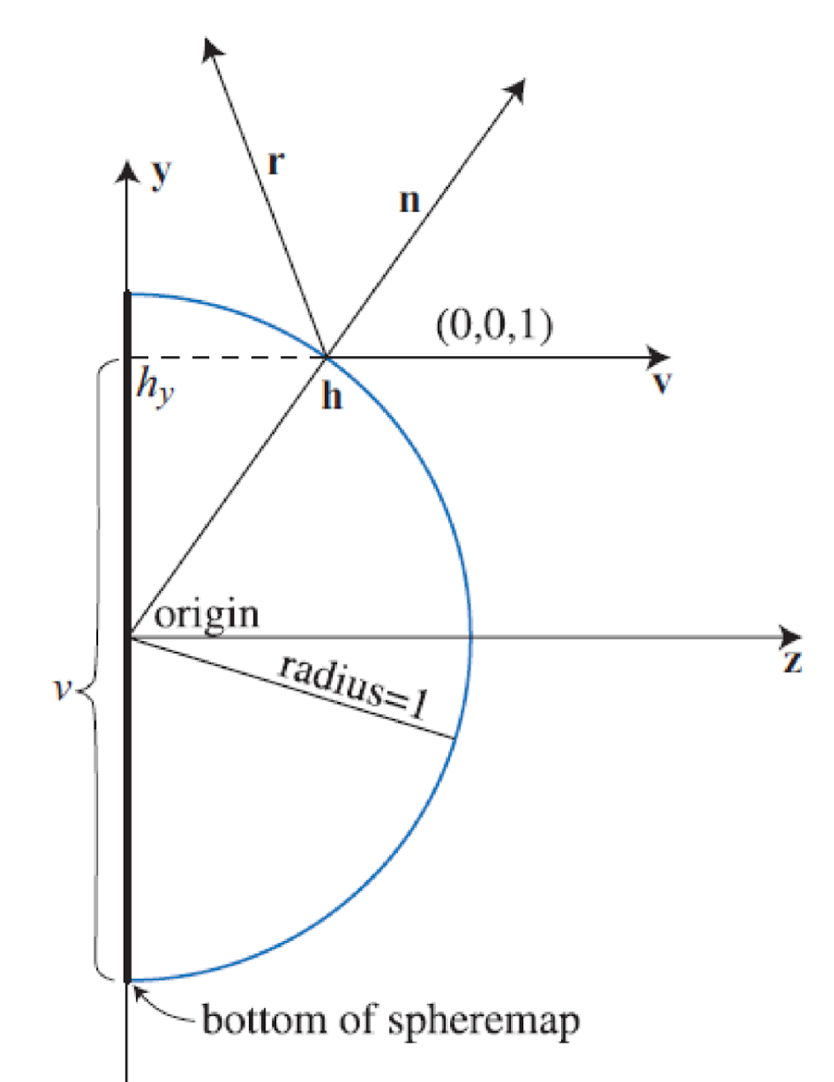
Why View Dependent?
Conceptually a sphere map is generated like ray-tracing
Records reflection under orthographic projection
From a given view direction
What is a drawback of this?

Slide 9
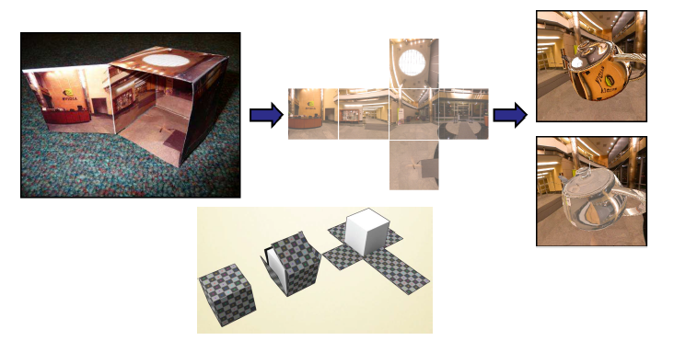
Cube Map
Cube mapping takes a different approach….
Imagine an object is in a box…and you can see the environment through that box

Slide 10
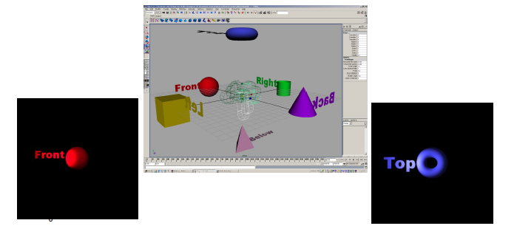
Forming a Cube Map
A cube map requires 6 images
Each covers a 90 degree angle from the center of the cube

Slide 11
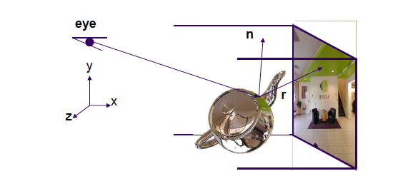
Index using the Reflection Vector

Slide 12
How Does WebGL Index into Cube Map?
To access the cube map you compute R = 2(N·V)N-V
Then, in your shader
How does WebGL compute the index?
Assume object at origin
Largest magnitude component of R determines face of cube
Other two components give texture coordinates
vec4 texColor = textureCube(texMap, R);
V
R

Slide 13
Indexing into a Cube Map
void convert_xyz_to_cube_uv(float x, float y, float z, int *index, float *u, float *v)
{
float absX = fabs(x);
float absY = fabs(y);
float absZ = fabs(z);
int isXPositive = x > 0 ? 1 : 0;
…
float maxAxis, uc, vc;
// POSITIVE X
if (isXPositive && absX >= absY && absX >= absZ) {
// u (0 to 1) goes from +z to -z
// v (0 to 1) goes from -y to +y
maxAxis = absX;
uc = -z;
vc = y;
*index = 0;
}
… // Convert range from -1 to 1 to 0 to 1
*u = 0.5f * (uc / maxAxis + 1.0f);
*v = 0.5f * (vc / maxAxis + 1.0f);
}

Slide 14
Example
R= (-4,3,-1)
Normalize so max value has magnitude of 1 R=(-1, ¾ , - ¼ )
Remap texture coordinates…x,y,z are in [-1,1]
Need them on [0,1]
v = ½ + ½ x ¾ = 0.875
u = ½ + ½ x -¼ = 0.375
Use face x = -1
Texture coordinates of (u,v) = (0.375, 0.875)

Slide 15
WebGL Implementation
WebGL supports only cube maps
vec4 texColor = textureCube(mycube, texcoord);
desktop OpenGL also supports sphere maps
First must form map
Use images from a real camera
Form images with WebGL
Texture map it to object

Slide 16
Vertex Shader
varying vec3 R;
attribute vec4 vPosition;
attribute vec4 vNormal;
uniform mat4 modelViewMatrix;
uniform mat4 projectionMatrix;
void main(){
//…other code
gl_Position = projectionMatrix*ModelViewMatrix*vPosition;
vec4 eyePos = ModelViewMatrix*vPosition;
vec4 N = ModelViewMatrix*vNormal;
R = reflect(eyePos.xyz, N.xyz); }

Slide 17
Fragment Shader
precision mediump float;
varying vec3 R;
uniform samplerCube texMap;
void main()
{
vec4 texColor = textureCube(texMap, R);
gl_FragColor = texColor;
}

Slide 18
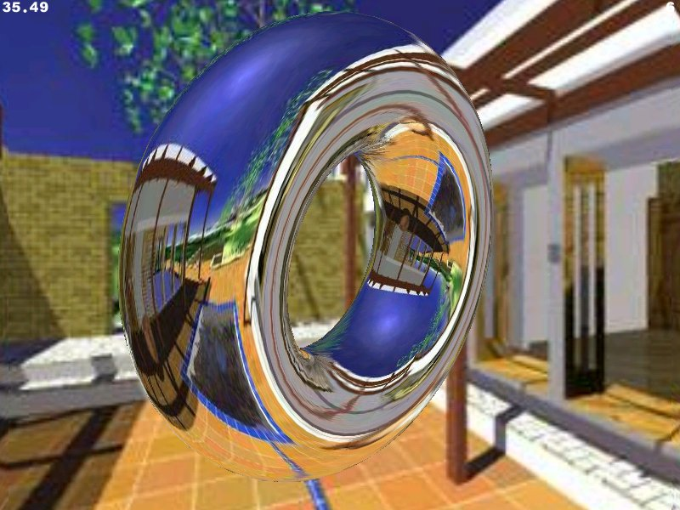
Limitations
What do you not see here that you should?

Slide 19
Issues
Assumes environment is very far from object
(equivalent to the difference between near and distant lights)
Object cannot be concave (no self reflections possible)
No reflections between objects

Slide 20
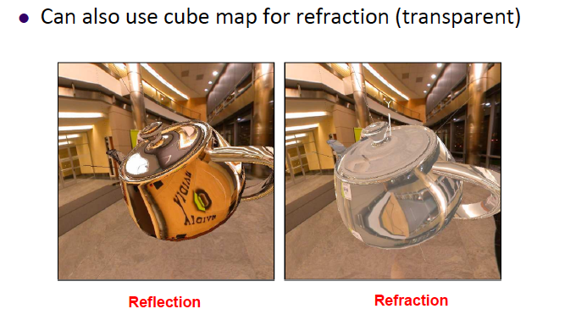
Refraction

Slide 21
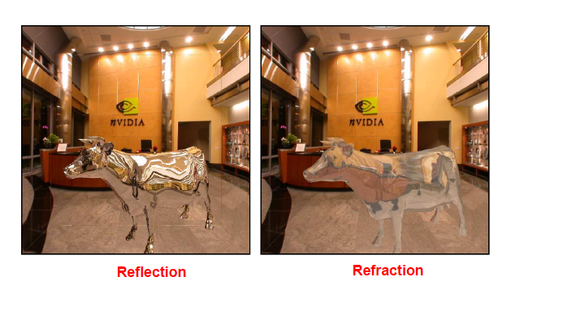
Refraction

Slide 22
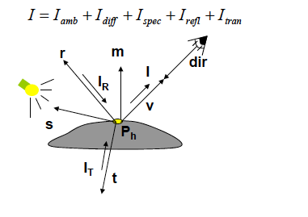
Need to Compute Refraction Vector

Slide 23
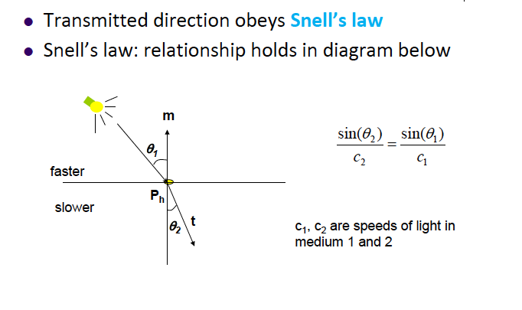
Snell’s Law

Slide 24
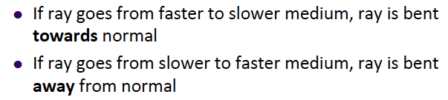
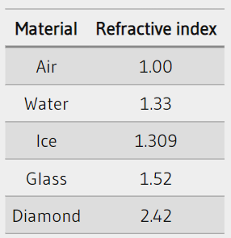
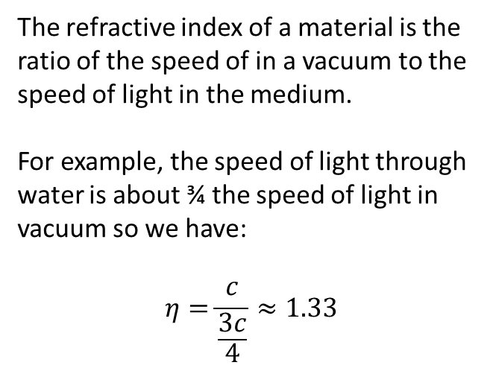
Medium is Important
In GLSL, the refract function expects the index of refraction to be specified as c1/c2 where:
C1 is the index of the outside medium
C2 is the index of the inside medium
So, to go from air to water you would call:
T=refract(V,N, 1.00/1.33)
The refractive index of a material is the ratio of the speed of in a vacuum to the speed of light in the medium. For example, the speed of light through water is about ¾ the speed of light in vacuum so we have: $$η=\frac{c}{\frac{3c}{4}}≈1.33$$

Slide 25
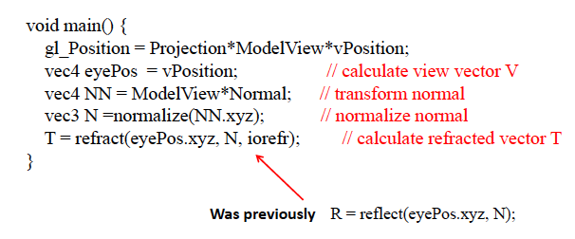
Refraction Vertex Shader
T is a varying….
Also eyePos.xyz needs to be the normalized view direction

Slide 26
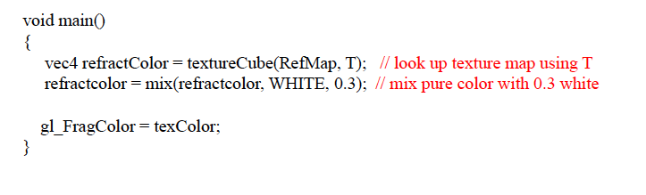
Refraction Fragment Shader
T is a varying….
RefMap is a uniform

Slide 27
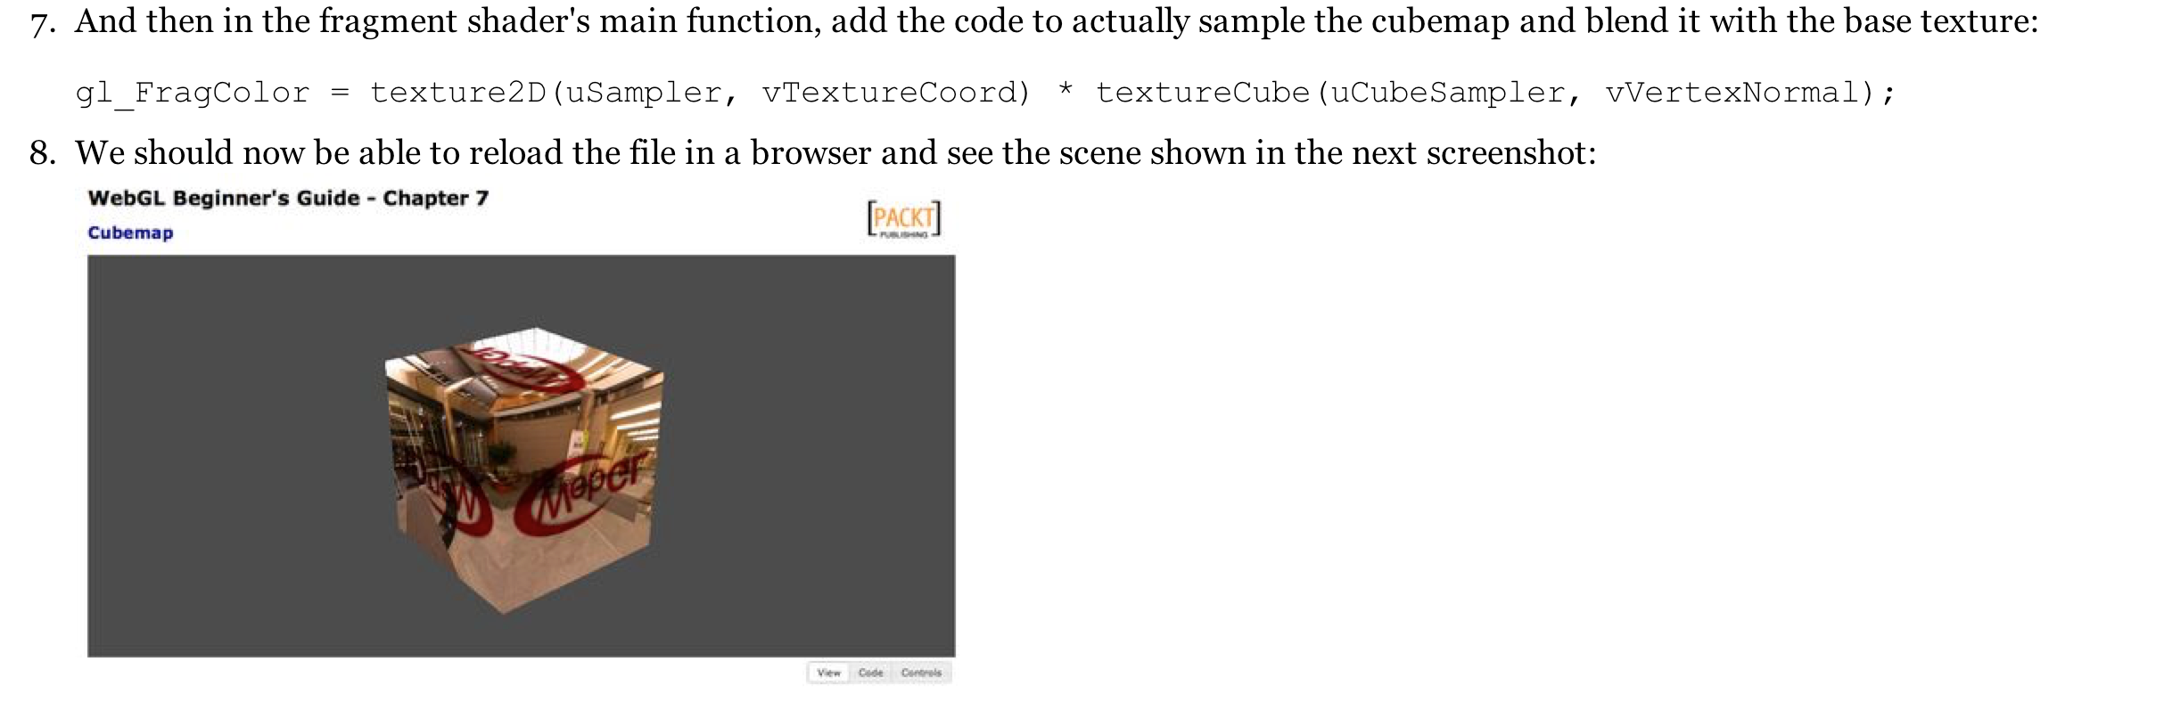
What’s Wrong with this Code?
From an actual published book…which has some good stuff in it:

