Slide 1

A Simple Physics Engine
CS 418: Interactive Computer Graphics
UNIVERSITY OF ILLINOIS AT URBANA-CHAMPAIGN
Eric Shaffer

Slide 2
Newtonian Physics
We will animate particles (aka point masses)
Position is changed by velocity
Velocity is changed by acceleration
Forces alter acceleration
Our physics engine will integrate to compute
Position
Velocity
We set the acceleration by applying forces

Slide 3
Force and Mass and Acceleration
How do we update acceleration when force is applied?
To find the acceleration due to a force we have
So we need to know the inverse mass of the particle
You can model infinite mass objects by setting this value to 0
For the MP, you can use a uniform mass of 1
Or make the masses different if you want…

Slide 4
Force: Gravity
Law of Universal Gravitation
G is a universal constant
m_{i} is the mass of an object
r is the distance between object centers
if we care only about gravity of the Earth
m1 and r are constants
r is about 6400 km on Earth
We simplify to f = mg
g is about 10ms⁻²

Slide 5
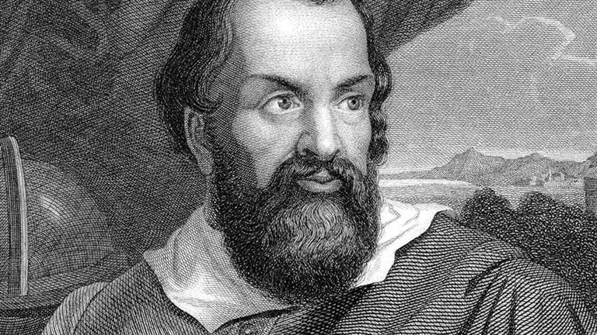
Acceleration due to Gravity
If we consider acceleration due to gravity we have
So acceleration due to gravity is independent of mass

Slide 6
Acceleration due to Gravity
In your MP the magnitude and direction of acceleration would be
For gaming, 10ms⁻² tends to look boring
Shooters often use 15ms⁻²
Driving games often use 20ms⁻²
Some tune g object-by-object

Slide 7
Force: Drag
Drag dampens velocity
Caused by friction with the medium the object moves through
Even neglecting drag, you need to dampen velocity
Otherwise numerical errors likely drive it higher than it should be
A velocity update with drag can be implemented as
important to incorporate time so drag changes if the frame rate varies
for the MP, have all objects have the same drag, calculate once per frame
What range should d be in?

Slide 8
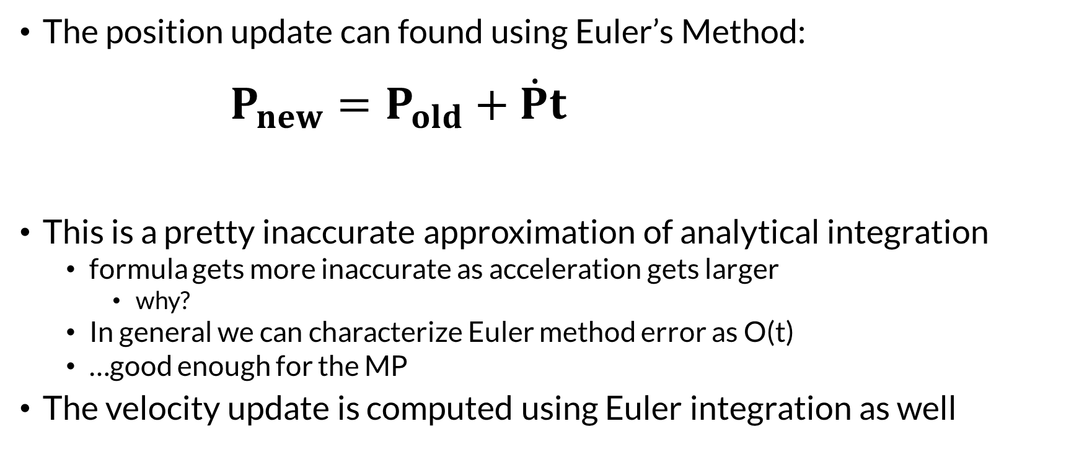
The Integrator
The position update can found using Euler’s Method: $P_{new}=P_{old}+\dot{P}t$
This is a pretty inaccurate approximation of analytical integration
formula gets more inaccurate as acceleration gets larger
why?
In general we can characterize Euler method error as O(t)
…good enough for the MP
The velocity update is computed using Euler integration as well

Slide 9
The Integrator
You should ideally use actual time for t
or some scaled version of it
In JavaScript, Date.now() returns current time in ms
so keep a previous time variable
each frame find out how much time has elapsesd
…or you could use some uniform timestep you like

Slide 10
Collision Detection
Surprisingly complex topic
Even a high-quality engine like Unity has issues
We will discuss how to simulate only two types of collision
Sphere-Wall
Sphere-Sphere
We check for a collision when updating position
If a collision occurs the velocity vector is altered
Position is determined by the contact
Position and velocity update are completed with new values
over the remaining time

Slide 11
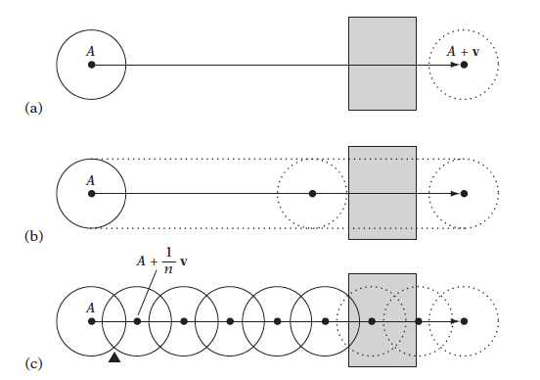
Dynamic Collision Detection
Dynamic collision tests an exhibit tunneling
if only the final positions of the objects are tested (a)
Or even if the paths of the objects are sampled (c)
A sweep test assures detection
….may not be computationally feasible.

Slide 12
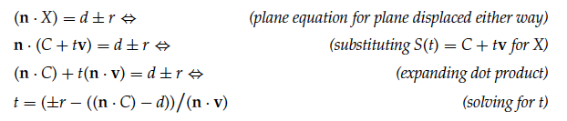
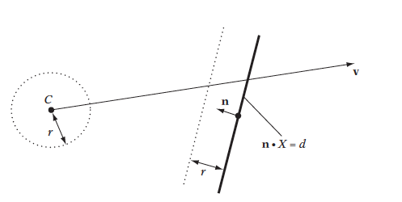

Sphere-Plane Collision
Why is it $±r$ ?
Can make it even simpler for the box walls in MP. How?

Slide 13

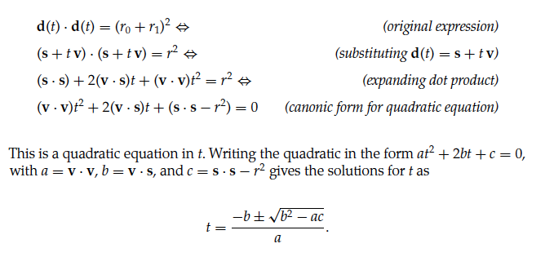
Sphere-Sphere Collision

Slide 14
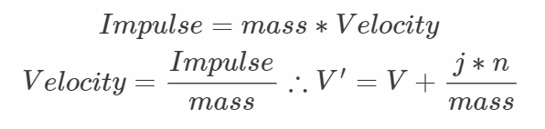
Resolving Particle-Particle Collisions
Simplest model of dynamic collision uses particles
particle is a mass located at a point
We need to compute an impulse that will be applied to both particles
An impulse is a change in momentum…we will use it to change velocity
V’ is the velocity of a particle after collision
j is the scalar magnitude of the impulse
n is a unit vector expressing the direction of the impulse…the contact normal
mass is the mass of the particle

Slide 15
The Contact (or Collision) Normal
The contact normal between two particles a and b is given by
This is a unit length vector derived from the difference in positions
This will be the direction of the separating velocity for Particle a
The separating velocity changes the velocity of Particle a

Slide 16
Separating Velocity
Need to compute the magnitude of the separating velocity
Collisions that preserve momentum are perfectly elastic
We will use v_{s_after} = -cv_{s}
C in [0,1] is the coefficient of restitution…a material property that you choose
The negative sign is a result of the collision flipping the direction
v_{c} is the closing velocity before collision…positive for objects closing in on each other
v_{s} is the separating velocity before collision…negative for objects closing in on each other

Slide 17

Separating Velocity
Still need to find the magnitude of the impulse for each particle…
Can solve for it:
$${(\dot{p}}_{a}^{′}−{\dot{p}}_{b}^{′})⋅n=−cv_{s}$$
…without going into details we can find the value j for the velocity updates
$${\dot{p}}_{a}^{′}={\dot{p}}_{a}+\frac{jn}{{mass}_{a}}$$
$${\dot{p}}_{b}^{′}={\dot{p}}_{b}−\frac{jn}{{mass}_{b}}$$
will be
$$j=\frac{−(1+c)(({\dot{p}}_{a}−{\dot{p}}_{a})⋅n)}{\frac{1}{{mass}_{a}}+\frac{1}{{mass}_{b}}}$$

Slide 18
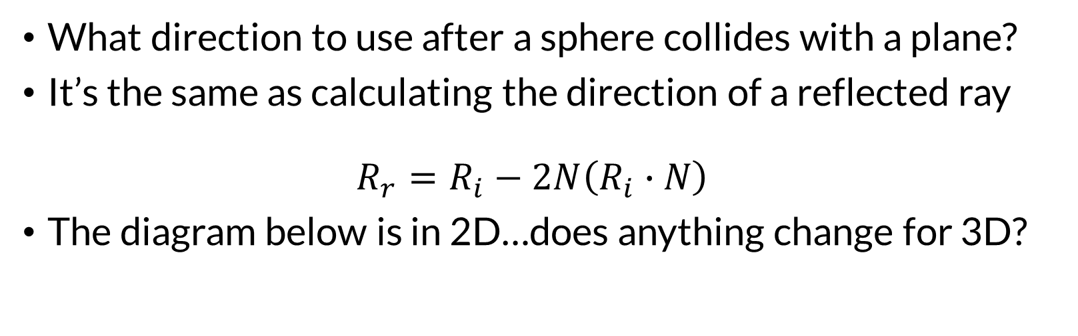
Resolving Particle-Wall Collisions
What direction to use after a sphere collides with a plane?
It’s the same as calculating the direction of a reflected ray $R_{r}=R_{i}−2N\left(R_{i}∙N\right)$
The diagram below is in 2D…does anything change for 3D?

Slide 19
General Collision Detection
Often requires use of bounding volumes or spatial data structures
Broad Phase: Uses bounding volumes to quickly determine which objects need to be checked closely for collision
Narrow Phase: Perform careful, expensive collision checks, such as triangle-triangle intersection for meshes

Slide 20
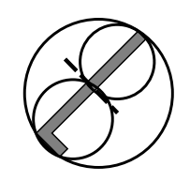
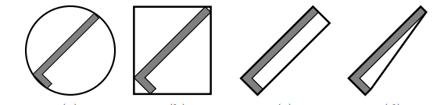
Bounding Volumes
Sphere AABB OOBB Convex Hull Hierarchical (BVH)
AABB=Axis Aligned Bounding Box
OOBB = Object-Oriented Bounding Box
BVH = Bounding Volume Hierarchy

Slide 21
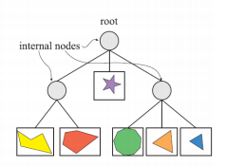
BVH Construction
Can be constructed top down:
Compute bounding volume enclosing all of the geometry
Split the geometry into two or more groups
Compute bounding volume for each group
Recurse
Leaf nodes will enclose only one geometric primitive
Can also be built by bottom up merging which offers better parallelism

Slide 22
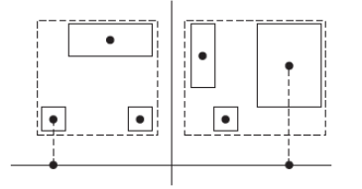
BVH: How to Split
Can compute a centroid for each geometric primitive
Split on median centroid, along longest axis
Split on average centroid, along longest axis
More sophisticated splitting criteria can be used
E.g. Surface Area Heuristic used on BVHs for ray-tracing

Slide 23
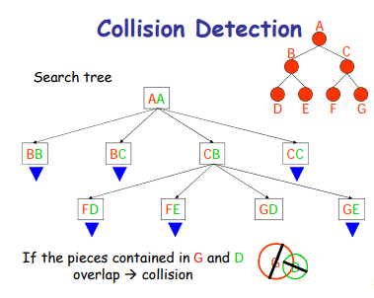
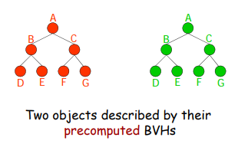
BVH: How to Collide
In a single BVH for scene
Two geometric primitives can overlap only if their volumes overlap
Or, BVHs can be used for each composite object (e.g. mesh)
A search tree is constructed that records descent into each BVH
Determines if any cells overlap

