Slide 1

Lab 4: Phong Shading
CS 418: Interactive Computer Graphics
UNIVERSITY OF ILLINOIS AT URBANA-CHAMPAIGN
Eric Shaffer

Slide 2
Phong Shading
Welcome to Lab 4!
Today you will implement Phong shading
This means the shading calculation is done in the fragment shader
For this lab, we will use the Phong reflectance model

Slide 3
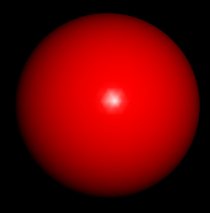

Gouraud Shading vs. Phong Shading

Slide 4
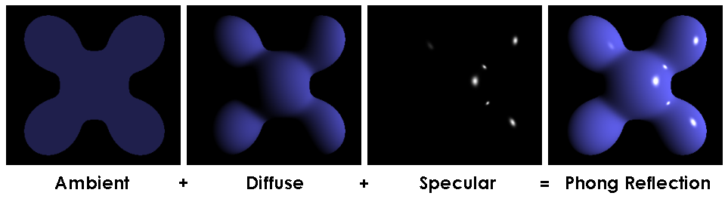
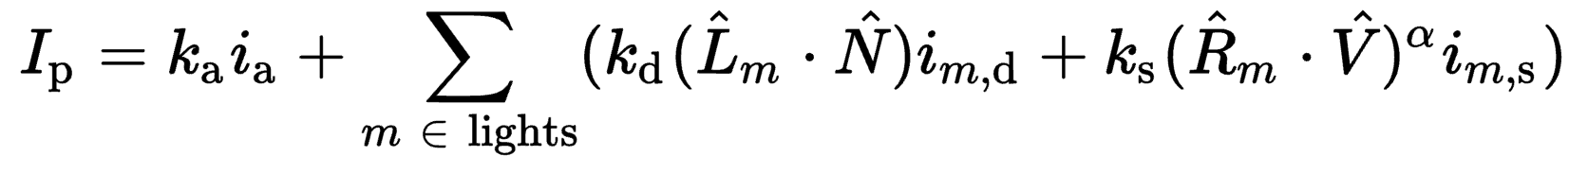
Phong Reflectance Model

Slide 5
What to do….
First, download the zip file Lab4.zip
Uncompress it
You should see 5 files…
You will add code to:
HelloPhong.html
You will look at:
HelloPhong.js

Slide 6
Complete the Phong Shader
In HelloPhong.html
Complete the vertex shader code
Implement shader-phong-phong-vs
Complete the fragment shader code
Implement shader-phong-phong-fs

Slide 7
More Specifically
You can use the existing shader code as a reference.
It implements Gouraud shading
The colors are computed per-vertex in the vertex shader
Sent to the Fragment Shader as varyings
And so interpolated across the fragments
You need to implement Phong shading
Compute gl_Position in the vertex shader like usual
Send the vertex normal and position to the fragment shader
Which means those vectors will be interpolated across fragments
Compute the color for the fragment
You’ll need to send the uniforms you need to fragment shader for this

Slide 8
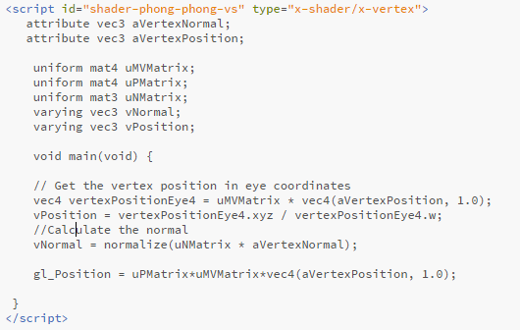
One More Hint…
Here’s the vertex shader you need to implement…code up a fragment shader to match….

Slide 9
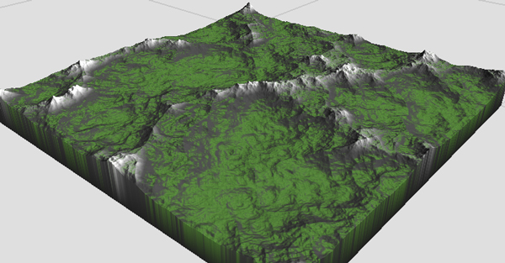
A Few Words about MP2
For MP 2 we are asking you to use the Blinn-Phong model
You’ll need to compute the H vector instead of R
Also, your material color should be based on height
You can compute it in the shader
Or you can compute it in a js file and pass it as an attribute

Slide 10
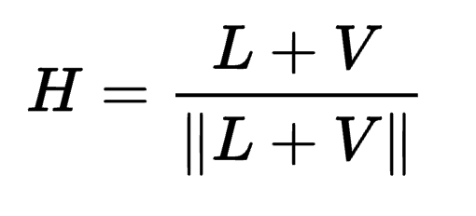
Blinn-Phong Reflectance Model
Jim Blinn suggested an approximating changing specular term
Replace (V · R )ª by (N · H )^{b} where
“Halfway vector”
More efficient in terms of the operations used
Closer to physically correct lighting
Pick exponent b to match what you want
Using higher b>a will make output similar to Phong with a

Slide 11

The Halfway Vector
H is normalized vector halfway between L and V
$$r=2(l⋅n)(n−l)$$

Slide 12
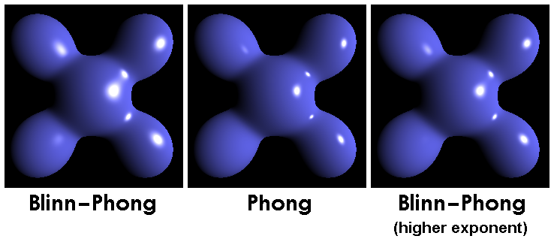
Phong versus Blinn-Phong

Slide 13
Some Final Questions….
What coordinate space is the shading calculation performed in?
Model?World?View?Clip?
You’ll notice that the light position is not transformed by the view transformation
In an animated scene, this could be a bug. Why?
In the js code, the shaders are recompiled and linked every time we switch shader programs.
How could we implement this more efficient?

