Slide 1

Simple Interaction with JavaScript
CS 418: Interactive Computer Graphics
UNIVERSITY OF ILLINOIS AT URBANA-CHAMPAIGN
Eric Shaffer

Slide 2
HTML Events
An HTML event can be
something the browser does
something a user does
Examples
an HTML web page has finished loading
an HTML input field was changed
an HTML button was clicked
user presses a keyboard key
user clicks a mouse button.
JavaScript lets you execute code when events are detected

Slide 3
on-event Handlers
•Legacy event handling
•Supported in virtually all browsers
•Simple…usually sufficient
•Specify event handlers aka JavaScript functions
In HTML
Or using DOM document in JavaScript
…this is better as you can change event handlers dynamically
Naming convention is onX where X is the event

Slide 4
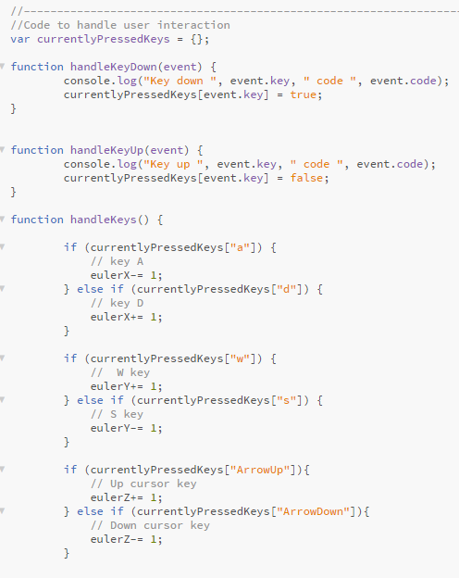
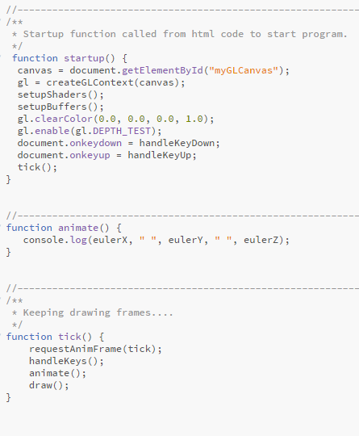
Example

Slide 5
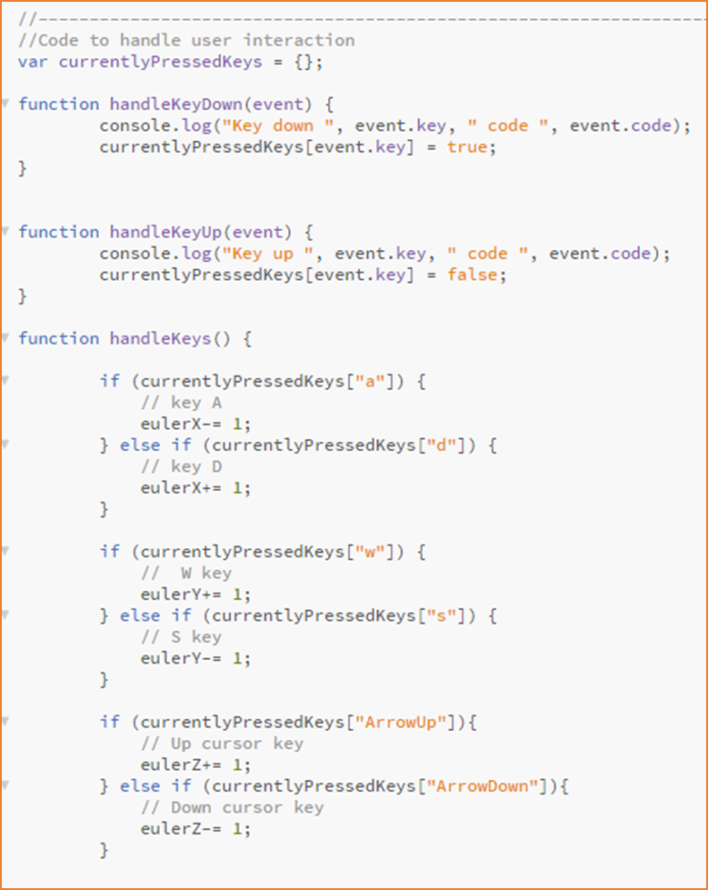
Key Events
keydown Physical key is pressed down
keyup Physical key has popped back up
event.key The character generated by the key event
event.code Name corresponding to location of key on keyboard (e.g. KeyQ). This property returns a value which isn't altered by keyboard layout or the state of the modifier keys.
https://developer.mozilla.org/en-US/docs/Web/API/KeyboardEvent/code

Slide 6
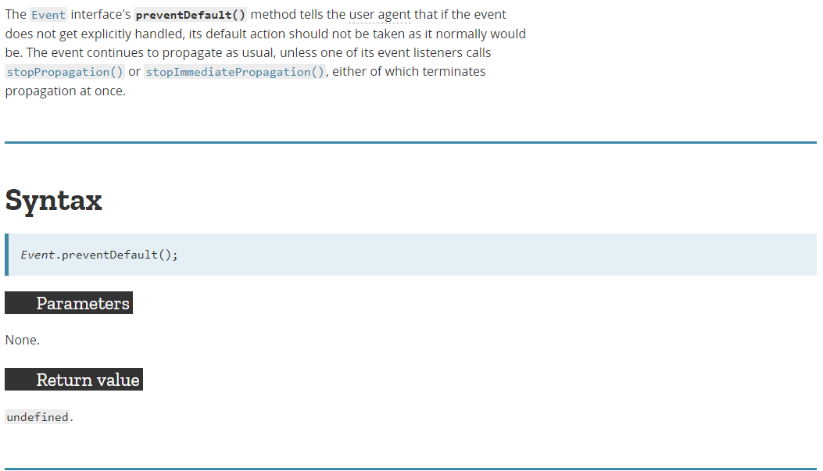
Stopping Default Actions
This can be used to stop page scrolling in response to the arrow keys

Slide 7
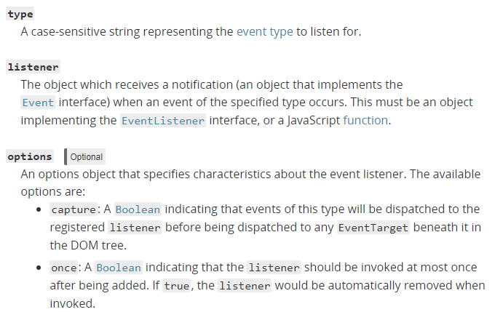
DOM Level 2 Event Handling
Uses addEventListener
target.addEventListener(type, listener[, options]);
Example: document.addEventListener('keydown’, handleKeyDown, false);
https://developer.mozilla.org/en-US/docs/Web/API/EventTarget/addEventListener

Slide 8
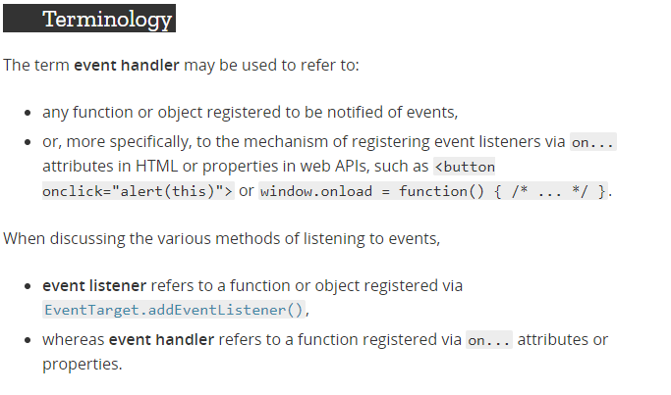
Handling and Listening

Slide 9
jQuery Event Handling
The jQuery library has it’s own event handling capabilities
Useful…it was more cross-platform than DOM Event Handling
However, most modern browsers handle events pretty uniformly now
So DOM event handling code you write should run everywhere
You can use jQuery if you wish to…

Slide 10
You Now Know Enough to Make This….
Developed by Tomohiro Nishikado and released in 1978

