Slide 1

Basic Animation
CS 418: Interactive Computer Graphics
UNIVERSITY OF ILLINOIS AT URBANA-CHAMPAIGN
Eric Shaffer

Slide 2
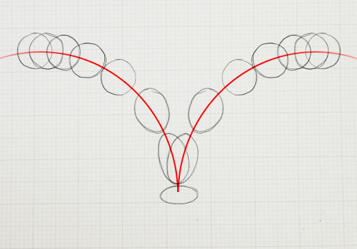
Simple Animation with WebGL
Animation means we:
Draw some things
Move the geometry slightly
Draw the things again
Repeat….
Things we will use:
glMatrix library for doing affine transformations of geometry http://glmatrix.net/
Code in a file called webgl-utils.js for some common tasks

Slide 3
Transforming Geometry in the Vertex Shader
<script id="shader-vs" type="x-shader/x-vertex">
attribute vec3 aVertexPosition;
attribute vec4 aVertexColor;
uniform mat4 uMVMatrix;
varying vec4 vColor;
void main(void) {
gl_Position =uMVMatrix*vec4(aVertexPosition, 1.0);
vColor = aVertexColor;
}
</script>
We can use the 3D transformations we’ve learned to alter geometry in the the vertex shader.
A Uniform variable is one that is the same for all the vertices being processed by the shader.
In the code at the left, we use Uniform 4x4 matrix to transform the coordinates of each vertex.

Slide 4
Getting the Transformation to the Shader
<script src="gl-matrix-min.js"></script> <script type="text/javascript" src="webgl-utils.js"></script>
var mvMatrix = mat4.create();
function setupShaders() { …
shaderProgram.mvMatrixUniform = gl.getUniformLocation(shaderProgram, "uMVMatrix");
}
function draw() {
…
mat4.identity(mvMatrix);
mat4.rotateX(mvMatrix, mvMatrix, degToRad(rotAngle));
gl.uniformMatrix4fv(shaderProgram.mvMatrixUniform, false, mvMatrix);
gl.drawArrays(gl.TRIANGLES, 0, vertexPositionBuffer.numberOfItems);
}
We will use the glMatrix library for vector and matrix math inside JavaScript code.
There are several steps to using the library and to create a matrix to be sent to the shader.
Include the library in the HTML file using <script> tags
We create a matrix
When we initialize the shader, we get a handle for the Uniform matrix in the shader
In the draw() function, we create a transformation and use the handle to send it to the shader

Slide 5
Requesting an Animation Frame
function startup() {
canvas = document.getElementById("myGLCanvas");
gl = createGLContext(canvas);
setupShaders();
setupBuffers();
gl.clearColor(0.0, 0.0, 0.0, 1.0);
gl.enable(gl.DEPTH_TEST);
tick(); }
function tick() {
requestAnimFrame(tick);
draw();
animate(); }
requestAnimFrame is a function in webgl-utils.js
tells the broswer you want to animate and gives it a function to call before the the next repaint.
The number of callbacks is usually 60 times per second, but will generally match the display refresh rate.

Slide 6
Request Animation Frame
requestAnimFrame is a wrapper function that tries to hide differences between platforms
Solves a problem from years ago…now you can probably just call requestAnimationFrame(callback)
See https://developer.mozilla.org/en-US/docs/Web/API/window/requestAnimationFrame

Slide 7
Animation
function animate() {
var timeNow = new Date().getTime();
if (lastTime != 0) {
var elapsedTime = timeNow - lastTime;
rotAngle= (rotAngle+1.0) % 360;
}
lastTime = timeNow;
}
With each frame, we update a global variable that is used to set the rotation matrix sent to the shader.
The time information isn’t used here, but you may find it useful for your work.

Slide 8
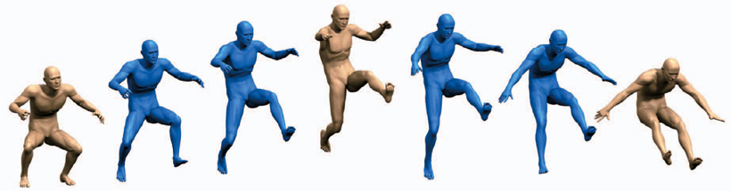
Using Wall Clock Time
How can the elapsedTime variable be useful?

Slide 9
Using Wall Clock Time
How can the elapsedTime variable be useful?
You can base your transformations off of elapsedTime instead of frame count
Framerates can vary…for things like game physics time can provide a better experience

Slide 10
Interpolation and Key Frames
In animation a key frame is a typically an artist generated geometry
Intermediate frames can be calculated using interpolation

Slide 11
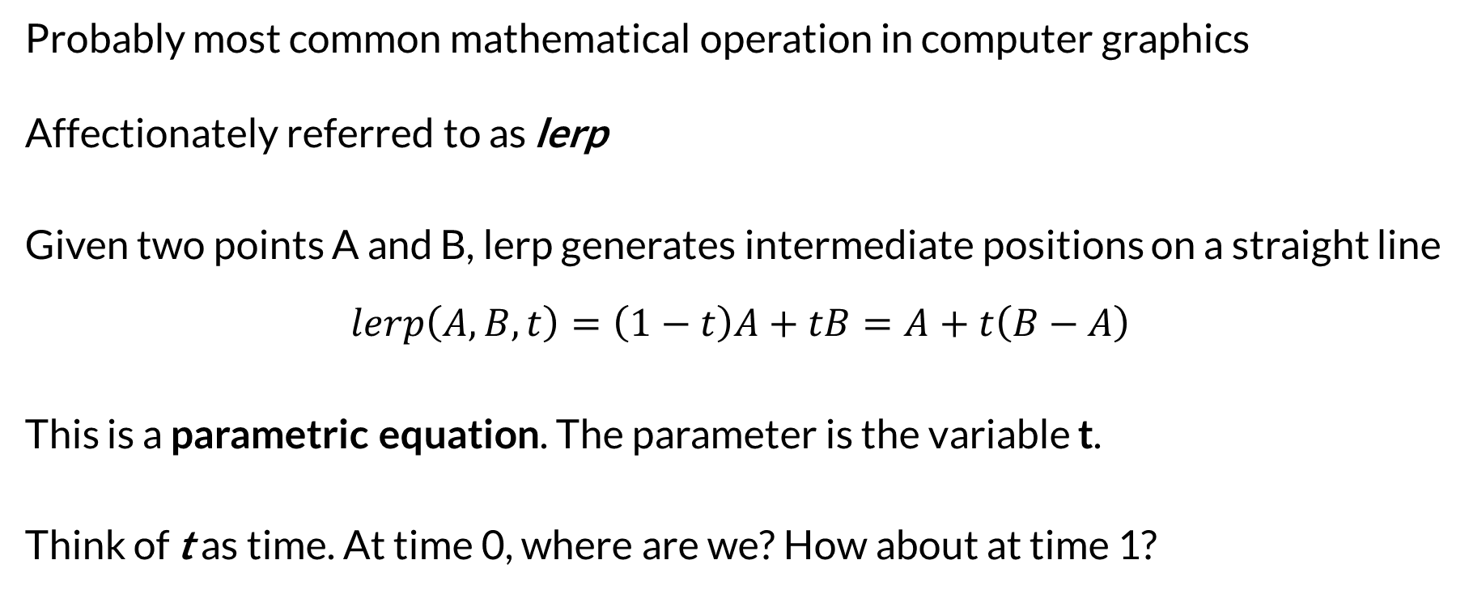
Linear Interpolation
Probably most common mathematical operation in computer graphics
Affectionately referred to as lerp
Given two points A and B, lerp generates intermediate positions on a straight line $$lerp\left(A,B,t\right)=\left(1−t\right)A+tB=A+t\left(B−A\right)$$
This is a parametric equation. The parameter is the variable t.
Think of t as time. At time 0, where are we? How about at time 1?

Slide 12
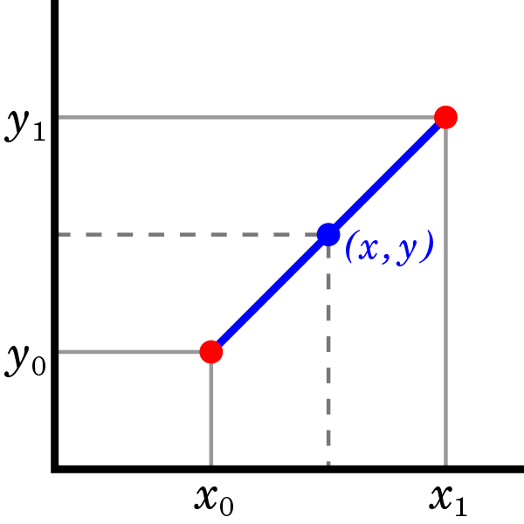
Linear Interpolation
If we wanted to code up lerp for 2D points, how do you do it?

Slide 13
Linear Interpolation
If we wanted to code up lerp for 2D points, how do you do it?
For 3D, just add a line to compute Out[2]
Maybe obvious here… but keep in mind that more complicated math that we will see usually generalizes to 3D similarly
function lerp(Out, A, B, t){
Out[0] = A[0] + (B[0]-A[0])*t;
Out[1] = A[1] + (B[1]-A[1])*t;
}

Slide 14
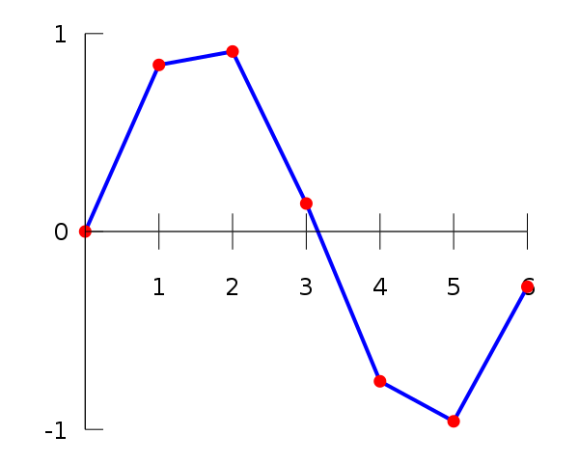
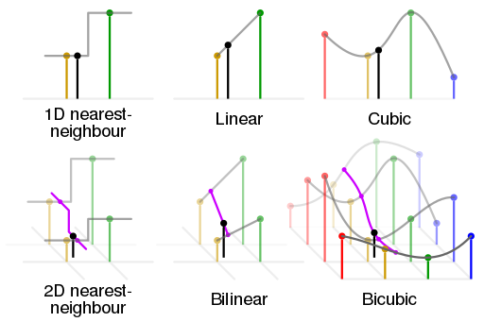
Linear Interpolation
Can also be thought of as reconstructing a function from sample points
We will see some other ways of doing this as well…

Slide 15
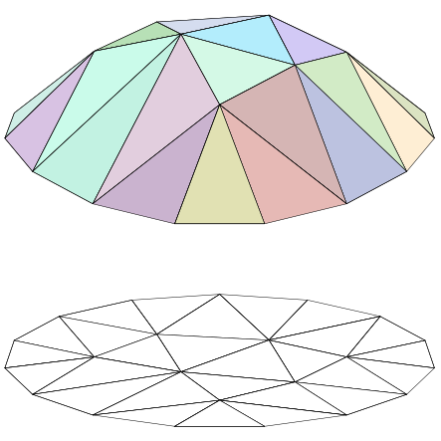
Triangle Meshes are Linear Interpolants

