Slide 1

Orthographic Projection
CS 418: Interactive Computer Graphics
UNIVERSITY OF ILLINOIS AT URBANA-CHAMPAIGN
Eric Shaffer

Slide 2
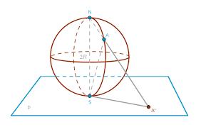
Projections
In computer graphics, eventually we need to move from 3D space to 2D space
More accurately: from 4D homogeneous coordinates to 3D homogeneous coordinates
A projection is a transformation that maps from a high-dimensional space into a lower-dimensional space.
We will look at some common projections…and then we will discuss projection within WebGL

Slide 3
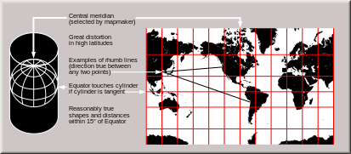
Planar Geometric Projections
Standard projections project onto a plane
Projectors are lines that either
converge at a center of projection
are parallel
Such projections preserve lines
but not necessarily angles
Non-planar projections are often used in map construction

Slide 4
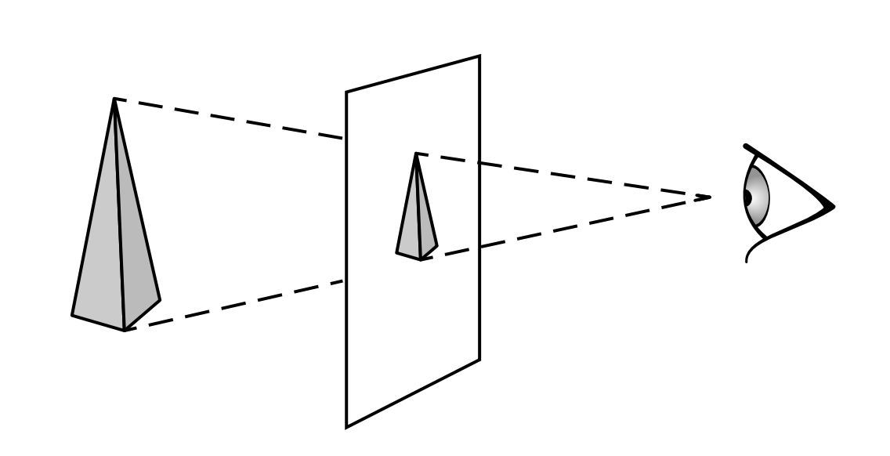
Perspective Projection

Slide 5
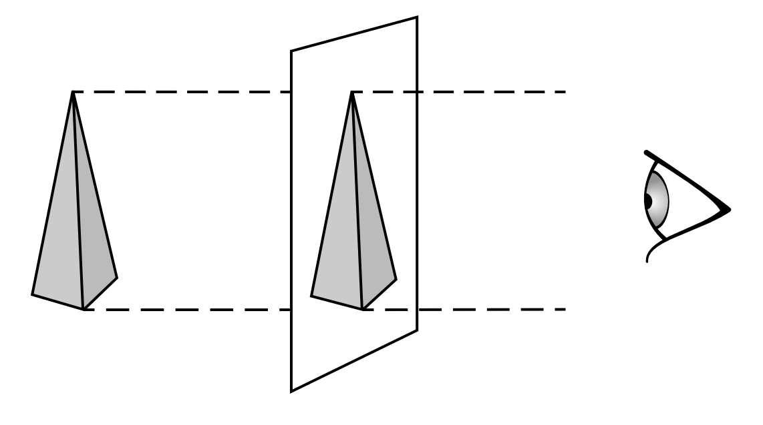
Orthographic Projection

Slide 6
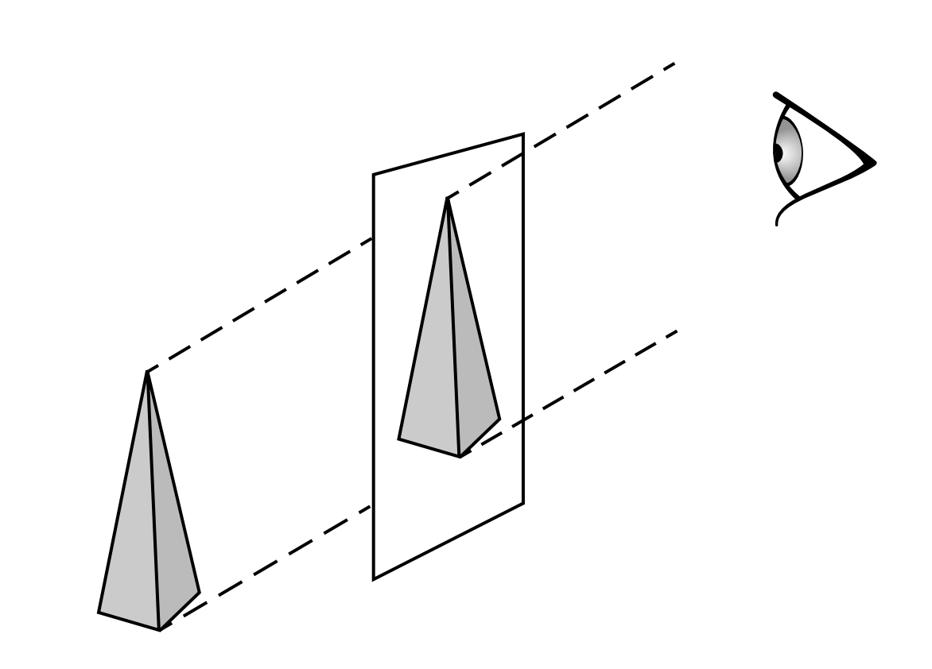
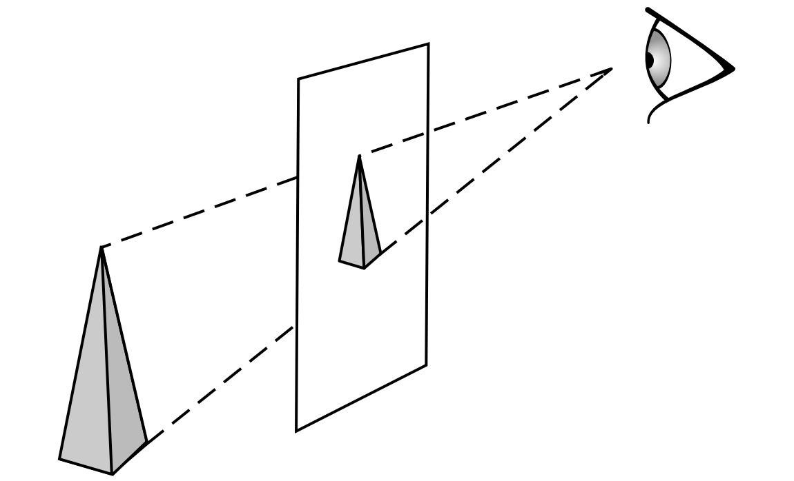
Oblique Projections
Oblique parallel projection Oblique perspective projection
Linear projections can be categorized
By whether the projectors are parallel
By whether the projectors are orthogonal to the view plane
We will not use these…..

Slide 7
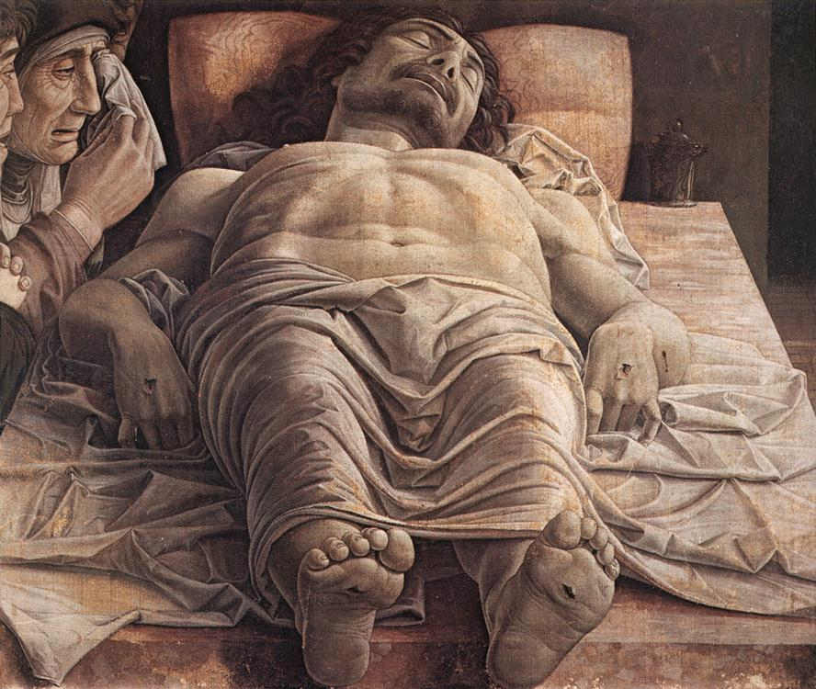
Definition to Know: Foreshortening
Foreshortening is the
visual effect
or optical illusion
that causes an
object or distance to
appear shorter than it
actually is because it is
angled toward the
viewer.
i.e. projections
squash
receding surfaces
Can foreshortening happen in orthographic projection?
Andrea Mantegna
The Lamentation over the Dead Christ

Slide 8
Clip Space View Volume
Before looking at projections in more detail…
…let’s experimentally determine what the default view and view volume are.
So, if we don’t do any transformations…where are we and what direction are we looking?
Take a look at https://developer.mozilla.org/en-US/docs/Web/API/WebGL_API/WebGL_model_view_projection http://jsfiddle.net/2x03hdc8/
It is a simple WebGL program that lets you draw rectangles
No transformations
By altering the rectangle coordinates, you can figure out the view….

Slide 9
Clip Space View Volume
Something new – the code enables hidden surface removal
Side note – the overall code uses different conventions than used in our course (e.g. no glmatrix library)
So, probably don’t base your assignments on this code

Slide 10
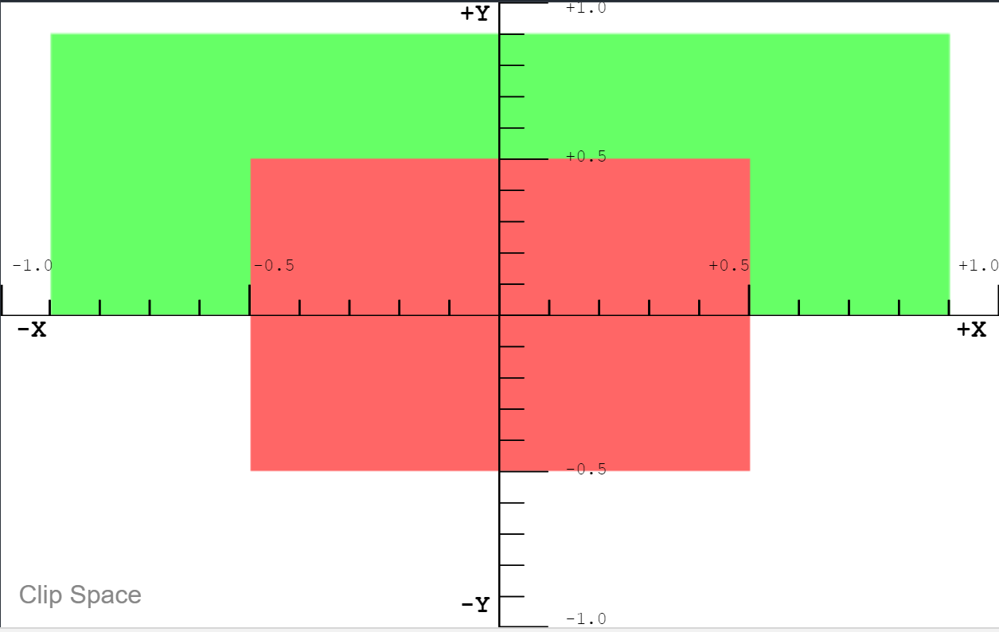
Clip Space View
Red rectangle has z=0
Green has z=0.5
What direction are we looking?

Slide 11
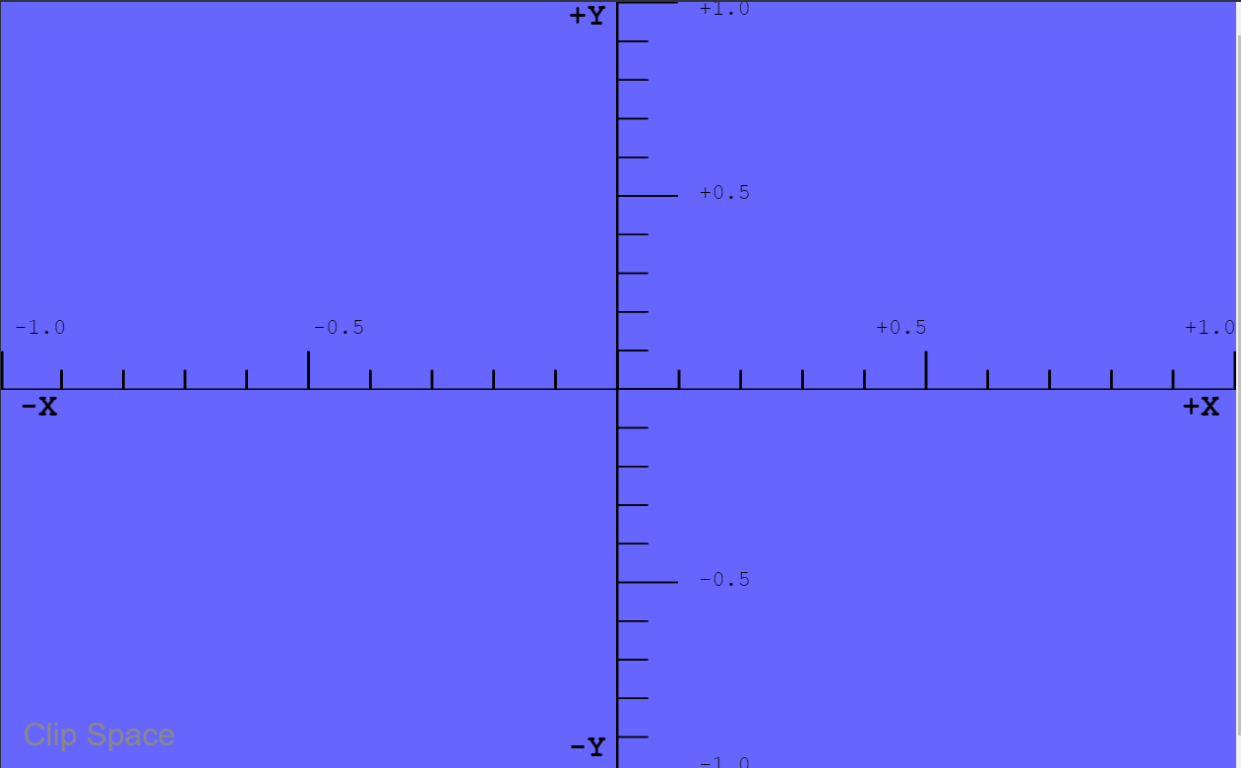
Clip Space View
We add a blue rectangle It’s at z=-1
Where is the near clipping plane?

Slide 12
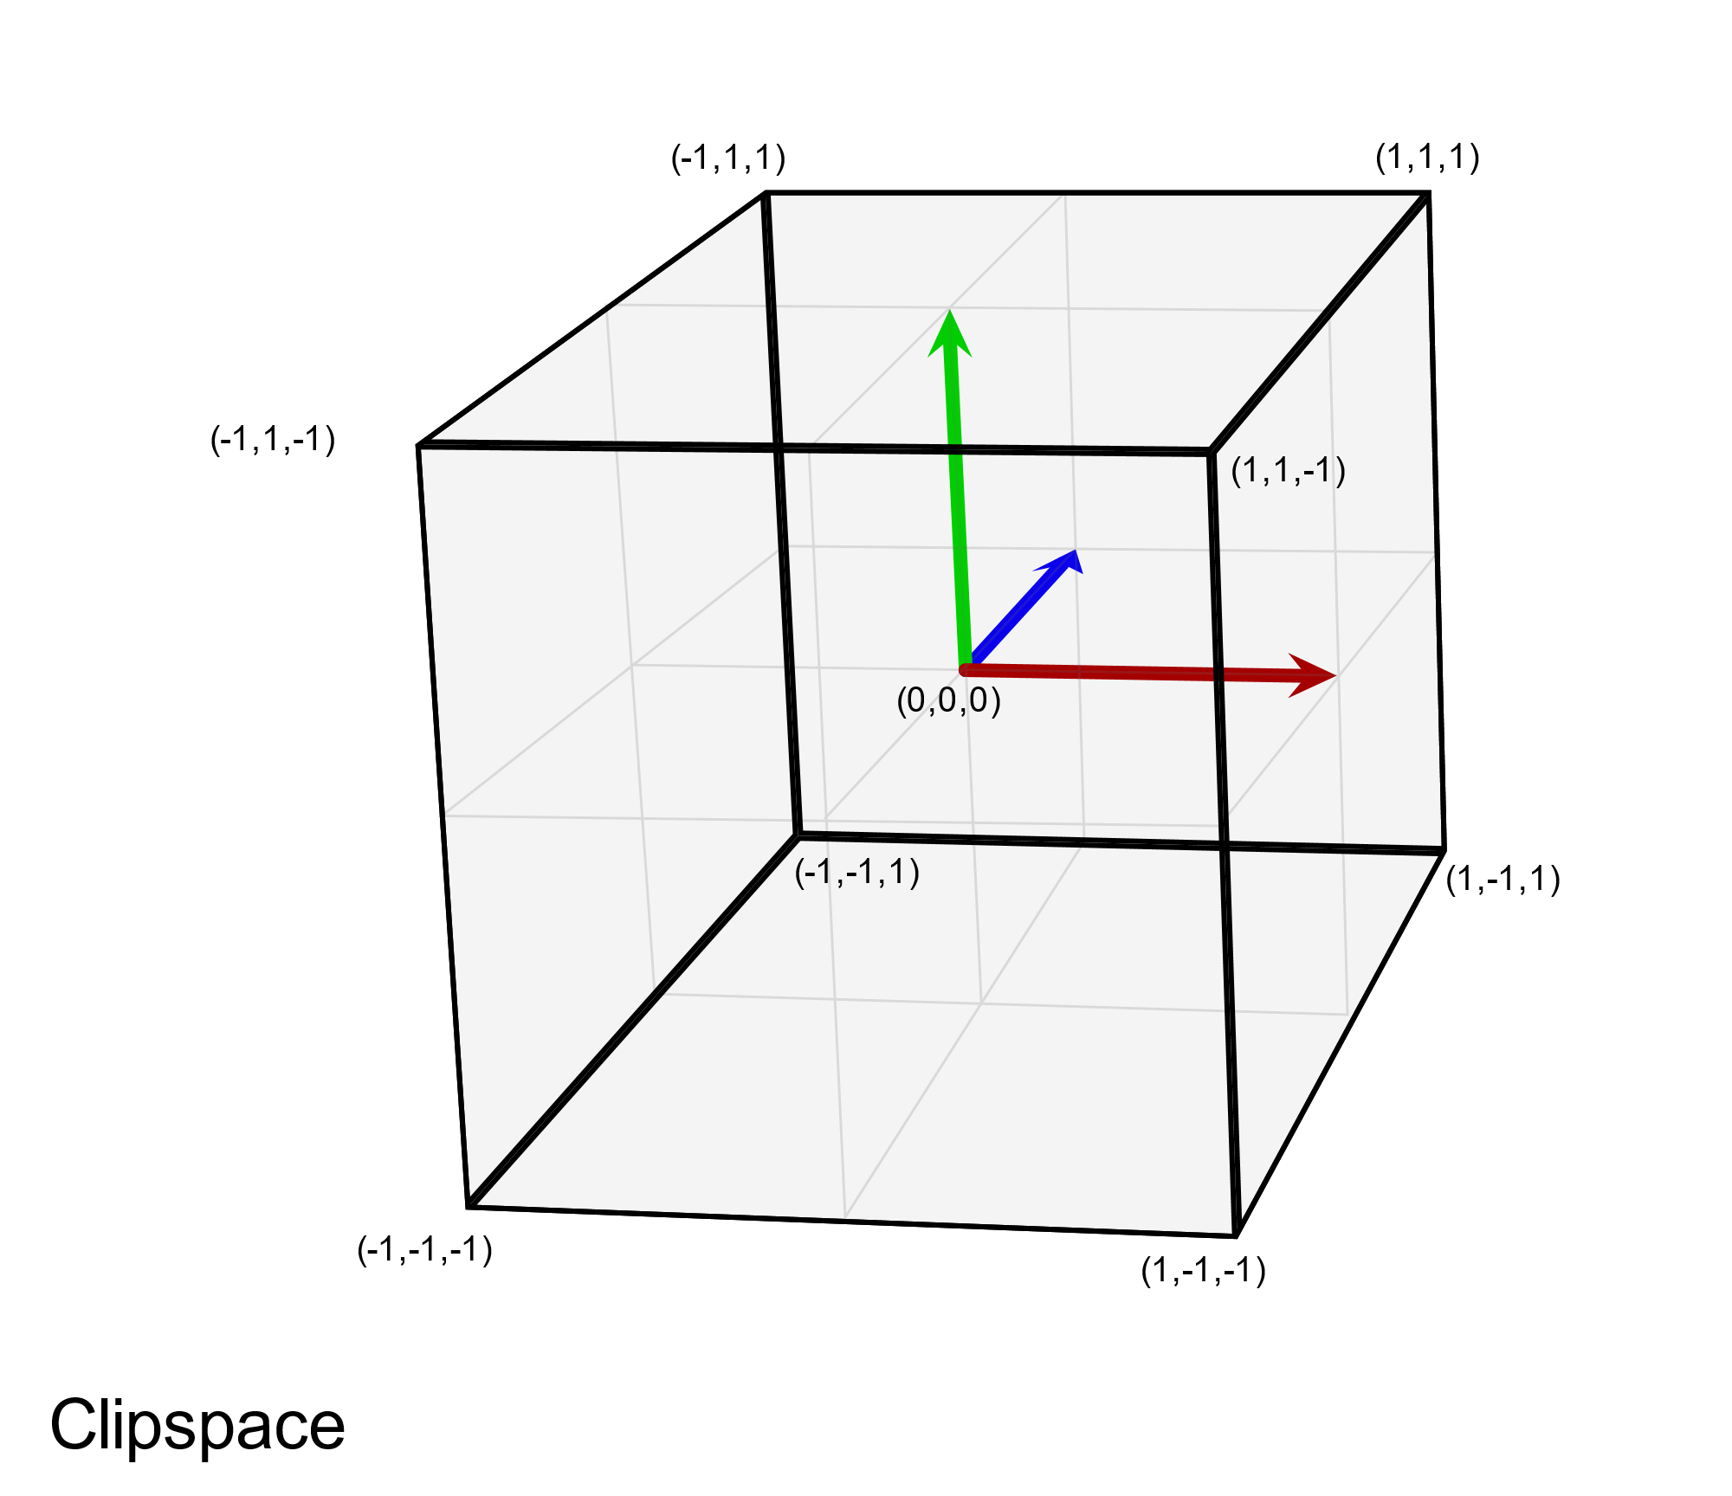
Clip Space View and View Volume
View is looking down Z+
Eyepoint is effectively at (0,0,-1)
This is a left-handed coordinate system
This is a little-known fact…. People often learn to use WebGL without ever learning this.
We’ll see why in a few slides

Slide 13
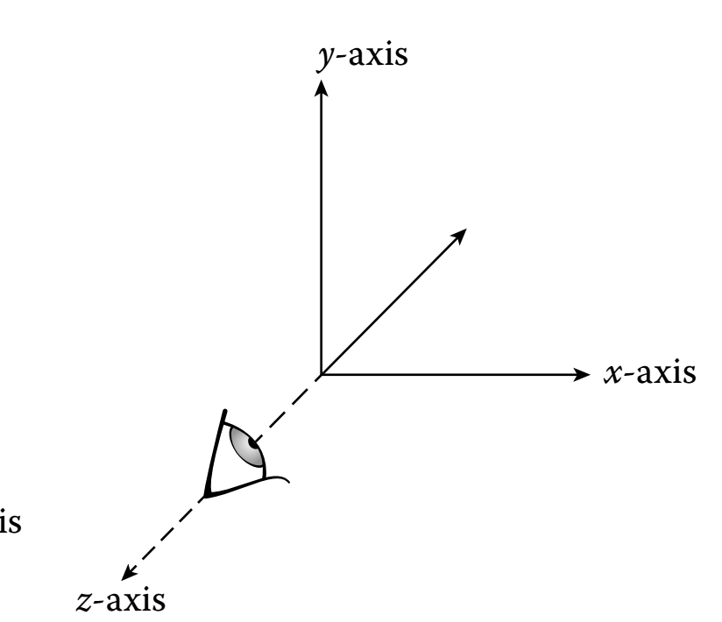
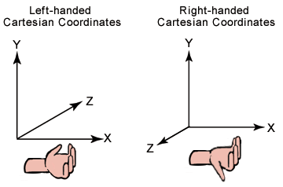
WebGL Style View
WebGL/OpenGL convention is to assume a right-handed world coordinate system
The ortho matrix is used to flip this coordinate system by scaling Z by -1
It then matches WebGL clip space

Slide 14
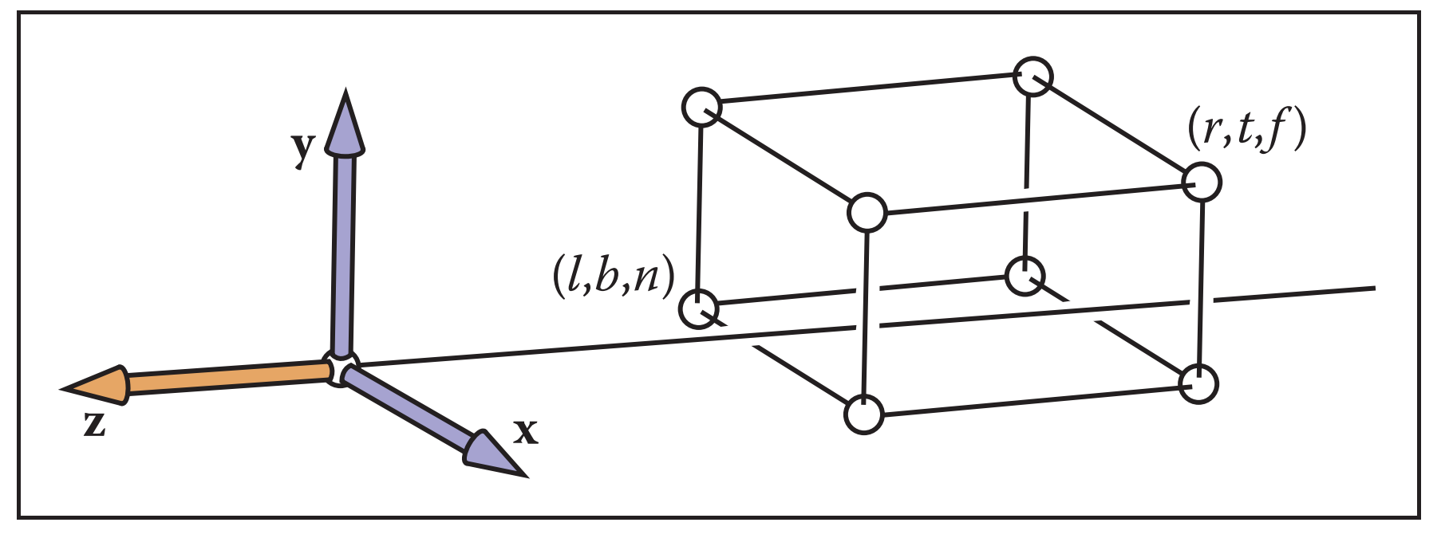
More WebGL Secrets
Model Coords
Model Xform
World Coords
Viewing Xform
Viewing Coords
Perspective Distortion
Still Clip Coords.
Clipping
Clip Coords.
Homogeneous Divide
Window
Coordinates
Window
to
Viewport
Viewport
Coordinates
WebGL only performs an orthogonal projection
Everything is projected to the z=0 plane in the normalized view volume
But you can distort your geometry to achieve a perspective projection
The projection occurs when the geometry is in clip space (NDC)
Even then, depth information is kept around to do hidden surface removal
Depth information means transformed z coordinates

Slide 15
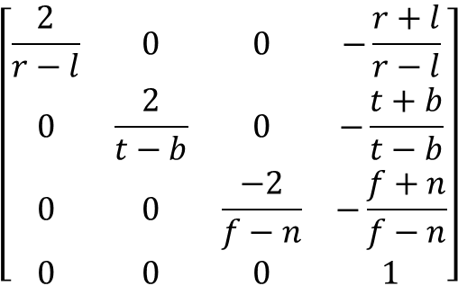
Orthographic Projection
View Volume
(left,top,-near)
y
Foreshortens
No change in size by depth
Classic Orthographic Projection matrix simply zeros the z- coordinate
mat4.ortho(out,left,right,bottom,top,near,far)
-z
z
x
(right,bottom,-far)
Viewing Coordinates
Ortho
Clip Coordinates
$$\left[\begin{matrix}\frac{2}{r−l} & 0 & 0 & −\frac{r+l}{r−l} \\ 0 & \frac{2}{t−b} & 0 & −\frac{t+b}{t−b} \\ 0 & 0 & \frac{−2}{f−n} & −\frac{f+n}{f−n} \\ 0 & 0 & 0 & 1\end{matrix}\right]$$
Does the ortho matrix perform a projection?

Slide 16
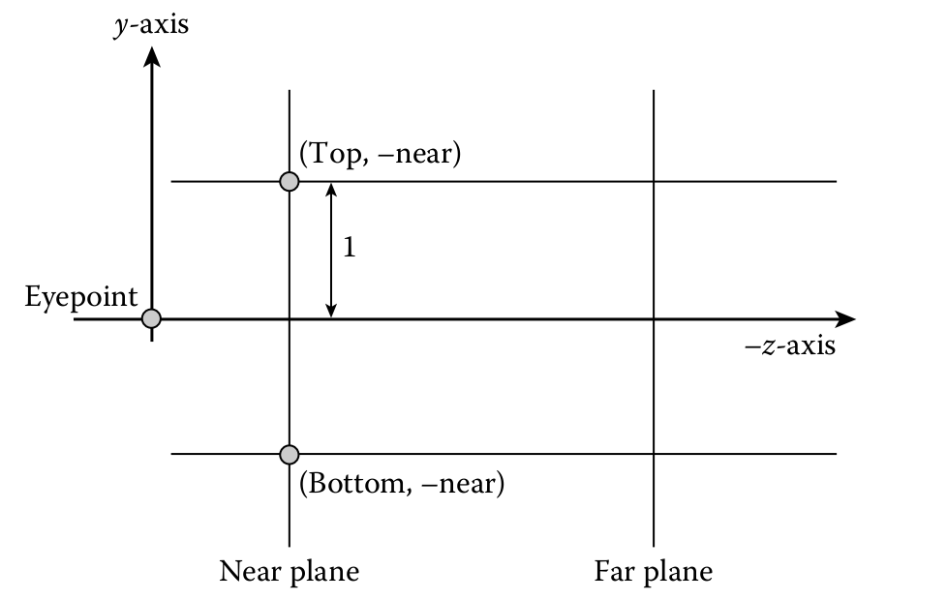
GLMatrix ortho matrix
ortho(left,right,bottom,top,near,far)
near and far are distances down the –z axis from origin
l,r,b,t are coordinates of the bounding planes
what does the matrix do?

Slide 17
GLMatrix ortho matrix
ortho(left,right,bottom,top,near,far)
Imagine the eye is at (0,0,0) We look down the –z axis
The view volume is: [left, right] =[-1, 1] [bottom, top]=[-1, 1]
near =0
far =2
What does the matrix look like?

Slide 18
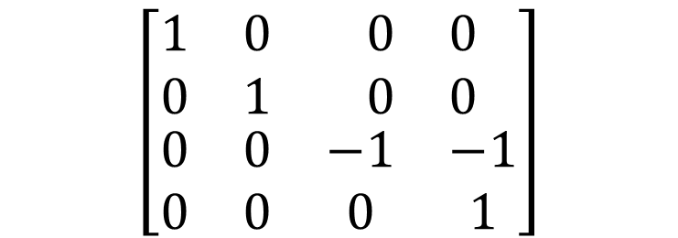
GLMatrix ortho matrix
ortho(left,right,bottom,top,near,far)
Imagine the eye is at (0,0,0) We look down the –z axis
The view volume is: [left, right] =[-1, 1] [bottom, top]=[-1, 1]
near =0
far =2
Where does (0,0,0) get moved to? What else happens?
$$\left[\begin{matrix}\begin{matrix}1 & 0 \\ 0 & 1\end{matrix} & \begin{matrix}0 & 0 \\ 0 & 0\end{matrix} \\ \begin{matrix}0 & 0 \\ 0 & 0\end{matrix} & \begin{matrix}−1 & −1 \\ 0 & 1\end{matrix}\end{matrix}\right]$$

