Slide 1

Images and some text courtesy of The Essentials of CAGD by Farin and Hansford
Geometric Design: Bezier Curves
CS 418: Interactive Computer Graphics
UNIVERSITY OF ILLINOIS AT URBANA-CHAMPAIGN
Eric Shaffer

Slide 2
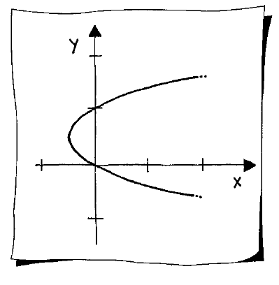
Geometric Modeling
We will finish the semester by briefly looking at some math for modeling
Geometric modeling is typically done by engineers and artists
Assisted by computational tools (e.g. Maya or Blender or AutoCAD)
The software provides a mathematical models of curves/surfaces
For rendering, ultimately everything will be turned into triangles. But modeling triangle-by-triangle would be too tedious

Slide 3
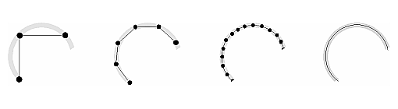
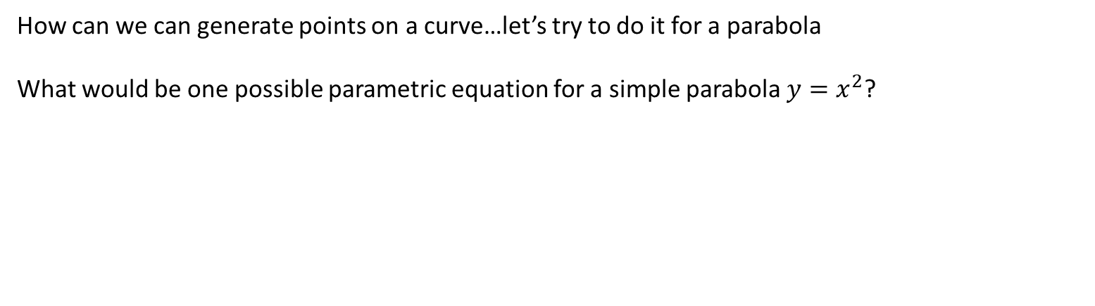
Modeling Curves – Some Questions
Suppose we render curves by approximating them with line segments
How can we can generate points on a curve…let’s try to do it for a parabola
What would be one possible parametric equation for a simple parabola $y=x^{2}$?

Slide 4
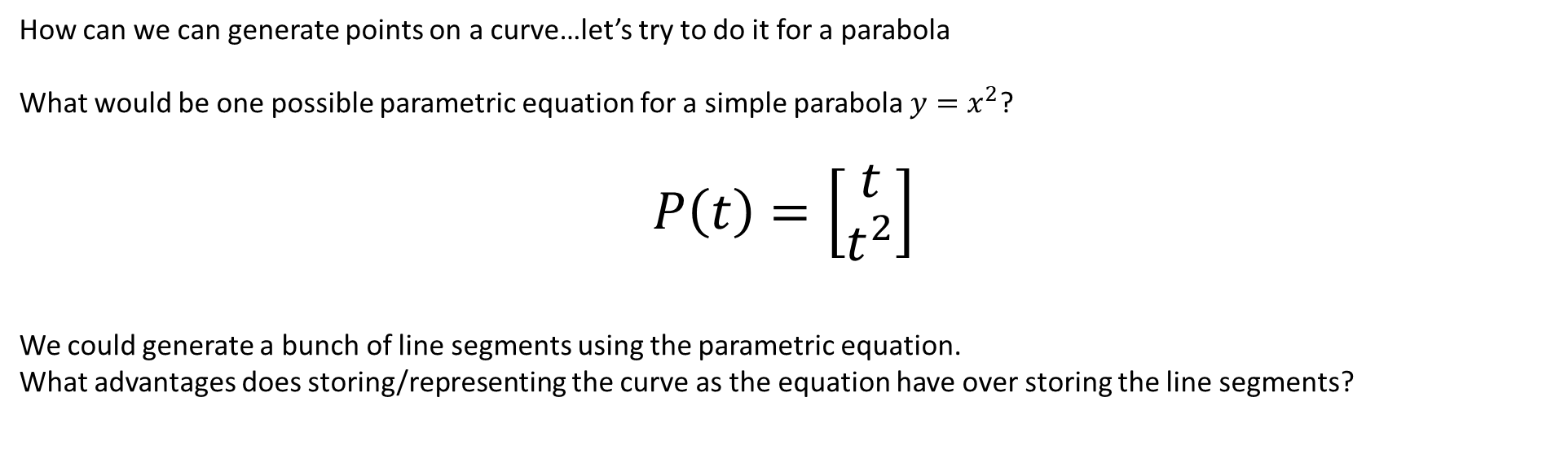
Modeling Curves – Some Questions
Suppose we render curves by approximating them with line segments
How can we can generate points on a curve…let’s try to do it for a parabola
What would be one possible parametric equation for a simple parabola $y=x^{2}$?
$$P\left(t\right)=\left[\begin{matrix}t \\ t^{2}\end{matrix}\right]$$
We could generate a bunch of line segments using the parametric equation.
What advantages does storing/representing the curve as the equation have over storing the line segments?

Slide 5

Modeling Curves – Some Questions
How can we can generate points on a curve…let’s try to do it for a parabola
What would be one possible parametric equation for a simple parabola $y=x^{2}$?
$$P\left(t\right)=\left[\begin{matrix}t \\ t^{2}\end{matrix}\right]$$
We could generate a bunch of line segments using the parametric equation.
What advantages does storing/representing the curve as the equation have over storing the line segments?
More compact
Infinite resolution
Some tasks are easier
e.g. finding derivatives or deforming the geometry

Slide 6
Modeling with Curves
Suppose we render curves by approximating them with line segments
Also, using alternative representations can have other advantages
More compact
Infinite resolution
Some tasks are easier
e.g. finding derivatives or deforming the geometry

Slide 7
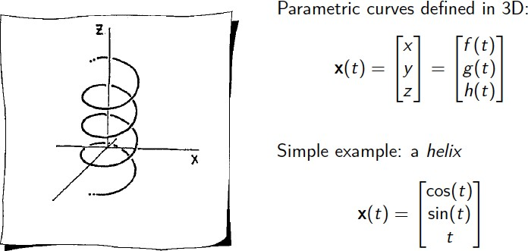
Parametric Curves

Slide 8
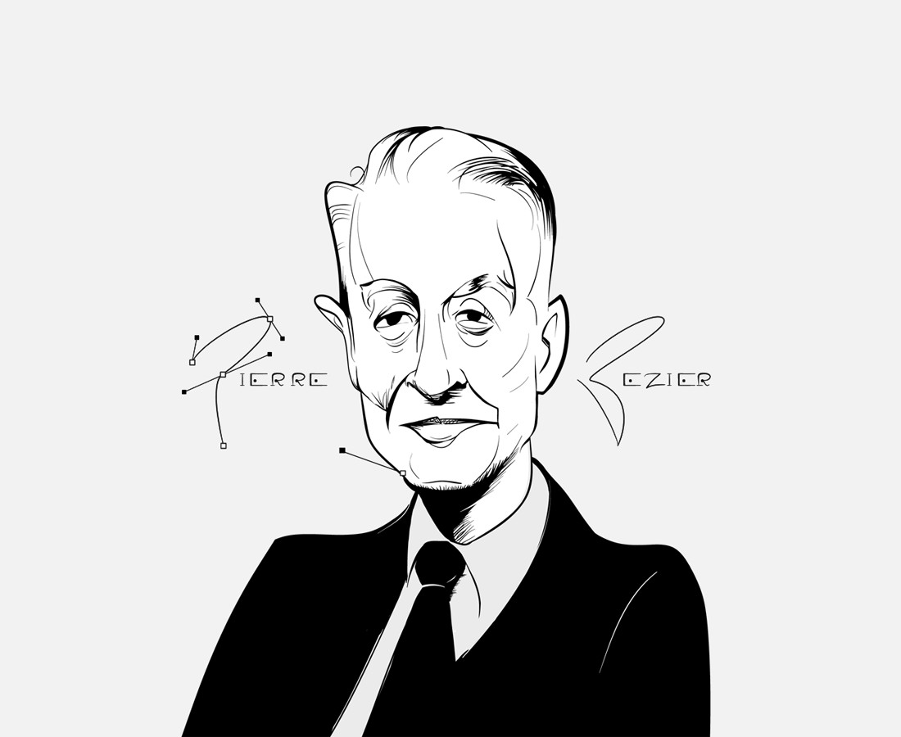
Bezier Curves
Named after Pierre Bezier French Mechanical Engineer Worked for Renault Lived 1910-1999
Type of polynomial curve
Curve is defined by a modeler (artist) specifying control points
Can be defined to generate a polynomial of any degree
Cubics are most common
Higher degree curve requires more control points
Can be joined together to form piecewise polynomial curves
Can form the basis of Bezier patches which define a surface

Slide 9
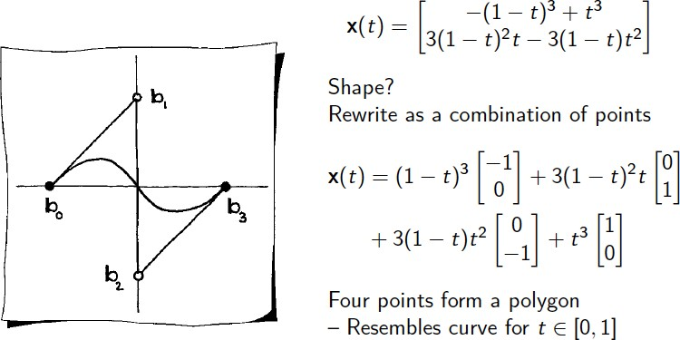
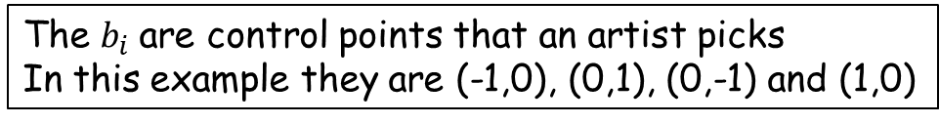
Cubic Bezier Curves
The $b_{i}$are control points that an artist picks
In this example they are (-1,0), (0,1), (0,-1) and (1,0)

Slide 10
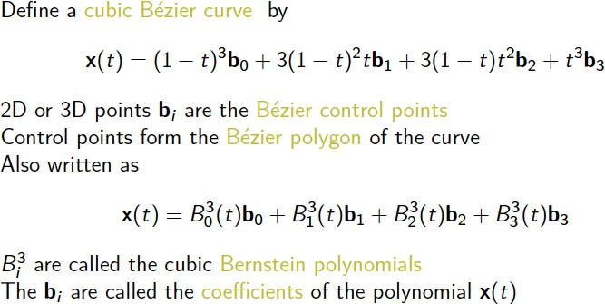
Cubic Bezier Curves

Slide 11
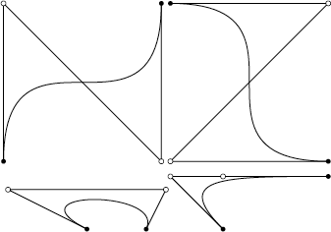
Bezier Curves
Important Properties of Bezier Curves
Endpoint Interpolation
Symmetry
Invariance under affine transformations
Convex hull property
Linear precision

Slide 12
Properties of Bezier Curves
Endpoint Interpolation
The curve will pass through the first and last control points:
x(0.0) = b₀
x(1.0) = b₃
Symmetry
Specifying contol points in order b₀,b₁,b₂,b₃ generates same curve as the order b₃,b₂,b₁,b₀

Slide 13
Propoerties of Bezier Curves
Invariance under affine transformations Transforming the control polygon similarly transforms the curve
Linear Precision
If b₁ and b₂ are evenly spaced on a straight line, the cubic Bezier curve will be the linear interpolant between b₀ and b₃

Slide 14
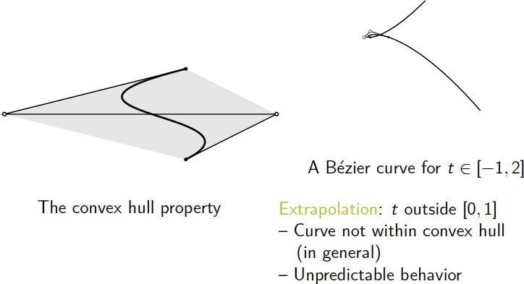
Properties of Bezier Curves

Slide 15
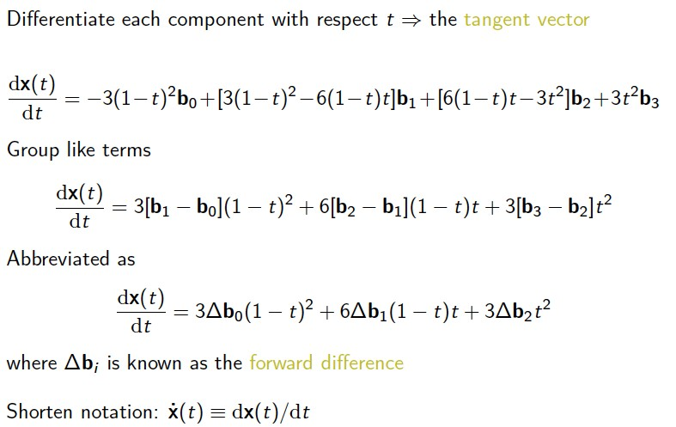
Derivatives

Slide 16
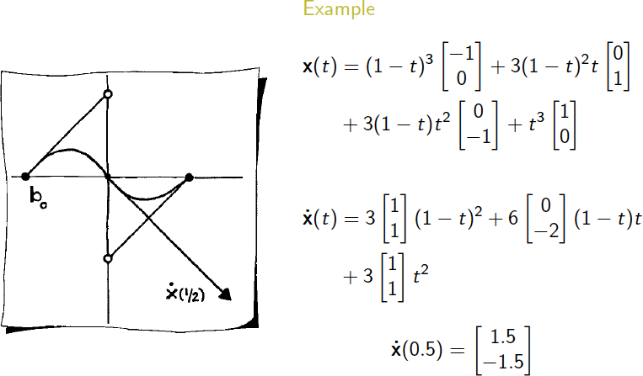
Derivatives

Slide 17
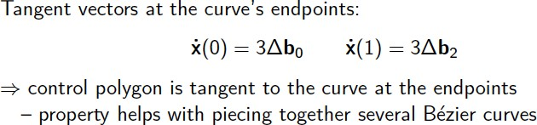
Piecing Curves Together

Slide 18
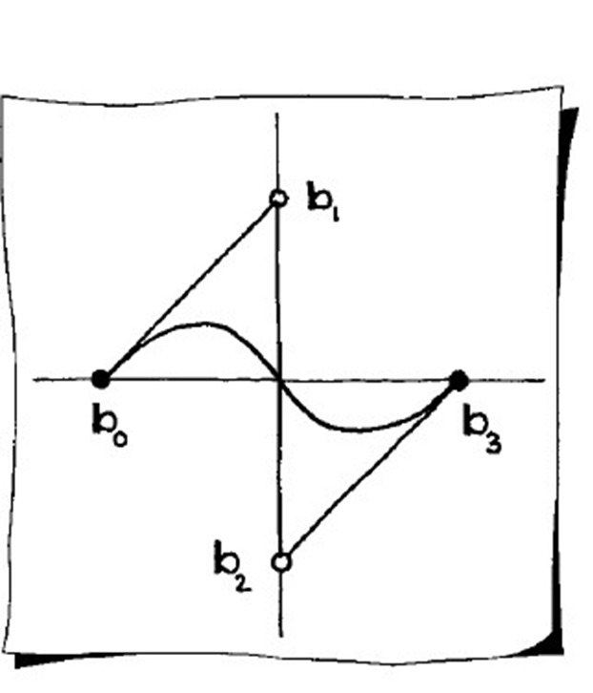
The de Casteljau Algorithm
How do you generate points on a Bezier Curve?
You could just plug values for t into the formula we have already seen and evaluate x(t)
The de Cateljau algorithm is an alternative way to generate points
More computationally efficient
Uses repeated linear interpolation
Can be implemented recursively or interatively
Invented by Paul de Faget de Casteljau in 1959

Slide 19
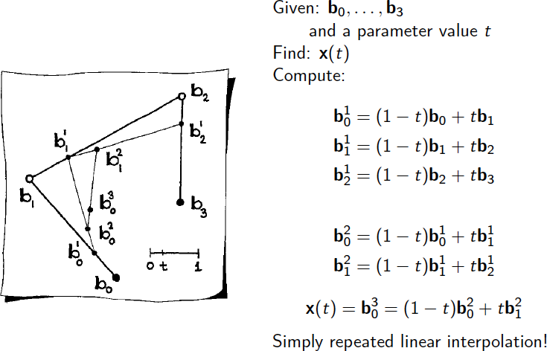
The de Casteljau Algorithm

Slide 20
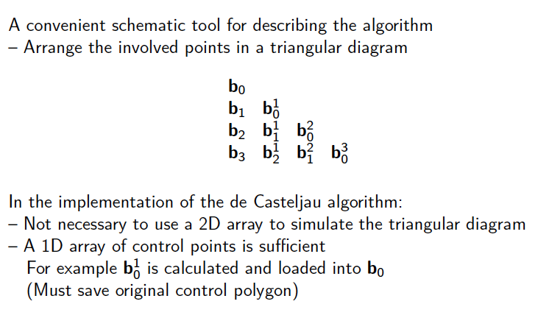
The de Casteljau Algorithm

Slide 21
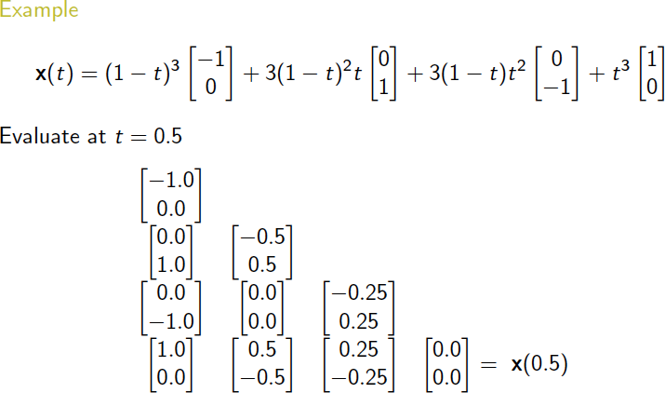
The de Casteljau Algorithm

Slide 22
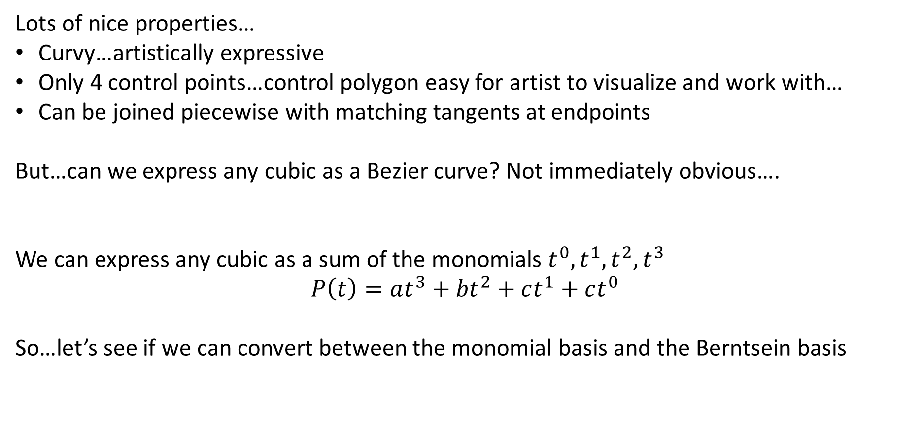
Modeling with Cubic Bezier Curves
Lots of nice properties…
Curvy…artistically expressive
Only 4 control points…control polygon easy for artist to visualize and work with…
Can be joined piecewise with matching tangents at endpoints
But…can we express any cubic as a Bezier curve? Not immediately obvious….
We can express any cubic as a sum of the monomials $t^{0},t^{1},t^{2},t^{3}$ $$P\left(t\right)=at^{3}+{bt}^{2}+ct^{1}+ct^{0}$$
So…let’s see if we can convert between the monomial basis and the Berntsein basis

Slide 23
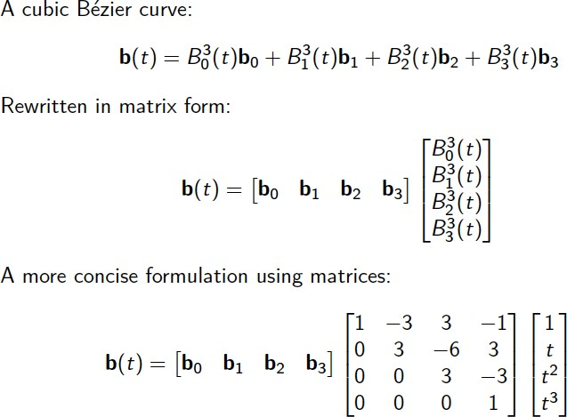
The Matrix Form and Monomials

Slide 24
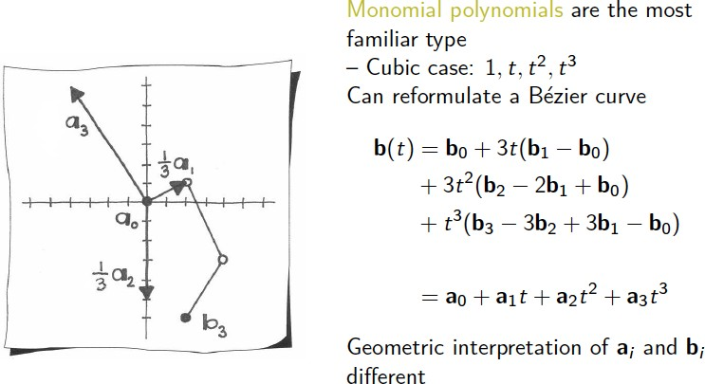
The Matrix Form and Monomials

Slide 25
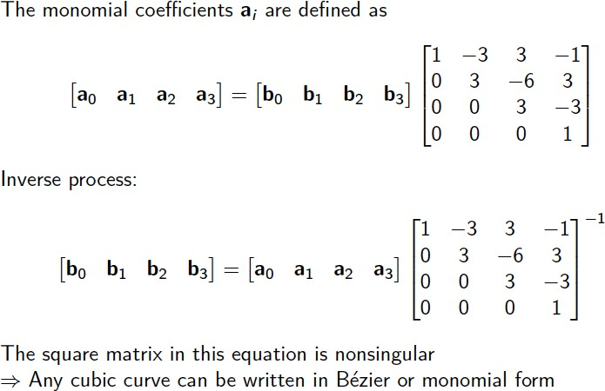
The Matrix Form and Monomials

