Slide 1

Polygon Rasterization
CS 418: Interactive Computer Graphics
UNIVERSITY OF ILLINOIS AT URBANA-CHAMPAIGN
Eric Shaffer

Slide 2
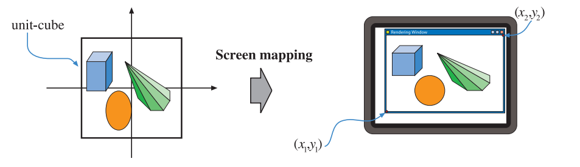
Rasterization and the Pipeline
Rasterization happens after the viewport transformation
“screen mapping” = “viewport transformation”
The vertex positions are now screen coordinates
The z values for depth are also included

Slide 3
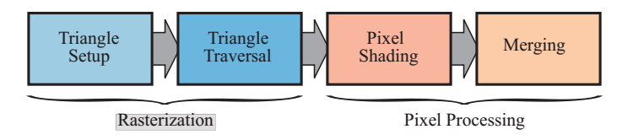
Triangle Rasterization
Triangle Setup Edge equations and other data are computed. This data may be used for triangle traversal, as well as for interpolation of other data.
Triangle Traversal
A fragment is generated for the part of the pixel that overlaps the triangle. Data associated with each fragment is computed using interpolation.

Slide 4
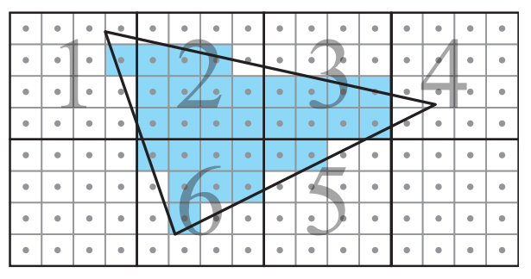
Tiled Rasterization
Pixels are grouped into tiles (4x4 in this example)
Tile processing has greater memory coherence than scanline
For example, texel data is cached more effectively

Slide 5
Basic Idea
Find which pixels lie on positive side of the three line equations
How can you test which side of a line a pixel falls on?

Slide 6

Edge Functions
Suppose the vertices of the triangle are p₀ p₁ and p₂
For each triangle edge compute a function
n is a normal vector pointing to inside of the triangle
p is a point on the line formed by the edge

Slide 7
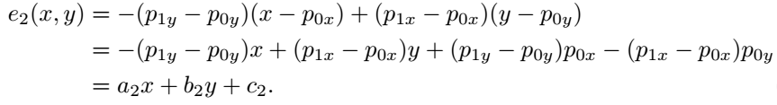
Example: Edge Functions
Edge vector is p₁ − p₀
Normal is p₁ − p₀ rotated 90 degrees counterclockwise:
n₂ points to the inside of the triangle inserting n₂ and p₀ into the edge function we have

Slide 8
Optimizations
Can use fixed point screen space coordinates (integer arithmetic)
Can do incremental updates to edge functions when testing pixels
Example: Suppose we test tested a pixel center at (x,y) Then, to test pixel center at (x+1,y) we have

Slide 9
Optimizations
Can quickly check if an entire tile lies outside triangle
If all corners of tile outside triangle → tile is outside
If all corners of tile inside → tile is inside
Otherwise, an edge passes through the tile

Slide 10
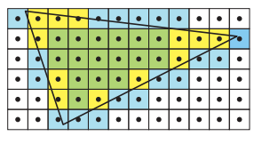
Conservative Rasterization
Outer Conservative Rasterization: all colored pixels (any pixel partially or fully in triangle)
Inner Conservative Rasterization: green pixels (pixels fully inside triangle)

Slide 11
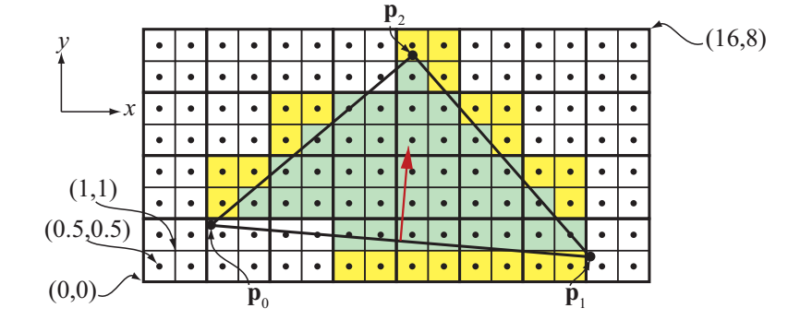
Triangle Rasterization
Fragments grouped into quads for texturing and other operations
Yellow fragments are “helper fragments”

