Slide 1

Compositing
CS 418: Interactive Computer Graphics
UNIVERSITY OF ILLINOIS AT URBANA-CHAMPAIGN
Eric Shaffer

Slide 2
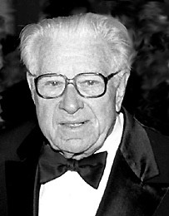

Lynwood Dunn (1904-1998)
Visual effects pioneer
Acme-Dunn optical printer
Run film through a projector and re-photograph it
Can zoom in or out, applies filters etc.

Slide 3
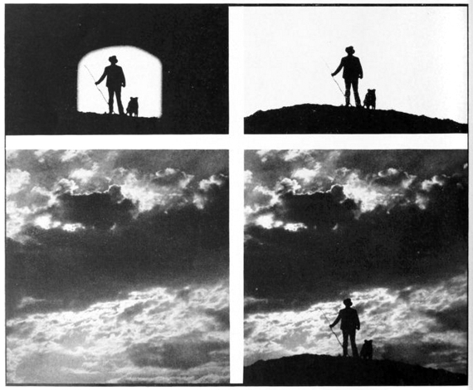
Compositing Example

Slide 4
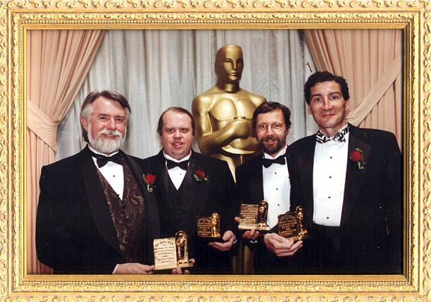
Academy of Motion Picture Arts & Sciences
Scientific and Engineering Award
To Alvy Ray Smith, Tom Duff, Ed Catmull and Thomas Porter for their Pioneering Inventions in Digital Image Compositing.
PRESENTED MARCH 2, 1996

Slide 5

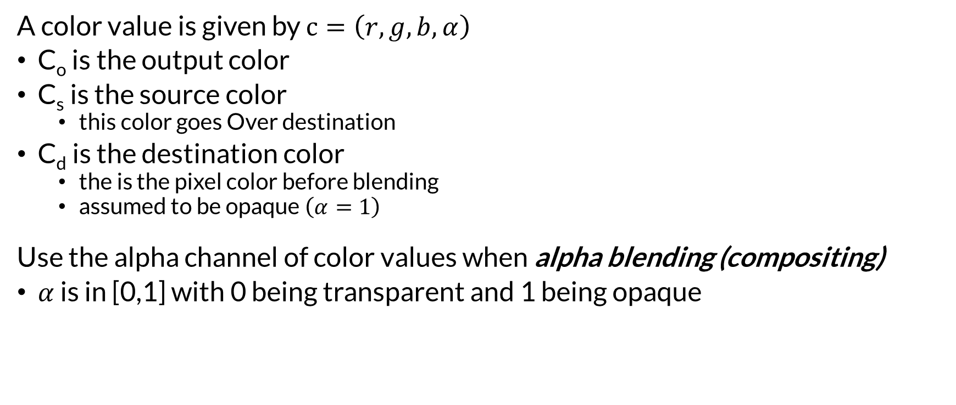
Compositing with the Over Operator
C_{d}
A color value is given by $c=\left(r,g,b,α\right)$
C_{o} is the output color
C_{s} is the source color
this color goes Over destination
C_{d} is the destination color
the is the pixel color before blending
assumed to be opaque $\left(α=1\right)$
Use the alpha channel of color values when alpha blending (compositing)
$α$ is in [0,1] with 0 being transparent and 1 being opaque
C_{o}
C_{s}

Slide 6
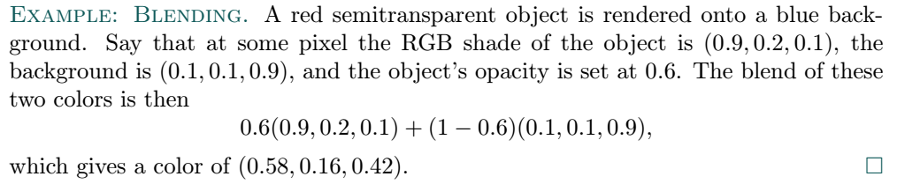
Example
C_{d}
C_{o}
C_{s}

Slide 7
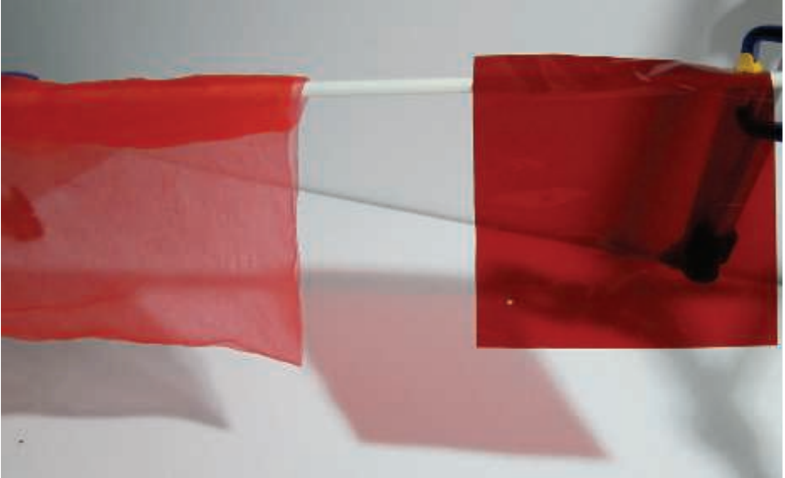
How Well Does It Match Reality?
Alpha blending simulates gauzy fabric well
Less convincing simulating other effects
Viewing through colored glass or plastic
A red filter held in front of a blue object in the real world usually makes the blue object look dark.
(Photograph courtesy of Morgan McGuire.)
Real-Time Rendering, Fourth Edition (Page 151

Slide 8
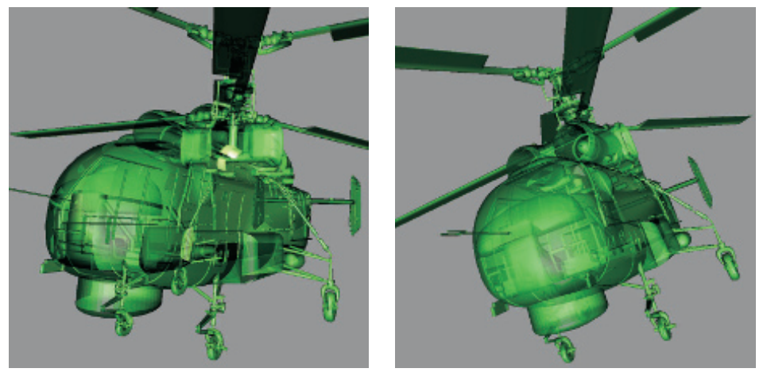
Blending with Over: Requires Back-to-Front Order
Transparent objects properly:
We need to draw them after the opaque objects
render all opaque objects first with blending off
then render transparent objects with over on
Z-buffer (depth buffer) only stores one object per pixel If several transparent objects overlap the same pixel z-buffer cannot hold and resolve the effects
Transparent surfaces must be rendered in back-to-front order
Not doing so can give incorrect perceptual cues
On the left the model is rendered with transparency using the z-buffer. Rendering the mesh in an arbitrary order creates serious errors. On the right, depth peeling provides the correct appearance, at the cost of additional passes.
Real-Time Rendering, Fourth Edition (Page 152)
Can sort objects by their centroids along the view direction
How does this method sometimes fail?

Slide 9
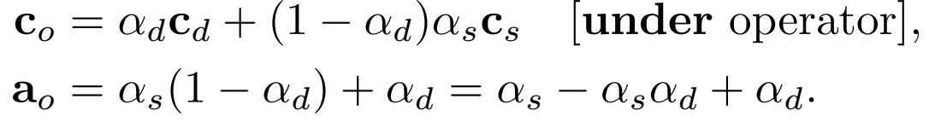
Blending Front-to-Back: Under Operator
Here the source and destination designations are swapped
We need to compute and carry along α values
C_{s}
C_{o}
Why was α not computed for the over operator?
C_{d}

Slide 10

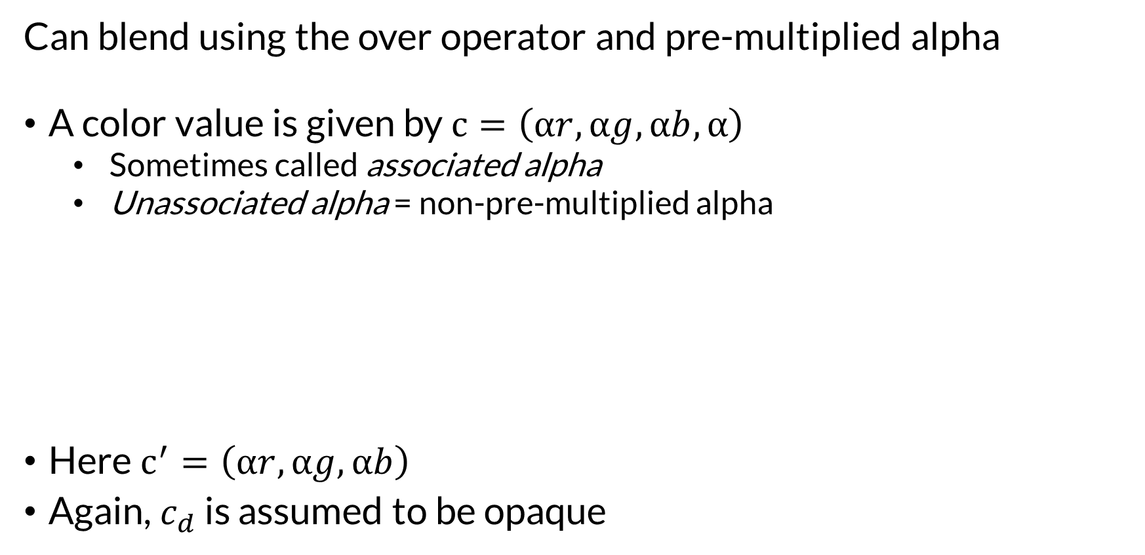
Pre-multiplied Alpha
Can blend using the over operator and pre-multiplied alpha
A color value is given by $c=\left(αr,αg,αb,α\right)$
Sometimes called associated alpha
Unassociated alpha = non-pre-multiplied alpha
Here $c^{′}=\left(αr,αg,αb\right)$
Again, $c_{d}$ is assumed to be opaque

Slide 11
Should You Use Pre-multiplied Alpha?
Yes - WebGL sort of expects you to use pre-multiplied alpha when blending
Over operator using pre-multiplied alpha is provably associative
…using non-pre-multiplied alpha…maybe not?
It is best to use pre-multiplied data whenever filtering and blending is performed, as operations such as linear interpolation do not work correctly using unmultiplied alphas
Pre-multiplied alphas also allow cleaner theoretical treatment
- Real-Time Rendering, Fourth Edition

Slide 12
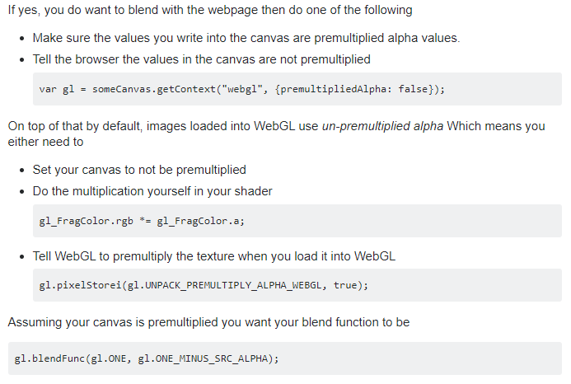
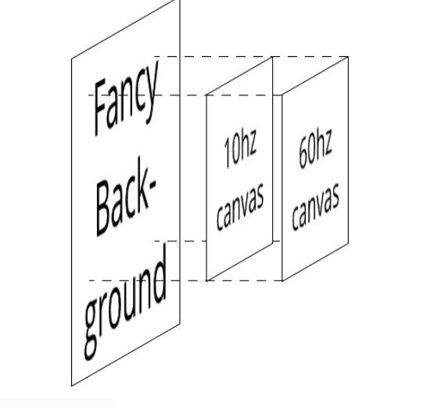
WebGL Canvases are Composited
A browser composites your WebGL canvas on the displayed page
This is done using pre-multipled alpha You could stack multiple canvasses
https://stackoverflow.com/questions/39341564/webgl-how-to-correctly-blend-alpha-channel-png

Slide 13
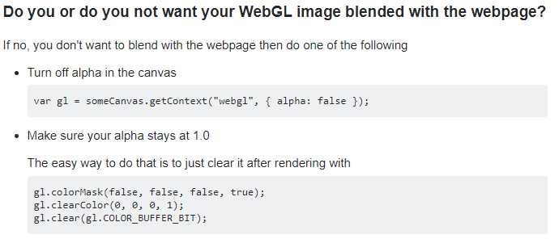
You Can Disable Canvas Compositing
https://stackoverflow.com/questions/39341564/webgl-how-to-correctly-blend-alpha-channel-png

Slide 14
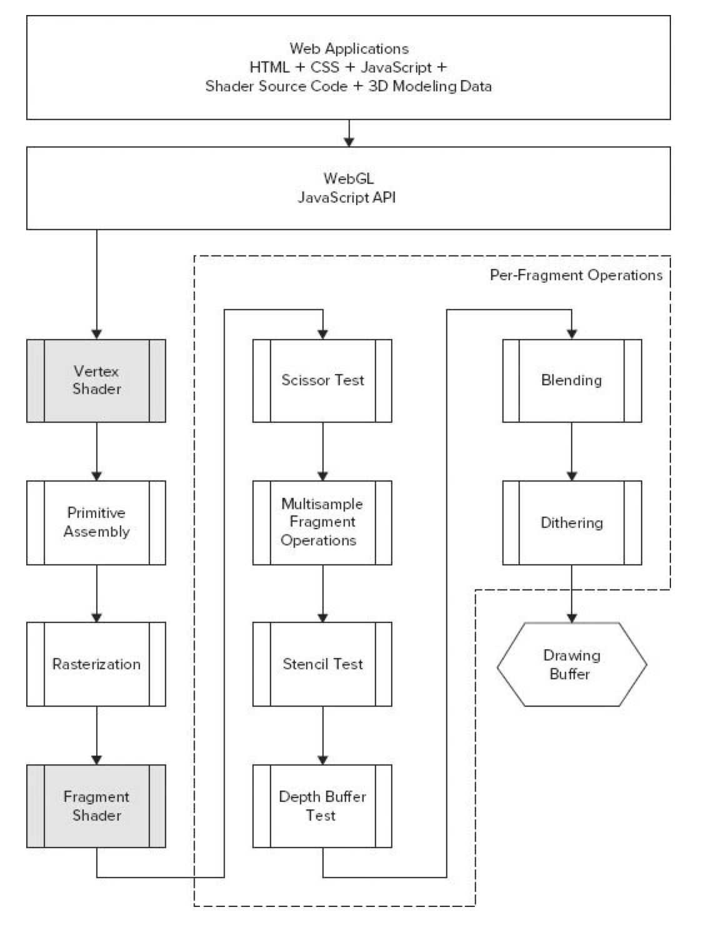
WebGL Pipeline
Scissor Test: cull pixels outside of a rectangular area
Multisample:
anti-aliasing operation
Stencil Test:
uses a stencil buffer to mask pixels
can be used in shadow generation
Depth Buffer Test:
hidden surface removal
Blending:
compositing using alpha channel

Slide 15
Blending
//enable blending
gl.Enable(gl.BLEND)
//to set up the parameters of the generic blending equation //call ONE of the functions below
gl.blendFunc(GLenum sfactor, GLenum dfactor); //OR gl.blendFuncSeparate(GLenum srcRGB, GLenum dstRGB, GLenum srcAlpha, GLenum dstAlpha);
WebGL lets you specify the factors and operations in the generic blending equation:
color_{final} = factor_{source} × color_{source} op factor_{dest} × color_{dest}

Slide 16
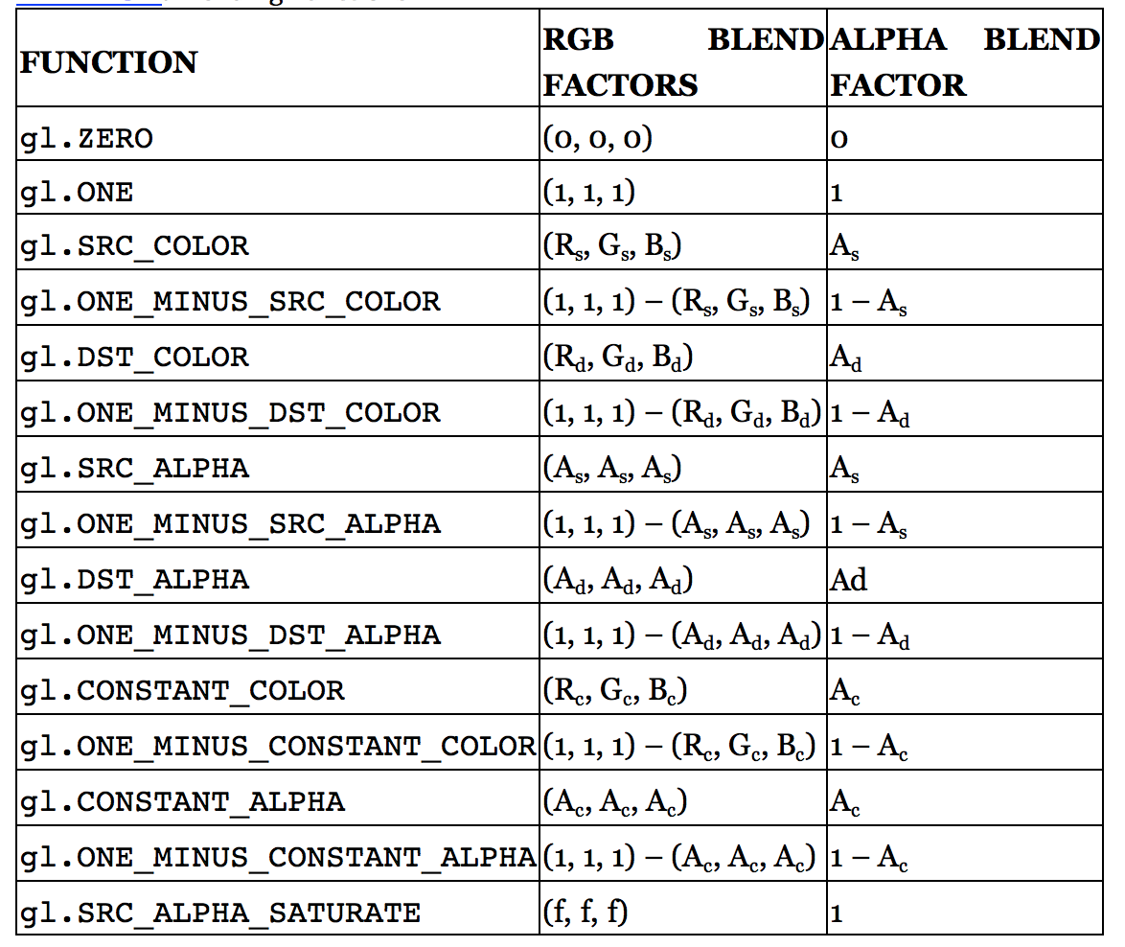
Blending
color_{final} = factor_{source} × color_{source} op factor_{dest} × color_{dest}

Slide 17
Changing the Blending Operator
gl.blendEquation(Glenum mode);
Lets you specify the blending operation.
Addition is the default.
//colorfinal = factorsource × colorsource + factordest × colordest gl.blendEquation(GL_FUNC_ADD);
//colorfinal = factorsource × colorsource − factordest × colordest
gl.blendEquation(GL_FUNC_SUBTRACT);
//colorfinal = factordest × colordest − factorsource × colorsource
gl.blendEquation(GL_FUNC_REVERSE_SUBTRACT);

Slide 18
Blending
gl.blendFunc(GLenum sfactor, GLenum dfactor);
Lets you specify the blending function for both the RGB and Alpha values for both the source and destination
gl.blendFunc(gl.SRC_ALPHA, gl.ONE_MINUS_SRC_ALPHA);
Is the traditional way to implement alpha blending in the style if non-pre-multiplied alpha.
Is this correct?

Slide 19
Blending
gl.blendFunc(GLenum sfactor, GLenum dfactor);
Lets you specify the blending function for both the RGB and Alpha values for both the source and destination
gl.blendFunc(gl.SRC_ALPHA, gl.ONE_MINUS_SRC_ALPHA);
Is the traditional way to implement alpha blending in the style if non-pre-multiplied alpha.
Is this correct? New alpha is calculated incorrectly….should use gl.blendFuncSeparate(gl.SRC_ALPHA, gl.ONE_MINUS_SRC_ALPHA, gl.ONE, gl.ONE_MINUS_SRC_ALPHA);

Slide 20
Pre-multiplied Alpha
Non-pre-multiplied alpha example: (1.0, 0.0, 0.0, 0.5)
Pre-multiplied alpha example: (0.5, 0.0, 0.0, 0.5)
For blending use:
PNG images use non-pre-multipled alpha
in case you are loading colors from an image
When you load use gl.UNPACK_PREMULTIPLY_ALPHA_WEBGL
You should use pre-multiplied alpha in your code
gl.blendFunc(gl.ONE, gl.ONE_MINUS_SRC_ALPHA);

Slide 21
Blending and Drawing Order
// 1. Enable depth testing, make sure the depth buffer is writable // and disable blending before you draw your opaque objects. gl.enable(gl.DEPTH_TEST); gl.depthMask(true); gl.disable(gl.BLEND); // 2. Draw your opaque objects in any order (preferably sorted on state) // 3. Keep depth testing enabled, but make depth buffer read-only // and enable blending gl.depthMask(false); gl.enable(gl.BLEND); // 4. Draw your semi-transparent objects back-to-front // 5. If you have UI that you want to draw on top of your // regular scene, you can finally disable depth testing gl.disable(gl.DEPTH_TEST); // 6. Draw any UI you want to be on top of everything else
Anyuru, Andreas Professional WebGL Programming: Developing 3D Graphics for the Web

Slide 22
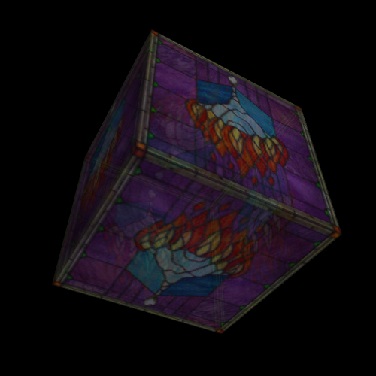
Blending in WebGL

Slide 23
Hidden Surface Removal
Hidden Surface Removal
…don’t render surfaces occluded by surfaces in front of them
Was a significant area of research in early days of CG
…lots of algorithms suggested
Painter’s Algorithm
Render objects in order from back to front
i.e. sort your triangles by depth and render deepest first
Can anyone imagine any problems with this approach?

Slide 24
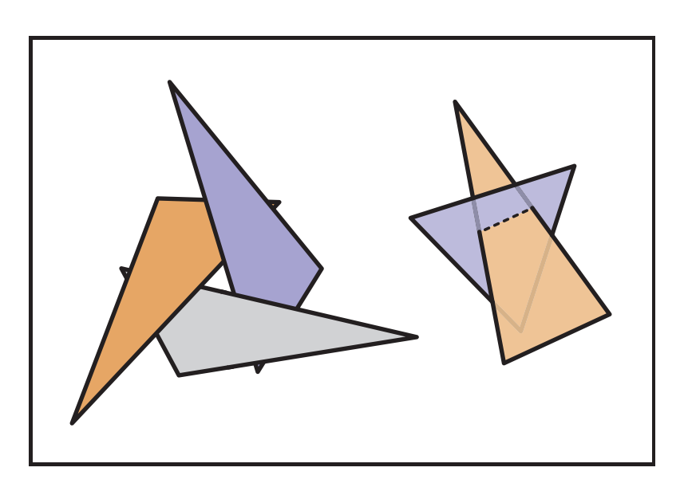
Problems with the Painter’s Algorithm
No correct rendering order for
intersecting triangle
occlusion cycles
Sorting is slow…too slow for interactivity in complex scenes

Slide 25
Hidden Surface Removal: Z-Buffer
Hidden Surface Removal: Z-Buffer
Key Observation: Each pixel displays color of only one triangle, Ignores everything behind it
Donʼt need to sort triangles, just find, for each pixel, the closest triangle
Z-buffer: one fixed or floating point value per pixel
Algorithm:
For each rasterized fragment (x,y)
If z < zbuffer(x,y) then framebuffer(x,y) = fragment color
zbuffer(x,y) = z
far
far
far
far
far
far
far
far
far
far
far
far
framebuffer
zbuffer
Frame Buffer: buffer that stores the colors for the pixels we will render

Slide 26
Z-Buffer
far
.1
.2
.3
.4
.5
.6
.7
.8
far
far
far
Key Observation: Each pixel displays color of only one triangle, ignores everything behind it
Donʼt need to sort triangles, just find for each pixel the closest triangle
Z-buffer: one fixed or floating point value per pixel
Algorithm:
For each rasterized fragment (x,y)
If z < zbuffer(x,y) then framebuffer(x,y) = fragment color
zbuffer(x,y) = z
framebuffer
zbuffer

Slide 27
Z-Buffer
Key Observation: Each pixel displays color of only one triangle, ignores everything behind it
Donʼt need to sort triangles, just find for each pixel the closest triangle
Z-buffer: one fixed or floating point value per pixel
Algorithm:
For each rasterized fragment (x,y)
If z < zbuffer(x,y) then framebuffer(x,y) = fragment color
zbuffer(x,y) = z
far
.1
.2
.3
.4
.3
.1
.7
.8
far
far
far
framebuffer
zbuffer

Slide 28
Z-Buffer
far
.1
.2
.3
.4
.3
.1
.7
.8
far
far
far
Get fragment z-values by interpolating z-values at vertices during rasterization
True perspective projection destroys z-values, setting them all to –d
The perspective distortion we use preserves at least the ordering of z-values
framebuffer
zbuffer

Slide 29
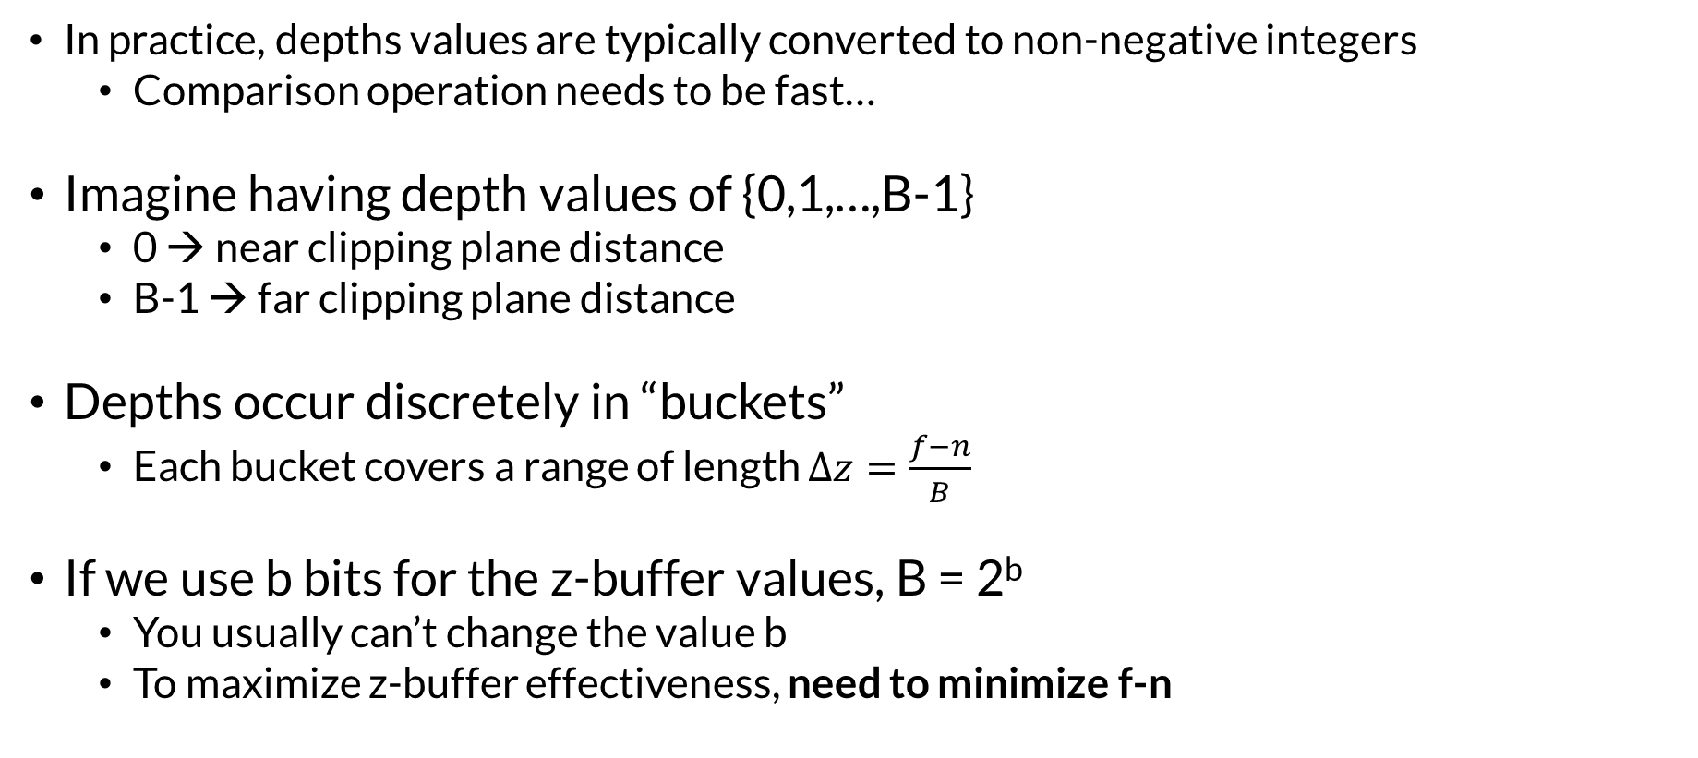
Precision Issues with Z-Buffering
In practice, depths values are typically converted to non-negative integers
Comparison operation needs to be fast…
Imagine having depth values of {0,1,…,B-1}
0 → near clipping plane distance
B-1 → far clipping plane distance
Depths occur discretely in “buckets”
Each bucket covers a range of length $∆z=\frac{f−n}{B}$
If we use b bits for the z-buffer values, B = 2^{b}
You usually can’t change the value b
To maximize z-buffer effectiveness, need to minimize f-n

Slide 30
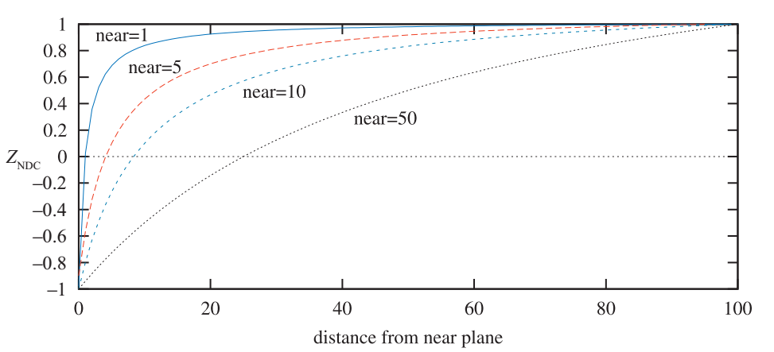
…More Precision Issues with Z-Buffering
The effect of varying the distance of the near plane from the origin. The distance f−n is kept constant at 100. As the near plane becomes closer to the origin, points nearer the far plane use a smaller range of the normalized device coordinate (NDC) depth space. This has the effect of making the z-buffer less accurate at greater distances.
Real-Time Rendering, Fourth Edition

Slide 31
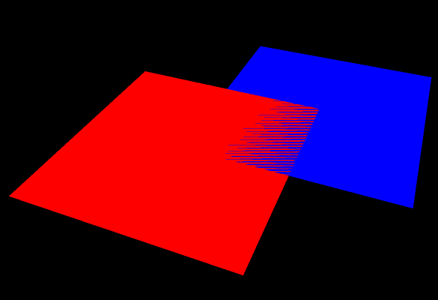
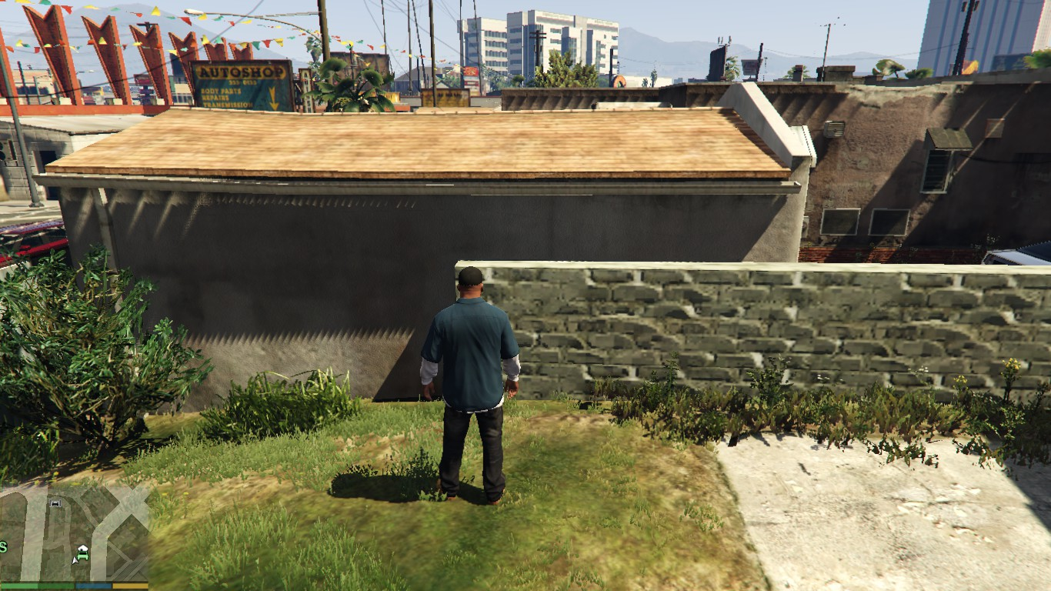
Z-Fighting
How can you fix z-fighting?

Slide 32
Z-Fighting
How can you fix z-fighting?
Move co-planar polygons slightly away from each other
Move near and far clipping planes as close together as you feasibly can

Slide 33
WebGL Hidden Surface Removal
gl.enable(gl.DEPTH_TEST); // use depth test for hidden surface remove
gl.depthFunc(gl.LESS); //this is the default
gl.clear(gl.DEPTH_BUFFER_BIT); // clear depth values form previous frame
Hidden surface removal uses the depth buffer (z-buffer)
Happens after the fragment shader

Slide 34
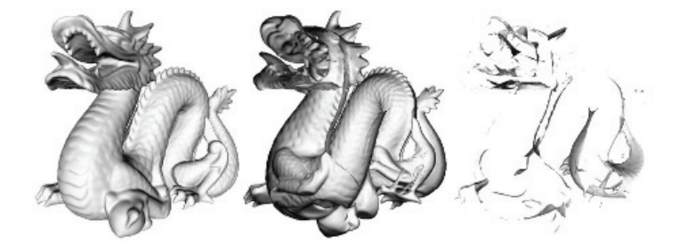
Order Independent Transparency
Alpha blending works for sorted rendering
Front to back
Back to front
Doesn’t work for out-of-order
Front, back, middle
Depth-peeling is an algorithm for order-independent blending

Slide 35
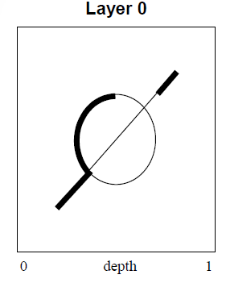
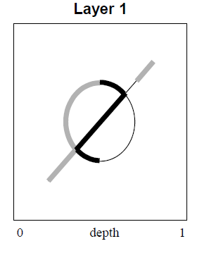
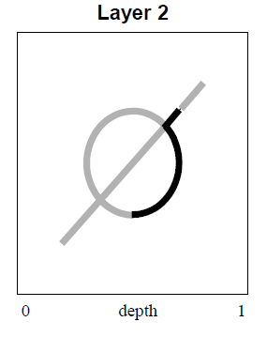
Depth Peeling
Cass Everett, NVIDIA
Needs 2 z-buffers (previous, current)
One rendering pass per layer
Fragment written to frame buffer if
Farther than previous z-buffer
Closer than current z-buffer
After each pass, current z-buffer written to previous z-buffer
Surviving fragment composited “under” displayed fragment

Slide 36
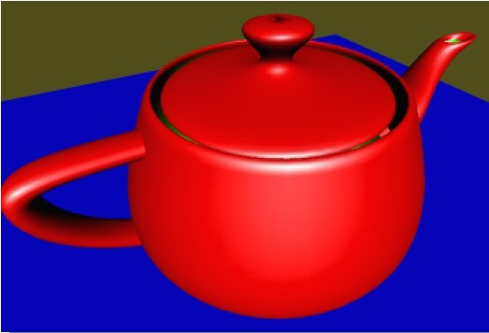
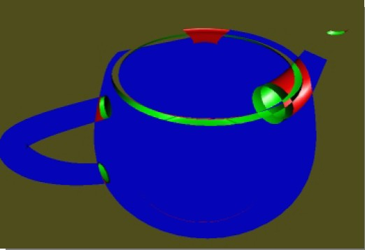
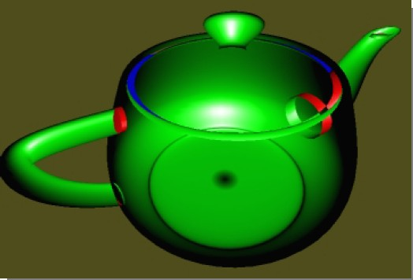
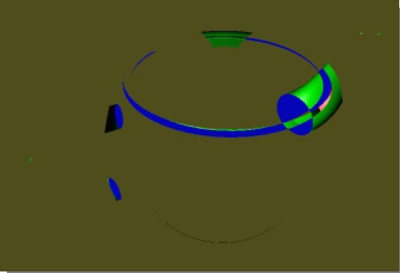
Depth Peels – Which Layer is Which?

Slide 37
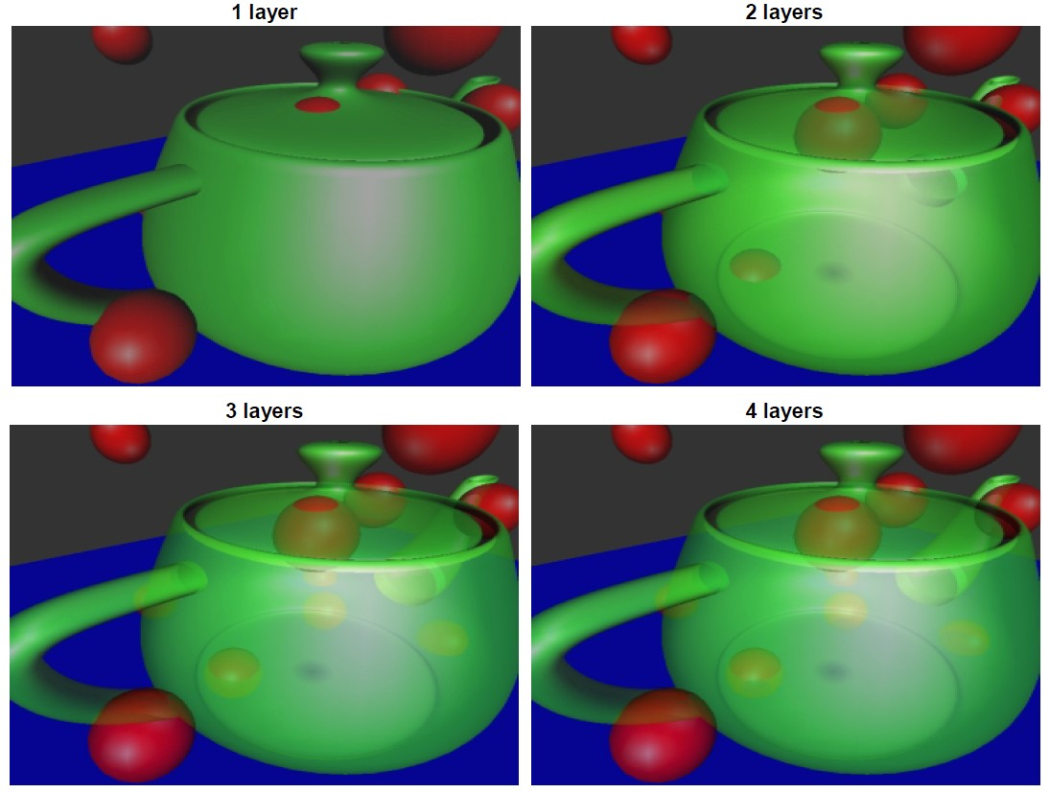
Results

Slide 38

Alternatives to Depth Peeling
Loren Carpenter proposed the A-Buffer in 1984
Linked list of fragments with depth and alphas at each screen location
Problematic for earlier generations of GPUs
Even now, memory must be pre-allocated and can easily run out
Not commonly used…performance
Multi-layer alpha blending
Possibly sort and blend first few layers correctly
Deeper layers blended using two buffers…one for opaque, one transparent

Slide 39
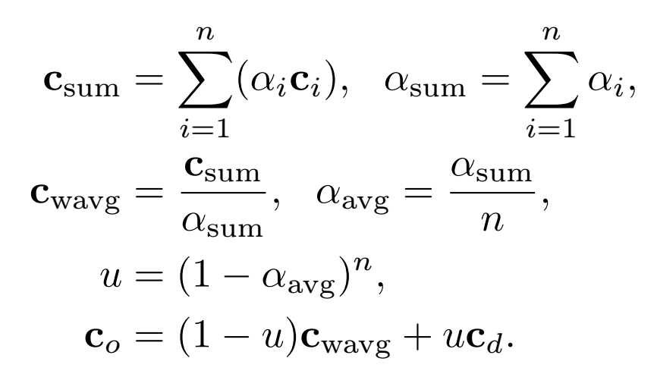
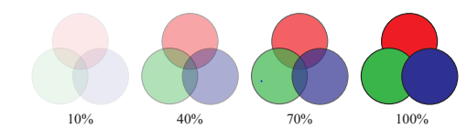
Multi-layer Blending: Weighted Average
Avoids problems with weighted sum
Saturated color values
Alphas exceeding 1.0
Order is more important at higher opacity

Slide 40
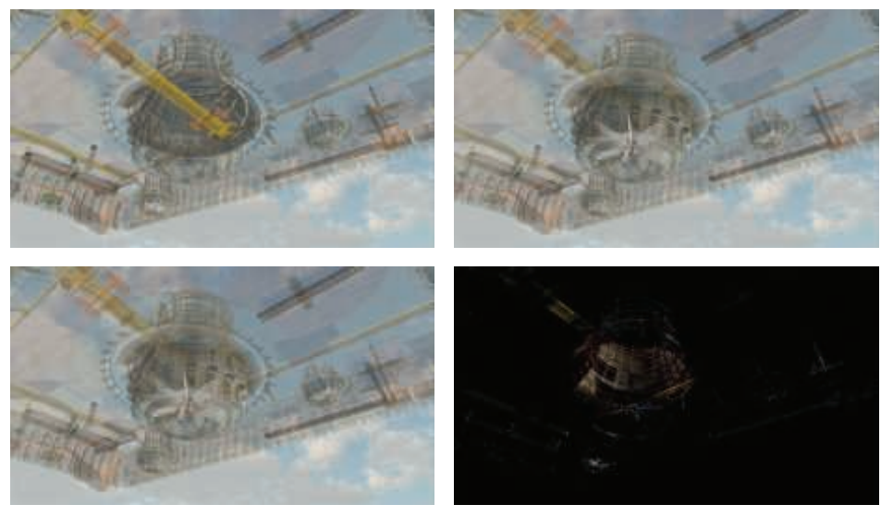
Examples
In the upper left, traditional back-to-front alpha blending is performed, leading to rendering errors due to incorrect sort order. In the upper right, the A-buffer is used to give a perfect, non-interactive result. The lower left presents the rendering with multi-layer alpha blending. The lower right shows the differences between the A-buffer and multi-layer images.(Images courtesy of Marco Salvi and Karthik Vaidyanathan, Intel Corporation.)
Real-Time Rendering, Fourth Edition

Slide 41




Is Over Associative?
A over (B over C)
= C_{A} + (1- α _{A})(C_{B} + (1- α _{B})C_{C})
= C_{A} + (1- α _{A})C_{B} + (1- α _{A})(1- α _{B})C_{C}
= C_{AB} + (1 – α_{A} – (1- α _{A}) α _{B})C_{C}
= C_{AB} + (1- α _{AB}) C_{C}
= (A over B) over C
What about α ?
= α _{A} + (1- α _{A}) α _{BC}
= α _{A} + (1- α _{A})(α _{B} + (1- α _{B}) α _{C})
= α _{A} + (1- α _{A}) α _{B} + (1- α _{A})(1- α _{B}) α _{C}
= α _{AB} + (1- α _{AB}) α _{C}
C
B
A

