Slide 1

Computing and Transforming Surface Normals
CS 418: Interactive Computer Graphics
UNIVERSITY OF ILLINOIS AT URBANA-CHAMPAIGN
Eric Shaffer

Slide 2
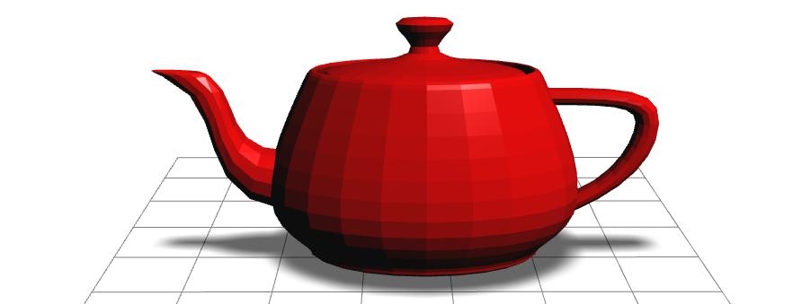
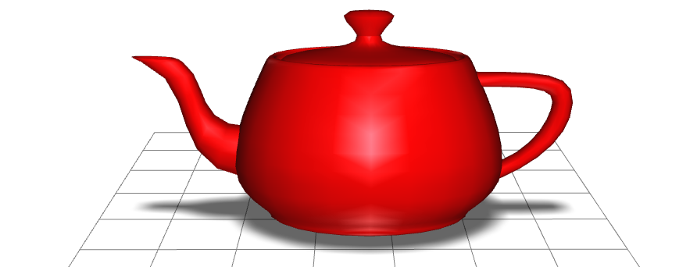
Normal Vectors on Surface Meshes
Can be defined per face or per vertex
Per face normal of a ccw face
n = (v₁ – v₀)×(v₂ – v₀)
Needs to be unitized before lighting
Per vertex normal
Sum of normals of adjacent faces
Needs to be normalized

Slide 3
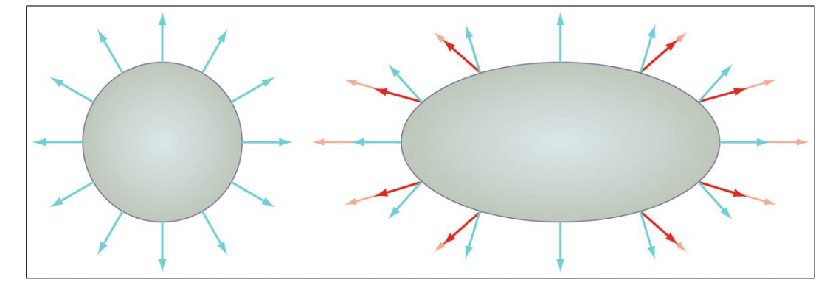
Transforming Normal Vectors
The light red normal vectors are transformed by the same scale matrix as the vertices
Dark red normals are unit length version of the transformed normal
The blue normals are the correct normal…
How can we transform the normal correctly?

Slide 4
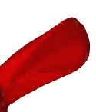
Transforming Normals
First order neighborhood of a point on a surface described by a tangent plane
A tangent vector t at a point and the normal n are orthogonal
So t•n=t^{T}n=0
This should be true of the transformed geometry as well
Let M be the modelview matrix
So we seek a matrix X such that (M t)•(Xn)= (Mt)^{T}(Xn)=0 (Mt)^{T}(Xn)=t^{T}M^{T}Xn=0 if M^{T}X=I So X = (M^{T})⁻¹=(M⁻¹) ^{T}

Slide 5
Computing the Inverse Transpose
If your ModelView only uses uniform scaling and rotations and translations
you can transform normals by the top left 3x3 portion of the ModelView matrix
Why?
Otherwise explicitly compute the inverse transpose
Only operate on the 3x3 portion (much faster that inverting 4x4)
Use a numerical library function to invert the matrix
Or keep track of the inverse transpose as you build the ModelView
In either case: always normalize the normal to unit length afterwards

Slide 6
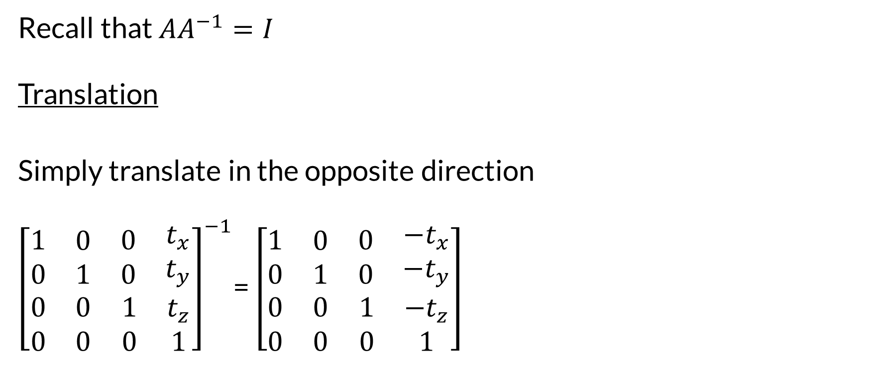
Inverting Affine Transformation Matrices
Recall that ${AA}^{−1}=I$
Translation
Simply translate in the opposite direction
${\left[\begin{matrix}\begin{matrix}\begin{matrix}1 \\ 0\end{matrix} & \begin{matrix}0 \\ 1\end{matrix}\end{matrix} & \begin{matrix}\begin{matrix}0 \\ 0\end{matrix} & \begin{matrix}t_{x} \\ t_{y}\end{matrix}\end{matrix} \\ \begin{matrix}0 & 0 \\ 0 & 0\end{matrix} & \begin{matrix}1 & t_{z} \\ 0 & 1\end{matrix}\end{matrix}\right]}^{−1}$= $\left[\begin{matrix}\begin{matrix}\begin{matrix}1 \\ 0\end{matrix} & \begin{matrix}0 \\ 1\end{matrix}\end{matrix} & \begin{matrix}\begin{matrix}0 \\ 0\end{matrix} & \begin{matrix}{−t}_{x} \\ −t_{y}\end{matrix}\end{matrix} \\ \begin{matrix}0 & 0 \\ 0 & 0\end{matrix} & \begin{matrix}1 & {−t}_{z} \\ 0 & 1\end{matrix}\end{matrix}\right]$

Slide 7
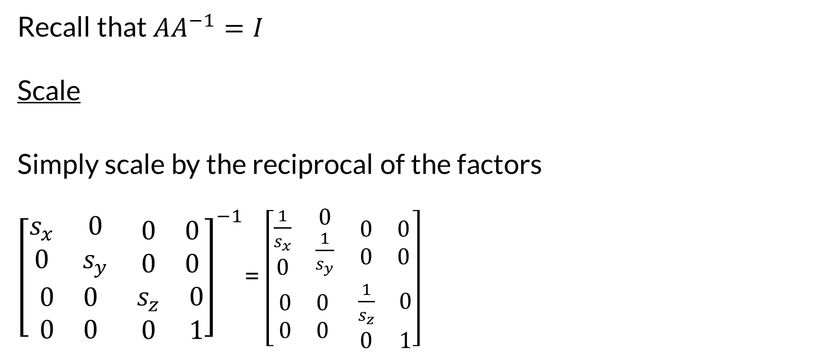
Inverting Scale Matrices
Recall that ${AA}^{−1}=I$
Scale
Simply scale by the reciprocal of the factors
${\left[\begin{matrix}\begin{matrix}s_{x} & 0 \\ 0 & s_{y}\end{matrix} & \begin{matrix}\begin{matrix}0 \\ 0\end{matrix} & \begin{matrix}0 \\ 0\end{matrix}\end{matrix} \\ \begin{matrix}0 & 0 \\ 0 & 0\end{matrix} & \begin{matrix}s_{z} & 0 \\ 0 & 1\end{matrix}\end{matrix}\right]}^{−1}$= $\left[\begin{matrix}\begin{matrix}\begin{matrix}\frac{1}{s_{x}} \\ 0\end{matrix} & \begin{matrix}0 \\ \frac{1}{s_{y}}\end{matrix}\end{matrix} & \begin{matrix}\begin{matrix}0 \\ 0\end{matrix} & \begin{matrix}0 \\ 0\end{matrix}\end{matrix} \\ \begin{matrix}0 & 0 \\ 0 & 0\end{matrix} & \begin{matrix}\frac{1}{s_{z}} & 0 \\ 0 & 1\end{matrix}\end{matrix}\right]$

Slide 8
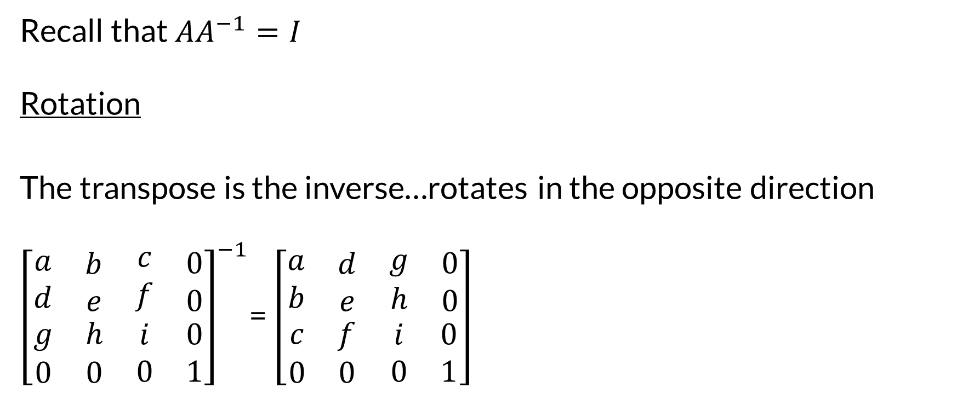
Inverting Affine Transformation Matrices
Recall that ${AA}^{−1}=I$
Rotation
The transpose is the inverse…rotates in the opposite direction
${\left[\begin{matrix}\begin{matrix}\begin{matrix}a \\ d\end{matrix} & \begin{matrix}b \\ e\end{matrix}\end{matrix} & \begin{matrix}\begin{matrix}c \\ f\end{matrix} & \begin{matrix}0 \\ 0\end{matrix}\end{matrix} \\ \begin{matrix}g & h \\ 0 & 0\end{matrix} & \begin{matrix}i & 0 \\ 0 & 1\end{matrix}\end{matrix}\right]}^{−1}$= $\left[\begin{matrix}\begin{matrix}\begin{matrix}a \\ b\end{matrix} & \begin{matrix}d \\ e\end{matrix}\end{matrix} & \begin{matrix}\begin{matrix}g \\ h\end{matrix} & \begin{matrix}0 \\ 0\end{matrix}\end{matrix} \\ \begin{matrix}c & f \\ 0 & 0\end{matrix} & \begin{matrix}i & 0 \\ 0 & 1\end{matrix}\end{matrix}\right]$

Slide 9
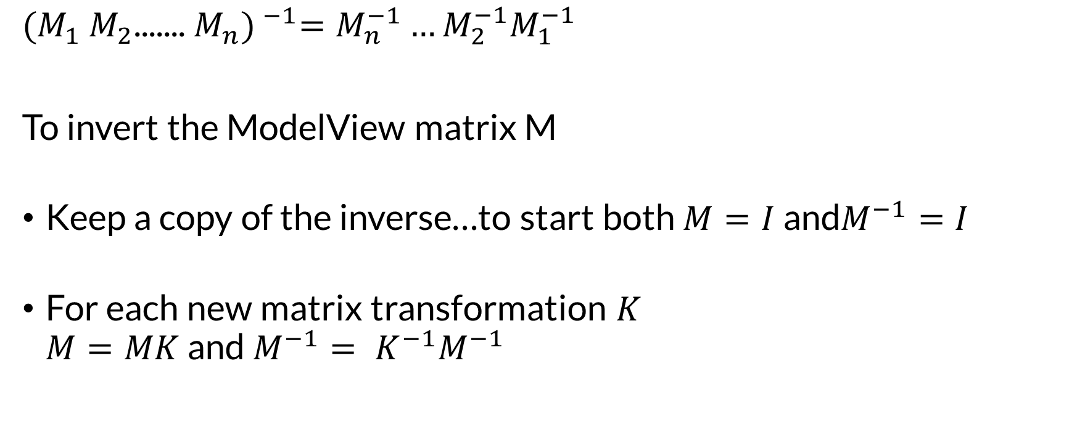
Inverting Matrix Products
$${(M_{1} M_{2}\text{....... }M_{n}) }^{−1}=M_{n}^{−1}…M_{2}^{−1}M_{1}^{−1}$$
To invert the ModelView matrix M
Keep a copy of the inverse…to start both $M=I$ and$M^{−1}=I$
For each new matrix transformation $K$ $M=MK$ and $M^{−1}= K^{−1}M^{−1}$

Slide 10
Computing per-Vertex Normals
To compute per-vertex normal on a mesh with M vertices
Initialize an array NArray containing M normals
Each normal starts as [0,0,0]
Iterate over all triangles T=[v1,v2,v3] with vi in CCW order
Compute normal N for T using N = (v2-v1)X(v3-v1)
NArray[v1]=(Narray[v1]+N)
NArray[v2]=(Narray[v2]+N)
NArray[v3]=(Narray[v3]+N)
Normalize each normal in Narray to unit length

Slide 11
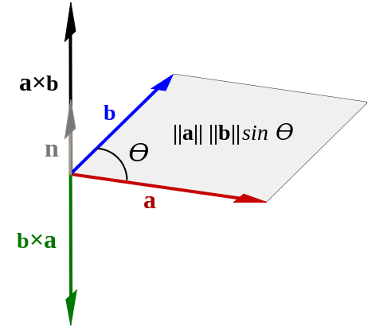
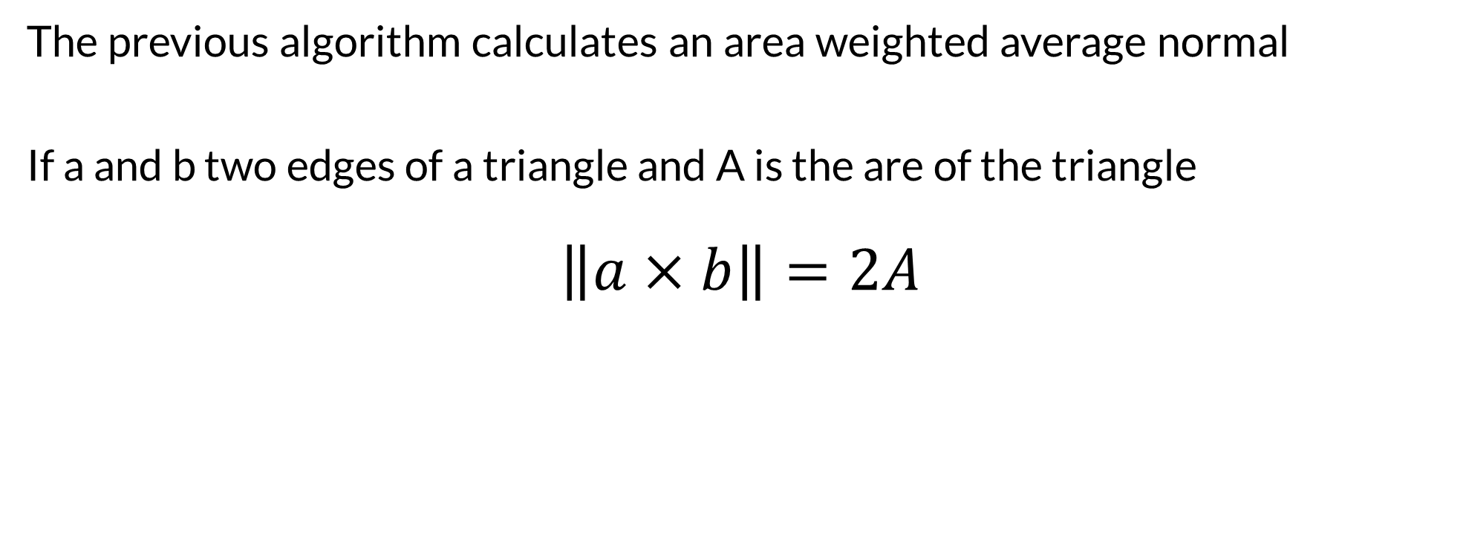
Average Vertex Normals
The previous algorithm calculates an area weighted average normal
If a and b two edges of a triangle and A is the are of the triangle $$\left\|a×b\right\|=2A$$

Slide 12
Average Vertex Normals
There is no single “correct” way to calculate the average vertex normal
Assuming that the mesh is approximating a smooth surface we could:
Use a uniformly weighted average
by making each triangle normal unit length before adding it in
Use triangle area weighting
by scaling each triangle normal by a factor of ½
Use parallelogram area weighting
by just using the normal resulting from the cross product
All of these methods are approximations and have tradeoffs
Triangle area weighting is probably most commonly used

