Slide 1

Motion in Real and Virtual Worlds
CS 498VR: Virtual Reality
UNIVERSITY OF ILLINOIS AT URBANA-CHAMPAIGN
Eric Shaffer

Slide 2
Mathematical Modeling of Motion
The physics of both real and virtual worlds impact VR experiences.
We will look at
How phsyics engines model motion in VR
How motion tracking methods rely on accelerations and velocities
How human vestibular organs rely on accelerations and velocities

Slide 3
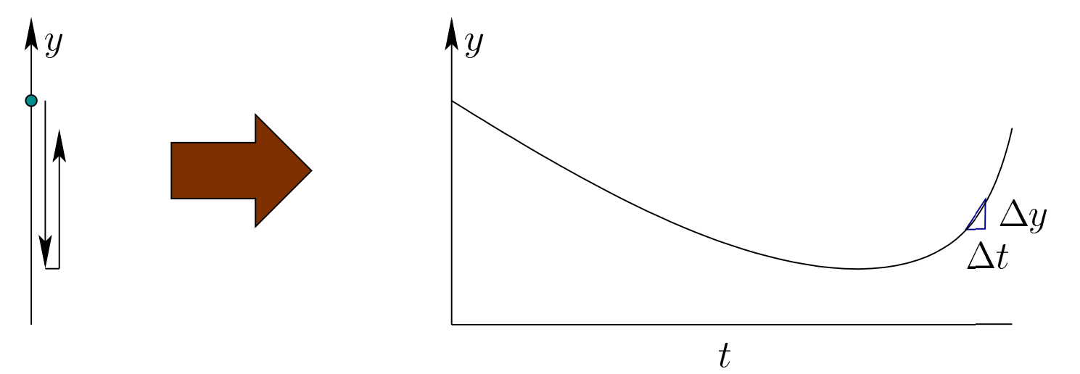
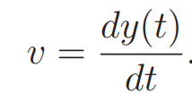
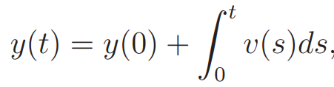


1D Motion
Suppose y(t) gives a position at a given time
How do you compute y(t) if you can measure velocity
Numerically we have since
Notes:
Sensor for v(t) is odometer
For constant v(t), y(t) = ? y(t) = y0 + vt For unconstant v(t), y(t) = ? numerical solution only

Slide 4

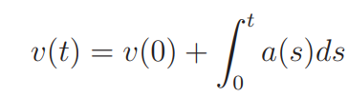

Acceleration
Acceleration is the rate of change of the velocity
We can approximate this numerically as before

Slide 5
Error
Numerically we have
We are approximating an integral by stepping in the direction of the velocity
This is called Euler Integration
Error is proportional to the size of the timestep O(Δt)…which is not good
Using a higher order method like 4th order Runge-Kutta (RK4) would be better
Notes:
Sensor for v(t) is odometer
For constant v(t), y(t) = ? y(t) = y0 + vt For unconstant v(t), y(t) = ? numerical solution only

Slide 6
A Simple Newtonian Physics Engine
We will animate particles (aka point masses)
Position is changed by velocity
Velocity is changed by acceleration
Forces alter acceleration
Our physics engine will integrate to compute
Position
Velocity
We set the acceleration by applying forces

Slide 7
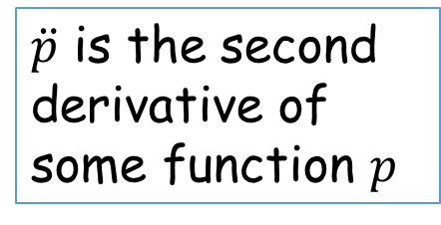
Mass and Acceleration
To find the acceleration due to a force we have
So we need to know the inverse mass of the particle
You can model infinite mass objects by setting this value to 0
$\ddot{p}$ is the second derivative of some function $p$

Slide 8
Force: Gravity
Law of Universal Gravitation
G is a universal constant
m_{i} is the mass of object I
r is the distance between object centers
we care only about gravity of the Earth
m1 and r are constants
r is about 6400 km on Earth
We simplify to f = mg
g is about 10ms⁻²
For gaming, 10ms⁻² tends to look boring
Shooters often use 15ms⁻²
Driving games often use 20ms⁻²
Some tune g object-by-object

Slide 9
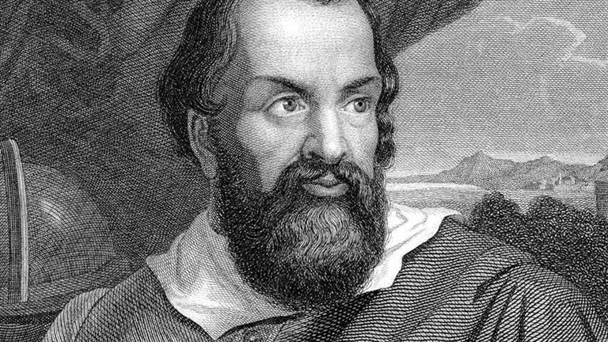
Force: Gravity
If we consider acceleration due to gravity we have
So acceleration due to gravity is independent of mass

Slide 10
Force: Drag
Drag dampens velocity
Caused by friction with the medium the object moves through
Even neglecting, you need to dampen velocity
Otherwise numerical errors likely drive it higher than it should be
A velocity update with drag can be implemented as
important to incorporate time so drag changes if the frame rate varies

Slide 11
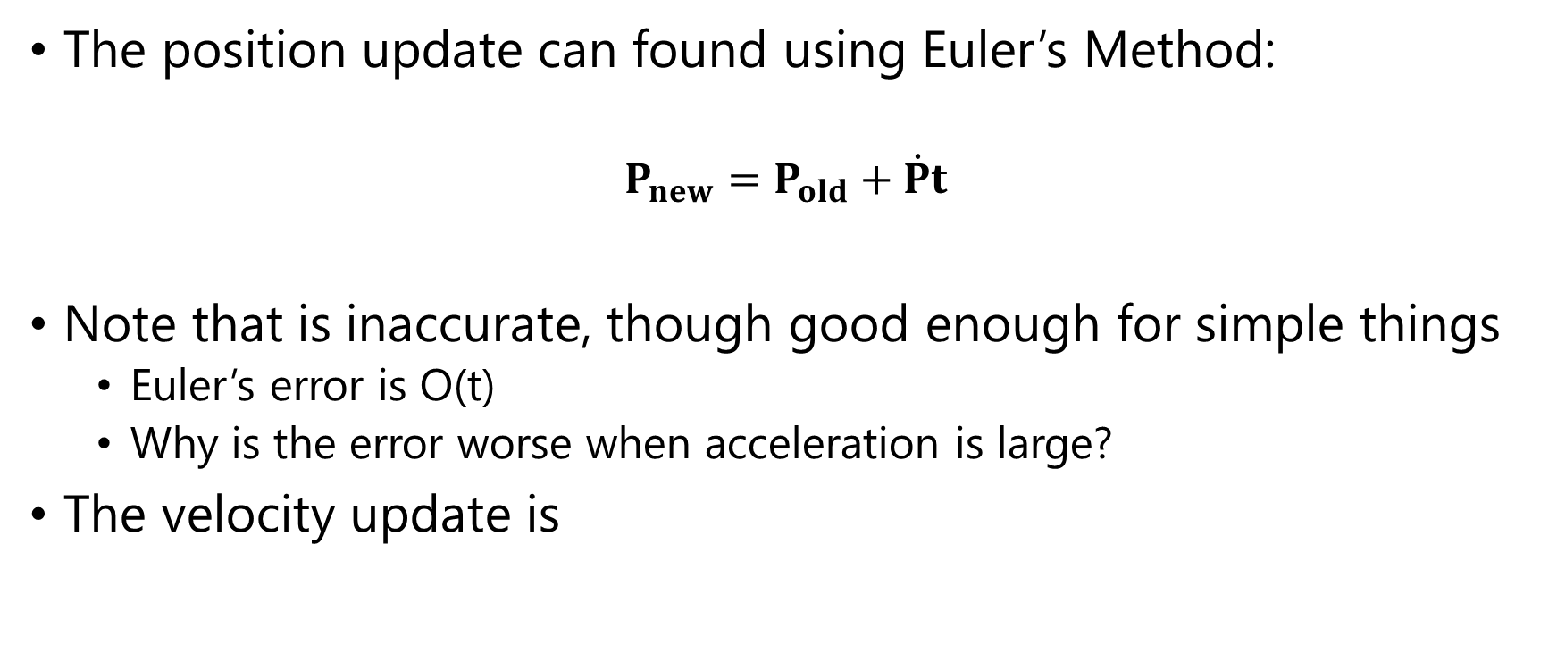
The Integrator
The position update can found using Euler’s Method:
$$P_{new}=P_{old}+\dot{P}t$$
Note that is inaccurate, though good enough for simple things
Euler’s error is O(t)
Why is the error worse when acceleration is large?
The velocity update is

Slide 12
Collision Detection
Often requires use of bounding volumes or spatial data structures
Broad Phase: Uses bounding volumes to quickly determine which objects need to be checked closely for collision
Narrow Phase: Perform careful, expensive collision checks, such as triangle-triangle intersection for meshes

Slide 13
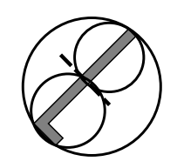
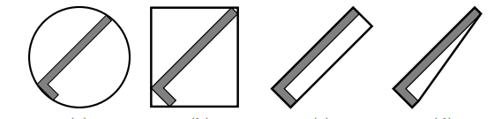
Bounding Volumes
Sphere AABB OOBB Convex Hull Hierarchical (BVH)
AABB=Axis Aligned Bounding Box
OOBB = Object-Oriented Bounding Box
BVH = Bounding Volume Hierarchy

Slide 14
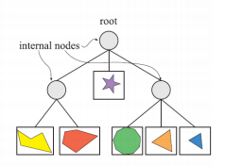
BVH Construction
Can be constructed top down:
Compute bounding volume enclosing all of the geometry
Split the geometry into two or more groups
Compute bounding volume for each group
Recurse
Leaf nodes will enclose only one geometric primitive
Can also be built by bottom up merging which offers better parallelism

Slide 15
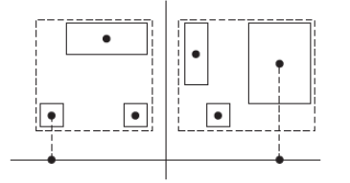
BVH: How to Split
Can compute a centroid for each geometric primitive
Split on median centroid, along longest axis
Split on average centroid, along longest axis
More sophisticated splitting criteria can be used
E.g. Surface Area Heuristic used on BVHs for ray-tracing

Slide 16
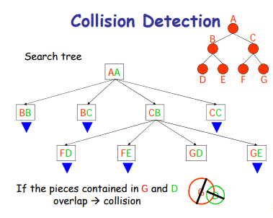
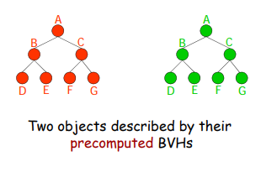
BVH: How to Collide
Ina single BVH for scene
Two geometric primitives can overlap only if their volumes overlap
Or, BVHs can be used for each composite object (e.g. mesh)
A search tree is constructed that records descent into each BVH
Determines if any cells overlap

Slide 17
Collision Detection
Surprisingly complex topic
Even a high-quality engine like Unity has issues
We will discuss how to simulate only two types of collision
Sphere-Wall
Sphere-Sphere
We check for a collision when updating position
If a collision occurs the velocity vector is altered
Position is determined by the contact
Position and velocity update are completed with new values
over the remaining time

Slide 18
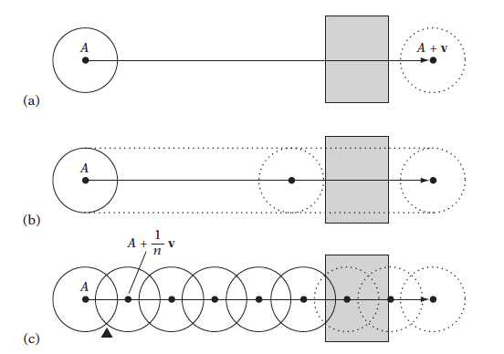
Dynamic Collision Detection
Dynamic collision tests an exhibit tunneling
if only the final positions of the objects are tested (a)
Or even if the paths of the objects are sampled (c)
A sweep test assures detection but may not be computationally feasible.

Slide 19
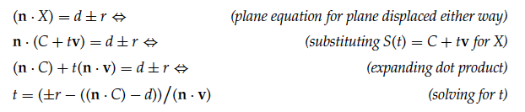
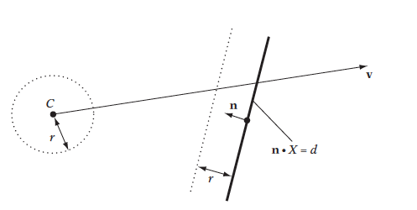
Sphere-Plane Collision
Can make it even simpler for the box walls in MP. How?

Slide 20

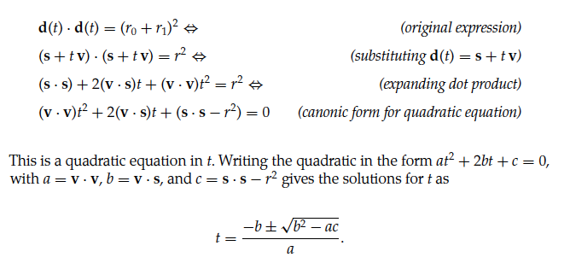
Sphere-Sphere Collision

Slide 21
Collision Resolution
First, find closing (aka separating) velocity
Component of velocity of two objects in direction from one to another
Collisions that preserve momentum are perfectly elastic
We will use v_{s_after} = -cv_{s}
c is the coefficient of restitution…a material property that you choose

Slide 22
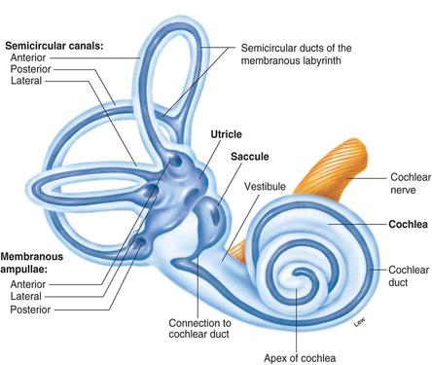
Perceiving Motion: the Human Vestibular System
What You Should Learn
Elements of the vestibular system
How they sense motion
Define vection
Identify factors that affect vection
Describe the effects of VR sickness
VR design principles for user comfort
Notes:
Image from: http://www.ourclipart.com/clipart/winding%20path%20clipart/#gal_winding-path-clipart_2211515.jpg

Slide 23
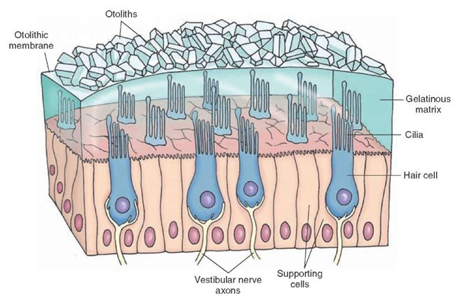
Otolith Organs - Linear Acceleration
Gelatinous matrix
Made of cilia (hair cells)
Converts acceleration into neural signals
Utricle → lateral acceleration
Saccule → vertical acceleration
Notes:
Otolithic membrane contains heavy calcium carbonate crystals called otoliths or otoconia. The heavy weight on the gelatinous matrix means that tilting or translational movements applies a shearing force to the cilia. The higher the acceleration magnitude, the larger the bending and a higher rate of neural impulses is transmitted.
Utricle - when accel is parallel to ground, saccule when orthogonal to the ground
Image from: http://what-when-how.com/neuroscience/auditory-and-vestibular-systems-sensory-system-part-2/

Slide 24
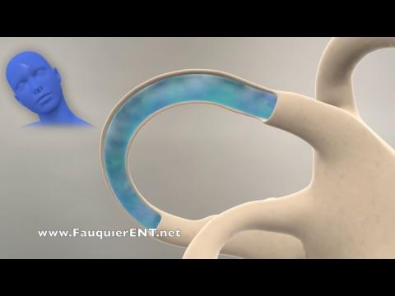
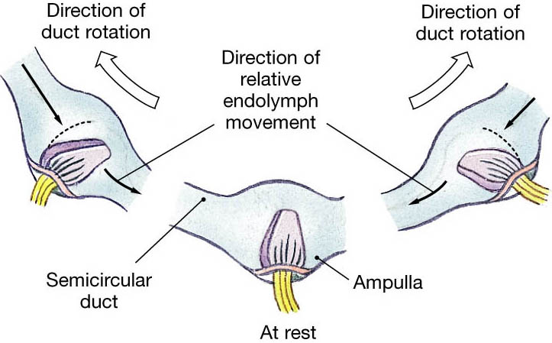
Semicircular Canals - Angular Acceleration
Notes:
For sensing angular acceleration, we have the semicircular canals.This video will explain how they work.
There are cilia in cupula (inside the ampulla) in the canals. Movement of the the fluid inside the canals causes the cilia to bend, which again is converted into neural signals sent to the brain.
Image from: http://droualb.faculty.mjc.edu/Lecture%20Notes/Unit%205/special_senses%20Spring%202007%20with%20figures.htm
Video from: https://www.youtube.com/watch?v=YMIMvBa8XGs

Slide 25
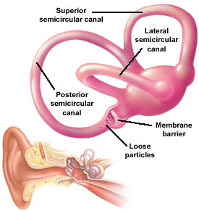
Semicircular Canals - Angular Acceleration
Anterior canal - pitch on yz plane
Lateral canal - yaw on xz plane
Posterior canal - roll on the xy plane
Notes:
Measure angular acceleration, not velocity because constant velocity does not apply shearing pressure to the cupula
Image from: http://www.medicalook.com/systems_images/Semicircular_canals.jpg

Slide 26
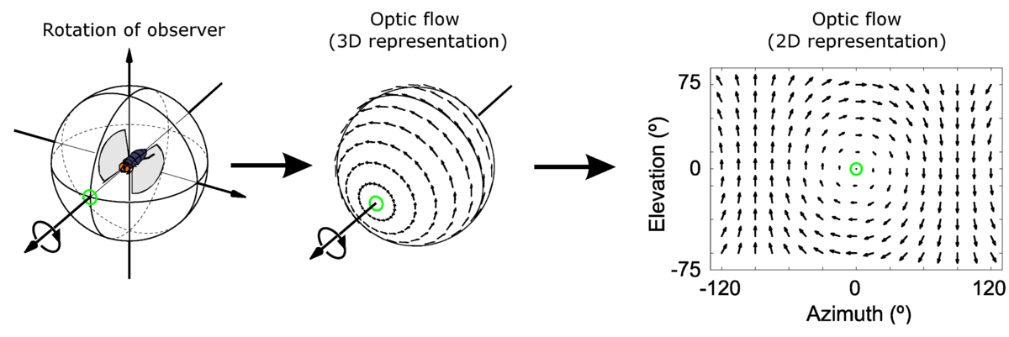
Optical Flow Pattern of Apparent Motion of Objects
LaValle, Ch 8.4
Notes:
We’re going to go back to something we talked about in the last lecture, optical flow. Remember the picture with the arrows on it pointing in the directions of movement smearing? That is a representation of the pattern of apparent motion that we perceive when we view movement. If I rotate to the right, it appears to me that everything is moving left. These smudges in our visual field aren’t something we think about, but they tell our brain about the movement of objects around us.
See chapter 8.4 for 6 types of optical flow
Image from: https://en.wikipedia.org/wiki/Optical_flow
Vestibular cues and sensation of gravity are weak compared w/ other sensory stimuli, but still important - skier buried in an avalanche can’t determine up w/o visual cues Very important to understand vestibular-ocular mismatch because this creates VR sickness!Image from: https://soterixmedical.com/research/vestibular

Slide 27
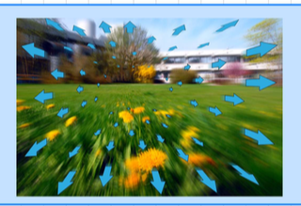
Optical Flow Pattern of Apparent Motion of Objects
Optical flow that contrasts with other perceptions can cause vection
Notes:
Going back to the image from last lecture, you see the smudging as items appear to drag across our visual field.
Why does this matter? Because our brains perceive motion based on this visual cue.
Vestibular cues and sensation of gravity are weak compared w/ other sensory stimuli, but still important - skier buried in an avalanche can’t determine up w/o visual cues Very important to understand vestibular-ocular mismatch because this creates VR sickness!Image from: https://soterixmedical.com/research/vestibular

Slide 28
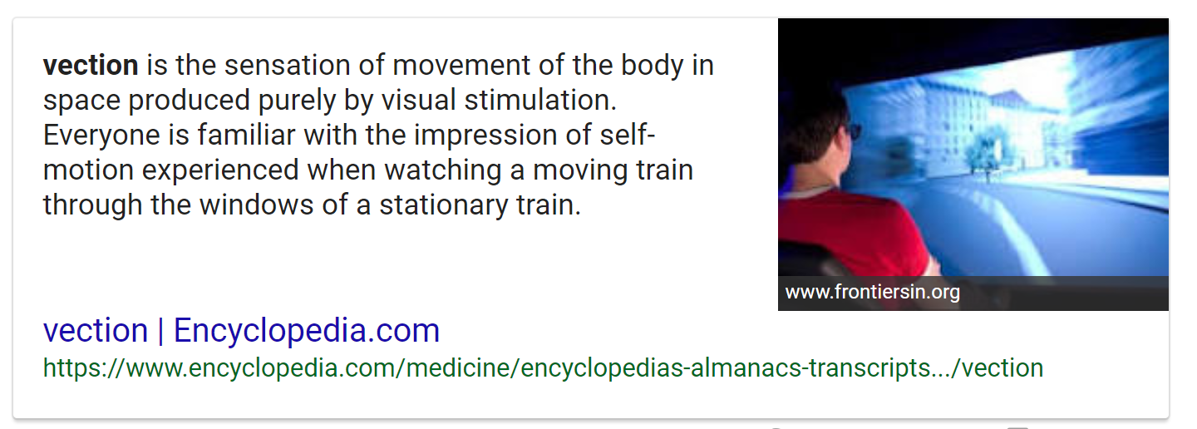
Vection Defined
Better VR has a greater chance of causing vection

Slide 29

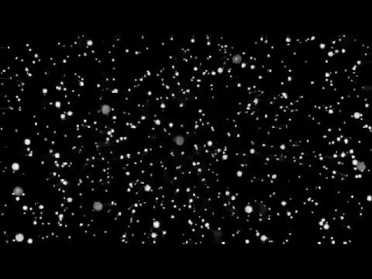

Vection: Illusion of Self-motion
What causes vection?
LaValle Ch 2.3, 6.2 & 8.4
Notes:
Does this make you feel like you are moving? Watch the edges of the orbs.. They are smearing as they go past. This says to our brain, hey, movement is happening! These cues can then create vection.
Vection is the illusion of self-motion caused by variations in visual stimuli that create the perception that you are moving even though no actual motion is occuring. It is based on the visual cues in your field of view. Sensory conflict arises when your vision sense reports that you are accelerating but your balance sense reports that you are stationary.
Are you moving or is the screen moving?
https://www.youtube.com/watch?v=2c76ztYfUOA
https://www.youtube.com/watch?v=RDAPdERG6JM
https://www.youtube.com/watch?v=cZH6oLDCL0c

Slide 30
Factors that Affect Vection
Percentage of field of view in motion - lower amount of FOV in motion means vection less likely
Distance of motion from center of view - motion at periphery can cause yaw or forward/backward vection - motion at center may induce other types of vection
Exposure time - longer the flow is perceived, greater the effect
Spatial frequency - more objects create stronger optical flow and vection more likely
Contrast - better view of objects creates stronger optical flow
Notes:
I’m not going to spend a lot of time on this slide, though these are important to understand.
For yaw and forward/backward vection, optical flow vectors stronger at the periphery. But better visual acuity at the center of our vision also means stronger detection there

Slide 31
Factors that Affect Vection
Other sensory cues - wind blowing, sounds of objects moving past increase vection
Prior knowledge - knowing about motion ahead of time (turn steering wheel) can increase
Attention - distraction can minimize perception of vection
Adaptation - repeated, prolonged exposure can prevent vection
Notes:
I’m not going to spend a lot of time on this slide, though these are important to understand.
For yaw and forward/backward vection, optical flow vectors stronger at the periphery. But better visual acuity at the center of our vision also means stronger detection there

Slide 32
The Problem with Mismatched Cues from the Vestibular and Visual Senses
Notes:
Perhaps the band Disturbed spent a little too much time in a head-mounted display

Slide 33
VR Sickness Symptoms
VR Sickness (also called Simulator Sickness) causes:
Fatigue
Headache
Nausea
Dizziness
Drowsiness
Increased Salivation
Cold Sweating
Pallor
Warmth/Flushing
Accommodation Issues
Notes:
These are some of the not fun symptoms of VR / simulator / motion sickness. We want to avoid making people experience these things, or they will hate VR and never want to do it. It only takes getting really nauseated from one experience to be like.. Never going to do that again. So we need to control as much as we can on our end because there are things on the hardware end that are out of our control.

Slide 34

But…why?
Sensory Conflict Theory - conflicting sensory stimuli create processing burden
Forced fusion - perceptual systems must work harder to integrate mismatched information, resulting in fatigue, headache and eyestrain
Poison hypothesis - symptoms from ingesting toxins involve conflicts of visual and vestibular systems. We become nauseated from this mismatch and vomit to remove poison from our bodies
Notes:
Image from: https://pngtree.com/freepng/vomiting--nausea--emoji_3446006.html
“The Buoyancy Hypothesis posits that alcohol causes vertigo by affecting the neutral buoyancy of the cupula within the surrounding fluid called the endolymph. Linear accelerations (such as that of gravity) should not in theory effect a movement of the cupula when it is neutrally buoyant. The Buoyancy Hypothesis assumes that alcohol, with a different specific gravity from that of the cupula/endolymph, diffuses at different rates into the cupula and the surrounding endolymph. The result is a temporary density gradient between the cupula and endolymph, and a consequent (erroneous) sensitivity to linear accelerations such as that of gravity by a system normally signalling rotational accelerations.^{[1]} This sensation is commonly referred to as "the spins"^{[citation needed]}.” - from https://en.wikipedia.org/wiki/Ampullary_cupula

Slide 35
Developer Recommendations
Virtual Worlds - less locomotion (e.g. elevator, not stairs)
Visual Rendering - avoid movement of objects in most of visual field Visual Rendering – reduce brightness and contrast
Visual Rendering – high, constant framerate
Tracking – no latency!
Interaction - reduce real-world motion to prevent gorilla arms
User Interface - embed into the virtual world to minimize head movement
LaValle, Ch 12.2
Notes:
These, and many additional super helpful pieces are in Chapter 12 in the book, so please read it!
We really didn’t get into as much of the UI stuff as I would have liked, so come talk to me if you are interested. I can share some good research articles on this from my thesis lit review as well.
Cummings, J. J., & Bailenson, J. N. (2016). How immersive is enough? A meta-analysis of the effect of immersive technology on user presence. Media Psychology, 19(2), 272–309. http://doi.org/10.1080/15213269.2015.1015740

