Slide 1
CS 498
Virtual Reality
Design Processes
(For internal use only)
Set 3

Slide 2
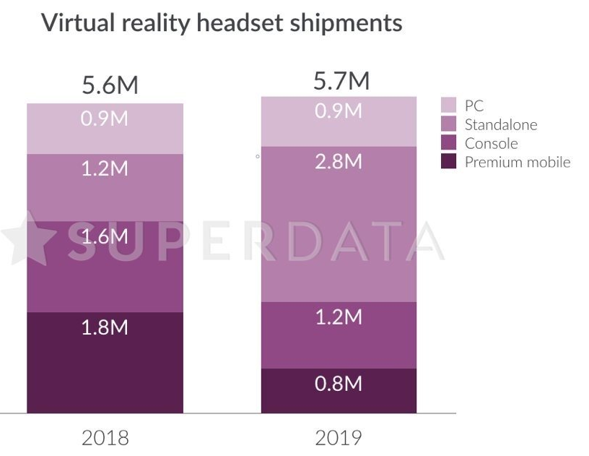
VR Design: General Concerns
Platforms
Numbers (end of 2019 estimated)
Samsung Gear: >5M
PSVR: 5M
Oculus Go: 1M as of March 2019, est 2M in July
Oculus Quest: 400K in Oct, estimated 1.2M
HTC Vive and Rift are under 1M each (hard to find numbers)
The platform you develop for has impact on the product sales Going for the broadest market can impact key elements
User interface
Scope (memory limitations as well as user comfort)
Graphics
Content volume (cost related)

Slide 3
VR Design: General Concerns
Immersion vs. Presence (Michael Abrash)
Immersion is being presented with data from a false environment
Your brain/body know it is false, but you suspend disbelief
Examples include Books, cinema, TV, etc.
Presence is having your body believe in the new environment on a fundamental level
The subconscious perceptual systems believe in the illusion
Hearing, proprioception, touch, etc.

Slide 4

VR Design: General Concerns
Issues with Presence
Cognitive load
Cognitive load refers to the amount of mental processing power needed to use your product.
Think of the things that a new user faces when they first enter VR
Confusion
Lack of Direction
Lack of know how

Slide 5
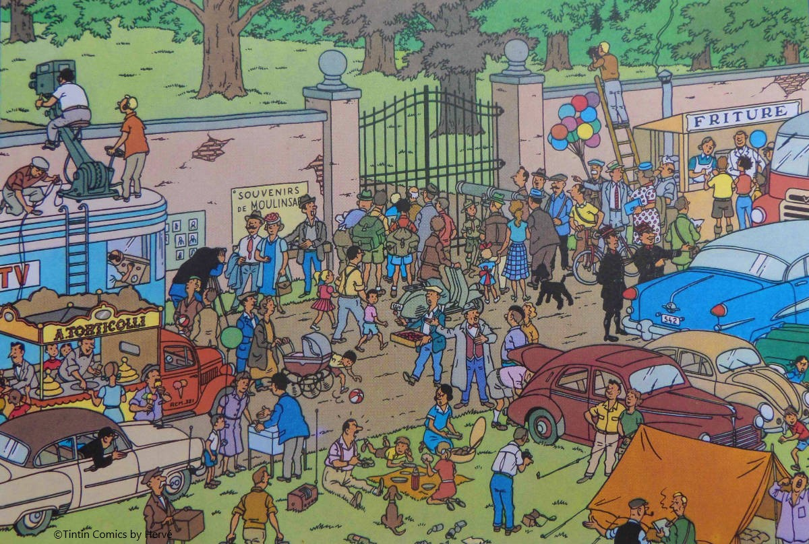
VR Design: Dealing with Cognitive Load
Cognitive load study
Simplify the scene (at least at first)
Fidelity should match the Target system
Head turning on mobile
Notes:
Cognitive overload, This is from Tin tin an old comic and the density of the comic was meant to cause the reader to pause.

Slide 6
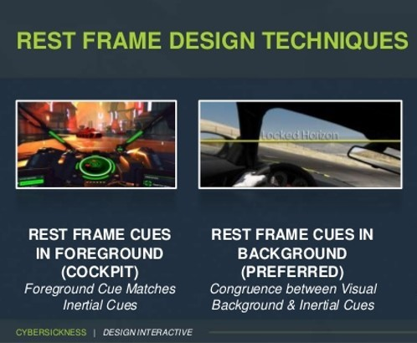
VR Design: Dealing with Cognitive Load
Use Rest Frames if possible
Give users control of their navigation
Driver vs. Passenger
Avoid Depth Confusion
UI can be problematic here
Notes:
Cognitive overload, This is from Tin tin an old comic and the density of the comic was meant to cause the reader to pause.

Slide 7

VR Design: General Concerns
Issues of Control
Users must feel they control their space
This is very important when you have walk around spaces
Direction is paramount
Knowing what to do and how to do it gives the feeling of control
Managing choices can be an issue with less input methodologies
Error handling in interactions can be problematic
Leads to frustration and the feeling of loss of control

Slide 8
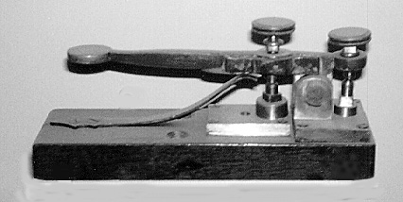
VR Design: General Concerns
Issues with Presence (cont)
Kinematic load (repetitive overload)
Kinematic load refers to the amount of physical activity needed to use your product.
Google Study on how people enjoy VR

Slide 9
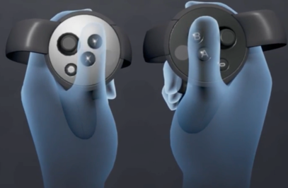
VR Design: Dealing with Kinematic Load
Limit arm, elbow and hand movement
We will speak specifics in a bit
Build simply and also support the high end
Oculus best practices

Slide 10
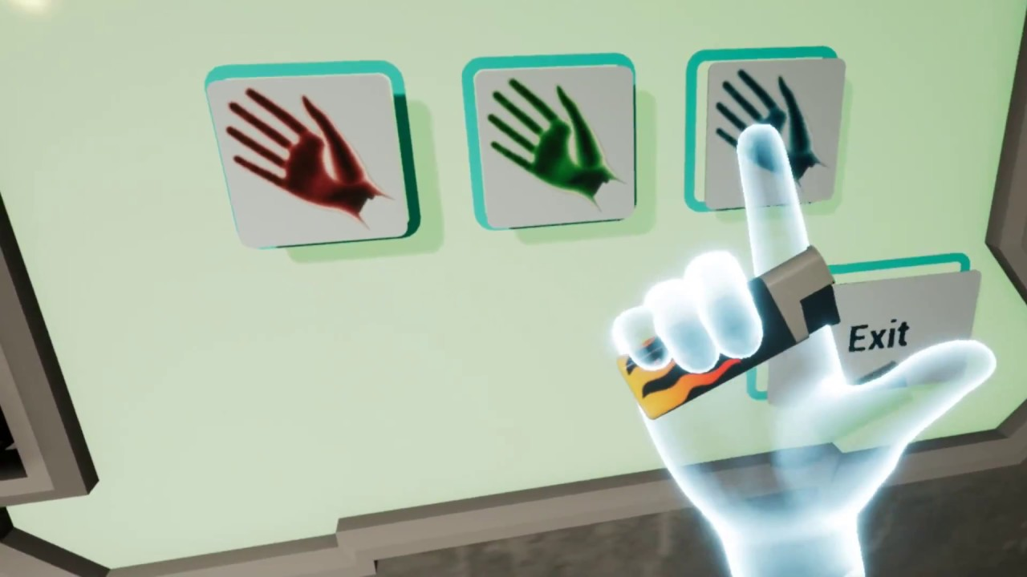
VR Design: Summary of General Concerns Yasser Malaika (Valve), Patrick O'Luanaigh (nDreams) Mike Agler (Google) , Design Best Practices (Oculus)
Presence but not full reality
Keep the user in your world but simplify the repetitive and mundane
Hand representation is key, players notice when things are wrong with game hands
Non-realistic hands
Don’t create an expectations where hands have to do more than is comfortable in VR

Slide 11
VR Design: Summary of General Concerns Yasser Malaika (Valve), Patrick O'Luanaigh (nDreams) Mike Agler (Google) , Design Best Practices (Oculus)
Don’t create objects that don’t behave as expected (handles on pots, etc.)
Make sure that objects with interactable elements are interactable
Drawers with handles should open, etc.
Real isn’t as important as ease of use and simple functionality
Watch out for simulation fatigue
Don’t make a person use big gestures to do common place things
Make any gesture a satisfying and meaningful experience

Slide 12
CS 498 VR Design Elements
Design Phase (Discovery) is here
Started with Team creation
Teams have been built
Discovery is the phase used to design or clarify the vision and high-level design
Discovery:
High Vision Canvas: Use the template provided and the example to create a clear vision for your group project.
World/Environment Description: Use the template provided to create a description of the app/game environment.
High Level Action Loop: Prepare an action loop that shows the main flow of your app/game.
TAs are set and they will guide you through the discovery process.
If you have a sponsored project you MUST CONTACT YOUR Sponsor as soon as possible, they are expecting it

Slide 13
Game Production: What we are going to do
Month 1 | Month 2 | Month 3 | Month 4 | Month 5 | Month 6 | Month 7 | Month 8 | Month 9 | Month 10 | Month 11 | Month 12 | Month 13 | Month 14 | Month 15 | Month 16 | Month 17 | Month 18 | Month 19 | Month 20 | Month 21 | Month 22 | Month 23 | Month 24
POC Work (~6-9 Months)
 |  |  |  |  |  | Production (~14-16 Months)
 |  |  |  |  |  |  |  |  |  |  |  |  |  |  |  |  |  |  |  |  | Lock Down
 |  |  |  |  |  |  |  |  |  |  |  |  |  |  |  |  |  |  |  |  | Sub/Man/Distrib
 |  |  |  |  |  |  |  |  |  |  |  |  |  |  |  |  |  |  |  |  |  |  | Street
Production
Proof Of Concept
Alpha
(Feature Complete)
Beta
(Content Complete)
Introduction | Discovery | Preproduction Phase 1 | Preproduction
Phase 2 | Production | Alpha | Demo Week
Alpha
Proof Of Concept Production
Discovery: 2-week Milestone Production Phase: 3 weeks
Pre-Production Phase 1: 2.5-week Milestone (Core Systems) Alpha & Beta: 2 weeks
Pre-Production Phase 2: 2.5-week Milestone (Vertical Slice)
Beta

Slide 14

Vision Canvas – Single Project/Level Version
Process for Completion:
Come up with an IDEA
or
Get a strong understanding of what your project originator’s idea is.
Then build a clear vision of:
The Environment
The Users
The Experience you want to user to have
Find inspirations that help clarify your vision
Set down the Core Pillars to define the features

Slide 15
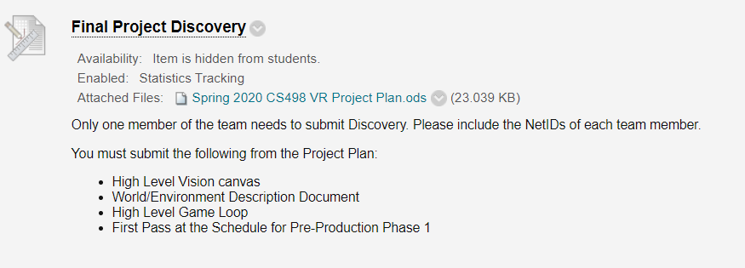
First Design Assignment

Slide 16
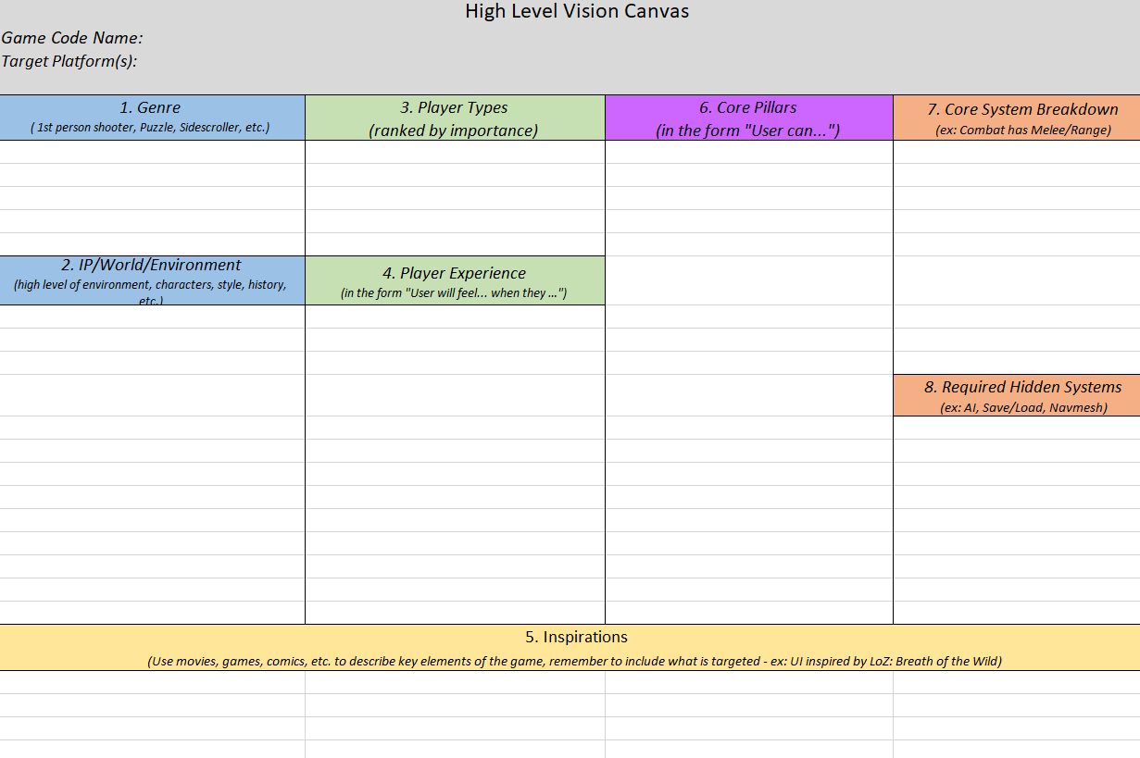
Vision Canvas – Single Project/Level Version
The layout is important
App/Game Name, Platform
Descriptors
Genre
IP/World
Targets
User Types
User Experience
Inspirations (for all categories)
Core Pillars
Systems
Core Systems
Required/Hidden Systems

Slide 17
Vision Canvas – Single Project/Level Version
Process for Completion:
Come up with an IDEA
Give it a code name
Determine the Target Platform

Slide 18
Vision Canvas – Single Project/Level Version
Determine the Descriptors
Define the Genre
2D/3D side scroller/action game/shooter
Don’t include info about the world
Expectation is for standard Genre vernacular
Describe the World or IP
Information about the background of the world
Post Apocalyptic, Sci Fi, Horror, etc.
Licensed Intellectual Properties, etc.
Concepts
Narrative
Source
These define the physical world, supplying context, interactions and connections. It describes how the player interacts (camera view) and relates (especially for a existing IP).

Slide 19
Genre (ex: 3rd Person)
The Genre describes, informs, and constrains the usage and camera style and sets expectations for the team what the team will be building for the User. These should be common genres
Don't put world descriptors here (Zombies are not a Genre, they are an element of the world, the genre would be Survival)
IP/World (high level descriptions)
The IP/World element is there to provide context for where the game/project is being placed. Elements about Narrative and environment belong here.
This is more important that most designers realize. Adding enough detail to describe the context of what you are building in just a few lines of text is key.
Timeframes matter (For example: Sci-fi tech. can vary greatly based on how far in the future we are talking about).

Slide 20
Vision Canvas – Single Project/Level Version
Target Information
Player Experience
The emotional experience the player is having
Can come from core game play and features
Should relate to core pillars
Player Types
Self defined
Should be descriptive
Should represent the key player/purchasers
In descending order
Don’t go too broad
Make up your own descriptors

Slide 21
User Types (prioritized)
These are the types of users you think your project will attract. These should be prioritized by size of group (biggest first). This list helps you make decisions when conflicts arise between supporting features and handling scope.
We found that personalizing the Names for these groups helped describe them. Knowing these groups well helps define your efforts.
You don’t have to be one of these types, but you need to find these types to try your app to make sure it is meeting their needs.
User Experience (the emotion elicited)
The User experiences should be the foundation for your core mechanics (Core Pillars and Core Systems). They should be the emotional experiences you are trying to evoke from the user.
If you want to build something that has an impression on users, then you need to develop this element properly, with real consideration for experiences you have had as well as emotions you want to drive.
If you don't have much to offer here you may need to consider adding depth to what you are building (if it’s a tour say, you might want to gamify it in some way).

Slide 22
Vision Canvas – Single Project/Level Version
Core Pillars
Features that drive the Player Experience
The Key focus of the game
Elements that, if removed, would change the game
In the form: “The player can …..”

Slide 23
Core Pillars (in the form "User can...")
The core pillars are the actions the user can perform that define the user actions (the core mechanics) that, if removed would change the user experience.
Make sure each core pillar reflects/supports a user experience.
Grouping like elements or sub elements is good for clarity (ex: pillars about ranged and melee combat would fit under a more general combat pillar)
Don’t put emotions here, they belong in User Experiences. They can be rewritten as core pillars.

Slide 24
Vision Canvas – Single Project/Level Version
Inspirations
Can inspire any area above
Therefore inspirations are foundational to a game
Should describe what it inspires
Get specific
UI
Game play features
Tone (Tone Targets)
Style (Graphic look)
Art Spectrums
Vehicle/Weapon/Character
Lighting

Slide 25
Inspirations (note what is it inspiring)
Inspirations inform about what the usage/gameplay, tone (humor or atmosphere), UI, Audio, and art style are like by providing similar examples.
Inspirations are key, they show others what surrounds your idea and makes it special. Remember to note what part of the game each element inspires.

Slide 26
Vision Canvas – Single Project/Level Version
Systems
Core Systems
Systems that need to be built to support core pillars
There should be more detail here
Combat might need both melee and ranged
Traversal might include special modes
Special lighting might be needed
AI, if it’s a core pillar
Narrative methods might need special systems
Hidden Systems
AI (if not a core pillar)
Audio
Cinematics
Save/Load
Etc.

Slide 27
Core & Hidden Systems (ex: Save/Load or Combat)
Core Systems are the key programmatic features/systems that need to be created to build your project, they should directly relate to Core Pillars
The details in this and core pillars drive the feature list. Be thoughtful here, start with higher level elements and then add contributing background elements).
Hidden Systems are those that are needed to make a project operate but don’t drive the Core Pillars (for example Save/Load)
Don't forget those background elements that drive key game play mechanics (AI, Audio, UI, etc.) These are key systems.

Slide 28
High Level Vision Canvas
Game Name: Storming Area 51
1. Genre ( 1st person shooter, Puzzle, Sidescroller, etc.) | 3. Player Types (ranked by importance) | 6. Core Pillars (in the form "Player can...") | 7. Core System Breakdown (ex: Combat has Melee/Range)
3rd Person Cooperative Action | completionist: likes to complete all elements | Collaboratively Complete Zones: | stealth engine
Stealth | social player: likes to play with friends | - players move through various zones of Area 51, conquering enemies and retrieving saucer parts | navigation system
 | Stealth Player: completes missions w/o getting caught | - combinations of parts from more difficult zones lead to more valuable outcomes | combat system
 | UFOer: likes anything related to aliens/area 51 conspiracy stuff | Maintain a Level of Stealth: | item system
 | grinder: likes slaughtering aliens | - each player has a stealth meter, if they blow their cover, all players will suffer | level selection system
2. IP/World (environment, characters, style, history, etc.) | 4. Player Experience (in the form "Player will feel... when they …") | - stealth meter resets after completion of each zone | spaceship construction system
Group of teens break into Area 51, Nevada | Satisfaction of attacking all types of aliens | - firing unsilenced weapons or entering an enemy's detection field will blow a player's cover | cutscene system
time period: Present day (2019) | Gratification of killing a super strong alien and unlocking the checkpoint | Win the Game | menu system
super powerful aliens who can vaporize you if caught | Generosity from helping out teammates and relying on each other to complete a difficult mission | - reach the final mission, where collected parts must be used to assemble an escape saucer | player outfit customization
various environments throughout the base: warehouses, hangars, tunnels, towers | excitement from discovering secret alien technology that’s well hidden in a game | - once the saucer is buit, the teens enter it and zoom off and out of area 51 | 8. Required Hidden Systems (ex: AI, Save/Load, Navmesh)
 | Feeling covert or sneaky carrying out objectives | Combat | Checkpoint Save System
 | Being spotted by the aliens induce a panicked state | - while stealth is important, sometimes it's impossible to evade being seen and must resort to combat | Enemy artificial intelligence
 |  | - use alien weapons and powers | Point tracker and score calculator
 |  | - combat is crucial during zone fights | Co-Op systems
5. Inspirations
(Use movies, games, comics, etc. to describe key elements of the game, remember to include what is targeted - ex: UI inspired by LoZ: Breath of the Wild)
Area 51 (1995 video game): GAMEPLAY/NARRATIVE and ART STYLE this game is centered around breaking into Area 51 and trying to activate a nuclear self destruct sequence. | GTA V: GAMEPLAY We want players to have a similar experience as they move from checkpoint to checkpoint, defeating enemies and even collecting items to use at a later time | General Area 51 Conspiracies: NARRATIVE there has always been conspiracy surrounding area 51 and the secret technologies it's told to hold. This inspires all sorts of novel weapons and even superhuman abilities for our game | 2019 "Break into Area 51" meme: NARRATIVE this idea was the underlying reason why Area 51 was so front of mind that we chose to set our game inside it. It shows that the general public is clearly aware of Area 51, and finds it entertaining

Slide 29
 | Game World Description (primarily used for game projects)
 | NOTE: The elements in italics are examples or explanations and can be deleted.
 | Art Style: (stylized, photorealistic, mixed, etc.): One word or a short sentence to give a general idea. Your Art design doc will be more specific.
 | Tone: (dark, upbeat, humorous, etc.): Again, a one word or short sentence to describe the overall tone, your tone target will be more specific.
 | Environment: Describe the environment clearly and in detail (enough for another person to have a good picture in their head).
 | Where does the game take place?
 | When does it take place?
 | What is the user trying to overcome in the environment (if anything)?
 | Describe the forces that drive the user from an environmental aspect.
 | History & Culture of the World/Environment:
 | Why is the world like it is, what is its backstory?
 | Relation to the real world:
 | Is it tied to the real world in any way?
 | Which key elements are similar, and which are different (for a reason)?
 | Important Audio Elements of the Environment/World: Audio can help define a world or environment.
Design Docs Process: Simple Action Loop

Slide 30
 | Characters: You can make up a character sheet for each character and character type (NUC Guard for example).
 | ● Main Character(s)
 | ○ Their Persona(s):
 | ■ History
 | ■ Reason for Conflict/Drive
 | ■ Skills: can be personal and/or combat (should tie into other parts of the design document).
 | ■ Relationships
 | ■ Strengths/Weaknesses
 | ■ Specials
 | ● NUCs (Non-User Character): Key characters in the world that are not the user
 | ○ Simple Persona(s)
 | ■ What do they provide (information, skills, assets)?
 | ■ Any gameplay impact
 | ● Boss Enemies
 | ○ Enemy Persona
 | ■ History with Main Characters (if any)
 | ■ Reason for Conflict/Drive
 | ■ Skills: can be personal and/or combat (should tie into other parts of the design document).
 | ■ Relationships
 | ■ Strengths/Weaknesses
 | ■ Specials
 | ● Enemy Minions
 | ○ Simple Persona(s)
 | ■ Level
 | ■ Skills
 | ■ Strengths/Weaknesses
 | ■ Differentiating factor
 | ■ Specials
Design Docs Process: Simple Action Loop

Slide 31
Design Docs Process: Simple Action Loop
Win/Lose, no repeat
Lose, repeat
Start
S01
Home Base
S02
Mission
S03
Combat
S04
Death

