Slide 1

Light and Optics I
CS 498: Virtual Reality
UNIVERSITY OF ILLINOIS AT URBANA-CHAMPAIGN
Eric Shaffer

Slide 2
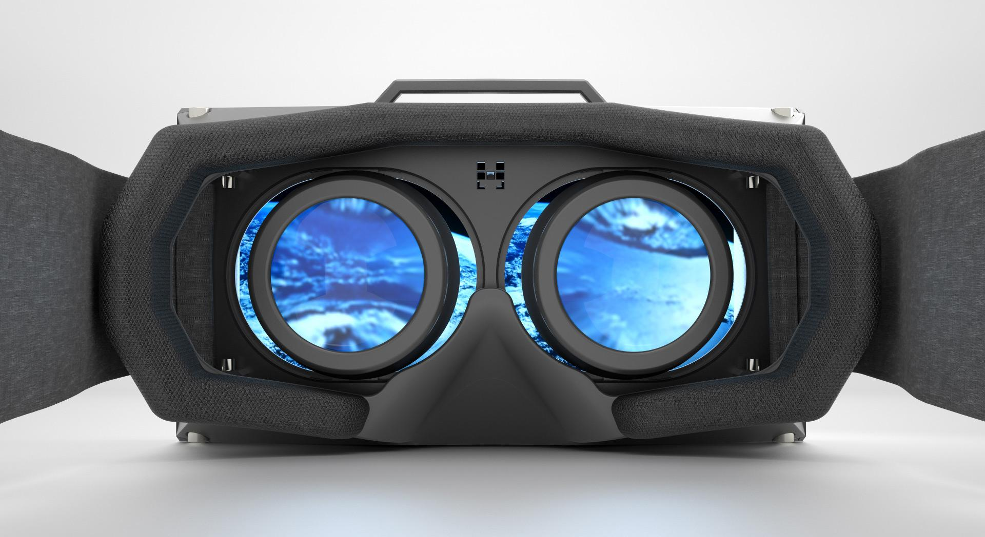
Light and Optics
Why are they relevant to VR?
To build a headset, need to understand interaction between eye and display
Need to model transport of light in the virtual world
Optics are also used in
Image acquisition (e.g. 360 degree cameras)
Tracking

Slide 3
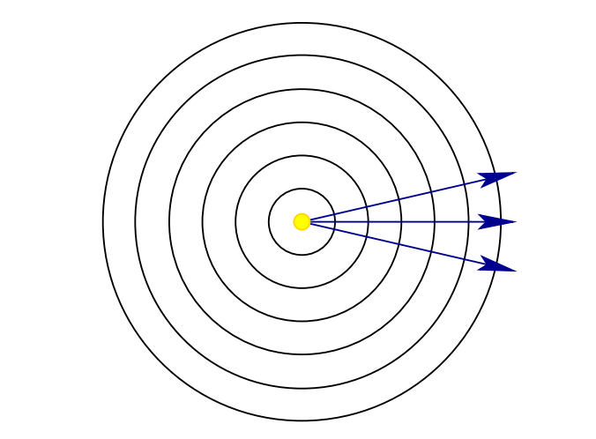
Light Models
Point source of light
Light is light…it isn’t any of these but it behaves like all of them.
Three light models
Ray model: A ray traces the motion of a single hypothetical photon. Helpful when explaining lenses and defining the concept of visibility
Wave mode: Ripples through space that are similar to waves propagating on the surface of water. Helpful when considering spectrum of light.
Particle model: Tiny particles of energy moving through space at high speeds Helpful measuring the amount of light received by a sensor.

Slide 4
Light Propagation
In the absence of lenses …or gravitational anomalies…light travels in straight lines
Can model a light as a point emitting photons in all directions
Photons spread spherically …surface area of a sphere is 4πr² …which implies the energy of light decreases quadratically with distance

Slide 5
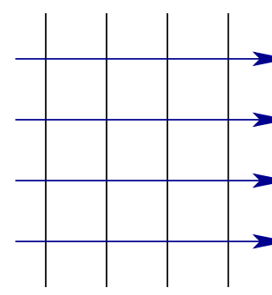
Light from Far Away…
Farther away a light source, the more the curvature of the wavefront flattens
For a light “infinitely” far away, the rays would become parallel
Sunlight on earth is often modeled this way

Slide 6
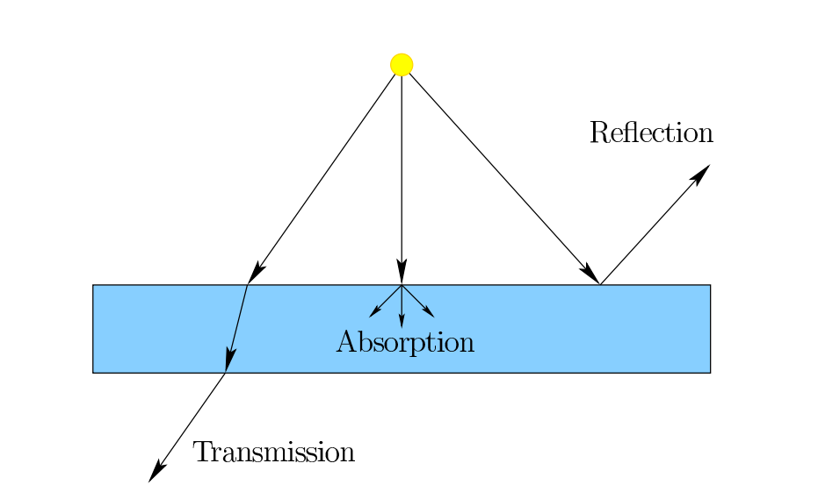
Light and Materials
Simple model of light/material interaction
Absorption
Reflection
Transmission

Slide 7
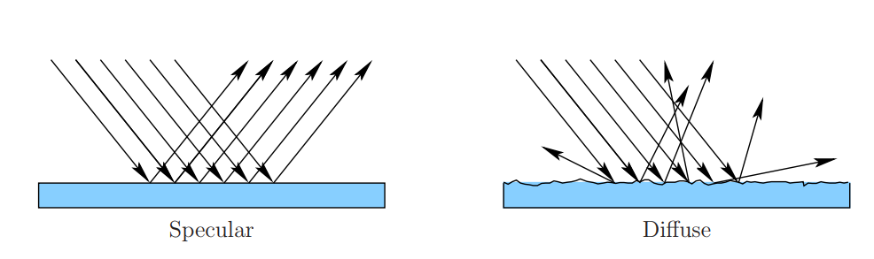
Models of Reflection

Slide 8
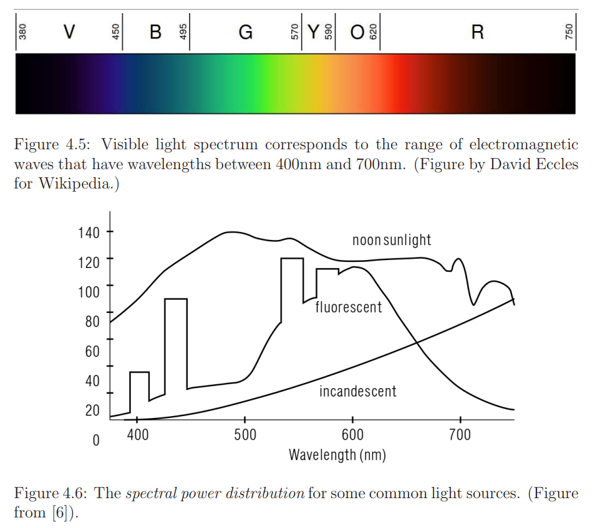
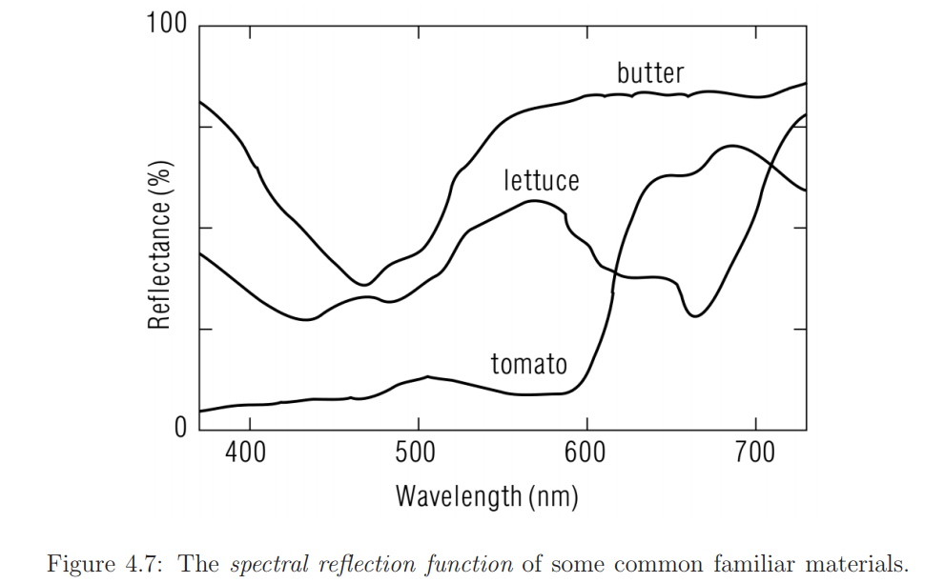
Visible Light is Usually a Jumble of Wavelengths
What do we call something emitting a single coherent wavelength of light?
From Virtual Reality by LaValle

Slide 9
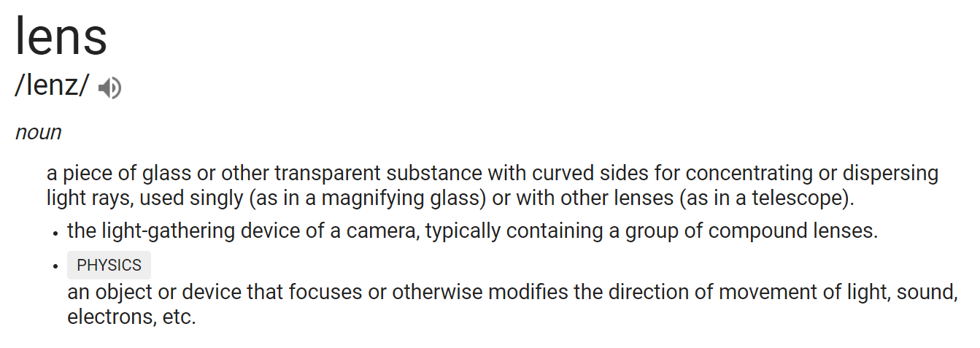
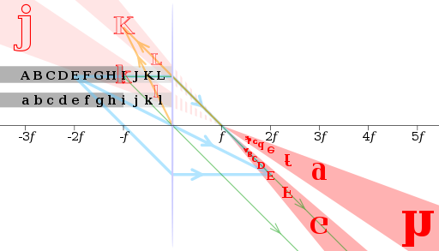
Lenses

Slide 10
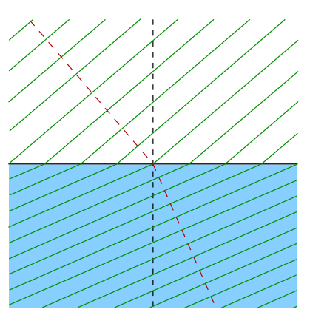
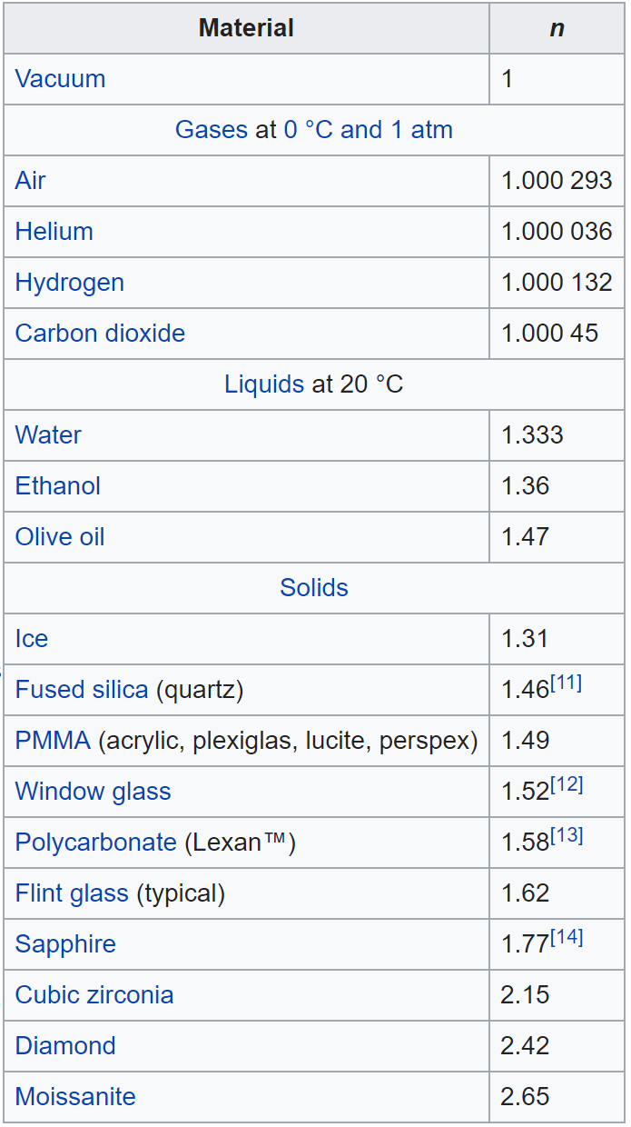
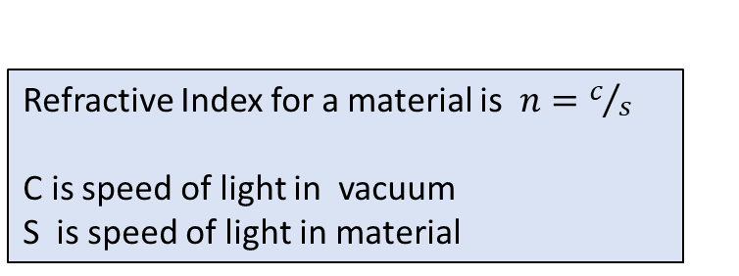
Snell’s Law
Describes how much light bends when entering or exiting a material
Refractive Index for a material is $n=c/s$
C is speed of light in vacuum S is speed of light in material

Slide 11
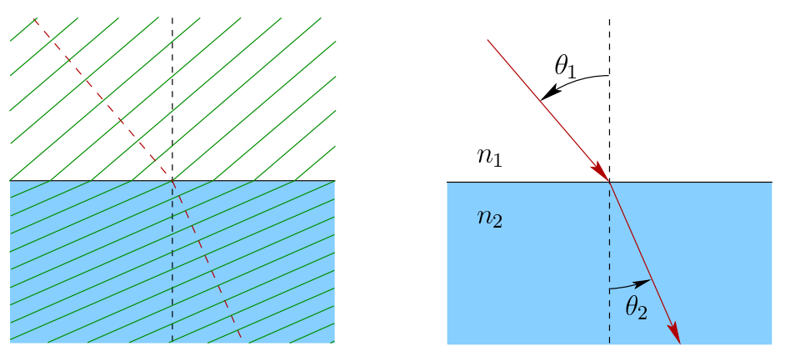

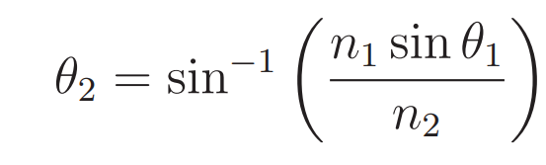
Snell’s Law

Slide 12

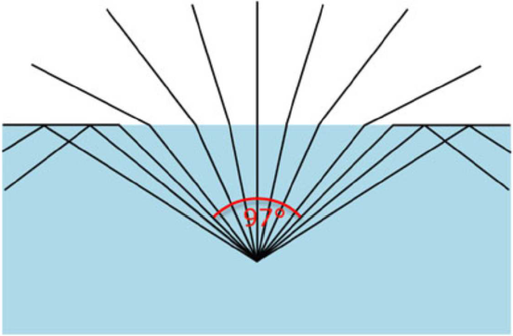
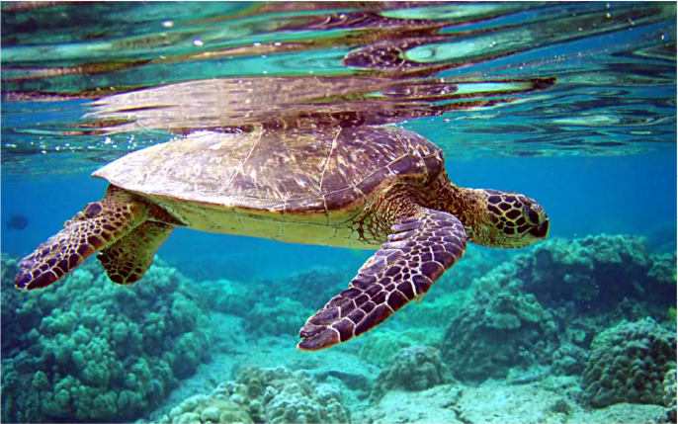
Internal Reflection
Light is transmitted if
Otherwise, there is internal reflection

Slide 13
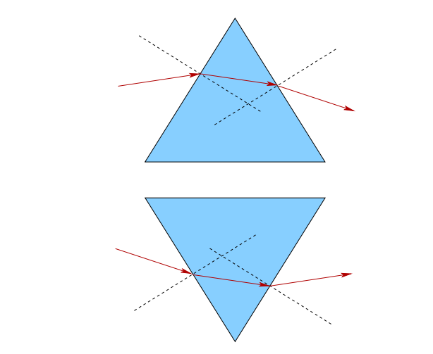
Light through a Prism
Slope of prism determines direction light bent

Slide 14
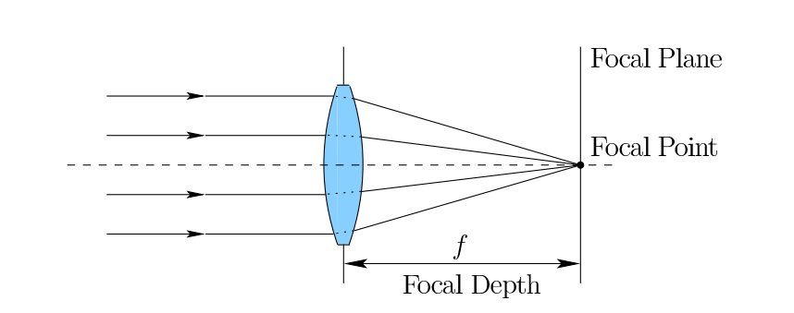
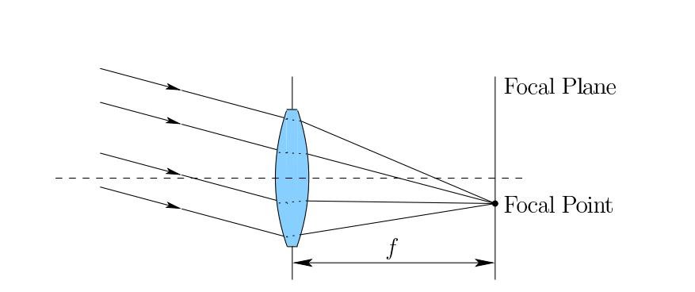
Simple Convex Lens Model
What is unrealistic about this model?

Slide 15
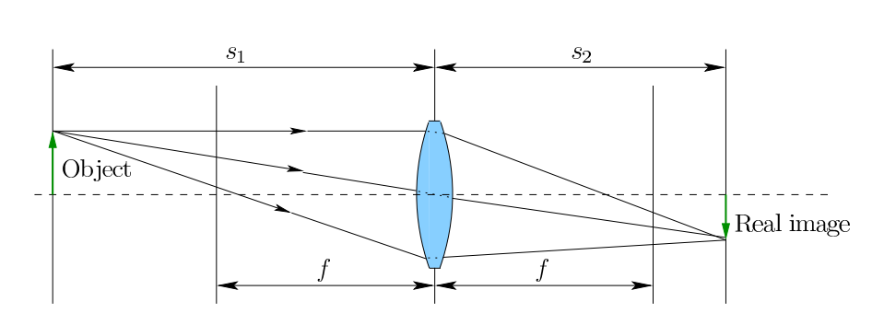
Focus
Light will not be from infinitely far away Light will be reflected from different distances to lens
No single plane in which entirety of object is in focus

Slide 16
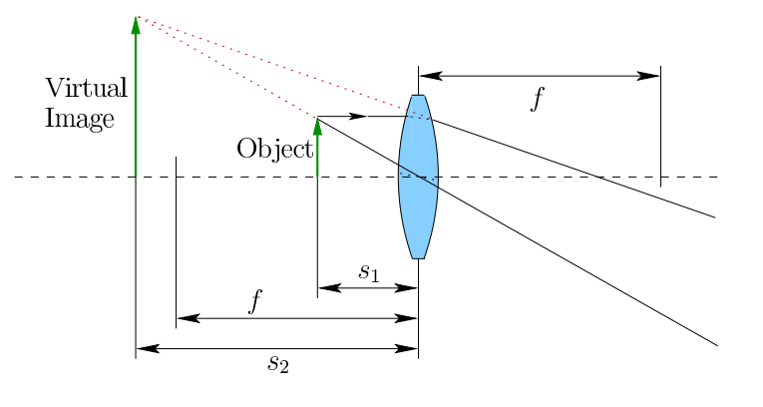
Magnification
If object very close to lens
Lens cannot force its outgoing light rays to converge to a focal point.
In this case, lens works as a magnifying glass.
This is the way lenses are commonly used for VR headsets.

Slide 17
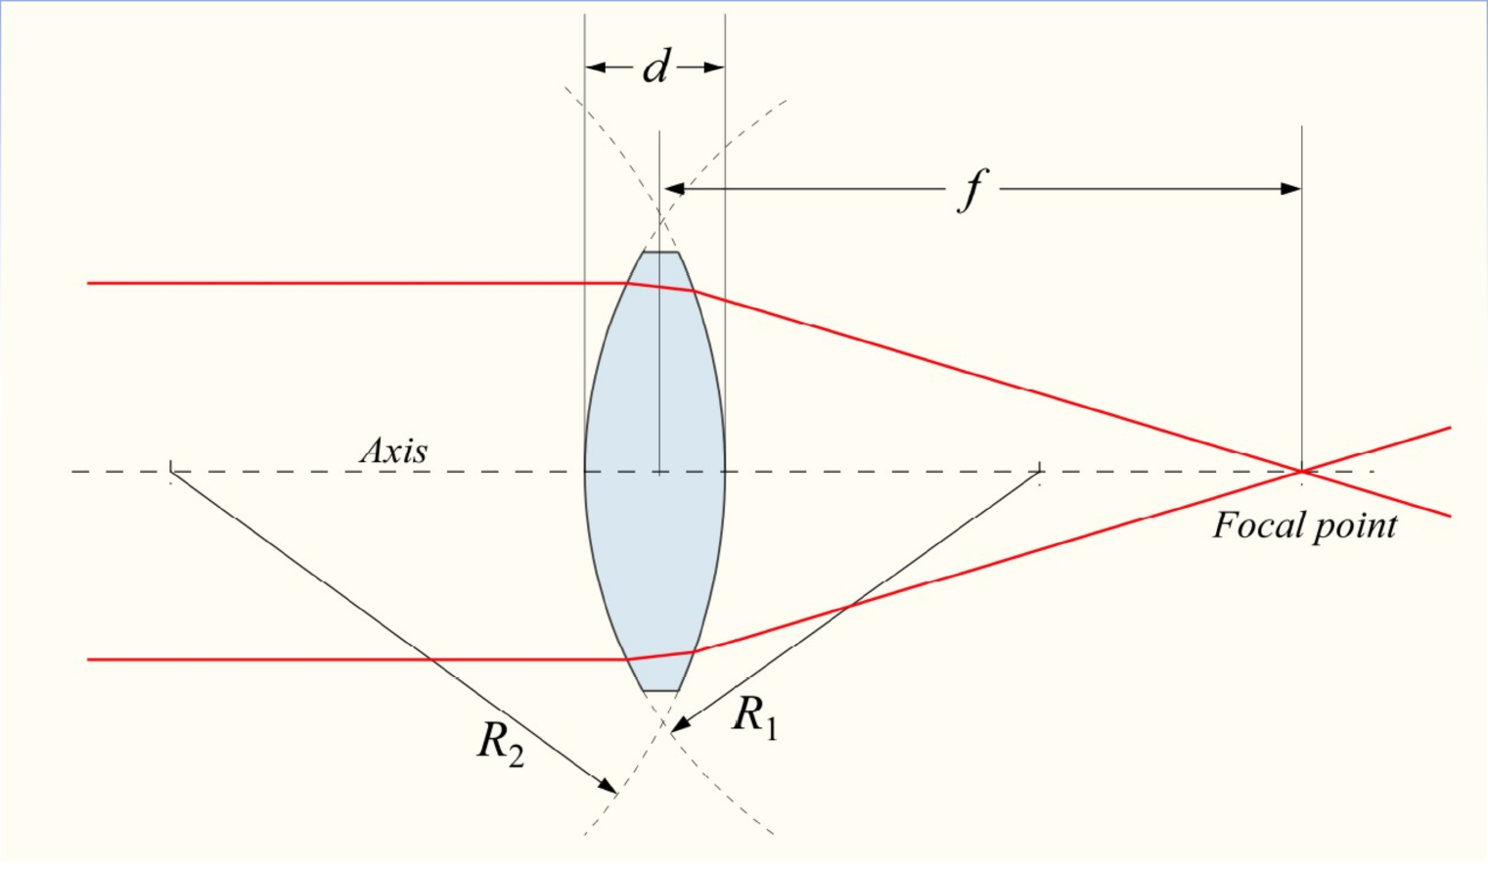
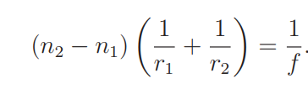
Lensmaker’s Equation: Converging Lens
What are we interested in computing with this? What could it be used for?
r₁ and r₂ are the radius of curvature of each of the two lens surfaces
also assumes a thin lens approximation, which means that the lens thickness is small relative to r1 and r2.

Slide 18
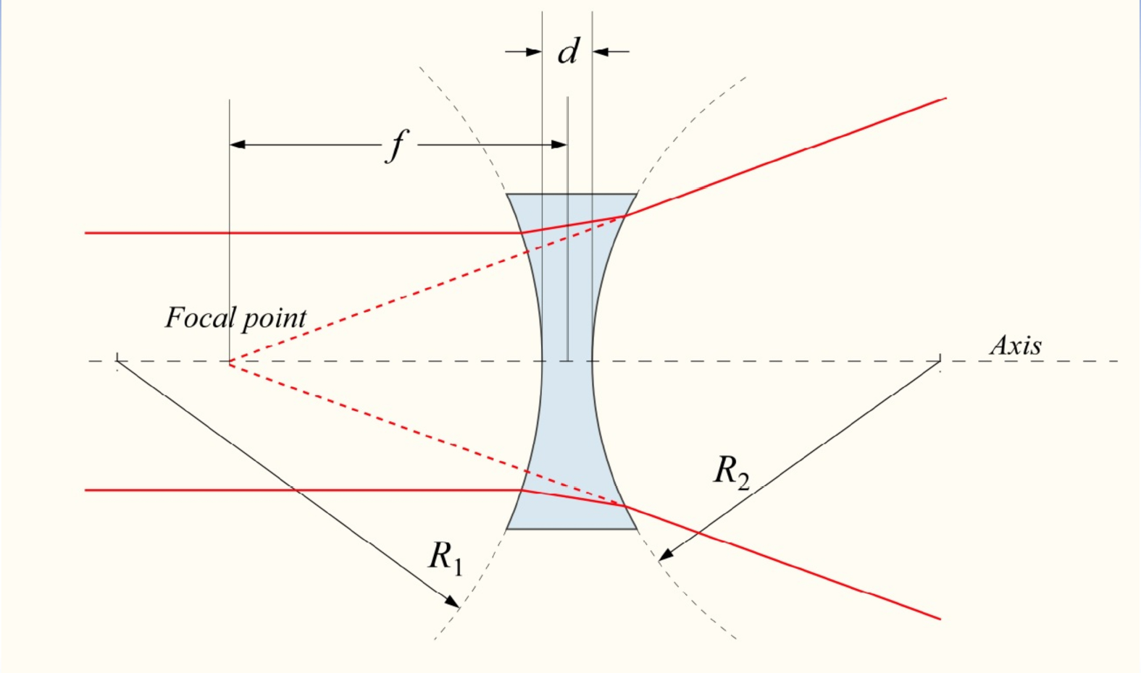
The Lensmaker’s Equation: Diverging Lens

Slide 19
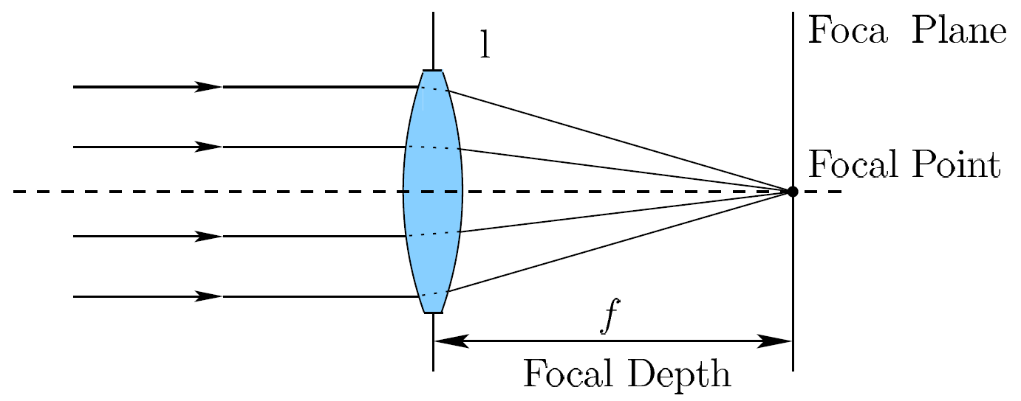
Convenient Unit: Diopter
Diopter is a converging (diverging) power of a lens.
D = 1 / f, (m⁻¹)

Slide 20
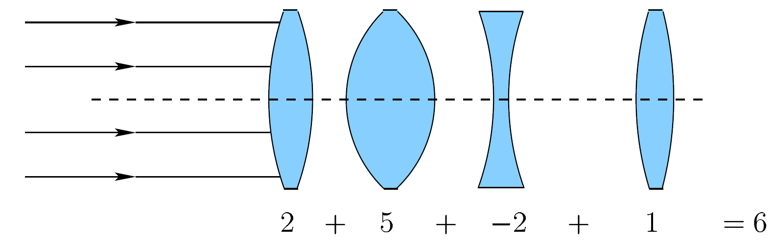
Combined Optical Power of a Chain of Lenses

Slide 21
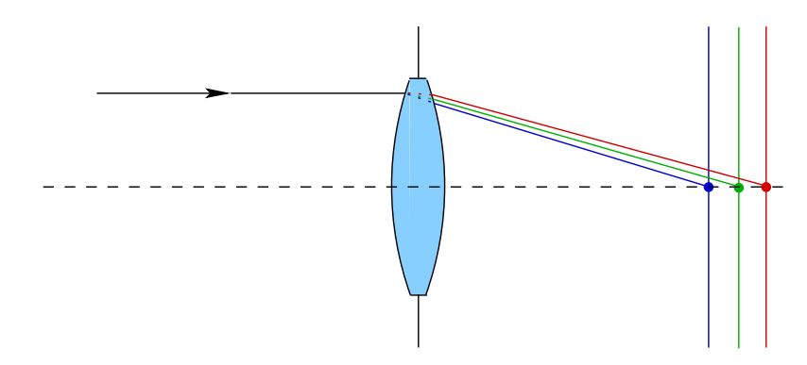
Problems with Lenses
Many issues have to be addressed to generate a high-quality image
Chromatic Aberration
Spherical Aberration
Optical Distortion
Astigmatism
Coma and Flare

Slide 22
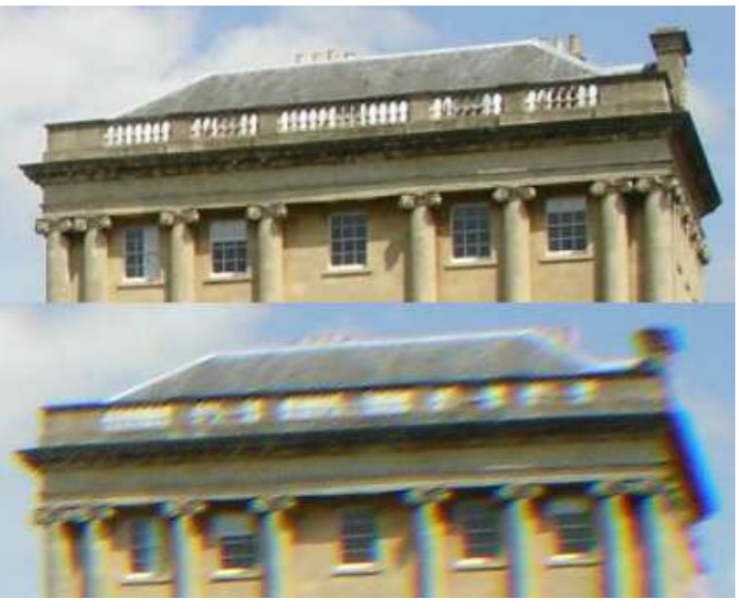
Chromatic Aberration
Different wavelengths of light
Different speeds through media
Causes divergence
Can be fixed
Multiple lenses of different media

Slide 23
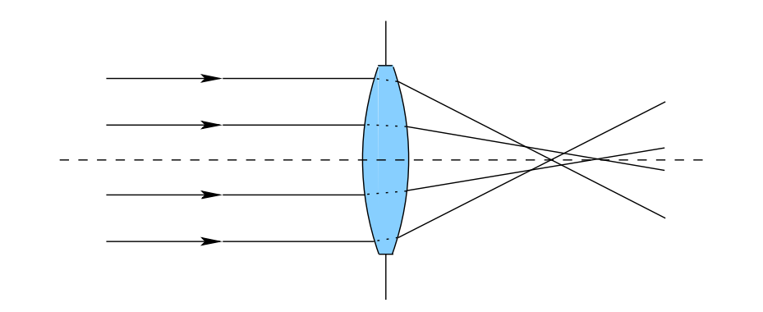
Spherical Aberration
Rays further from lens center refracted more
Fixes are possible…aspheric lens…complicated….

Slide 24
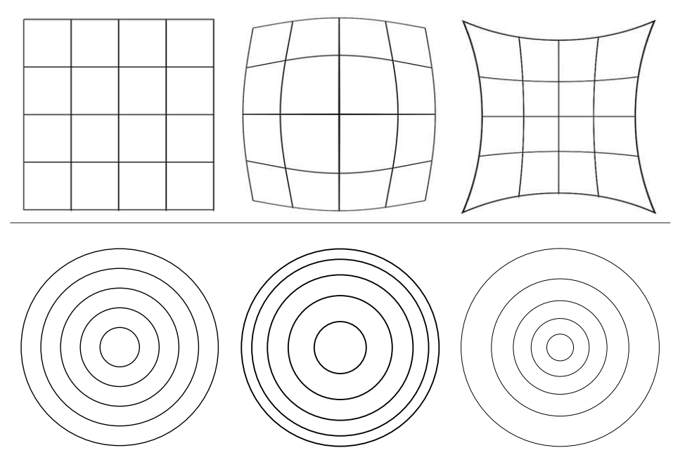
Optical Distortion
Different from spherical aberration (which is blurring)
Image magnification increases or decreases with distance from the optical axis

Slide 25
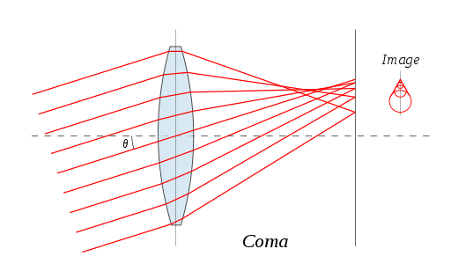
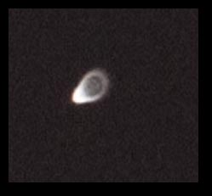
Coma and Flare
Off-axis point lights have tails or flare

