Slide 1
CS 498 VR
VR
Design & Development
Methodologies
(For internal use only)

Slide 2
Admin Stuff
Dan Cermak
Office Hours: Thursdays at 11:00 in the VR lab
My Email: dcermak@Illinois.edu
Phone: 217 778 5596

Slide 3
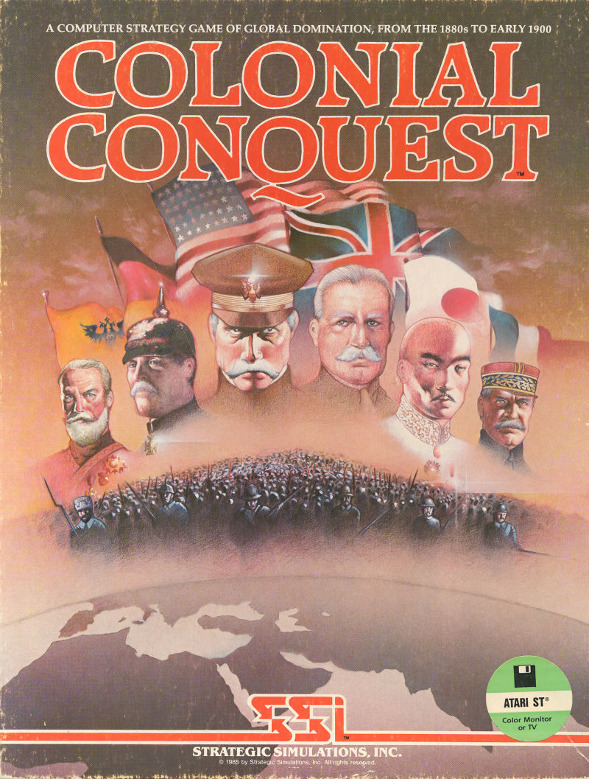

Who am I?
35 years in the video game industry
Self taught programmer
Designed, programmed & shipped 2 games
Spent 11 years doing external development
Taught me communication and information gathering
Basically a production guy with lots of design input
Game development from all sides
Last 15 years I was responsible for Volition game Dev.
Experimented with various structures/methodologies

Slide 4
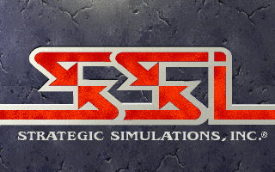
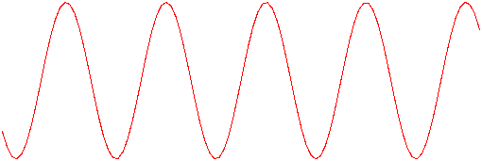
My 30 Game Industry Career had its ups and downs
SSI: Developer and Publisher – PROS
Amazing people
The golden age, worked on every kind of game imaginable
Produced in every genre (Sports, RTS, RPG, Adventure, Wargames, & Shooters)
Learned production processes
Filled about every position in the hierarchy
SSI: Developer and Publisher – CONS
Did external production primary, missed some team management processes
The company was privately owned, couldn’t sustain itself
Had to sell (3 times) and each new buyer was an adventure in ineptitude
Went through a layoff

Slide 5


My 30 Game Industry Career
EA: Westwood – PROS
Great group of people, very professional
Interfaced with EA Studio Execs daily
Learned a lot of high-level elements
Got to meet some amazing designers
EA: Westwood – CONS
EA Studio Management was broken, politics & BS.
Studio had an odd culture of secrecy, & mistrust
Studio direction was off…

Slide 6

My 30 Game Industry Career
Volition: - PROS
Latitude to set structure and process
Really smart, amazing teams
Great culture
Saw some success, SR3 hit 6 million
Location meant that corp. stayed away
Volition: - CONS
2 Product lines in cycle, 1 wasn’t a hit
Stockholders meant time constraints
To be AAA (high end), you need big bucks
Location made it tough to hire
Bankruptcy

Slide 7
CS 498 VR Goals and Expectations
General
Set up the project teams as soon as possible
Complete the projects via a simplified project plan
Develop the key elements of the projects
Figure out an initial idea or take on a sponsored project
Get the Game/Project World or Environment clearly defined
Project Plan details
High & Mid-level design
Simple production documents
Discuss VR (design elements, key considerations)
Present a survey of the video game industry, studios and projects
Go into more detail about the Design and Production processes

Slide 8
CS 498 VR Projects
Projects
Course is becoming more project oriented
Can be either a Sponsored Project, App, or Game
Team sizes of 4-5 preferred (we prefer not to create 6 person teams)
Consideration is given to those that want to work together
We also consider the student tenure (3 seniors could be considered okay)
A survey will go out shortly to see what you are interested in creating
Sponsored projects
We have 17 VR projects and 5 AR projects
Most of the VR projects are continuations of previous projects
We are fairly new to AR so it is a learning experience for everyone
Your CA/TA will provide you with a link to a google drive folder containing project info
Sponsoring professors should be involved in the process

Slide 9
CS 498 VR Projects continued
Games
Prefer something other than escape rooms
The last semester projects can be seen on the website
Experience tells us that scope is usually the biggest issue
Documentation & ongoing development (progress throughout the semester) are Key

Slide 10
Game Production: What we are going to do
Month 1 | Month 2 | Month 3 | Month 4 | Month 5 | Month 6 | Month 7 | Month 8 | Month 9 | Month 10 | Month 11 | Month 12 | Month 13 | Month 14 | Month 15 | Month 16 | Month 17 | Month 18 | Month 19 | Month 20 | Month 21 | Month 22 | Month 23 | Month 24
POC Work (~6-9 Months)
 |  |  |  |  |  | Production (~14-16 Months)
 |  |  |  |  |  |  |  |  |  |  |  |  |  |  |  |  |  |  |  |  | Lock Down
 |  |  |  |  |  |  |  |  |  |  |  |  |  |  |  |  |  |  |  |  | Sub/Man/Distrib
 |  |  |  |  |  |  |  |  |  |  |  |  |  |  |  |  |  |  |  |  |  |  | Street
Production
Proof Of Concept
Alpha
(Feature Complete)
Beta
(Content Complete)
Introduction | Discovery | Preproduction Phase 1 | Preproduction
Phase 2 | Production | Alpha | Demo Week
Alpha
Proof Of Concept Production
Discovery: 2-week Milestone Production Phase: 3 weeks
Pre-Production Phase 1: 2.5-week Milestone (Core Systems) Alpha & Beta: 2 weeks
Pre-Production Phase 2: 2.5-week Milestone (Vertical Slice)
Beta

Slide 11
CS 498 VR: Sponsored Projects
VR Data Center (continuation of previous work) Our idea is to create a VR representation of a data center and constituent components (networking, software systems, etc.). It will provide a virtual playground to teach concepts in a real environment where students can move around and get the "real" experience. Data centers are the huge powerhouses behind modern internet services like Netflix and Google. Creating a virtual representation of one will allow students to see and work with these environments at a scale not previously possible. Students will be able to rack mount and create networks, set up software. But beyond this, students will be able to look into the machines and wires and actually see the packets in flight, the system software running and its state, peer within the routers and switches and view their protocols and operations. Our environment will also be very useful to network operators who can run "fire drills" and perform certifications/audits within the virtual environment. VR has shown to provide massive benefits to aircraft mechanics (https://www.youtube.com/watch?v=CyMzFenEuNI) and doctors (https://www.youtube.com/watch?v=x9D9eIWZNgM) and we envision to bring these huge benefits to the realm of computer science with our project. Your team will be paired with a team from Prof Matthew Caesar CS 436 course who can provide expertise on data center design and assist in prototyping.

Slide 12
CS 498 VR: Sponsored Projects
VR Data Center (continuation of previous work) Our idea is to create a VR representation of a data center and constituent components (networking, software systems, etc.). It will provide a virtual playground to teach concepts in a real environment where students can move around and get the "real" experience. Data centers are the huge powerhouses behind modern internet services like Netflix and Google. Creating a virtual representation of one will allow students to see and work with these environments at a scale not previously possible. Students will be able to rack mount and create networks, set up software. But beyond this, students will be able to look into the machines and wires and actually see the packets in flight, the system software running and its state, peer within the routers and switches and view their protocols and operations. Our environment will also be very useful to network operators who can run "fire drills" and perform certifications/audits within the virtual environment. VR has shown to provide massive benefits to aircraft mechanics (https://www.youtube.com/watch?v=CyMzFenEuNI) and doctors (https://www.youtube.com/watch?v=x9D9eIWZNgM) and we envision to bring these huge benefits to the realm of computer science with our project. Your team will be paired with a team from Prof Matthew Caesar CS 436 course who can provide expertise on data center design and assist in prototyping.
African Savannah Animal Tagging Project (continuation of previous work) Sponsor: Prof Matthew Caesar
The creation of an open world VR environment linked to a server-side data system that allows the user to tag animals roaming the savannah. The user can track various animals across the savannah and tag them for tracking. Data about location of animals will be pulled from server.

Slide 13
CS 498 VR: Sponsored Projects
Driving Sim for KAR Automotive (continuation of previous work)
This sponsor is looking to continue work on creating a high-end driving simulation that allows research and data collection in support of a new driving aid. Current focus will be on creating an environment based on a 2 lane highway in the countryside. The driving model includes a navigation system, weather impact, various environments, distractions and difficult driving situations.
VR Lab for ECE 329 (continuation of previous work) This project group will continue to work with ECE faculty to build out the VR lab exercise app for ECE 329. The VR lab allows students to visualize electromagnetic fields and experience and explore various properties of electromagnetism.
CITL VR-ification of Lectures: work will continue on the app created last semester. This is an effort to put a lecture into a VR environment to see if learning is different in person vs. 3D vs. VR.
Extension to the WebVR 360 tour of the Main Library Book Stacks
The plan is to add a menu system and a game based around using a conveyor from the 1980s to move large numbers of books.
French Language VR app: (continuation of previous work)
The goal is to create a VR environment on the Oculus Go in the form of a French Village as a backdrop for immersive use of the French Language. The time setting for the Village will be the 1960s (not much actual impact on the architecture but it will allow for interesting interactions as the project develops).

Slide 14
CS 498 VR: Sponsored Projects
Accountancy VR App: This app will create 3 environments in order to demonstrate accountancy principles as they apply to a startup, mid-size business and high-end international company.
Financial AR App: (continuation of previous work) The goal is to create an app that can take financial/market data (either in real-time or from a database of supplied information) and display it in various forms that can then be interacted with or manipulated.
Interactive VR recreation of the Illini Quad during the 60s and 70s: (continuation of previous work)
The goal of this app is to build a recreation of the Illini Quad during the tumultuous times of the late 1960s and early 1970s. Users would experience different interactions based on their chosen appearance. Issues include racial tension, feminism, anti-Vietnam War protests, and gay rights.
VR for Studying Spatial and Temporal Perception: (continuation of previous work) Students will design and build a realistic but minimal 1st person virtual street grid and corridor environment that will be used to conduct research for Department of Psychology-sponsored research experiments. Students must produce VR and non-VR versions of the environment.
Virtual home fall risk assessment: (continuation of previous work)
This is now an AR app based around scanning a space looking for situations that could cause a fall.

Slide 15
CS 498 VR: Sponsored Projects
Hazards and risks of injury in auto industry: (continuation of previous work)
This is now an AR app based around scanning a job site and finding specific risks of injury and potential hazards.
Drop jump simulator: (continuation of previous work) The goal is to create a VR app to simulate drop jump landing on different ground surfaces. The virtual reality environment will allow for the simulation of drop jump landings to different surface conditions, which require different coordination patterns for landing safely, which could be detected using in-lab sensors.
Virtual obstacle navigation: (continuation of previous work) This is a continuation of last semester’s work. The goal is to create an AR app that will allow the user to see either 1) 3-D blocks that must be avoided or 2) numbers and letters overlaid on the surface of the floor to step on, that are coinciding with the projection of white rectangles on the ground or an instrumented treadmill. This app will allow for a novel clinical assessment of cognitive and motor function in older adults, by monitoring gaze and foot placement on the ground, relative to the obstacles or targets.
Paddle Boarding Simulation: (continuation of previous work) This is a continuation of last semester’s work. The goal is to create a VR app to simulate paddle boarding on 3 different environments that would require different challenges in maintaining balance. The virtual reality environment requires environments of constant aesthetic for the background, foreground, and water elements, and the combination of visual and auditory elements to increase interactivity in the environment. The virtual reality environment will provide a testbed for testing and training using an actuated platform and wireless sensors to monitor performance.

Slide 16
CS 498 VR: Sponsored Projects
Nursing Conversational training VR application Create a VR environment in the form of a series of Hospital and Therapy rooms/environments. These environments will be used to simulate conversational situations. Various interactive areas should be created to allow for different potential interactions (conversations).
Chicago Trading Floor VR Experience Create a VR environment in the form of the Chicago exchange trading floors of the 80s and 90s. Those environments were not only incredibly intense and stressful, but they were also a cacophony of colors, sounds, smells and physicality. They were also incredible places to learn how to make decisions under pressure which is my goal for the students. It is one thing to make rational decisions in a rational and peaceful environment. It is yet another to stay rational when faced with these other stimuli.
AR App for Veterinary Dental Training on Dogs This app would take work done by another group and finish an interactive dentistry module in Unity in order to provide a robust interactive teaching tool. The model sets required for the dog are completed and available. An interactive AR app for a cow exists as an example.
AR App for Veterinary Equine Hoof Anatomy We propose an application that would allow the student to interactively view the anatomy of this reconstructed horse hoof in 3D, a Microsoft HoloLens, or an AR enabled iPhone/iPad or Android phone/tablet. The models of the hoof will be supplied. An interactive AR app for a cow exists as an example.

Slide 17
CS 498 VR: Sponsored Projects
VR App for Situational Understanding GOAL: Design and Develop a perspective-sharing tool utilizing VR to enable diverse types of individuals to share their differing experiences of the same “location” or “environment”
VR for National Park Entrance Fee Study The goal is to create a VR environment in the form of a national park for an experiment to investigate the effect of paying an entrance fee (versus not paying an entrance fee) on park visitors’ behavior. The ambitious goal of the project is to create an immersive park visit experience which includes various interactive areas to examine participants’ response to the experimental stimuli.

Slide 18
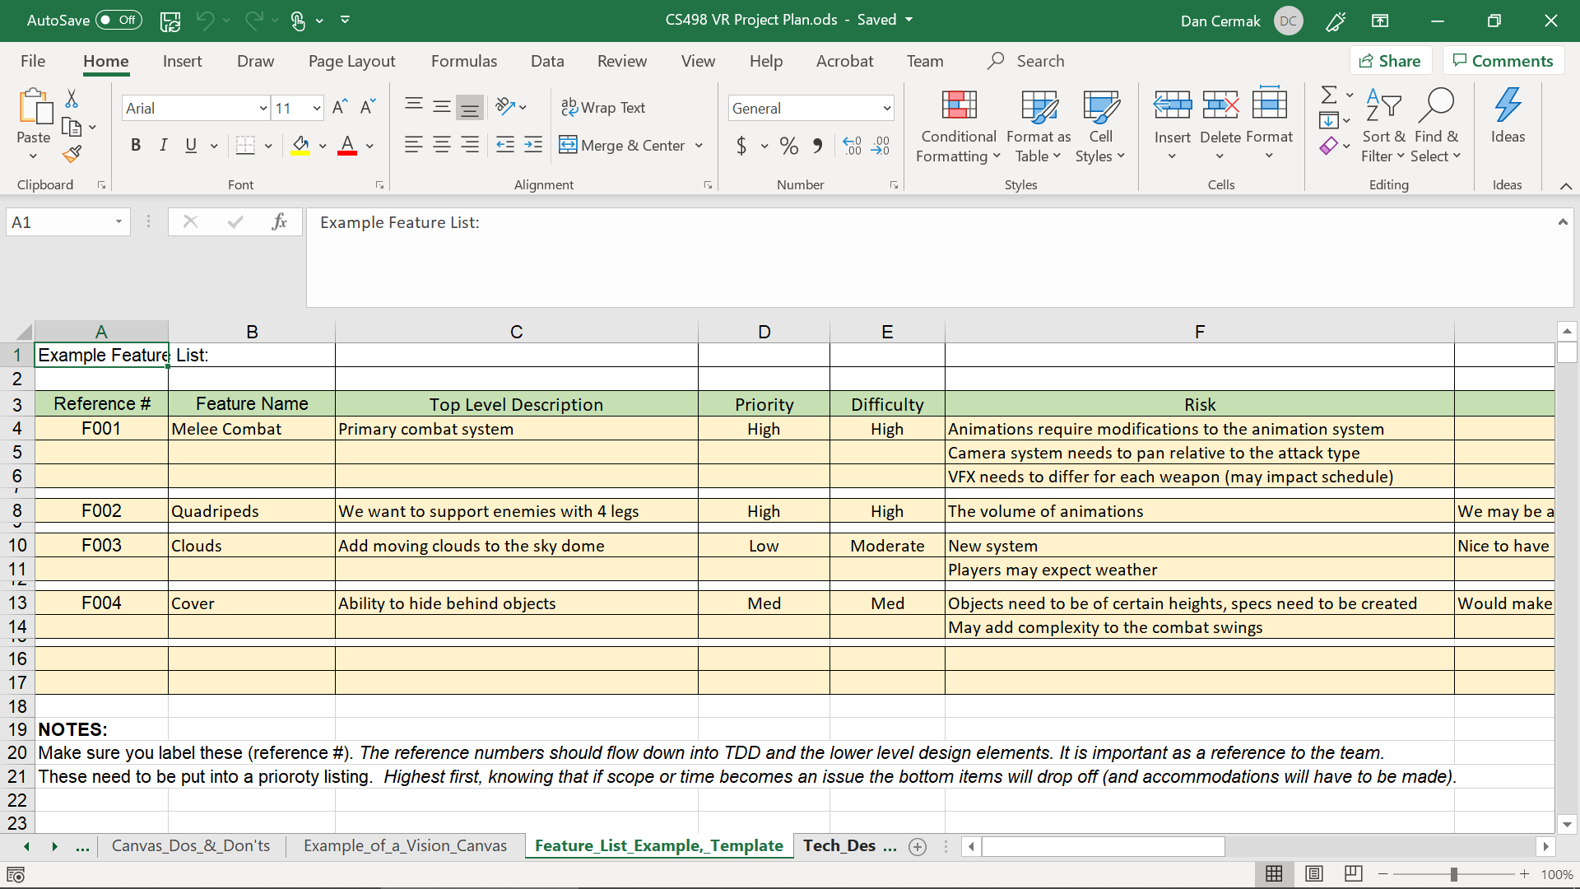
CS 498 VR Project Plan
Google Sheet Workbook
World Description Template
Could easily be a Word or Docs File
Some of the detail is game oriented
Vision Canvas Template
includes a Dos & Don’ts version
Feature List Template
Technical Design Template
Asset list (cumulative for all milestones)
3 Milestone Templates
QC Test Plan Template
This is abbreviated because we are building the design and project in one semester

