Slide 1

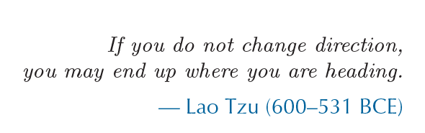
Orientation
CS 498: Virtual Reality
UNIVERSITY OF ILLINOIS AT URBANA-CHAMPAIGN
Eric Shaffer

Slide 2
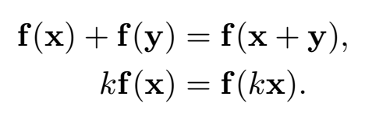
A Review of Transformations
Linear transformations preserve vector addition and scalar multiplication
Does translation do this?

Slide 3
Rigid-Body Transformations
A rigid-body transformation preserves Euclidean distance between points
Are all of Translation, Rotation, and Scale rigid-body transformations?

Slide 4
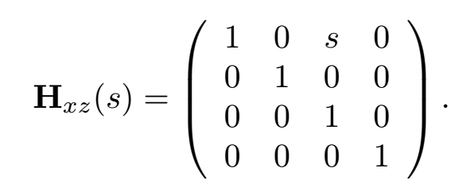
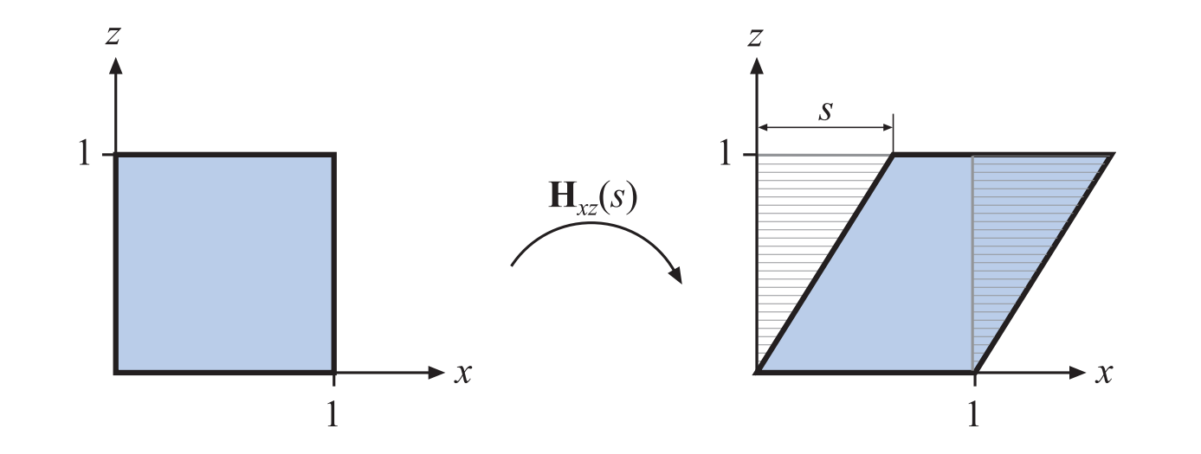
A New Transform: Shear
Is shear is an affine transformation?
Is it a rigid-body transformation?
Here, the transform changes the x coordinate to be x+sz
There are six basic shear transforms: H_{xz} , H_{xy} , H_{yx} , H_{yz} , H_{zx} , H_{zy}
The first letter of the subscript is which coordinate is changed
The second letter of the subscript is which coordinate is used to do the shear

Slide 5
A New Transform: Shear
Is shear is an affine transformation?
YES
Is it a rigid-body transformation?
NO
Here, the transform changes the x coordinate to be x+sz
There are six basic shear transforms: H_{xz} , H_{xy} , H_{yx} , H_{yz} , H_{zx} , H_{zy}
The first letter of the subscript is which coordinate is changed
The second letter of the subscript is which coordinate is used to do the shear

Slide 6
Concatenation of Transforms
We can concatenate transforms using matrix multiplication
Suppose we have translation T, scale S, and rotation R M = TRS is a composite transform
When applied to a point p we have Mp = T(R(Sp)) so M first scales then rotates then translates

Slide 7
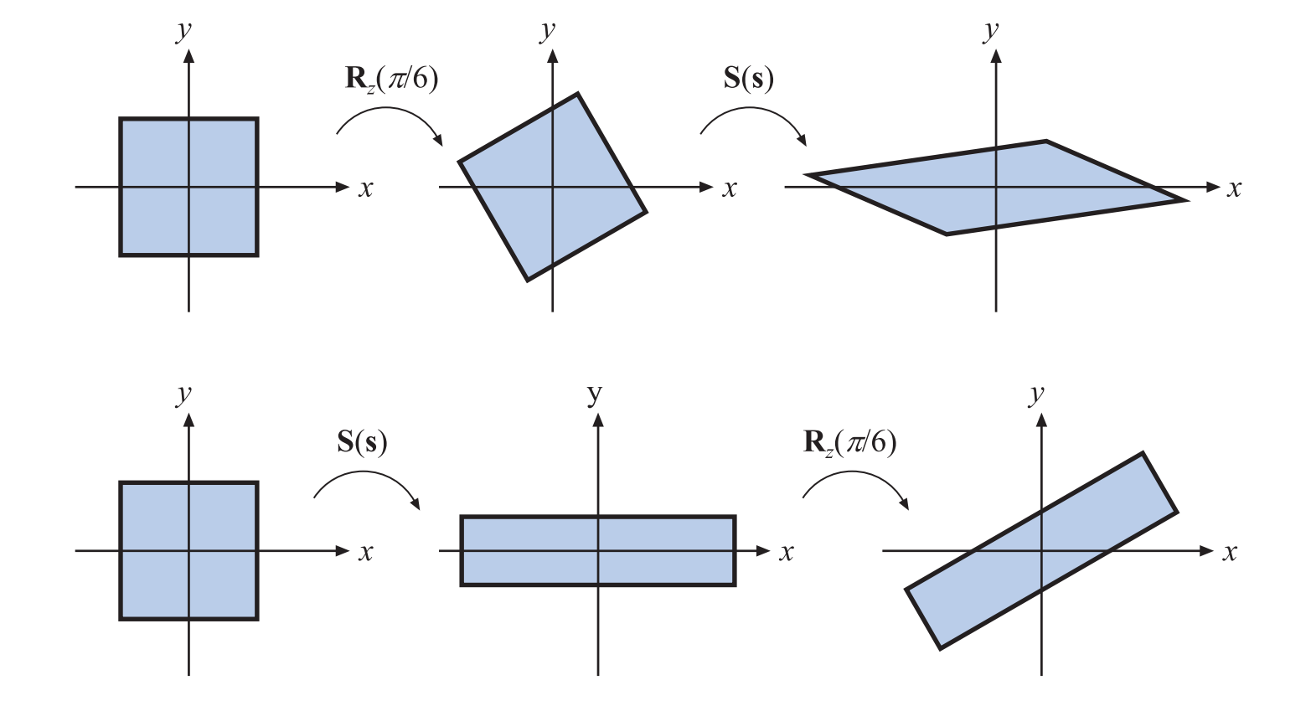
Order is Important
In general, two affine transformation N and M will not commute
Which means for some N and M it is true that NM ≠ MN
…but some do commute…

Slide 8
Rotating a Model Around a Point
Suppose we have a model and a point p
How can we get the model to rotate around p?
What happens when we apply just a rotation R ?
What transformation would work?

Slide 9
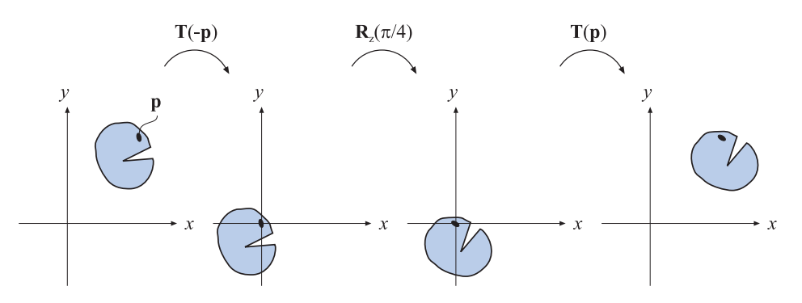
Rotating a Model Around a Point
What transformation matrix would work?
M=(T_{p}RT_{-p})

Slide 10
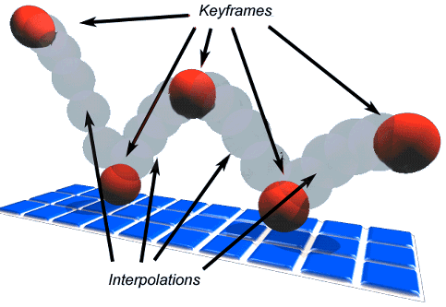
Animation and Interpolation
Animation often uses a technique called keyframing.
The animator specifies the state of a model at keyframes
The animation fills in frames in between keyframes using interpolation.

Slide 11
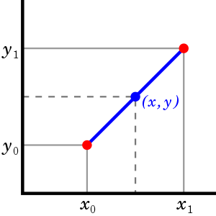
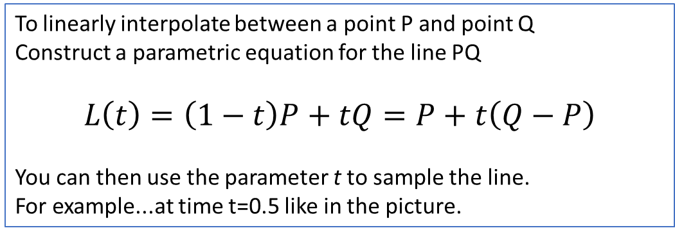
Linear Interpolation
Affectionately known as LERPing
Linear Interpolation is the simplest way to fill in in-between values
Just create a straight line between two points and sample at regular intervals
To linearly interpolate between a point P and point Q Construct a parametric equation for the line PQ $$L\left(t\right)=\left(1−t\right)P+tQ=P+t\left(Q−P\right)$$
You can then use the parameter t to sample the line.
For example...at time t=0.5 like in the picture.

Slide 12
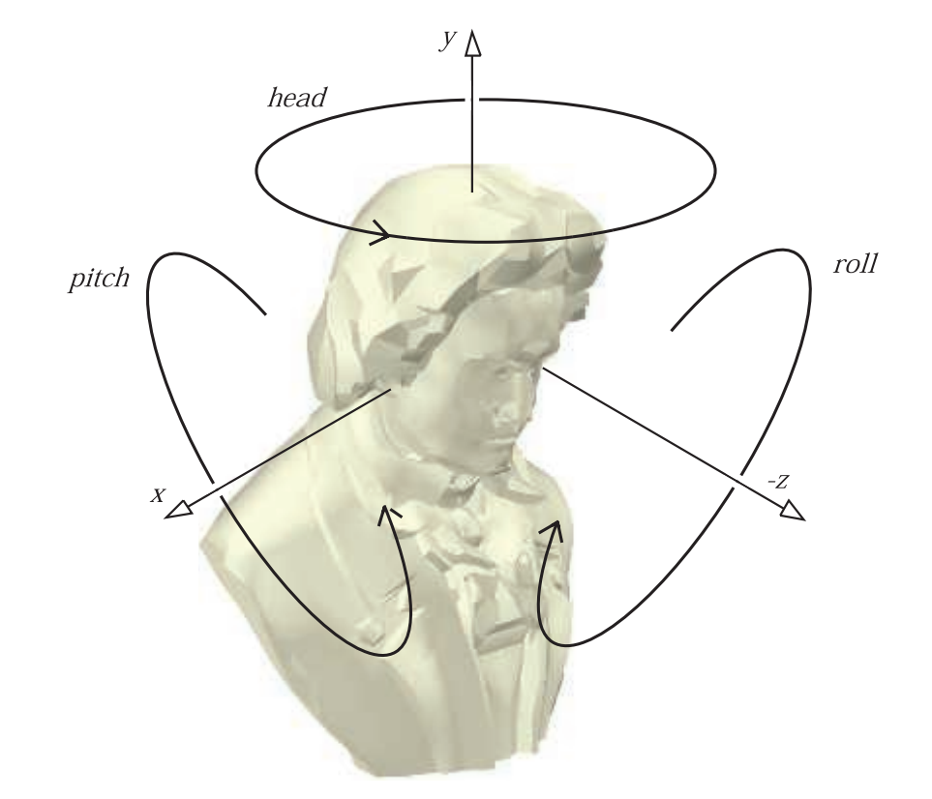
Orientation
We can position a model in our 3D virtual world pretty easily
Just 3 values to translate it to desired position
What about orientation? How will we specify that for a model?
Or for a camera?

Slide 13
Orientation is not Direction
Rotating a vector around itself does not change it
Rotating an object around its principal direction changes its orientation
Orientations require more information to represent than a vector

Slide 14
Representing Orientations
In 3D…how much information is needed to represent a direction?
How about an orientation?
There are several popular options to encode orientation:
Euler angles
Rotation vectors (axis/angle)
3x3 matrices
Quaternions

Slide 15
Euler Angles
We can represent an orientation with 3 numbers
A sequence of rotations around principal axes is called an Euler Angle Sequence
Assume we limit ourselves to 3 rotations
no successive rotations about the same axis
we could use any of the following 12 sequences to specify an orientation
XYZ | XZY | XYX | XZX
YXZ | YZX | YXY | YZY
ZXY | ZYX | ZXZ | ZYZ

Slide 16
Applying an Euler Angle Sequence
Which axes are being rotated around in this sequence?

Slide 17
Applying an Euler Angle Sequence
Which axes are being rotated around in this sequence? M=R_{z}R_{x}R_{y} This is a very commonly used order…

Slide 18
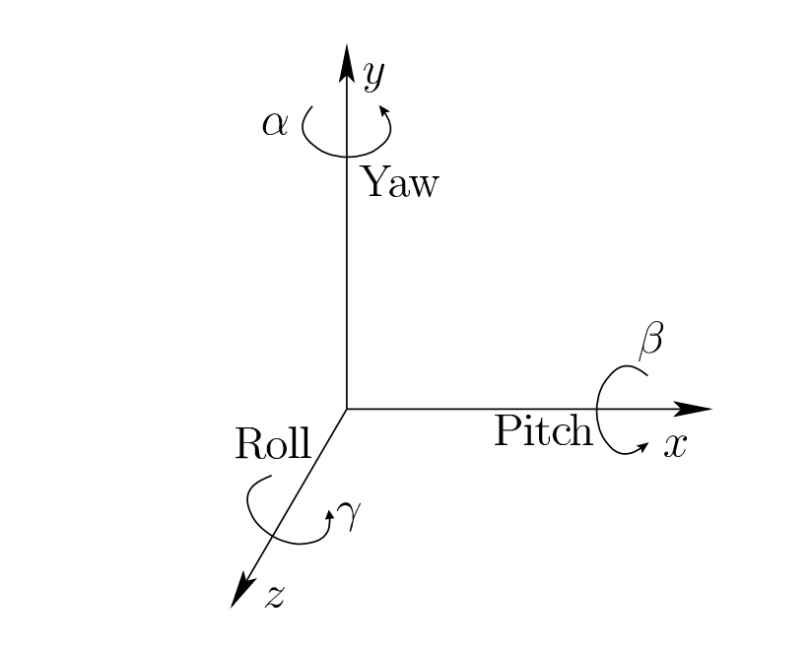
Euler Angles
As in Virtual Reality by Lavalle we will define
Roll
rotation about z
Pitch
rotation about x
Yaw
rotation about y
Orientation
Rz(roll) Rx(pitch) Ry(yaw)

Slide 19
Euler Angles to Matrix Conversion
To build a matrix from a set of Euler angles just multiply a sequence of rotation matrices together:
Why would we care about being able to convert to a matrix ?

Slide 20
Euler Angles…Good and Bad
Euler angles can generate any possible orientation in 3D (Good!)
Euler angles are used in a lot of applications…they are intuitive (Good!)
They are compact…requiring only 3 numbers (Good!)
Ambiguous: different triples can be same orientation (Bad!)
They do not interpolate in a obvious way (Bad!)
They can suffer from Gimbal lock (Bad! But not as bad as it sounds)
Conversion to/from a matrix requires several trig operations (Bad!)

Slide 21
Gimbal Lock
y
Airplane orientation
Rz(roll) Rx(pitch) Ry(yaw)
Two axes have collapsed onto each other
Think about this from a user-interface perspective Imagine you have 3 dials…one for each angle
What action caused the orientation you see? What happens when z dial is moved now?
x
-z
What problem could this cause for someone playing a game with this interface?

Slide 22
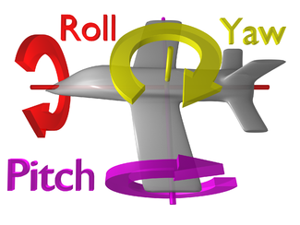
Thinking about Gimbal Lock
M=R_{z}R_{x}R_{y}
In what order are the transformations applied to the points?
Which axis and angle(s) can cause Gimbal Lock?
Y? X? Z?

Slide 23
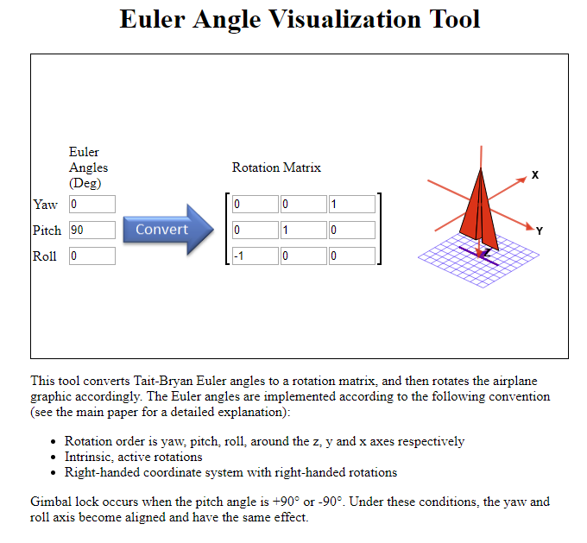
Experiment
http://danceswithcode.net/engineeringnotes/rotations_in_3d/demo3D/rotations_in_3d_tool.html

Slide 24
Is Gimbal Lock that Important?
“In the video game industry there has been some back-and-forth battles about whether this problem is crucial. In an FPS game, the avatar is usually not allowed to pitch his head all the way to ±π/2, thereby avoiding this problem. In VR, it happens all the time that a user could pitch her head straight up or down. The kinematic singularity often causes the viewpoint to spin uncontrollably…”
-- Virtual Reality by Lavalle Section 3.3

Slide 25
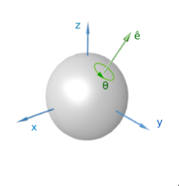
Euler’s Rotation Theorem (1775)
In geometry, Euler's rotation theorem states that, in three-dimensional space, any displacement of a rigid body such that a point on the rigid body remains fixed, is equivalent to a single rotation about some axis that runs through the fixed point. It also means that the composition of two rotations is also a rotation.
--Wikipedia
Is an angle-axis representation of an orientation unique?
This means that any set of Euler angles is equivalent to some single rotation around some axis.
So, any orientation can be represented by and angle and an axis (i.e. a vector)

Slide 26
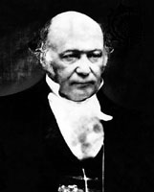
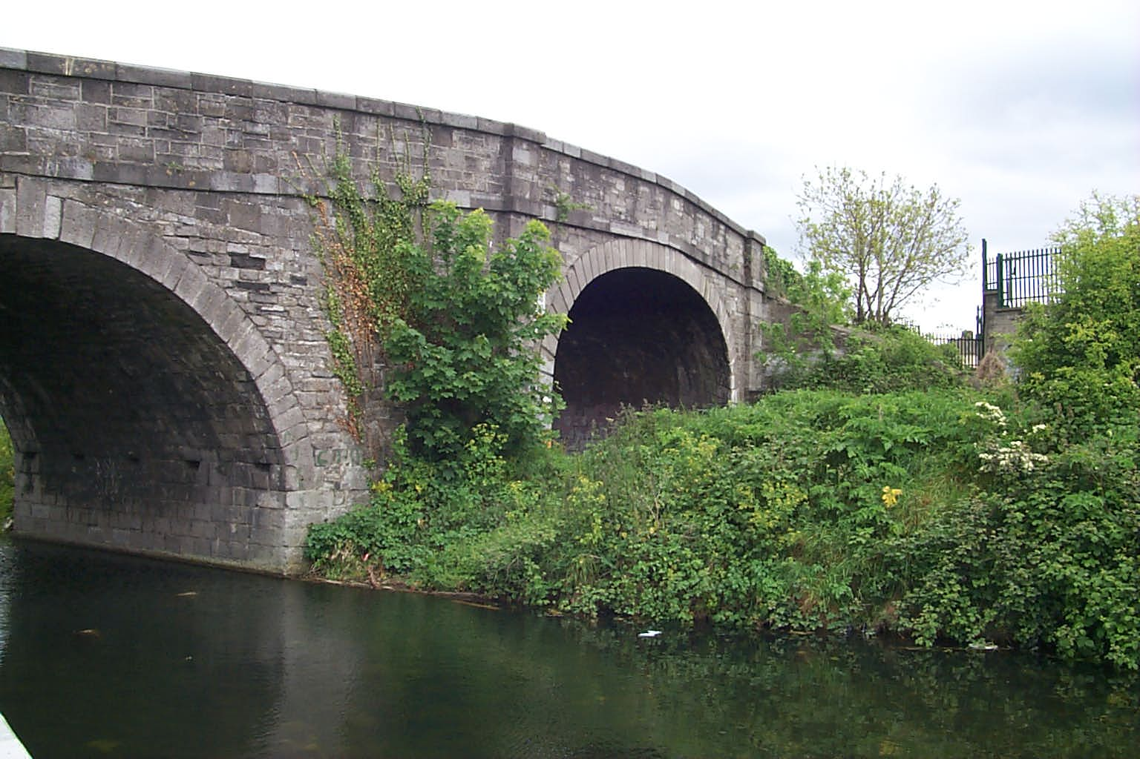
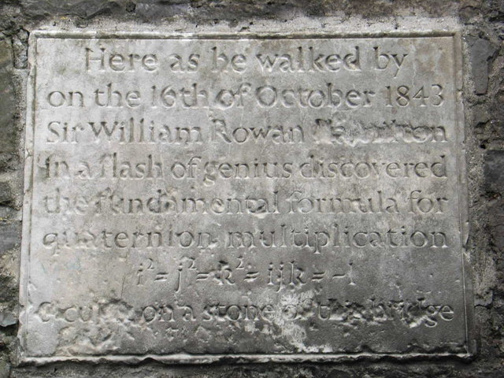
Quaternions
Alternative to Euler Angles
Developed by Sir William Rowan Hamilton [1843]
Quaternions are 4-D complex numbers
With one real axis
And three imaginary axes: i,j,k
TL;DL It turns out that quaternions are effectively an angle-axis representation of an orientation…just think of them as a way of encoding that information
Hamilton Math Inst., Trinity College

Slide 27
Quaternions
Introduced to Computer Graphics by Shoemake [1985]
Given an angle and axis, easy to convert to and from quaternion
Euler angle conversion to and from arbitrary axis and angle difficult
Quaternions allow stable and constant interpolation of orientations
Cannot be done easily with Euler angles

Slide 28
Unit Quaternions
For convenience, we will use only unit length quaternions
These correspond to the set of 4D vectors
They form the ‘surface’ of a 4D hypersphere of radius 1

Slide 29
Quaternions as Rotations
A quaternion can represent a rotation by angle θ around a unit vector a:
If a is unit length, then q will be also

Slide 30
A Rotation Quaternion is Unit-Length

Slide 31
Rotation using Quaternions
We haven’t talked about how to multiply quaternions yet, but don’t worry about that for now…
Let q = cos(θ/2) + sin(θ/2) u be a unit quaternion: |q| = |u| = 1
Let point p = (x,y,z) = x i + y j + z k
Then the product q p q⁻¹ rotates the point p about axis u by angle θ
Inverse of a unit quaternion is its conjugate …just negate the imaginary part
q⁻¹ = (cos(θ/2) + sin(θ/2) u)⁻¹
= cos(-θ/2) + sin(-θ/2) u
= cos(θ/2) – sin(θ/2) u
Composition of rotations q₁₂ = q₁ q₂ ≠ q₂ q₁
θ
u
p
q p q⁻¹

Slide 32
Rotation using Quaternions
Let q = cos(θ/2) + sin(θ/2) u be a unit quaternion: |q| = |u| = 1
Let point p = (x,y,z) = x i + y j + z k
Then the product q p q⁻¹ rotates the point p about axis u by angle θ
Inverse of a unit quaternion is its conjugate …just negate the imaginary part
q⁻¹ = (cos(θ/2) + sin(θ/2) u)⁻¹
= cos(-θ/2) + sin(-θ/2) u
= cos(θ/2) – sin(θ/2) u
Composition of rotations q₁₂ = q₁ q₂ ≠ q₂ q₁
What would the identity quaternion look like? What are q₀, q_{1,} q_{2,} q₃ ?
θ
u
p
q p q⁻¹

Slide 33
Quaternion to Matrix
Again, why do we want to be able to do this?
To convert a quaternion to a rotation matrix:

Slide 34
Matrix to Quaternion
This assumes M is a 4x4 homogeneous rotation matrix…so the diagonal ends with a 1
Matrix to quaternion is not hard
it involves a few ‘if’ statements,
a square root,
three divisions,
and some other stuff
tr(M) is the trace
sum of the diagonal elements

Slide 35
Quaternion Dot Products
The dot product of two quaternions:
The angle between two quaternions in 4D space is half the angle one would need to rotate from one orientation to the other in 3D space

Slide 36
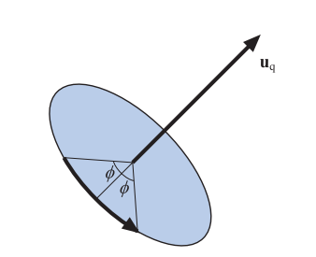
Rotation using Quaternions
“The angle between two quaternions in 4D space is half the angle one would need to rotate from one orientation to the other in 3D space…”
Let φ be the angle between two orientations in 4D space
So, it’s the angle between 2 quaternions Q1 and Q2 in 4D space
That means that for some quaternion U we have Q2 = U Q1 Where U = (cos φ , sin φ Uq)
The angle rotate through in 3D Euclidean space will be 2φ

Slide 37
Quaternion Multiplication
We can perform multiplication on quaternions
we expand them into their complex number form
If q represents a rotation and q’ represents a rotation, qq’ represents q rotated by q’
This follows very similar rules as matrix multiplication (i.e., non-commutative)
It’s just like multiplying 2 rotation matrices together….

Slide 38
Quaternion Multiplication
Two unit quaternions multiplied together results in another unit quaternion
This corresponds to the same property of complex numbers
Remember(?) multiplication by complex numbers is like a rotation in the complex plane
Quaternions extend the planar rotations of complex numbers to 3D rotations in space

Slide 39
Linear Interpolation
If we want to do a linear interpolation between two points a and b in normal space
Lerp(t,a,b) = (1-t)a + (t)b
where t ranges from 0 to 1
Note that the Lerp operation can be thought of as a weighted average (convex)
We could also write it in its additive blend form:
Lerp(t,a,b) = a + t(b-a)

Slide 40
Spherical Linear Interpolation
If we want to interpolate between two points on a sphere (or hypersphere), we do not just want to Lerp between them
Instead, we will travel across the surface of the sphere by following a ‘great arc’
If we lerped between 2 unit quaternions would our interpolated quaternions be valid orientations?

Slide 41
Spherical Linear Interpolation
The spherical linear interpolation of two unit quaternions a and b is:
Quick quiz: explain what the angle theta is? What space is it in?

Slide 42
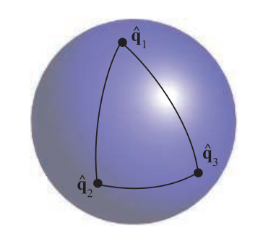
Quaternion Interpolation
Useful for animating objects between two poses
Not useful for all camera orientations
up vector can become tilted and annoy viewers
depends on application
Interpolated path through SLERP rotates
around a fixed axis
at a constant speed
so, no acceleration
If we want to interpolate through a series of orientations q1,q2,…,qn is SLERP a good choice?
“Don’t stick UI to camera component in Unity”

Slide 43
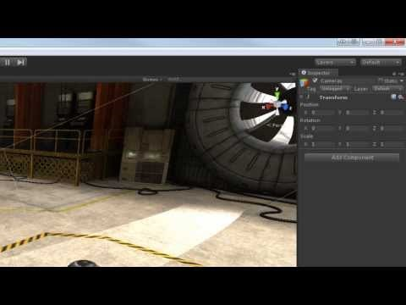
Quaternions in Unity
https://www.youtube.com/watch?v=TdjoQB43EsQ

Slide 44
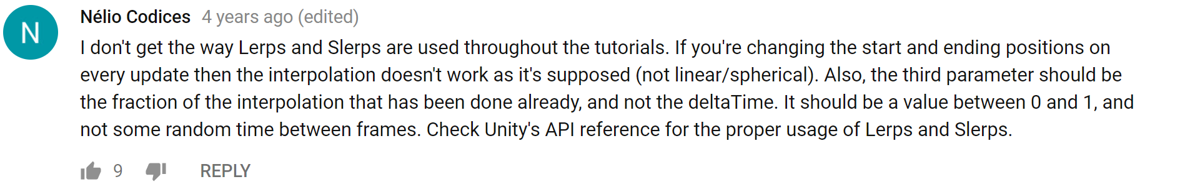
You’re Right Nelio….It’s Not Really Correct….

