Slide 1
CS 498 VR
VR
Design & Development
Methodologies
(For internal use only)

Slide 2
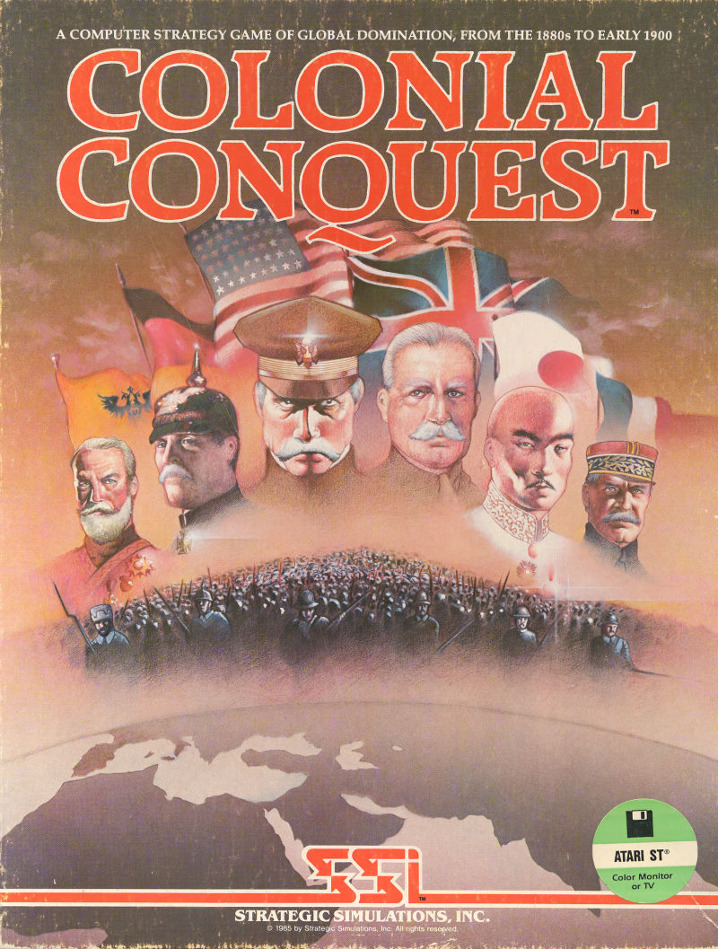

Who am I?
35 years in the video game industry
Self taught programmer
Designed, programmed & shipped 2 games
Spent 11 years doing external development
Taught me communication and information gathering
Basically a production guy with input on design
Game development from all sides
Last 15 years I was responsible for Volition game Dev.
Experimented with various structures/methodologies

Slide 3
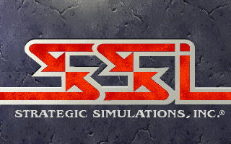

My 30 Game Industry Career had its ups and downs
SSI: Developer and Publisher – PROS
Amazing people
The golden age, worked on every kind of game imaginable
Produced in every genre (Sports, RTS, RPG, Adventure, Wargames, & Shooters)
Learned production processes
Filled about every position in the hierarchy
SSI: Developer and Publisher – CONS
Did external production primary, missed some team management processes
The company was privately owned, couldn’t sustain itself
Had to sell (3 times) and each new buyer was an adventure in ineptitude
Went through a layoff

Slide 4


My 30 Game Industry Career
EA: Westwood – PROS
Great group of people, very professional
Interfaced with EA Studio Execs daily
Learned a lot of high-level elements
Got to meet some amazing designers
EA: Westwood – CONS
EA Studio Management was broken, politics & BS.
Studio had an odd culture of secrecy, & mistrust
Studio direction was off…

Slide 5

My 30 Game Industry Career
Volition: - PROS
Latitude to set structure and process
Really smart, amazing teams
Great culture
Saw some success, SR3 hit 6 million
Location meant that corp. stayed away
Volition: - CONS
2 Product lines in cycle, 1 wasn’t a hit
Stockholders meant time constraints
To be AAA (high end), you need big bucks
Location made it tough to hire
Bankruptcy

Slide 6
CS 498 VR Goals and Expectations
General
Set up the project teams as soon as possible
Complete the projects via a simplified project plan
Develop the key elements of the projects
Initial idea
Game/Project World or Environment clearly defined
Project Plan details
High & Mid-level design
Simple production documents
Discuss VR (design elements, key considerations)
Present a survey of the video game industry, studios and projects
Go into a bit more detail about the Design and Production processes

Slide 7
CS 498 VR Projects
Projects
Course is becoming more project oriented
Can be either a Sponsored Project or a Game
Team sizes of 4-5 preferred (we prefer not to create 6 person teams)
Consideration is given to those that want to work together
We also consider the student tenure (3 seniors could be considered okay)
A survey will go out shortly to see what you are interested in creating
Sponsored projects
We have 10 VR projects and 4 AR projects
Most of the VR projects are continuations of previous projects
We are just starting up AR so that will be a learning experience for everyone
Your CA/TA will provide you with a link to a google drive folder containing project info
Sponsoring professors should be involved in the process

Slide 8
CS 498 VR Projects continued
Games
Prefer something other than escape rooms
The last semester projects can be seen on the website
Experience tells us that scope is usually the biggest issue
Documentation & ongoing development (progress throughout the semester) are Key

Slide 9
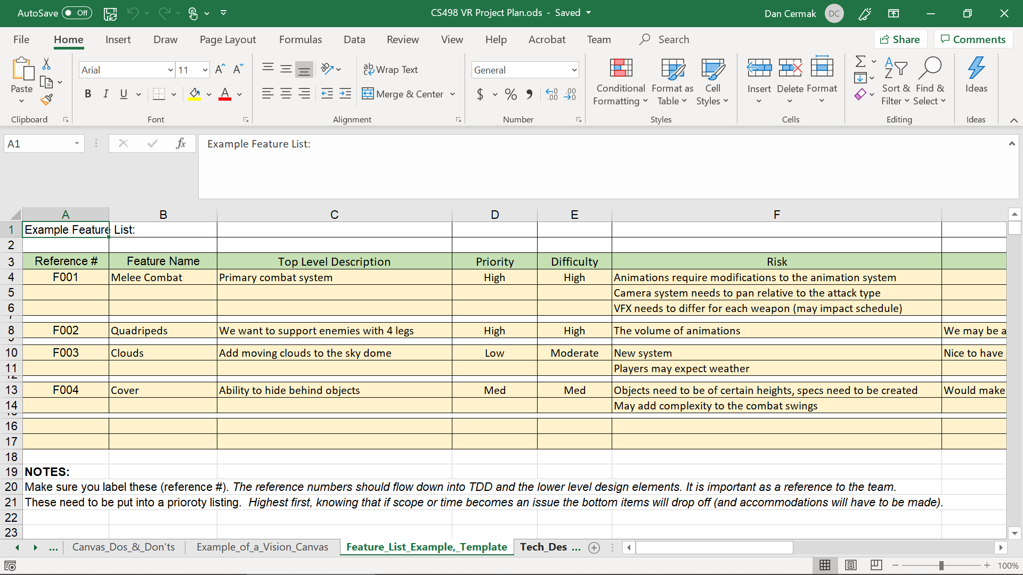
CS 498 VR Project Plan
Google Sheet Workbook
World Description Template
Could easily be a Word or Docs File
Some of the detail is game oriented
Vision Canvas Template
includes a Dos & Don’ts version
Feature List Template
Technical Design Template
Milestone Template
QC Test Plan Template
This is abbreviated because we are building the design and project in one semester

Slide 10
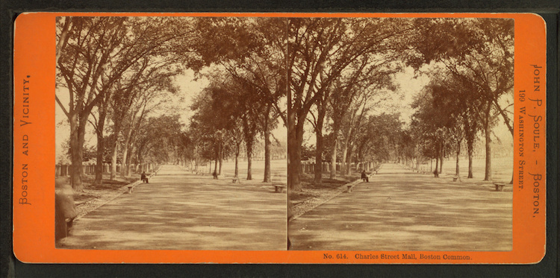
History of VR
1838: Stereoscopic Vision – Invented by Charles Wheatstone, it brought depth to photography via a viewer and special slides

Slide 11
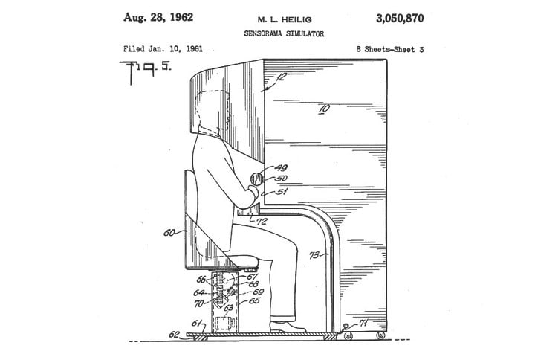
History of VR
1952: Sensorama - Morton Heilig created a device to address all sensory input, it included stereoscopic 3D display, fans, smell generators, stereo speakers and a vibrating chair. He built working models in 1956 and made several movies for the device.

Slide 12
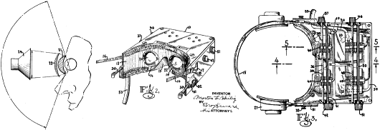
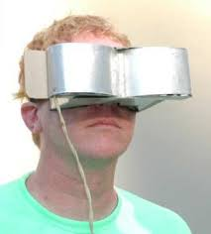
History of VR
1960: Telesphere Mask – Heilig followed up with what is considered to be the first HMD. It featured stereo 3D as well as wide vision and stereophonic sound.

Slide 13
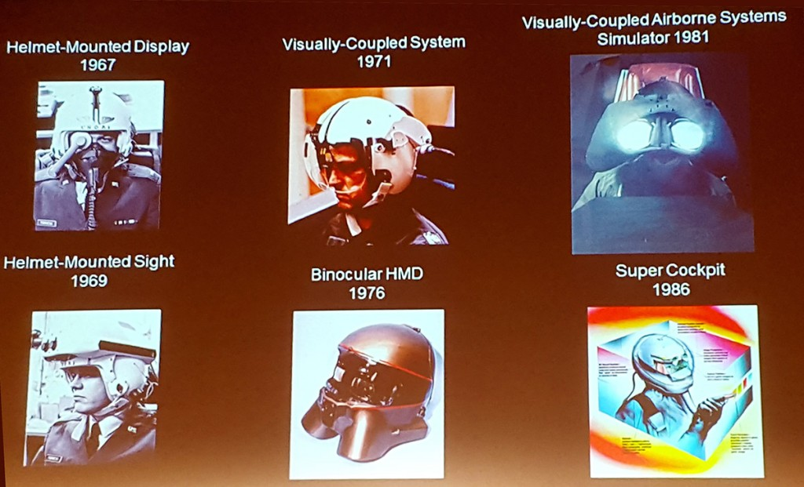
History of VR
1960s: Super Cockpit Program – Tom Furness, working in the Air Force, created some of the first HMDs. He worked on fully immersive cockpit simulations for 20 years before leaving and working at he forefront of VR at the U. of Washington.
He created Human Interface Technology Lab and the Virtual World Society to drive VR in the educational realm.

Slide 14
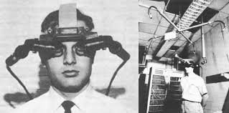
History of VR
1961: Headsight – Developed by Comeau and Bryan,engineers from the Philco Corporation) engineers (Comeau & Bryan) developed the first precursor to the HMD as we know it today – the Headsight. Each eye had a video screen and there was a motion tracking device that linked to a remote camera, moving your head moved the camera. Headsight was the beginning of modern HMD but it lacked computer integration and with that, computer generated images.

Slide 15
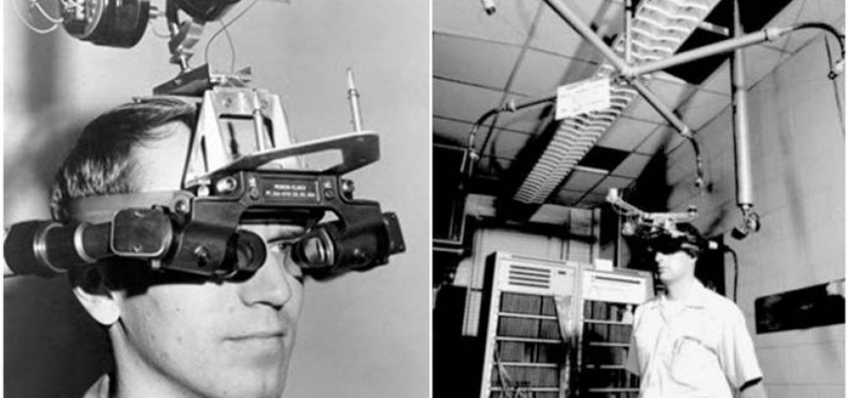
History of VR
1965: Ivan Sutherland, MIT scientist, described the “Ultimate Display” concept, a description of Virtual Reality that became a blueprint for what modern VR became.
1968: Sword of Damocles project – Sutherland created the first VR HMD attached to a computer. It was tethered to a telescoping arm that hung over the user, hence the name, collecting data on head tracking while simple geometric shapes were shown via a stereoscopic display.
https://vrroom.buzz

Slide 16
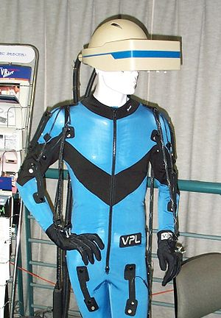
History of VR: VPL Research
1987: - The term Virtual Reality is popularized by Jaron Lanier and the he went on to create VPL Research which built various items in support of VR including :
the DataGlove (a major development in VR haptics)
the Datasuit
Eyephone (HMD)

Slide 17
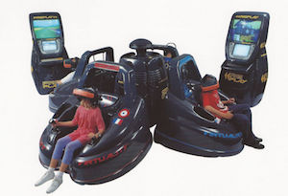
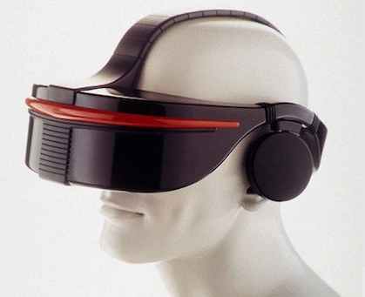
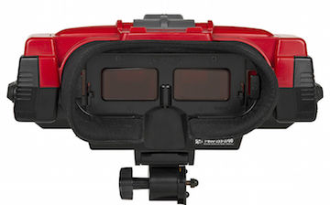
History of VR
1990s: VR Goes Mainstream
1991: Virtuality Group
launched a range of VR arcade games and machines
1993: Sega VR (never Shipped)
1995: Nintendo Virtual Boy

Slide 18
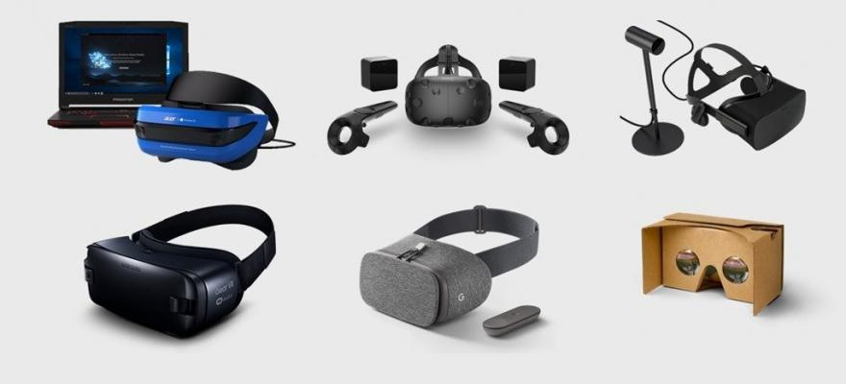
History of VR
2010: 18-year-old entrepreneur Palmer Luckey created a VR prototype called the Oculus Rift. He raised over $2M in a Kickstarter and created huge consumer and corporate interest in VR, sold to Facebook for $2B in 2014.
2015-2016: Various VR systems shipped
Oculus Rift
HTC Vive (in conjunction with Valve)
Samsung Gear
Playstation VR
Google Cardboard
2018 & 2019
Oculus Go
HP Reverb
HTC Vive Focus
Oculus Quest
Oculus Rift S
Valve Index

Slide 19
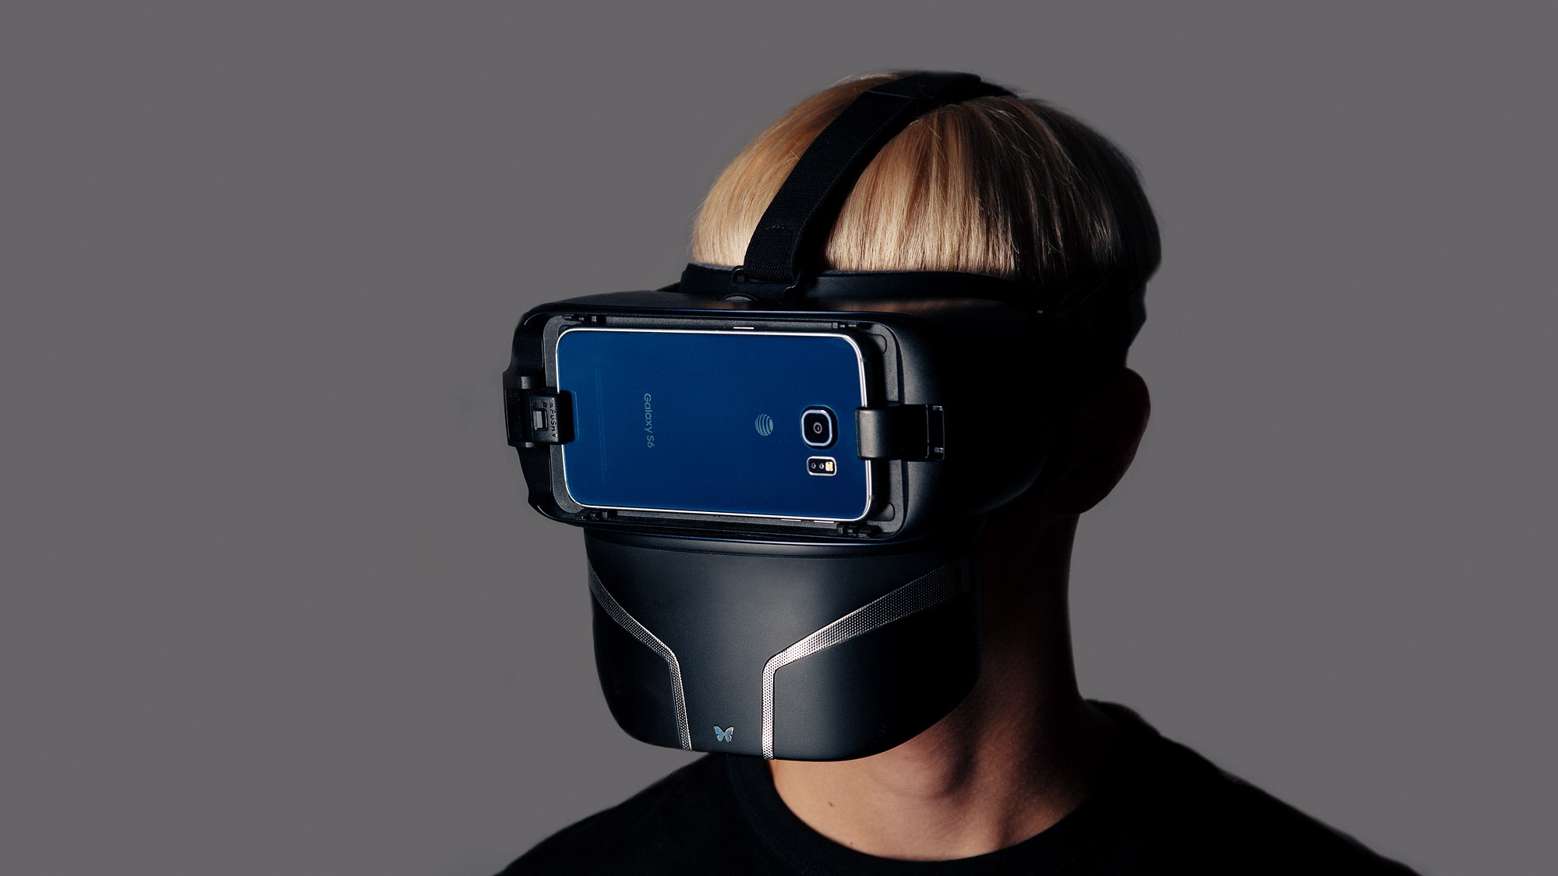
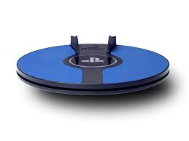
History of VR: 2019 Peripherals
Feelreal - Modern version of the original Sensorama. Feelreal is a new company producing a VR mask add-on that provides olfactory, water, hear, wind and vibration feedback for the current VR masks.
3dRudder: Foot controller for PSVR, removes teleporting and reduces motion sickness
Feelreal.com

Slide 20
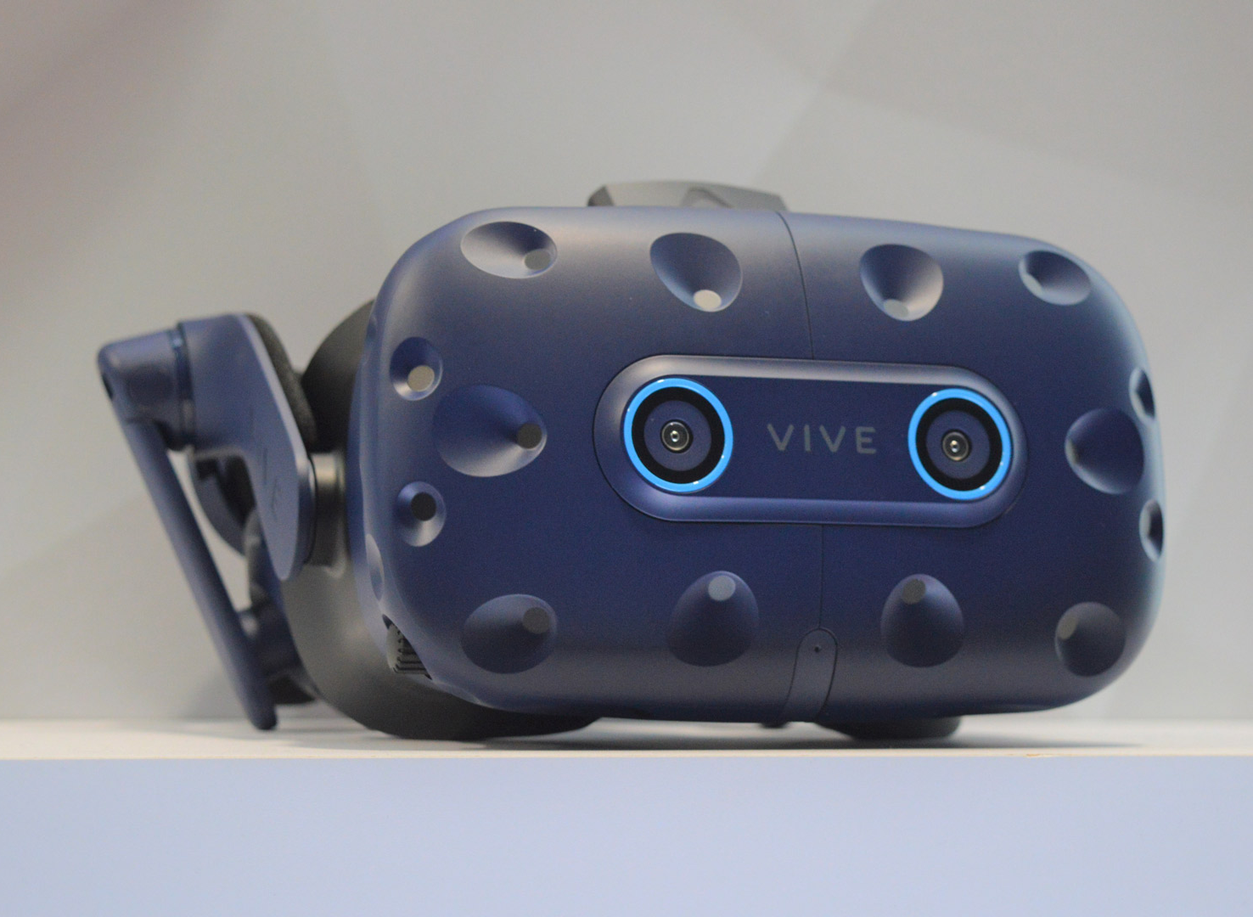
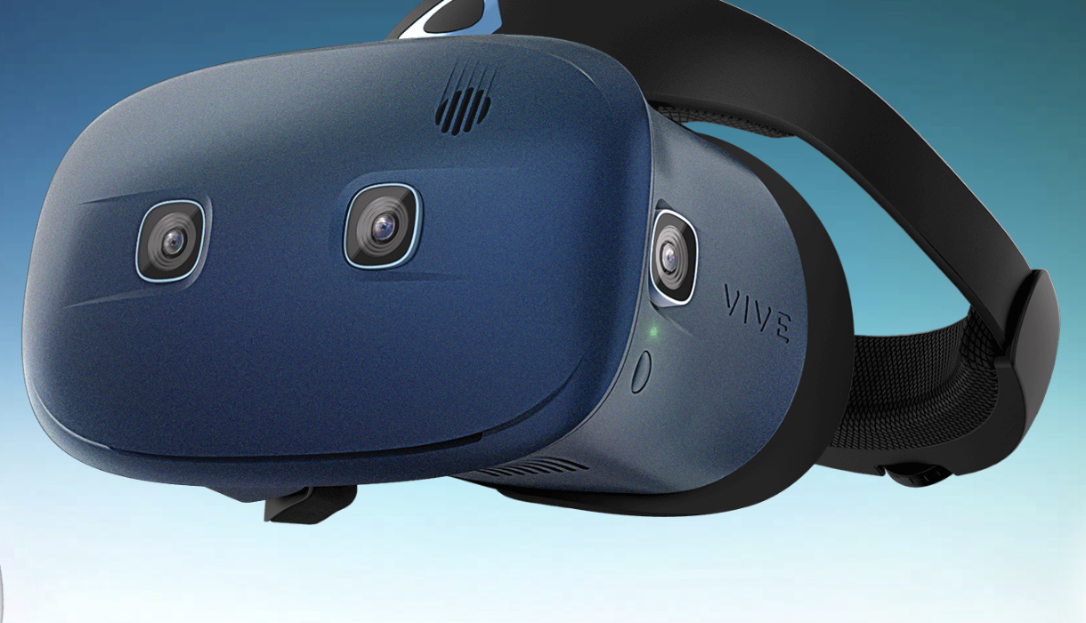
History of VR
2019: Still to come: HTC Vibe Pro with Eye tracking, HTC Cosmos
Vive Pro Features
Foveated rendering
“gaze-oriented menu navigation"
Cosmos Features
Modular, higher res,
Flip-up screen, still tethered

