Slide 1
Cloud Computing: Perspectives for Research
Roy Campbell
Sohaib and Sara Abbasi Professor Computer Science, University of Illinois

Slide 2
Takeaway
The new information technologies are disruptive
Utility computing is changing industry
Efficient information sharing provides a new model for business

Slide 3
Overview
What is meant by
Cloud Computing
Utility Computing
{Infrastructure, Platform, Software} as a Service
General principles
Cloud Computing Testbed (CCT)
Research

Slide 4
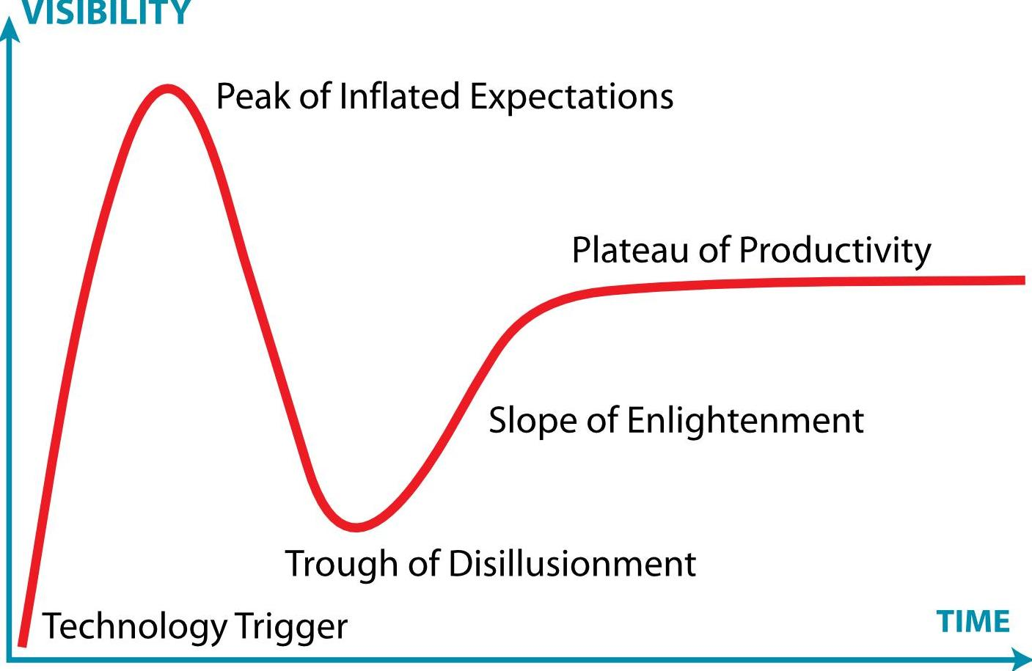
Gartner Hype Cycle*
Cloud Computing
* From http://en.wikipedia.org/wiki/Hype_cycle

Slide 5
Cloud Computing
Computing paradigm where the boundaries of computing will be determined by economic rationale rather than technical limits
Professor Ramnath Chellappa
Emory University
It is not just Grid, Utility, or Autonomic computing.

Slide 6
Cloud Characteristics
On-demand self-service
Ubiquitous network access
Location independent resource pooling
Rapid elasticity
Pay per use
Notes:
On-demand self-service. A consumer can unilaterally provision computing capabilities, such as server time and network storage, as needed without requiring human interaction with each service’s provider.
Ubiquitous network access. Capabilities are available over the network and accessed through standard mechanisms that promote use by heterogeneous thin or thick client platforms (e.g., mobile phones, laptops, and PDAs).
Location independent resource pooling. The provider’s computing resources are pooled to serve all consumers using a multi-tenant model, with different physical and virtual resources dynamically assigned and reassigned according to consumer demand. The customer generally has no control or knowledge over the exact location of the provided resources. Examples of resources include storage, processing, memory, network bandwidth, and virtual machines.
Rapid elasticity. Capabilities can be rapidly and elastically provisioned to quickly scale up and rapidly released to quickly scale down. To the consumer, the capabilities available for rent often appear to be infinite and can be purchased in any quantity at any time.
Pay per use. Capabilities are charged using a metered, fee-for-service, or advertising based billing model to promote optimization of resource use. Examples are measuring the storage, bandwidth, and computing resources consumed and charging for the number of active user accounts per month. Clouds within an organization accrue cost between business units and may or may not use actual currency.

Slide 7
Delivery Models
Software as a Service (SaaS)
Use provider’s applications over a network
SalesForce.com
Platform as a Service (PaaS)
Deploy customer-created applications to a cloud
AppEng
Infrastructure as a Service (IaaS)
Rent processing, storage, network capacity, and other fundamental computing resources
EC2, S3
Notes:
Cloud Software as a Service (SaaS). The capability provided to the consumer is to use the provider’s applications running on a cloud infrastructure and accessible from various client devices through a thin client interface such as a Web browser (e.g., web-based email). The consumer does not manage or control the underlying cloud infrastructure, network, servers, operating systems, storage, or even individual application capabilities, with the possible exception of limited user-specific application configuration settings.
Cloud Platform as a Service (PaaS). The capability provided to the consumer is to deploy onto the cloud infrastructure consumer-created applications using programming languages and tools supported by the provider (e.g., java, python, .Net). The consumer does not manage or control the underlying cloud infrastructure, network, servers, operating systems, or storage, but the consumer has control over the deployed applications and possibly application hosting environment configurations.
Cloud Infrastructure as a Service (IaaS). The capability provided to the consumer is to rent processing, storage, networks, and other fundamental computing resources where the consumer is able to deploy and run arbitrary software, which can include operating systems and applications. The consumer does not manage or control the underlying cloud infrastructure but has control over operating systems, storage, deployed applications, and possibly select networking components (e.g., firewalls, load balancers).

Slide 8
Software Stack
Mobile (Android), Thin client (Zonbu) Thick client (Google Chrome)
Identity, Integration Payments, Mapping, Search, Video Games, Chat
Peer-to-peer (Bittorrent), Web app (twitter), SaaS (Google Apps, SAP)
Java Google Web Toolkit, Django, Ruby on Rails, .NET
S3, Nirvanix, Rackspace Cloud Files, Savvis,
Full virtualization (GoGrid), Management (RightScale), Compute (EC2), Platform (Force.com)
Clients
Services
Application
Platform
Storage
Infrastructure

Slide 9
Success?
Salesforce.com
Customer Relations Management
1999 Benioff took over company
Killed of Siebel Systems (Big Switch)
Made profit through recession (AMR Research):
FY2009 4Q growth of 44% over 2008,
Yearly revenue >$1B

Slide 10
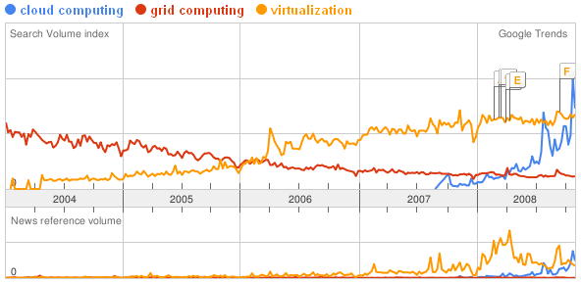
Recent Trends
Amazon S3
(March 2006)
Amazon EC2
(August 2006)
Salesforce
AppExchange
(March 2006)
Google App Engine
(April 2008)
Facebook Platform
(May 2007)
Microsoft Azure
(Oct 2008)

Slide 11
Perils of Corporate Computing
Own information systems ☺
However
Capital investment ☹
Heavy fixed costs ☹
Redundant expenditures ☹
High energy cost, low CPU utilization ☹
Dealing with unreliable hardware ☹
High-levels of overcapacity (Technology and Labor) ☹
NOT SUSTAINABLE

Slide 12
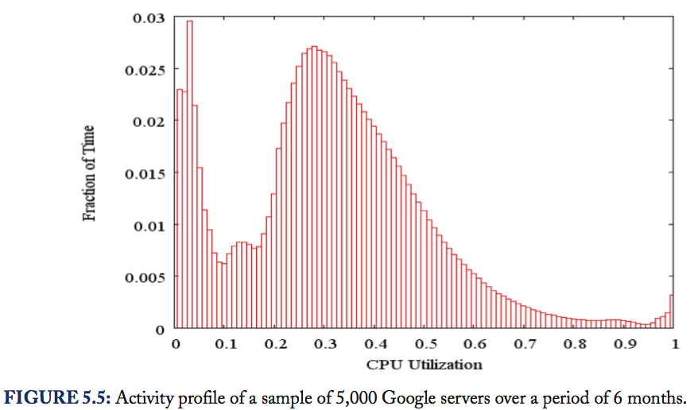
CPU Utilization
Activity profile of a sample of 5,000 Google Servers over a period of 6 months

Slide 13
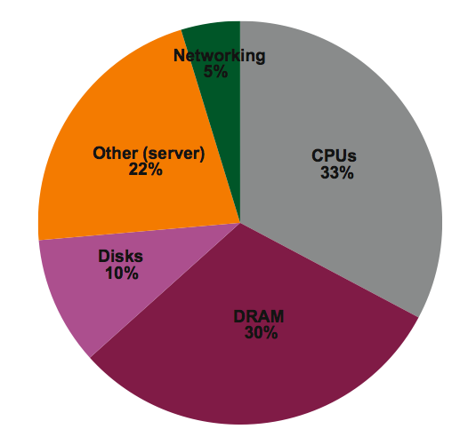
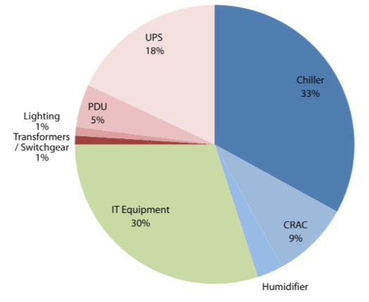
Energy Overhead

Slide 14
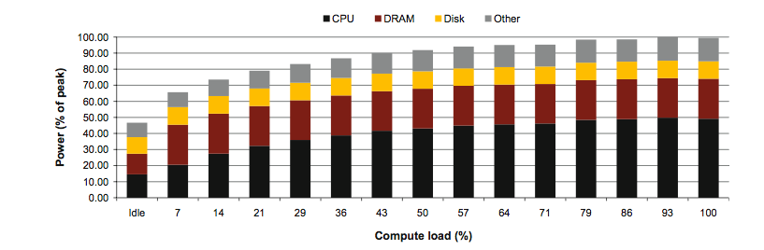
Subsystem Power Usage
Subsystem power usage in an x86 server as the compute load varies from idle to full usage.

Slide 15
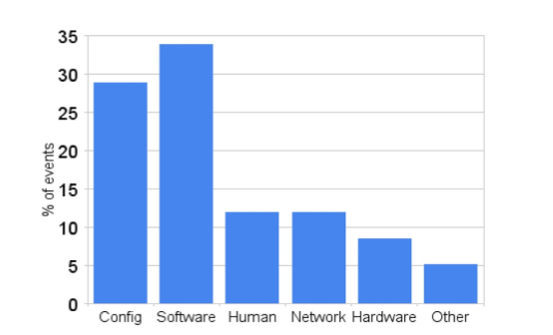
Service Disruptions

Slide 16
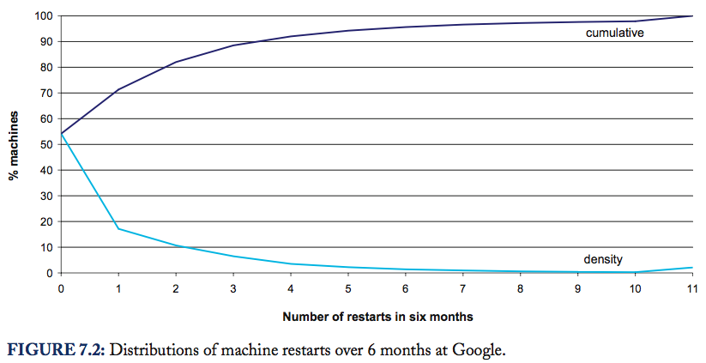
Machine Restarts
Distributions of machine restarts over 6 months at Google

Slide 17
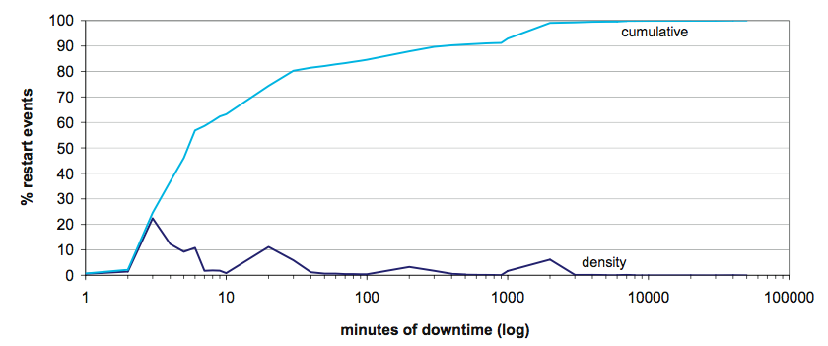
Machine Downtime
Distribution of machine downtime, observed at Google over 6 months. The average annualized restart rate across all machines is 4.2, corresponding to a mean time between restarts of just less than 3 months.

Slide 18
Utility Computing
Let economy of scale prevail
Outsource all the trouble to someone else
The utility provider will share the overhead costs among many customers, amortizing the costs
You only pay for:
the amortized overhead
Your real CPU / Storage / Bandwidth usage

Slide 19
Why Utility Computing Now
Large data stores
Fiber networks
Commodity computing
Multicore machines
+
Huge data sets
Utilization/Energy
Shared people
Utility Computing

Slide 20
UIUC Cloud Research
Who
What

Slide 21
UIUC Cloud Investigators
Principal Investigator
Michael Heath – parallel algorithms
Co-PIs and lead systems researchers
Roy Campbell – O/S, file systems, security
Indranil Gupta – distributed systems and protocols
Lead Power/Cooling researchers
Tarek Abdelzaher, Roy Campbell, Indranil Gupta, Michael Heath
Lead applications researchers
Kevin Chang – search and query processing
Jiawei Han – data mining
Klara Nahrstedt – multimedia, QoS
Dan Roth – machine learning, NLP
Cheng Zhai – information retrieval
Peter Bacjsy, Rob Kooper - NCSA

Slide 22
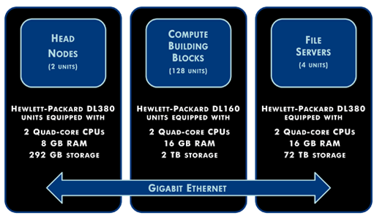





UIUC Cloud Infrastructure Testbed
CCT

Slide 23
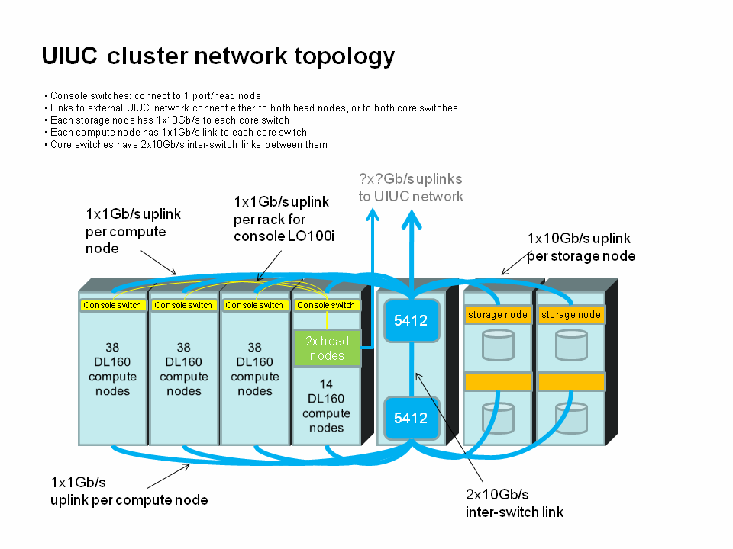
CCT Topology
CCT
128 compute nodes = 64+64
500 TB & 1000+ shared cores
Notes:
23

Slide 24

Open Cirrus Federation
Founding 6 sites
24
Notes:
Berkeley, CMU, Cornell, Umass-Amherst
24

Slide 25
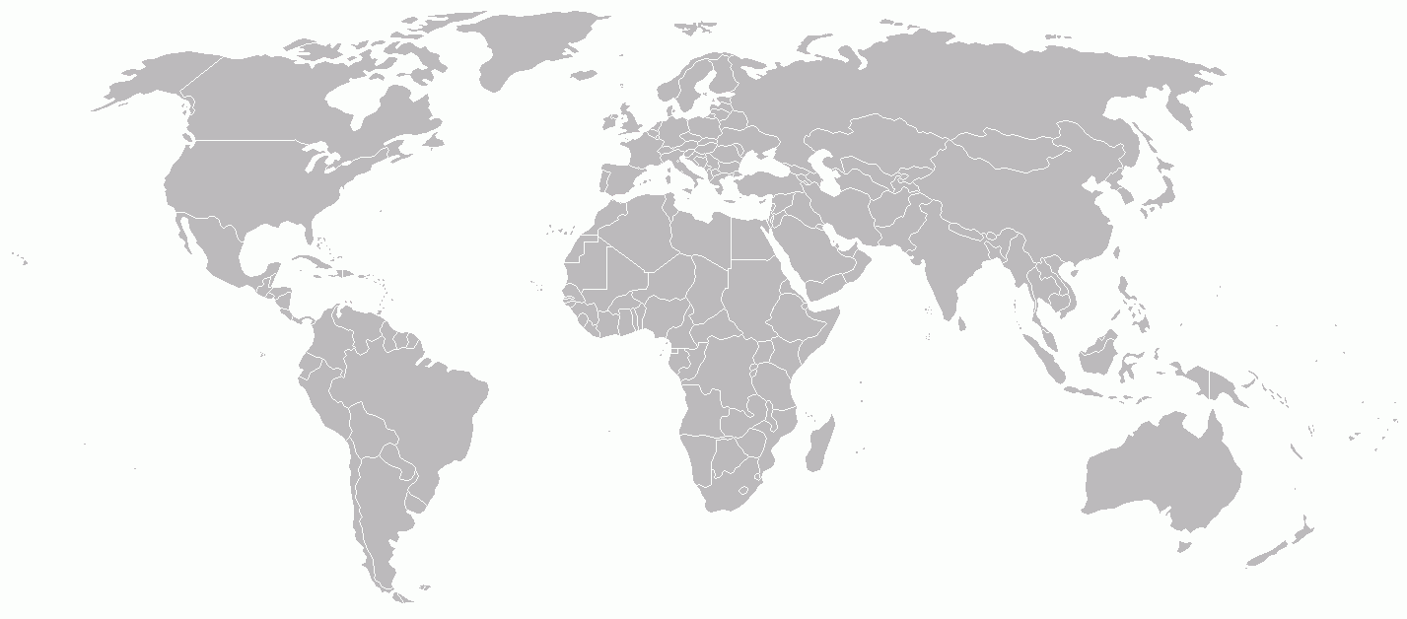
Open Cirrus Federation
Shared: research, applications, infrastructure (6*1,000 cores), data sets
Global services: sign on, monitoring, store, etc., Cloud stack (prs, tashi, hadoop, ),
RAS
KIT (de)
HP
Intel
Yahoo
ETRI
UIUC
CMU
IDA (sg)
MIMOS
25
18 September 2009
Grown to 9 sites, with more to come

Slide 26
Goal
Support both
Systems Research and
Applications Research
in Data-intensive Distributed Computing

Slide 27
Data Intensive Computing
Data collection too large to transmit economically over Internet --- Petabyte data collections
Computation produces small data output containing a high density of information
Implemented in Clouds
Easy to write programs, fast turn around.
MapReduce.
Map(k1, v1) -> list (k2, v2)
Reduce(k2,list(v2)) -> list(v3)
Hadoop, PIG, HDFS, Hbase
Sawzall, Google File System, BigTable

Slide 28
CCT Services
Accessing and Using CCT:
Systems Partition (64 nodes):
CentOS machines, with sudo access
Dedicated access to a subset of machines (~ Emulab)
User accounts
User requests # machines (<= 64) + storage quota (<= 30 TB)
Machine allocation survives for 4 weeks, storage survives for 6 months (both extendible)
Hadoop/Pig Partition and Service (64 nodes):

Slide 29
CCT Services
Accessing and Using CCT:
Systems Partition (64 nodes):
Hadoop/Pig Partition and Service (64 nodes):
Looks like a regular shared Hadoop cluster service
Users share 64 nodes. Individual nodes not directly reachable.
4 slots per machine
Several users report stable operation at 256 instances
During Spring 09, 10+ projects running simultaneously
User accounts
User requests account + storage quota (<= 30 TB)
Storage survives for 6 months (extendible)

Slide 30
CCT Services
Some Services running inside CCT
ZFS: backend file system.
Zenoss: Monitoring. Shared with department’s other computing clusters
Hadoop + HDFS
Ability to make datasets publicly available
How do users request an account: two-stage process
User account request – require background check
Allocation request

Slide 31
Internal UIUC Projects
10+ projects inside Computer Science departments
Growing number
Includes
4 course projects in CS 525 (Advanced Distributed Systems)
Research projects in multiple research groups
Systems Research primarily led by:
Indranil Gupta’s group (DPRG: dprg.cs.uiuc.edu)
Roy Campbell’s group (SRG: srg.cs.uiuc.edu)
Several NCSA-driven projects

Slide 32
NSF Funded External Projects
Abadi (Yale), Madden (MIT), and Naughton (Wisc.)
Study trade-offs in performance and scalability between MapReduce and parallel DBMS for large-scale data analysis
Baru and Krishnan (SDSC)
Study effectiveness of dynamic strategies for provisioning data intensive applications, based on large topographic data sets from airborne LiDAR surveys

Slide 33
Projects Timeline and Progress to Date
Hardware received December 2008
Cluster ready for user accounts in February 2009
Yahoo conducted initial training session for 70 users
About 215 accounts on cluster to date
First two major external NSF-funded user groups now have accounts and we expect more to follow
About 50TB of storage has been assigned thus far
We run around 50 Hadoop jobs in a typical week
http://cloud.cs.illinois.edu

Slide 34
Data Intensive Genetic Algorithms
Applicability of Map Reduce
Pig/Sawzall
Develop/Extend a language for expressing arbitrary data flow
Not just DAGs
Scientific simulations

Slide 35
Map Reduce Optimizations
Break the barrier between Map and Reduce phases
Memoization
Iterative Redundant computation
Optimizations for Multicore
Concurrent threads

Slide 36
Distributed File System
Make the file system decentralized
Hierarchical Distributed Hash Table
Preserves locality
Inherent load balancing
No single point of failure
Implementation under progress
C++

Slide 37
MITHRA: Multiple data Independent Tasks on a Heterogeneous Resource Architecture (MapReduce for a cluster of GPUs)
Reza Farivar, Abhishek Verma, Ellick Chan, Roy H Campbell
University of Illinois at Urbana-Champaign
Systems Research Group
farivar2@illinois.edu
Wednesday, September 2, 2009

Slide 38
Motivation for MITHRA
Scaling GPGPU is a problem
Orders of magnitude performance improvement
But only on a single node and up to 3~4 GPU cards
A cluster of GPU enabled computers
Concerns: node reliability, redundant storage, networked file systems, synchronization, …
MITHRA aims to scale GPUs beyond one node
Scalable performance with multiple nodes
Notes:
GPGPU is …..

Slide 39
Presentation Outline
Opportunity for Scaling GPU Parallelism
Monte Carlo Simulation
Massive Unordered Distributed (MUD)
Parallelism Potentials of MUD
MITHRA Architecture
How MITHRA Works, Practical Implications
Evaluation

Slide 40
Opportunity for Scaling GPU Parallelism
Similar underlying hardware model for MapReduce and CUDA
Both have spatial independence
Both prefer data independent problems
A large class of matching scientific problems: Monte Carlo Simulation
In a sequential implementation, there is temporal independence

Slide 41
Monte Carlo Simulation
Create a parametric model
y = f (x₁ , x₂ , ..., x_{q} )
For i = 1 to n
Generate a set of random input
x_{i1} , x_{i2} , ..., x_{iq}
Evaluate the model - and store the results as y_{i}
Analyze the results
Histograms, summary statistics, etc.

Slide 42
Black Scholes Option Pricing
A Monte Carlo simulation method to estimate the fair market value of an asset option
Simulates many possible asset prices
Input parameters
S: Asset Value Function
r: Continuously compounded interest rate
σ: Volatility of the asset
G: Gaussian Random number
T: Expiry date
y = f (S, r, σ, T, G )

Slide 43
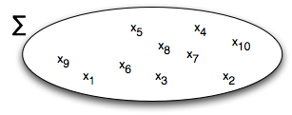
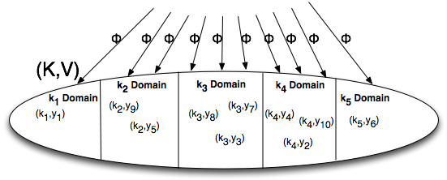


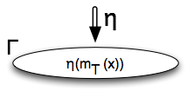
Parallelism Potential of MUD
Input data set creation
Data independent execution of Φ
Intra-key parallelism of ⊕
If ⊕ is associative and commutative, it can be evaluated via a binary tree reduction
Inter-key parallelism of ⊕
When ⊕ is not associate or commutative
Φ creates multiple key domains
Example: Median computation
Notes:
Φ may use a single key domain if there is no need for multiple key domains

Slide 44
MITHRA Architecture
The key important factor in MITHRA
The “best” computing resource for each parallelism potential in MUD is different
Leverage heterogeneous resources in MITHRA design
MITHRA takes MUD, and adapts it to run on a commodity cluster
Each node contains a mid range CPU and the best GPU (within budget)
Majority of computation involves evaluating Φ, which now is performed in GPU
Connected with Gigabit Ethernet

Slide 45
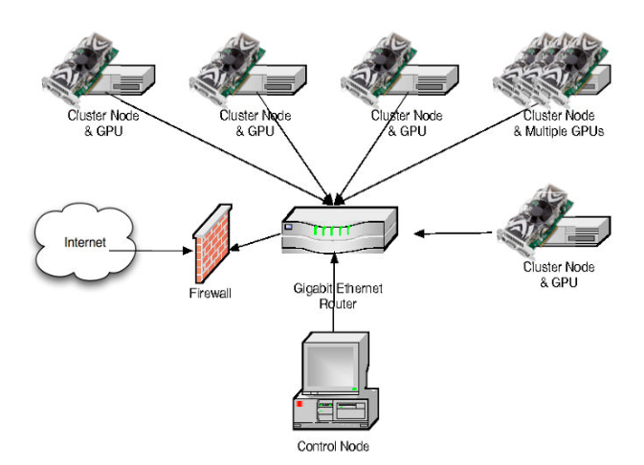
MITHRA Architecture (ctd.)
Based on Hadoop Framework
Scalability
Up to 10,000s
Reliable and Fault Tolerant
Nodes fail frequently
Software fault tolerance
Speculation on slow nodes
Periodic heartbeats
Re-execution
Redundant Distributed File System
HDFS

Slide 46
Evaluation
Multiple Implementations
Multi-core
Pthread
Phoenix (MapReduce on Multi-cores)
Hadoop
Single Node CUDA
MITHRA

Slide 47
Hadoop
Hadoop 0.19, 496 cores (62 nodes)
248 nodes allocated to mappers

Slide 48
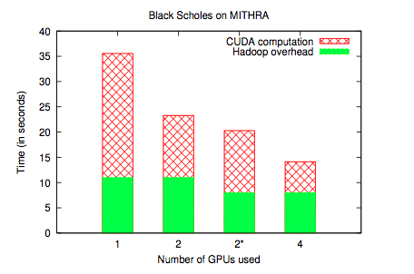
MITHRA
Overhead determined using Identity Mapper and Reducer
Mostly startup and finishing time, more or less constant
CUDA speedup seems to scale linearly
Speculation: The speedup will eventually flatten, probably on a large number

Slide 49
Per Node Speedup
The 62 quad-core node Hadoop cluster (248 mappers) takes 59 seconds for 4 billion iterations
The 4 node (4 GPUs) MITHRA cluster takes 14.4 seconds

Slide 50
Future Work
Experiment on larger GPU clusters
Key Domain partitioning and allocation
Evaluate other Monte Carlo algorithms
Financial risk analysis
Extend beyond Monte Carlo to other motifs
Data mining (K-Means, Apriori)
Image Processing / Data Mining
Other Middleware Paradigms
Meandre
Dryad

Slide 51
Conclusion
We have entered a new phase of computer technology
Utility computing and sharing of massive data sets are disruptive technologies
Join us in exploring the new way of doing business

