Slide 1

Tutorial
SQL Server and Matlab
CIS 526

Slide 2
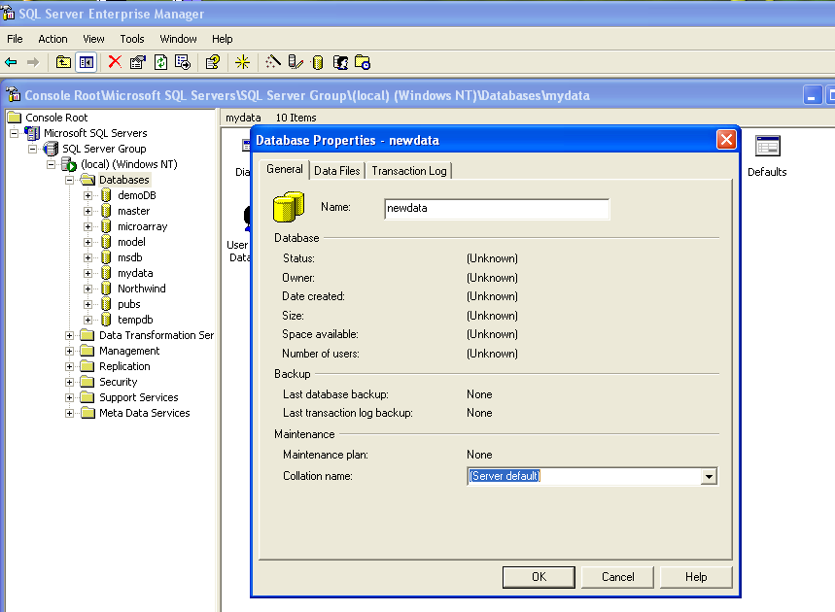
Build a New Database in SQL server

Slide 3
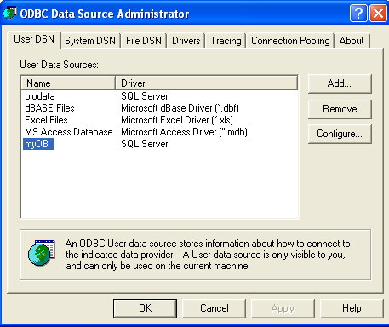
Connect SQL Server to ODBC driver
Click control panel-> Administrative Tools -> Data Source (ODBC)

Slide 4
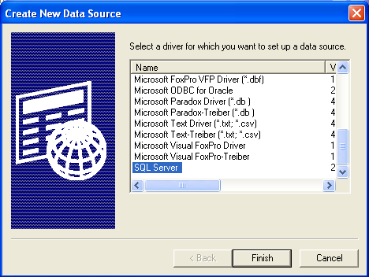
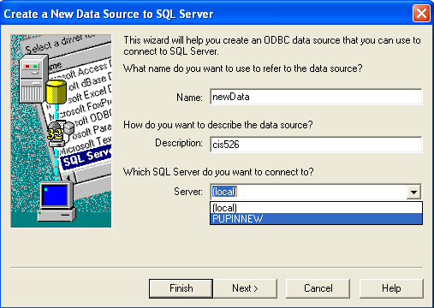
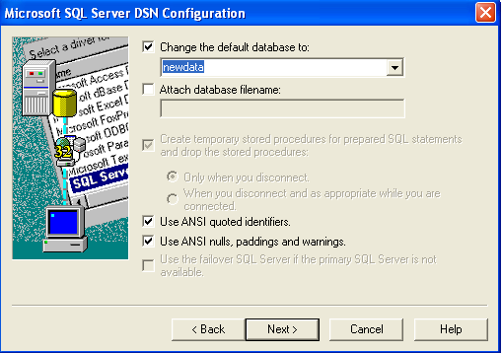
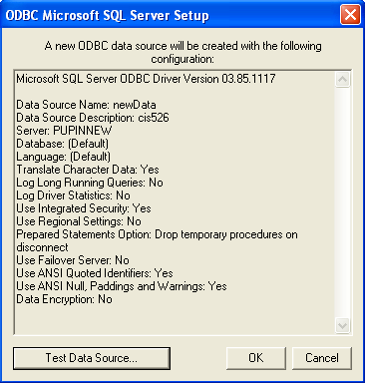
Click Add

Slide 5
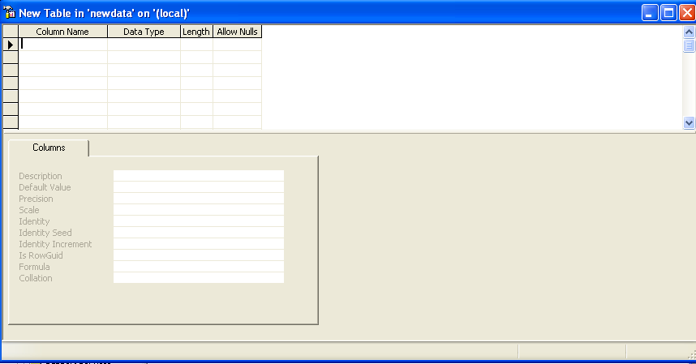
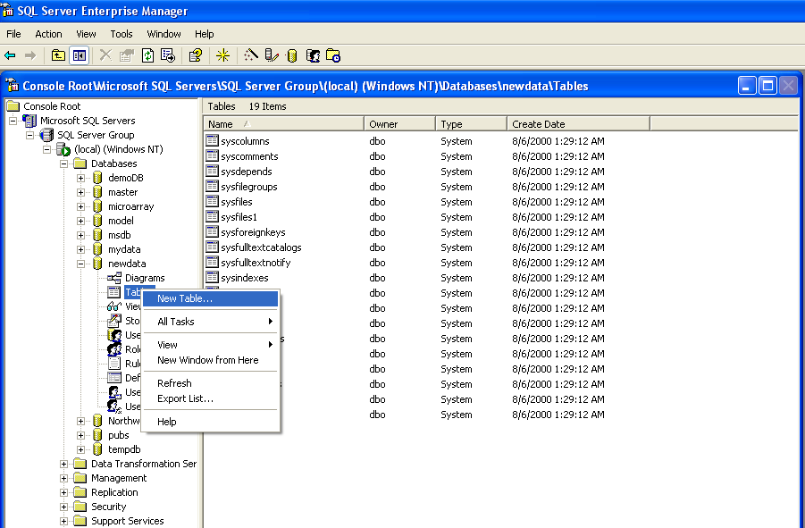
Build tables for your data
Click “SQL server enterprise manager”

Slide 6
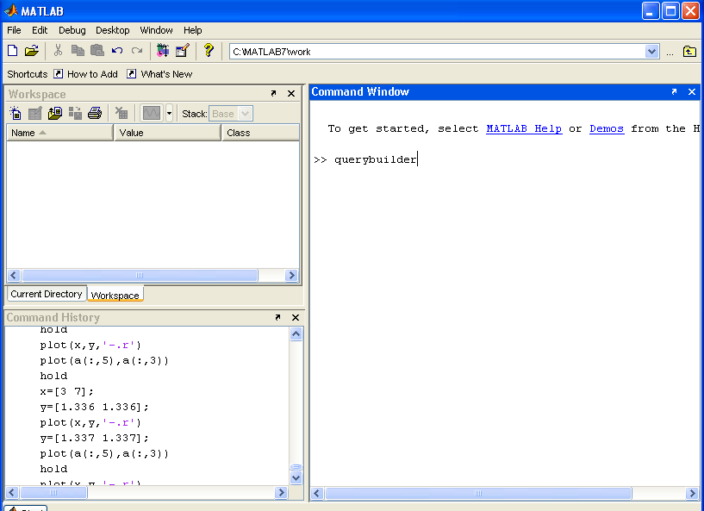
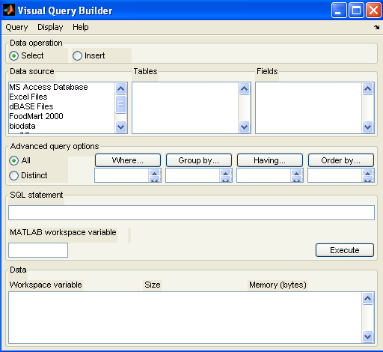
How to connect Matlab to SQL server

Slide 7
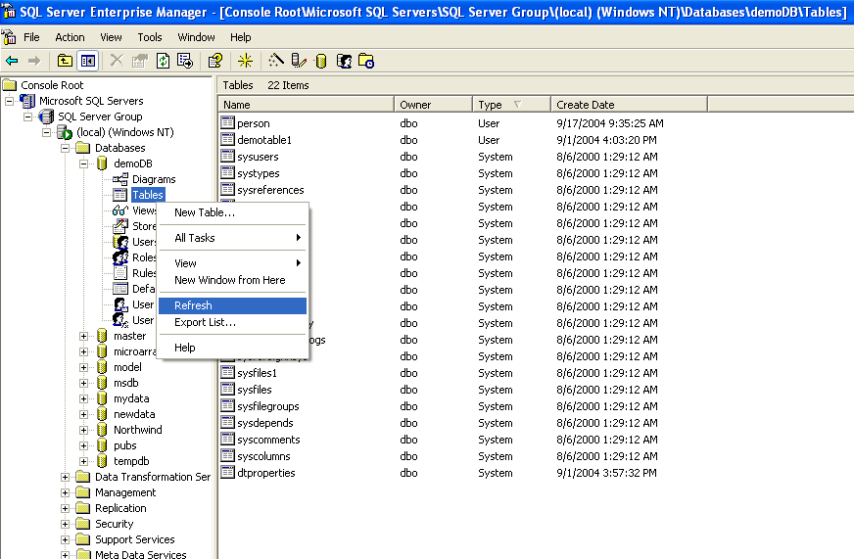
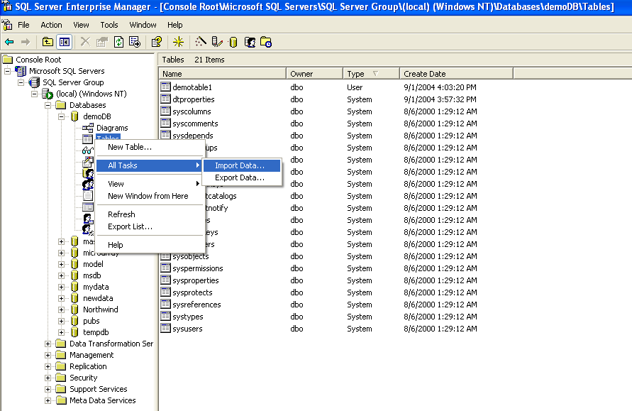
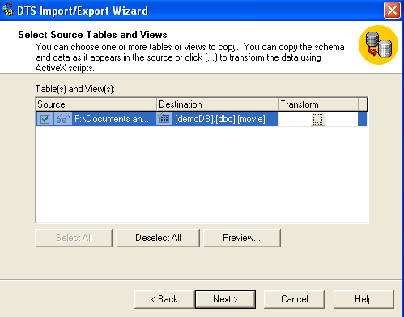
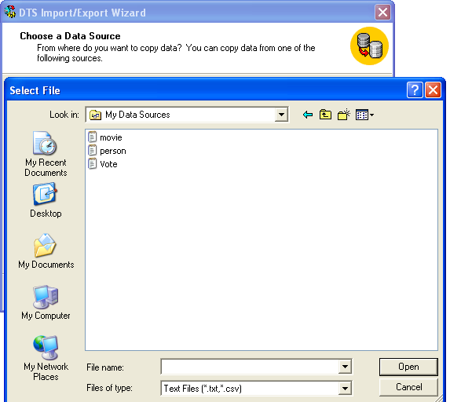
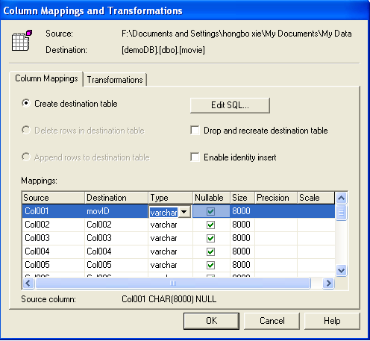
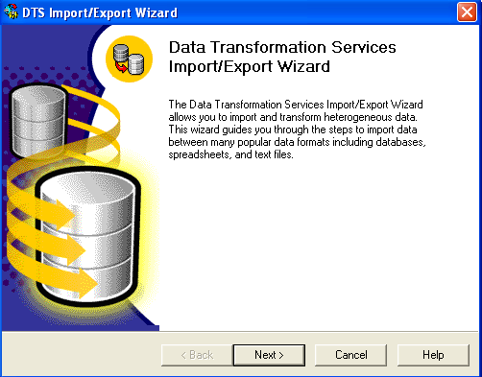
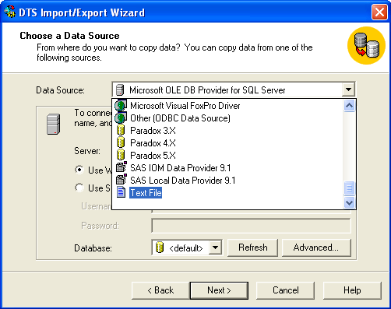
Import data into SQL server

Slide 8
Import data using Matlab
conn = database(‘demoDB','',''); setdbprefs; colname={‘custID',‘age‘,’gender’,’zip_code’}; Insert(conn,‘person',colname,data); % ‘person’ is table name which we already built in sql server %colname is the names of column in table ‘person’ %data is person data which we read from file using Matlab, it is a % cell format variable type, for example data{m,n} close(conn);

Slide 9
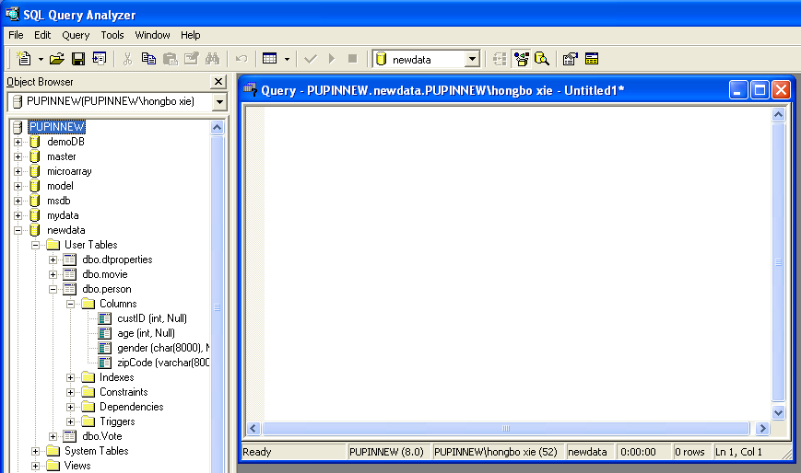
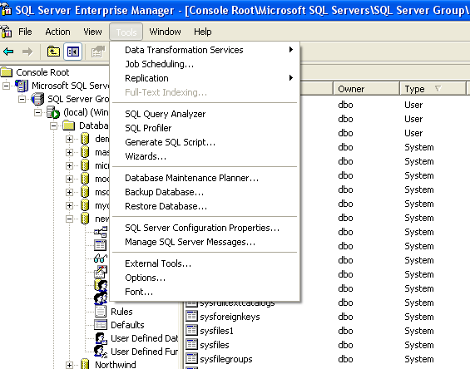
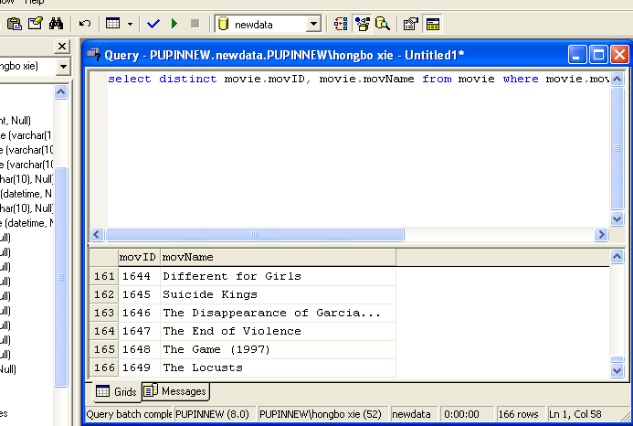
Executing SQL command
Using query analyzer
Question:
How many movies did not receive any vote?
select distinct movie.movID, movie.movName
from movie
where movie.movID not in
( select Vote.movID from Vote)

Slide 10
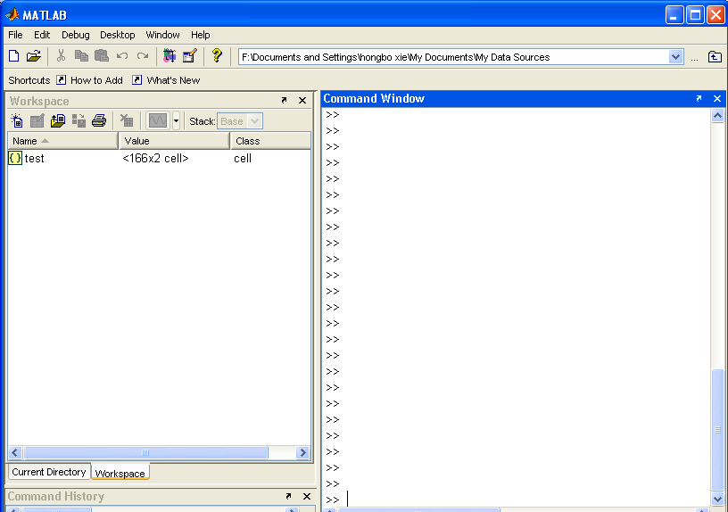
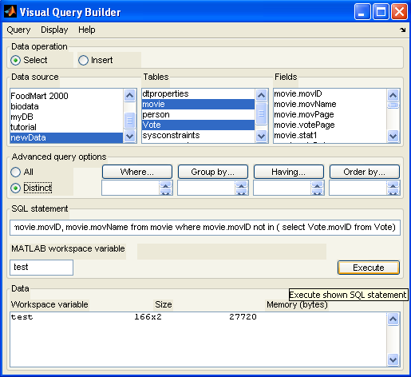
Using Matlab Querybuilder

Slide 11
Some times Query is not easy!
Question: for all movies receiving more than 30 votes, find the 5 with highest and 5 with lowest scores.
  Not a easy job for query analyzer
  select movID, avg(rate1)as pop from Vote group by movID having count(*) >30 order by pop
  But for querybuilder bonded with matlab program, it will be much more easier!

Slide 12
If the question change to for all movies receiving more than 30 votes, find the 5 with highest and 5 with lowest average scores exclude the top 5% and lowest 5% of the rating?
  SQL analyzer may not helpful
  But Matlab will sure did !

Slide 13
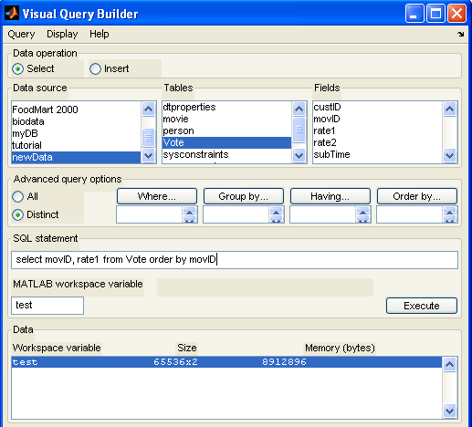
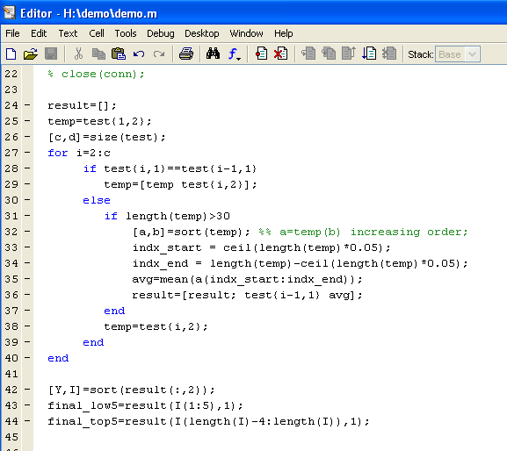
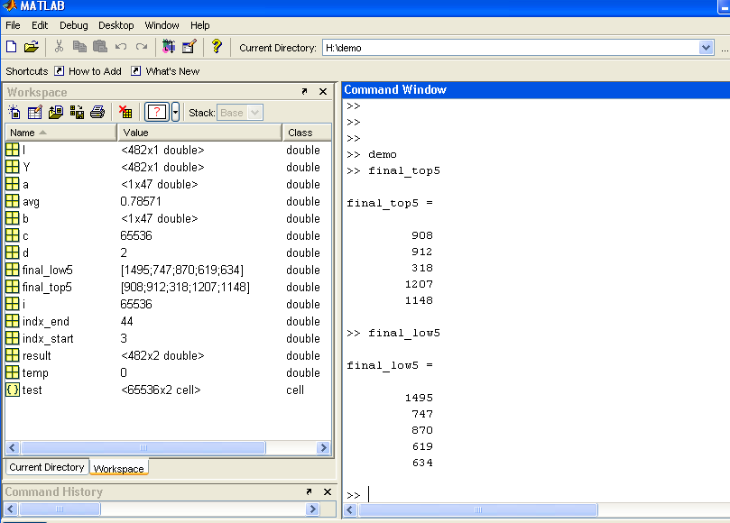

Slide 14
Thank you !!!

