Slide 1

ME 498CM Fall 2015
Contact & Fracture Modeling

Slide 2
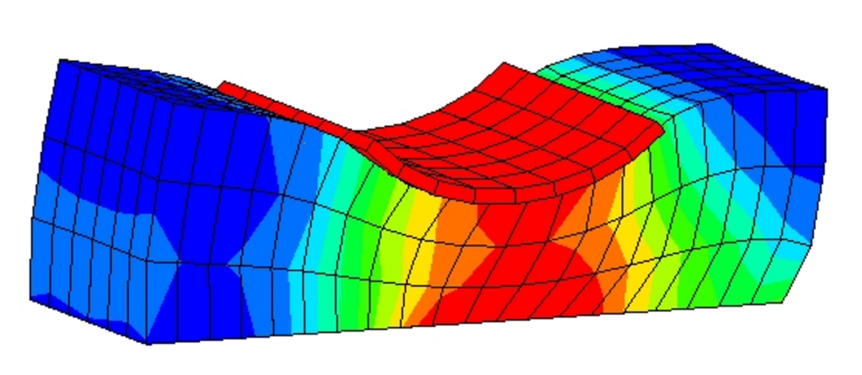
ABAQUS Contact
Primary References
Abaqus/CAE User’s Manual, §15
Abaqus Analysis User’s Manual, §2.3
Getting Started with Abaqus: Keywords Edition, §3.2, 12
Abaqus Theory Manual, §5

Slide 3
ABAQUS Contact
Surface Interactions

Slide 4
ABAQUS Contact
Models (Abaqus/Standard)
General Contact—highly automated, based on all-inclusive surface definition
  simple models, rubber, solid propellant, elastomer
Contact Pairs—explicit pair surfaces (like ANSYS APDL)
  metal, clay, ice at low strain
Contact Elements—
Contact Properties—friction, pressure–overclosure, spot welds

Slide 5
ABAQUS Contact
Surfaces (Abaqus/Standard)
Element-based—associate surface area w/ node, calculated contact stress
  Single-sided—test for contact in direction of normal
  Double-sided—more general (more expensive)
  Edge-based—perimeter edges of model (shells)
Node-based—similar to edge-based but using nodes
Analytical—mobile but perfectly rigid

Slide 6
ABAQUS Contact
Surface Interactions
deformable
slave surface
gaussian
integration
points
surface
penetration
rigid or deformable
master surface

Slide 7
ABAQUS Contact
Surface Interactions
deformable
slave surface
gaussian
integration
points
surface
penetration
(not allowed)
rigid or deformable
master surface

Slide 8
ABAQUS Contact
Surface Interactions
slave surface
slave surface
master surface
master surface

Slide 9
ABAQUS Contact
Rigid Surfaces

Slide 10
ABAQUS Contact
Surface Orientations

Slide 11
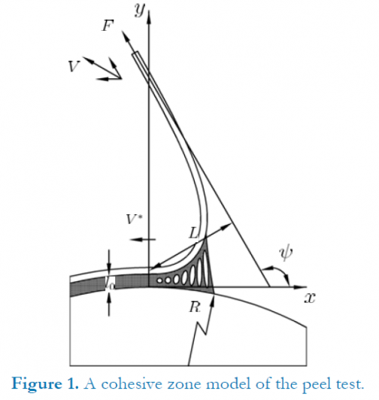
ABAQUS Fracture
Cohesive Zone Model
http://plastics.tamu.edu/node/149

Slide 12
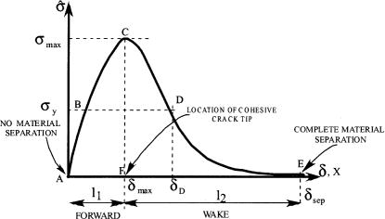
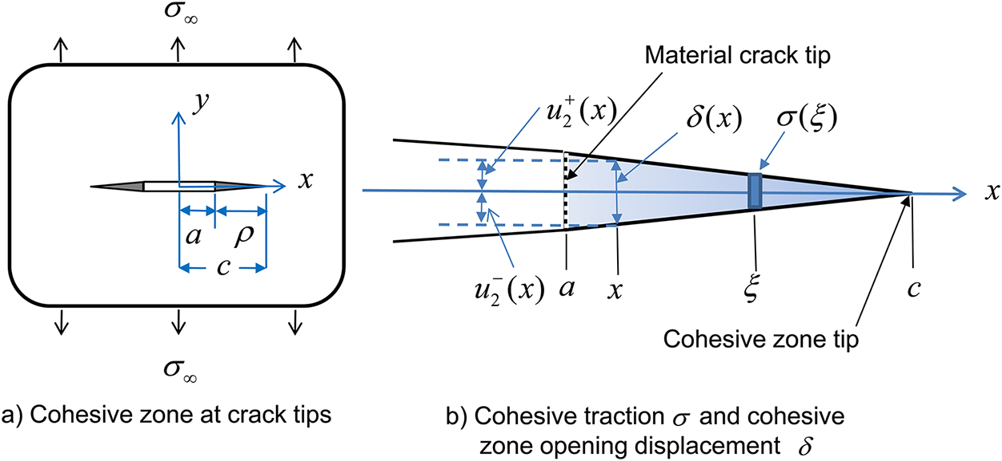
ABAQUS Fracture
Cohesive Zone Model

