Slide 1

ME 498CM Fall 2015
Loading & Analysis

Slide 2
ABAQUS Loading
Primary References
Abaqus/CAE User’s Manual, §16
Getting Started with Abaqus: Keywords Edition, §11
Abaqus Theory Manual, §2, 6

Slide 3
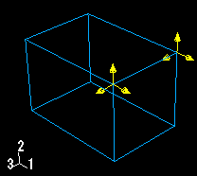
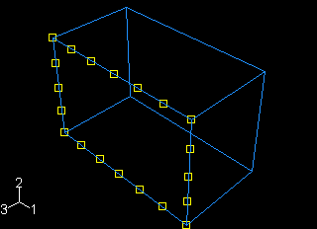
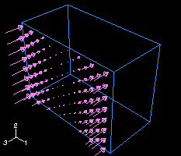
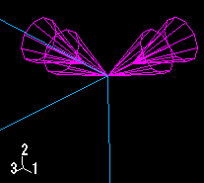
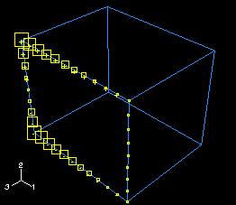
ABAQUS Loading
Prescribed Loads
concentrated force
uniform field
variable field
degree of freedom
analytical field
In addition, for symbols other than arrows, a plus sign (+) or a minus sign (–) is displayed inside each symbol to indicate whether the magnitude of the prescribed condition is positive or negative at that location

Slide 4
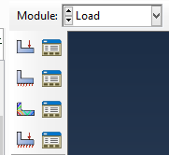
ABAQUS Loading
Load Module
Analysis steps (no BCs or predefined conditions)
  Physical loads (point DOFs)
  Boundary conditions (d/v/T)
  Predefined fields (void ratio, temperature, exp’l data)
  Load cases (sets of BCs + loads)
Rigid body motion error:
  static: “numerical singularity”, “zero pivot”
  dynamic: “excessive plasticity”

Slide 5
ABAQUS Loading
Step Module
Initial step
Analysis steps (no BCs or predefined conditions)
  General steps (nonlinear/linear, standard/explicit)
  Linear perturbation steps (linear/standard)
  Using the previous load/deformation state as a basis, simulate a linear perturbation.
Loads are specified absolutely, not as additional accruals.
E.g., 1000 N→3000N should specify 1000, then 3000
(not 1000 then 2000)

Slide 6
ABAQUS Loading
Step Module—Load Manager
Initial step
Analysis steps (no BCs or predefined conditions)
  General steps (nonlinear/linear, standard/explicit)
  Linear perturbation steps (linear/standard)
  Using the previous load/deformation state as a basis, simulate a linear perturbation.
Nlgeom—persists across later steps
Loads are specified absolutely, not as additional accruals.
E.g., 1000 N→3000N should specify 1000, then 3000
(not 1000 then 2000)

Slide 7
ABAQUS Loading
Step Module
Total time
increases throughout all general steps
Step time
begins at zero for each step

Slide 8
ABAQUS Loading
Output Requests
Run complex simulations in stages
Restart stores values in:
  res (Abaqus/Standard)
  adq (Abaqus/Explicit)
Frequency: every increment or interval by default
The model used for a restart must be identical to the previous one in Geometry, Property, Mesh, prior Steps.
odb of same name req.

Slide 9
ABAQUS Loading
Restarts
Field History
History Output
odb file—default output
rpt file—requested output (tabular)
variables of interest
region to output
rate of output

Slide 10
ABAQUS Loading
Example: Modal Analysis
3D beam
L=5m
D=0.18m
t=0.02m
need load such that lowest vibrational mode > 50 Hz
start with F=4 MN

Slide 11
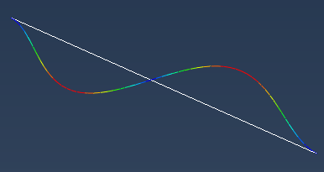
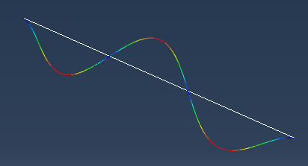
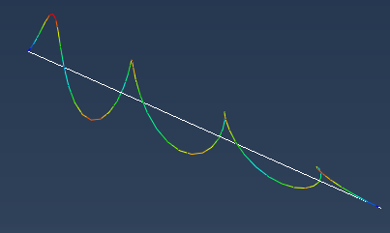
ABAQUS Loading
Example: Modal Analysis

Slide 12
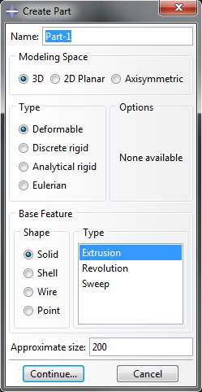
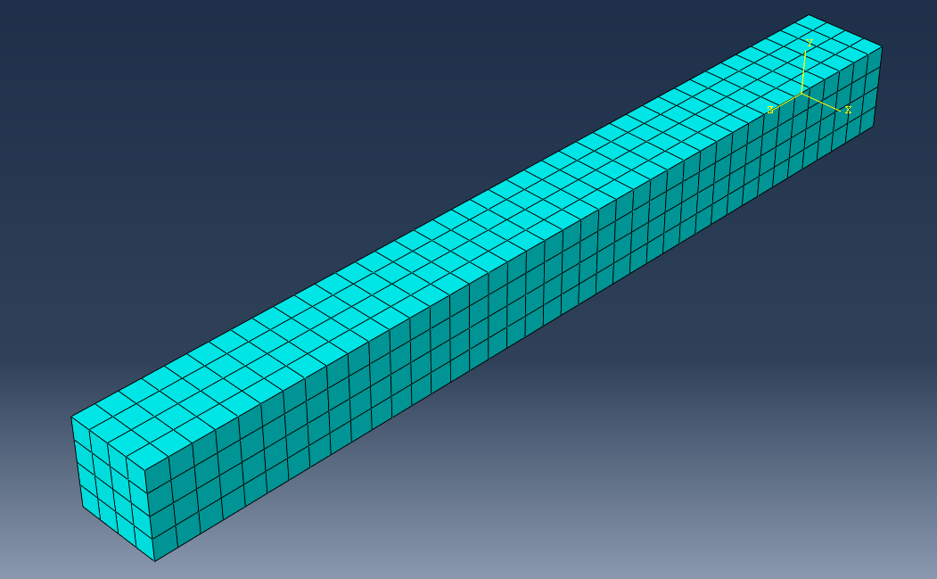
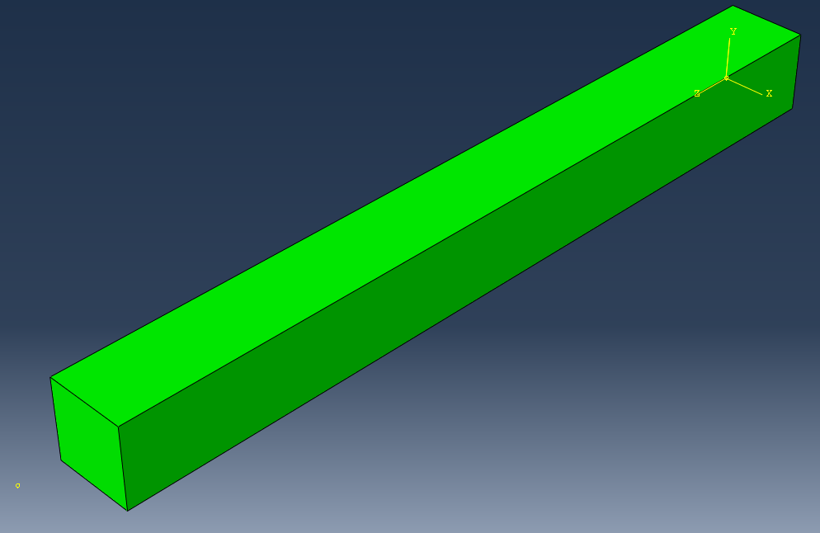
ABAQUS Loading
Geometry Features
3D/ 2D/ Axisymmetric
Part Type:
Deformable/Discrete rigid/ Analytical rigid/Eulerian
Shape:
Solid/ Shell/ Wire (Beam)/ Point
Deformable/ Discrete Rigid
Analytical Rigid

Slide 13
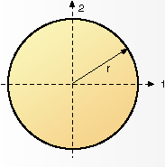
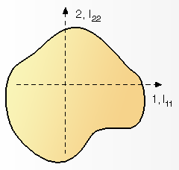
ABAQUS Loading
Geometry Features
Wire (Beam)
one dimension sig. greater, stress most imp.
section point (orientation)

Slide 14
ABAQUS Loading
Geometry Features
Wire (Beam)
one dimension sig. greater, stress most imp.
section point (orientation)

Slide 15
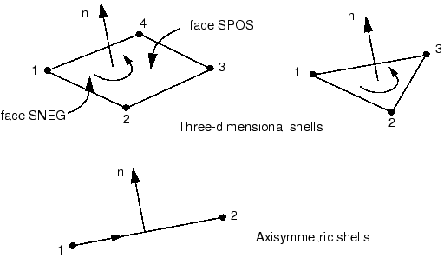
ABAQUS Loading
Geometry Features
Shell
one dimension sig. smaller, stress insig.
section point (orientation)
RH rule for normal

