Slide 1

ME 498CM Fall 2015
Material, Failure, and Yield Modeling

Slide 2
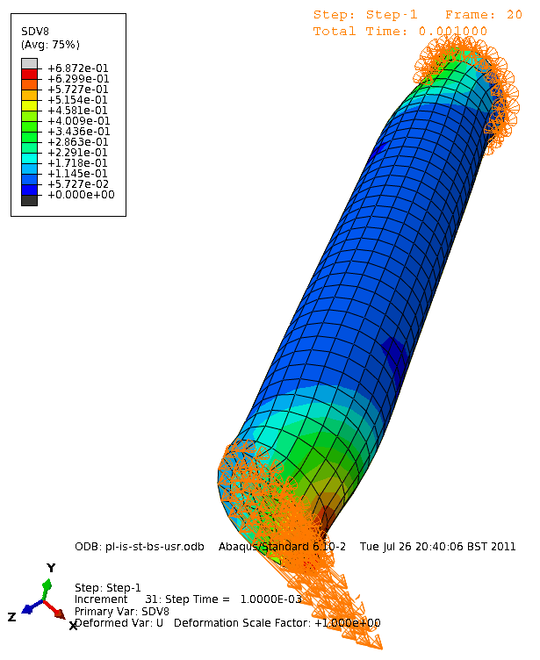
ABAQUS Materials
Primary References
Abaqus/CAE User’s Manual, §12.7–11
Getting Started with Abaqus: Keywords Edition, §10
Abaqus Theory Manual, §4

Slide 3
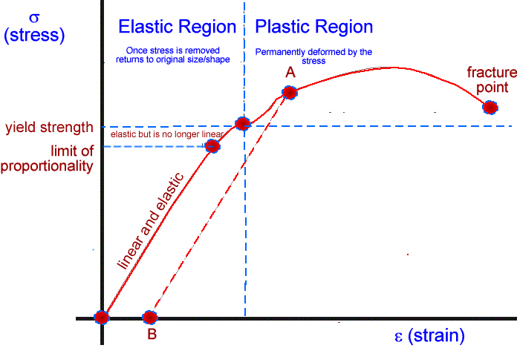
ABAQUS Materials
Stress–Strain Modeling

Slide 4
ABAQUS Materials
Models
Elastic—Purely elastic response (linear or hyper)
  simple models, rubber, solid propellant, elastomer
Plastic—Ductility beyond yield
  metal, clay, ice at low strain
Particulate—Friction-dominated
  sand
Brittle—Little yield before failure
  rock, concrete, ceramic

Slide 5
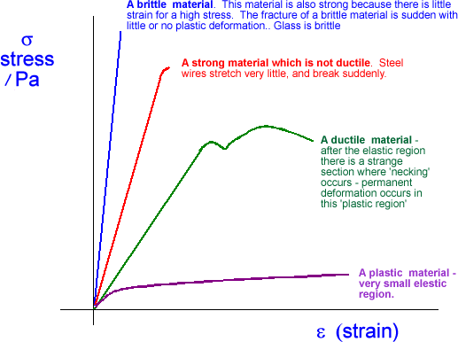
ABAQUS Materials
Models

Slide 6
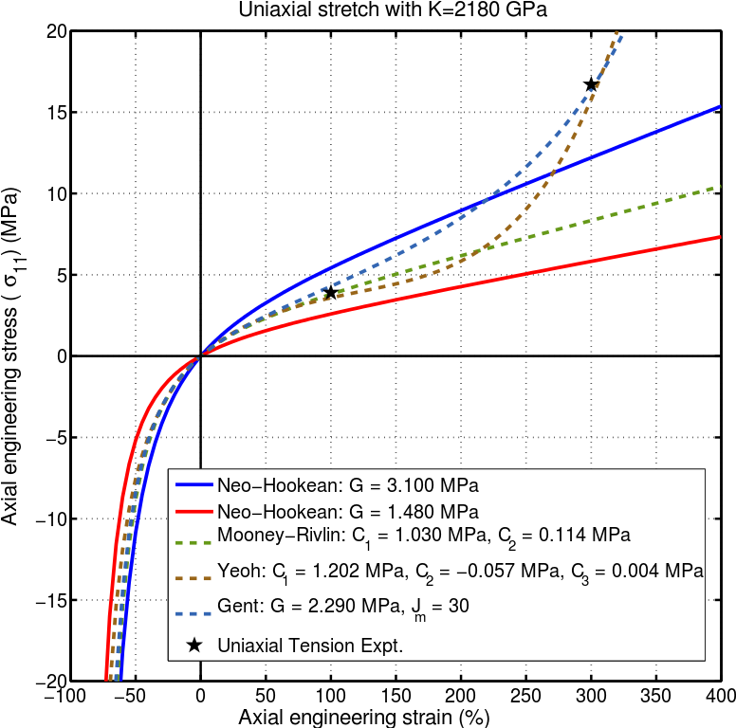
ABAQUS Materials
Models—Hyperelasticity

Slide 7
ABAQUS Materials
Models
Inelastic models
  classical plasticity (metals)
  cyclic loading/hardening
  rate-dependent yield
  creep/swelling (incl. anisotropicity)
  annealing/melting
  dynamic failure (Abaqus/Explicit)
  etc.

Slide 8
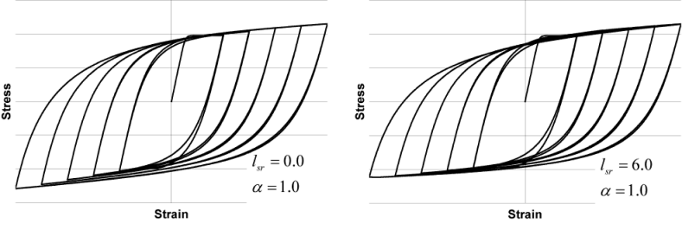
ABAQUS Materials
Models—Cyclic Hardening

Slide 9
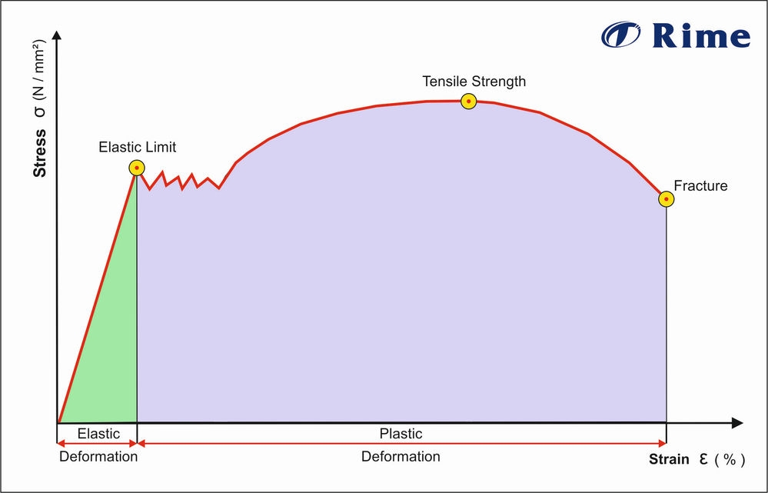
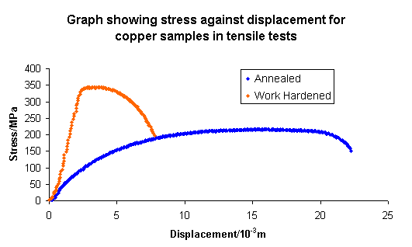
ABAQUS Materials
Models—Work-Hardening/Annealing
strain hardening

Slide 10
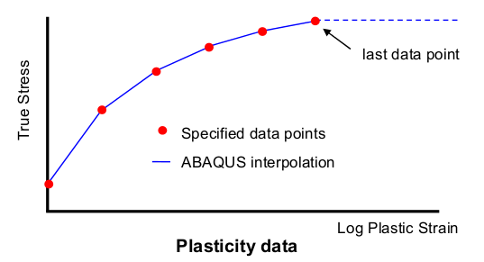
ABAQUS Materials
Models—Internal Representation

Slide 11
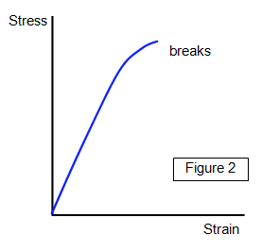
ABAQUS Materials
Models—Brittleness

Slide 12
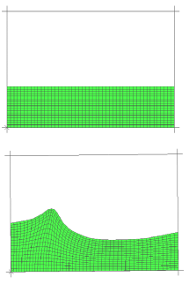
ABAQUS Materials
Models—Hydrodynamic/EOS
Simulation of water sloshing in a tank using hydrodynamic material models.

