Slide 1

ME 498CM Fall 2015
Introduction & Workflow

Slide 2
Outline of Module
FEA Workflow (Redux), Postprocessing
Meshing
Loading & Analysis
Coupling Physics
Materials & Modeling
Fracture & Contact FEA
Dynamic FEA (Standard v. Explicit)
Batch Jobs & Scripting

Slide 3
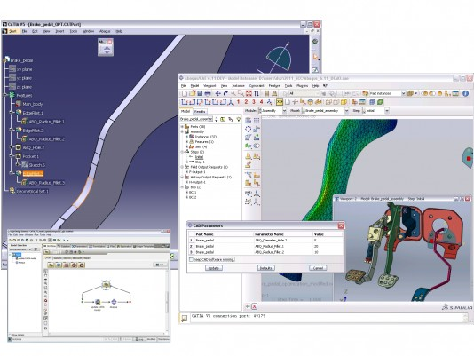
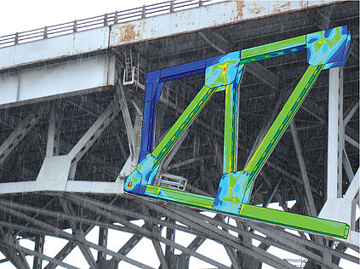
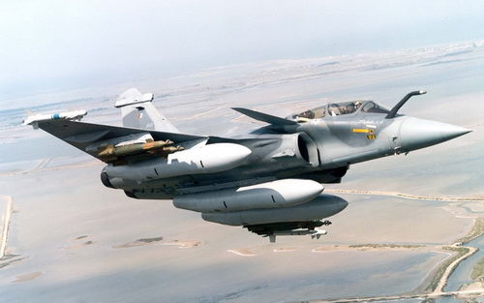
User-friendly software of
1.FEA (finite element analysis)
2.CAE (Computational aided engineering)
Company: Dassault Systemes
  dynamic vibration
  multibody systems
  impact/crash
  nonlinear static analysis
  thermal coupling
  acoustic–structural coupling
ABAQUS mastery saves time and money by optimizing designs before really building them.

Slide 4
ABAQUS Ecosystem
Third-party
CAD
Associative
interfaces
XX.iges file
ABAQUS/CAE
Preprocess
Modeling
Elysium direct
translators
Job control/monitoring
Third-party preprocessor
XX.inp file
Analysis (Solver)
ABAQUS/Standard
ABAQUS/Explicit
ABAQUS/Aqua
….
XX.inp file
Translators
Third-party
postprocessor
ABAQUS Viewer
Visualization
Postprocess

Slide 5
Comparison of Implicit and Explicit
Quantity | ABAQUS/Standard | ABAQUS/Explicit
Element library | Extensive | Subset
Analysis procedures | General & linear perturbation | General
Material models | Wide range of material models | Wide range + failure material models
Contact formulation | contact problems | complex contact problems
Solution technique | unconditionally stable stiffness-based solution technique | conditionally stable explicit integration solution technique
Disk space & memory | large with many iterations | small
Ideal Problem | smooth nonlinear problems etc. | brief transient dynamic events

Slide 6
Comparison of Implicit and Explicit
Cost of Degrees of Freedom Refinement
Implicit: computational cost proportional to square of degrees of freedom (actually f(connectivity))
Implicit
computational cost
Explicit
Explicit: computational cost proportional to number of elements, inversely proportional to smallest element dimension
degrees of freedom
(mesh elements × equations)

Slide 7
ABAQUS Workflow
ABAQUS/CAE
Modules:
Part, Property, Assemble,
Step, Interaction, Load, Mesh
Preprocessing
inp file
ABAQUS/Standard
ABAQUS/Explicit
Module:
Job
Simulation
odb, fil, dat, res files
ABAQUS/CAE
Module:
Visualization
Postprocessing
png, txt, csv files, etc.

Slide 8
ABAQUS Workflow
Draw 2D sketch and create 3D parts.
Assign Material and Section property.
Assemble the model; give interactions in form.
Mesh the frame.
Apply Load and boundary conditions.
Create job and configure output requests.
Submit it for analysis (Standard/Explicit).
Visualize the results of analysis.

Slide 9
ABAQUS Preprocessing
Discretized
Geometry
(Mesh)
Material
Model
(Property)
Element
Section
Properties
(Section)
Loads and
Boundary
Conditions
(Load)

Slide 10
ABAQUS Solvers
ABAQUS/Standard
  Solves system of equations implicitly at each solution “increment”.
ABAQUS/Explicit
  Marches solution forward through time explicitly in small time increments without solving coupled system of equations at each increment.

Slide 11
ABAQUS Solvers—Standard
K₀
K_{a}
K_{b}
load p
R_{b}≈0
Δp
c_{a}
c_{b}
displacement u
u₀
u_{a}
u_{b}

Slide 12
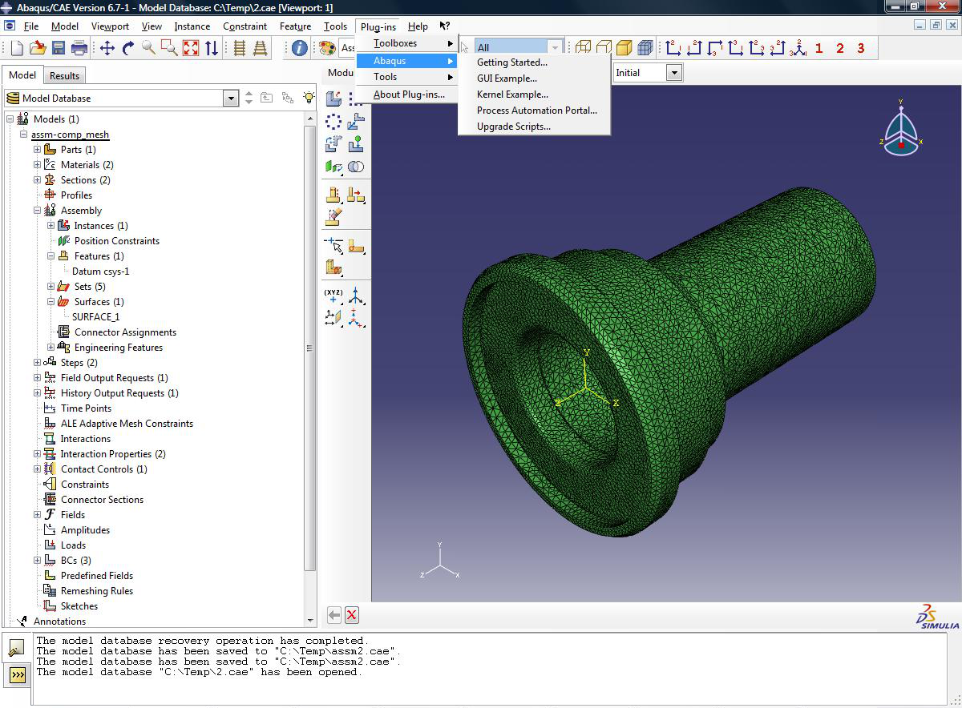
ABAQUS/CAE
Modeling
Geometry
Material Property
Mesh
Load & BC
Job manage
Result Viewing
Message area/
command-line
interface
Context bar
Toolbar
Menu bar
Canvas/
viewport
Model tree/
Result tree
Prompt
area
Toolbox
area

Slide 13
ABAQUS Documentation
The documentation for ABAQUS is extensive and complete which has both HTML and PDF version
1. Abaqus Analysis User's Guide
2. Abaqus/CAE User's Guide
3. Abaqus Example Problems Guide
4. Abaqus Benchmarks Guide
5. Getting Started with Abaqus: Interactive/Keyword Edition
6. Programming Guide
7. Reference
8. Etc..

Slide 14
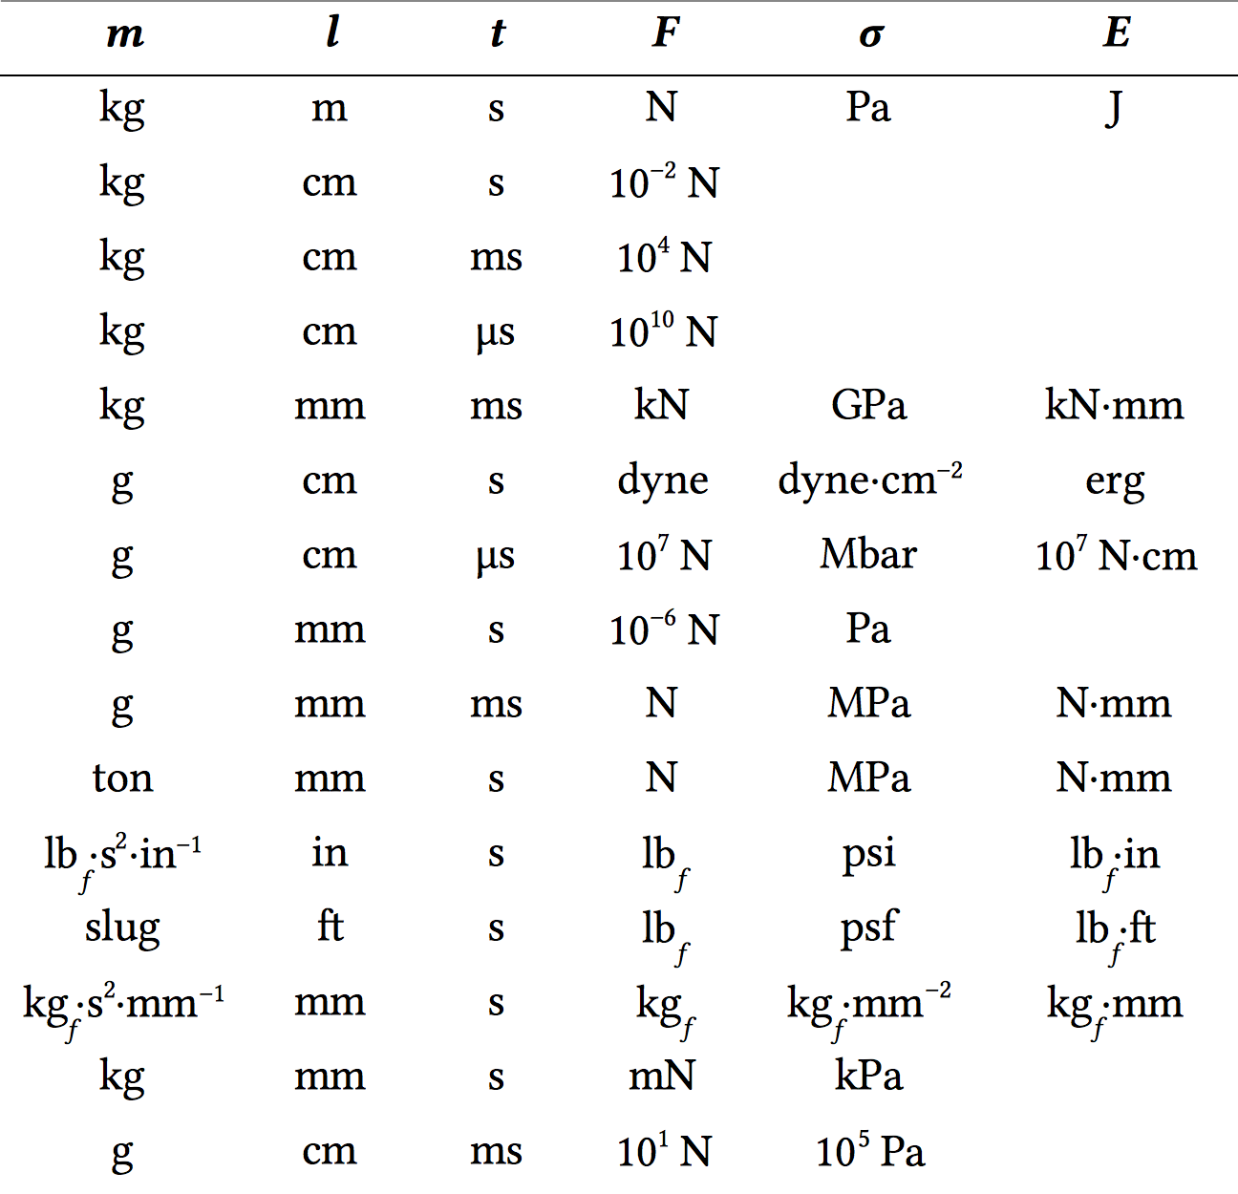
ABAQUS Units
ABAQUS has no
built-in units
Specify all input
data in consistent
units

Slide 15
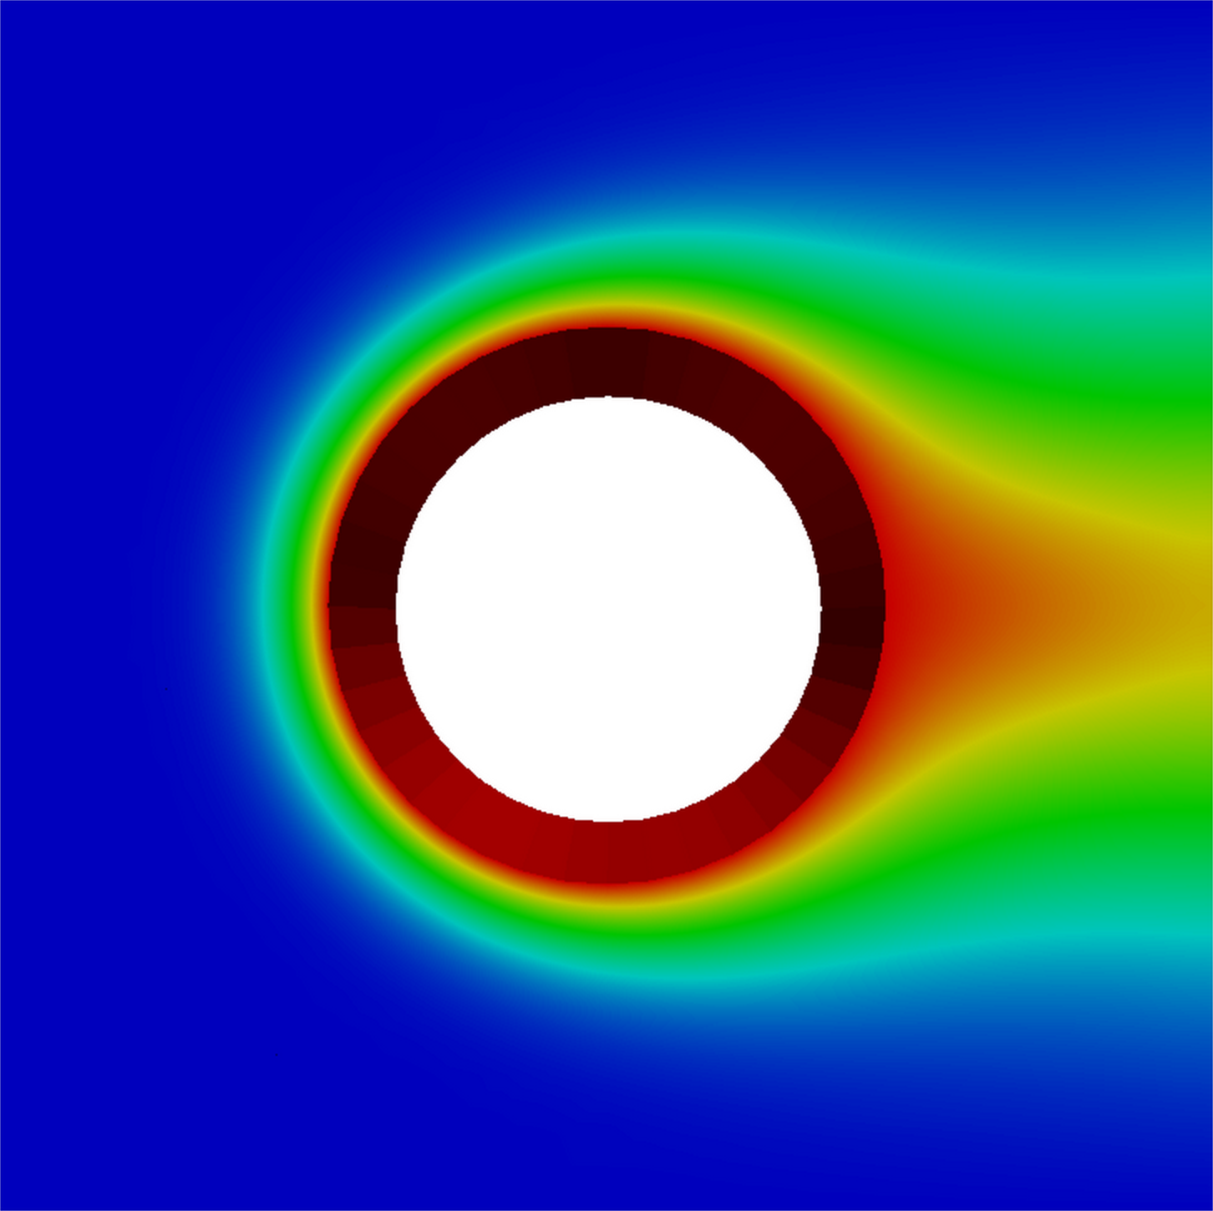
Suggested FEM Courses
ME 471—Introduction to Finite Element Analysis
ME 570—Nonlinear Solid Mechanical Design
CEE 470—Structural Analysis
CEE 570—Finite Element Methods
CEE 576—Nonlinear Finite Elements
CS 555—Numerical Methods for PDES
TAM 574—Advanced Finite Element Methods

Slide 16
Beam Exercise #1
y axis
200 Pa
x axis
Steel beam with continuous loading of F = 200 Pa
  E = 2 × 10¹¹ Pa Young’s modulus
  ν = 0.26 Poisson's ratio
  L × W × H = (200 cm) × (20 cm) × (20 cm) Dimensions

Slide 17
Beam Exercise #2
Steel beam with end load of 20,000 Pa at x_{L} = 200 cm
E = 2 × 10¹¹ Pa Young’s modulus
ν = 0.26 Poisson ratio
ρ = 7.8 × 10³ Density
L = 200 cm Length
∅ 20 cm
y axis 2
20,000 Pa
x axis 1

