Slide 1
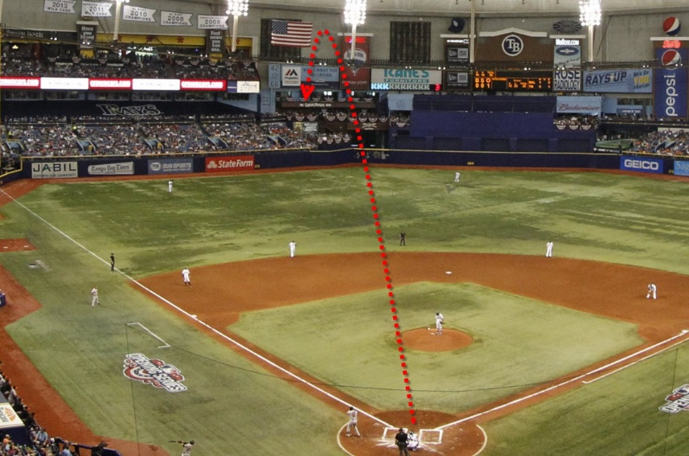
Baseball Physics & Analytics: A Powerful Combination
Alan M. Nathan, @pobguy
Dept of Physics, University of Illinois
Why do fly balls carry better to CF?
What is role of drag in home run rates?
What’s with the humidor?
Notes:
Effects of drag, backspin, sidespin

Slide 2
What Does Fly Ball Distance Depend On?
Magnus
Physics 101
EV and LA
Physics 301
Drag ⇒ D↓
Backspin ⇒ ”lift” ⇒ D↑
Sidespin ⇒ hook or slice ⇒ D↔
Physics 501
Life is more complicated
Spin
Drag
gravity

Slide 3
1. Why do fly balls carry better to CF?
Evidence from Statcast
2016-2019 Trackman data
only covered stadiums
only “well-tracked” balls
The underlying physics involving …
baseball aerodynamics
ball-bat collision

Slide 4
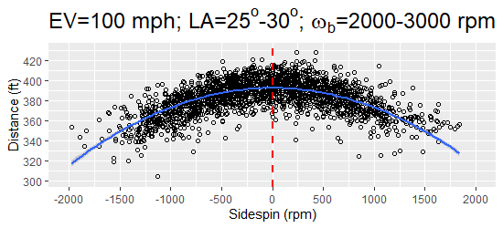
Sidespin Reduces Distance
Why?

Slide 5
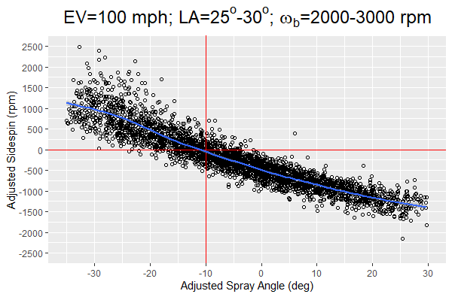
Sidespin Depends on Spray Angle
Hook
OPPO
PULL
Slice
Why?
Why shift to pull side?

Slide 6
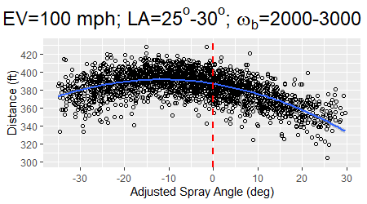
Therefore Distance Depend on Spray Angle
PULL
OPPO

Slide 7
Questions I Need To Answer
For fixed EV, LA, backspin
Why does sidespin reduce distance?
Why does sidespin depend on spray angle?
Why the shift to pull side?
Or…why slice to straightaway CF?
Notes:
7 minute mark

Slide 8
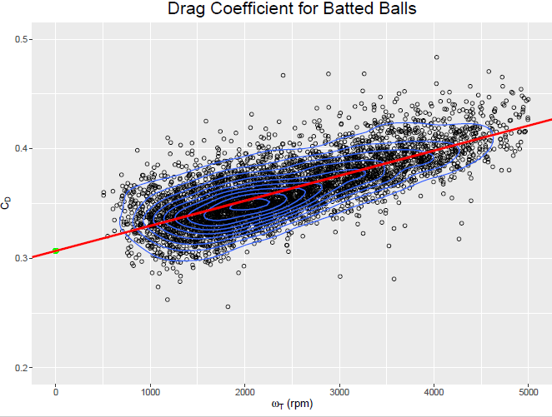
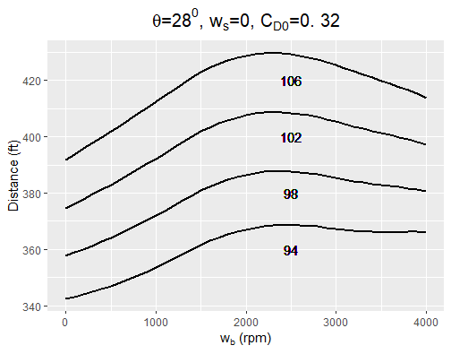
Why does sidespin reduce distance?
Primary reason:
Drag increases with spin
For backspin, increased drag competes with increased lift
Drag
Spin Rate

Slide 9
Why does sidespin reduce distance?
Primary reason:
Drag increases with spin
For backspin, increased drag competes with increased lift
Adding sidespin with fixed backspin increase drag, reduces distance

Slide 10
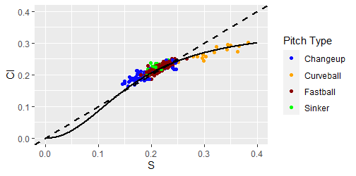
Why does sidespin reduce distance?
Secondary Reasons…all subtle
Magnus-vs-Spin is nonlinear
adding sidespin increases Magnus
but it reduces the lift contribution to Magnus
As direction changes due to sidespin
Some of backspin → gyrospin, reducing lift
Some of sidespin → topspin or negative lift
↑
Magnus
Spin →
Notes:
Other reasons more minor and more subtle

Slide 11
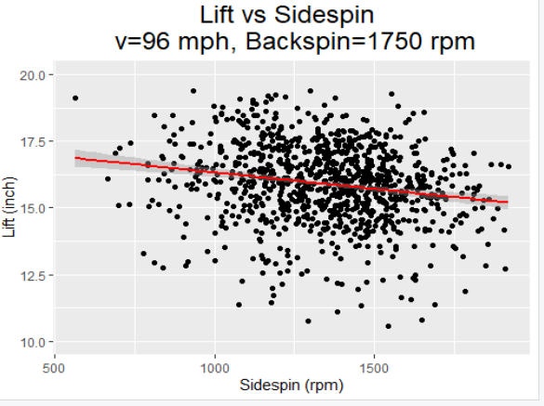
Some Evidence from Pitch Data: Sidespin reduces vertical movement
Lift
Sidespin

Slide 12
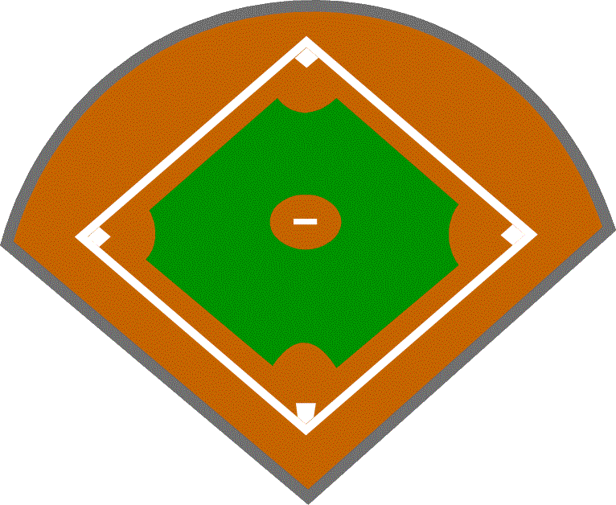
Why Does Sidespin Depend on Spray Angle? I. Horizontal Bat Angle
0⁰
f
-45⁰
45⁰
f

Slide 13
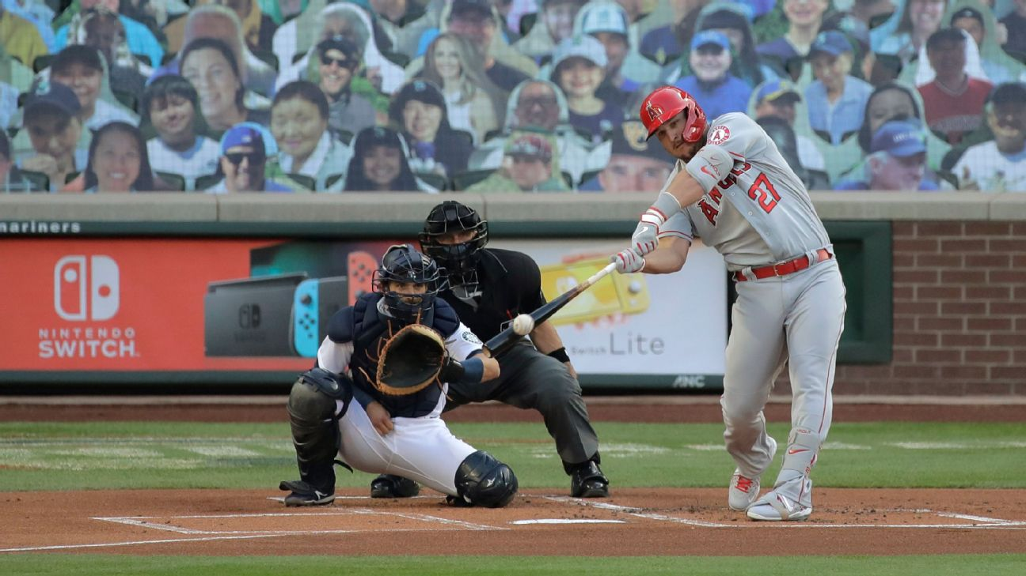
Why Does Sidespin Depend on Spray Angle? II. Vertical Bat Angle
Pure Backspin
Backspin+Slicing Sidespin
Notes:
Arrow shows direction of movement, pitchers pov

Slide 14
Sidespin vs. Spray Angle
Hook
OPPO
Slice
PULL
Two Competing Mechanisms
Net results:
Zero sidespin at 10⁰ to pull side
CF slices
Notes:
15 minute mark

Slide 15
Summary
Thanks to Statcast data, we have an improved understanding of the role of spin & drag in determining fly ball distance
Role of sidespin and physics thereof

Slide 16
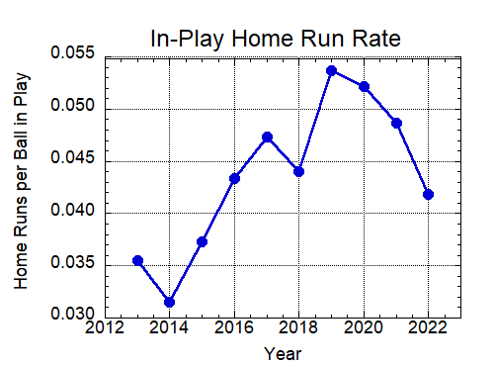
2. Role of Drag in Home Run Rates
2014-2019:
~70% increase
2019-2022:
~20% decrease
16

Slide 17
Why All The Changes?
Ball is “juiced” (or deadened)
Higher COR ⇒ Higher exit velocity
Lab tests rule this out
Change in batter behavior
Swinging harder ⇒ Higher exit velocity
More optimum launch angle
Accounts for some of changes
Change in “carry”
Reduced air drag ⇒ ball carries farther
Confirmed by lab and Statcast
Accounts for most of changes

Slide 18
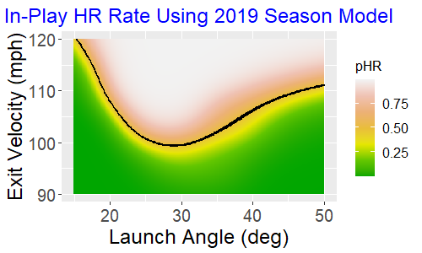
Here’s the analysis plan
1. Use 2019 data to model dependence of home run probability (pHR) on EV and LA

Slide 19
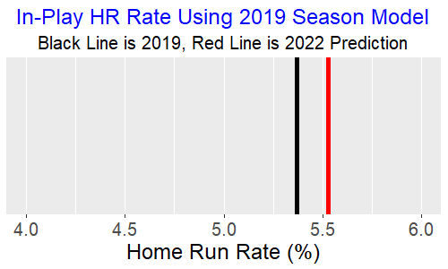
Here’s the analysis plan
2. Apply model to 2022 data to obtain a HR prediction based on actual EV and LA
Conclusion:
Launch parameters equally
favorable for HR in 2019,2022

Slide 20
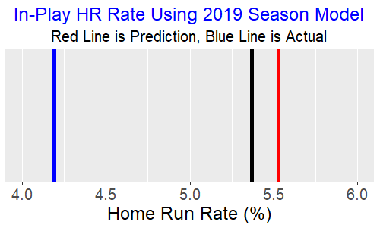
Here’s the analysis plan
3. Compare predicted with actual
2022 Actual
2019
2022 Prediction
Conclusion:
Increased drag reduces
HR by 30%

Slide 21
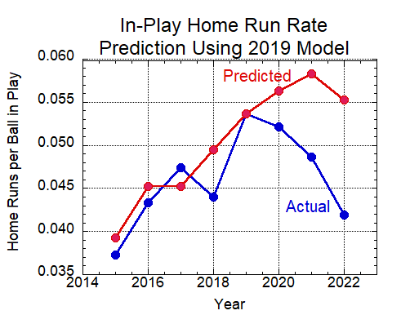
Apply Same Procedure 2015-2022

Slide 22
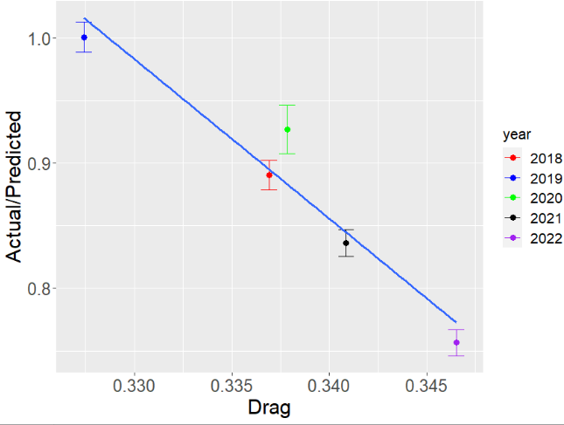

Slide 23
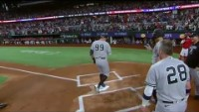
Aaron Judge: HR #62!

Slide 24
Aaron Judge: HR#62
Aaron Judge hit 62 HR in 2022
New American League record
Roger Maris, 61 in 1961
But baseball did not carry as well in 2022 as in 2019
Could he have hit more with 2019 carry?
24

Slide 25
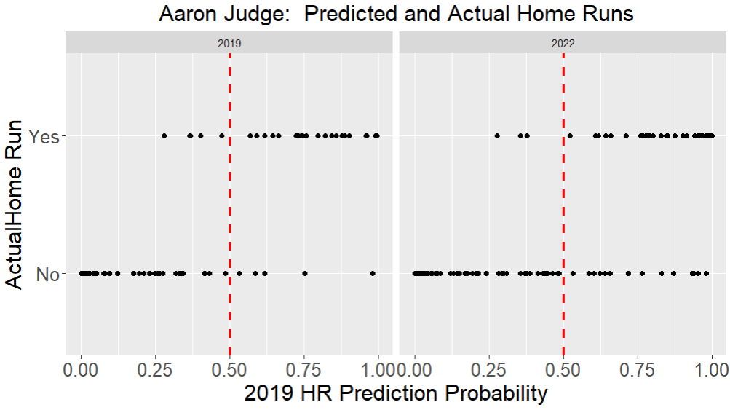
Result:
Actual=62 Predicted=75
A new MLB record!

Slide 26
Summary
Thanks to Statcast data, we have an improved understanding of the role of spin & drag in determining fly ball distance
Role of sidespin and physics thereof
We also have improved understanding of role of drag in HR rates

Slide 27
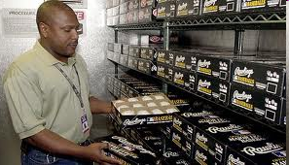

3. What’s With The Humidor?
Case Study: The Chase Field Humidor

Slide 28
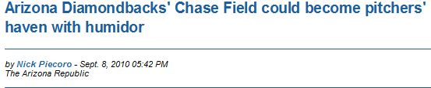
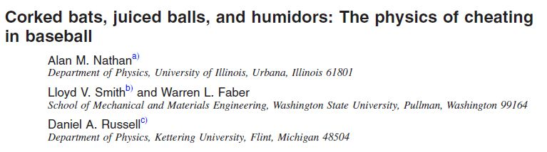
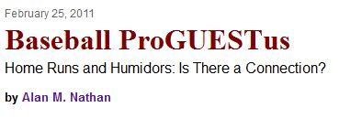
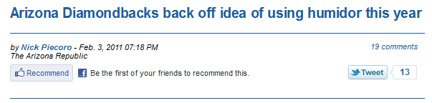
The Chase Field Humidor: 2010
Sept 2010
Shortly thereafter
37% reduction
And finally

Slide 29
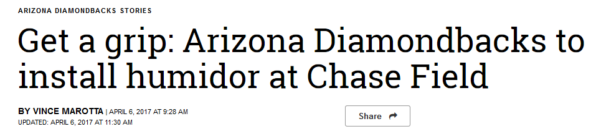
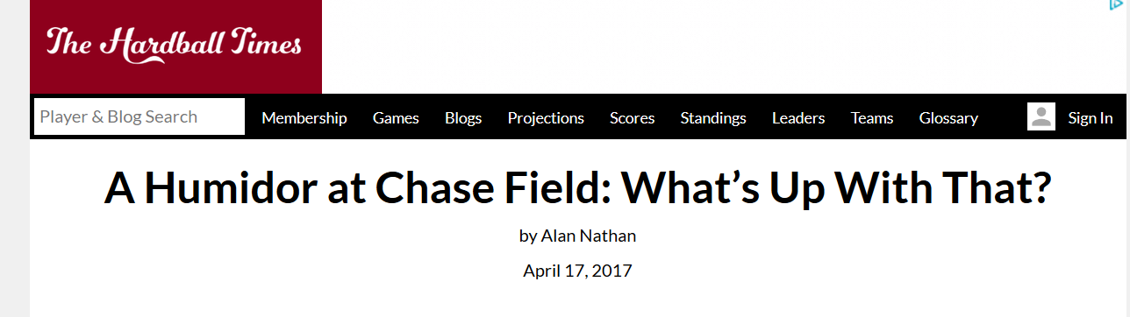
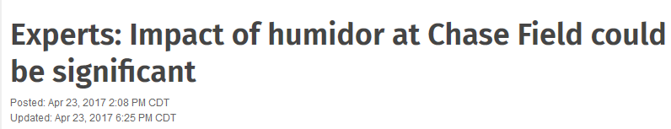
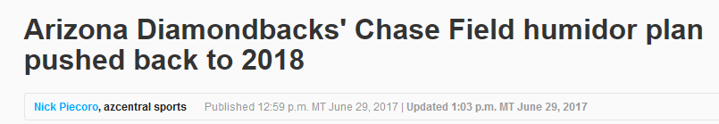
Then in 2017….
4/6/17
4/17/17
4/23/17
6/29/17

Slide 30
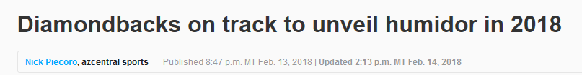
And finally in 2018
2/14/18

Slide 31
Effects of Humidity on Ball Properties
Humid air makes the ball “less bouncy”
“Coefficient of Restitution” (COR) decreases
Ball isn’t hit as hard
Humid air make the ball heavier
Ball isn’t hit as hard
But carries better
Humid air makes the ball larger
Doesn’t carry as well
These effects can be measured

Slide 32
So Here’s The Plan:
Use laboratory measurements to determine effect of humidity on ball properties
Use physics of ball-bat collision to predict change in batted ball speed
Use physics of baseball trajectories to predict change in fly ball distance
Use Statcast statistical data to estimate how change in distance affects home run production

Slide 33
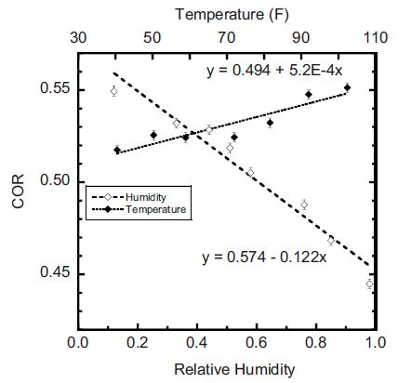
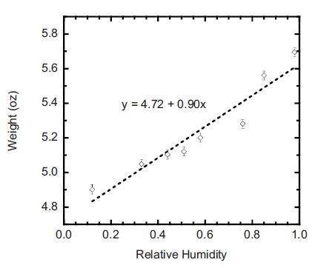
So this is what we found
American Journal of Physics 779, 575-580 (2011)
weight vs humidity
COR vs humidity

Slide 34
Summary of Findings for Chase Relative Humidity: 20% →50%
Weight increases by ~3.7%
COR decreases by ~4.6%
Diameter change negligible
Weight (1/3) +COR (2/3) ⇒
4.0 mph decrease in exit velocity
Exit Velocity (-20’) + Weight (6’) ⇒
14 ft decrease in distance
Distance ⇒ 35% reduction in HR

Slide 35
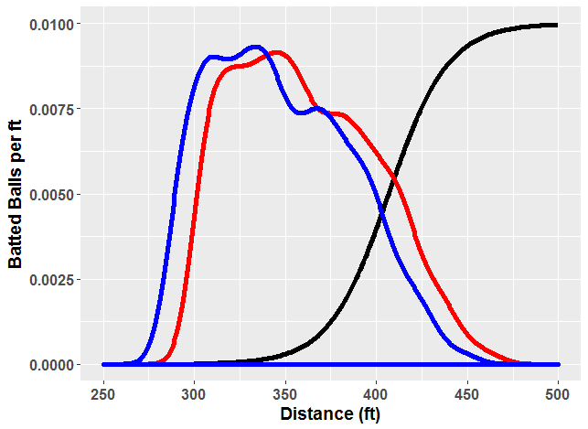
Getting into the weeds….
HR probability
1
w/humidor
w/humidor
home run
probability
14 ft
Batted Ball Distance Density
0.5
actual
actual
0

Slide 36
Confronting reality….
Assuming RH goes from 20% to 50%
Prediction: 35% reduction in HR
2010 prediction: 37%
Estimated margin of error: ±10% (25%-45%)
Let’s look at the data

Slide 37
Compare Dbacks Batters Home-Away Splits pre-Humidor vs. post-Humidor
Year | DBacks HR Away | Dbacks HR @ Chase
2015-2017 | 257 | 257
2018-2019 | 254 | 174
254→174 is a 32% reduction

Slide 38
Summary
The numbers:
Predicted reduction: 35% (±10)
Actual reduction: 32% (±??)
Home runs @ Chase have definitely decreased
Prediction and actual are amazingly similar ☺
Physics rocks!!!

Slide 39
Postscript
Where are the humidors?
1995 Coors (Denver)
2018 Chase (Phoenix)
2021 10 MLB stadiums
2022 all 30 MLB stadiums
Net effect:
Less variation in ball properties with venue and season

Slide 40
My Final Slide!
Things that keep me busy:
Improved “trajectory calculator”
Improved bat-ball collision model
Why do some wood bats outperform others?
Thanks for listening. I’m ready to answer questions!
Notes:
21 minute mark

