Slide 1
Building a Preprocessing Pipeline for fMRI Data in R
Max Egan
Dec 8, 2022
Final Project for STAT 447

Slide 2
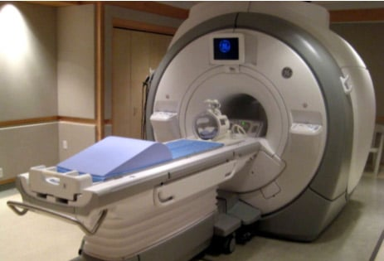
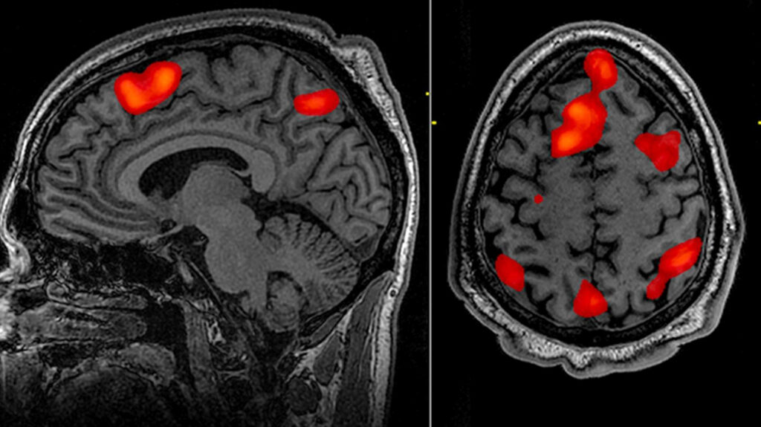
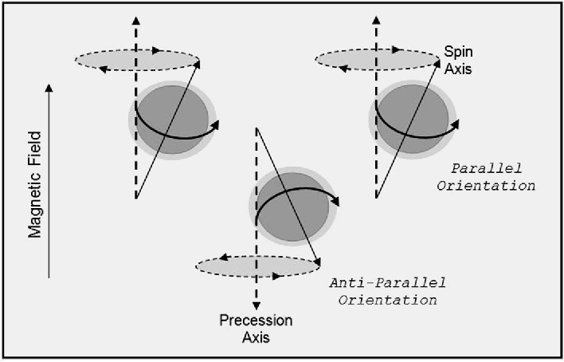
What is fMRI

Slide 3
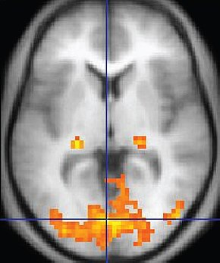
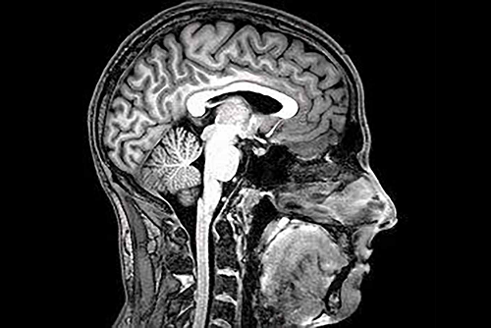
What do we get
Raw DICOM files
Converted to NifTi files
Structural and functional

Slide 4
Preprocessing
Many steps to get to data analysis
Slice timing correction
Head motion correction
Coregistration
Normalization
Smoothing

Slide 5
Final result
Useable data for GLM analysis in a different program
Typically MATLAB or Python
R is not exactly great at preprocessing

