Slide 1

A
Cyber Range is Born!
A study in Cloud Computing
by ITMT 497/597

Slide 2
What we set out to do...
The human mind has a desire to explore...
  Rule over and subdue their environment...
This group of elite ITM students set out to do just that...
We set out to build a Cyber Range!

Slide 3
Build a Cyber Range
Not just building a few VMs on a laptop...
We decided to build the entire thing...
  From first principles
  Using our bare hands, and Opensource
  Not because it was easy, but because it was hard

Slide 4
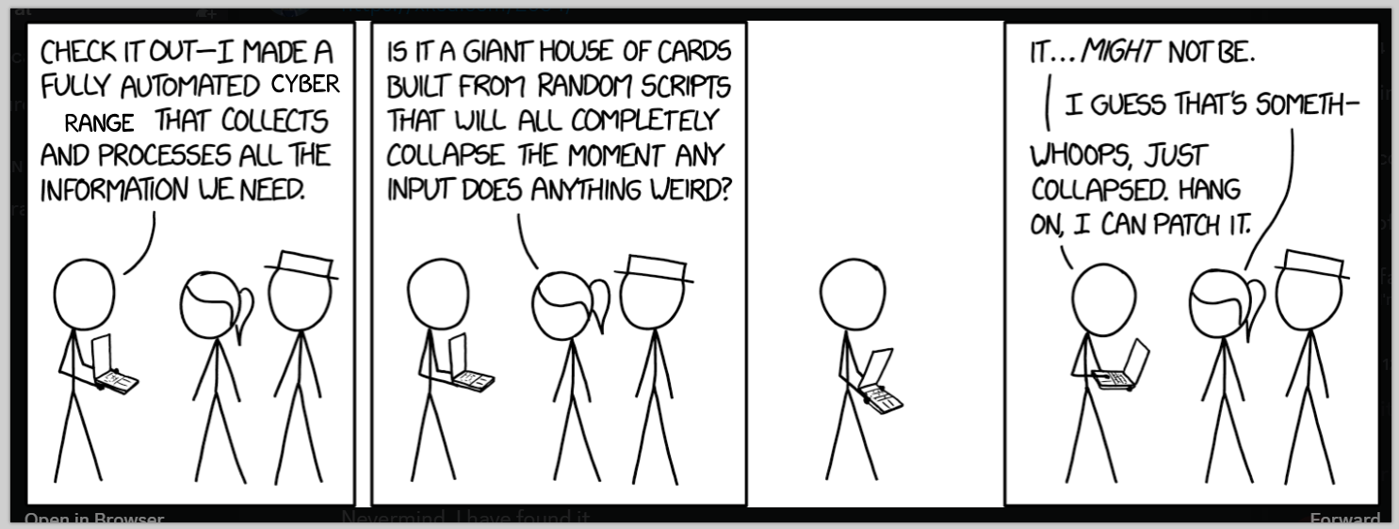
Definitely Not Built From Random Scripts...

Slide 5
What Hath We Wrought...
We made use of the See-Through-Cloud Platform
  ITM Department Internal Cloud Platform
Based on Proxmox - Linux based KVM platform
  Using HashiCorp Terraform (for automating cloud infrastructure)
  Using HashiCorp Consul (for service discovery)
  Using HashiCorp Vault (for secrets management)
  Using IIT VPN/VLAN and multiple internal networks for security

Slide 6
A Journey of a thousand miles...
On top of our cloud platform, we built/integrated software
  The Cyber Range web application was developed -> Clinic++
  Users can login and choose from an array of "tests"
    Capture the flag, pen-testing, and other hacking scenarios
  Each "test" launches its own set of prepared and isolated VMs
  Each "test" is separated via SDN: we can isolate each user's "test"
  Scalable to multiple users via the Clinic++ web portal

Slide 7
There is method to the madness...
Technical details - three short presentations
  Anthoinette Ilolo
    Secrets management
  Aditya Waghmare
    Network Isolation via SDN on the Proxmox Cloud Platform
  Ivan Zziwa and Jacob Holtz
    Putting it all together and delivering the working Cyber Range prototype

Slide 8
Secrets Management
Anthoinette Ilolo (ITM)

Slide 9
Secrets Management
  "The process of securely storing, accessing, and managing sensitive information (secrets) like API keys, passwords, certificates, encryption keys, and database credentials used by applications, services, and systems."

Slide 10
Problems with Secrets
Some major problems with secrets include the following;
  Secrets scattered across systems
  Risk of exposure due to hardcoding
  Risk of exposure due to mismanagement
  Lack of centralized control
  Breaches due to compromised credentials or misconfigurations
  They live in email and live beyond your term of employment

Slide 11
Our Solution – HashiCorp Vault
What is Vault?
  Like a bank vault, Vault stores our credentials (Encrypted on disk)
  Secrets are centrally stored and managed
  Using the Network allows any application to access secrets
  Users authenticate via tokens (Access Control)
  Tokens have a TTL and fine-grained access control
  Secrets are accessed via HTTPS

Slide 12
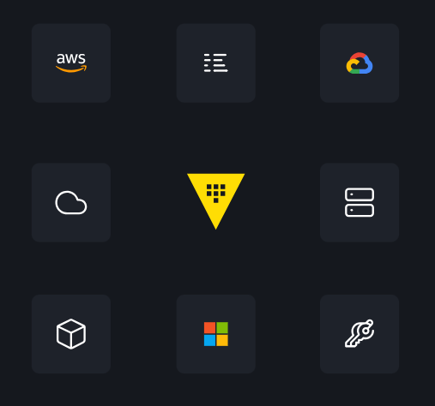
Vault in Action

Slide 13
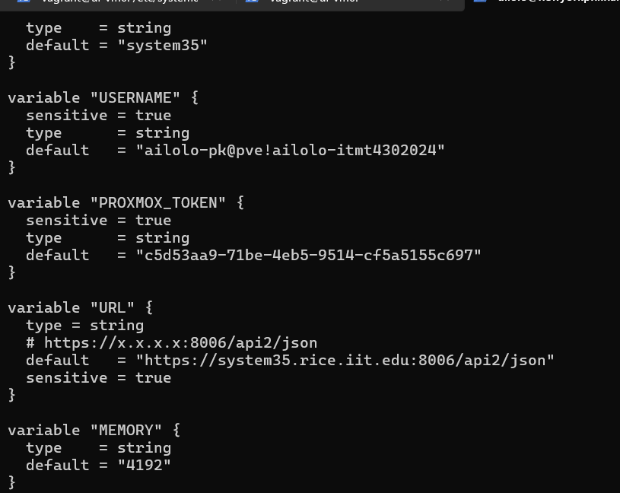
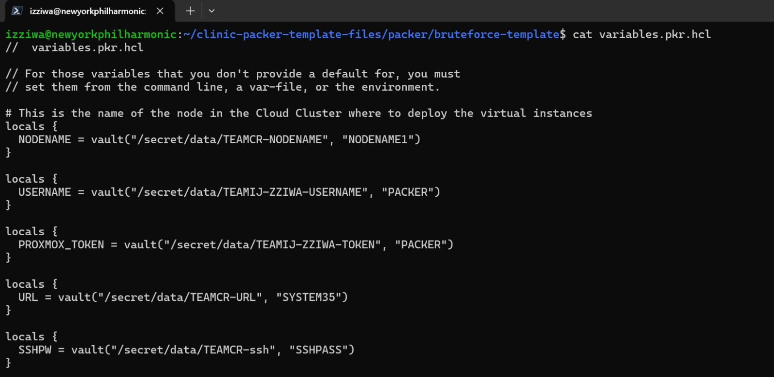
Packer and Hard-coded variables

Slide 14
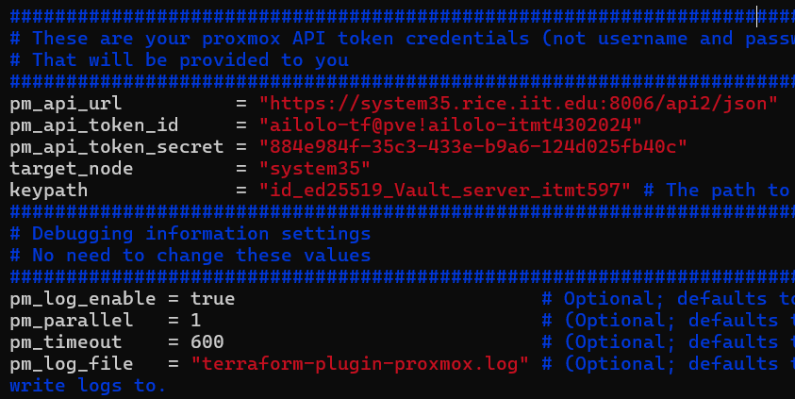
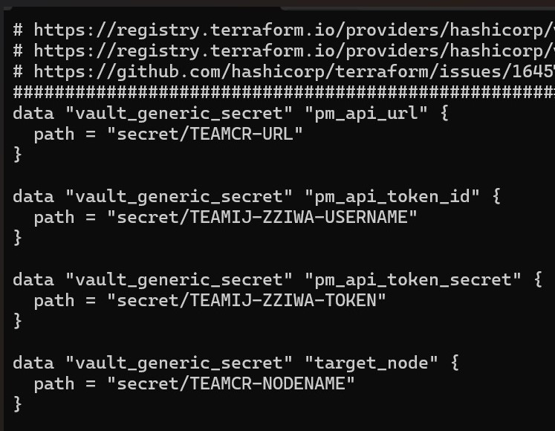
Terraform and Hard-coded variables

Slide 15
Summary
Key Achievements
Built and configured a Vault server to securely manage API keys for our cloud platform, handling the creation of over 200 virtual machines.
Centrally managed team credentials for secure and seamless deployments and teardowns.
Team members never saw their passwords but could perform required tasks.

Slide 16
Network Isolation via SDN on the Proxmox Cloud Platform
Aditya Waghmare (ITM)

Slide 17
The need for Network Isolation
Real World Analogies...
  Think about a gun range and how each person is isolated
  Think about a highway and how the lanes are seperated
This is the primary concept for a Cyber Range
  On a local system you really can't isolate VMs
  With a cloud paltform you can
  Traffic between labs must remain isolated

Slide 18
Achieve Network Isolation via SDN
SDN is a network architecture that uses software to manage and control a network
SDN transforms traditional hardware-based networking into software-defined infrastructure

Slide 19
Hardware vs Software Isolation
Features | Hardware Isolation | SDN (Software Isolation)
Scalability | Low | High
Flexibility | Low (requires physical changes) | High (programable adjustments)
Cost | Expensive hardware required | Cost effective virtualization
Management | Decentralized and complex | Centralized and simplified

Slide 20
Network Isolation via SDN in Proxmox
SDN in Proxmox
  Zones: Logical groupings of networks (e.g., VLAN, VXLAN) for workload isolation.
  Subnets: Define IP ranges and gateways for each zone.
  Firewall Integration: Control inter-zone communication and external access.

Slide 21
What it takes to get zones working
Installation of Required Packages
  libpve-network-perl
  /etc/network/interfaces
    Add line at the end source /etc/network/interfaces.d/*
  dnsmaq
  frr-pythontools
Configure the network by defining zones and subnets

Slide 22
SDN in Proxmox and Network Isolation
Example Topology:
  Zone 1: Hosts A, B.
  Zone 2: Hosts C, D.
Having multiple zones that can't talk to each other ensures network isolation

Slide 23
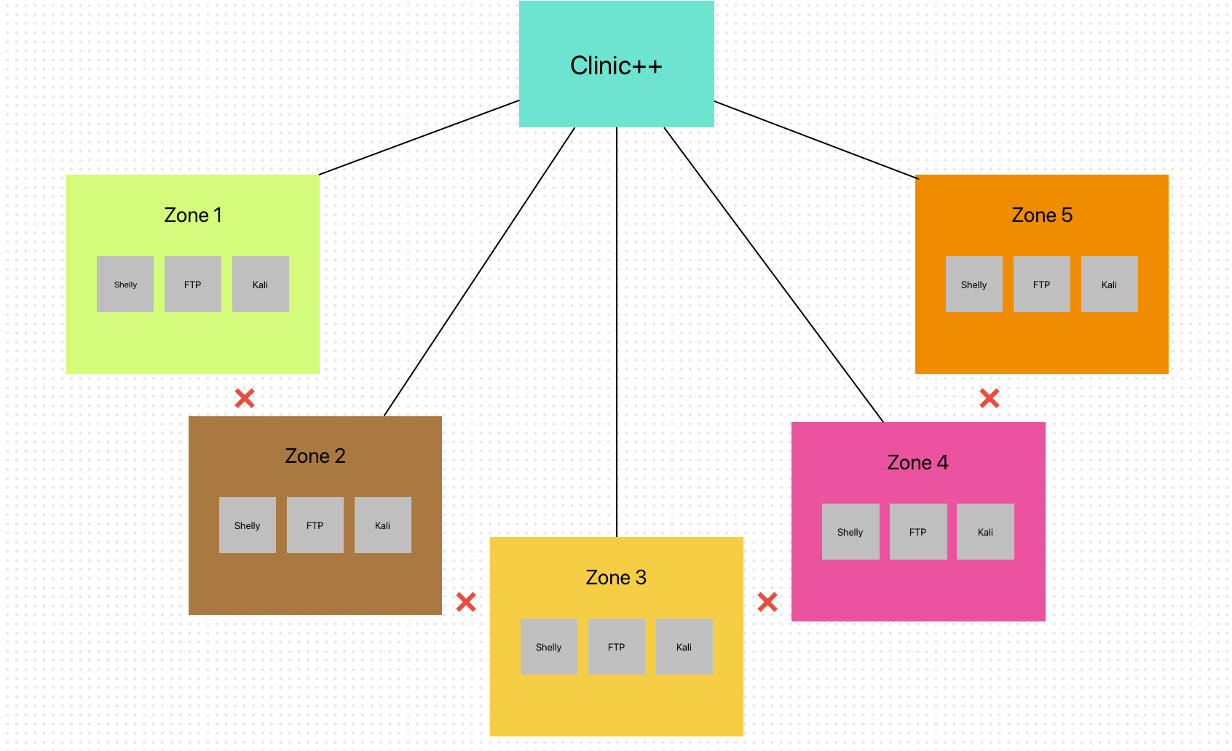
SDN in Proxmox and Network Isolation

Slide 24
Cyber Range
Ivan Zziwa and Jacob Holtz (ITM)

Slide 25
Problem Statement
Cyber security students often need environments running simulated cyber security tests. This prompts them to resort to installing these environments on their local machines.
01

Slide 26
Problem Statement Cont'd
On a good day, for someone familiar with Linux this can take anywhere between 4 hours – weeks to set up these environments that might include Kali Linux, OWASP juice shop and other web applications to be used.
02

Slide 27
Problem Statement Cont'd
Other service providers for these services such as US Cyber Range, Test Out, Skillable and others are very costly.
Our solution could over Illinois Tech Cyber security students and professors, a user friendly, consistent, cost effective software platform where students can deploy the lab environment within minutes reducing effort put into setting up lab environments and actually focusing on the skills development

Slide 28

Tools Used
A community open-source tool for creating identical machine images for multiple platforms.
Gives up to 90% confidence of building the same virtual machine.
Over 20+ machine images(servers) built. Approximately 4.5 hours of build time

Slide 29
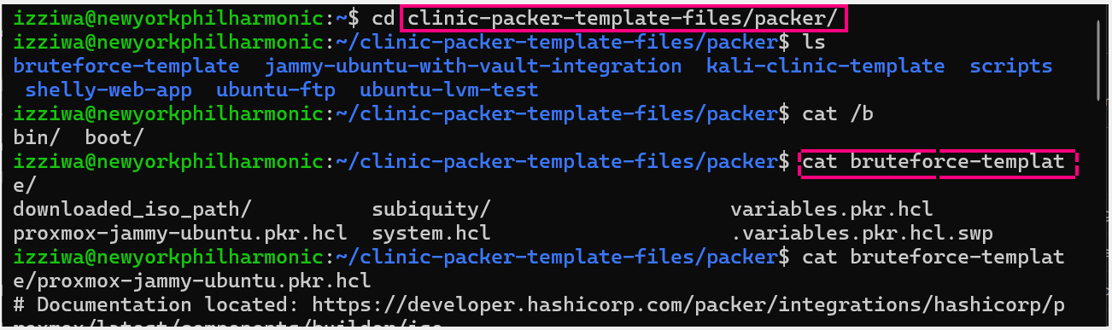
Packer Template Files

Slide 30
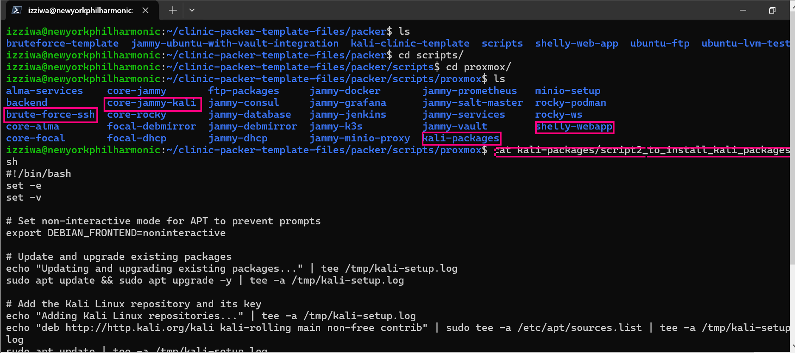
Packer Template Files Cont'd

Slide 31

Tools Used Cont'd
Infrastructure as code tool to build, change, and version cloud and on-prem resources safely and efficiently
Creates and manages resources on cloud platforms and other services through their application programming interfaces (APIs)
Close to 200 servers built during the course of the project

Slide 32
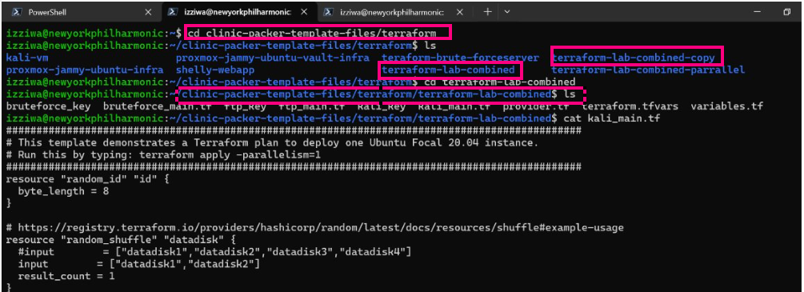
Terraform files

Slide 33
Lab Environment
The lab consists of 3 VMs. One kali workstation, and two intentionally vulnerable ubuntu servers.
The vulnerable services are ssh and ftp.
One of the biggest challenges was isolate them from the school network, as well as create different zones such that VMs from one users session don't interact with another users session.

Slide 34
Clinic++ Cyber Range Web Application
Flask: Used for building the web application, handling routing, and HTTP requests.
Flask-SocketIO: Enables real-time, bidirectional communication between the server and clients.
Flask-Login: Manages user sessions and ensures authentication for protected routes.
OAuth2 with requests_oauthlib: Integrates Google OAuth for secure login.
Paramiko: Provides SSH functionalities to control remote servers. Proxmox API, Automates interactions with Proxmox for managing VMs.
Dotenv and configparser: Reads and manages configuration details (e.g., Proxmox API credentials).
Key Features

Slide 35
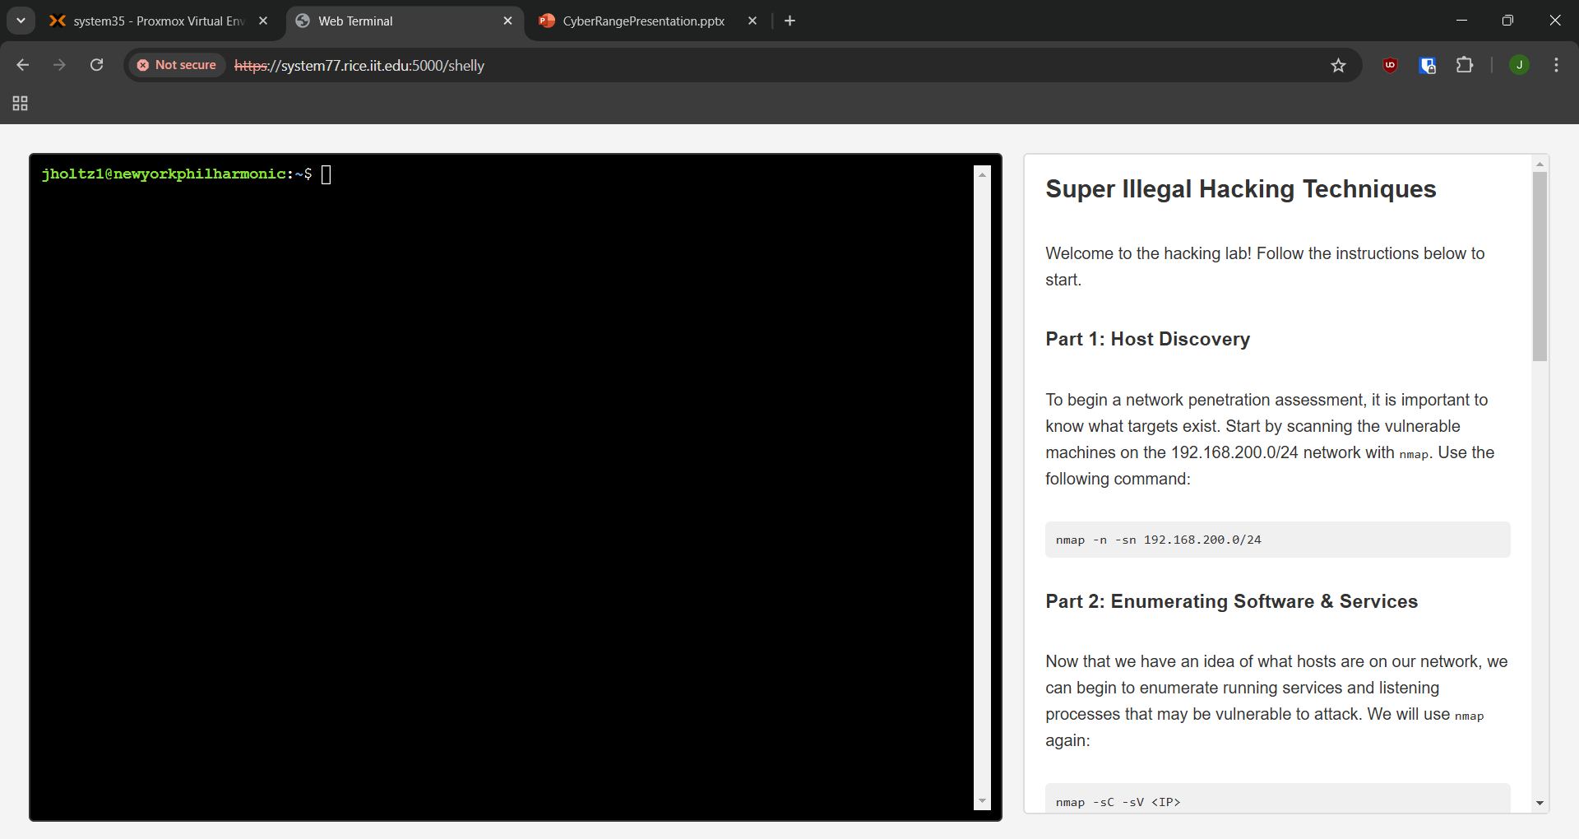
Clinic Webserver

Slide 36
Features of Clinic++ Application
User Authentication:
Google OAuth2 login and session management.
Secure token handling with refresh capabilities.
Lab Automation:
Automates the provisioning and destruction of VMs.
Lab scripts (lab_launch.sh, lab_destroy.sh) invoked via SSH to manage environments.
Real-Time Interaction:
Integrated support for dynamic user interaction using Flask-SocketIO.

Slide 37
Features of the Application Cont'd
VM Monitoring and IP Retrieval:
Retrieves and manages running VMs based on tags.
Dynamically updates IP addresses for user-specific sessions.
User Interface:
HTML templates (launch-labs.html, shelly.html) for user interaction and VM launch workflows.
Error Handling:
Manages and logs issues during VM provisioning.
Safeguards session data and refreshes expired tokens.
Security:
Environment variables for sensitive data.
Secure SSH connections for server commands.

Slide 38
Features Detailed
Extensibility:
  The modular design allows for adding more labs or features like analytics.

Slide 39
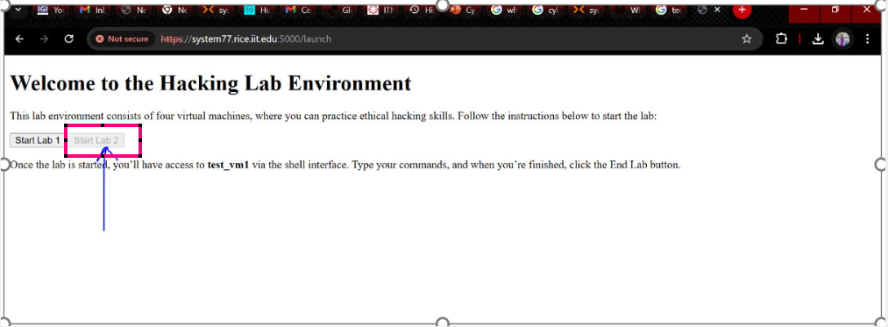
Features Detailed Cont'd
Extensibilty

Slide 40
Feature Detailed Cont'd
Scalability:
  Proxmox integration supports scaling virtual environments as needed.

Slide 41
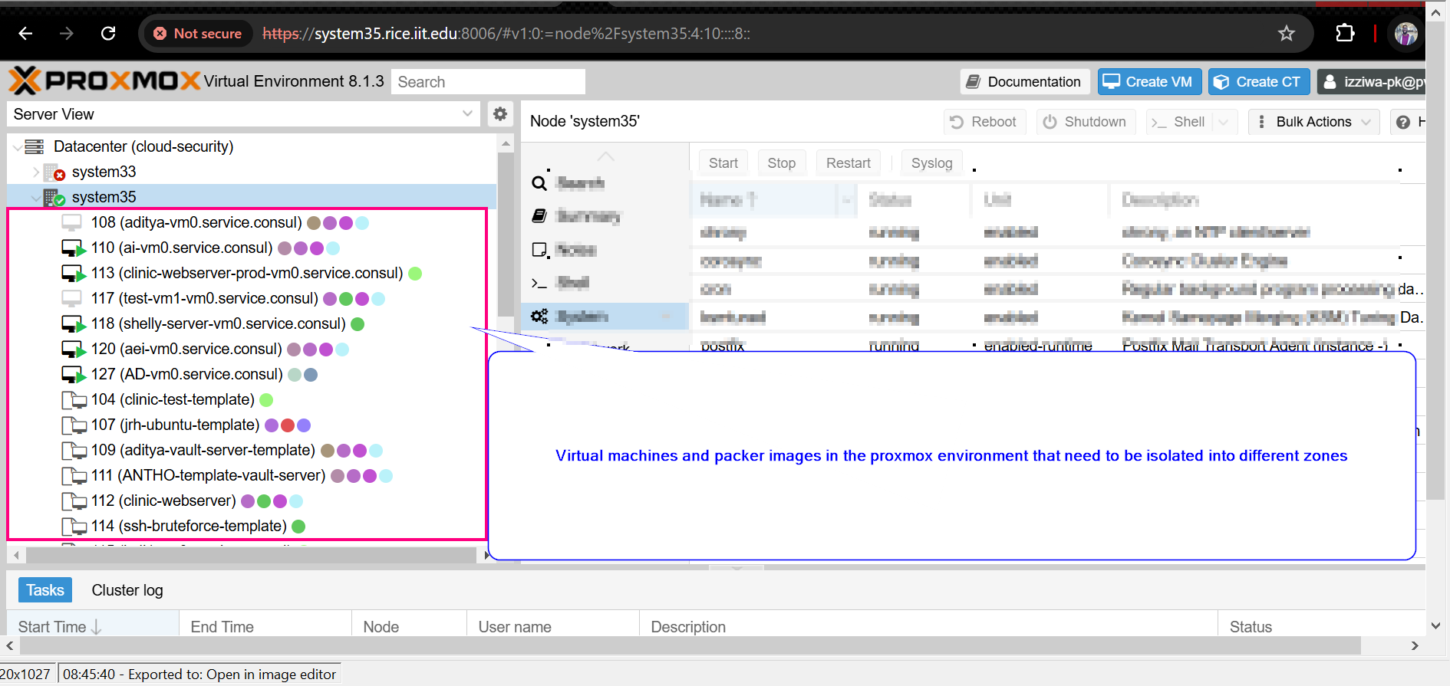
Features Detailed Cont'd
Scalability- Plenty of Disk and RAM availability

Slide 42
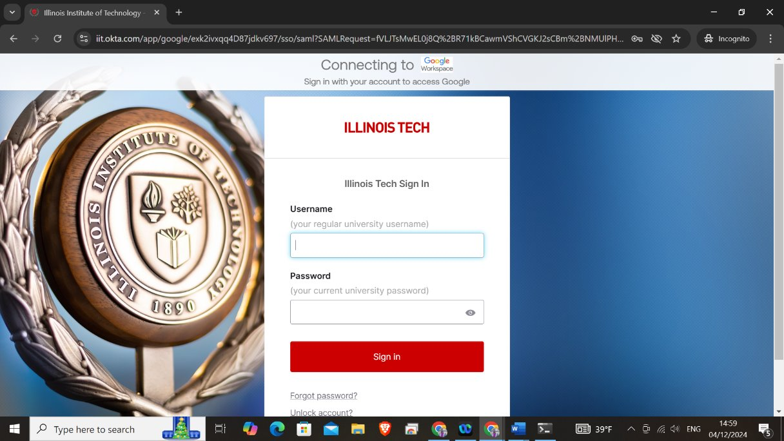
Featured Detailed Cont'd
Real-World Applications:
Ideal for cybersecurity training, educational labs, or cloud-based infrastructure management.
.Collaboration Tools:
OAuth integration simplifies access for team members using their existing Google accounts.

Slide 43
Challenges: Development and Deployment
Slow Build Times
  Outdated hardware, especially older disk drives, slows down the process of copying VM templates and provisioning virtual machines.
  Impacts the efficiency and scalability of the system.
Terraform apply Breakage
  Frequent interruptions or errors during terraform apply due to misconfigurations or conflicts in the provisioning script.
  Lack of clear debugging output complicates troubleshooting.
User Experience (Delayed Lab Availability)
  Extended VM provisioning times can frustrate users awaiting lab environments.
  Need for clear status updates or progress indicators during provisioning.

Slide 44
Challenges Cont'd
Limited Parallel Deployments:
Current system struggles to handle multiple lab requests simultaneously due to hardware or Proxmox node constraints.
Manual intervention required for some scaling tasks
SSH Key Management:
Risk of key misplacement or improper permissions leading to unauthorized access.
Misconfigured .env files could expose sensitive information like API keys and secrets.

Slide 45
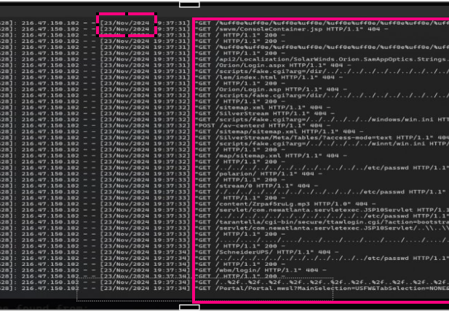
Challenges Cont'd
Routine scan from OTS

Slide 46
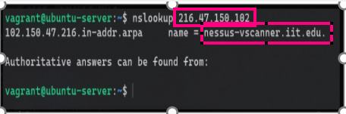
Challenges Cont'd
Nameserver lookup

Slide 47
Challenges Cont'd
Cluster with multiple VMs and templates

Slide 48
In conclusion...
What is the future?
  Continue to iterate and improve this platform
  Open development up for the development of new "tests"
  Provide resources for students/faculty to use, study, and learn with
  Create a one-step installer for the entire platform so others can implement their own Cyber Range
  Conduct studies and publish research
  Create a business to produce custom "tests"
    Sell them on a marketplace

