Slide 1
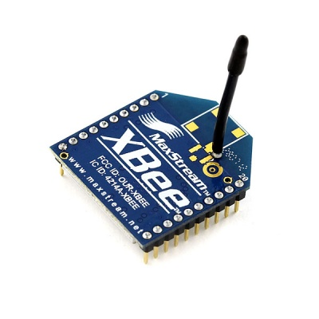
Radio Data
By: Jonathan Garcia
Jose Garcia

Slide 2
Objectives
Monitor/Send information
Extend distance
Low energy consumption

Slide 3
The Action

Slide 4

Components
XBee 802.15

Slide 5
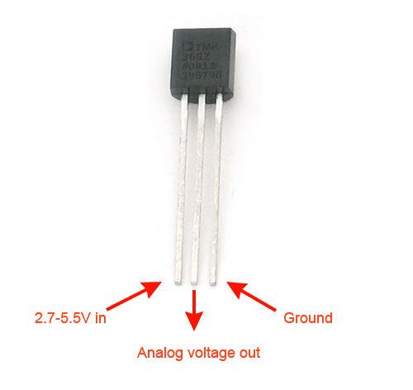
Components
TMP-Sensor

Slide 6
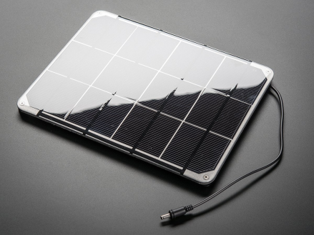
Components
Solar Panel

Slide 7
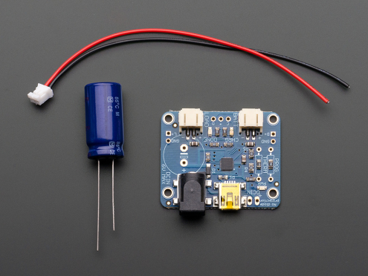
Components
Capacitor/Transformer

Slide 8
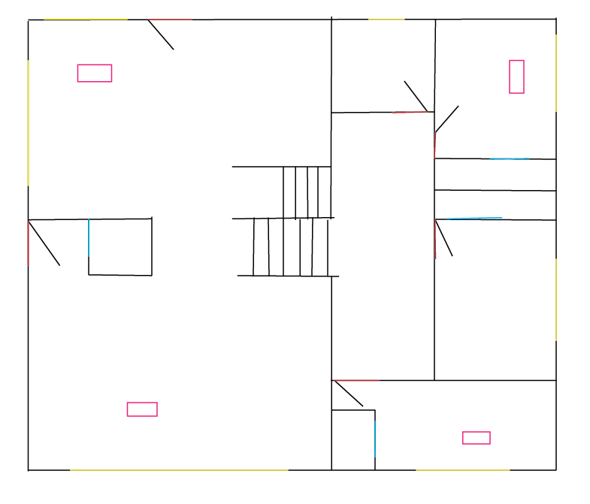
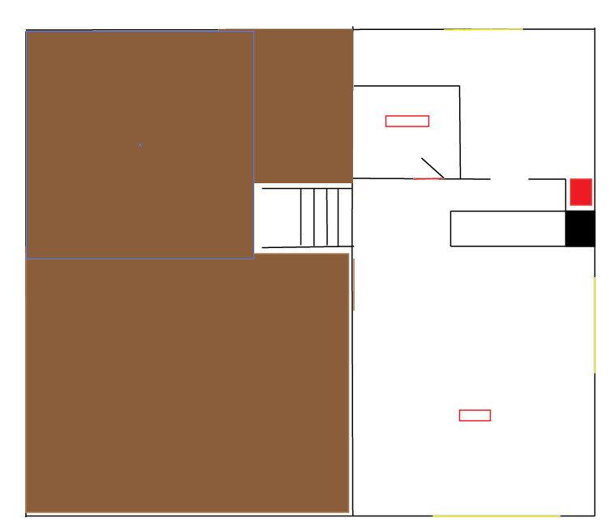
Application
Solar/Light
Sound
Humidity
Carbon Dioxide
Radiation
Temperature

Slide 9
What has been done?
Purdue-Calumet University
  Small group of graduate students.
  Detected irregularities in ventilation systems.
    Used similar devices
    Prevented University from unnecessary spending

Slide 10
Difficulties
Structural Layout
-materials of the surrounding area
Connecting multiple endpoints

Slide 11
Solutions
XBee’s had to be set to verify connection
Change in equation’s logic to get Fahrenheit
Locations had to be moved
  Interference in some areas

Slide 12
Demonstration
https://www.youtube.com/watch?v=krbNBtYlkC0&t=2s

Slide 13
Final Assessment
Lower temperature detected in one room
Battery operated
  Easily moveable
  Not anchored down
Cheaper alternative to many solutions

