Slide 1
Online Food Ordering Application
Made by-
Sarvesh Shinde

Slide 2

Application
Foodies is an online food ordering application which allows the user to order food from multiple restaurants at the same time. The application partners with multiple restaurants and displays their entire catalogue. It reduces the time user wastes between switching into applications of different restaurants.

Slide 3
Application
Multiple restaurants supported
Home delivery
Latest offers updated
Order history saved
Special discounts with partners
No minimum order value
Reliable and fast
Easy to search and use

Slide 4

Requirements
Compiler: NetBeans
Database: MySQL
Platform: Java
Time Period: 2 Months

Slide 5
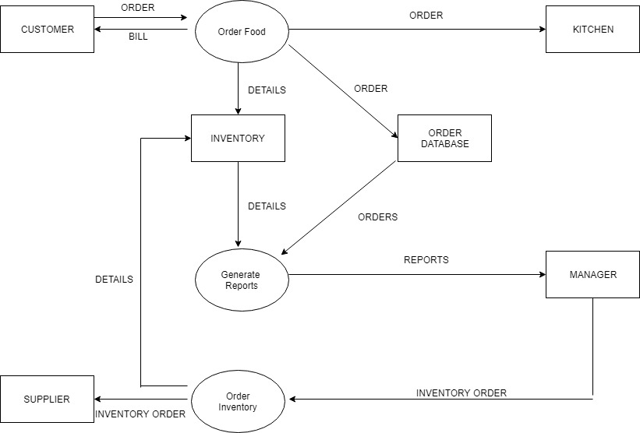
Data Flow Diagram

Slide 6
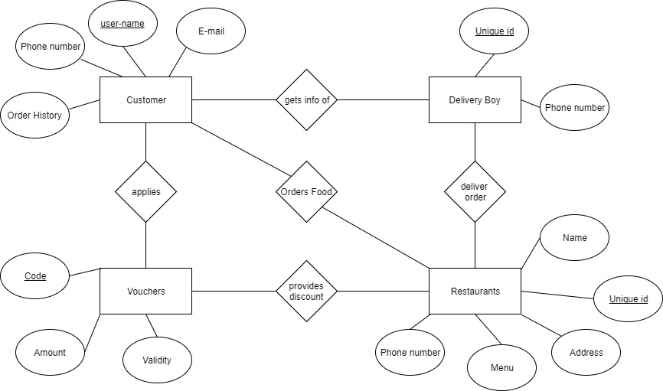
Application Architecture

Slide 7
Preview

Slide 8

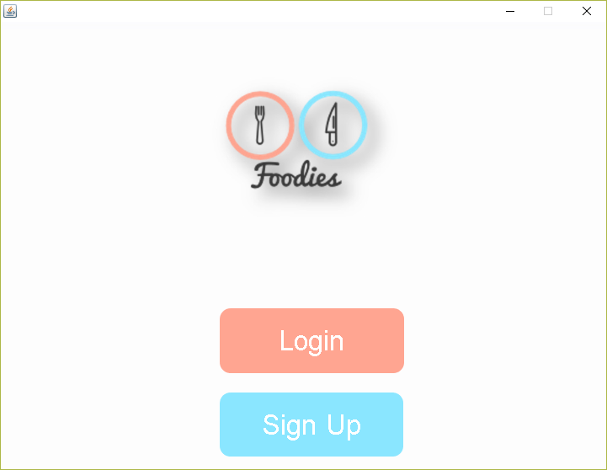
Startup

Slide 9
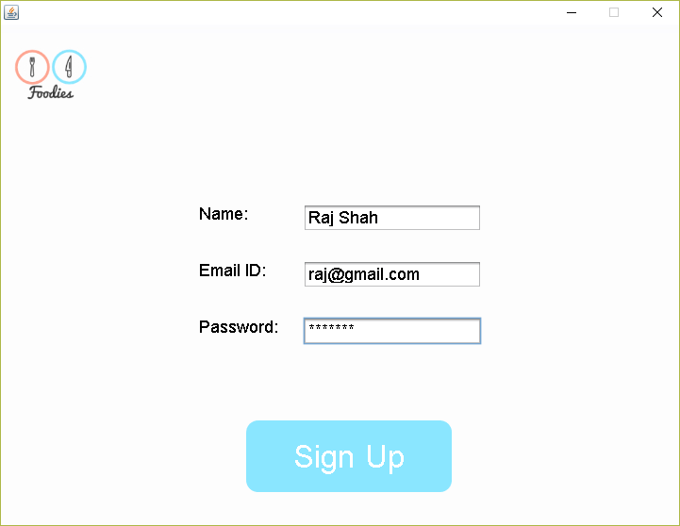
Sign Up

Slide 10
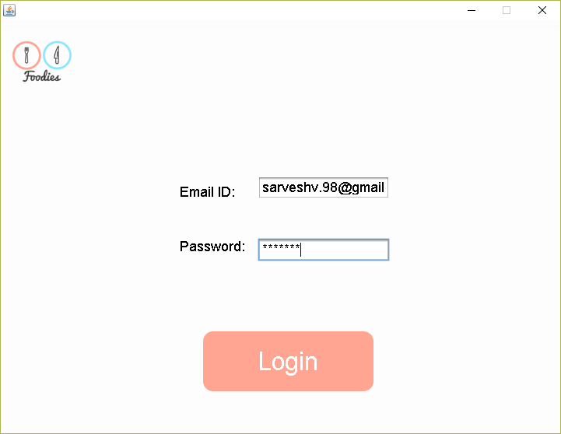
Login

Slide 11
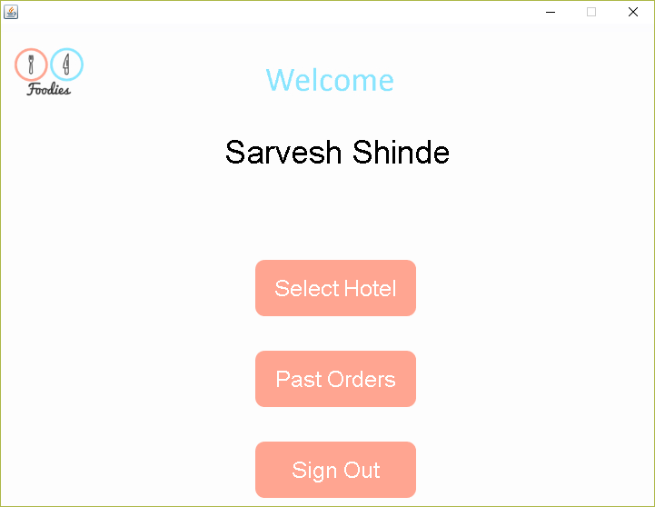
Welcome

Slide 12
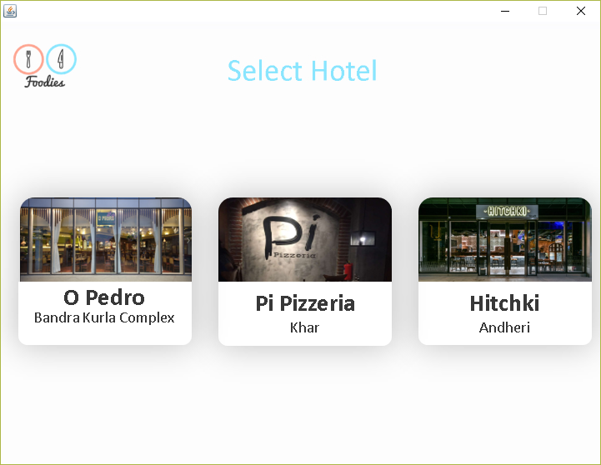
Selection

Slide 13
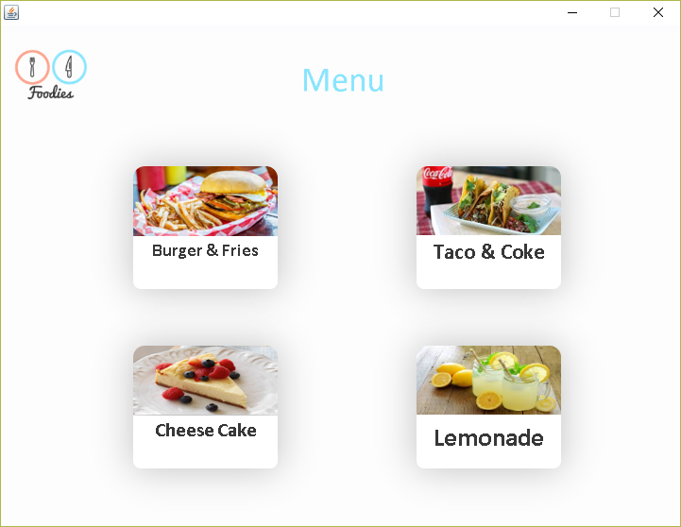
Menu

Slide 14
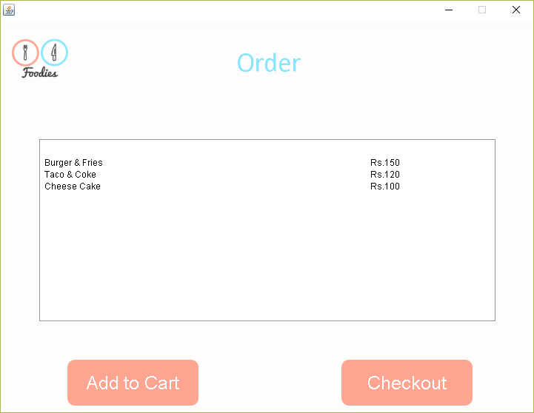
Order

Slide 15
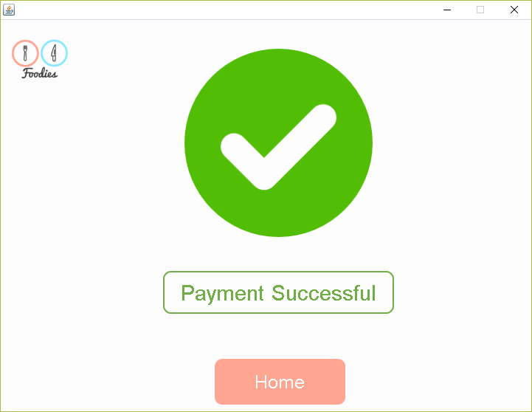
Payment

Slide 16
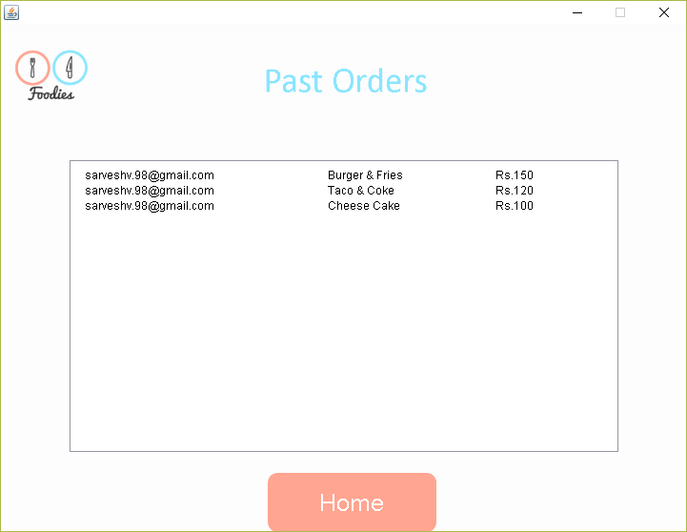
History

Slide 17
Future Scope
Wider support range.
Android Portability.
Order Scheduling.
Multi-lingual Support
Live Order Tracking

Slide 18
Thank You!

