Slide 1

BKU / Rvc / cadence collaboration
LaB 1 - Simulation
May 05th , 2021
Nhan Le
OA-ICT Group / Frontend Design 1 Department
HW Engineering Division
Renesas Design Vietnam Co., Ltd
Notes:
Date

Slide 2
Overview
This Lab will familiarize you with one of Cadence simulation tool - Xcelium.
This Lab will cover the following:
How to use Xcelium for execute simulation
How to generate Waveform file by Xcelium
How to debug by using GUI (Graphic User Interface)
In this material, command-line instructions are shown with gray background, for example:
%> mkdir simulation_env
%> cd simulation_env

Slide 3
Getting Started
Firstly, please create the tree folder as below:
${Student_ID}
|-- output → Output folder
|-- design → Used to store your output design
`-- doc → Used to store your output document
|-- work → Working folder
|-- simulation_env → Simulation’s work-place
|-- synthesis_env → Synthesis’s work-place
`-- lec_env → Equivalence checking’s work-place
To do that, execute below commands:
%> mkdir {Student_ID}
%> cd {Student_ID}
%> mkdir output
%> mkdir output/design
%> mkdir output/doc
%> mkdir work
%> mkdir work/simulation_env
%> mkdir work/synthesis_env
%> mkdir work/lec_env

Slide 4
Simulate with Xcelium (1/2)
Step 1: Change directory to simulation_env folder. In this Lab 1, we will work at this place:
Step 2: Copy Design file and Testbench file into this place.
Step 3: Execute below commands to get permission for using Xcelium: The last command “cd -” use to turn back to simulation_env directory
Step 4: Execute “xrun -access rw -licqueue -64BIT -l run.log ${design_file} ${testbench_file}” For example:
%> cd work/simulation_env
%> cd /home/share_file/cadence/
%> source add_path
%> source add_license
%> cd -
%> xrun -access rw -licqueue -64BIT -l run.log bound_flasher.v testbench.v

Slide 5
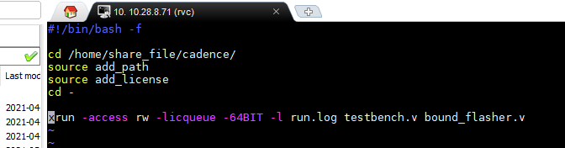
Simulate with Xcelium (2/2)
Step 5: After the simulation finishes, you can check the simulation result via Log file “run.log”
Step 6: Each time you want to execute simulation, you need to perform Step 3 -> Step 4 again. It may be inconvenience. To avoid that, you can add all commands into 1 file (ex “go_sim” file): After that, for simulation, you can execute only:
%> vi run.log
Don’t forget to add this line
%> go_sim
WARNING: The simulation time might less than 5 minutes. If it over 5 minutes, it might hang-up. When it hang-up, please press “Ctrl + C” to stop the simulation

Slide 6
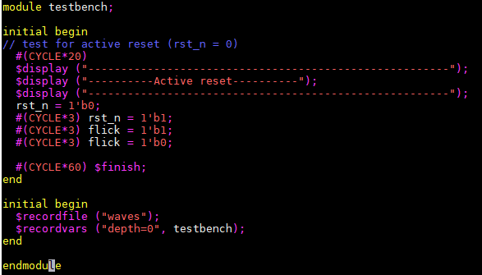
Generate Waveform file
Step 1: Add following code lines into the testbench file:
Step 2: Re-execute simulation.
Step 3: After simulation finish, check that the Waveform file has been dumped – “waves.dsn” and “waves.trn”
initial begin
$recordfile ("waves");
$recordvars ("depth=0", testbench);
end
Must be same
End simulation
WARNING: Before execute simulation with dumping Waveform, please ensure that your Testbench has the “$finish” code line to end the simulation

Slide 7
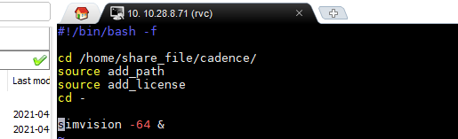
Open Waveform by GUI (1/4)
Step 1: Execute below commands to get permission for using Xcelium:
Step 2: Execute
Step 3: Like above, you can add all command into 1 file (ex “go_gui” file) and execute only:
%> cd /home/share_file/cadence/
%> source add_path
%> source add_license
%> cd -
simvision -64 &
%> go_gui
Don’t forget to add this line

Slide 8
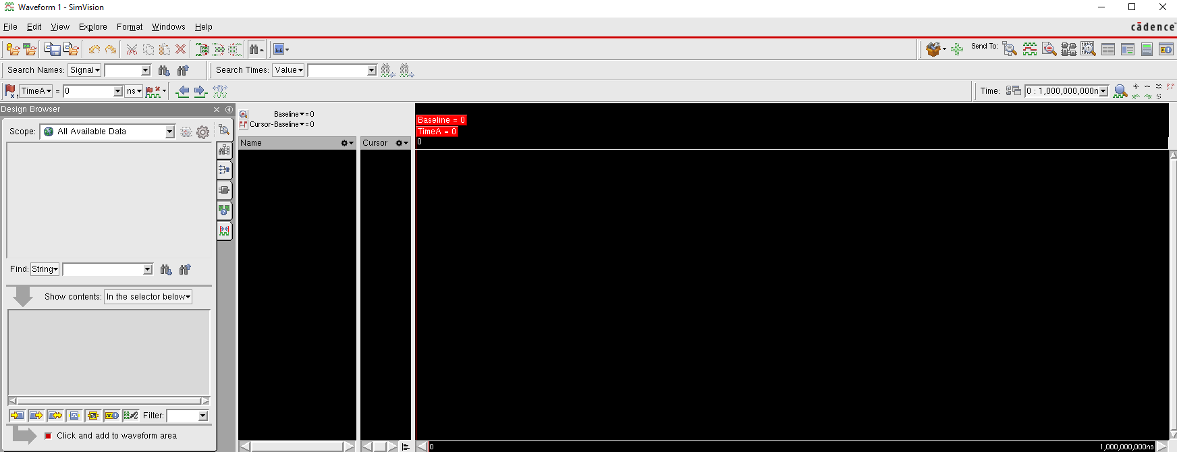
Open Waveform by GUI (2/4)
Step 4: The GUI will be opened like below
Tool bar
Waveform’s display area
Signal name area
Signal name area

Slide 9
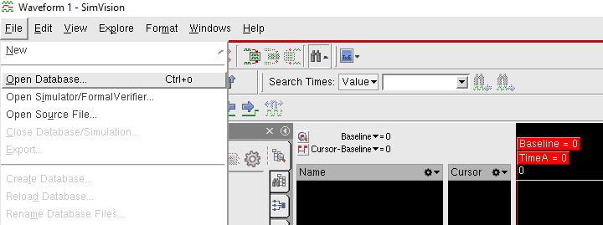
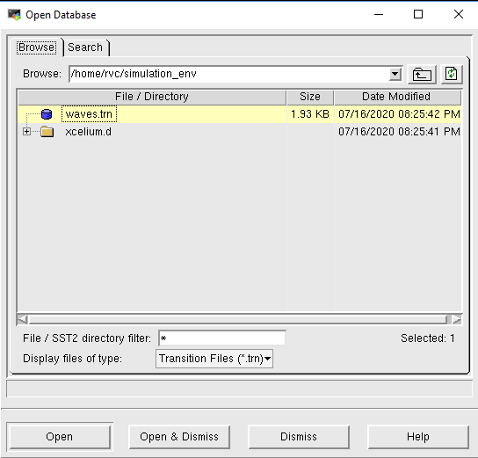
Open Waveform by GUI (3/4)
Step 5: Click “File” -> “Open Database”
Step 6: Choose Waveform file -> “Open & Dismiss”

Slide 10
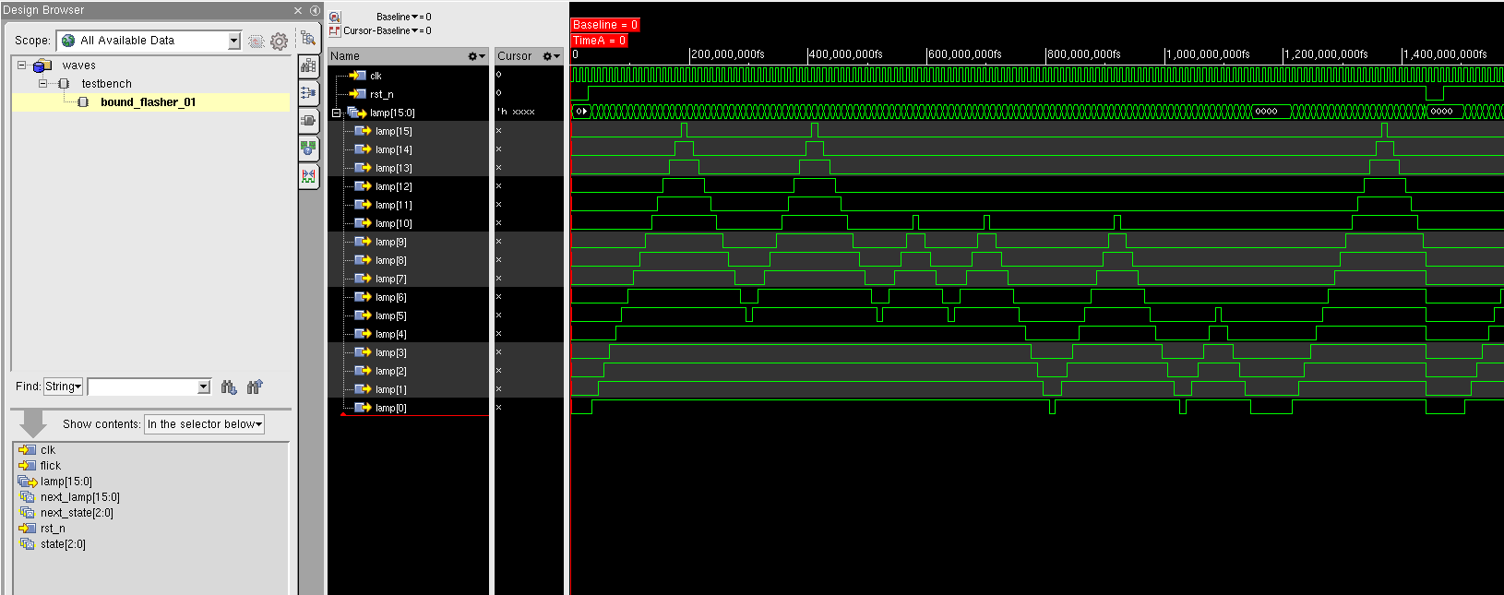
Open Waveform by GUI (4/4)
Step 7: Select Design -> Select signals -> Signal’s wave will be displayed
Select design
Select signals
Signal’s wave

Slide 11
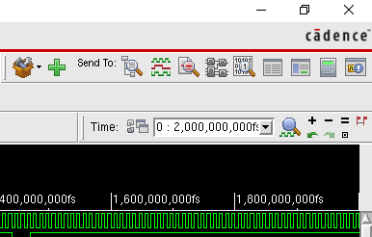
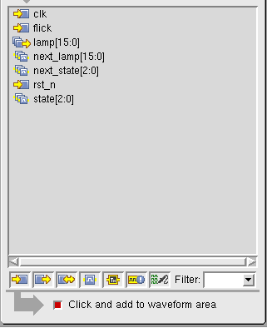
Some useful buttons in GUI (1/3)
Zoom In (+) - Zoom Out (-) - Zoom Full (=) buttons
Auto add to Wave-view button When this button active (red light), click on to any signal will add it to Wave-view automatically. When this button in-active, you need to press “Ctrl + W” to add targeted signal to Wave-view

Slide 12
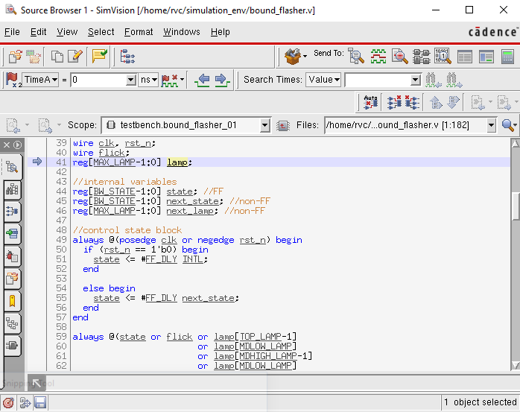
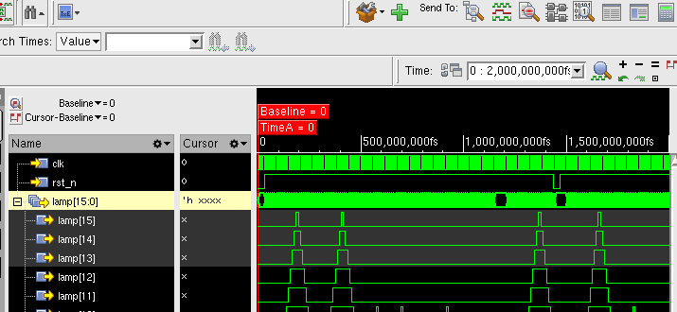
Some useful buttons in GUI (2/3)
Open Source code Browser button
Select signal then Click

Slide 13
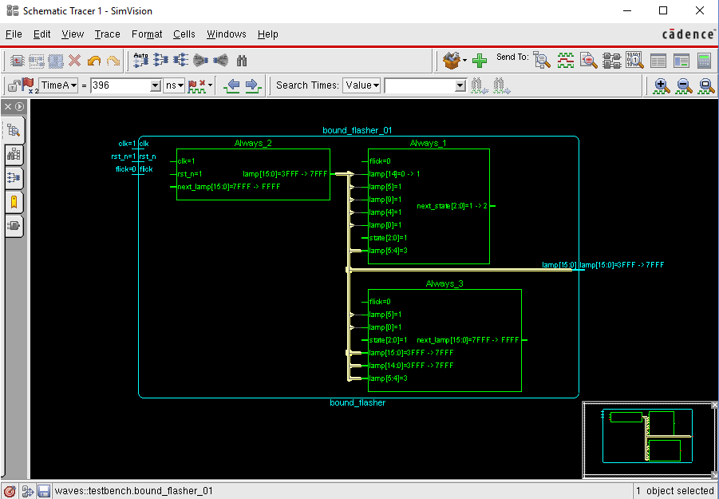
Some useful buttons in GUI (3/3)
Open Schematic Tracer button
Select signal then Click

Slide 14
THANK YOU FOR YOUR LISTENING

