Slide 1

BKU / Rvc / cadence collaboration
LaB 4 – logic equivalence check
June 09th , 2021
Nhan Le
OA-ICT Group / Frontend Design 1 Department
HW Engineering Division
Renesas Design Vietnam Co., Ltd
Notes:
Date

Slide 2
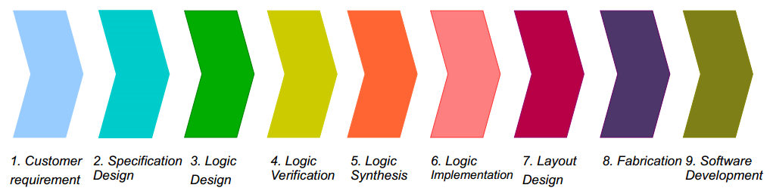
Overview
In LSI design flow, after Synthesis, we need to perform Logic Equivalence checking (LEC) between RTL and its Netlist to ensure that the functionality of them are the same:
This Lab will familiarize you with one of Cadence tool – Conformal-LEC, which perform LEC.
This Lab will cover the following:
How to use Conformal-LEC
How to debug Non-equivalent points by using GUI (Graphic User Interface)
Phases that Logic Equivalence checking is performed

Slide 3
Advantages of Conformal-LEC
Conformal-LEC has many product to adapt with your purpose:
Conformal L (ASIC): Verify synthesized and place & route netlist transformation.
Conformal XL (Ultra): Conformal L + Verify complex datapath.
Conformal GXL (Custom) : Conformal XL + Verify custom logic and custom memories.
Conformal Low Power: Conformal XL + Verify low-power logic and power domains.
It’s self-contained and it not tied to any particular synthesis environment. Thus, it gives you a higher degree of confidence than equivalence checkers integrated with a particular logic synthesis tool.
It has excellent debugging capabilities. It automatically diagnoses design mismatches and accurately pinpoints the source of the differences.
It supports Hierarchical Comparison, which speed up the compare process. Moreover, Cadence already introduced Smart LEC with special engine, which can execute hierarchical comparison in parallel to achieve the best run time.
More information about LEC: link

Slide 4
Perform LEC with Conformal (1/4)
Step 1: Change directory to “lec_env” folder. In this Lab 4, we will work at this place:
Step 2: Link the RTL, Netlist and Library file from “synthesis_env” into this place:
Step 3: Confirm there has no broken link (link files successfully):
%> cd /home/ccxxgroup??/vlsi/${Student_ID}/work/lec_env
%> ln –sf ../synthesis_env/Genus_BoundFlasher/RTL/bound_flasher.v
%> ln –sf ../synthesis_env/Genus_BoundFlasher/LAB1/outputs??/bound_flasher_m.v
%> ln –sf ../synthesis_env/Genus_BoundFlasher/LIB/slow.lib
%> ll

Slide 5
Perform LEC with Conformal (2/4)
Step 4: Prepare the setup script for Conformal as below:
%> vi ./lec.tcl
lec.tcl
set_log_file lec.log -replace
read_library slow.lib -lib -revised
read_design bound_flasher.v -verilog -golden
read_design bound_flasher_m.v -verilog -revised
set_mapping_method -name only
set_system_mode lec
map_key_points
add_compared_points -all
compare
Set Log file name
Read libraries
Read RTL
Read Netlist
Mapping process
Compare process

Slide 6
Perform LEC with Conformal (3/4)
Step 5: Prepare the execution script as below:
Step 6: Execute
%> vi ./go_lec
go_lec
#!/bin/bash -f
cd /home/share_file/cadence
source add_path
source add_license
cd -
lec -64 -dofile ./lec.tcl &
Setting license for using Conformal
Invoke Conformal
%> ./go_lec

Slide 7
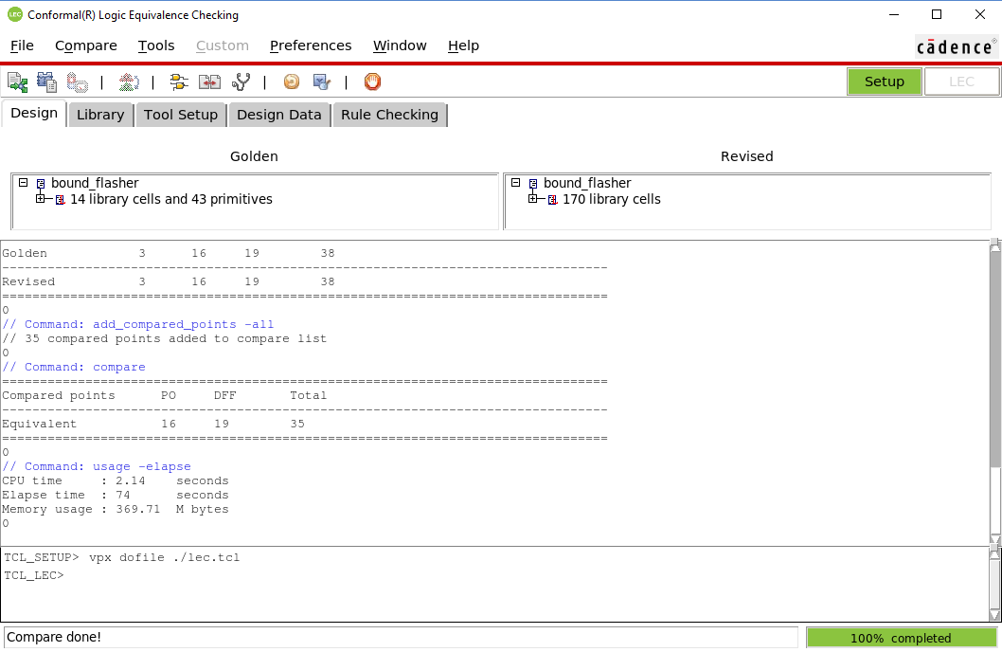
Perform LEC with Conformal (4/4)
Step 7: It will automatically open the GUI and execute processes that we described in file “lec.tcl”
Don’t have any Non-equivalent points
=> Netlist equivalent vs RTL
Type “exit” here to exit the GUI

Slide 8
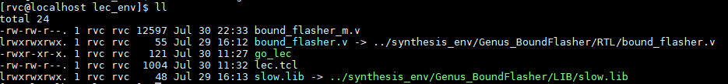
Debug Non-equivalent point (1/8)
Step 1: Copy Netlist into this place:
Step 2: Confirm Netlist already copied (not link):
%> rm –rf bound_flasher_m.v
%> cp –rf ../synthesis_env/Genus_BoundFlasher/LAB1/outputs??/bound_flasher_m.v ./
%> ll

Slide 9
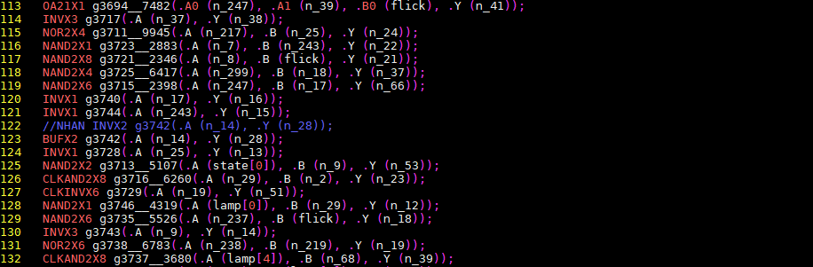
Debug Non-equivalent point (2/8)
Step 3: Modify Netlist to make a “bug” intentionally:
Step 4: Re-execute
%> vi ./bound_flasher_m.v
Pick up 1 INV-cell randomly and change it to BUF-cell
%> ./go_lec

Slide 10
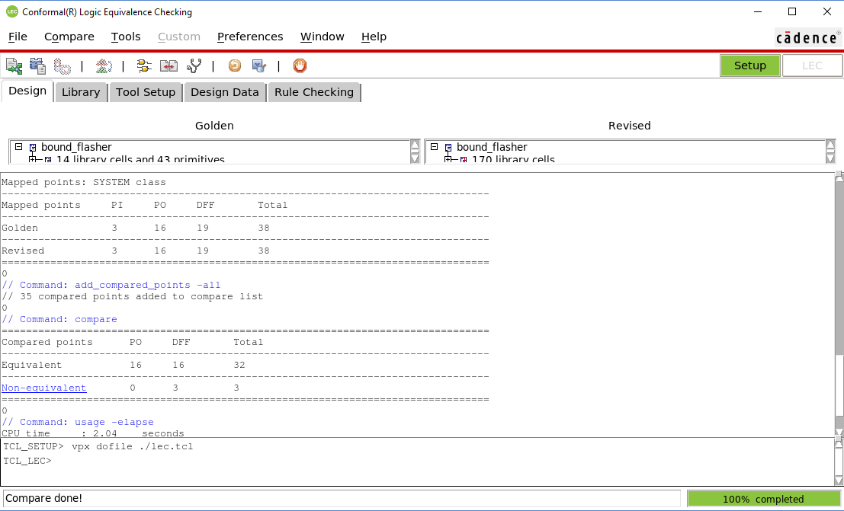
Debug Non-equivalent point (3/8)
Step 5: When execution is done, “Non-equivalent” points will appear:
Non-equivalent points

Slide 11
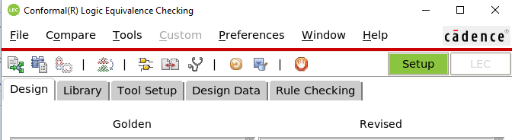
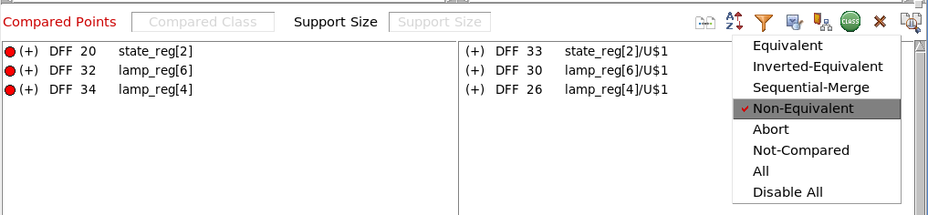
Debug Non-equivalent point (4/8)
Step 6: There are many ways for debugging nonequivalent points. The following part is the debugging example using “Diagnosis Manager” and “Schematics Viewer” in GUI:
① Click to open “Mapping Manager”
② In “Mapping Manager” window, click “Class”, choose “Disable All” then choose “Non-Equivalent” to display only nonequivalent points

Slide 12
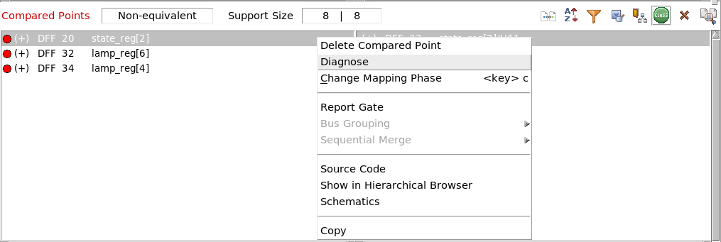
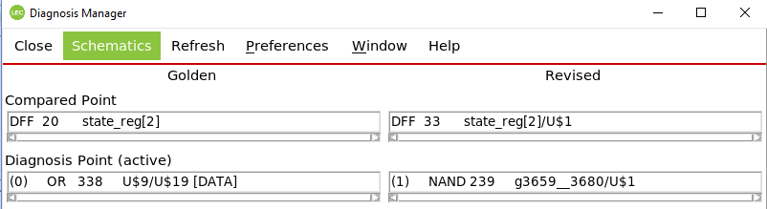
Debug Non-equivalent point (5/8)
③ Right-click to first nonequivalent key point and choose “Diagnose” to open “Diagnosis Manager”
④ In “Diagnosis Manager” window, choose “Schematics” to open “Schematics Viewer”

Slide 13
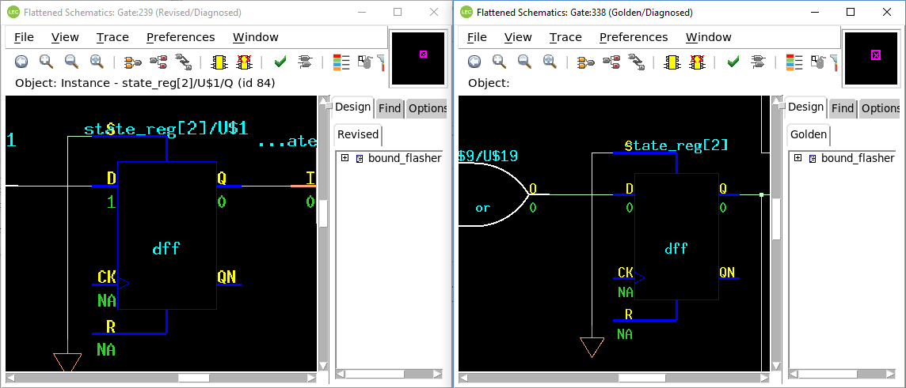
Debug Non-equivalent point (6/8)
⑤ As you can see, on the Revised schematic (left), the end-point simulation (pink circle) is 1, while the Golden is 0
⑥ If you want to expand the logic cone at specific pin, right-click to this pin and choose “Fan-in Cone –> Open”

Slide 14
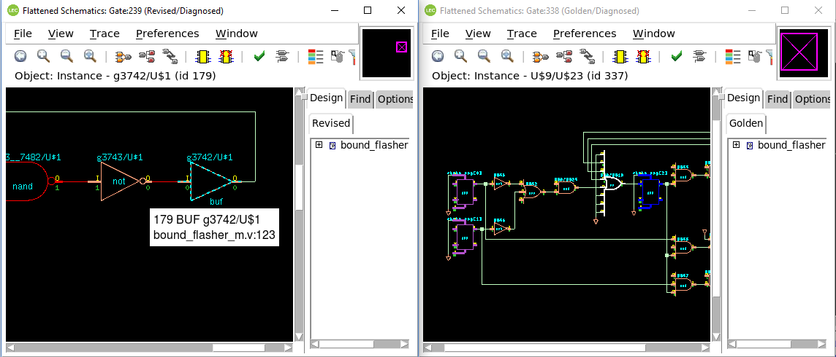
Debug Non-equivalent point (7/8)
⑦ Purple gate is the gate has a corresponding equivalent gate on the other schematic, you can use it for easier debugging
⑧ After trace back, you can find that the root cause is BUF-gate (pink rectangle) in Revised design
⑨ When you hover your mouse over any gate, it will show the corresponding line number in source code

Slide 15
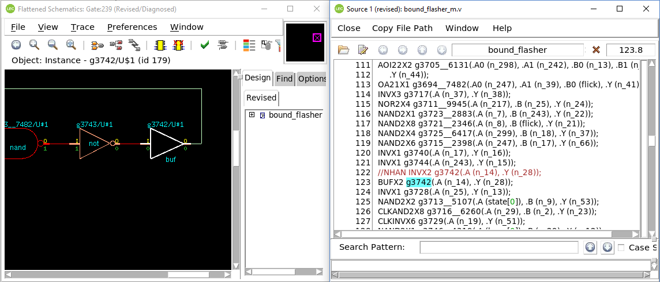
Debug Non-equivalent point (8/8)
⑩ Double-click to the error gate (BUF gate) in Revised design, the corresponding source code will be opened
⑪ You can confirm and give the suitable solution such as re-synthesize, do ECO…

Slide 16
THANK YOU FOR YOUR LISTENING

