Slide 1
LAB4
VIRTUOSO(CONT)

Slide 2
Outline
Virtuoso setup
Create Library
Schematic
Run Spectre simulation
Layout
DRC

Slide 3
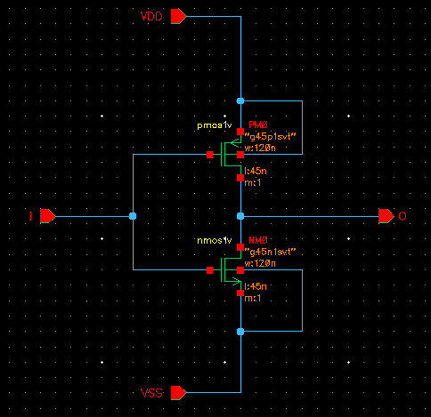
5. Layout
Step 1: From the Schematic view (section 3), select Launch → Layout XL.
Choose Create New.

Slide 4
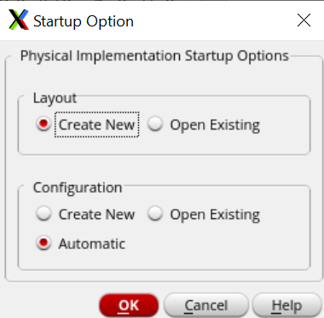
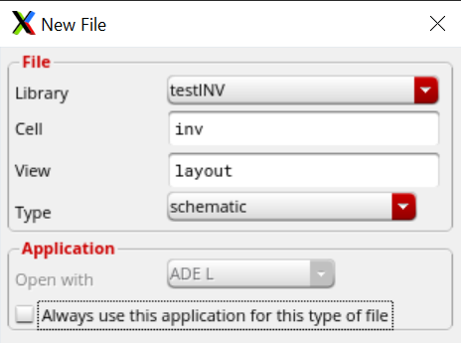
5. Layout
Then OK.

Slide 5
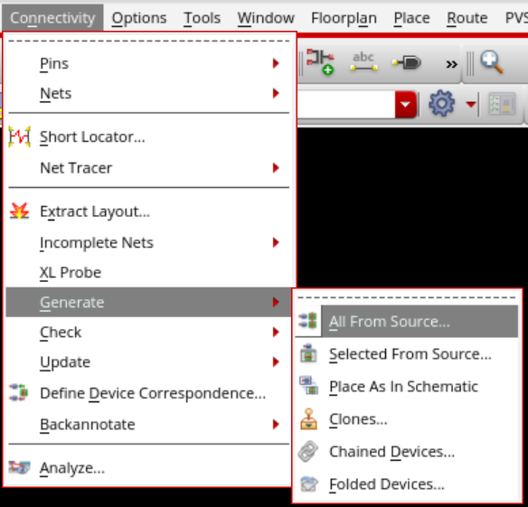
5. Layout
Step 2: Then draw the layout for the inv cell.
Choose Connectivity → Generate → All From Source.

Slide 6
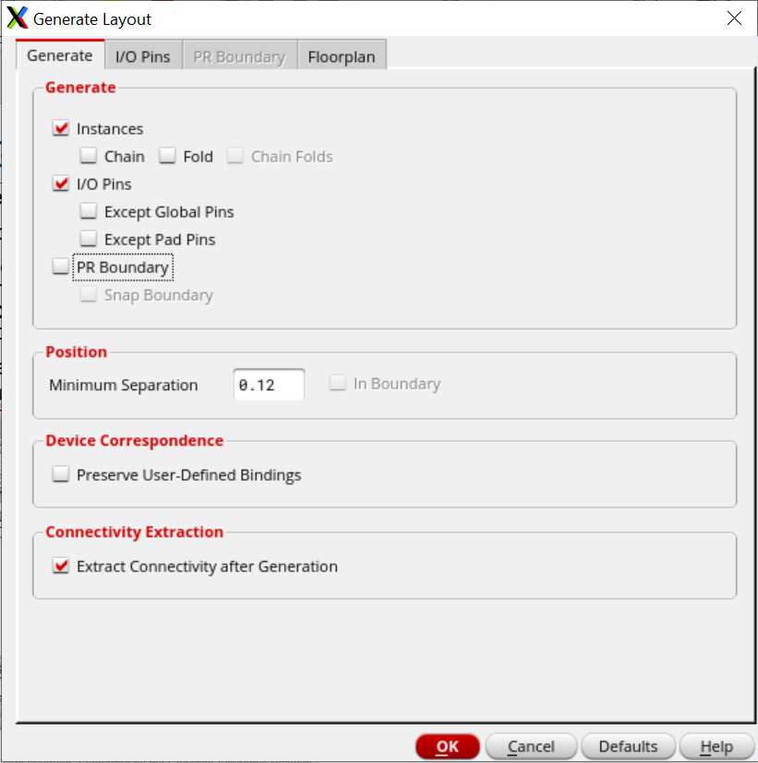
5. Layout
The Generate Layout window opens, uncheck the PR Boundary and click on the I/O Pins tab.

Slide 7
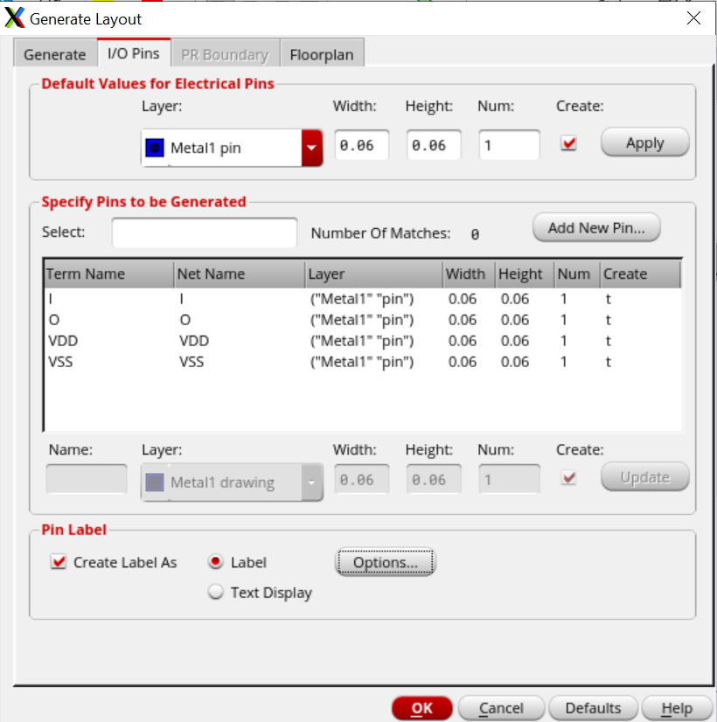
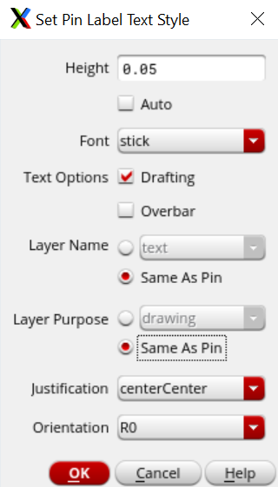
5. Layout
Change the Layer to “Metal1 pin” from the drop-down list and click on Apply.
Select “Create Label As”, choose “Label”, and click on Options.
Change the “Set Pin Label Text Style” form as shown in the figure.
Click OK to close the Set Pin Label Text Style form and the Generate Layout form
Press Shift + F to view the terminals of each transistor.

Slide 8
5. Layout
Press Shift + F to view the terminals of each transistor.
In order to make things easier, some useful keybinds are mentioned below:
To move any object: M
To draw a rectangle: R
To create a path: P
To stretch a path: S
To create a ruler: K
To delete all rulers: Shift + K

Slide 9
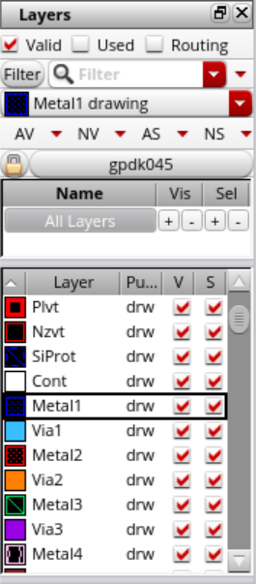
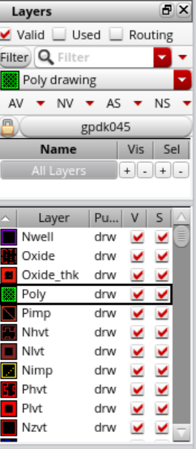
5. Layout
You can draw Metal1, Poly,… from the LSW.
To add the Via on top of the drawn rectangle: Create → Via

Slide 10
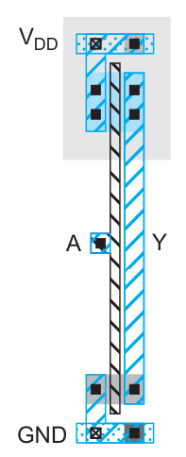

5. Layout
Before you draw layout, turn DRD Notify On
Now, place and route the components.
Read more:
- “CMOS VLSI Design”, section 1.5 “CMOS Fabrication and Layout”

Slide 11
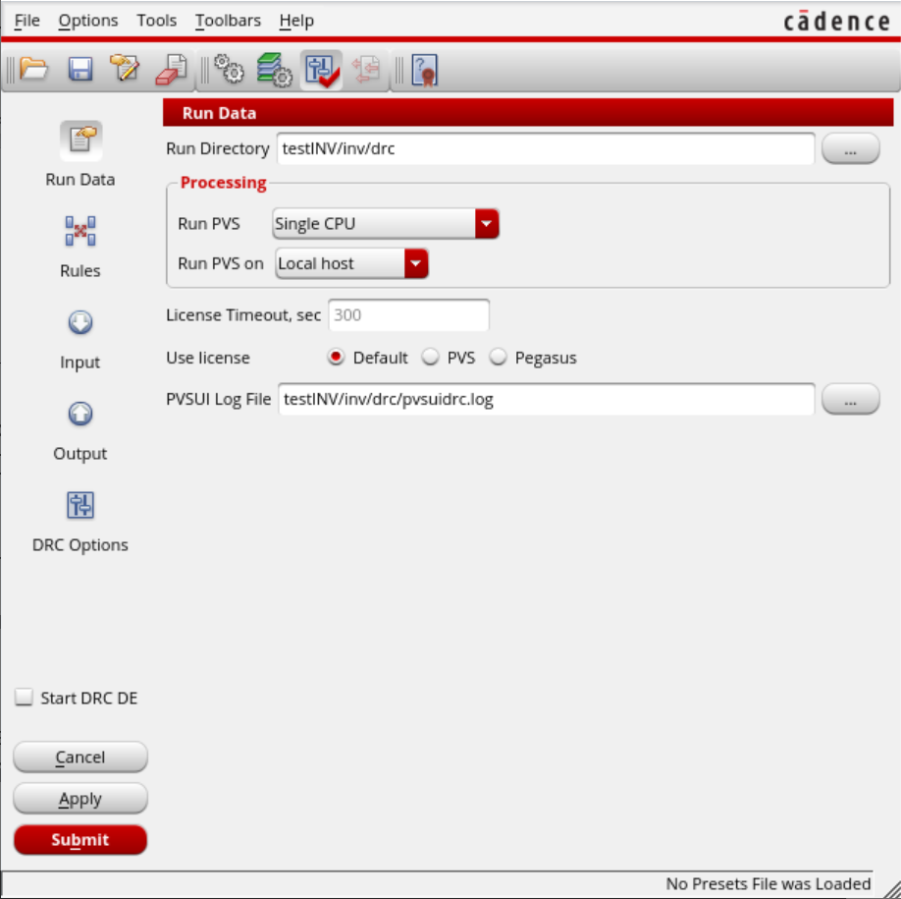
6. DRC
Make sure that your layout contains no DRC violations. To check DRC, from the Layout, choose PVS → Run DRC…
The DRC Run Submission Form opens.
Make sure to Turn on Start DRC DE.
Choose the following for the Run Directory:
“testINV/inv/drc”
Note that the tool will automatically create the folder “drc” in the inv folder.

Slide 12
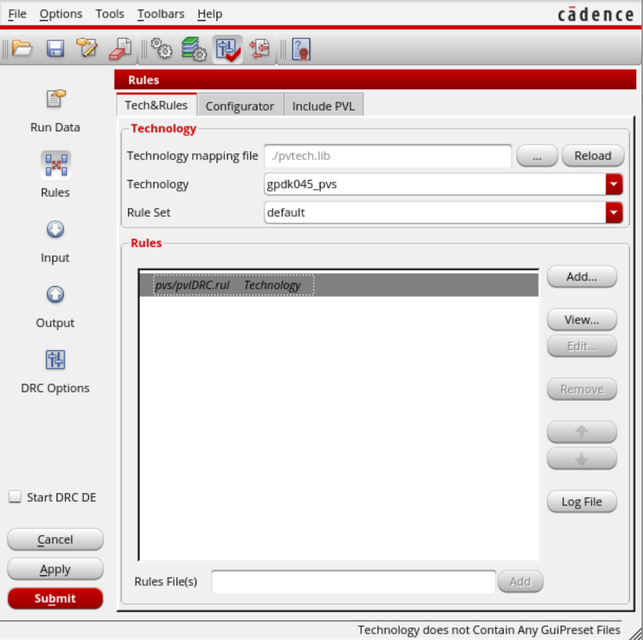
6. DRC
On Rules tab, Set the Technology and Rule Set from the drop-down list to gpdk045_pvs and default, respectively.
The Input and Output parameters are set by default.
Click Submit and the verification should be running.
DRC will check design against strict rules and report violations. The rules can be found in the folder "docs" of the pdk

Slide 13
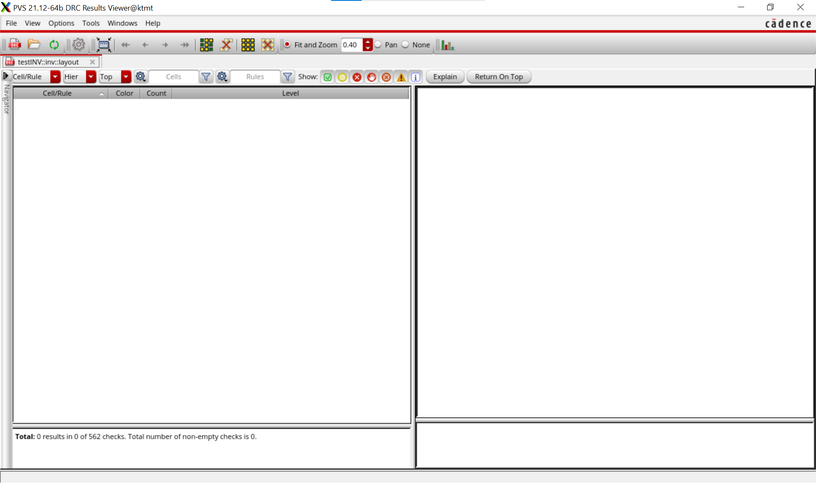
6. DRC
All the errors must be fixed before proceeding with the module.
If the layout does not violate any of the rule, the Results Viewer window will be empty.
Close this windows.

Slide 14
6. LVS
LVS compares the layout with the schematic, and report whether they correspond to each other or not.
To check LVS, choose PVS → Run LVS
The DRC Run Submission Form opens.
Make sure to Turn on Start LVS DE.
Choose the following for the Run Directory:
“testINV/inv/pvs"
Note that the tool will automatically create the folder “pvs” in the inv folder.

Slide 15
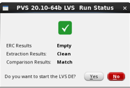
6. LVS
On Rules tab, Set the Technology and Rule Set from the drop-down list to gpdk045_pvs and default, respectively.
The Input and Output parameters are set by default.
Click Submit and the verification should be running.
If the comparison results in a match, click No to close the form. Otherwise, click Yes, the errors will be clearly stated along with how to fix them.

Slide 16
Submission
Each group submits the layout design, DRC report, and LVS report in a PDF file.

