Slide 1

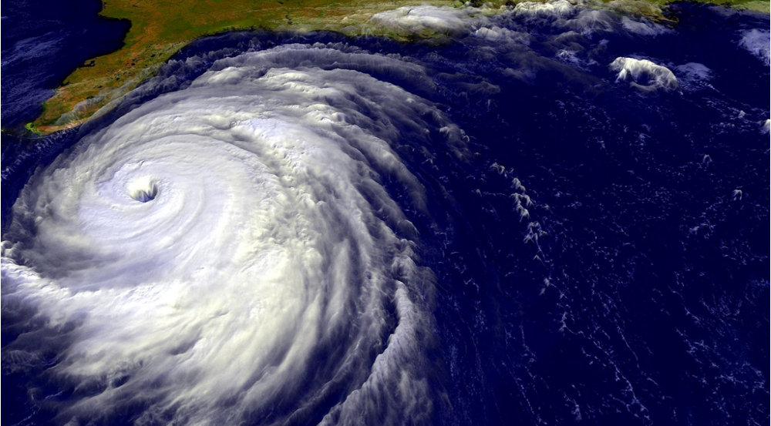
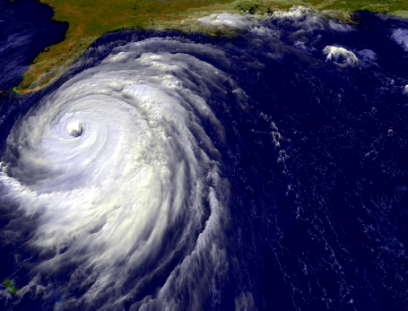
Chapter 5
Fluid Mechanics

Slide 2
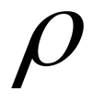
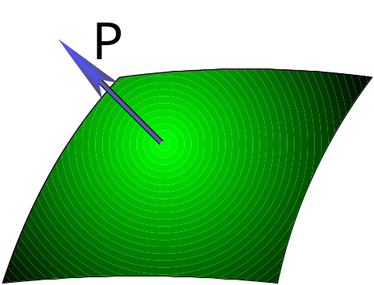


§1. Ideal fluid
1-1 Definition Fluid Statics
We consider the relation between (density) and
P (pressure).
We should establish an simple model:
① =constant incompressible
( is negligible ) same in solid
②No viscous force “dry fluid”.
No shearing stress like the pressure in “static fluid”.
P is independent of the “ orientation of area ” , but
depend on the position and velocity (when it flows).

Slide 3
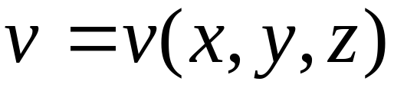

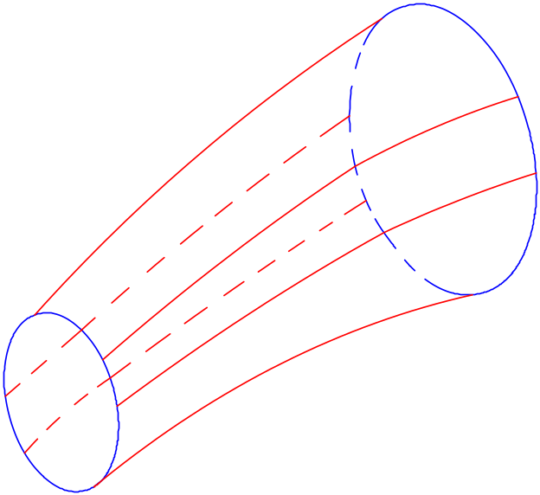
1-2 Streamline and stream tubule
Flow field
Curve:
tangential line
indicate the direction of
like “electric line of force”.
For any point , is unique.
Stream tube:
No cross.
No flow through.


Slide 4
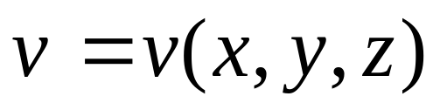
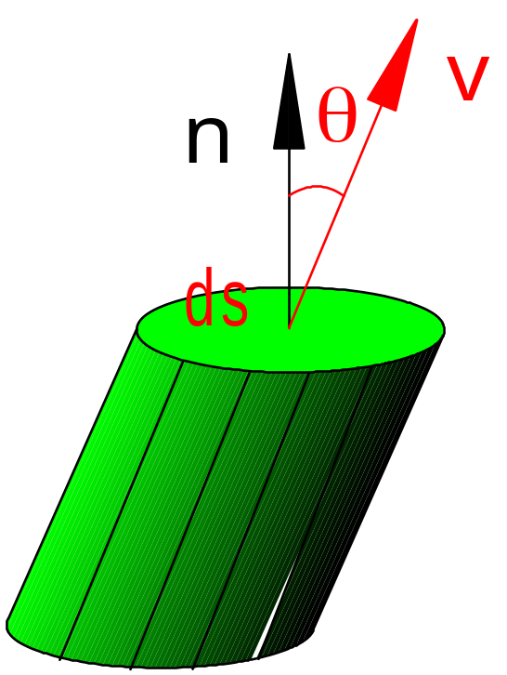

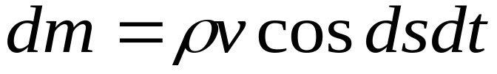
1-3 Steady flow and unsteady flow
Steady flow
path line
Unsteady flow
stream line
1-4 Fluid flux

Slide 5
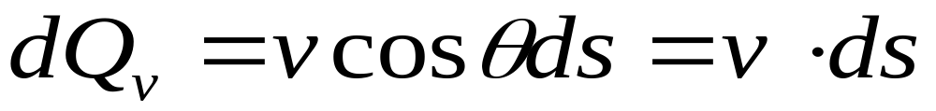
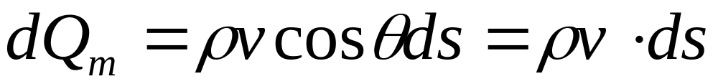
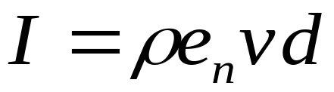
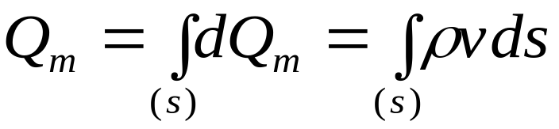
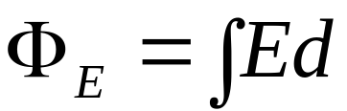
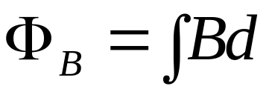
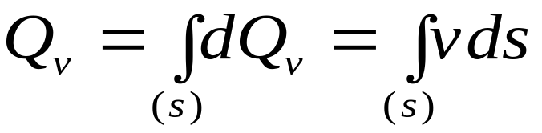
Volume flux:
Mass flux:
current
Finite surface
Similar:

Slide 6
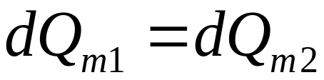
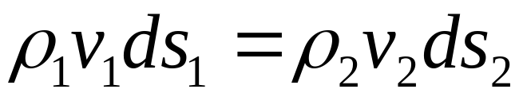
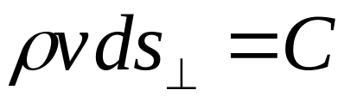

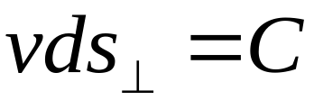
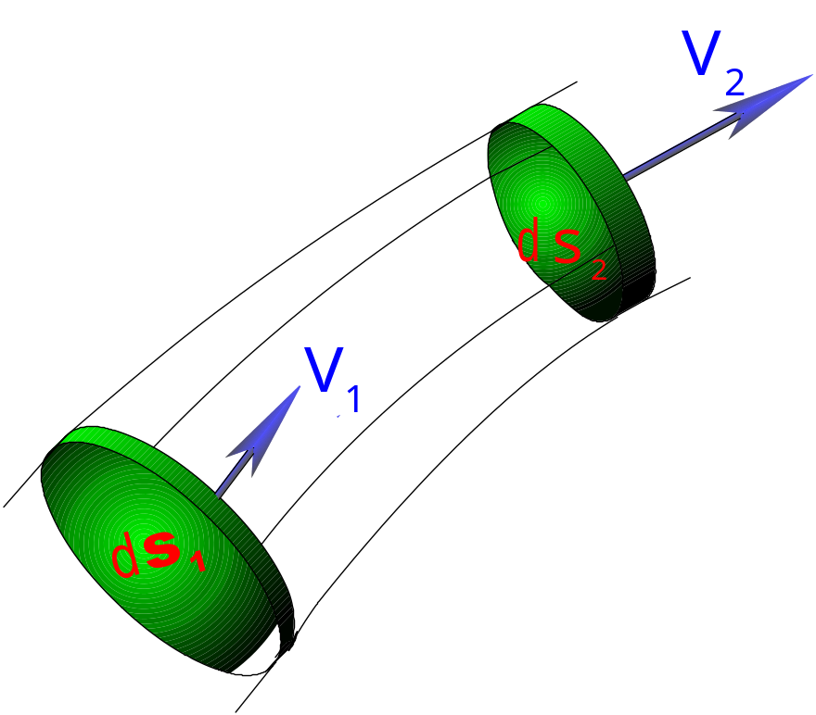
1-5 Principle of continuity
Steady flow:
Fluid is incompressible.
No cross.
No flow through.


Slide 7
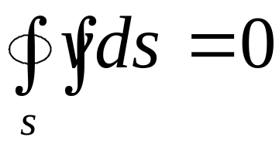
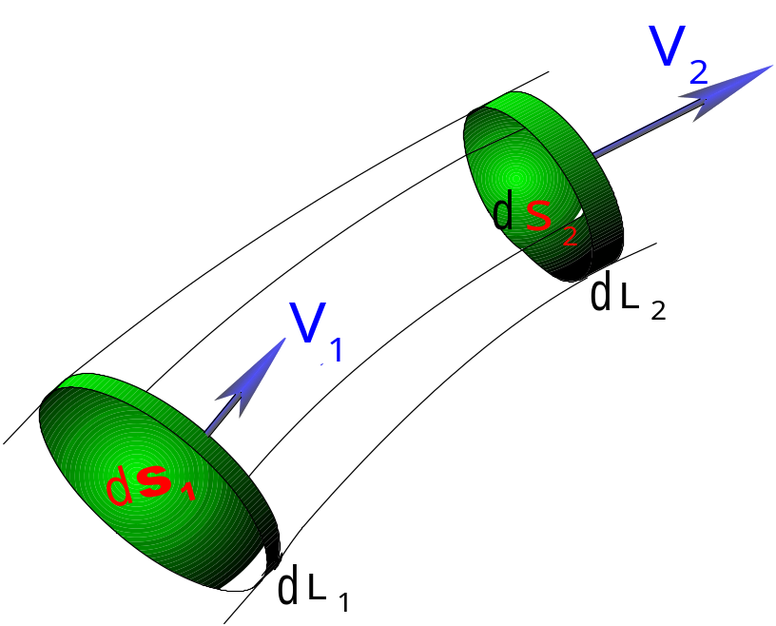
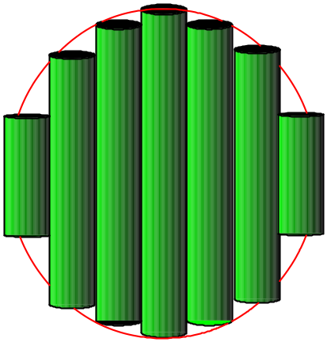
or
important.
Stream tube:

Low of conservation
of:
Energy,
charge,
mass,
……
number of particle,
electromagnetic field,
quantum mechanics.

Slide 8

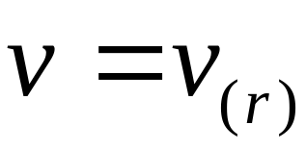
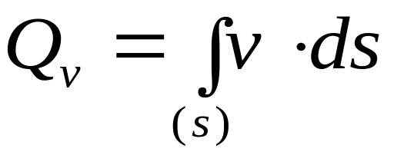
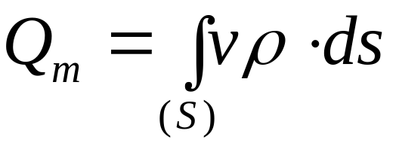
Remember:
①
Incompressible.
Indeed fluid
②
No viscous “dry”.
Streamline: No cross.
Steady flow
Stream tube:
No flow through.
Volume flux:
Mass flux:

Slide 9
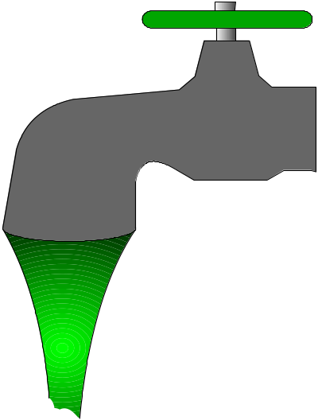
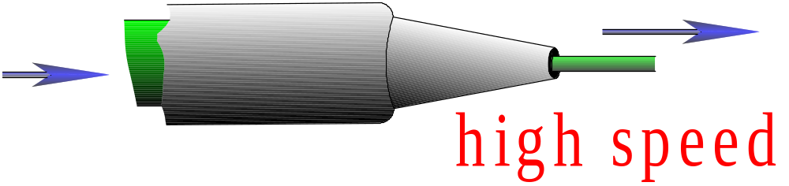

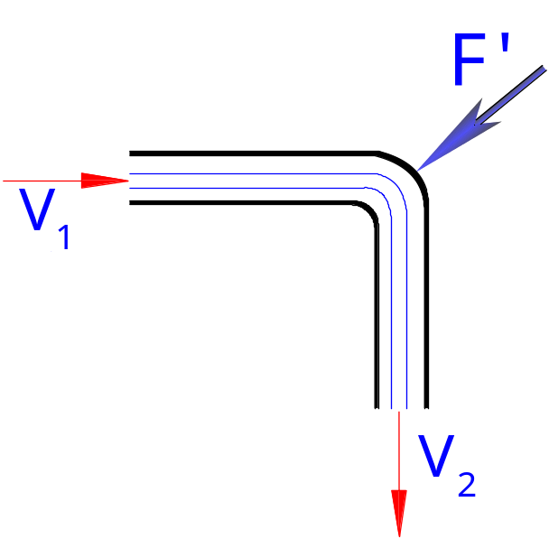


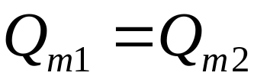
Example :
1-6 Reaction of fluid
In dt interval
In:
Out:
Steady flow:

Slide 10
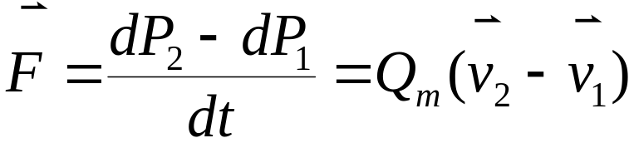
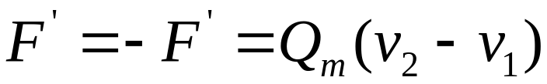
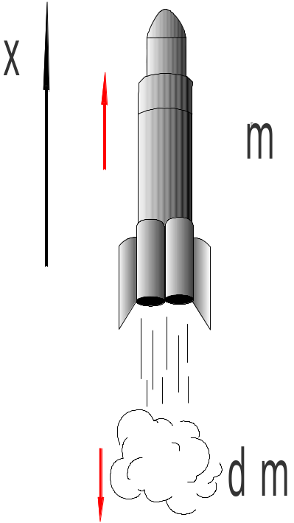
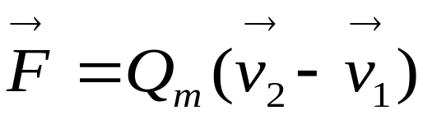
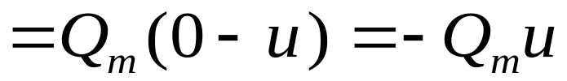
Force exert on fluid:
Rocket:

Slide 11
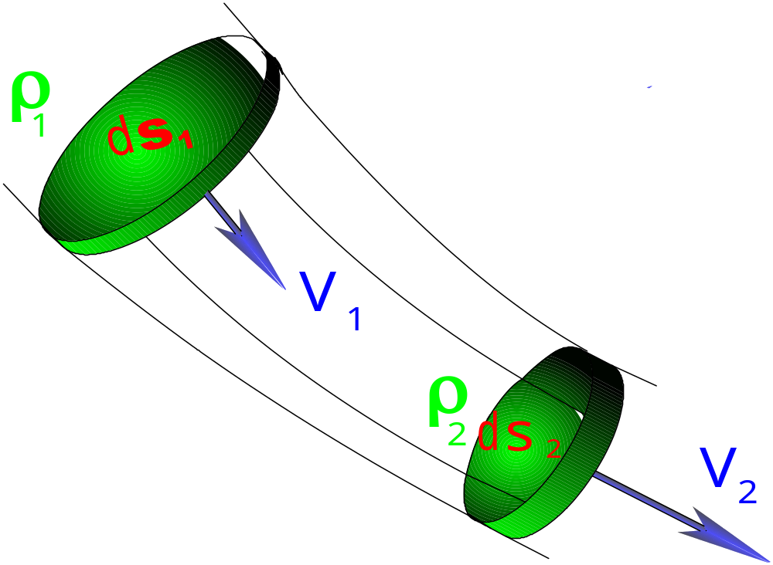
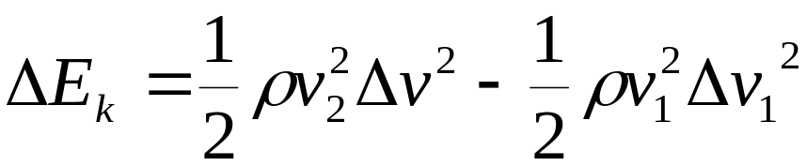
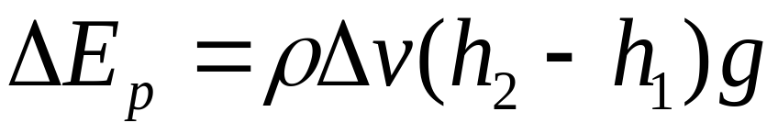


§2. Bernoulli equation
2-1 Equation
Ideal fluid.
Steady fluid.
Conservative system.
Work down by P:

Slide 12

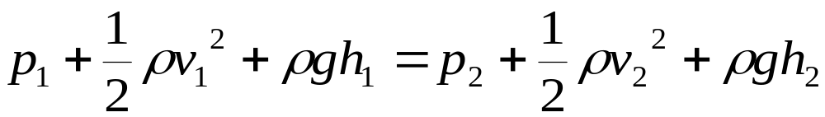
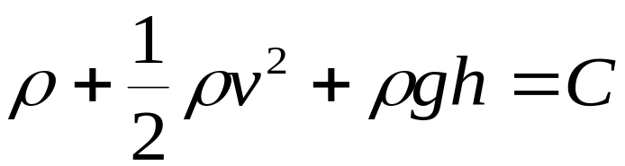
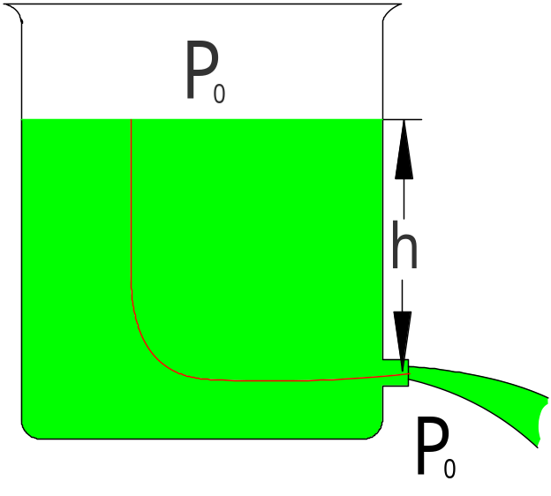
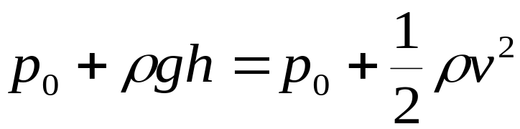
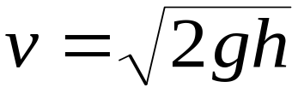

Bernoulli equation:
For an arbitrary
streamline
2-2 Application

Slide 13
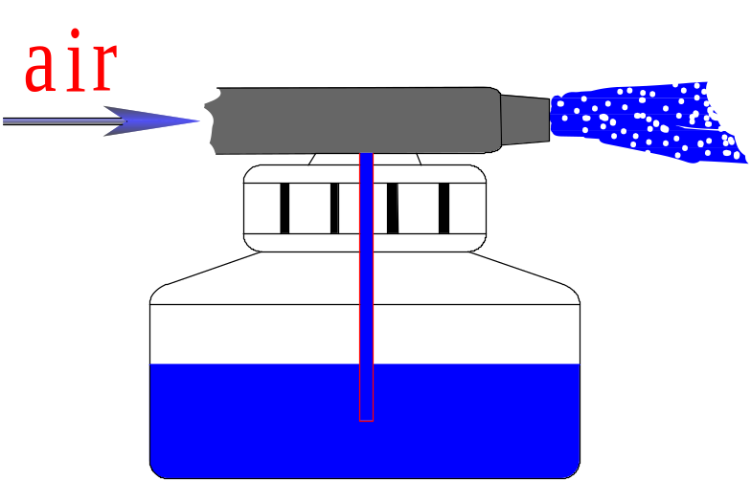
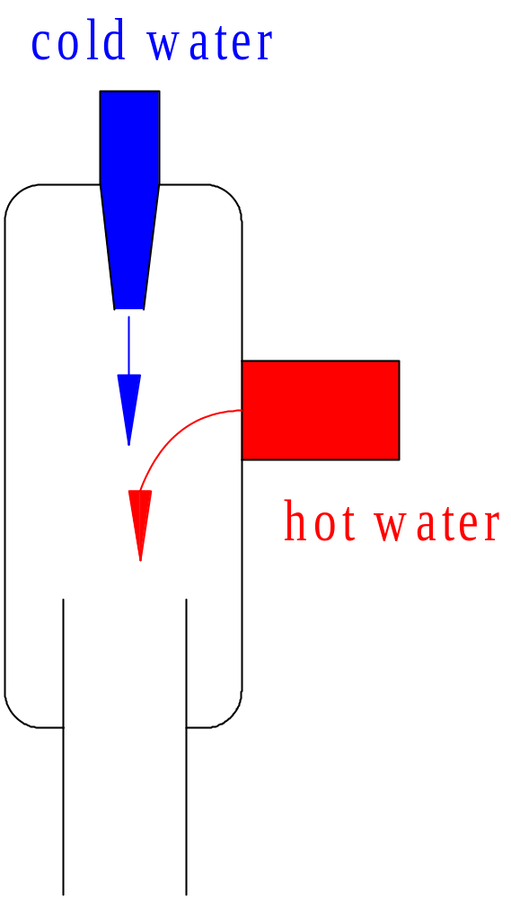

Example :
(3).
(1).
(2).
Flow air control a ball:

Slide 14




