Slide 1
第四章: Root finding in one dimension
f(x)=exp(x)*ln(x)-x²
1. Bisection method
2. Linear interpolation (regula falsi)
3. The Newton method
4. Secant (chord) method
5. Direct iteration
6. Brute force method

Slide 2
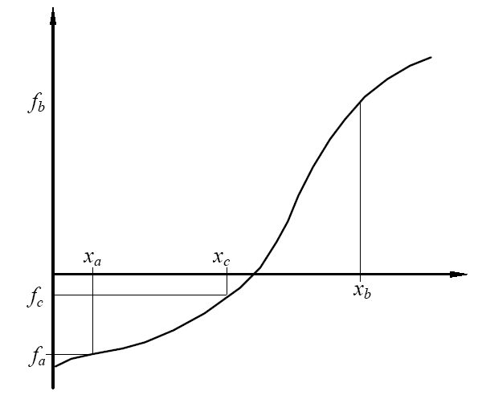
1. Bisection method
If there is a root in the region x∈[a,b] for f(x)=0, we can use Bisection method to find it within a required accuracy.

Slide 3
The basic algorithm for the bisection method relies on repeated application of
* Let x_{c} = (x_{a}+x_{b})/2,
* if f_{c} = f(x_{c}) = 0 then x = x_{c} is an exact solution,
*else if f_{a} f_{c}<0 then the root lies in the interval (x_{a}, x_{c}), then replacing the interval (x_{a}, x_{b}) with (x_{a}, x_{c}).
*else the root lies in the interval (x_{c}, x_{b}), then replacing the interval (x_{a}, x_{b}) with (x_{c}, x_{b}).
We repeat this interval halving until either the exact root has been found or the interval is smaller than some specified tolerance.

Slide 4
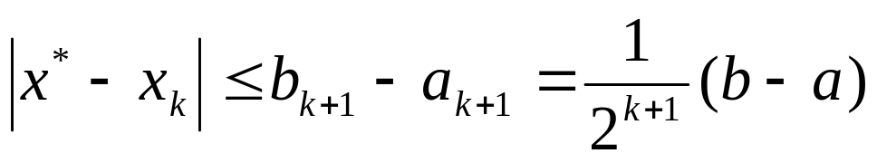
ε_{n} < |x_{a} - x_{b}|. ε_{n+1} ~ ε_{n} /2.
More generally, if x_{n} is the estimate for the root x* at the nth iteration, then the error in this estimate is
ε_{n} = x_{n} - x*.
则称该序列是p 阶收敛
|ε_{n+1}| =C|ε_{n} |^{p}.
当p=1时，称为线性收敛
p = 1 and C = 1/2

Slide 5
Example
用二分法求方程 f(x)=x³-x-1, 在[1,1.5]内的实根的近似值，要求误差小于0.1, 0.01.
f(1)= -1
f(1.5)=3.375-1.5-1=0.875

Slide 6
用二分法，这里a = 1, b = 1.5， 且f (a) < 0，f (b) > 0。取区间[a, b]的中点x₀ = 1.25将区间二等分，由于f (x₀)< 0，即f (x₀)与f (a)同号，
故所求的根必在x₀的右侧，这里应令a₁ = x₀ = 1.25，b₁ = b = 1.5，而得到新的有根区间（a₁, b₁）。
对区间（a₁, b₁）再用中点x₁ = 1.375二分，并进行根的隔离，重复步骤2、3；
如此反复二分下去，我们预先估计一下二分的次数：按误差估计式
解得k = 5，即二分5次，即达所求精度误差小于0.01 。

Slide 7
计算结果如下表：
k | a_{k} | b_{k} | x_{k} | f (x_{k})的符号
0 | 1 | 1.5 | 1.25 | -
1 | 1.25 | 1.5 | 1.375 | +
2 | 1.25 | 1.375 | 1.3125 | -
3 | 1.3125 | 1.375 | 1.3438 | +
4 | 1.3125 | 1.3438 | 1.3281 | +
5 | 1.3125 | 1.3281 | 1.3203 | -
6 | 1.3203 | 1.3281 | 1.3242 | -

Slide 8
f(x)=exp(x)*ln(x)-x²
f(1)= -1
f(2)=1.12
x∈[1,2]
A=1.0
B=2.0
DX=B-A
DX=B-A
ISTEP=ISTEP+1
ENDDO
WRITE(*,*) ISTEP,
X0, DX
STOP
END
DL=1.0E-06
ISTEP=0
DO WHILE(ABS(DX).GT.DL)
X0=(A+B)/2.0
IF((F(A)*F(X0)).LT.0) THEN
B=X0
ELSE
A=X0
ENDIF
FUNCTION F(X)
F=exp(x)*ALOG(x)-X*X
RETURN
END

Slide 9
1 1.500000 5.000000E-01
2 1.750000 2.500000E-01
3 1.625000 1.250000E-01
4 1.687500 6.250000E-02
5 1.718750 3.125000E-02
6 1.703125 1.562500E-02
7 1.695313 7.812500E-03
8 1.691406 3.906250E-03
9 1.693359 1.953125E-03
10 1.694336 9.765625E-04

Slide 10
11 1.694824 4.882813E-04
12 1.694580 2.441406E-04
13 1.694702 1.220703E-04
14 1.694641 6.103516E-05
15 1.694611 3.051758E-05
16 1.694595 1.525879E-05
17 1.694603 7.629395E-06
18 1.694599 3.814697E-06
19 1.694601 1.907349E-06
20 1.694600 9.536743E-07

Slide 11
f(x) = cos x - 1/2.
Initial guesses
x = 0 and x = π/2.

Slide 12
f(x) = cos x - 1/2. x_{a} = 0 and x_{b} = p/2.
A=0.0
B=3.1415926/2.0
DX=B-A
DX=B-A
ISTEP=ISTEP+1
ENDDO
WRITE(*,*) ISTEP,
X0, DX
STOP
END
DL=1.0E-06
ISTEP=0
DO WHILE(ABS(DX).GT.DL)
X0=(A+B)/2.0
IF((F(A)*F(X0)).LT.0) THEN
B=X0
ELSE
A=X0
ENDIF
FUNCTION F(X)
F=cos(x)-1./2.
RETURN
END

Slide 13
x∈[1,2]
x∈[0,π/2]
1 7.853981E-01 7.853981E-01
2 1.178097 3.926991E-01
3 9.817477E-01 1.963496E-01
4 1.079922 9.817475E-02
5 1.030835 4.908741E-02
6 1.055379 2.454364E-02
7 1.043107 1.227188E-02
8 1.049243 6.135941E-03
9 1.046175 3.067970E-03
10 1.047709 1.533985E-03
11 1.046942 7.669926E-04
12 1.047325 3.834963E-04
13 1.047133 1.918077E-04
14 1.047229 9.584427E-05
15 1.047181 4.792213E-05
16 1.047205 2.396107E-05
17 1.047193 1.204014E-05
18 1.047199 5.960464E-06
19 1.047196 2.980232E-06
20 1.047198 1.549721E-06
21 1.047197 7.152557E-07
1 1.500000 5.000000E-01
2 1.250000 2.500000E-01
3 1.125000 1.250000E-01
4 1.062500 6.250000E-02
5 1.031250 3.125000E-02
6 1.046875 1.562500E-02
7 1.054688 7.812500E-03
8 1.050781 3.906250E-03
9 1.048828 1.953125E-03
10 1.047852 9.765625E-04
11 1.047363 4.882813E-04
12 1.047119 2.441406E-04
13 1.047241 1.220703E-04
14 1.047180 6.103516E-05
15 1.047211 3.051758E-05
16 1.047195 1.525879E-05
17 1.047203 7.629395E-06
18 1.047199 3.814697E-06
19 1.047197 1.907349E-06
20 1.047198 9.536743E-07

Slide 14
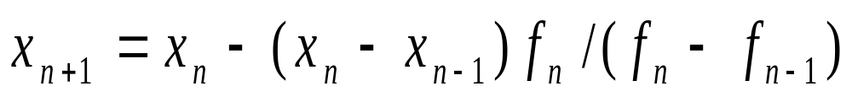
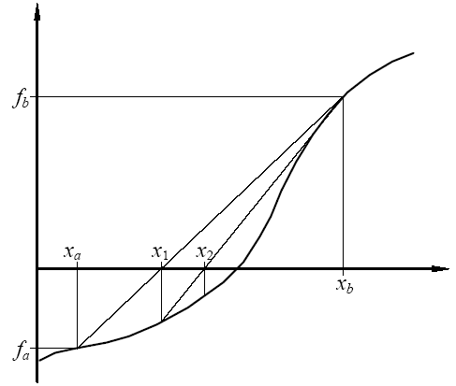
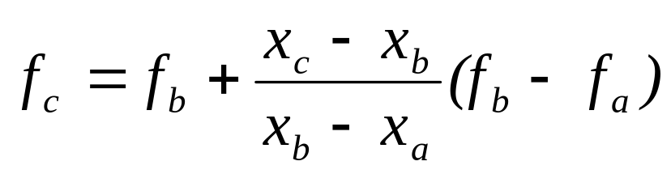
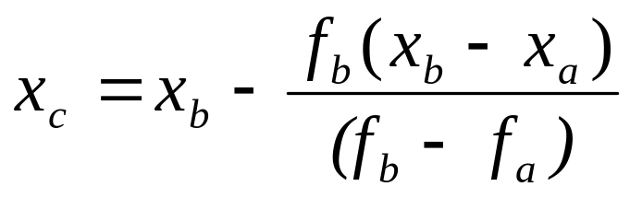
2. Linear interpolation (regula falsi)

Slide 15
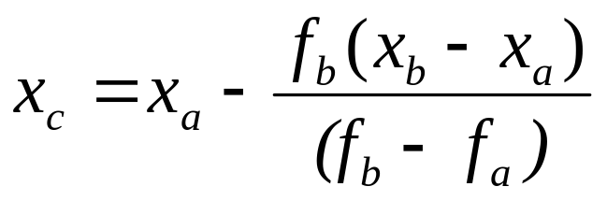
The basic algorithm for the Linear interpolation method relies on repeated application of
* Let
* if f_{c} = f(x_{c}) = 0 then x = x_{c} is an exact solution,
*else if f_{a} f_{c} <0 then the root lies in the interval (x_{a}, x_{c}), then replacing the interval (x_{a}, x_{b}) with (x_{a}, x_{c}).
*else the root lies in the interval (x_{c}, x_{b}), then replacing the interval (x_{a}, x_{b}) with (x_{c}, x_{b}).

Slide 16
|ε_{n+1}| =C|ε_{n} |^{p}.
p = 1 and C < 1/2
线性收敛

Slide 17
f(x)=exp(x)*ln(x)-x²
f(1)=-1
f(2)=1
x∈[1,2]
A=1.0
B=2.0
DX=B-A
DX=B-A
ISTEP=ISTEP+1
ENDDO
WRITE(*,*) ISTEP,
X0, DX
STOP
END
DL=1.0E-06
ISTEP=0
DO WHILE(ABS(DX).GT.DL)
X0=A-(B-A)*F(A)/(F(B)-F(A))
IF((F(A)*F(X0)).LT.0) THEN
B=X0
ELSE
A=X0
ENDIF
FUNCTION F(X)
F=exp(x)*ALOG(x)-X*X
RETURN
END

Slide 18
1 1.471319 5.286806E-01
2 1.630462 3.695379E-01
3 1.677136 3.228641E-01
4 1.689923 3.100768E-01
5 1.693354 3.066462E-01
6 1.694269 3.057312E-01
7 1.694512 3.054875E-01
8 1.694577 3.054227E-01
9 1.694595 3.054054E-01
10 1.694599 3.054007E-01
11 1.694600 3.053995E-01
12 1.694601 3.053992E-01
13 1.694601 1.192093E-07

Slide 19
f(x) = cos x - 1/2. x_{a} = 0 and x_{b} = p/2.
A=0.0
B=3.1415926/2.0
DX=B-A
DX=B-A
ISTEP=ISTEP+1
ENDDO
WRITE(*,*) ISTEP,
X0, DX
STOP
END
DL=1.0E-06
ISTEP=0
DO WHILE(ABS(DX).GT.DL)
X0=A-(B-A)*F(A)/(F(B)-F(A))
IF((F(A)*F(X0)).LT.0) THEN
B=X0
ELSE
A=X0
ENDIF
FUNCTION F(X)
F=cos(x)-1./2.
RETURN
END

Slide 20
1 7.853982E-01 7.853981E-01
2 1.015436 5.553603E-01
3 1.044138 5.266579E-01
4 1.046912 5.238844E-01
5 1.047171 5.236253E-01
6 1.047195 5.236012E-01
7 1.047197 5.235989E-01
8 1.047198 2.384186E-07

Slide 21
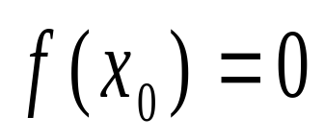


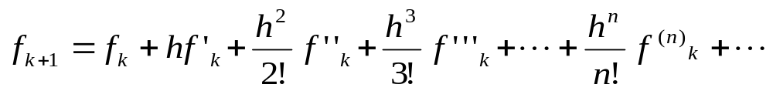
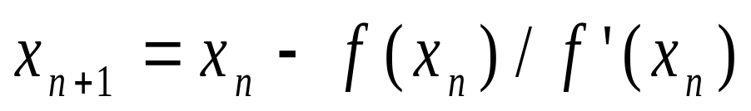
3. The Newton method
Taylor Series expansion In the neighborhood of x₀

Slide 22
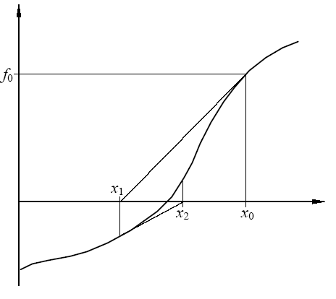

Slide 23
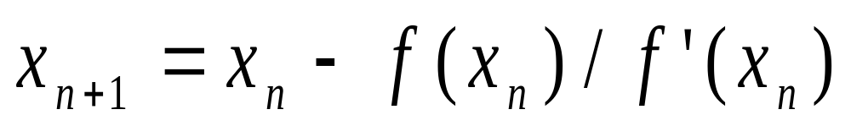
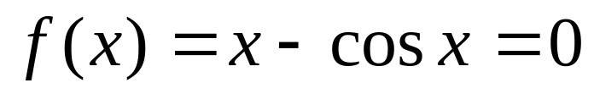

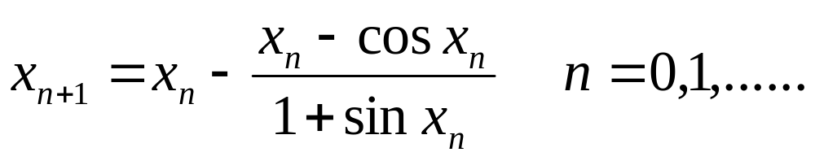
例题
用Newton法求 在(0,π/2)内
的近似解。

Slide 24
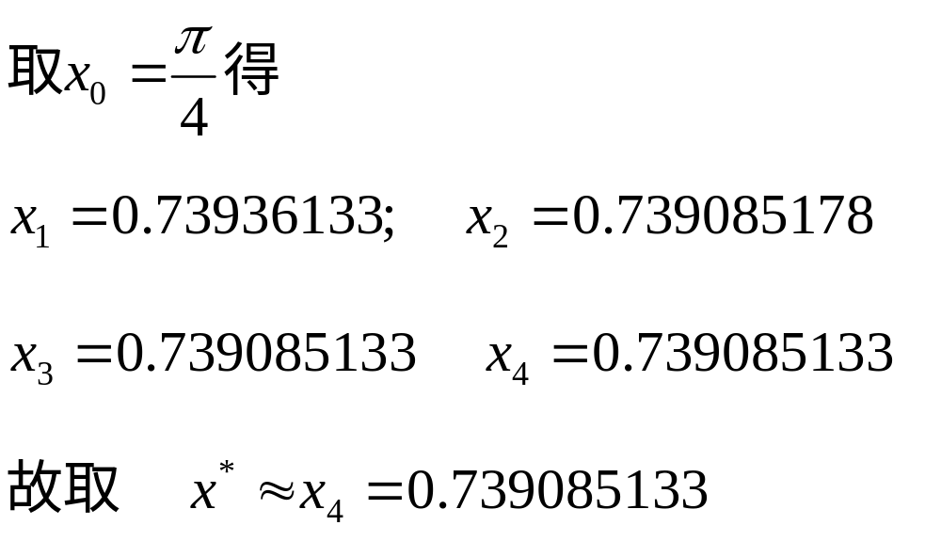

Slide 25
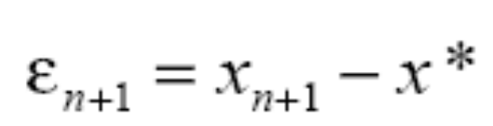
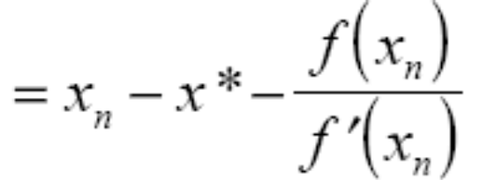
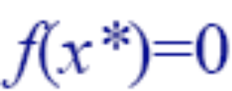
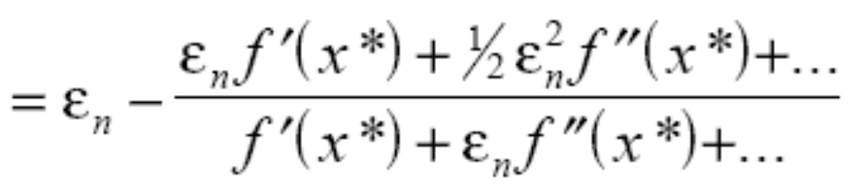
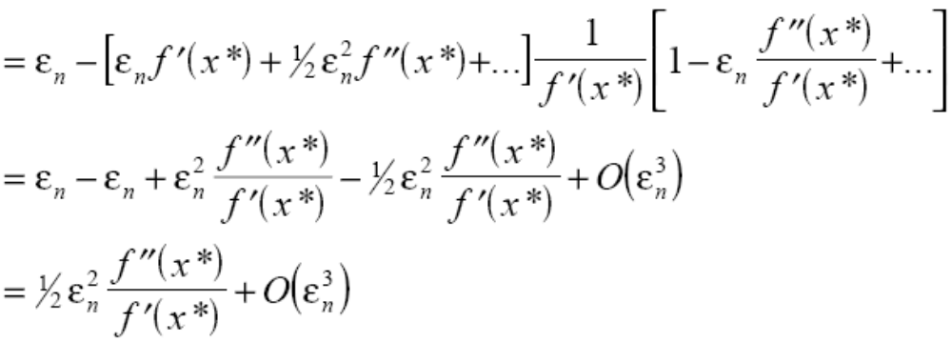
|ε_{n+1}| ~ C|ε_{n} |^{p}. p = 2
平方收敛或二次收敛

Slide 26
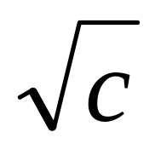
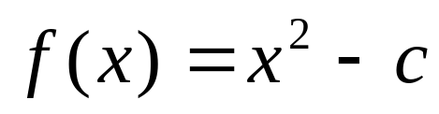
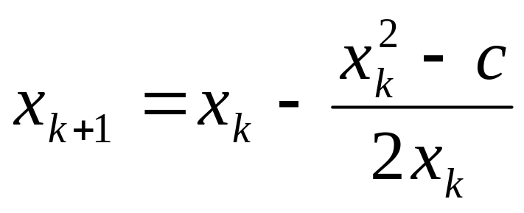
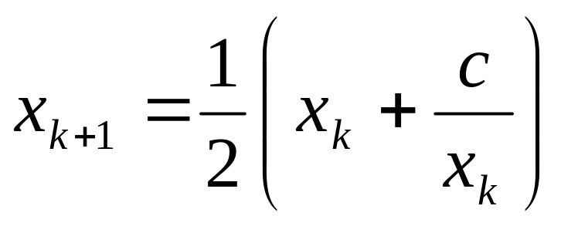
用牛顿迭代法建立求平方根
（c >0）的迭代公式
解：设
（x >0）
则c就是f (x) =0的正根。由 f ’(x) = 2x，所以由迭代公式
得

Slide 27
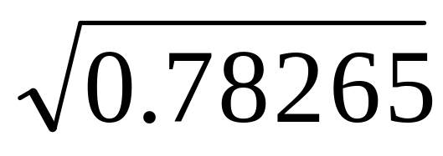
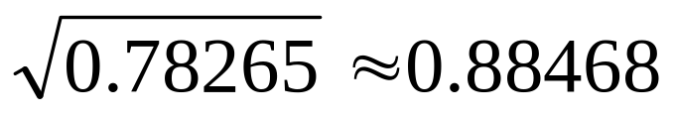
用以上公式求
取初值x = 0.88，利用以上公式计算结果见表
k | x_{k}
0 | 0.88
1 | 0.88469
2 | 0.88468
3 4 | 0.88468
0.8
0.88916
0.88469
0.88468
0.88468
故可取

Slide 28
f(x)=exp(x)*ln(x)-x²
f(1)=-1
f(2)=1 x∈[1,2]
A=1.0
B=2.0
DX=B-A
X0=(A+B)/2
WRITE(*,*) ISTEP,X0,DX
STOP
END
DL=1.0E-06
ISTEP=0
FUNCTION F(X)
F=exp(x)*ALOG(x)-X*X
RETURN
END
DO WHILE(ABS(DX).GT.DL)
X1=X0-F(X0)/DF(X0)
DX=X1-X0
X0=X1
FUNCTION DF(X)
DF=exp(x)*(ALOG(x)+
1.0/X)-2.0*X
RETURN END
ISTEP=ISTEP+1
ENDDO

Slide 29
1 1.739801 2.398010E-01
2 1.696568 -4.323277E-02
3 1.694605 -1.963484E-03
4 1.694601 -3.869925E-06
5 1.694601 -2.718537E-08

Slide 30
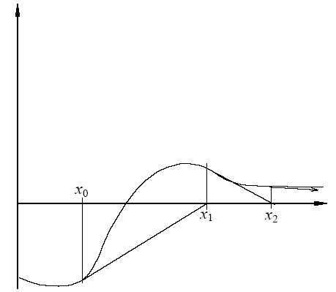
Divergence of the Newton algorithm due to the presence of a turning point close to the root.

Slide 31

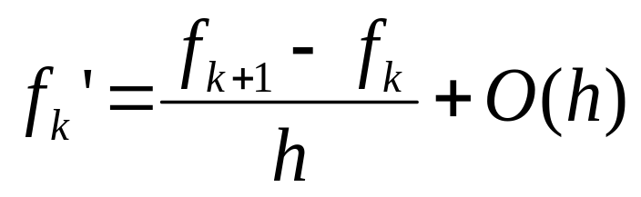
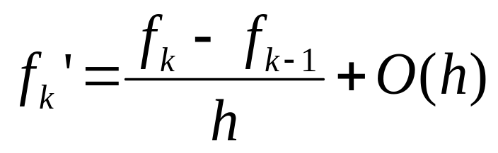
4. Secant method
割线, 正切

Slide 32
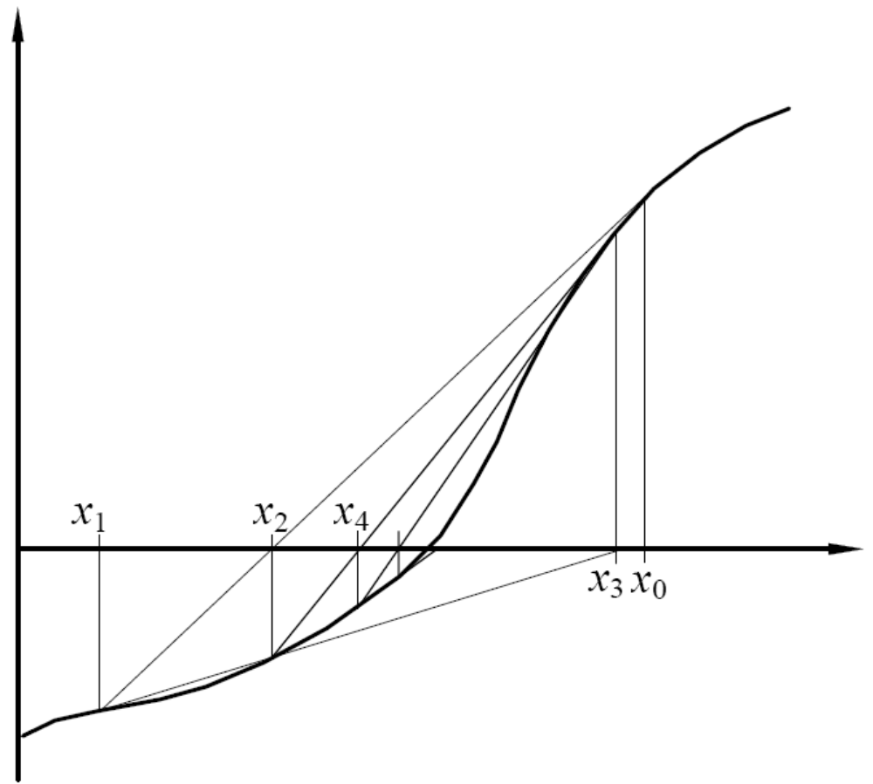
Convergence on the root using the secant method

Slide 33
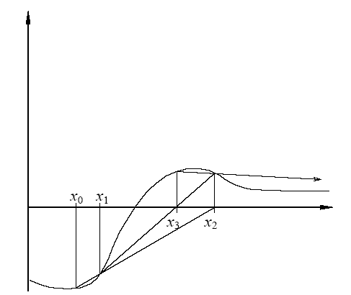
Divergence using the secant method

Slide 34
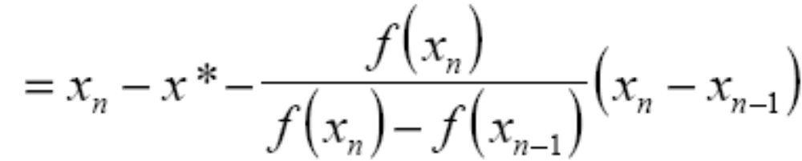
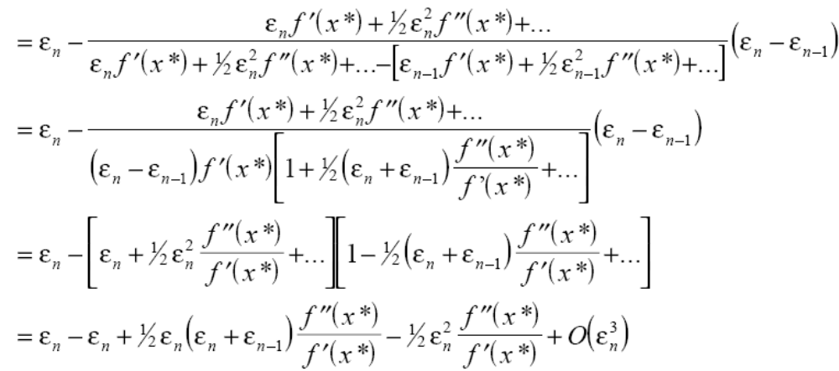

Slide 35

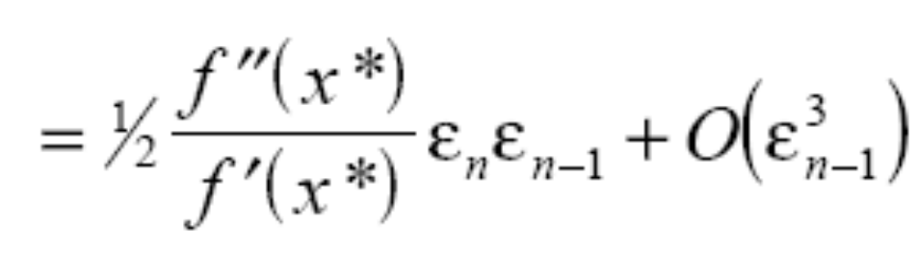
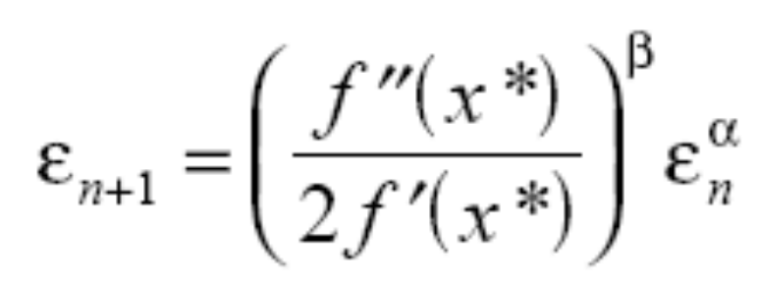
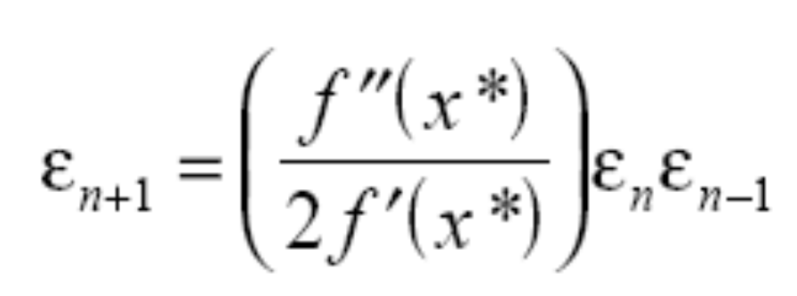

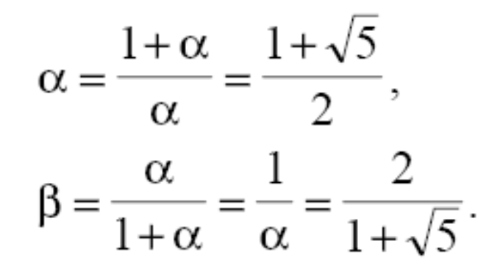
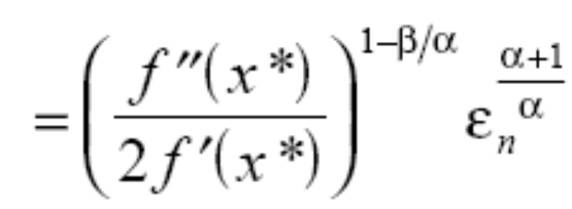
=1.618
=0.618

Slide 36
Linear interpolation (regula falsi)

Slide 37
f(x)=exp(x)*ln(x)-x²
f(1)=-1
f(2)=1 x∈[1,2]
A=1.0
B=2.0
DX=(B-A)/10.0
X0=(A+B)/2.0
FUNCTION F(X)
F=exp(x)*ALOG(x)-X*X
RETURN
END
DL=1.0E-06
Call secant(DL,X0,DX,ISTEP)
WRITE(*,*) ISTEP,X0,DX
STOP
END

Slide 38
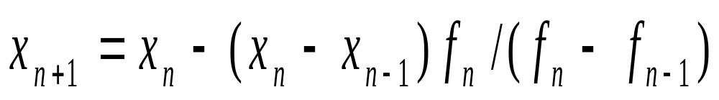
SUBROUTINE secant(DL,X0,DX,ISTEP)
X1=X0+DX
ISTEP=0
DO WHILE(ABS(DX).GT.DL)
D= F(X1)- F(X0)
X2=X1-(X1-X0)* F(X1)/D
X0=X1
X1=X2
DX=X1-X0
ISTEP=ISTEP+1
ENDDO
RETURN
END

Slide 39
5. Direct iteration （直接迭代法）
迭代法是求方程近似根的一个重要方法，也是计算方法中的一种基本方法，它的算法简单，应用范围广，故学好这一方法对以后的学习也很有帮助。

Slide 40
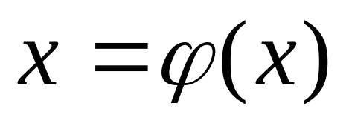
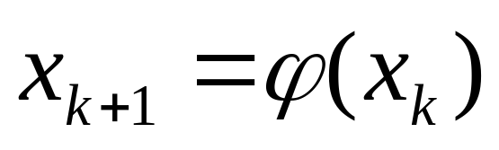
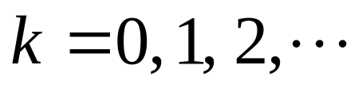
简单迭代法
简单迭代法的基本思想是：将方程f (x) = 0化为一个等价的方程
从而构成序列
给定一个初值x₀，由上式可算得x₁ = ϕ (x₀)，再将x₁代入上式的右端又可得x₂ =ϕ (x₁)，…。我们称{x_{k}}为迭代序列，而称 x=ϕ (x) 中的ϕ (x)为迭代函数，上式为迭代格式。如果ϕ (x)连续，迭代序列{x_{k}}收敛于x*，则x*就是方程 x=ϕ (x) 的解。

Slide 41


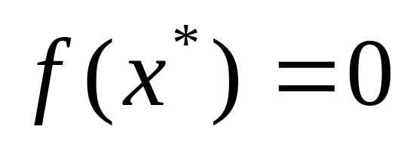
方程f (x) = 0 等价于方程

Slide 42




迭代法的几何意义
方程f (x) = 0
⎧
y
=
x
交点的横坐标
x
=
ϕ
(
x
)
⇒
⎨
⎩
y
=
ϕ
(
x
)
y=x
y=ϕ(x)

Slide 43
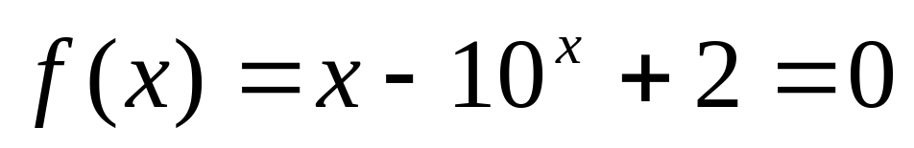
求以下方程在[0,1]内的根的近似值

Slide 44
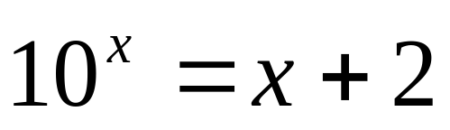
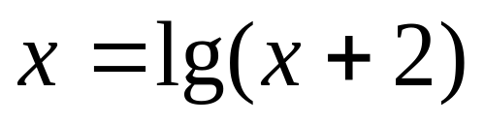
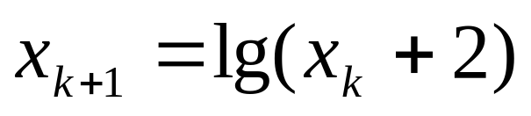
求以下方程在[0,1]内的根的近似值
现将原方程改为同解方程
由此得迭代格式
取初始值x₀ = 1，可逐次算得
x₁ = 0.4771, x₂ = 0.3939 … x₆ = 0.3758, x₇ =0.3758
因为x₆ 和x₇ 已趋于一致，所以取x₇ =0.3758 为原方程在[0, 1]内的一个根的近似值。

Slide 45
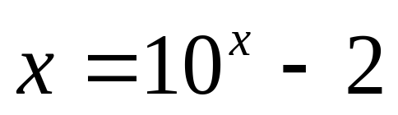
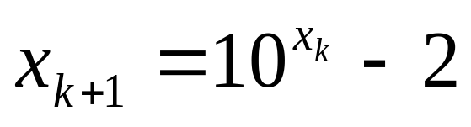
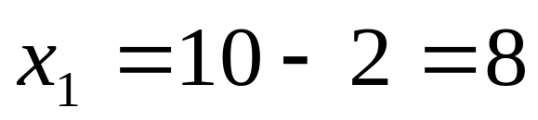


一个方程的迭代格式并不是唯一的，且迭代也不总是收敛的。如上例的方程也可改写
得迭代格式
仍取x₀ = 1算得：
显然，该迭代序列不趋向于某个定值，这种不收敛的迭代过程称为发散。那么迭代格式要满足哪些条件才能保证迭代收敛呢？下面我们来讨论这个问题。

Slide 46



|ε_{n+1}| ~ g’|ε_{n} |^{p}. p = 1
收敛;否则发散

Slide 47
迭代过程的收敛性
y=x y
y
Q
y
=
ϕ
(
x
)
1
P
Q
0
2
P
*
P
1
P
2
x
*
x
x
x
x
2
1
0
0
<
ϕ
′
(
x
*
)
<
1

Slide 48
迭代过程的收敛性
y
y
=
ϕ
(
x
)
y=x
ϕ
(
x
)
P
*
x
x
x
*
x
x
x
1
3
2
0
−
1
<
ϕ
′
(
x
*
)
<
0

Slide 49
y=x
P
*
y
y
=
ϕ
(
x
)
x
x
x
x
*
x
2
1
0
ϕ
′
(
x
*
)
>
1
迭代法的几何意义

Slide 50
y
y
=
ϕ
(
x
)
y=x
ϕ
(
x
)
P
*
x
x
x
*
x
x
x
3
1
0
2
ϕ
′
(
x
*
)
<
-1
迭代法的几何意义

Slide 51
由以上图形可以看出，序列{x_{k}}的收敛速度，取决于曲线在根附近的斜率，所以在根x*附近|ϕ’(x*) |恒小于1，则此迭代序列收敛，
若|ϕ’(x*) |>1，则此序列发散。

Slide 52

[0,1]内
现将原方程改为同解方程
由此得迭代格式
取初始值x₀ = 1，可逐次算得

Slide 53


[0,1]内
(a^x)'=lna *a^x
取初始值x₀ = 1，可逐次算得
取初始值x₀ = 0，可逐次算得

Slide 54




求以下方程在[0, 0.5]内的根的近似值
因为
，在[0, 0.5]内为增函数，所以
满足收敛条件，取x₀ = 0.25，算得

Slide 55
x₁ = ϕ (0.25) = 0.3385416
x₂ = ϕ (x1) = 0.3462668
x₃ = ϕ (x2) =0.3471725
x₄ = ϕ (x3) =0.3472814
x₅ = ϕ (x4) =0.3472945
x₆ = ϕ (x5) =0.3472961
x₇ = ϕ (x6) =0.3472963
取近似根为 x* = 0.347296

Slide 56

求以下方程在[0, 0.5]内的根的近似值

Slide 57
6. Brute force method
All the methods above are designed to find a single root on an interval [a,b]. However, the following situations are possible:
(i) there are two or more roots on the interval [a,b];
(ii) there is one root, but the function does not change sign, as in the equation x² −2x+1 = 0;
(iii) there are no roots at all;
(iv) there is a singularity, so that the function does change sign but the equation does not have a root. The bisection method in the last case will converge on the singularity if the interval has no roots.

Slide 58
The brute force method is a good approach for dealing with multiple roots. You split the original interval [a,b] into smaller intervals with a stepsize h, applying some of the methods mentioned above to each subinterval. Care should be taken in selecting the size of h. If the interval is too large we may miss multiple zeros. On the other hand, choosing too small a step may result in time consuming calculations. A graphical analysis of the equation may help determine the most reasonable size for h.

